Slide 1
객체지향 23조
신동진
범동권
유채은

Slide 2
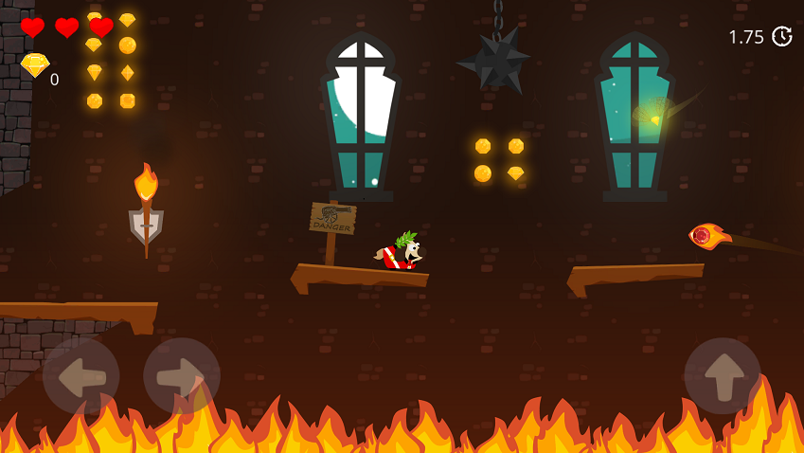
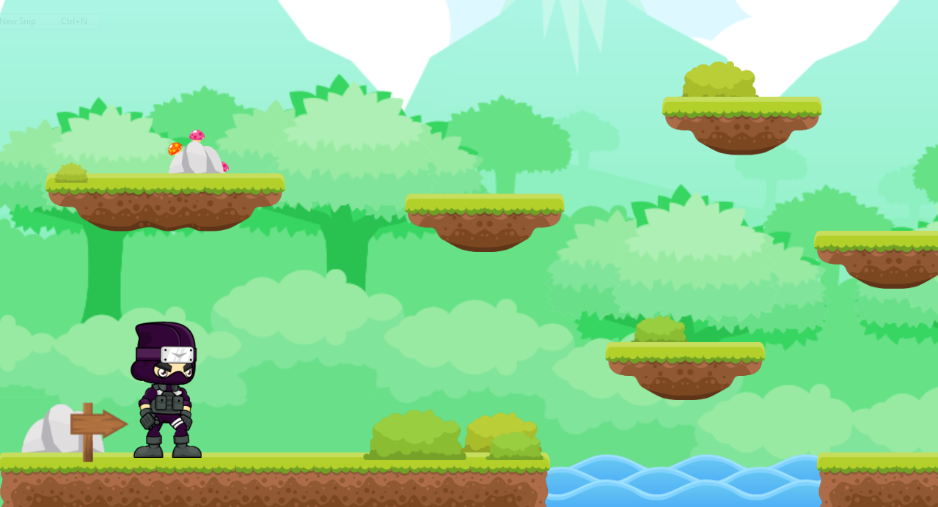
2D Platformer

Slide 3
S h i n e !

Slide 4
Table of Contents
Features
Structure
Control
Interface & Goal

Slide 5
Features
2D Physics Engine
Random Map
Delicate Control
Sound Effect

Slide 6



2D Physics Engine
Collision
Gravity
Friction

Slide 7
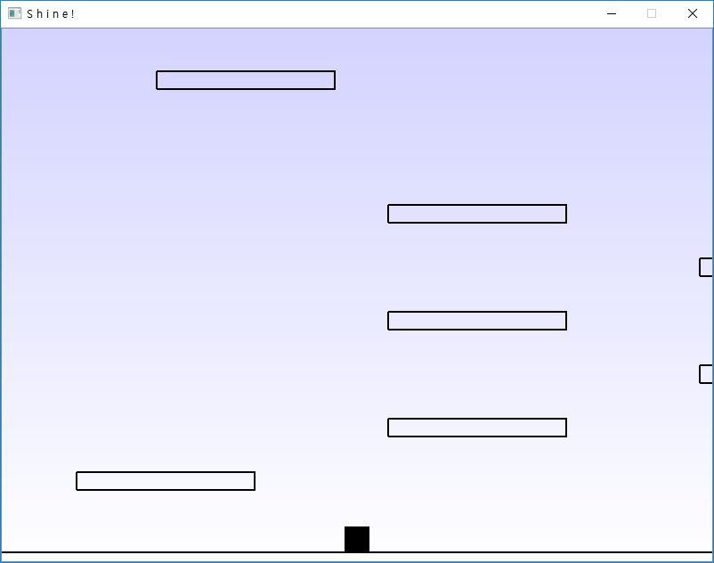
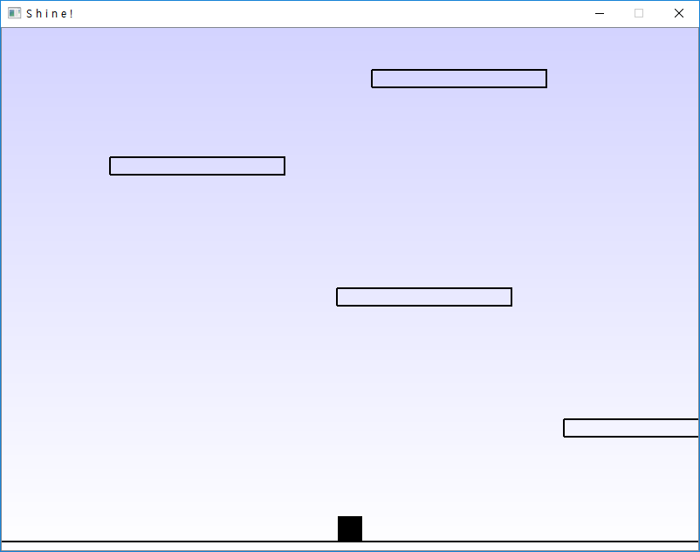
Random Map

Slide 8
Delicate Control
Discussed in Control part

Slide 9

Sound Effect
Sound from freesound.org(저작권 없음)
Bgm & sound effects

Slide 10

Structure
Platform: Qt 5.11.2
Genre: 2D Platformer game
Control: Mouse

Slide 11
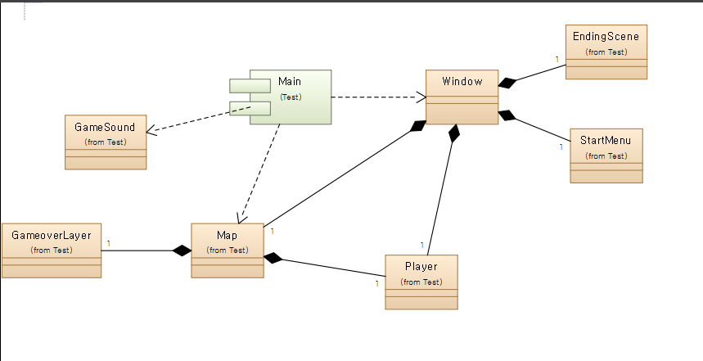
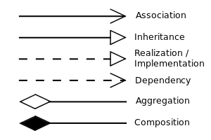
Class Diagram

Slide 12
Map Class
Map
+playerSideMove()
+playerVertMove()
+keyPressEvent()
+blockInit()
-update()
-respawn()
gameover()
gameend()
-blocks
-timer
-endblock
+player
+gameoverLayer
+Map()
+addBlock()
+checkPlayerLeftCollision()
+checkPlayerRightCollision()
+checkPlayerTopCollision()
+checkPlayerBotCollision()

Slide 13
Window Class
Window
-mousePressEvent()
-mouseMoveEvent()
-mouseReleaseEvent()
-centerOnPlayer()
-showGameoverInterface()
-gameend()
-regame()
-timer
-map
-player
-mouseInitX
-mouseInitY
-mouseFinalX
-mouseFinalY
-mousePressed
-line
-projection
-lineLength
-maxLength
+Window()

Slide 14
Player Class
Player
+respawn()
-maxfallspd
+w
+h
+xspd
+yspd
+maxspd
+deathspd
+isAlive
+Player()
+applyGravity()
+applyFriction()
+die()

Slide 15
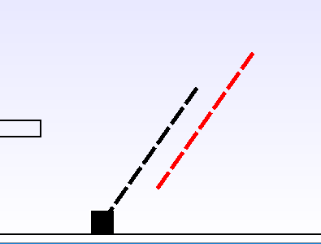
Control
Sling-shot System

Slide 16
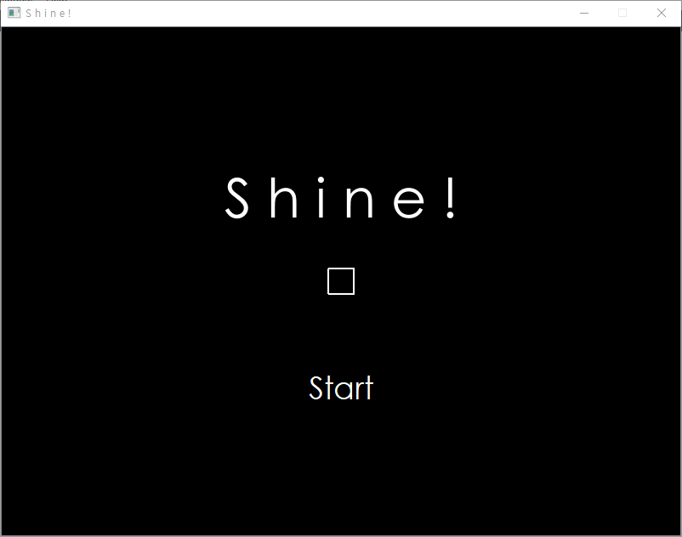
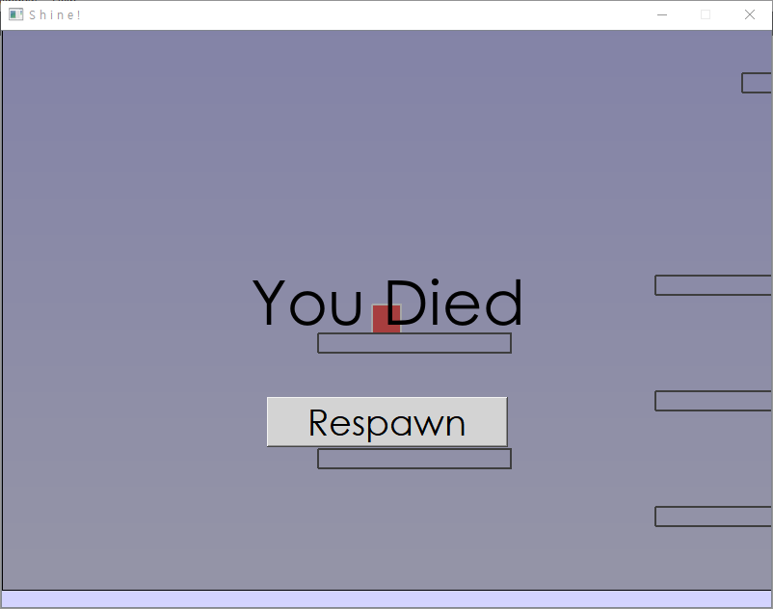
Interface & Goal

Slide 17
Testing

