Slide 1


PRESENTATION
PAST, PRESENT, AND FUTURE APPROACHES OF
CLINICAL NATURAL LANGUAGE
TECHNOLOGY FOR HEALTH CARE
NISHA RAVISHANKAR · COTIVITI INTERNSHIP ASSESSMENT · JUNE 2026

Slide 2
AGENDA
1
WHAT IS CLINICAL NLP?
4
THREATS & RISKS
DEFINITION AND CORE TECHNOLOGIES
HALLUCINATION, HIPAA, EXPLAINABILITY
2
EVOLUTION OF THE FIELD
5
STRATEGIC RECOMMENDATION
RULES → ML → LLMS → MULTIMODAL
COTIVITI'S CLINICAL DOCUMENT INTELLIGENCE LAYER
3
OPPORTUNITIES
6
POC DEMO
PRIOR AUTH, HCC CODING, CLAIMS INTEGRITY
LIVE CLINICAL NOTE ANALYZER

Slide 3
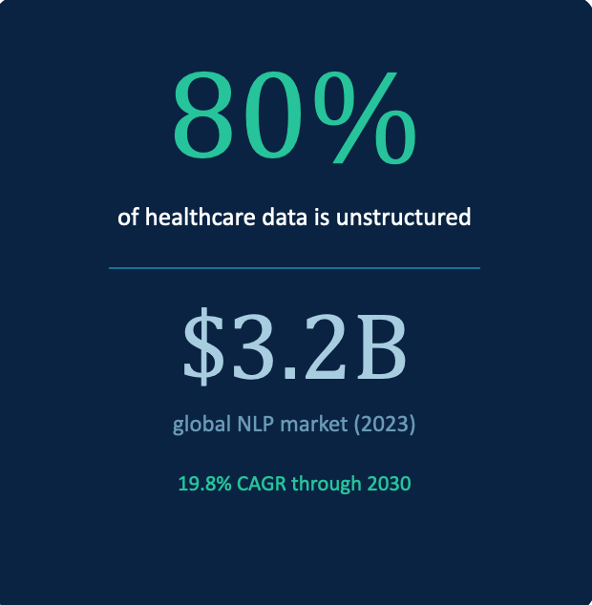
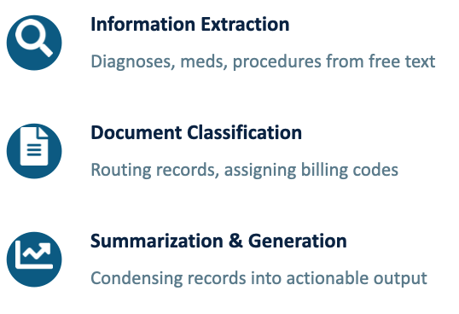
Clinical NLP applies computational techniques to extract and structure information from unstructured medical text, physician notes, discharge summaries, radiology reports, and insurance claims.
WHAT IS CLINICAL NLP?
IT SPANS THREE CORE FUNCTIONS:

Slide 4
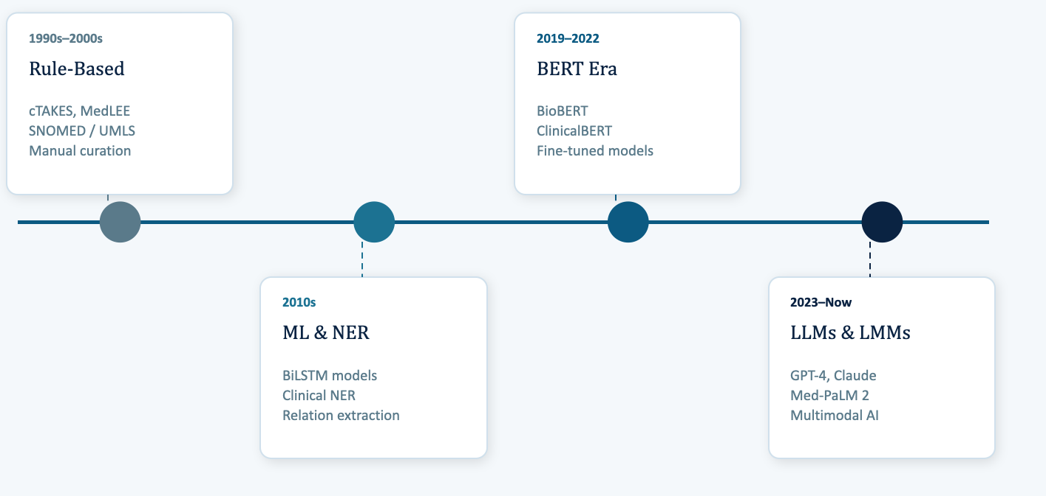
EVOLUTION OF CLINICAL NLP

Slide 5




OPPORTUNITIES IN HEALTHCARE
PRIOR AUTH AUTOMATION
HCC RISK ADJUSTMENT
LLMs extract clinical criteria from notes and match against payer policies in real time, reducing admin burden and appeal cycles.
NLP-driven HCC extraction from clinical documentation improves risk score accuracy in capitated payment models.
CLAIMS INTEGRITY
</>
CLINICAL DOCUMENTATION (CDI)
Automated ICD-10/CPT cross-referencing against clinical notes flags unsupported claims before adjudication.
Real-time NLP feedback during documentation helps physicians capture specificity needed for accurate coding and reimbursement.

Slide 6




THREATS & RISKS
HALLUCINATION RISK
LLMs can generate clinically plausible but inaccurate outputs. Erroneous diagnosis codes or fabricated medication history carry serious consequences for patient safety and financial integrity.
HIPAA & PHI COMPLIANCE
Processing protected health information through third-party LLM APIs requires Business Associate Agreements and strict data handling controls.
EXPLAINABILITY GAP
Deep learning models remain opaque, complicating audit trails required for regulatory compliance and provider dispute resolution.

Slide 7

STRATEGIC RECOMMENDATION FOR COTIVITI
Clinical Document Intelligence Layer
A modular LLM pipeline: ingest unstructured clinical docs → OCR + entity extraction → structured FHIR output with confidence scores and audit traces
1
2
3
HCC Capture
Claims-to-Clinical
Prior Auth Support
Extract hierarchical condition categories from notes to improve RAF score accuracy
Cross-reference ICD-10/CPT codes against clinical notes before adjudication
Match extracted clinical criteria against payer policy rules in real time
RISK MITIGATIONS :
RAG architecture anchors outputs to source spans · HIPAA-compliant private cloud — no public API endpoints · Human-in-the-loop review for low-confidence extractions

Slide 8
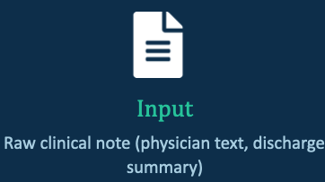
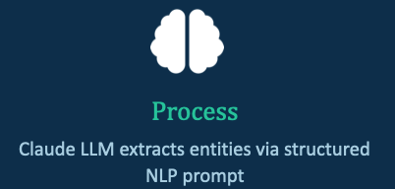
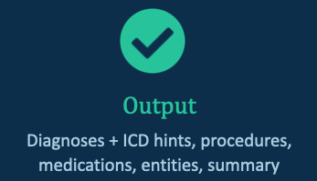
PROOF OF CONCEPT DEMO
CLINICAL NOTE ANALYZER — BUILT WITH PYTHON + CLAUDE API
->
->
Technologies used:
Python · Anthropic Claude API (claude-sonnet-4-6) · JSON structured output · Terminal CLI

Slide 9

KEY TAKEAWAYS
1
Clinical NLP has matured from brittle rule sets to powerful multimodal LLMs capable of reading, structuring, and summarizing medical text at scale.
2
The healthcare NLP market is growing at 19.8% CAGR, the window for early-mover advantage is now.
3
Cotiviti's strongest opportunity is an LLM-powered Clinical Document Intelligence Layer that feeds payment integrity and risk adjustment workflows.
4
Risks are real but manageable: RAG architecture, HIPAA-compliant deployment, and human-in-the-loop review form the mitigation stack.

Slide 10
PRESENTATION
THANK
YOU.
NISHA RAVISHANKAR · NRGNISHA02@GMAIL.COM · (602) 918-3008

