Slide 1

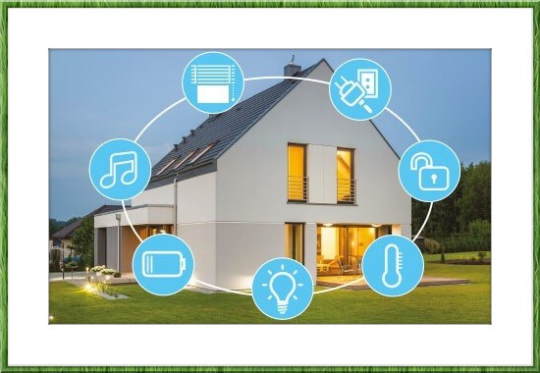
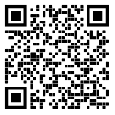

SMART HOME
🏰
Group : Hazrat Ali
Teacher: Fredrik Stridh

Slide 2
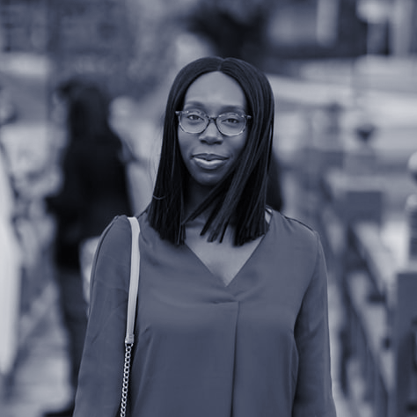
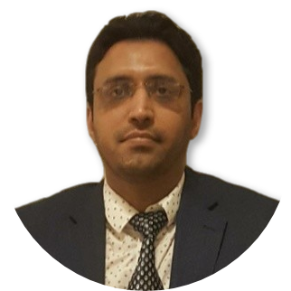
HELLO!
I am HAZRAT ALI
Master in Computer Science (BTH 2014), (HKR 2020)
Software developer (Ericsson, Flygresor, Trisoft, TriggySport)
Interests
  Web, Mobile App, Smart Apps development
  JS, React, Native, PHP, Python, Node, Java
You can find me at @hali_dev

Slide 3
AGENDA
Motivation
Architecture
Application
Reflection and Evaluation
Demonstration
Questions
GITHUB: https://github.com/iloveyii/mobile-platforms-dt581b-project

Slide 4
MOTIVATION!
Affordable
Keys are lost or duplicated, more repair costs
Easily extendable - control more devices
Market is growing (30B in 2022)
Resource conservation
Improved living experience

Slide 5
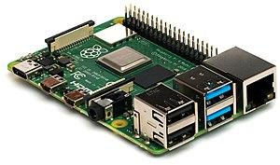

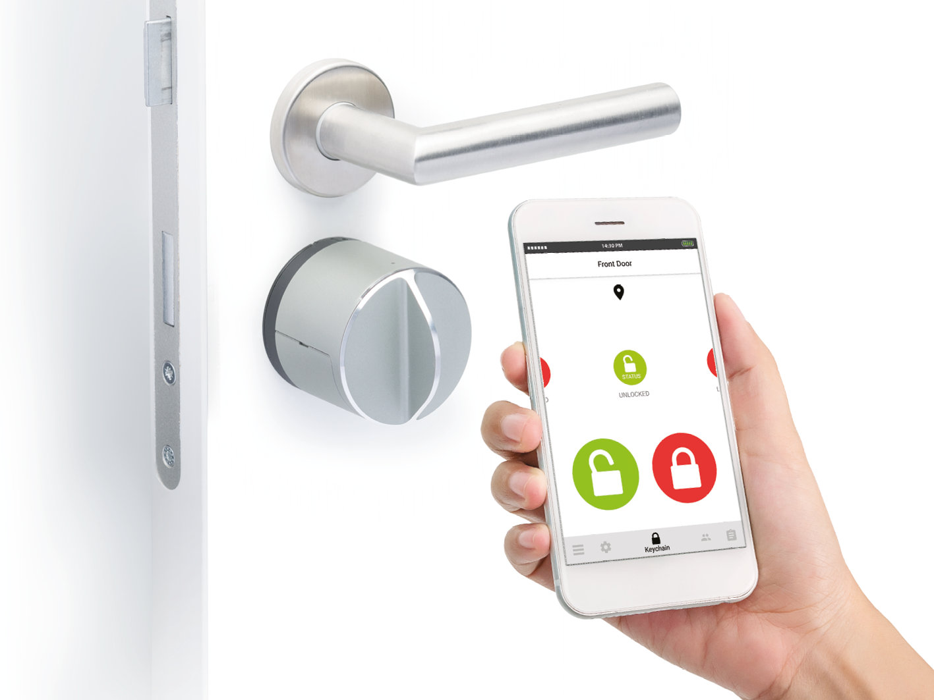
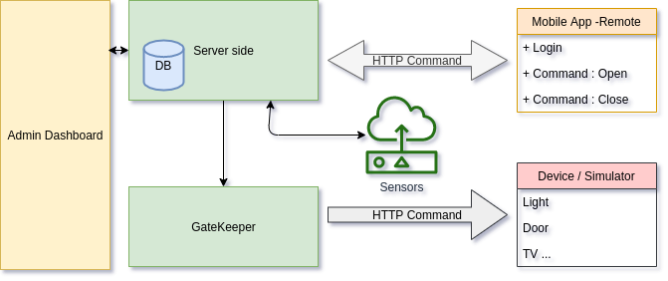
ARCHITECTURE
Technologies
  Raspberry PI / Orange PI
  React, JS, Node, Mongo
  Smart Sensor devices
Architecture
  6 main components

Slide 6
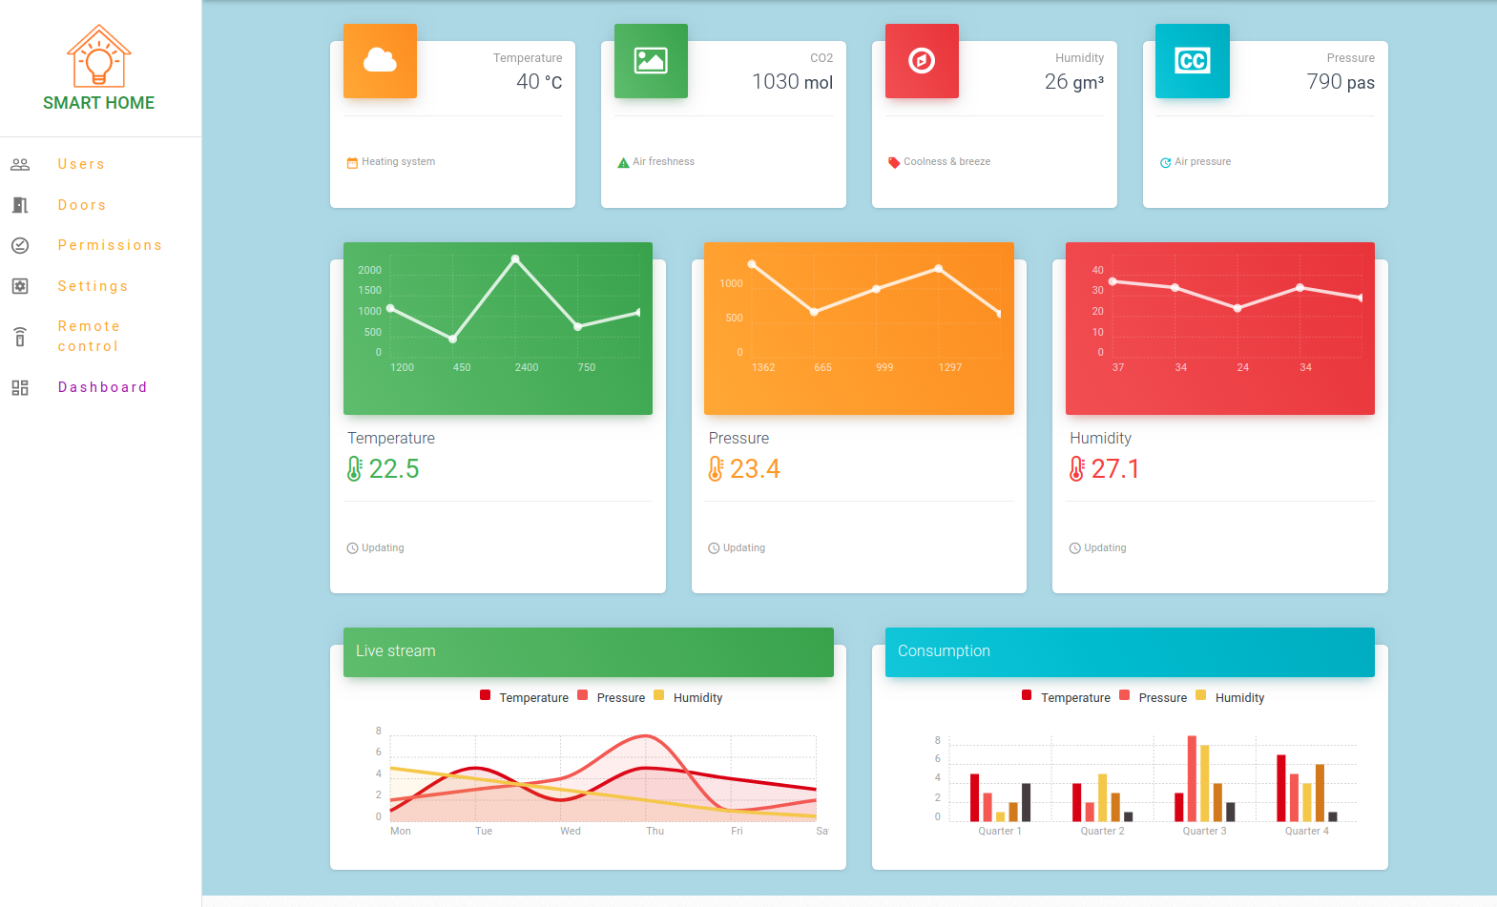
APPLICATION
Login
User Management
Devices
Permissions to devices
Dashboard

Slide 7
REFLECTION & EVALUATION
Login
User Management
Devices
Permissions to devices
Dashboard

Slide 8
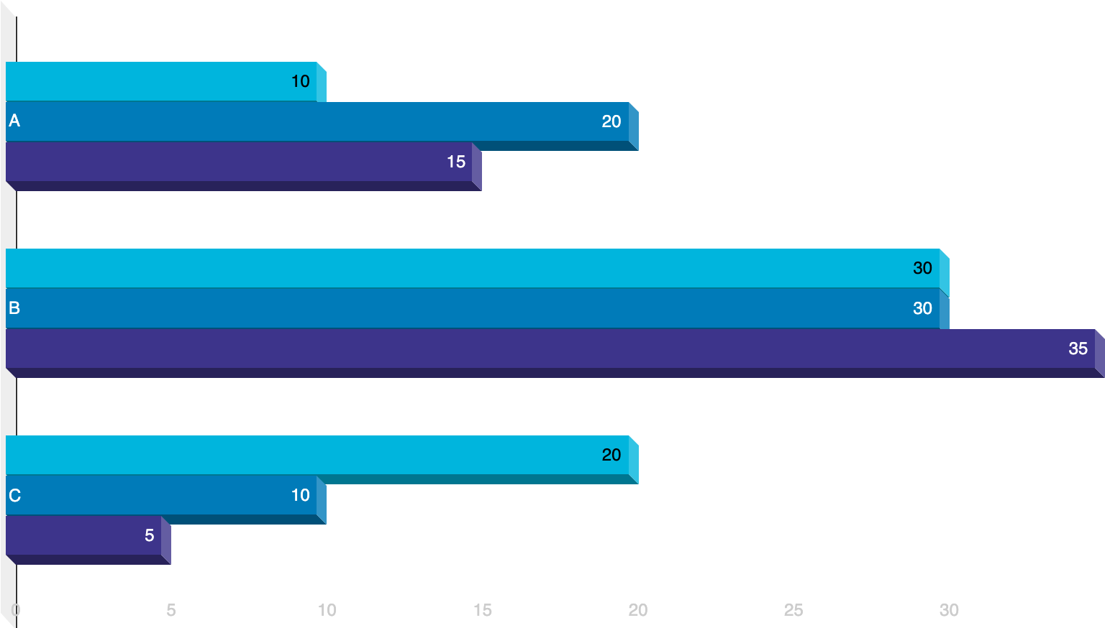
DEMONSTRATION
Backend
Frontend
Mobile Apps
Deployment
  Github hooks
  Bash Script
  Node Server

Slide 9
THANKS!
👦
Any questions?
You can find me at:
@hali_dev
ali.dev.se@gmail.com

