Slide 1


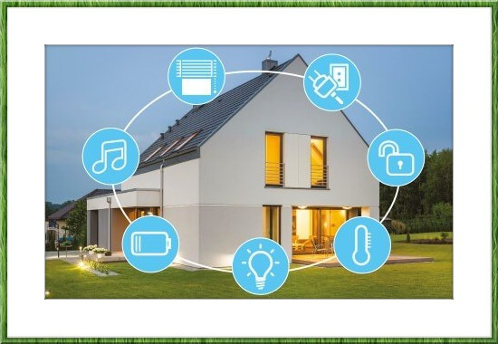
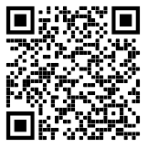

SMART HOME
Group : Hazrat Ali
Teacher: Fredrik Stridh
November 2020

Slide 2
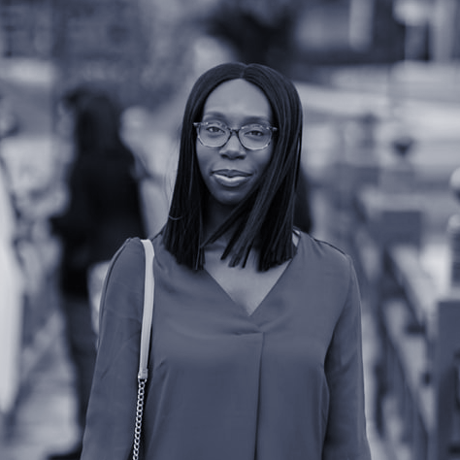
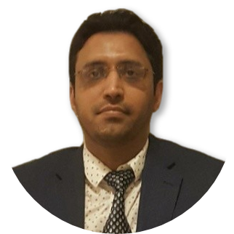
HELLO!
I am HAZRAT ALI
Master in Computer Science (BTH 2014), (HKR 2020)
Software developer (Ericsson, Flygresor, Trisoft, TriggySport)
Interests
Web, Mobile App, Smart Apps development
JS, React, Native, PHP, Python, Node, Java
Sports, Gym, Badminton
You can find me at @hali_dev
Notes:
Good morning guys, my name is Hazrat Ali and today I am present my project which is smart homes.
Educationally I have done masters in Computer sc from BTH 2014, and master with emphasis on SD HKR
I am interested in web, mobile apps, and smart apps development,
I mostly use technologies like JS, React, And Native, PHP, Python and Java
In my free time i like to go to gym or do some sports like badminton
You can find me on twitter at hali_dev

Slide 3
AGENDA
Motivation
Architecture
Application
Reflection and Evaluation
Demonstration
Questions
GITHUB: https://github.com/iloveyii/mobile-platforms-dt581b-project
Notes:
The agenda of this presentation is as follows.
First I will present you the motivation for this project.
Then I will show you the architecture of the system, the main components involved and how they interact with one another.
I will show the application user interface, and its functions.
The I will discuss the evaluation of the project.
At the end I will show you the demonstration of the developed system.
At the end, if you have any questions.

Slide 4
MOTIVATION!
Affordable & industry innovation (SDG)
Keys are lost or duplicated, more repair costs
Easily extendable - control more devices
Market is growing (30B in 2022)
Resource conservation
Improved living experience

Slide 5
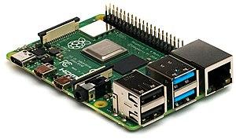

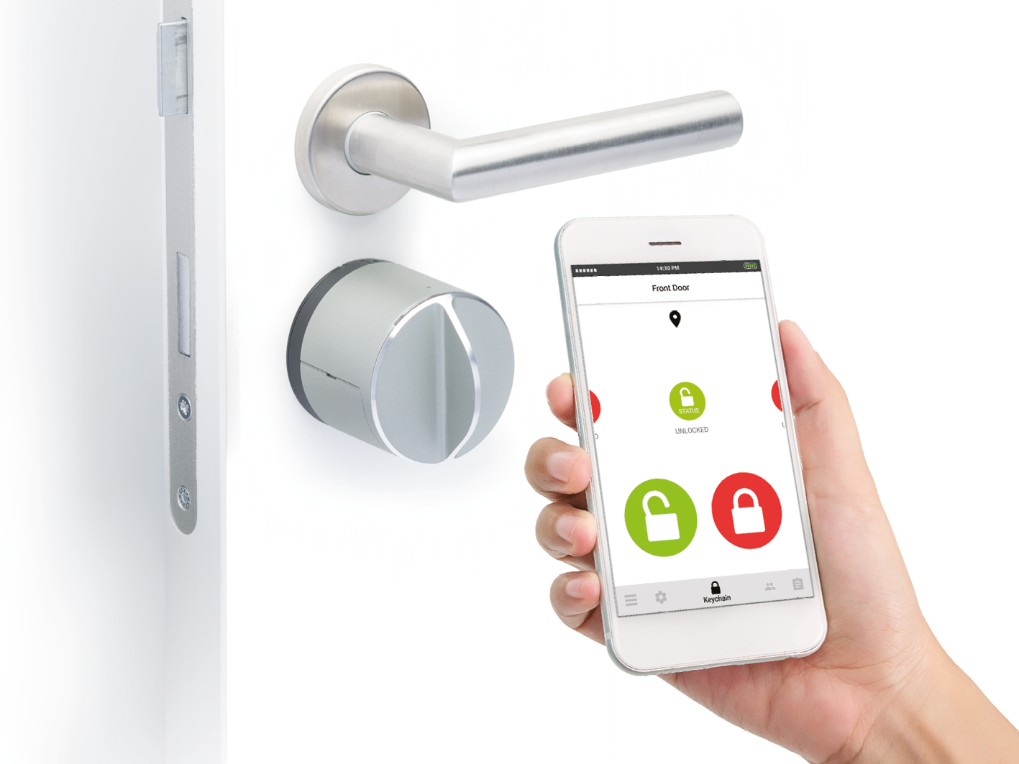
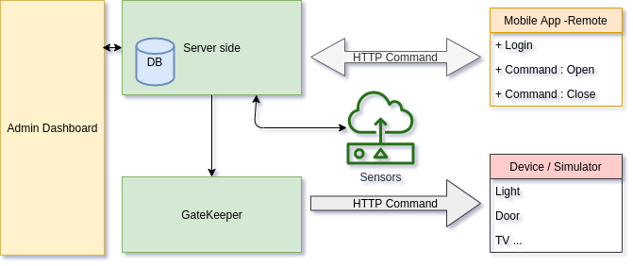
ARCHITECTURE
Technologies
Raspberry PI / Orange PI
React, JS, Node, Mongo
Smart Sensor devices
Architecture
6 main components
Dashboard
Server
Gatekeeper
Mobile app
Device / Simulator
Sensors

Slide 6
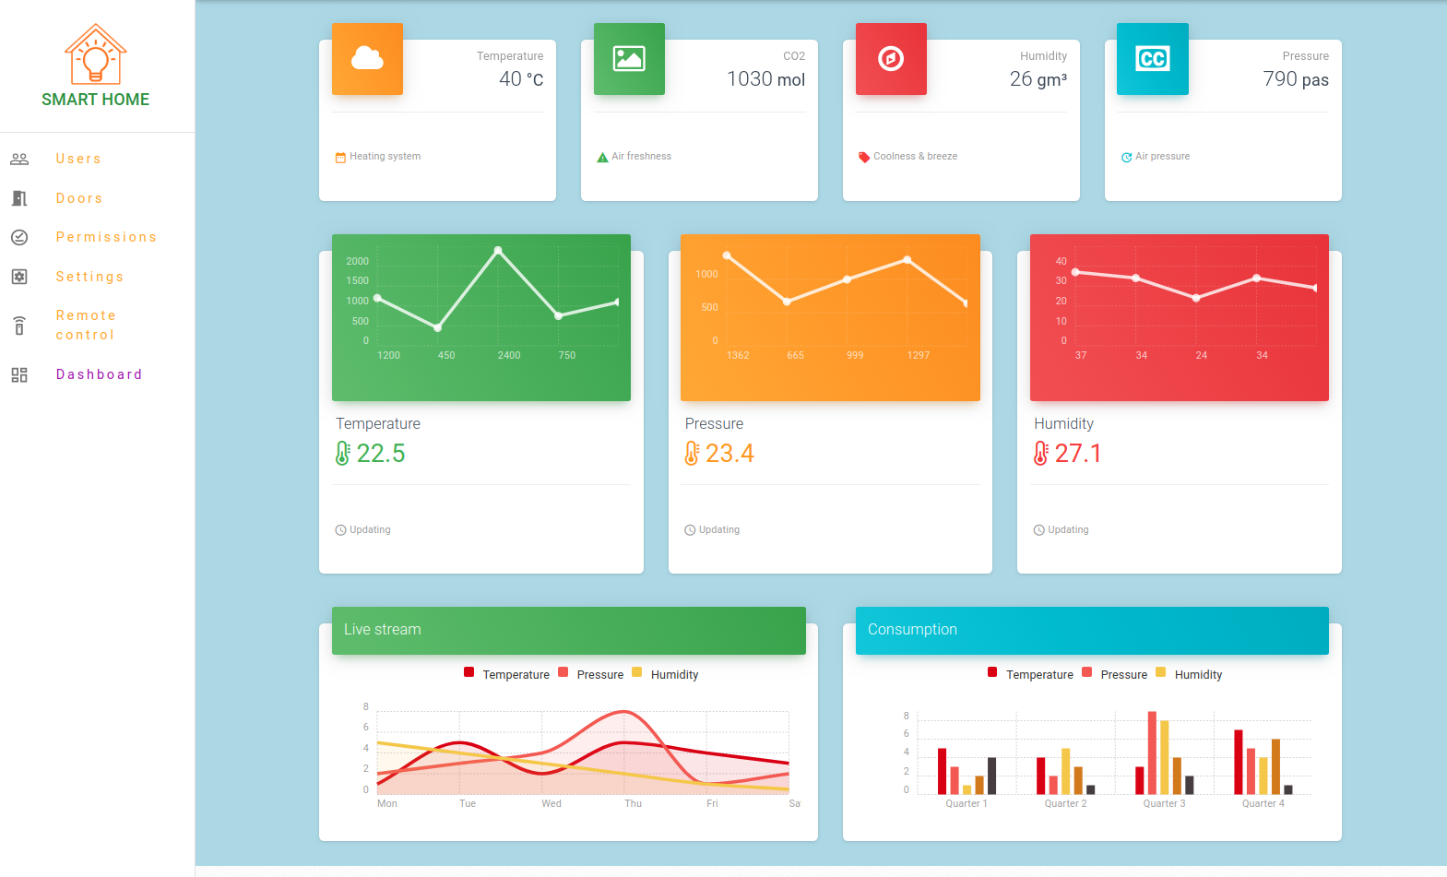
APPLICATION
Login
User Management
Devices
Permissions to devices
Dashboard

Slide 7
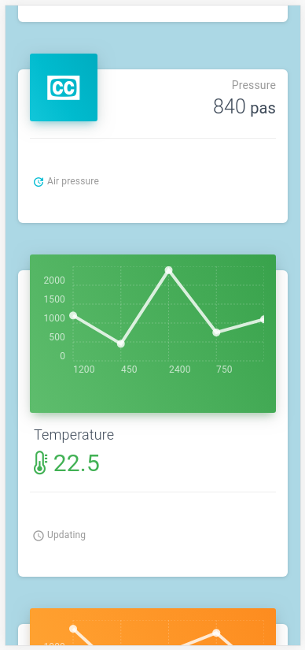

REFLECTION & EVALUATION
Environmental footprint
Power consumption
Hardware requirements
Cross platform
Lifetime of hw/sw, sustainable
Future work
AI
Home assistant
Gesture control

Slide 8
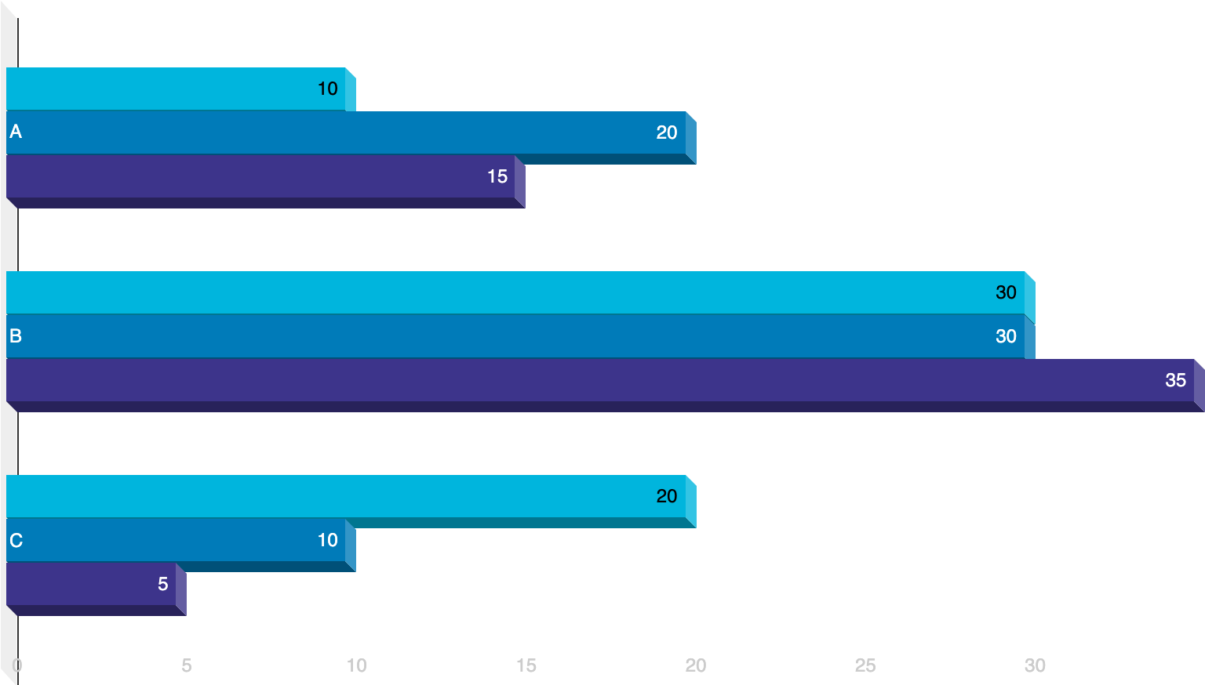
DEMONSTRATION
Backend
Frontend
Mobile Apps
Deployment
Github hooks
Bash Script
Node Server

Slide 9
THANKS!
👦
Any questions?
You can find me at:
@hali_dev
ali.dev.se@gmail.com

