Slide 1
Lesser Known Design Patterns
Ken Baum
Notes:
Good evening. I’m Ken Baum and tonight we’re going to consider some of the lesser known design patterns. But before we begin…

Slide 2
Who Am I?
Senior Consultant at SDS, Inc.
Retired from the Air Force in 1992
C#, .NET, JavaScript, etc.
Currently live in Springboro
Nine Grandchildren (including triplet granddaughters)

Slide 3







Slide 4
Strategic Data Systems – What We Do
Application Development and Application Renovations
Architecture, Development, and Architectural Design Reviews
.NET, Java, SharePoint
Agility – Agile Coaching and Transformations
Cloud Enablement
Mobile – iOS, Android, Windows
Training – Agile, .NET
Our place or yours!
Contact me at ken.baum@sds-consulting.com

Slide 5
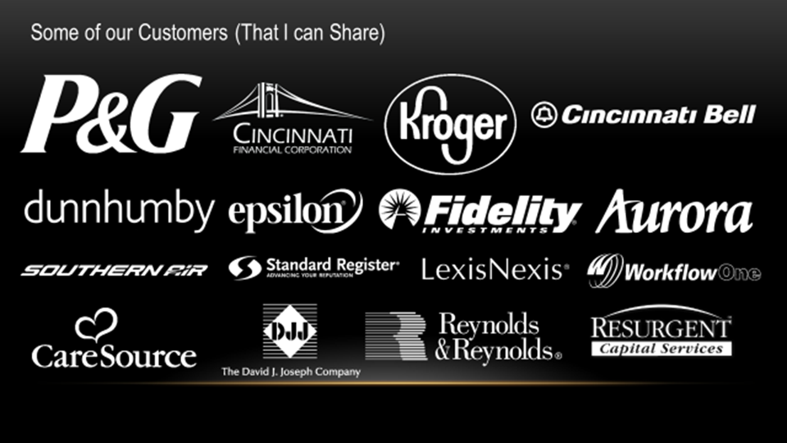

Slide 6
What is a Design Pattern?
Notes:
Most of us, I’m sure have heard of and probably used design patterns. Is there anyone here that has never heard of design patterns?
Of course, to find out what something is, you should go to an authoritative source, and in the area of design patterns, that source is…

Slide 7
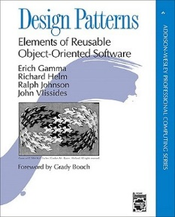
Gang of Four

Slide 8
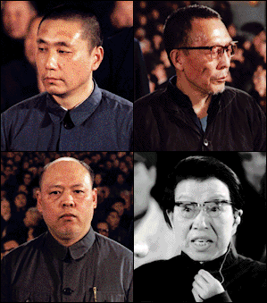
Gang of Four

Slide 9
Gang of Four
Gamma
Helm
Johnson
Vlissides
Notes:
Ok, I can’t back that up. I’m sure John Vlissides looks nothing like Mao’s wife. For his sake, I hope not.

Slide 10
Gang of Four
Notes:
Published in the mid-90’s, this book is still the canonical reference for software design patterns.

Slide 11
What is a Design Pattern?
“Each pattern describes a problem which occurs over and over again in our environment, and then describes the core of the solution to that problem, in such a way that you can use this solution a million times over, without ever doing it the same way twice.”
A Pattern Language, Christopher Alexander, et. al., quoted in GOF, p. 2
“…descriptions of communicating objects and classes that are customized to solve a general design problem in a particular context.” GOF, p. 3

Slide 12
What a Design Pattern Isn’t
A cookbook recipe
A one-size fits all solution
A callable library
An excuse to suspend critical thought

Slide 13
WHY?
WHY?
WHY?
A a
WHY?
WHY?
WHY?
WHY?
WHY?
WHY?
Notes:
Why questions are not allowed.

Slide 14
Why Use Patterns?
Use of patterns guarantees that your code will be readable, maintainable, extensible, indestructible, indefatigable, indomitable, formidable, unbreakable, inestimable, unimpeachable…you get the idea.
Notes:
Piggybacking on the idea that a pattern is not a canned solution, neither will the user of patterns automatically cause your code to be bullet-proof.
As Fred Brooks famously said, there is no “silver bullet” when it comes to software development.

Slide 15
Using design patterns can…
Leverage your cumulative experience
Minimize reinvention
Shorten development time for complex features
Increase stability of solutions
Notes:
Of course, your mileage will vary. Many of these ‘ilities’ are subjective in nature and there is precious little objective research that we can appeal to.
What we can appeal to is the community. Over the years we have developed principles, idioms, and practices that most practitioners agree will produce ‘better’ code, however you define it. The catch phrase that comes to mind is ‘best practices,’ that particular idea seems to have dropped off in recent years.

Slide 16
Lesser Known Design Patterns
Null Object “I have nothing to do, and I’m doing it.”
Memento “Rule #3 – Never open the package.”
State “If it moves, tax it. If it keeps moving, regulate it.
If it stops, subsidize it.”
Flyweight “Where’s my stunt double?”
Pipes and Filters “This world is not my home, I’m just a passin’ through.”

Slide 17
Our Process
The Issue
The Solution – UML
Demo
Summary

Slide 18
Null Object
I have nothing to do
…and I’m doing it.
(With apologies to John Cage)

Slide 19
The Issue
if (obj != null)
{
obj.DoIt();
}

Slide 20
The Issue
try
{
obj.DoIt();
}
catch()
{
}

Slide 21
The Issue
The irony: If it’s not important enough to throw an exception or log a message, then why clutter up your code?
Notes:
I’m not a hipster, so I can’t say this too ironically. Although I could say it with an 8 dollar can of PBR in my hand.

Slide 22
The Solution: Null Object
For a null reference substitute an object which does nothing.
var objCollection = new List<int>();
foreach (var obj in objCollection)
{
….
}

Slide 23
The Solution: Null Object
For a null reference substitute an object which does nothing.

Slide 24
Demo
Notes:
Application: logging service
--client: LoggingService
-- LoggingDevice: in App.Config (console, file, none)
-- LoggingServiceFactory: returns appropriate LoggingService
-- Before program
-- has null checks
-- After program 1
-- no null checks
-- silent but not deadly
-- After program 2
-- abstract class with static member, NullLog
-- don’t have to allocate everywhere

Slide 25
Summary
Checks for null references can clutter your code
Many times the null reference does not indicate a problem.
If you are doing null checks and not doing anything with that knowledge, then the Null Object pattern can eliminate a lot of clutter.
Provide an object that does nothing when the actual object reference is null.
We see this pattern already in collections…we don’t need to protect them when we enter a foreach loop.
C# 6.0 introduces the null propagation operator, which smell a lot like the Null Object pattern.

Slide 26
Memento
Rule #3 – Never
open the package
Notes:
Rule #1 The deal is the deal
Rule #2 No Names
Rule #3 Never open the package

Slide 27
The Issue
You sometimes need to restore an object or a module to a previous state
-- undo
-- checkpoints

Slide 28
The Issue
What about encapsulation?

Slide 29
The Solution: Memento Pattern
Take a snapshot!
Notes:
Memento (Memento)
stores internal state of the Originator object. The memento may store as much or as little of the originator's internal state as necessary at its originator's discretion.
protect against access by objects of other than the originator. Mementos have effectively two interfaces. Caretaker sees a narrow interface to the Memento -- it can only pass the memento to the other objects. Originator, in contrast, sees a wide interface, one that lets it access all the data necessary to restore itself to its previous state. Ideally, only the originator that produces the memento would be permitted to access the memento's internal state.
Originator (Client)
creates a memento containing a snapshot of its current internal state.
uses the memento to restore its internal state
Caretaker (Caretaker)
is responsible for the memento's safekeeping
never operates on or examines the contents of a memento.

Slide 30
Demo
Notes:
Memento 1
-- Originator: SalesProspect
-- Memento: Memento
-- Caretaker: ProspectBuffer
Memento 2
-- InkCanvasMemento:Imemento – memento class
-- CareTaker – stack of Imemento
-- Originator – application
-- InkCanvasWithUndo: InkCanvas – gives us access to the Strokes array

Slide 31
Summary
Restore state without giving up secrets
A good fit anytime you need to restore the system to a previous state
For large state can be expensive

Slide 32
State
Government's view of the economy could be summed up in a few short phrases: If it moves, tax it. If it keeps moving, regulate it. And if it stops moving, subsidize it. Ronald Reagan

Slide 33
The Issue
An object’s behavior
changes with state

Slide 34
switch(objState) {
case State1:
switch(command) { case Command1: doCommand1(); break; case Command2:
doCommand2();
break; … }
break;
case State2:
switch(command) { case Command1: …. } …
}
Code Smell: Nested Switch Statements

Slide 35
State
Use an object per state

Slide 36
Demo – Robert Martin Fowler’s Turnstile
Notes:
Example taken from Agile Patterns, Principles, and Practices in C# by Robert Martin Fowler.
Turnstile: Put in a coin, it unlocks
Pass through it locks Put in a coin while unlocked: eats your money Pass through while locked and sets off an alarm

Slide 37
Summary
Separation of concerns
Localization of state-specific behavior
Transition between states is explicit and clear
Easier to extend – new state = new class
Reuse of the state objects

Slide 38
Flyweight
Where’s my
stunt double?

Slide 39
The Issue
A plethora of small,
fine-grained objects

Slide 40
For instance…
Text Processing
Graphics system
Games – scene generators

Slide 41
When?
Large number of objects
Storage expensive because of the number of objects
Object state extrinsic (context-dependent)
Many objects replaced with few, shared objects containing intrinsic (context-free) state
No dependence on object identity

Slide 42
Example
…
var s1 = “A String”;
var s2 = “A String”;
…
Notes:
.NET String Class
String.Intern method returns a flyweight
Used to reduce memory footprint, increase performance
Intern pool, contains a single reference to each unique string in program
Considerations
Interned strings are not released till CLR terminates
To intern a string, you must first create (allocate memory) it
String.Intern(): flyweight factory
Related patterns: Composite, strategy, state
Summary: Share objects for better efficiency; retain fine grained objects

Slide 43
Flyweight
Notes:
The classes and objects participating in this pattern are:
Flyweight (Character)
declares an interface through which flyweights can receive and act on extrinsic state.
ConcreteFlyweight (CharacterA, CharacterB, ..., CharacterZ)
implements the Flyweight interface and adds storage for intrinsic state, if any. A ConcreteFlyweight object must be sharable. Any state it stores must be intrinsic, that is, it must be independent of the ConcreteFlyweight object's context.
UnsharedConcreteFlyweight ( not used )
not all Flyweight subclasses need to be shared. The Flyweight interface enables sharing, but it doesn't enforce it. It is common for UnsharedConcreteFlyweight objects to have ConcreteFlyweight objects as children at some level in the flyweight object structure (as the Row and Column classes have).
FlyweightFactory (CharacterFactory)
creates and manages flyweight objects
ensures that flyweight are shared properly. When a client requests a flyweight, the FlyweightFactory objects assets an existing instance or creates one, if none exists.
Client (FlyweightApp)
maintains a reference to flyweight(s).
computes or stores the extrinsic state of flyweight(s).

Slide 44
Demo

Slide 45
Summary
Group of objects are replaced by a few shared objects once extrinsic state is removed
Storage savings are derived from
Reduced instances
Amount of intrinsic state per object
Application can no longer depend on the object’s identity

Slide 46
Pipes and Filters
This world is not my home,
I’m just a passin’ through.

Slide 47
The Issue
An object passes through
successive stages

Slide 48
Examples
IIS Pipeline
Compiler pipeline
Message processing
Document workflow
UNIX command line

Slide 49
Pipes and Filters
Key Concept: Output of one stage is input to the next

Slide 50
Pipes and Filters

Slide 51
Key Word in Context (KWIC) Index
Create permutations of book and article titles by rotating the first word to the end successively until all words in the title appear at the beginning of a line. Lines are then sorted so that any word in the title can be used as a search term (sans stop words).
Example: Key Word in Context
Key Word in Context
Word in Context Key
In Context Key Word
Context Key Word In
Context Key Word In
In Context Key Word
Key Word in Context
Word in Context Key
Sort

Slide 52
Key Word in Context (KWIC) Index
Reader
Shifter
Sorter
Writer

Slide 53
Demo

Slide 54
Summary
Useful when processing can be decomposed into a set of discreet steps (filters), and each step performs some transformation on the data
Think UNIX command line:
cat dataFile | grep customer | awk ‘{print $1}’

Slide 55
Questions?

Slide 56
Patterns Resources
Pluralsight Design Patterns Library – 31 patterns
doFactory.com – Gang of Four, Enterprise, etc.
Gang of Four – 23 patterns
Microsoft Patterns and Practices: https://msdn.microsoft.com/en-us/library/ff921345.aspx
Microsoft Cloud Patterns: https://msdn.microsoft.com/en-us/library/dn568099.aspx

Slide 57
Contact Me
ilpadre1953@gmail.com
ken.baum@sds-consulting.com
Slides and Code available at GitHub: https://github.com/ilpadre

