Slide 1

Command Pattern Deep Dive
Ken Baum
Notes:
Good evening. I’m Ken Baum and tonight we’re going to consider some of the lesser known design patterns. But before we begin…

Slide 2
What is a Design Pattern?
Why do we need design patterns?
How do we teach (O-O) programming?
Notes:
Most of us, I’m sure have heard of and probably used design patterns. Is there anyone here that has never heard of design patterns?
Of course, to find out what something is, you should go to an authoritative source, and in the area of design patterns, that source is…

Slide 3
Language Features
UML
Abstraction
O-O Design
Encapsulation
IDEs
Inheritance
Polymorphism
Notes:
Most of us, I’m sure have heard of and probably used design patterns. Is there anyone here that has never heard of design patterns?
Of course, to find out what something is, you should go to an authoritative source, and in the area of design patterns, that source is…

Slide 4
Language Features
UML
Abstraction
What?
O-O Design
Encapsulation
IDEs
Inheritance
Polymorphism
Notes:
Most of us, I’m sure have heard of and probably used design patterns. Is there anyone here that has never heard of design patterns?
Of course, to find out what something is, you should go to an authoritative source, and in the area of design patterns, that source is…

Slide 5
Language Features
UML
Abstraction
How?
O-O Design
Encapsulation
IDEs
Inheritance
Polymorphism
Notes:
Most of us, I’m sure have heard of and probably used design patterns. Is there anyone here that has never heard of design patterns?
Of course, to find out what something is, you should go to an authoritative source, and in the area of design patterns, that source is…

Slide 6
Language Features
UML
Abstraction
When?
O-O Design
Encapsulation
IDEs
Inheritance
Polymorphism
Notes:
Most of us, I’m sure have heard of and probably used design patterns. Is there anyone here that has never heard of design patterns?
Of course, to find out what something is, you should go to an authoritative source, and in the area of design patterns, that source is…

Slide 7
Language Features
UML
Abstraction
Why?
O-O Design
Encapsulation
IDEs
Inheritance
Polymorphism
Notes:
Most of us, I’m sure have heard of and probably used design patterns. Is there anyone here that has never heard of design patterns?
Of course, to find out what something is, you should go to an authoritative source, and in the area of design patterns, that source is…

Slide 8
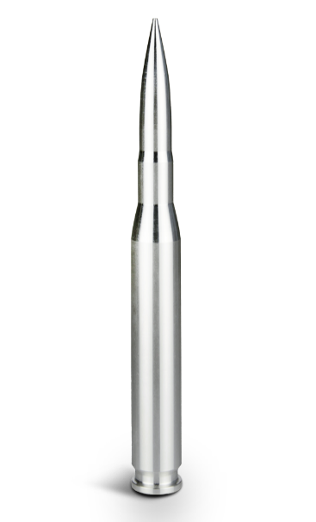
Notes:
Most of us, I’m sure have heard of and probably used design patterns. Is there anyone here that has never heard of design patterns?
Of course, to find out what something is, you should go to an authoritative source, and in the area of design patterns, that source is…

Slide 9

Notes:
Most of us, I’m sure have heard of and probably used design patterns. Is there anyone here that has never heard of design patterns?
Of course, to find out what something is, you should go to an authoritative source, and in the area of design patterns, that source is…

Slide 10
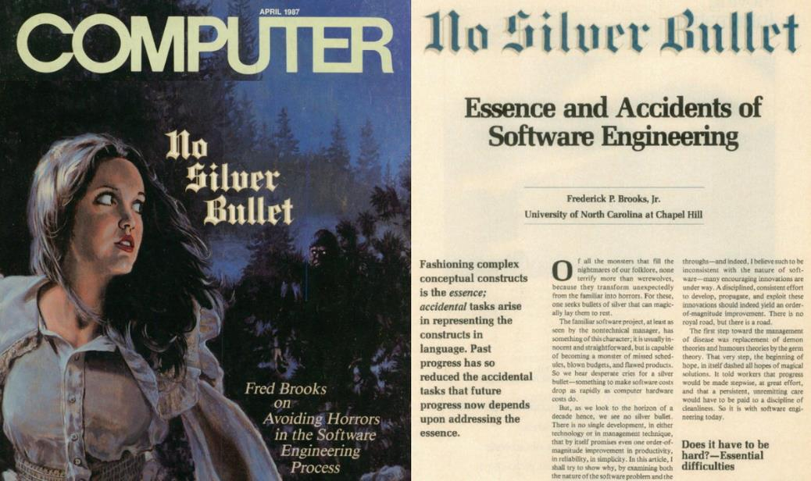

Slide 11
Software is Hard!
Complexity
Above the statement level, no two parts are alike
Complexity grows at an exponential rate
Conformity
Much of the complexity is arbitrary
Requirements come from humans
Changeability
Software is infinitely configurable and modifiable
Perception: it’s easy to make changes in software
Invisibility
“Software is invisible and unvisualizable”
When you look at a floor plan, you can picture the room or the floor

Slide 12
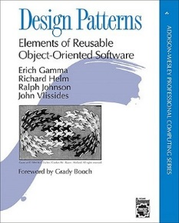
Gang of Four

Slide 13
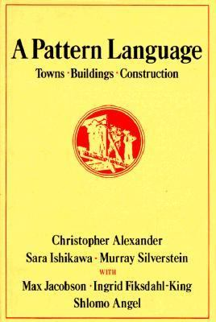
“Each pattern describes a problem which occurs over and over again in our environment, and then describes the core of the solution to that problem, in such a way that you can use this solution a million times over, without ever doing it the same way twice.”
A Pattern Language, Christopher Alexander, et. al., 1977 quoted in GOF, p. 2

Slide 14
Gang of Four
“…descriptions of communicating objects and classes that are customized to solve a general design problem in a particular context.” GOF, p. 3

Slide 15
What a Design Pattern Isn’t:
A cookbook recipe
A one-size fits all solution
A callable library
An excuse to suspend critical thought

Slide 16
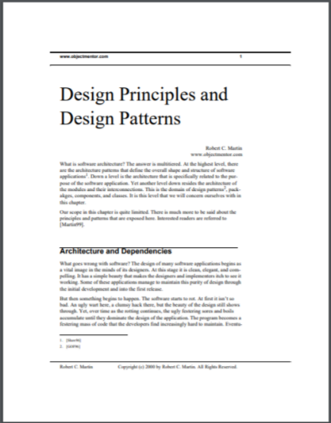
“The essential definition of a design pattern is a well worn and known good solution to a common problem. Design patterns are definitively not new. Rather they are old techniques that have shown their usefulness over a period of many years.” p. 28
https://fi.ort.edu.uy/innovaportal/file/2032/1/design_principles.pdf

Slide 17
A design pattern is a reusable object-oriented structure that solves a common problem in a particular context.

Slide 18
Creational Patterns
Abstract Factory
Builder
Factory Method
Prototype
Singleton
Structural Patterns
Adapter
Bridge
Composite
Decorator
Facade
Flyweight
Proxy
Behavioral Patterns
Chain of Responsibility
Command
Interpreter
Iterator
Mediator
Memento
Observer
State
Strategy
Template
Visitor
Notes:
Most of us, I’m sure have heard of and probably used design patterns. Is there anyone here that has never heard of design patterns?
Of course, to find out what something is, you should go to an authoritative source, and in the area of design patterns, that source is…

Slide 19
GOF Organization
Intent
Also Known As
Motivation
Applicability
Structure
Participants
Collaborations
Consequences
Implementation
Sample Code
Known Uses
Related Patterns

Slide 20

Notes:
Most of us, I’m sure have heard of and probably used design patterns. Is there anyone here that has never heard of design patterns?
Of course, to find out what something is, you should go to an authoritative source, and in the area of design patterns, that source is…

Slide 21
Intent Encapsulate a request as an object, thereby letting you parameterize clients with different requests, queue or log requests, and support undoable operations.

Slide 22
AKA Action, Transaction

Slide 23
Motivation Sometimes it's necessary to issue requests to objects without knowing anything about the operation being requested or the receiver of the request.

Slide 24

Self-destruct

Slide 25
Release the Kraken

Slide 26
Fire Ze Missiles

Slide 27
Applicability (Use Cases)
Use the Command Pattern when you want to:
Parameterize objects by an action to perform
Specify, queue, and execute requests at different times
Support undo
Support logging changes so that they can be reapplied in case of a system crash
Structure a system around high-level operations built on primitives operations
Notes:
Most of us, I’m sure have heard of and probably used design patterns. Is there anyone here that has never heard of design patterns?
Of course, to find out what something is, you should go to an authoritative source, and in the area of design patterns, that source is…

Slide 28
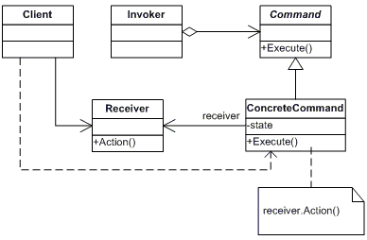
Structure
Client: Editor Application
Receiver: Document
Invoker: MenuItem
Command: Abstract class
or interface
ConcreteCommand: PasteCommand
Notes:
Most of us, I’m sure have heard of and probably used design patterns. Is there anyone here that has never heard of design patterns?
Of course, to find out what something is, you should go to an authoritative source, and in the area of design patterns, that source is…

Slide 29
Participants
Command (Abstract class or interface)
declares an interface for executing an operation
ConcreteCommand (PasteCommand)
defines a binding between a Receiver object and an action
implements Execute by invoking the corresponding operation(s) on Receiver
Client (Editor Application)
creates a ConcreteCommand object and sets its receiver
Invoker (MenuItem)
asks the command to carry out the request
Receiver (Document)
knows how to perform the operations associated with carrying out the request.

Slide 30
Collaborations
The client creates a ConcreteCommand object and specifies its receiver.
An Invoker object stores the ConcreteCommand object.
The invoker issues a request by calling Execute on the command. When commands are undoable, ConcreteCommand stores state for undoing the command prior to invoking Execute.
The ConcreteCommand object invokes operations on its receiver to carryout the request.

Slide 31


Slide 32
Consequences
1. Command decouples the object that invokes the operation from the one that knows how to perform it.
2. Commands are first-class objects. They can be manipulated and extended like any other object.
3. You can assemble commands into a composite command.
4. It's easy to add new Commands, because you don't have to change existing classes.

Slide 33
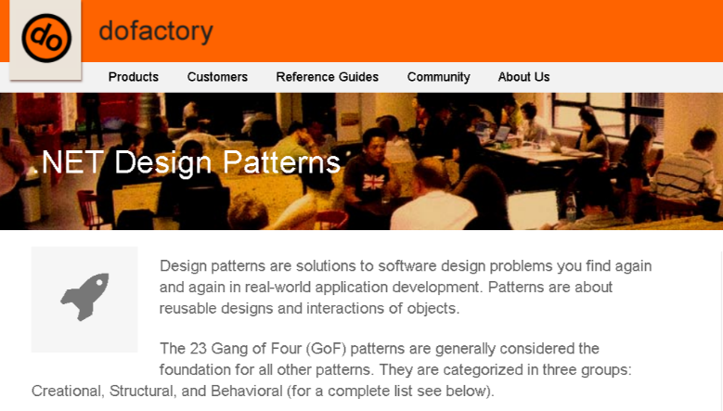
https://www.dofactory.com/net/design-patterns

Slide 34


Slide 35
Copier Controller

Slide 36
Copier Controller
Command
Execute()
Relay On Command
Motor On Command
Clutch On Command
Relay Off Command
Motor Off Command
Clutch Off Command

Slide 37
Copier Controller
Sensor
Command

Slide 38
Copier Controller
Sensor
Command
Configuration Method
Text File
Binding

Slide 39



Slide 40
References
Design Patterns: Elements of Reusable Object-oriented Software, Gamma et al.
DoFactory (www.dofactory.com)
Agile Principles, Patterns, and Practices in C#, Robert and Micah Martin

Slide 41
Contact Info:
ken.baum@ingagepartners.com
ilpadre1953@gmail.com
github.com/ilpadre

