Slide 1
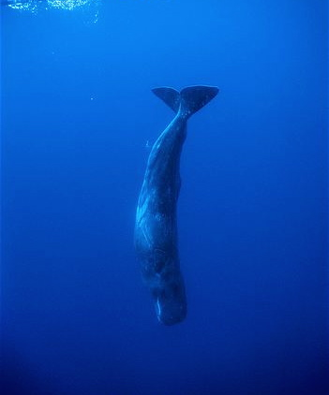
Command Pattern Deep Dive
Ken Baum
Notes:
Good evening. I’m Ken Baum and tonight we’re going to consider some of the lesser known design patterns. But before we begin…

Slide 2
Who Am I?
Notes:
Before we begin the presentation proper, though, let me tell you who I am. I’m currently a Senior Consultant with Ingage Partners. I have been with Ingage for well over two weeks now. I retired from the Air Force in 1992 and settled in Dayton. After a brief stint with a defense contractor, something of a detox period, I found work at a startup doing Visual C++ on Visual Studio 1.0. I’ve been mostly on the Microsoft stack ever since, although I have done a smattering of C, perl, and Java over the years. For the past few years I’ve been working with C#, .NET, and various javascript libraries such as jQuery, Knockout, and Angular.
I live in Springboro, and I enjoy reading and writing, working with college students at my church,

Slide 3
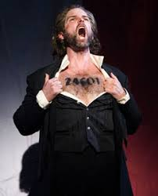

Slide 4
Who Am I?
Managing Consultant at Ingage
Retired from the Air Force in 1992
C#, .NET, JavaScript, etc.
Currently live in Springboro
Nine Grandchildren (including triplet granddaughters)
Notes:
Before we begin the presentation proper, though, let me tell you who I am. I’m currently a Senior Consultant with Ingage Partners. I have been with Ingage for well over two weeks now. I retired from the Air Force in 1992 and settled in Dayton. After a brief stint with a defense contractor, something of a detox period, I found work at a startup doing Visual C++ on Visual Studio 1.0. I’ve been mostly on the Microsoft stack ever since, although I have done a smattering of C, perl, and Java over the years. For the past few years I’ve been working with C#, .NET, and various javascript libraries such as jQuery, Knockout, and Angular.
I live in Springboro, and I enjoy reading and writing, working with college students at my church,

Slide 5
Our Why
We exist for the purpose of providing an authentic and measurable impact on the community by focusing on a triple bottom line business model: people, planet, and profits.
OUR MISSION
To provide high performing management and technology consulting services to be used as a force for positive change in the lives of our stakeholders.
OUR VISION
To be a thriving example of business for good in order to inspire others to think differently, thereby growing our collective impact on the world.

Slide 6
Southwest Ohio Givecamp 2019
Who: Developers, Designers, Testers, and anyone else willing to help.
What: Spend the weekend creating software projects for non-profits
When: October 18, 6:00PM – October 20, 4:00 PM
Where: Miami University Voice of America Learning Center, West Chester, Ohio.
Why: Weekend of learning, networking, and giving back
How: Sign up at southwestohiogivecamp.org

Slide 7
Command Pattern Deep Dive
Ken Baum
Notes:
Good evening. I’m Ken Baum and tonight we’re going to consider some of the lesser known design patterns. But before we begin…

Slide 8
What is a Design Pattern?
Why do we need design patterns?
How do we teach (O-O) programming?
Notes:
Most of us, I’m sure have heard of and probably used design patterns. Is there anyone here that has never heard of design patterns?
Of course, to find out what something is, you should go to an authoritative source, and in the area of design patterns, that source is…

Slide 9
Language Features
UML
Abstraction
O-O Design
Encapsulation
IDEs
Inheritance
Polymorphism
Notes:
Most of us, I’m sure have heard of and probably used design patterns. Is there anyone here that has never heard of design patterns?
Of course, to find out what something is, you should go to an authoritative source, and in the area of design patterns, that source is…

Slide 10
Language Features
UML
Abstraction
What?
O-O Design
Encapsulation
IDEs
Inheritance
Polymorphism
Notes:
Most of us, I’m sure have heard of and probably used design patterns. Is there anyone here that has never heard of design patterns?
Of course, to find out what something is, you should go to an authoritative source, and in the area of design patterns, that source is…

Slide 11
Language Features
UML
Abstraction
How?
O-O Design
Encapsulation
IDEs
Inheritance
Polymorphism
Notes:
Most of us, I’m sure have heard of and probably used design patterns. Is there anyone here that has never heard of design patterns?
Of course, to find out what something is, you should go to an authoritative source, and in the area of design patterns, that source is…

Slide 12
Language Features
UML
Abstraction
When?
O-O Design
Encapsulation
IDEs
Inheritance
Polymorphism
Notes:
Most of us, I’m sure have heard of and probably used design patterns. Is there anyone here that has never heard of design patterns?
Of course, to find out what something is, you should go to an authoritative source, and in the area of design patterns, that source is…

Slide 13
Language Features
UML
Abstraction
Why?
O-O Design
Encapsulation
IDEs
Inheritance
Polymorphism
Notes:
Most of us, I’m sure have heard of and probably used design patterns. Is there anyone here that has never heard of design patterns?
Of course, to find out what something is, you should go to an authoritative source, and in the area of design patterns, that source is…

Slide 14


Slide 15

Notes:
Most of us, I’m sure have heard of and probably used design patterns. Is there anyone here that has never heard of design patterns?
Of course, to find out what something is, you should go to an authoritative source, and in the area of design patterns, that source is…

Slide 16
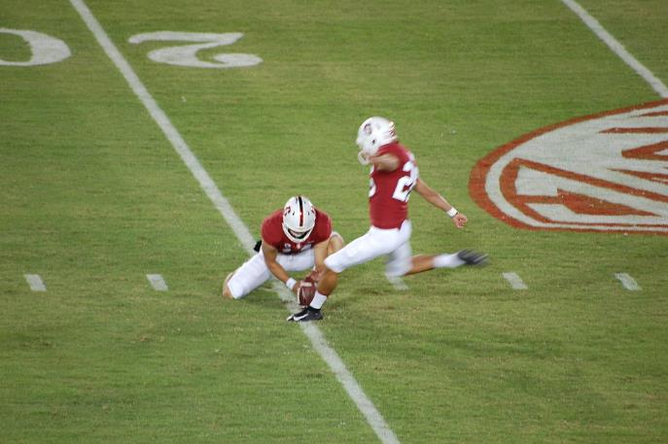

Slide 17

Notes:
Most of us, I’m sure have heard of and probably used design patterns. Is there anyone here that has never heard of design patterns?
Of course, to find out what something is, you should go to an authoritative source, and in the area of design patterns, that source is…

Slide 18
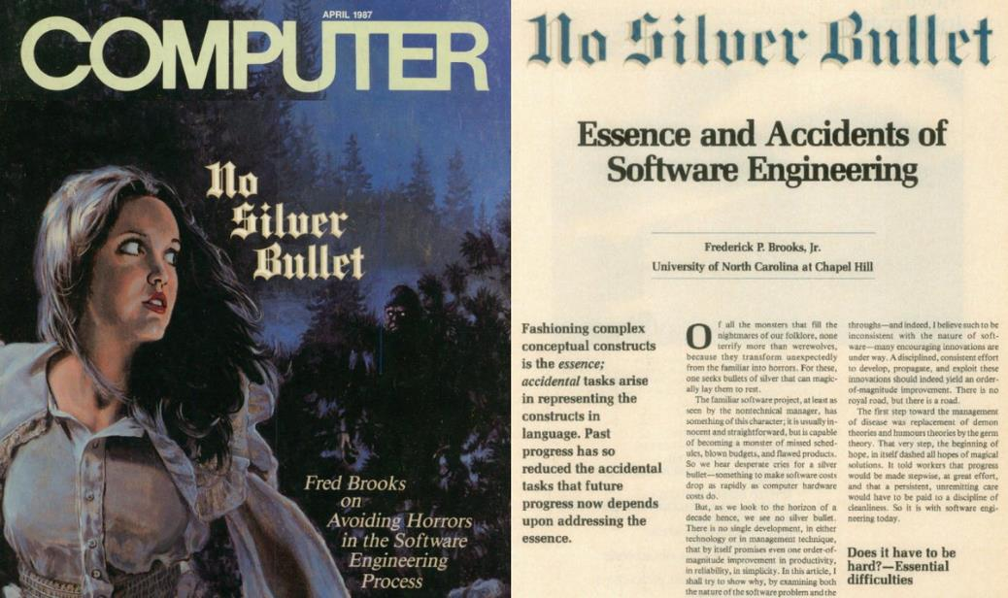

Slide 19
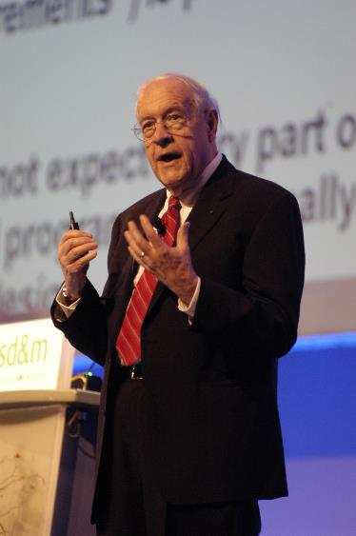
Fred Brooks
Designed the IBM 7090 “Stretch”
Chose the 8-bit addressable character
Owns a patent on early mainframe interrupts
Coined the term “computer architecture”
Led System/360

Slide 20


Slide 21
Brooks’s Law
Adding manpower to a
late software project makes it later.
(Mythical Man-Month, p. 25)

Slide 23
Software is Hard!
Complexity
Above the statement level, no two parts are alike
Complexity grows at an exponential rate
Conformity
Much of the complexity is arbitrary
Requirements come from humans
Changeability
Software is infinitely configurable and modifiable
Perception: it’s easy to make changes in software
Invisibility
“Software is invisible and unvisualizable”
When you look at a floor plan, you can picture the room or the floor

Slide 24
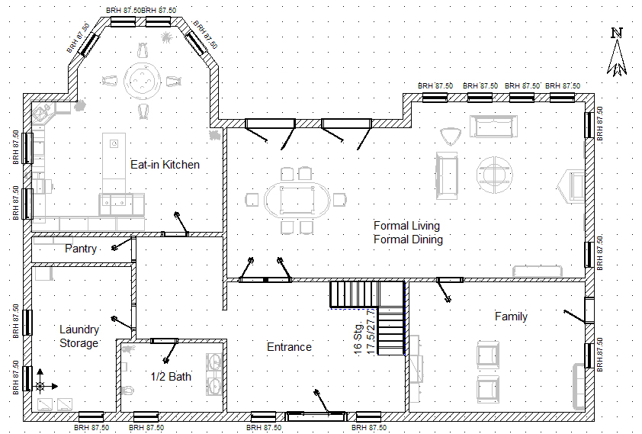

Slide 25
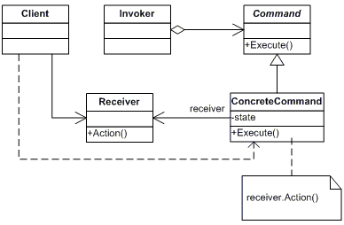

Slide 26
What is a Design Pattern?
Why do we need design patterns?
How do we teach (O-O) programming?
Notes:
Most of us, I’m sure have heard of and probably used design patterns. Is there anyone here that has never heard of design patterns?
Of course, to find out what something is, you should go to an authoritative source, and in the area of design patterns, that source is…

Slide 27
Software is Hard!
Complexity
Above the statement level, no two parts are alike
Complexity grows at an exponential rate
Conformity
Much of the complexity is arbitrary
Requirements come from humans
Changeability
Software is infinitely configurable and modifiable
Perception: it’s easy to make changes in software
Invisibility
“Software is invisible and unvisualizable”
When you look at a floor plan, you can picture the room or the floor

Slide 28
What is a Design Pattern?
Why do we need design patterns?
How do we teach (O-O) programming?
Notes:
Most of us, I’m sure have heard of and probably used design patterns. Is there anyone here that has never heard of design patterns?
Of course, to find out what something is, you should go to an authoritative source, and in the area of design patterns, that source is…

Slide 29
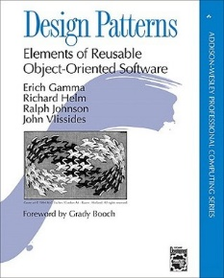
Gang of Four

Slide 30

“Each pattern describes a problem which occurs over and over again in our environment, and then describes the core of the solution to that problem, in such a way that you can use this solution a million times over, without ever doing it the same way twice.”
A Pattern Language, Christopher Alexander, et. al., 1977 quoted in GOF, p. 2

Slide 31
Gang of Four
“…descriptions of communicating objects and classes that are customized to solve a general design problem in a particular context.” GOF, p. 3

Slide 32
What a Design Pattern Isn’t:
A cookbook recipe
A one-size fits all solution
A callable library
An excuse to suspend critical thought

Slide 33
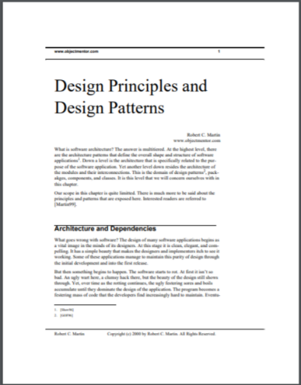
“The essential definition of a design pattern is a well worn and known good solution to a common problem. Design patterns are definitively not new. Rather they are old techniques that have shown their usefulness over a period of many years.” p. 28
https://fi.ort.edu.uy/innovaportal/file/2032/1/design_principles.pdf

Slide 34
A design pattern is a reusable object-oriented structure that solves a common problem in a particular context.

Slide 35
Creational Patterns
Abstract Factory
Builder
Factory Method
Prototype
Singleton
Structural Patterns
Adapter
Bridge
Composite
Decorator
Facade
Flyweight
Proxy
Behavioral Patterns
Chain of Responsibility
Command
Interpreter
Iterator
Mediator
Memento
Observer
State
Strategy
Template
Visitor
Notes:
Most of us, I’m sure have heard of and probably used design patterns. Is there anyone here that has never heard of design patterns?
Of course, to find out what something is, you should go to an authoritative source, and in the area of design patterns, that source is…

Slide 36
GOF Organization
Intent
Also Known As
Motivation
Applicability
Structure
Participants
Collaborations
Consequences
Implementation
Sample Code
Known Uses
Related Patterns

Slide 37

Notes:
Most of us, I’m sure have heard of and probably used design patterns. Is there anyone here that has never heard of design patterns?
Of course, to find out what something is, you should go to an authoritative source, and in the area of design patterns, that source is…

Slide 38
Intent Encapsulate a request as an object, thereby letting you parameterize clients with different requests, queue or log requests, and support undoable operations.

Slide 39
Motivation Sometimes it's necessary to issue requests to objects without knowing anything about the operation being requested or the receiver of the request.

Slide 40

Self-destruct

Slide 41
Release the Kraken

Slide 42
Fire Ze Missiles!

Slide 43
Applicability (Use Cases)
Use the Command Pattern when you want to:
Parameterize objects by an action to perform
Specify, queue, and execute requests at different times
Support undo
Support logging changes so that they can be reapplied in case of a system crash
Structure a system around high-level operations built on primitive operations
Notes:
Most of us, I’m sure have heard of and probably used design patterns. Is there anyone here that has never heard of design patterns?
Of course, to find out what something is, you should go to an authoritative source, and in the area of design patterns, that source is…

Slide 44
Structure
Client: Editor Application
Receiver: Document
Invoker: MenuItem
Command: Abstract class
or interface
ConcreteCommand: PasteCommand
Notes:
Most of us, I’m sure have heard of and probably used design patterns. Is there anyone here that has never heard of design patterns?
Of course, to find out what something is, you should go to an authoritative source, and in the area of design patterns, that source is…

Slide 45
Participants
Command (Abstract class or interface)
declares an interface for executing an operation
ConcreteCommand (PasteCommand)
defines a binding between a Receiver object and an action
implements Execute by invoking the corresponding operation(s) on Receiver
Client (Editor Application)
creates a ConcreteCommand object and sets its receiver
Invoker (MenuItem)
asks the command to carry out the request
Receiver (Document)
knows how to perform the operations associated with carrying out the request.

Slide 46
Collaborations
The client creates a ConcreteCommand object and specifies its receiver.
An Invoker object stores the ConcreteCommand object.
The invoker issues a request by calling Execute on the command. When commands are undoable, ConcreteCommand stores state for undoing the command prior to invoking Execute.
The ConcreteCommand object invokes operations on its receiver to carryout the request.

Slide 47


Slide 48
Consequences
1. Command decouples the object that invokes the operation from the one that knows how to perform it.
2. Commands are first-class objects. They can be manipulated and extended like any other object.
3. You can assemble commands into a composite command.
4. It's easy to add new Commands, because you don't have to change existing classes.

Slide 49
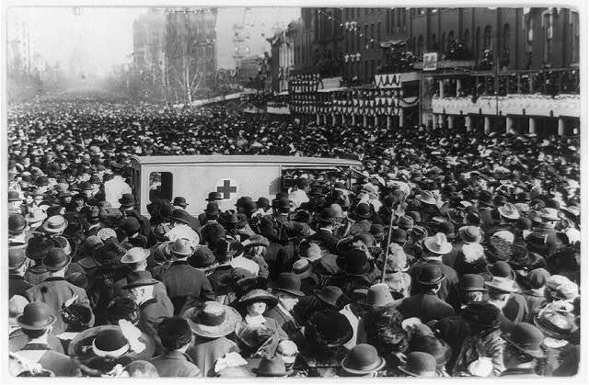

Slide 50
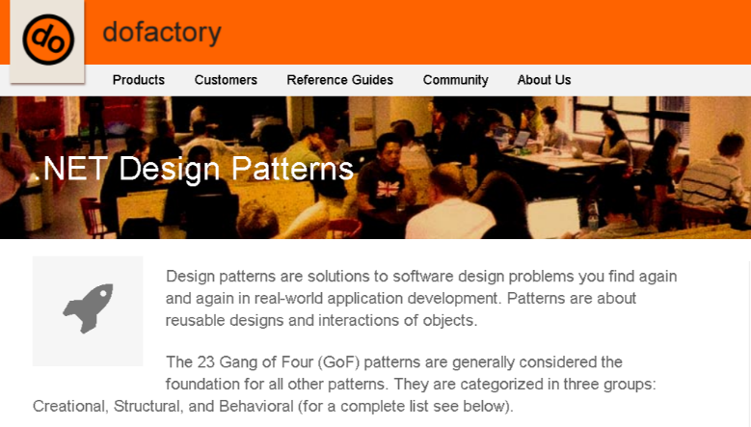
https://www.dofactory.com/net/design-patterns

Slide 51
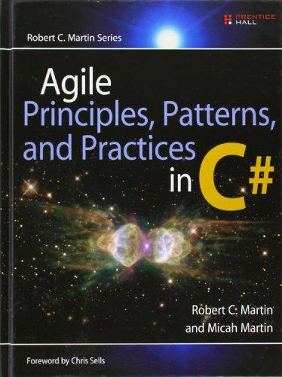

Slide 52
Copier Controller
Command
Execute()
Relay On Command
Motor On Command
Clutch On Command
Relay Off Command
Motor Off Command
Clutch Off Command

Slide 53
Copier Controller
Sensor
Command

Slide 54
Copier Controller
Sensor
Command
Configuration Method
Text File
Binding

Slide 55



Slide 56
References
Design Patterns: Elements of Reusable Object-oriented Software, Gamma et al.
DoFactory (www.dofactory.com)
Agile Principles, Patterns, and Practices in C#, Robert and Micah Martin

Slide 57
Contact Info:
ken.baum@ingagepartners.com
ilpadre1953@gmail.com
github.com/ilpadre

