Slide 1
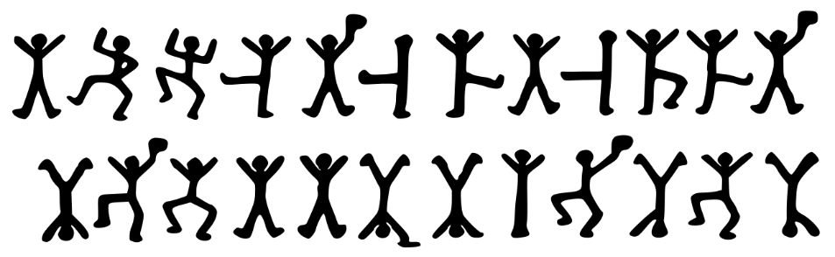
Fun With Cryptography Ken Baum

Slide 2
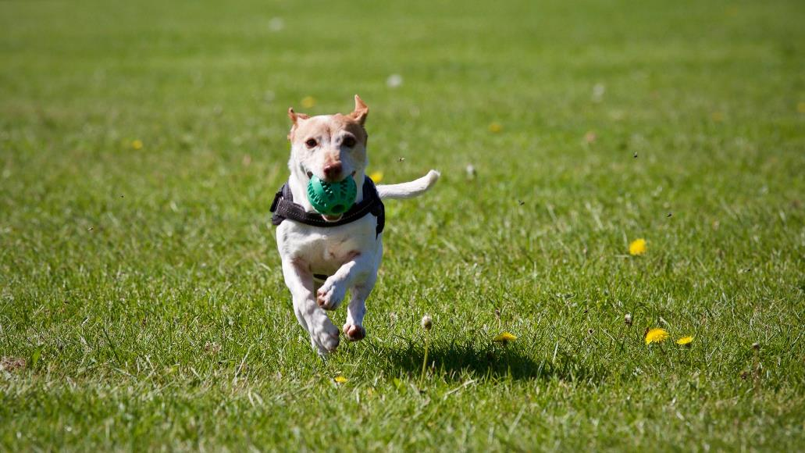

Slide 3
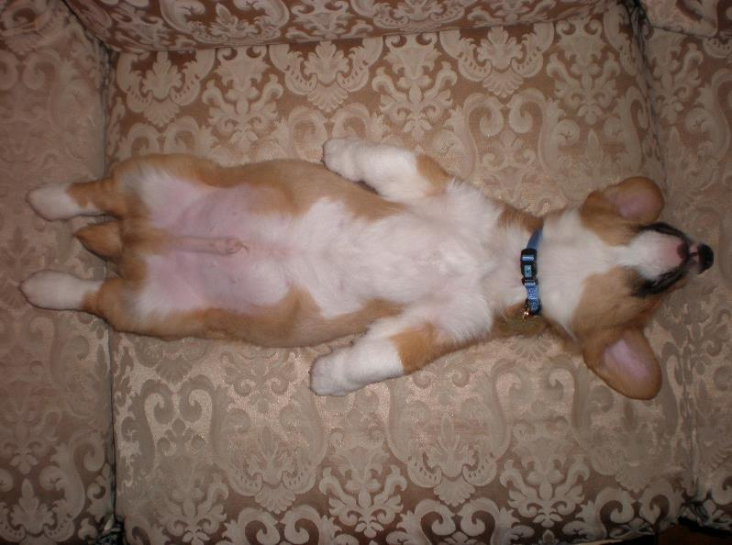

Slide 4

CincyDeliver 2019 Sponsors

Slide 5
Southwest Ohio Givecamp 2019
Who: Developers, Designers, Testers, and anyone else willing to help.
What: Spend the weekend creating software projects for non-profits
When: October 18, 6:00PM – October 20, 4:00 PM
Where: Miami University Voice of America Learning Center, West Chester, Ohio.
Why: Weekend of learning, networking, and giving back
How: Sign up at southwestohiogivecamp.org

Slide 6
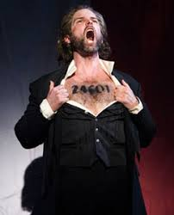
Who am I?

Slide 7
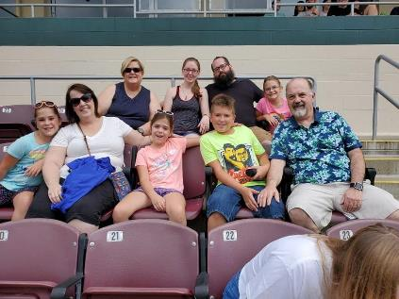
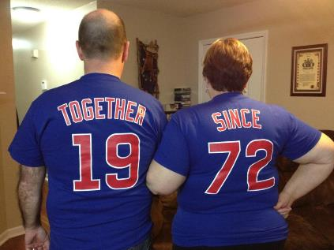



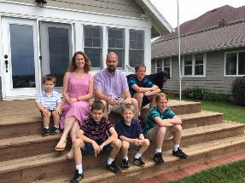

Slide 8




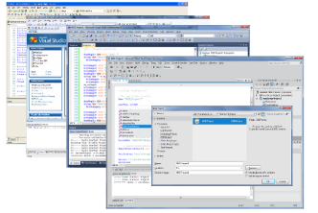



Slide 9
Fun With Cryptography

Slide 10
What is Cryptography?

Slide 11
Why Cryptography?

Slide 12
What is Cryptography?

Slide 13
“The practice or art of encoding messages”
Concise Oxford English Dictionary

Slide 14
“The practice or art of encoding messages”
Concise Oxford English Dictionary

Slide 15
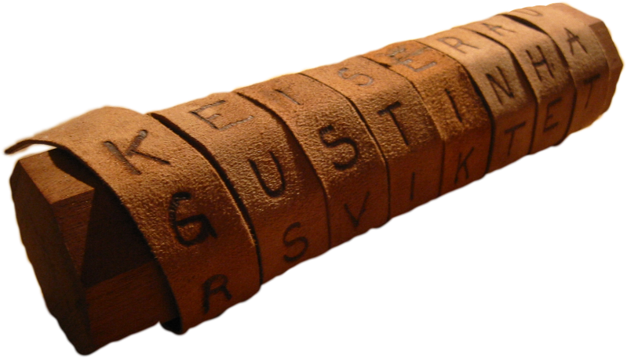
Classical Cryptography
Scytale or Baton Cylinder

Slide 16

Scytale

Slide 17
Substitution Cipher
A | B | C | D | E | F | G | H | I | J | K | L | M | N | O | P | Q | R | S | T | U | V | W | X | Y | Z
X | E | U | A | D | N | B | K | V | M | R | O | C | Q | F | S | Y | H | W | G | L | Z | I | J | P | T
Plaintext: We charge the ruins at dawn
Ciphertext: idukxhbdgkdhlvqwxgaxiq

Slide 18
Shift Cipher
(aka Caesar Cipher)
Shift = 5
A | B | C | D | E | F | G | H | I | J | K | L | M | N | O | P | Q | R | S | T | U | V | W | X | Y | Z
F | G | H | I | J | K | L | M | N | O | P | Q | R | S | T | U | V | W | X | Y | Z | A | B | C | D | E

Slide 19
The Adventure of the Dancing Men,
The Return of Sherlock Holmes, 1905, chapter 3

Slide 20
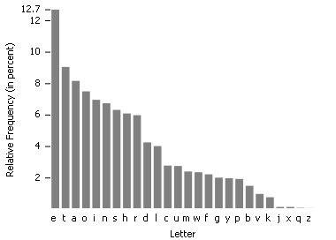
Frequency Analysis

Slide 21
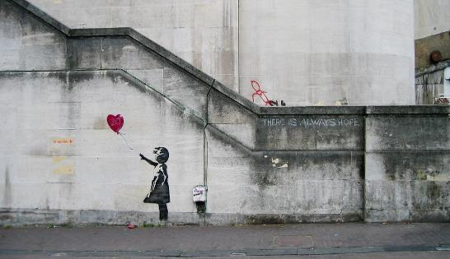
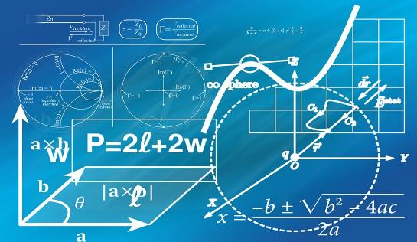
Modern
Classical
Notes:
Historical cryptography – an art form focusing on codes
Modern cryptography – a rich theory emerged, enabling the study of cryptography as a science and a mathematical discipline
-- also became widely adopted; prior to 1970, encryption was almost exclusively military and governmental

Slide 22

When did modern cryptography begin?

Slide 23
What is modern cryptography?
“The practice or art of encoding messages”
“The study of mathematical techniques for securing digital information, systems, and distributed computations against adversarial attacks.”
Modern Cryptography, Katz and Lindell, p. 3

Slide 24
plaintext
encrypt
ciphertext
key
decrypt
1. Key is secret
2. Key is symmetric
Goal: Hide message from eavesdropper

Slide 25



Private-key Encryption
message
encrypt
ciphertext
decrypt
message
key
key

Slide 26
Encryption Scheme
Message Space M = {all possible messages}
Three Algorithms
GEN – key generation k = GEN(), k in K
ENC – encryption c = ENC_{k}(m), m in M
DEC – decryption m = DEC_{k}(c)
Correctness requirement: DEC_{k}(ENC_{k}(m)) = m
Notes:
Gen: selects a uniform key k from K

Slide 27


Slide 28
The Security of an encryption scheme depends on
Answer: 1. a
2. b
3. c
4. a & b
5. b & c
6. a, b, and c
The randomness of the key
Keeping the key secret
Keeping the encryption/decryption algorithm secret

Slide 29
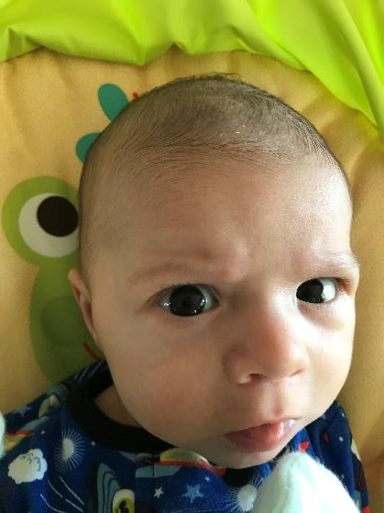

Slide 30
Keeping the encryption and decryption algorithms secret is of no consequence!

Slide 31
Kerckhoffs’s Principle
“The cipher method must not be required to be secret and it must be able to fall into the hands of the enemy without inconvenience.”
Auguste Kerckhoffs, 1883
Shannon’s Maxim: “The enemy knows the system"

Slide 32
Why don’t we care?
It’s easier to keep a short key secret than a potentially lengthy algorithm
If the system becomes compromised, it’s easier to generate a new key than to create and distribute a new algorithm
For large scale deployment, everyone using the same scheme is easier to manage

Slide 33
Are there encryption schemes that cannot be broken?
YES!

Slide 34
What does it mean to “break” an encryption scheme?
What is perfect secrecy?

Slide 35

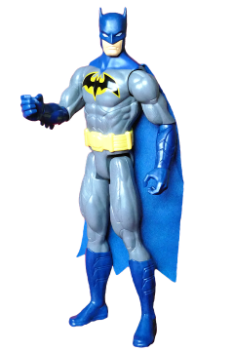


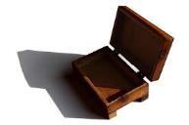

Eve’s Game*
Eve instructs Bob to enter a room that contains a box, some locks, and a deck of cards.
She tells Bob to choose a card from the deck and hide it.
If Eve can determine which card Bob chose, she wins.
* Taken from Britt Cruise, Kahn Academy https://www.khanacademy.org/computing/computer-science/cryptography/crypt/v/perfect-secrecy

Slide 36
Rules of the Game
Bob cannot leave the room with anything
Bob can put at most one card in the box
Eve has never seen the locks

Slide 37
What are Bob’s options?
Use a key lock, place his card and the key in the box, and then lock the box.
Place his card in the box, lock it with a combination lock.
What is the problem with these solutions?

Slide 38
Placing a card in the box tells Eve exactly which card Bob chose!
(She just has to go through the deck and determine which card is missing.)

Slide 39
The solution:
Bob chooses a card and places it back in the deck
Bob shuffles the deck.
Why is this the answer?
-- Eve can do no better than guess (1 in 52, < 2% probability)

Slide 40
Perfect Secrecy
The probability of determining the message text, given the ciphertext, is no better than a blind guess.
If your message space is much larger than 52, say 2²⁵⁶ , the probability will be much lower.
(1/2²⁵⁶ or 2⁻²⁵⁶, 8.6361686e-76 %)

Slide 41
Perfect Secrecy
.00000000000000000000000000000000000000000000000000000000000000000000000000086361686 %

Slide 42
Are there perfectly secret encryption schemes?
YES!

Slide 43

The One-time Pad
Frank Miller invented in 1882
Claude Shannon proved perfect secrecy in 1945

Slide 44
The One-time Pad
Choose an integer l > 0. M, K, C = {0,1}^{l}
Gen: choose key from K according to a uniform distribution.
Enc: c = k ^ m (^ = exclusive-or)
Dec: m = k ^ c

Slide 45
The One-time Pad
1^1 = 0
1^0 = 1
0^1 = 1
0^0 = 0
k: 1 1 0 1
m: 0 1 1 0
c: 1 0 1 1
k: 1 1 0 1
c: 1 0 1 1
m: 0 1 1 0

Slide 46
Limitations of the One-time Pad
Key Length
Perfectly secret ONLY if the key is used once and only once

Slide 47
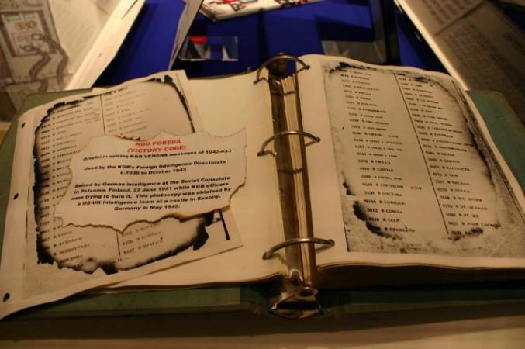
OTP in the Real World
The Venona Project
1943-1980

Slide 48
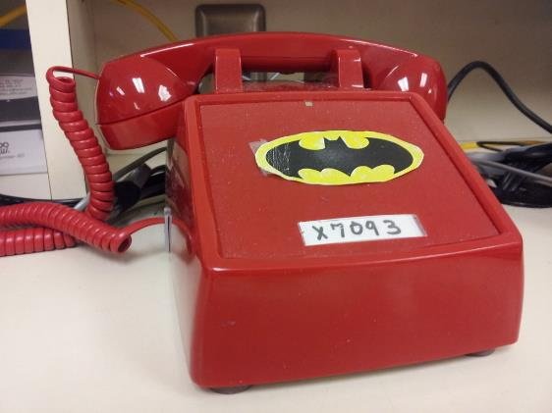
OTP in the Real World

Slide 49
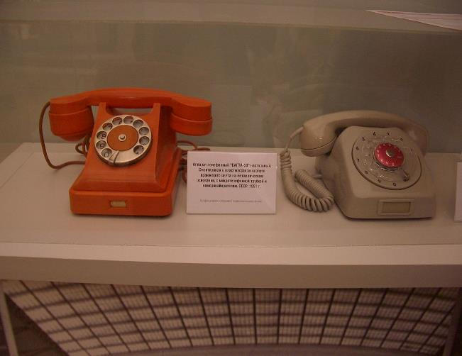
OTP in the Real World

Slide 50

The Big Problem
Key Exchange!

Slide 51
How do we exchange keys?

Slide 52
How do we exchange keys?
message
encrypt
ciphertext
decrypt
message
key
key

Slide 53
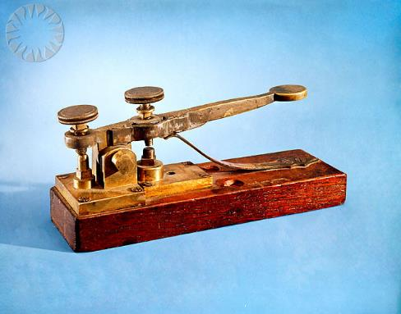
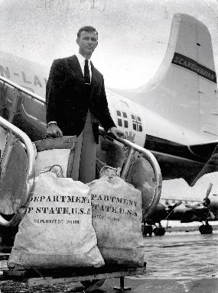
How do we exchange keys?

Slide 54
What’s on your list of earth-shattering events?

Slide 55
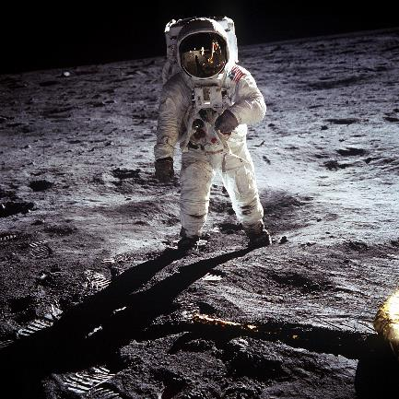
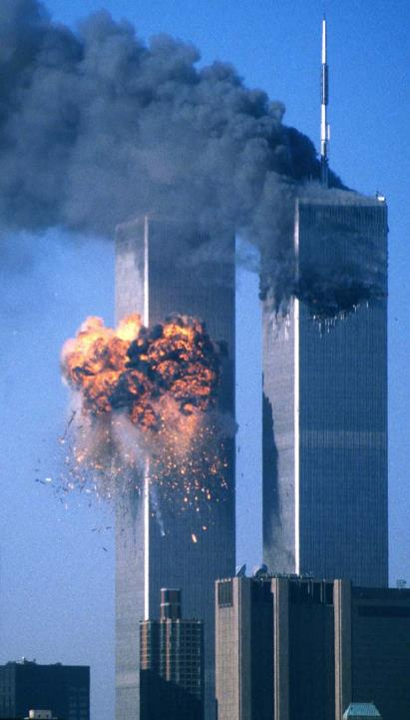
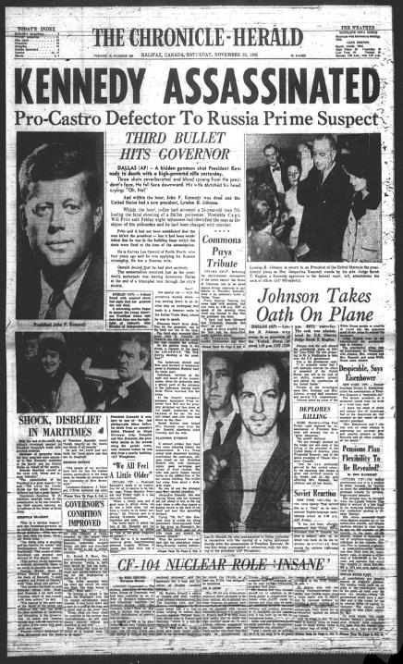
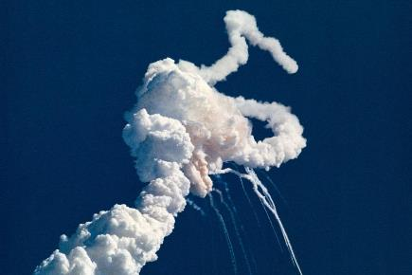

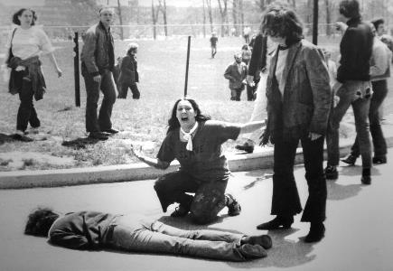

Slide 56
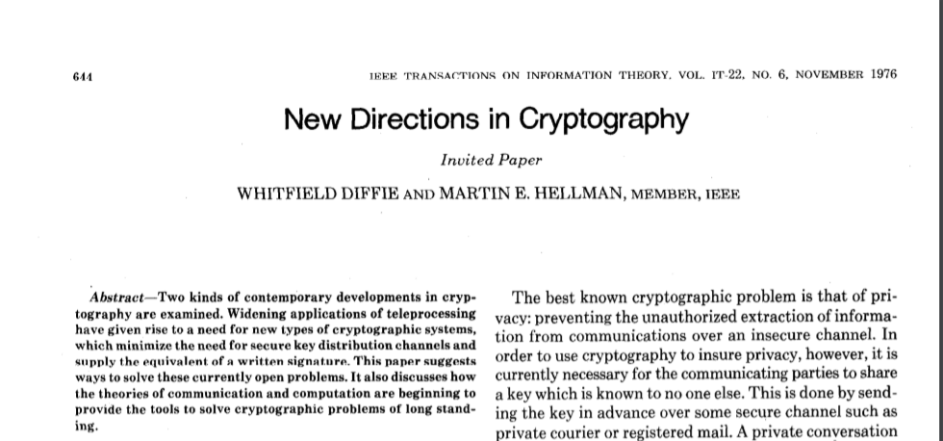
How about…

Slide 57
Diffie-Hellman Key Exchange Protocol
Solves the key exchange problem securely
Is simple and easy to implement
Inspired most subsequent cryptographic
breakthroughs, including public-key cryptograpy, digital-signatures, and secure cryptographic hashes

Slide 58
Diffie-Hellman Key Exchange
Alice and Bob agree on a prime number p and a base g.
2. Alice chooses a secret number a, and sends Bob ( gª mod p).
3. Bob chooses a secret number b, and sends Alice ( g^{b} mod p).
4. Alice computes shared secret key = (( g^{b} mod p )ª mod p).
5. Bob computes shared secret key = (( gª mod p )^{b} mod p).
Both Alice and Bob can use this number as their key.
Notice that p and g need not be protected.

Slide 59
Alice and Bob agree on p = 23 and g = 5
Eve is listening!

Slide 60
Alice chooses a = 6 and sends A = 5⁶ mod 23 = 8
p = 23 g = 5
p = 23 g = 5
Eve is still listening!
p = 23 g = 5

Slide 61
Bob chooses b = 15 and sends B = 5¹⁵ mod 23 = 19
p = 23 g = 5 a = 6 A = 8
p = 23 g = 5
A = 8
Does she never tire?
p = 23 g = 5 A = 8

Slide 62
Alice computes 19⁶ mod 23 = 2
Bob computes 8¹⁵ mod 23 = 2
p = 23 g = 5 a = 6 A = 8 B = 19
p = 23 g = 5
b = 15 A = 8 B = 19
And yet she persists!
p = 23 g = 5 A = 8 B = 19

Slide 63
Secret key = 2!
p = 23 g = 5 a = 6 A = 8 B = 19
Key = 2
p = 23 g = 5
A = 8 b = 15 B = 19
Key = 2
Eve has no clue!
p = 23 g = 5 A = 8 B = 19

Slide 64
Why do we get the same answer?
Basic identity in modular exponentiation: x^{y} mod C = ( (x mod C)^{y}) mod C
Alice’s Key = (( g^{b} mod p )ª mod p)
Bob’s Key = (( gª mod p )^{b} mod p)
a
= ( g^{b}) mod p
b
= ( gª) mod p

Slide 65
Why do we get the same answer?
(gª) = (g^{b}) = g^{ab}
b
a

Slide 66

What can Eve do?
She knows p, g, A, and B
She knows that A = gª mod p = 5⁶ mod 23 = 8
She knows that B = g^{b} mod p = 5¹⁵ mod 23 = 19
All she has to do is solve for either a or b and she has the key!
Minor issue: IT CAN’T BE DONE!
p = 23 g = 5 A = 8 B = 19

Slide 67
The Discrete Logarithm Problem
Given 5ª mod 23 = 8, solve for a or given 5^{b} mod 23 = 19, solve for b
Suppose instead of 23, p is a prime of around 300 digits, and a and b at least 100 digits each.
Solving for a or b would take longer than the lifetime of the universe, using the best known algorithm.

Slide 68
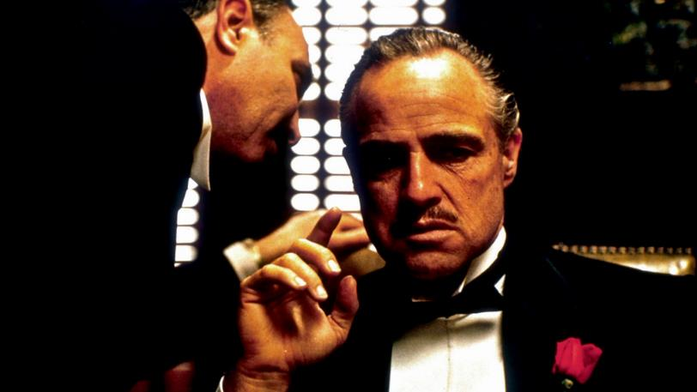
One-way Function

Slide 69
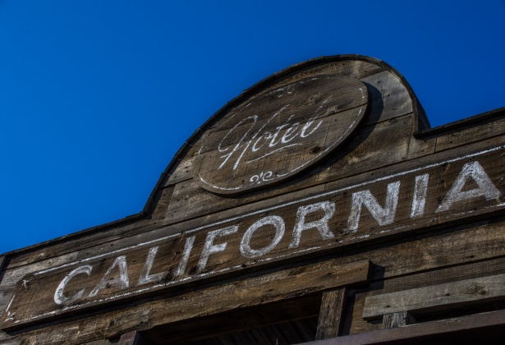
One-way Function

Slide 70
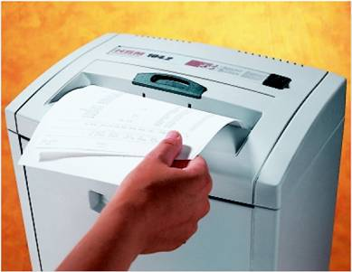

One-way Function

Slide 71
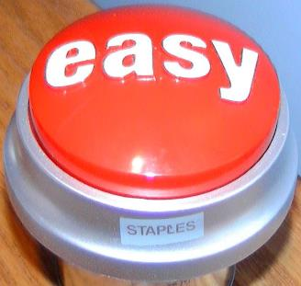
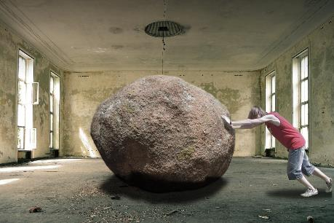
One-way Function
5⁶ mod 23 = 8
5ª mod 23 = 8, discovering that a = 6

Slide 72
Let me sum up…

Slide 73
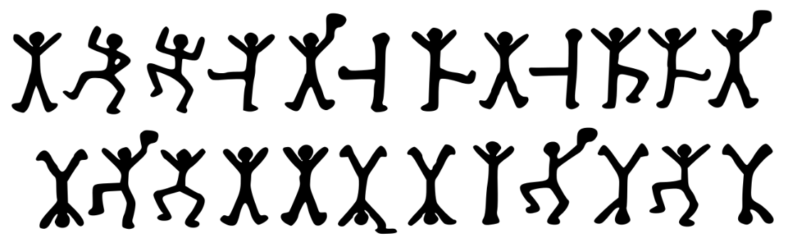
Let me sum up…

Slide 74

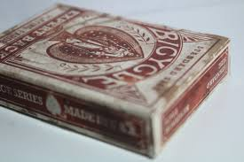

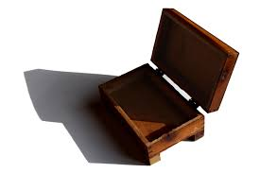
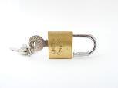
Let me sum up…

Slide 75
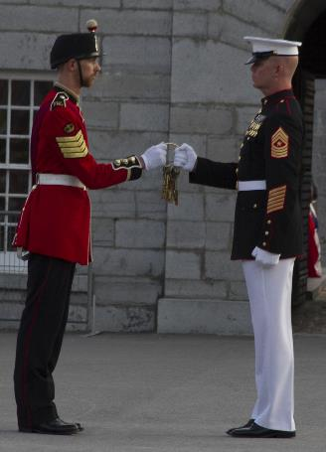
Let me sum up…

Slide 76

Let me sum up…

Slide 77
Let me sum up…
message
encrypt
ciphertext
decrypt
message
key
key
key

Slide 78

Let me sum up…

Slide 79


Slide 80
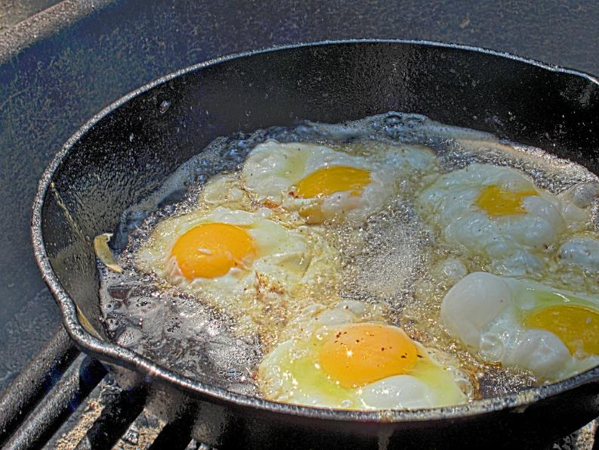


Slide 81
Contact Info:
ken.baum@ingagepartners.com
ilpadre1953@gmail.com
github.com/ilpadre

