Slide 1
Integer Linear Programming Formulations in Natural Language Processing
Dan Roth and Vivek Srikumar
University of Illinois, University of Utah
http://ilpinference.github.io

Slide 2
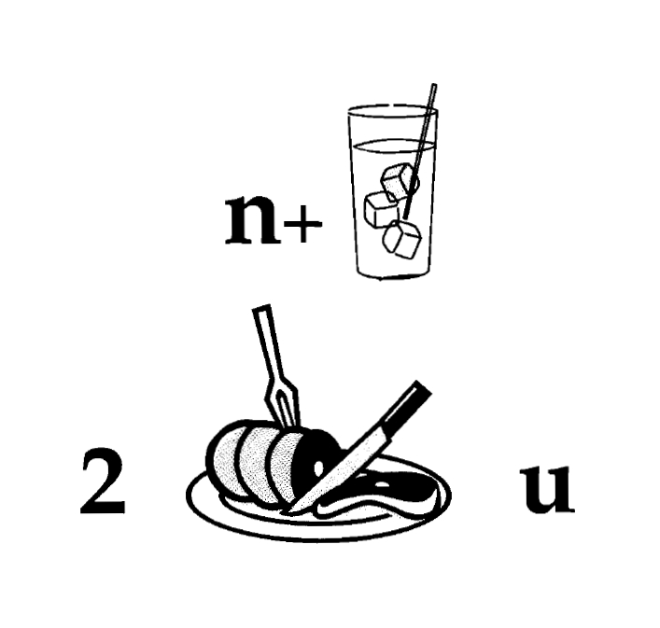
Nice to Meet You
Notes:
2
This is how we think about decisions in NLP

Slide 3
ILP Formulations in NLP
Part 1: Introduction [30 min]
Part 2: Applications of ILP Formulations in NLP [15 min]
Part 3: Modeling: Inference methods and Constraints [45 min]
BREAK
Part 4: Training Paradigms [30 min]
Part 5: Constraints Driven Learning [30 min]
Part 6: Developing ILP based applications [15min]
Part 7: Final words [15min]

Slide 4
PART 1: INTRODUCTION

Slide 5
ILP Formulations in NLP
Part 1: Introduction [30 min]
Motivation
Examples:
NE + Relations
Vision
Additional NLP Examples
Problem Formulation
Constrained Conditional Models: Integer Linear Programming Formulations
Initial thoughts about learning
Learning independent models
Constraints Driven Learning
Initial thoughts about Inference

Slide 6
Joint Inference with General Constraint Structure [Roth&Yih’04,07,….] Recognizing Entities and Relations
Joint inference gives good improvement
other | 0.05
per | 0.85
loc | 0.10
other | 0.05
per | 0.85
loc | 0.10
other | 0.10
per | 0.60
loc | 0.30
other | 0.10
per | 0.60
loc | 0.30
other | 0.05
per | 0.50
loc | 0.45
other | 0.05
per | 0.50
loc | 0.45
other | 0.05
per | 0.50
loc | 0.45
Key Questions:
How to learn the model(s)?
What is the source of the knowledge?
How to guide the global inference?
An Objective function that incorporates learned models with knowledge (output constraints)
A Constrained Conditional Model
Bernie’s wife, Jane, is a native of Brooklyn
E1 E2 E3
R₁₂
R₂₃
irrelevant | 0.05
spouse_of | 0.45
born_in | 0.50
irrelevant | 0.05
spouse_of | 0.45
born_in | 0.50
irrelevant | 0.05
spouse_of | 0.45
born_in | 0.50
irrelevant | 0.10
spouse_of | 0.05
born_in | 0.85
irrelevant | 0.10
spouse_of | 0.05
born_in | 0.85
Models could be learned separately/jointly; constraints may come up only at decision time.
Notes:
6
Let’s look at another example in more details.
We want to extract entities (person, location and organization) and relations between them (born in, spouse of).
Given a sentence, suppose the entity classifier and relation classifier have already given us their predictions along with the confidence values. The blue ones are the labels that have the highest confidence individually. However, this global assignment has some obvious mistakes. For example, the second argument of a born_in relation should be location instead of person. Since the classifiers are pretty confident on R23, but not on E3, so we should correct E3 to be location.
Similarly, we should change R12 from “born_in” to “spouse_of”

Slide 7
Pipeline
Motivation I
Raw Data
Most problems are not single classification problems
POS Tagging
Phrases
Semantic Entities
Relations
Either way, we need a way to learn models and make predictions (inference; decoding)
that assign values to multiple interdependent variables
Parsing
WSD
Semantic Role Labeling
Conceptually, Pipelining is a crude approximation
Interactions occur across levels and down stream decisions often interact with previous decisions.
Leads to propagation of errors
Occasionally, later stages could be used to correct earlier errors.
But, there are good reasons to use pipelines
Reusability of components; not putting everything in one basket
How about choosing some stages and thinking about them jointly?

Slide 8

Example 2: Object detection
How would you design a predictor that labels all the parts using the tools we have seen so far?
saddle/seat
handle bar
Right
facing
bicycle
right wheel
left wheel
Photo by Andrew Dressel - Own work. Licensed under Creative Commons Attribution-Share Alike 3.0

Slide 9
One approach to build this structure
Left wheel detector: Is there a wheel in this box? Binary classifier
1. (Left) wheel detector
Final output: Combine the predictions of these individual classifiers (local classifiers)
The predictions interact with each other
Eg: The same box can not be both a left wheel and a right wheel, handle bar does not overlap with seat, etc
Need inference to compose the output
2. (Right) wheel detector
3. Handle bar detector
4. Seat detector
Photo by Andrew Dressel - Own work. Licensed under Creative Commons Attribution-Share Alike 3.0

Slide 10
Task of Interests: Structured Output
For each instance, assign values to a set of variables
Account for the fact that output variables depend on each other
Common NLP tasks
Parsing; Semantic Parsing; Summarization; Co-reference…
Common Information Extraction Tasks:
Entities, Relations,…
Common Vision Task:
Parsing objects; scene segmentation and interpretation,….
Many “pure” machine learning approaches exist
Hidden Markov Models (HMMs)‏; CRFs […there are special cases…]
Structured Perceptrons and SVMs… [… to be discussed later]
However, …
Notes:
10

Slide 11
Information Extraction without Output Expectations
Lars Ole Andersen . Program analysis and specialization for the C Programming language. PhD thesis. DIKU , University of Copenhagen, May 1994 .
Small #(examples)
Prediction result of a trained HMM
Lars Ole Andersen . Program analysis and
specialization for the
C
Programming language
. PhD thesis .
DIKU , University of Copenhagen , May
1994 .
[AUTHOR]
[TITLE]
[EDITOR]
[BOOKTITLE]
[TECH-REPORT]
[INSTITUTION]
[DATE]
Violates lots of natural constraints!
Notes:
11
11

Slide 12
Strategies for Improving the Results
(Standard) Machine Learning Approaches
Higher Order HMM/CRF? NN?
Increasing the window size?
Adding a lot of new features
Requires a lot of labeled examples
What if we only have a few labeled examples?
Instead:
Constrain the output to make sense – satisfy our output expectations
Push the (simple) model in a direction that makes sense – minimally violates our expectations.
Increasing the model complexity
Increase difficulty of Learning
Can we keep the learned model simple and still make expressive decisions?
Notes:
12

Slide 13
Expectations from the output (Constraints)
Each field must be a consecutive list of words and can appear at most once in a citation.
State transitions must occur on punctuation marks.
The citation can only start with AUTHOR or EDITOR.
The words pp., pages correspond to PAGE.
Four digits starting with 20xx and 19xx are DATE.
Quotations can appear only in TITLE
…….
Easy to express pieces of “knowledge”
Non Propositional; May use Quantifiers

Slide 14
Information Extraction with Expectation Constraints
Adding constraints, we get correct results!
Without changing the model
[AUTHOR] Lars Ole Andersen .
[TITLE] Program analysis and specialization for the
C Programming language .
[TECH-REPORT] PhD thesis .
[INSTITUTION] DIKU , University of Copenhagen ,
[DATE] May, 1994 .
We introduce the Constrained Conditional Models formulation which allows:
Learning a simple model
Making decisions with a more complex model
Some of the structure imposed externally/declaratively
Accomplished by directly incorporating constraints to bias/re-rank decisions made by the simpler model
Notes:
14

Slide 15
Constrained Conditional Models
Any MAP problem w.r.t. any probabilistic model, can be formulated as an ILP [Roth+ 04, Taskar 04]
Penalty for violating
the constraint.
Variables are models
y = argmax_{y} ∑ 1_{Á(x,y)} w_{x,y} subject to Constraints C(x,y)
y = argmax_{y 2 Y} w^{T}Á(x, y) + u^{T}C(x, y)
Knowledge component:
(Soft) constraints
Weight Vector for “local” models
Features, classifiers (Lin; NN); log-linear models (HMM, CRF) or a combination
How far y is from
a “legal/expected” assignment
E.g., an entities model; a relations model.
Training: learning the objective function (w, u)
Decouple? Decompose? Force u to model hard constraints?
Inference: A way to push the learned model to satisfy our output expectations (or expectations from a latent representation)
How? [CoDL, Chang, Ratinov, Roth (07, 12); Posterior Regularization, Ganchev et. al (10); Unified EM (Samdani & Roth(12), dozens of applications in NLP]
The benefits of thinking about it as an ILP are conceptual and computational.

Slide 16
Examples: CCM Formulations
The 2nd and 3rd parts of the tutorial are on how to model and do inference
The 4th and 5th parts of the tutorial are on how to learn
y = argmax_{y 2 Y} w^{T}Á(x, y) + u^{T}C(x, y)
While Á(x, y) and C(x, y) could be the same; we want C(x, y) to express high level declarative knowledge over the statistical models.
Formulate NLP Problems as ILP problems (inference may be done otherwise)
1. Sequence tagging (HMM/CRF + Global constraints)
2. Sentence Compression (Language Model + Global Constraints)
3. SRL (Independent classifiers + Global Constraints)
Sequential Prediction
HMM/CRF based:
Argmax ∑ ¸_{ij} x_{ij}
Sentence Compression/Summarization:
Language Model based:
Argmax ∑ ¸_{ijk} x_{ijk}
Knowledge/Linguistics Constraints
Cannot have both A states and B states in an output sequence.
Knowledge/Linguistics Constraints
If a modifier chosen, include its head
If verb is chosen, include its arguments
Constrained Conditional Models Allow:
Decouple complexity of the learned model from that of the desired output
Learn a simple model (multiple; pipelines); reason with a complex one.
Accomplished by incorporating constraints to bias/re-rank global decisions to satisfy (minimally violate) expectations.

Slide 17
Semantic Role Labeling (SRL)
Archetypical Information Extraction Problem: E.g., Concept Identification and Typing, Event Identification, etc.
I left my pearls to my daughter in my will .
[I]_{A0} left [my pearls]_{A1} [to my daughter]_{A2} [in my will]_{AM-LOC} .
A0 Leaver
A1 Things left
A2 Benefactor
AM-LOC Location
I left my pearls to my daughter in my will .
Notes:
In the context of SRL, the goal is to predict for each possible phrase in a given sentence if it is an argument or not and what type it is.

Slide 18
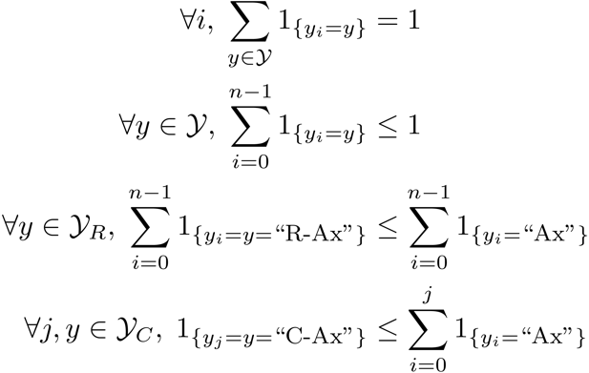
Algorithmic Approach
Learning Based Java: allows a developer to encode constraints in First Order Logic; these are compiled into linear inequalities automatically.
No duplicate argument classes
I left my nice pearls to her
candidate arguments
Identify argument candidates
Pruning [Xue&Palmer, EMNLP’04]
Argument Identifier
Binary classification
Classify argument candidates
Argument Classifier
Multi-class classification
Inference
Use the estimated probability distribution given
by the argument classifier
Use structural and linguistic constraints
Infer the optimal global output
Unique labels
Variable y^{a,t} indicates whether candidate argument a is assigned a label t.
c^{a,t} is the corresponding model score
I left my nice pearls to her
I left my nice pearls to her
[ [ [ [ [
] ] ] ] ]
argmax ∑_{a,t} y^{a,t} c^{a,t} = ∑_{a,t} 1_{a=t} c_{a=t}
Subject to:
One label per argument: ∑_{t} y^{a,t} = 1
No overlapping or embedding
Relations between verbs and arguments,….
One inference problem for each verb predicate.
I left my nice pearls to her
Use the pipeline architecture’s simplicity while maintaining uncertainty: keep probability distributions over decisions & use global inference at decision time.
Notes:
We follow a now seemingly standard approach to SRL.
Given a sentence, first we find a set of potential argument candidates by identifying
which words are at the border of an argument.
Then, once we have a set of potential arguments, we use a phrase-level classifier to tell us how likely an argument is to be of each type.
Finally, we use all of the information we have so far to find the assignment of types to argument that gives us the “optimal” global assignment.
Similar approaches (with similar results) use inference procedures tied to their represntation.
Instead, we use a general inference procedure by setting up the problem as a linear programming problem.
This is really where our technique allows us to apply powerful information that similar approaches can not.

Slide 19
Semantic Role Labeling (SRL)
I left my pearls to my daughter in my will .
0.5
0.15
0.15
0.1
0.1
0.05
0.1
0.2
0.6
0.05
0.15
0.6
0.05
0.05
0.05
0.05
0.05
0.7
0.05
0.15
0.3
0.2
0.2
0.1
0.2
Notes:
19
Here is how we use it to solve our problem. Assume each line and color here represent all possible arguments and argument types with the grey color means null or not actually an argument. Associated with each line is the score obtained from the argument classifier.

Slide 20
Semantic Role Labeling (SRL)
I left my pearls to my daughter in my will .
0.5
0.15
0.15
0.1
0.1
0.05
0.1
0.2
0.6
0.05
0.15
0.6
0.05
0.05
0.05
0.05
0.05
0.7
0.05
0.15
0.3
0.2
0.2
0.1
0.2
Notes:
20
If we were to let the argument classifier to make the final prediction, we would have this output which violates the non-overlapping constarints.

Slide 21
Semantic Role Labeling (SRL)
I left my pearls to my daughter in my will .
0.5
0.15
0.15
0.1
0.1
0.05
0.1
0.2
0.6
0.05
0.15
0.6
0.05
0.05
0.05
0.05
0.05
0.7
0.05
0.15
0.3
0.2
0.2
0.1
0.2
Notes:
21
Instead, when we use the ILP inference, it will eliminate bottom argument which is now the assignment that maximizes the linear summation of the scores that also satisfy the non-overlapping constraints.

Slide 22



Constraints
The tutorial web page will point to material on how to write down linear inequalities for various logical expressions [details later].
Any Boolean rule can be encoded as a set of linear inequalities.
No duplicate argument classes
Reference-Ax
Continuation-Ax
Many other possible constraints:
Unique labels
No overlapping or embedding
Relations between number of arguments; order constraints
If verb is of type A, no argument of type B
If there is an Reference-Ax phrase, there is an Ax
If there is an Continuation-x phrase, there is an Ax before it
Universally quantified rules
Learning Based Java: allows a developer to encode constraints in First Order Logic; these are compiled into linear inequalities automatically.
Notes:
22
Animation to show the following 3 constraints step by step
Binary constraints
Summation = 1 assures that it’s assigned only one label
Non-overlapping constraints
Remember to put a small bar picture

Slide 23
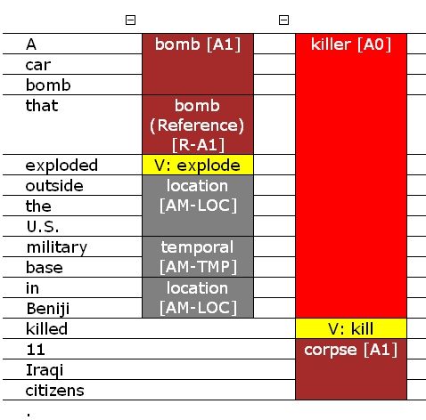
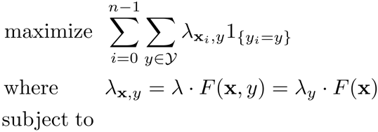
SRL: Posing the Problem

Slide 24











Example 2: Sequence Tagging
HMM :
Here, y’s are labels; x’s are observations.
The ILP’s objective function must include all entries of the Conditional Probability Table.
Example:
the
man
saw
the
dog
Every edge is a Boolean variable that selects a transition CPT entry.
D
D
D
D
D
N
N
N
N
N
They are related: if we choose
y₀ = D
then we must choose an edge
A
A
A
A
A
y₀ = D Æ y₁ = ? .
V
V
V
V
V
Every assignment to the y’s is a path.

Slide 25
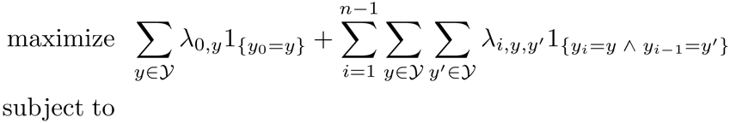

Example 2: Sequence Tagging
HMM:
Example:
the
man
saw
the
dog
D
D
D
D
D
N
N
N
N
N
Inference Variables
A
A
A
A
A
As an ILP:
V
V
V
V
V
Learned Parameters

Slide 26

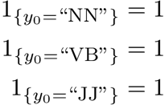
Example 2: Sequence Tagging
HMM:
Example:
the
man
saw
the
dog
D
D
D
D
D
N
N
N
N
N
A
A
A
A
A
As an ILP:
V
V
V
V
V
Unique label for each word

Slide 27
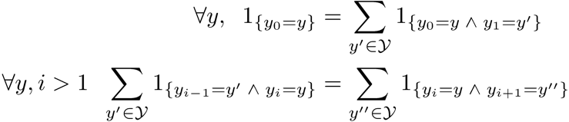


Example 2: Sequence Tagging
HMM :
Example:
the
man
saw
the
dog
D
D
D
D
D
N
N
N
N
N
A
A
A
A
A
As an ILP:
V
V
V
V
V
Unique label for each word
Edges that are chosen must form a path

Slide 28

Example 2: Sequence Tagging
HMM :
Example:
the
man
saw
the
dog
D
D
D
D
D
N
N
N
N
N
A
A
A
A
A
As an ILP:
V
V
V
V
V
Unique label for each word
Without additional constraints the ILP formulation of an HMM is totally unimodular
Edges that are chosen must form a path
There must be a verb!
[Roth & Yih, ICML’05] discuss training paradigms for HMMs and CRFs, when augmented with additional knowledge

Slide 29
Constraints
We have seen three different constraints in this example
Unique label for each word
Chosen edges must form a path
There must be a verb
All three can be expressed as linear inequalities
In terms of modeling, there is a difference
The first two define the output structure (in this case, a sequence)
The third one adds knowledge to the problem
A conventional model
In CCMs, knowledge is an integral part of the modeling

Slide 30
Constrained Conditional Models—ILP Formulations
Have been shown useful in the context of many NLP problems
[Roth&Yih, 04,07: Entities and Relations; Punyakanok et. al: SRL …]
Summarization; Co-reference; Information & Relation Extraction; Event Identifications and causality ; Transliteration; Textual Entailment; Knowledge Acquisition; Sentiments; Temporal Reasoning, Parsing,…
Some theoretical work on training paradigms [Punyakanok et. al., 05 more; Constraints Driven Learning, PR, Constrained EM…]
Some work on Inference, mostly approximations, bringing back ideas on Lagrangian relaxation, etc.
Good summary and description of training paradigms:
[Chang, Ratinov & Roth, Machine Learning Journal 2012]
Summary of work & a bibliography: http://L2R.cs.uiuc.edu/tutorials.html

Slide 31
The Rest of the Tutorial
The 2nd and 3rd parts of the tutorial will discuss modeling and inference
The 4th and 5th parts of the tutorial will focus on learning
y = argmax_{y} ∑ 1_{Á(x,y)} w_{x,y} subject to Constraints C(x,y)
y = argmax_{y 2 Y} w^{T}Á(x, y) + u^{T}C(x, y)
The next two parts will provide more details on how to model structured decisions problems in NLP as ILP problems.
After the break we will discuss learning
First, learning paradigms within this framework
Inference is necessary, but can be incorporated in multiple ways into the learning process
Then, move to Constraints Driven Learning
How constraints can take the place of many examples
Semi-supervised scenarios
Learning with latent representations; response driven learning

Slide 32
END of PART 1
END of PART 1

Slide 33
First Summary
Introduced Structured Prediction
Many examples
Introduced the key building blocks of structured learning and inference
Focused on Constraints Conditional Models
CCMS: The motivating scenario is the case in which
Joint INFERENCE is essential
Joint LEARNING should be done thoughtfully
Not everything can be learned together
We don’t always want to learning everything together
Moving on to
Details on Joint Learning
Details on Inference
Notes:
33

