Slide 1
PART 4: LEARNING PARADIGMS

Slide 2
ILP Formulations in NLP
Part 4: Learning Paradigms [30 min]
Motivation
Multiclass Classification
Learning Approaches
Independently of constraints (L+I);
Jointly (Global) Learning (with constraints) (IBT)
Examples
Extended SRL

Slide 3
Structured Prediction: Inference
Placing in context: a very high level view of what you will see next
Inference: given input x (a document, a sentence),
predict the best structure y = {y₁,y₂,…,y_{n}} 2 Y (entities & relations)
Assign values to the y₁,y₂,…,y_{n}, accounting for dependencies among y_{i}s
Inference is expressed as a maximization of a scoring function
y’ = argmax_{y 2 Y} w^{T} Á (x,y)
Inference requires, in principle, touching all y 2 Y at decision time, when we are given x 2 X and attempt to determine the best y 2 Y for it, given w
For some structures, inference is computationally easy.
Eg: Using the Viterbi algorithm
In general, NP-hard (can be formulated as an ILP)
Joint features on inputs and outputs
Set of allowed structures
Feature Weights
(estimated during learning)

Slide 4
Structured Prediction: Learning
Learning: given a set of structured examples {(x,y)}
find a scoring function w that minimizes empirical loss.
Learning is thus driven by the attempt to find a weight vector w such that for each given annotated example (x_{i}, y_{i}):

Slide 5
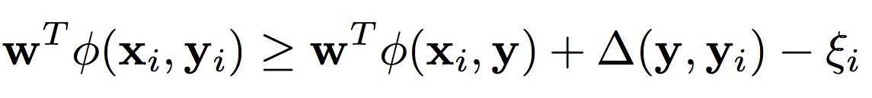
Structured Prediction: Learning
Learning: given a set of structured examples {(x,y)}
find a scoring function w that minimizes empirical loss.
Learning is thus driven by the attempt to find a weight vector w such that for each given annotated example (x_{i}, y_{i}):
We call these conditions the learning constraints.
In most learning algorithms used today, the update of the weight vector w is done in an on-line fashion,
Think about it as Perceptron; this procedure applies to Structured Perceptron, CRFs, Linear Structured SVM
W.l.o.g. (almost) we can thus write the generic structured learning algorithm as follows:
Score of annotated structure
Score of any other structure
Penalty for predicting other structure
8 y

Slide 6
Structured Prediction: Learning Algorithm
In the structured case, prediction (inference) is often intractable but needs to be done many times
For each example (x_{i}, y_{i})
Do: (with the current weight vector w)
Predict: perform Inference with the current weight vector
y_{i}’ = argmax_{y 2 Y} w^{T} Á ( x_{i} ,y)
Check the learning constraints
Is the score of the current prediction better than of (x_{i}, y_{i})?
If Yes – a mistaken prediction
Update w
Otherwise: no need to update w on this example
EndFor

Slide 7
Structured Prediction: Learning Algorithm
Solution I: decompose the scoring function to EASY and HARD parts
For each example (x_{i}, y_{i})
Do:
Predict: perform Inference with the current weight vector
y_{i}’ = argmax_{y 2 Y} w_{EASY}^{T} Á_{EASY} ( x_{i} ,y) + w_{HARD}^{T} Á_{HARD} ( x_{i} ,y)
Check the learning constraint
Is the score of the current prediction better than of (x_{i}, y_{i})?
If Yes – a mistaken prediction
Update w
Otherwise: no need to update w on this example
EndDo
EASY: could be feature functions that correspond to an HMM, a linear CRF, or even Á_{EASY} (x,y) = Á(x), omiting dependence on y, corresponding to classifiers.
May not be enough if the HARD part is still part of each inference step.

Slide 8
Structured Prediction: Learning Algorithm
Solution II: Disregard some of the dependencies: assume a simple model.
For each example (x_{i}, y_{i})
Do:
Predict: perform Inference with the current weight vector
y_{i}’ = argmax_{y 2 Y} w_{EASY}^{T} Á_{EASY} ( x_{i} ,y) + w_{HARD}^{T} Á_{HARD} ( x_{i} ,y)
Check the learning constraint
Is the score of the current prediction better than of (x_{i}, y_{i})?
If Yes – a mistaken prediction
Update w
Otherwise: no need to update w on this example
EndDo

Slide 9
Structured Prediction: Learning Algorithm
Solution III: Disregard some of the dependencies during learning; take into account at decision time
For each example (x_{i}, y_{i})
Do:
Predict: perform Inference with the current weight vector
y_{i}’ = argmax_{y 2 Y} w_{EASY}^{T} Á_{EASY} ( x_{i} ,y) + w_{HARD}^{T} Á_{HARD} ( x_{i} ,y)
Check the learning constraint
Is the score of the current prediction better than of (x_{i}, y_{i})?
If Yes – a mistaken prediction
Update w
Otherwise: no need to update w on this example
EndDo
y_{i}’ = argmax_{y 2 Y} w_{EASY}^{T} Á_{EASY} ( x_{i} ,y) + w_{HARD}^{T} Á_{HARD} ( x_{i} ,y)
This is the most commonly used solution in NLP today

Slide 10
Constrained Conditional Models
Any MAP problem w.r.t. any probabilistic model, can be formulated as an ILP [Roth+ 04, Taskar 04]
Penalty for violating
the constraint.
Variables are models
y = argmax_{y} ∑ 1_{Á(x,y)} w_{x,y} subject to Constraints C(x,y)
y = argmax_{y 2 Y} w^{T}Á(x, y) + u^{T}C(x, y)
Knowledge component:
(Soft) constraints
Weight Vector for “local” models
Features, classifiers (Lin; NN); log-linear models (HMM, CRF) or a combination
How far y is from
a “legal/expected” assignment
E.g., an entities model; a relations model.
Training: learning the objective function (w, u)
Decouple? Decompose? Force u to model hard constraints?
Inference: A way to push the learned model to satisfy our output expectations (or expectations from a latent representation)
How? [CoDL, Chang, Ratinov, Roth (07, 12); Posterior Regularization, Ganchev et. al (10); Unified EM (Samdani & Roth(12), dozens of applications in NLP]
The benefits of thinking about it as an ILP are conceptual and computational.

Slide 11
Where are we?
Modeling & Algorithms for Incorporating Constraints
Showed that CCMs support formalizing many problems
Showed several ways to incorporate global constraints in the decision.
Training: Coupling vs. Decoupling Training and Inference.
Incorporating global constraints is important but
Should it be done only at evaluation time or also at training time?
How to decompose the objective function and train in parts?
Issues related to:
Modularity, efficiency and performance, availability of training data
Problem specific considerations

Slide 12
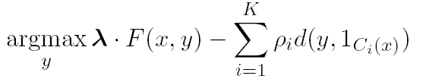
Training Constrained Conditional Models
Decompose Model
Decompose Model from constraints
Learning paradigms
Independently of the constraints (L+I)
Jointly, in the presence of the constraints (IBT)
Decomposed to simpler models
Note that structured prediction algorithms can be used in both paradigms
When we decide to learn jointly
When the left part is structured but we still want to add additional constraints only at inference time
It is possible to train a model (left side), but make decisions with additional information (right side) that was not incorporated during learning model. (Not available, not needed, or just too expensive)

Slide 13
Learning Paradigms [Punyakanok+ 05]
Local Learning
Learning local models independently: ignore constraints during training
Ensure output is coherent at test time
E.g., One-against-all multiclass classification
Global Learning
Learning with inference: consider constraints during training
Training and test are consistent
E.g., constrained classification for multiclass; multiclass SVM [Har-Peled et. el 2002; Crammer et. al 2002]
Question: Isn’t “global” always better?
Not so simple…
Next, the “Local model story”

Slide 14
Multiclass Classification
From the full dataset, construct three binary classifiers, one for each class
w_{blue}^{T}x > 0 for blue inputs
w_{org}^{T}x > 0 for orange inputs
w_{black}^{T}x > 0 for black inputs
Notation: Score for blue label
Winner Take All will predict the right answer. Only the correct label will have a positive score

Slide 15
One-vs-all may not always work
Red points are not separable with a single binary classifier
The decomposition is not expressive enough!
w_{blue}^{T}x > 0 for blue inputs
w_{org}^{T}x > 0 for orange inputs
w_{black}^{T}x > 0 for black inputs
???

Slide 16
Local Learning: One-vs-all classification
Easy to learn
Use any binary classifier learning algorithm
Potential Problems
Calibration issues
We are comparing scores produced by K classifiers trained independently. No reason for the scores to be in the same numerical range!
Train vs. Train
Does not account for how the final predictor will be used
Does not optimize any global measure of correctness
Yet, works fairly well
In most cases, especially in high dimensional problems (everything is already linearly separable).

Slide 17
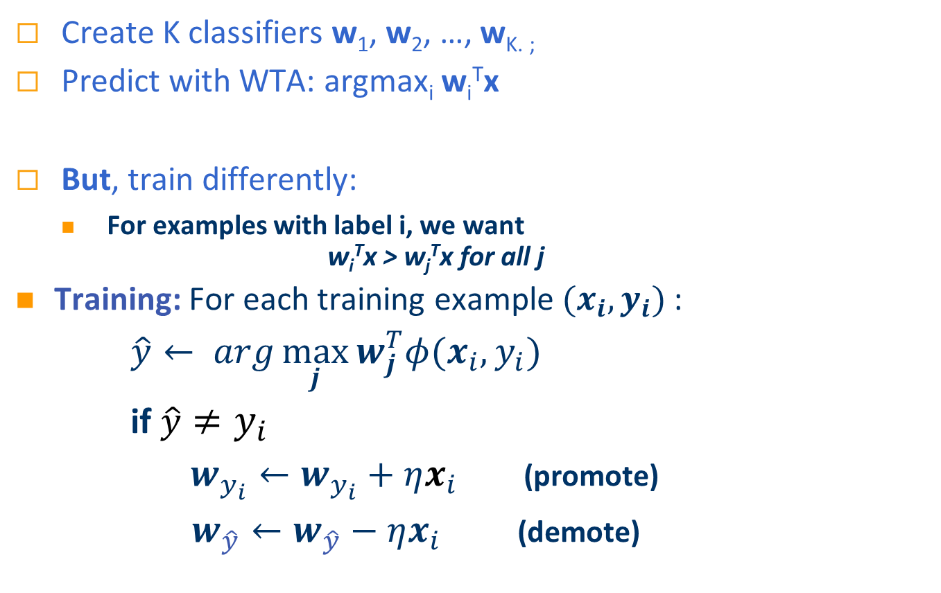
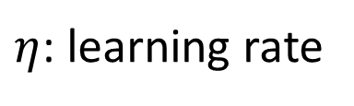
Global Multiclass Approach [Constraint Classification, Har-Peled et. al ‘02]
Create K classifiers w₁, w₂, …, w_{K. ;}
Predict with WTA: argmax_{i} w_{i}^{T}x
But, train differently:
For examples with label i, we want w_{i}^{T}x > w_{j}^{T}x for all j
Training: For each training example $(x_{i},y_{i})$:
$\hat{y}← arg\max_{j}{w_{j}^{T}φ(x_{i},y_{i})}$
if $\hat{y}≠y_{i}$
$w_{y_{i}}←w_{y_{i}}+ηx_{i}$ (promote)
$w_{\hat{y}}←w_{\hat{y}}−ηx_{i}$ (demote)
$η$: learning rate

Slide 18
Moving to Structures: Training Methods
Learning + Inference (L+I)
Learn models independently
y₂
y₁
y₃
f₁(x)
Inference Based Training (IBT)
Learn one model, all y’s together!
y₄
f₂(x)
y₅
f₃(x)
Y
Intuition: Learning with constraints may make learning more difficult
f₄(x)
x₃
x₄
f₅(x)
x₁
x₅
x₂
X
x₇
x₆
Notes:
18
Figure1: Collection of X1,…,Xn and Collection of Y1…Ym with links among X and links among Y and between.
Figure2: Collection of X1,…,Xn and single Y
Description:
Task is to predict a “consistent” output that respects the structural dependencies among Y1…Ym and from X to Y.
One way is to learn a classifier using the structure so that the final classifiers are consistent.
Second way is to learn classifiers that predict each Y separately and then consolidate the predications post learning inference phase.
================
3 basic learning strategies
Local learning only
Local learning + Inference
Inference based Training
Also refer to others’ work
The benefits of each strategy.

Slide 19
Training with Constraints: Joint (Global) Learning; IBT
Both procedures can be used with any “local” model f (including a structured model, NN,….)
True Global Labeling:
Local Predictions:
Y
-1
1
-1
-1
1
Apply Constraints (Inference):
Y’
-1
1
1
1
1
Y’
-1
1
-1
1
1
f₁(x)
X
f₂(x)
x₃
f₃(x)
Y
x₄
f₄(x)
x₁
x₅
f₅(x)
x₂
x₇
Which one is better? When and Why?
x₆
Notes:
19
Figure1: Collection of X1,…,Xn and Collection of Y1…Ym with links among X and links among Y and between.
Figure2: Collection of X1,…,Xn and single Y
Description:
Task is to predict a “consistent” output that respects the structural dependencies among Y1…Ym and from X to Y.
One way is to learn a classifier using the structure so that the final classifiers are consistent.
Second way is to learn classifiers that predict each Y separately and then consolidate the predications post learning inference phase.
================
3 basic learning strategies
Local learning only
Local learning + Inference
Inference based Training
Also refer to others’ work
The benefits of each strategy.

Slide 20
L+I & IBT: General View – Structured Perceptron
Graphics for the case: F(x,y) = F(x)
For each iteration
For each (X, Y_{GOLD} ) in the training data
If Y_{PRED} != Y_{GOLD}
λ = λ + F(X, Y_{GOLD} ) - F(X, Y_{PRED})
(λ, ½) = (λ, ½) + Á(X, Y_{GOLD} ) – Á(X, Y_{PRED})
endif
endfor
Y_{pred}=
The difference between
L+I and IBT
In IBT, can also train ½
(Á augments feature vector with constraints)

Slide 21
Claims [Punyakanok et. al , IJCAI 2005]
Theory applies to the case of local models
F(x,y) = F(x ); applies broadly, e.g., SRL
When the local modes are “easy” to learn, L+I outperforms IBT.
In many applications, the components are identifiable and easy to learn (e.g., argument, open-close, PER).
Only when the local problems become difficult to solve in isolation, IBT outperforms L+I, but needs a larger number of training examples.
Other training paradigms are possible
Pipeline-like Sequential Models: [Roth, Small, Titov: AI&Stat’09]
Identify a preferred ordering among components
Learn k-th model jointly with previously learned models
Constrained Driven Learning [Chang et. al’07,12; later]
L+I: cheaper computationally; modular
IBT is better in the limit, and when there is strong interaction among y’s
Notes:
Take-home messages:
It is a reasonable assumption that local classification is easy, because: (1) we already identify the important components
In many applications, the components are identifiable and easy to learn. Person & Subject

Slide 22
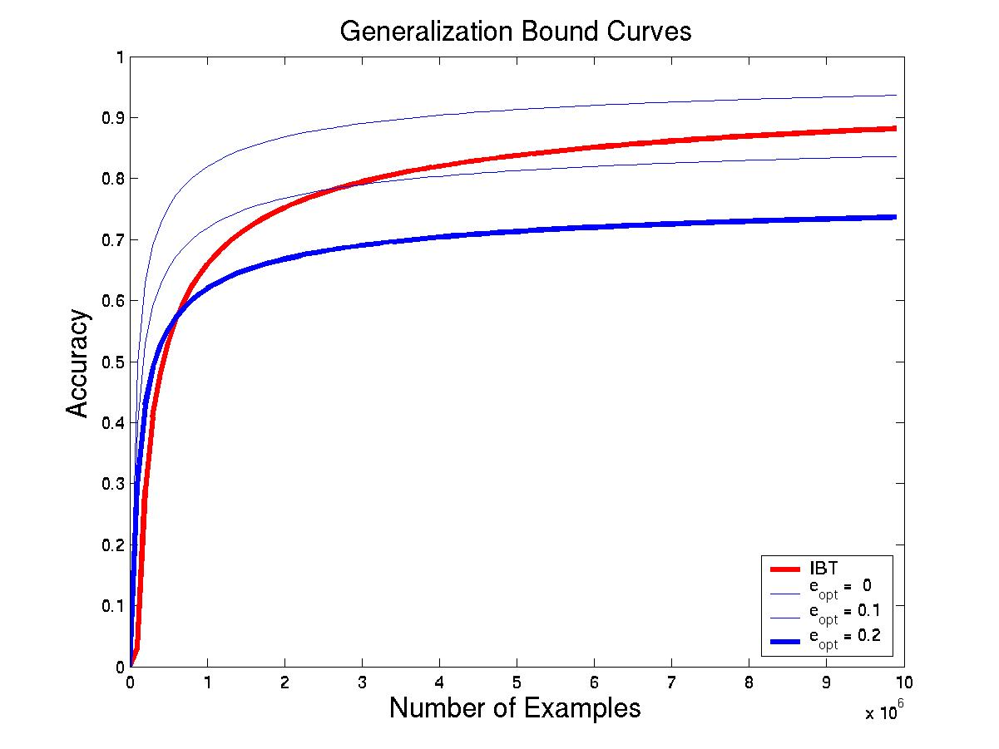
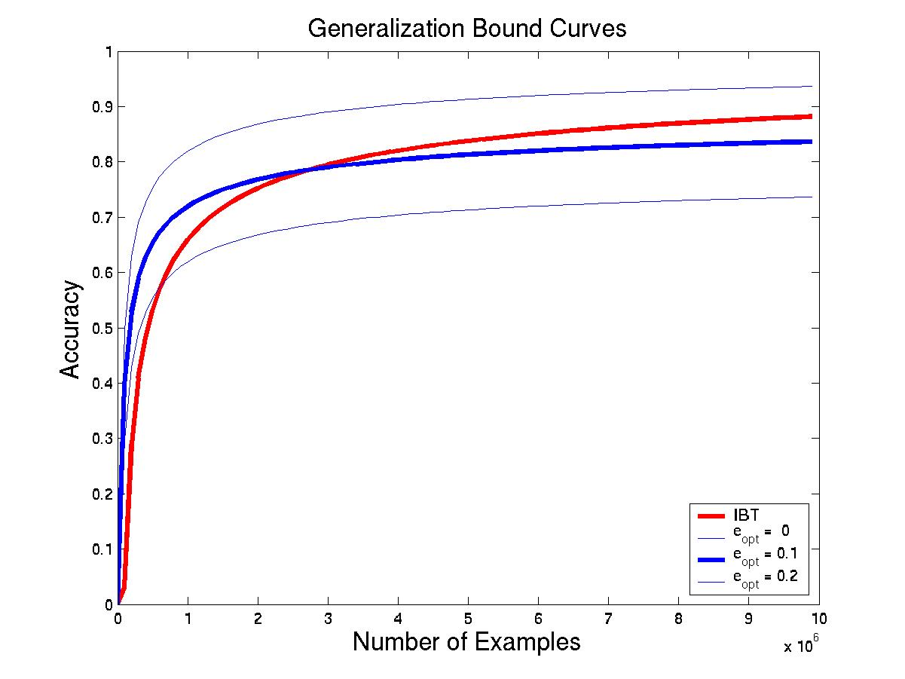
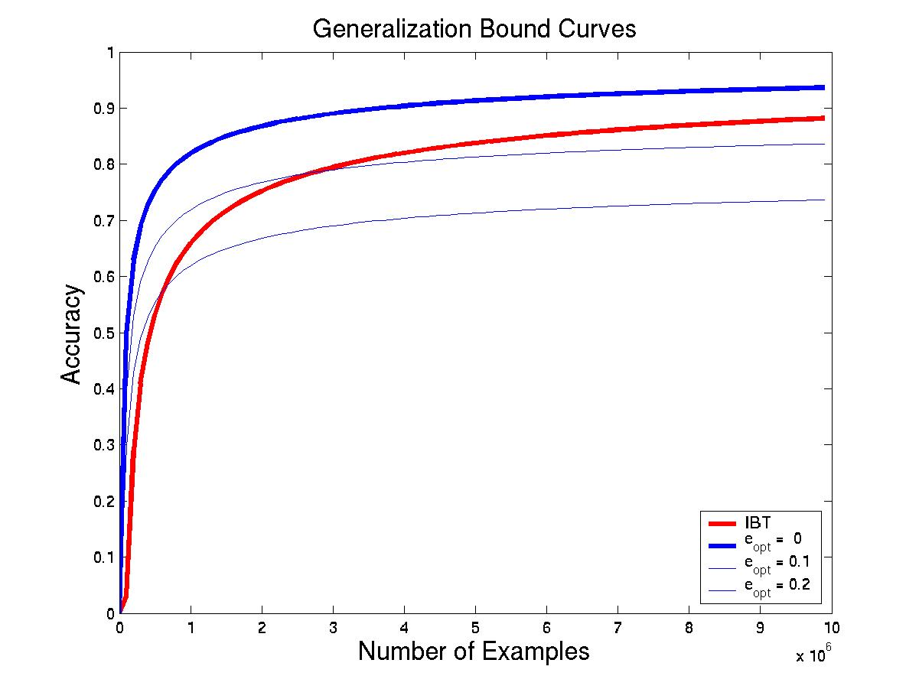
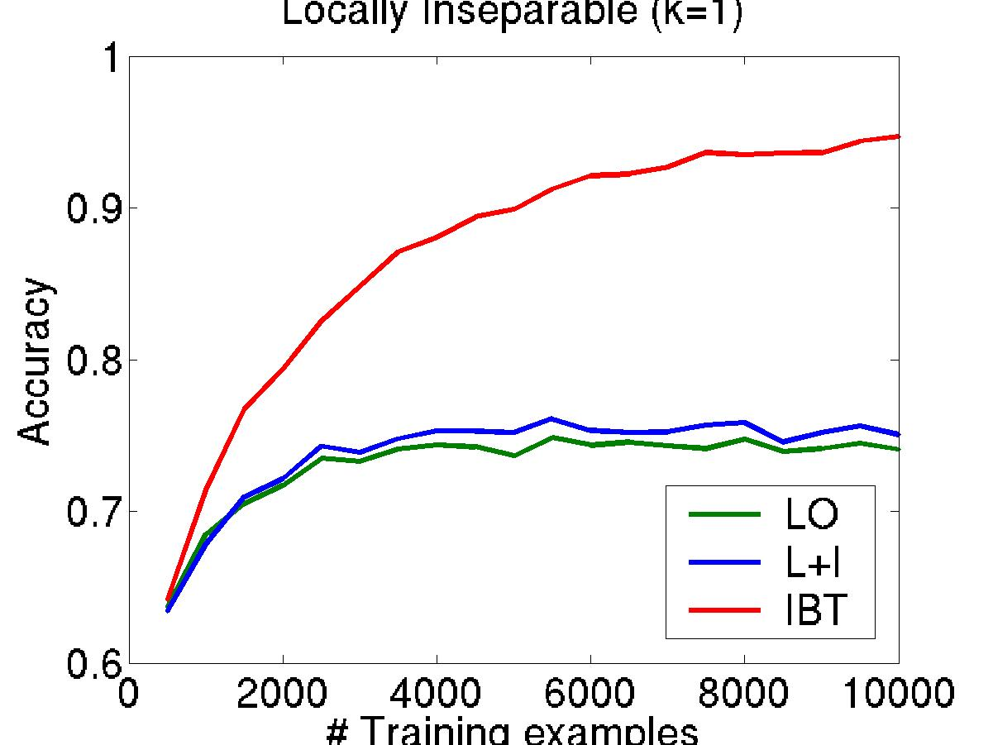
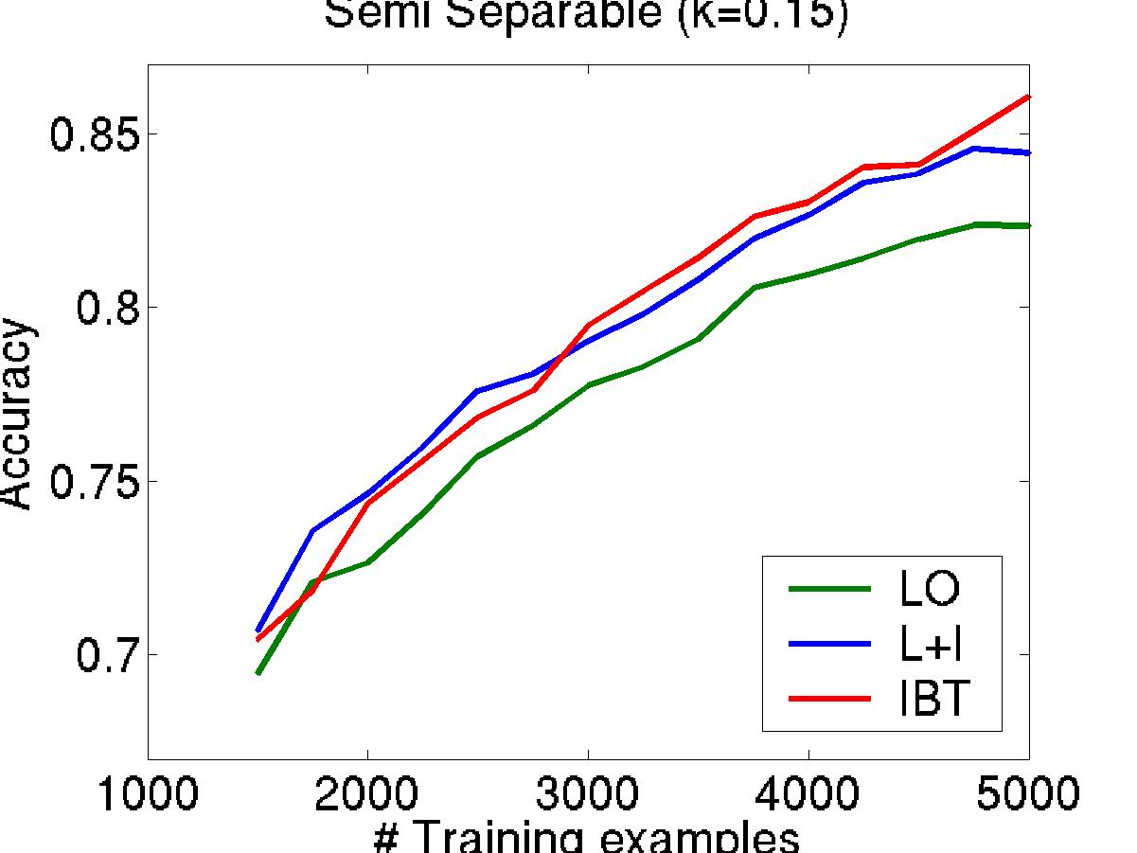
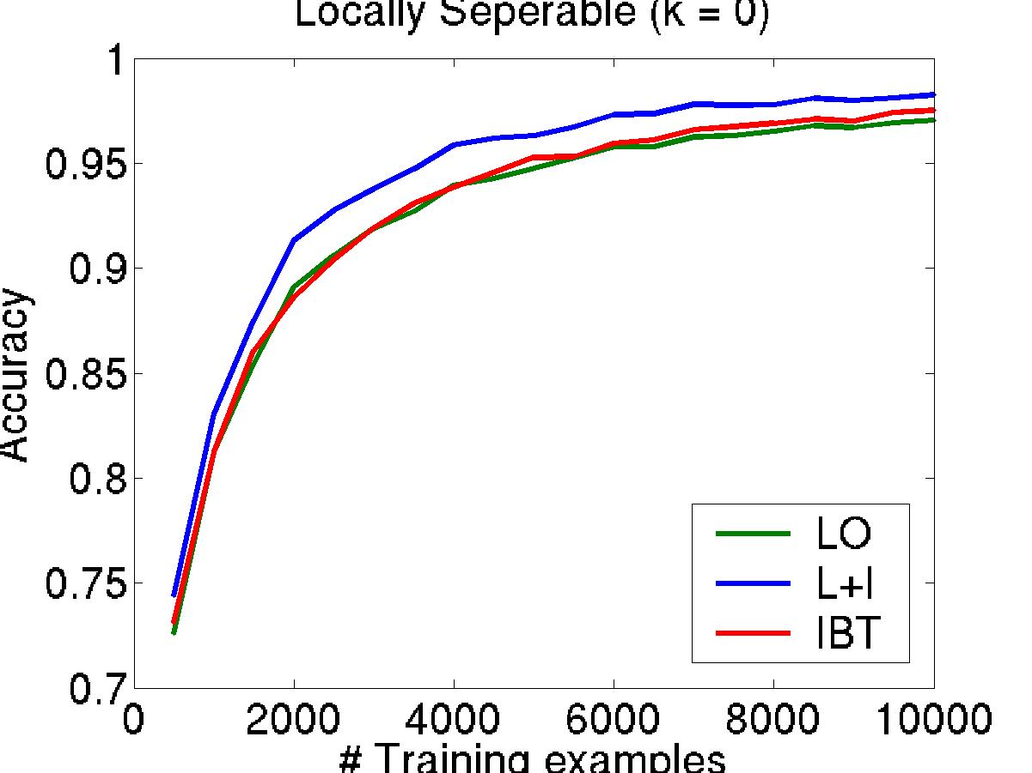
L+I vs IBT
L+I vs. IBT: the more identifiable individual problems are, the better overall performance is with L+I
Local ε ≤ ε_{opt} + ( ( d log m + log 1/δ ) / m )^{1/2}
Global ε ≤ 0 + ( ( cd log m + c²d + log 1/δ ) / m )^{1/2}
Indication for hardness of problem
Bounds
Simulated Data
Accuracy
Accuracy
ε_{opt}=0.1
ε_{opt}=0
ε_{opt}=0.2
# of Examples
# of Examples
Notes:
22
Caption/text: bound vs. simulated data
ARROW: Eopt = 0, 0.1, 0.2

Slide 23
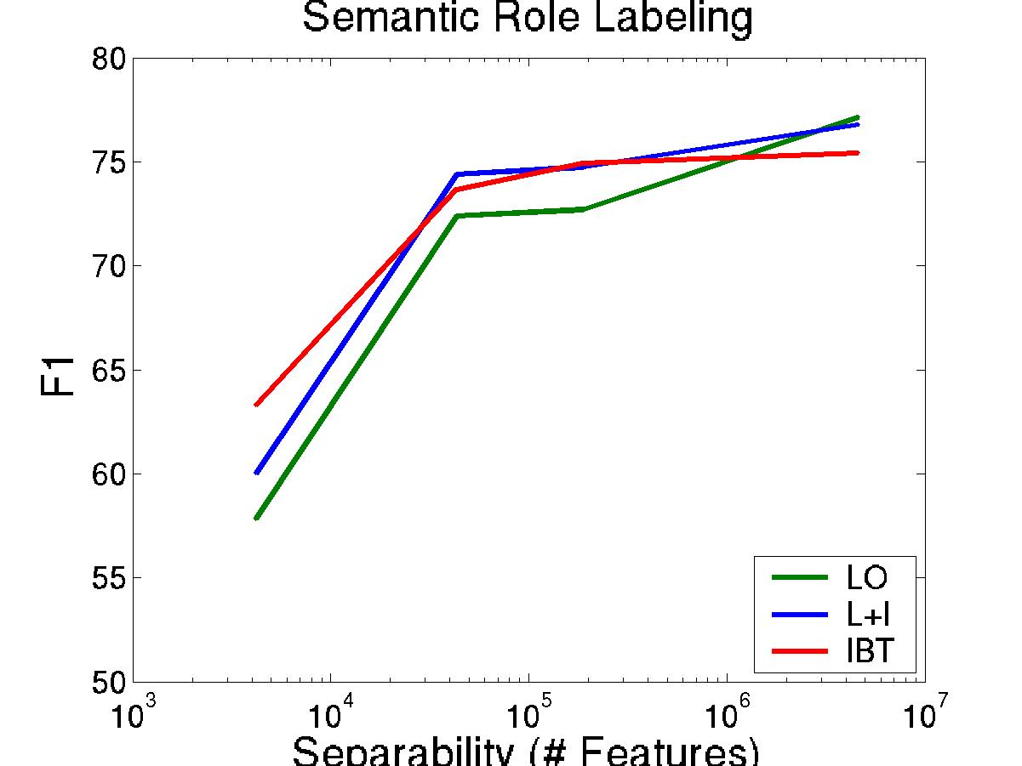
Relative Merits: SRL
In some cases problems are hard due to lack of training data.
Semi-supervised learning
L+I is better.
When the problem is artificially made harder, the tradeoff is clearer.
Difficulty of the learning problem (# features)
hard
easy
Notes:
23

Slide 24
Learning Paradigms: Summary
So far, we discussed some Pros & Cons for when to use each
Joint (Global; IBT)
More expressive; better in the limit
More expensive computationally
Requires more examples
Decoupled (L+I)
Simpler, more modular.
More flexible; gives rise to compositionality
Better if local components are individually good.
But, sometimes there is no choice
Lack of jointly labeled data
Constraints appearing only at evaluation time

Slide 25
Semantic Role Labeling (SRL)
Archetypical Information Extraction Problem: E.g., Concept Identification and Typing, Event Identification, etc.
I left my pearls to my daughter in my will .
[I]_{A0} left [my pearls]_{A1} [to my daughter]_{A2} [in my will]_{AM-LOC} .
A0 Leaver
A1 Things left
A2 Benefactor
AM-LOC Location
I left my pearls to my daughter in my will .
Notes:
In the context of SRL, the goal is to predict for each possible phrase in a given sentence if it is an argument or not and what type it is.

Slide 26

Verb SRL is not Sufficient
John, a fast-rising politician, slept on the train to Chicago.
Verb Predicate: sleep
Sleeper: John, a fast-rising politician
Location: on the train to Chicago
Who was John?
Relation: Apposition (comma)
John, a fast-rising politician
What was John’s destination?
Relation: Destination (preposition)
train to Chicago

Slide 27
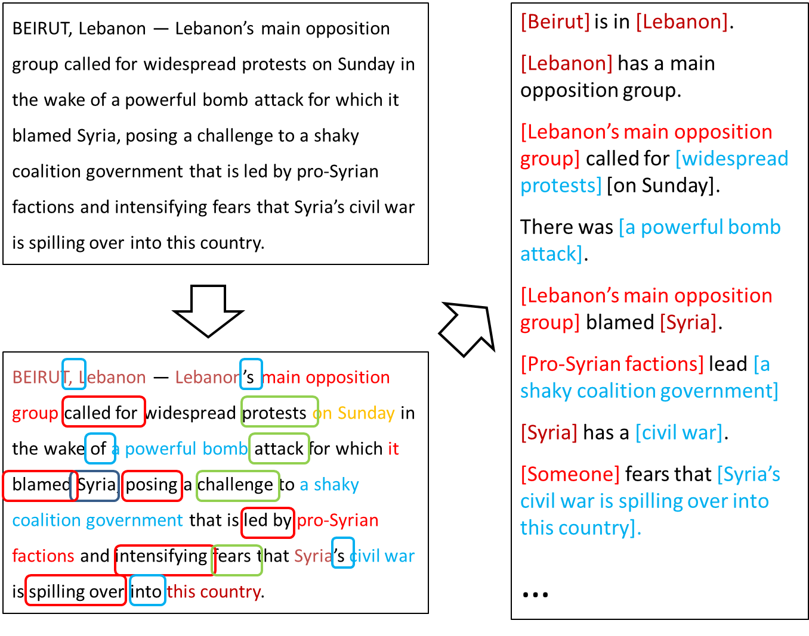
Extended Semantic Role Labeling
Many predicates; many roles; how to deal with more phenomena?
Sentence level analysis may be influenced by other sentences

Slide 28
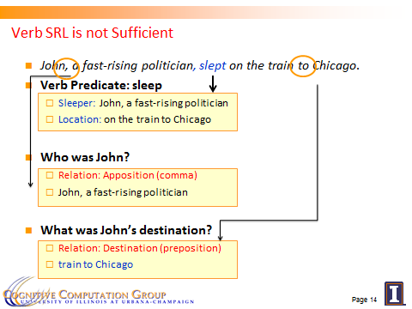
Computational Challenges
Predict the [preposition] relations
[EMNLP, ’11]
Identify the relation’s arguments
[PP: Trans. Of ACL, ’13, Comma: AAAI’16]
Very little supervised data
per phenomena
Minimal annotation
only at the predicate level
Learning models in these settings exploits two principles:
Latent structure can be constrained (via CCMs)
Coherency among multiple phenomena: learn simple models; infer together

Slide 29
Coherency in Semantic Role Labeling
Predicate-arguments generated should be consistent across phenomena
The touchdown scored by Brady cemented the victory of the Patriots.
Verb | Nominalization | Preposition
Predicate: score A0: Brady (scorer) A1: The touchdown (points scored) | Predicate: win A0: the Patriots (winner) | Sense: 11(6) “the object of the preposition is the object of the underlying verb of the nominalization”
Linguistic Constraints:
A0: the Patriots ⇔ Sense(of): 11(6)
A0: Brady ⇔ Sense(by): 1(1)
Notes:
29

Slide 30
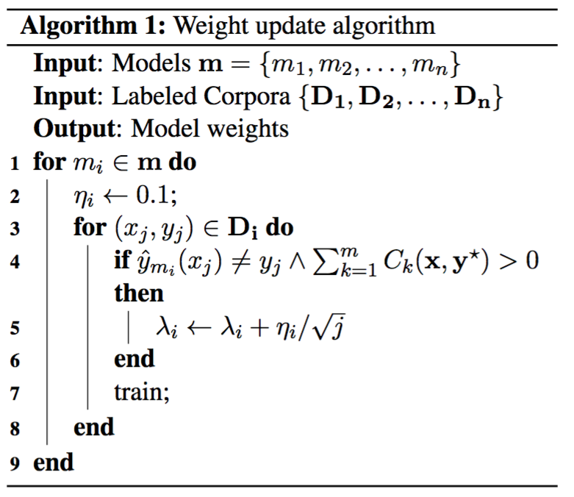
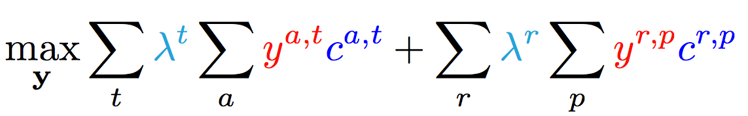
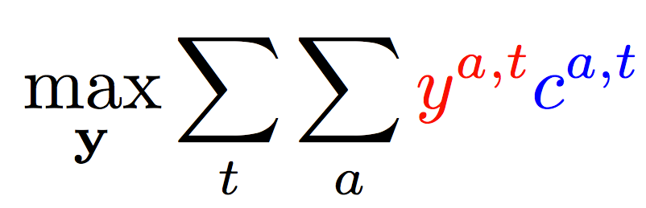
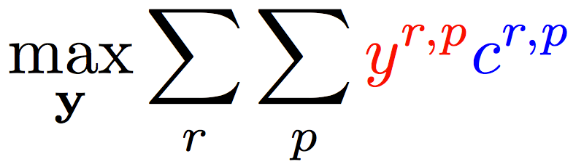
Enforce Coherence via Joint inference (CCMs)
Variable y^{a,t} indicates whether candidate argument a is assigned a label t.
c^{a,t} is the corresponding model score
Verb arguments
Preposition relations
+ ….
Argument candidates
Re-scaling parameters (one per label)
Preposition relation
label
Constraints:
Preposition
Each argument label
Verb SRL constraints
Preposition SRL Constraints
+ Joint constraints between tasks
How to learn the coefficients of different components?
Either use a little bit of jointly labeled data, or
learn scaling coefficients without jointly annotated data

Slide 31
Training Complex Models without Joint Supervision
Verbs
Nouns
Commas
Prepositions
Compounds
Possessives
Adjective-Noun
Light verbs
Phrasal verbs
NER
Wikification
Events
Implicit relations
Missing Arguments
Missing Predicates
Conjunctions
Quantifiers
Negations
Quantities (comparators)
Temporal
There is a need to understand multiple phenomena in natural language text
We will never have enough jointly annotated data
Joint inference via declarative constraints
Is essential both to provide coherent structured prediction, and
At a way to get around lack of joint annotation
Lack of data is also our starting point
for the next section, on
Constraint Driven Learning.

