Slide 1
PART 5: CONSTRAINTS DRIVEN LEARNING

Slide 2
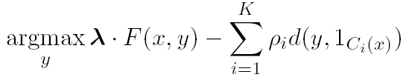
Training Constrained Conditional Models
Decompose Model
Training:
Independently of the constraints (L+I)
Jointly, in the presence of the constraints (IBT)
Decomposed to simpler models
How can we exploit constraints (knowledge) in order to
Train better models
Use less examples
Develop interesting/useful learning paradigms
Decompose Model from constraints

Slide 3
ILP Formulations in NLP
Part 5: Constraints Driven Learning [30 min]
Constraint Driven Learning
Examples
Posterior Regularization
Learning with Constrained Latent Representations
Response Driven Learning
Amortized Inference
Notes:
3

Slide 4

Information Extraction without Output Expectations
Lars Ole Andersen . Program analysis and specialization for the C Programming language. PhD thesis. DIKU , University of Copenhagen, May 1994 .
Prediction result of a trained HMM
Lars Ole Andersen . Program analysis and
specialization for the
C
Programming language
. PhD thesis .
DIKU , University of Copenhagen , May
1994 .
[AUTHOR]
[TITLE]
[EDITOR]
[BOOKTITLE]
[TECH-REPORT]
[INSTITUTION]
[DATE]
Violates lots of natural constraints!
Notes:
4
4

Slide 5
Strategies for Improving the Results
(Standard) Machine Learning Approaches
Higher Order HMM/CRF?
Increasing the window size?
Adding a lot of new features
Requires a lot of labeled examples
What if we only have a few labeled examples?
Instead:
Constrain the output to make sense – satisfy our expectations
Push the (simple) model in a direction that makes sense – minimally violates our expectations.
Increasing the model complexity
Increase difficulty of Learning
Can we keep the learned model simple and still make expressive decisions?
Notes:
5

Slide 6
Expectations from the output (Constraints)
Each field must be a consecutive list of words and can appear at most once in a citation.
State transitions must occur on punctuation marks.
The citation can only start with AUTHOR or EDITOR.
The words pp., pages correspond to PAGE.
Four digits starting with 20xx and 19xx are DATE.
Quotations can appear only in TITLE
…….
Easy to express pieces of “knowledge”
Non Propositional; May use Quantifiers

Slide 7
Information Extraction with Expectation Constraints
Adding constraints, we get correct results!
Without changing the model
[AUTHOR] Lars Ole Andersen .
[TITLE] Program analysis and specialization for the
C Programming language .
[TECH-REPORT] PhD thesis .
[INSTITUTION] DIKU , University of Copenhagen ,
[DATE] May, 1994 .
Notes:
7

Slide 8
Guiding (Semi-Supervised) Learning with Constraints
In traditional Semi-Supervised learning the model can drift away from the correct one.
Constraints can be used to generate better training data
At training to improve labeling of un-labeled data (and thus improve the model)
At decision time, to bias the objective function towards favoring constraint satisfaction.
Seed examples
Model
Constraints
Better Predictions
Better model-based labeled data
Un-labeled Data
Decision Time
Constraints

Slide 9
Constraints Driven Learning (CoDL)
Archetypical Semi/un-supervised learning: A constrained EM
[Chang, Ratinov, Roth, ACL’07;ICML’08,MLJ’12]
See also: Ganchev et. al. 10 (PR)
(w,½)=learn(L)‏
For N iterations do
T=φ
For each x in unlabeled dataset
h Ã argmax_{y} w^{T} Á(x,y) - ∑ ½ d_{C}(x,y)
T=T ∪ {(x, h)}
(w,½) = γ (w,½) + (1- γ) learn(T)
Supervised learning algorithm
parameterized by (w,½).
Inference with constraints:
augment the training set
Learn from new training data
Weigh supervised &
unsupervised models.
Excellent Experimental Results showing the advantages of using constraints, especially with small amounts of labeled data [Chang et. al, Others]
Notes:
9
9

Slide 10

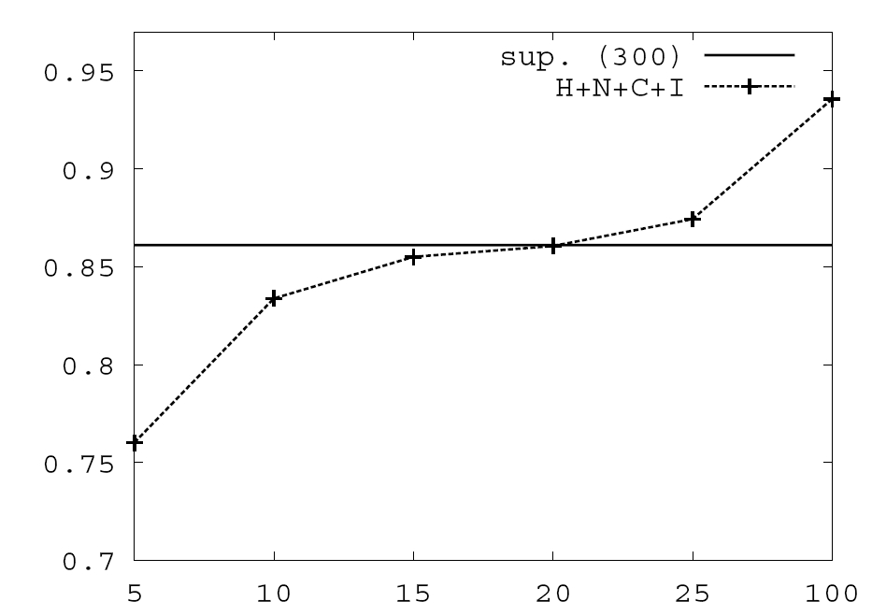
Value of Constraints in Semi-Supervised Learning
Bottom line: CoDL allows you to improve the “standard” semi-supervised approach by using inference with constraints in intermediate steps.
Objective function:
Constraints are used to Bootstrap a semi-supervised learner
simple model + constraints used to annotate unlabeled data, which in turn is used to keep training the model.
Learning w/o Constraints: 300 examples.
Learning w 10 Constraints
See Chang et. al. MLJ’12 on the use of soft constraints in CCMs.
The tutorial’s web page will include a write-up on ILP formulations incorporating soft constraints.
Skip
# of available labeled examples

Slide 11
CoDL as Constrained Hard EM
Hard EM is a popular variant of EM
While EM estimates a distribution over hidden variables in the E-step,
… Hard EM predicts the best output in the E-step
h= y*= argmax_{y} P_{w}(y|x)
Alternatively, hard EM predicts a peaked distribution
q(y) = ±_{y=y*}
Constrained-Driven Learning (CoDL) – can be viewed as a constrained version of hard EM:
y*= argmax_{y:Uy· b} P_{w}(y|x)
Constraining the feasible set

Slide 12
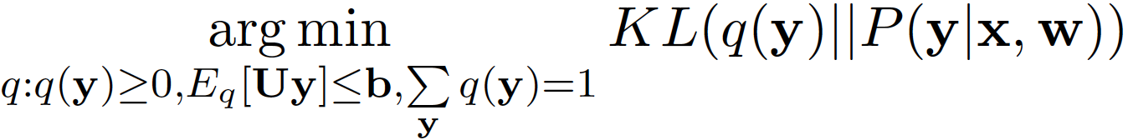
Constrained EM: Two Versions
While Constrained-Driven Learning [CODL; Chang et al, 07,12]
is a constrained version of hard EM:
y*= argmax_{y:Uy· b} P_{w}(y|x)
… It is possible to derive a constrained version of EM:
To do that, constraints are relaxed into expectation constraints on the posterior probability q:
E_{q}[Uy] · b
The E-step now becomes: [Neal & Hinton ‘99 view of EM]
q’ =
This is Taskar’s Posterior Regularization [PR] [Ganchev et al, 10]
Constraining the feasible set

Slide 13
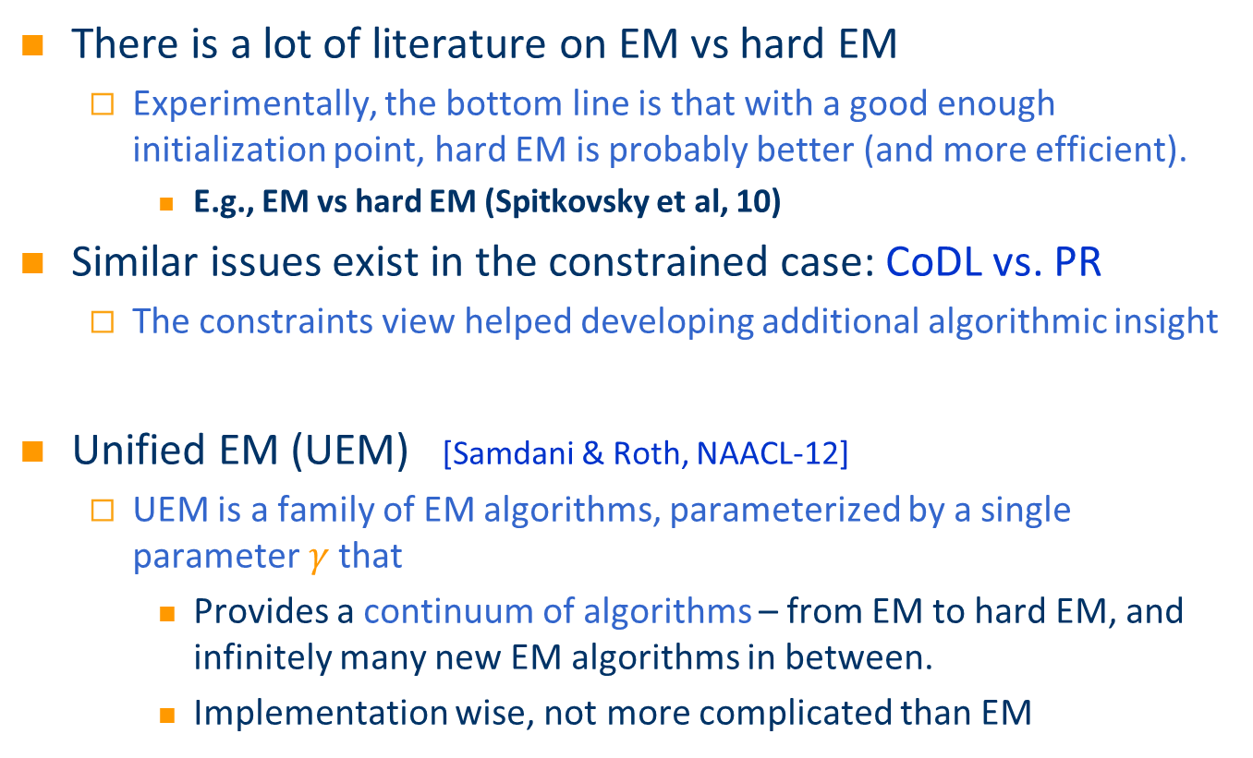
Which (Constrained) EM to use?
There is a lot of literature on EM vs hard EM
Experimentally, the bottom line is that with a good enough initialization point, hard EM is probably better (and more efficient).
E.g., EM vs hard EM (Spitkovsky et al, 10)
Similar issues exist in the constrained case: CoDL vs. PR
The constraints view helped developing additional algorithmic insight
Unified EM (UEM) [Samdani & Roth, NAACL-12]
UEM is a family of EM algorithms, parameterized by a single parameter$γ$that
Provides a continuum of algorithms – from EM to hard EM, and infinitely many new EM algorithms in between.
Implementation wise, not more complicated than EM

Slide 14
Unified EM (UEM)
EM (PR) minimizes the KL-Divergence KL(q , P (y|x;w)) KL(q , p) = ∑_{y} q(y) log q(y) – q(y) log p(y)
UEM changes the E-step of standard EM and minimizes a modified KL divergence KL(q , P (y|x;w); °) where
KL(q , p; °) = ∑_{y} ° q(y) log q(y) – q(y) log p(y)
Provably: Different ° values ! different EM algorithms
Neal & Hinton 99
Changes the entropy of the posterior
Notes:
In order to see the details of UEM, let’s have a look at how em WORKS.

Slide 15
Effect of Changing °
KL(q , p; °) = ∑_{y} ° q(y) log q(y) – q(y) log p(y)
q with ° = 1
q with ° = 1
Original Distribution p
q with ° = 0
q with ° = -1
Notes:
Explain why 0 is linear programming

Slide 16
Unifying Existing EM Algorithms
EM minimizes the KL-Divergence:
KL(q, p ) = ∑_{y} q(y) log q(y) – q(y) log p(y)
Varying ° results in different existing & new EM algorithms
; °
°
Infinitely many new EM algorithms
No
Constraints
Deterministic Annealing (Smith and Eisner, 04; Hofmann, 99)
Hard EM
EM
-1
0
1
1
With Constraints
°
CODL
(New)LP approx to CODL
PR
Notes:
Put a tick

Slide 17
Unsupervised POS tagging: Different EM instantiations
Introducing output expectations via constraints help guiding semi-supervised learning
Constrained hard EM (CoDL) – Constrained EM (PR) – UEM
Initialization with 40-80 examples
Initialization with 20 examples
Performance relative to EM
Initialization with 10 examples
Initialization with 5 examples
Uniform Initialization
EM
Gamma
Hard EM

Slide 18
Summary: Constraints as Supervision
Introducing domain knowledge-based constraints can help guiding semi-supervised learning
E.g. “the sentence must have at least one verb”, “a field of type y appears once in a citation”
Constrained Driven Learning (CoDL) : Constrained hard EM
PR: Constrained soft EM
UEM : Beyond “hard” and “soft”
Related literature:
Domain Adaptation (Kundu et. al. 11)
Constraint-driven Learning (Chang et al, 07; MLJ-12),
Posterior Regularization (Ganchev et al, 10),
Generalized Expectation Criterion (Mann & McCallum, 08),
Learning from Measurements (Liang et al, 09)
Unified EM (Samdani et al 2012)

Slide 19
Different types of structured learning tasks
Type 1: Structured output prediction
Dependencies between different output decisions
We can add constraints on the output variables
Examples: information extraction, parsing, pos tagging, ….
Type 2: Binary output tasks with latent structures
Output: binary, but requires an intermediate representation (structure)
The intermediate representation is hidden
Examples: paraphrase identification, TE, …

Slide 20
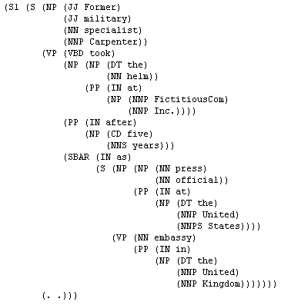
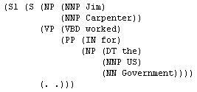
Textual Entailment
Former military specialist Carpenter took the helm at FictitiousCom Inc. after five years as press official at the United States embassy in the United Kingdom.
Jim Carpenter worked for the US Government.
Entailment Requires an Intermediate Representation
Alignment based Features
Given the intermediate features – learn a decision
Entail/ Does not Entail
x₃
x₃
x₄
x₄
x₁
x₁
x₅
x₂
x₂
x₇
x₆
But only positive entailments are expected to have a meaningful intermediate representation

Slide 21
Paraphrase Identification
Given an input x 2 X
Learn a model f : X ! {-1, 1}
Consider the following sentences:
S1: Druce will face murder charges, Conte said.
S2: Conte said Druce will be charged with murder .
Are S1 and S2 a paraphrase of each other?
There is a need for an intermediate representation to justify this decision
We need latent variables that explain:
why this is a positive example.
Given an input x 2 X
Learn a model f : X ! H ! {-1, 1}

Slide 22
Structured output learning
Use constraints to capture the dependencies
Structure Output Problem:
Dependencies between different outputs
y₂
y₁
y₃
y₄
y₅
x₃
Y
x₄
x₁
x₅
x₂
x₇
x₆
X

Slide 23
Standard Binary Classification problem
Single Output Problem:
Only one output
constraints!?
y₁
Y
x₃
x₄
x₁
x₅
x₂
x₇
x₆
X

Slide 24
Binary classification problem with latent representation
Binary Output Problem
with latent variables
y₁
Y
f₂
f₁
f₃
f₄
f₅
Use constraints to capture the dependencies on the latent representation
x₃
x₄
x₁
x₅
x₂
x₇
x₆
X

Slide 25


Algorithms: Two Conceptual Approaches
Feedback
Two stage approach (typically used for TE and paraphrase identification)
Learn hidden variables; fix it
Need supervision for the hidden layer (or heuristics)
For each example, extract features over x and (the fixed) h.
Learn a binary classier
Proposed Approach: Joint Learning
Drive the learning of h from the binary labels
Find the best h(x) [Use constraints here to search only for “legitimate” h’s]
An intermediate structure representation is good to the extent is supports better final prediction.
Algorithm?
Structure prediction
Binary Prediction
Input
$$x →h$$
$$\text{Á}\left(x,h\right)→Y$$
Binary
label
b
Predicted Structure
Feature representation

Slide 26
Learning with Constrained Latent Representation (LCLR): Intuition
If x is positive
There must exist a good explanation (intermediate representation)
9 h, w^{T} Á(x,h) ¸ 0
or, max_{h} w^{T} Á(x,h) ¸ 0
If x is negative
No explanation is good enough to support the answer
8 h, w^{T} Á(x,h) · 0
or, max_{h} w^{T} Á(x,h) · 0
Altogether, this can be combined into an objective function:
Min_{w} 1/2||w||² + C∑_{i} L(1-z_{i}max_{h 2 C} w^{T} ∑_{{s}} h_{s} Á_{s} (x_{i}))
This is an inference step that will gain from the CCM formulation
CCM on the latent structure
New feature vector for the final decision. Chosen h selects a representation.
Inference: best h subject to constraints C

Slide 27
Optimization
Non Convex, due to the maximization term inside the global minimization problem
In each iteration:
Find the best feature representation h* for all positive examples (off-the shelf ILP solver)
Having fixed the representation for the positive examples, update w solving the convex optimization problem:
Not the standard SVM/LR: need inference
Asymmetry: Only positive examples require a good intermediate representation that justifies the positive label.
Consequently, the objective function decreases monotonically

Slide 28


Iterative Objective Function Learning
A CCM goes here: restrict possible hidden structures considered.
Generate features
Formalized as Structured SVM + Constrained Hidden Structure
LCRL: Learning Constrained Latent Representation [NAACL’10, ICML’10]
Inference
best h subj. to C
Prediction
with inferred h
Initial Objective Function
Update weight vector
Feedback relative to binary problem
Training
w/r to binary decision label
Notes:
Over training iterations the model’s weights change-
➔ Better feature representations➔ Better classification results ➔ used for self training ➔ Better feature representations …

Slide 29
Learning with Constrained Latent Representation (LCLR): Framework
LCLR provides a general inference formulation that allows the use of expressive constraints to determine the hidden level
Flexibly adapted for many tasks that require latent representations.
Paraphrasing: Model input as graphs, V(G1,2), E(G1,2)
Four (types of) Hidden variables:
hv1,v2 – possible vertex mappings; he1,e2 – possible edge mappings
Constraints:
Each vertex in G1 can be mapped to a single vertex in G2 or to null
Each edge in G1 can be mapped to a single edge in G2 or to null
Edge mapping active iff the corresponding node mappings are active
H
LCLR Model
H: Problem Specific
Declarative Constraints
X
Y

Slide 30
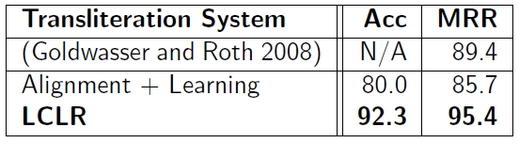
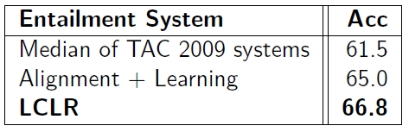

Experimental Results [~2010]
Transliteration:
Recognizing Textual Entailment:
Paraphrase Identification:*

Slide 31
Summary
Many important NLP problems require latent structures
LCLR:
An algorithmic framework that applies CCM to a latent structure
Can be used for many different NLP tasks
Easy to inject linguistic constraints on latent structures
A general learning framework that is good for many loss functions
Take home message:
It is possible to apply constraints on many important problems with latent variables!

Slide 32

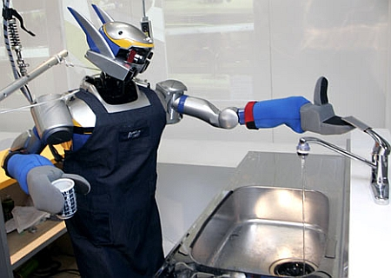

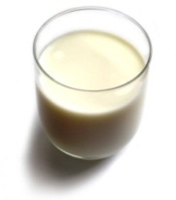
Understanding Language Requires (some) Supervision
Can we rely on this interaction to provide supervision (and eventually, recover meaning) ?
Can I get a coffee with lots of sugar and no milk
Great!
Arggg
Semantic Parser
MAKE(COFFEE,SUGAR=YES,MILK=NO)
How to recover meaning from text?
Standard “example based” ML: annotate text with meaning representation
The teacher needs deep understanding of the learning agent ; not scalable.
Response Driven Learning: Exploit indirect signals in the interaction between the learner and the teacher/environment
Notes:
NLU: about recovering meaning from text – a lot of work aims directly at that or at some subtasks that might look like this:….

Slide 33
Response Based Learning
We want to learn a model that transforms a natural language sentence to some meaning representation.
Instead of training with (Sentence, Meaning Representation) pairs
Think about some simple derivatives of the models outputs
Supervise the derivative (easy!) and
Propagate it to learn the complex, structured, transformation model
English Sentence
Model
Meaning Representation

Slide 34
Response Driven Learning – Invent a (derivative) Problem
We care about the structured output
y₁
Y
f₂
f₁
f₃
We invent the derivative Boolean problem (so it’s easy to supervise) and learn the structure as a latent layer
f₄
f₅
x₃
x₄
x₁
x₅
x₂
x₇
x₆
X

Slide 35
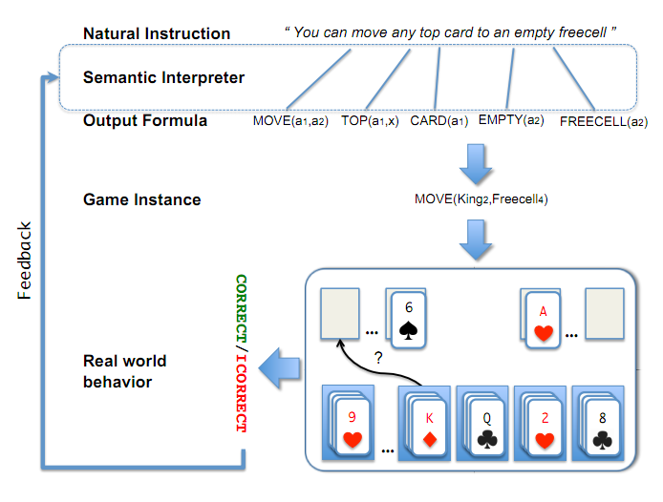
Scenario I: Freecell with Response Based Learning
We want to learn a model to transform a natural language sentence to some meaning representation.
English Sentence
Model
Meaning Representation
A top card can be moved to the tableau if it has a different color than the color of the top tableau card, and the cards have successive values.
Move (a1,a2) top(a1,x1) card(a1) tableau(a2) top(x2,a2) color(a1,x3) color(x2,x4) not-equal(x3,x4) value(a1,x5) value(x2,x6) successor(x5,x6)
Play Freecell (solitaire)
Simple derivatives of the models outputs: game API
Supervise the derivative and Propagate it to learn the transformation model

Slide 36
Scenario II: Geoquery with Response based Learning
We want to learn a model to transform a natural language sentence to some formal representation.
Guess” a semantic parse. Is [DB response == Expected response] ?
Expected: Pennsylvania DB Returns: Pennsylvania→ Positive Response
Expected: Pennsylvania DB Returns: NYC, or ???? → Negative Response
English Sentence
Model
Meaning Representation
What is the largest state that borders NY?
largest( state( next_to( const(NY))))
Simple derivatives of the models outputs
Query a GeoQuery Database.
A fifth grader can play with it and supervise it – no need to know SQL

Slide 37
Response Based Learning
We want to learn a model that transforms a natural language sentence to some meaning representation.
Instead of training with (Sentence, Meaning Representation) pairs
Think about some simple derivatives of the models outputs,
Supervise the derivative (easy!) and
Propagate it to learn the complex, structured, transformation model
LEARNING:
Train a structured predictor (semantic parse) with this binary supervision
Many challenges: e.g., how to make a better use of a negative response?
Learning with a constrained latent representation, use inference to exploit knowledge (e.g., on the structure of the meaning representation).
[Clarke, Goldwasser, Chang, Roth CoNLL’10; Goldwasser, Roth IJCAI’11, MLJ’14]
English Sentence
Model
Meaning Representation
As for other problems, people are excited today about NN models, but this does not get around the need to supervise model in a realistic way.

Slide 38
Summary
Constrained Conditional Models: Computational Framework for global inference and a vehicle for incorporating knowledge
This part: discussed learning paradigms, with an emphasis on
Supervision via constraints and inference
Indirect supervision via constraints and inference
CCM Inference is key in propagating the simple supervision
Notes:
38

Slide 39
Bonus Coverage
Amortized Inference
Notes:
39

Slide 40
Amortized ILP based Inference
Imagine that you already solved many structured output inference problems
Co-reference resolution; Semantic Role Labeling; Parsing citations; Summarization; dependency parsing; image segmentation,…
Your solution method doesn’t matter either
How can we exploit this fact to save inference cost?
We will show how to do it when your problem is formulated as a 0-1 LP:
Max c ¢ x
Ax ≤ b
x 2 {0,1}
After solving n inference problems, can we make the (n+1)^{th} one faster?
Very general: All discrete MAP problems can be formulated as 0-1 LPs [Roth & Yih’04; Taskar ’04]
We only care about inference formulation, not algorithmic solution

Slide 41
The Hope: POS Tagging on Gigaword
Number of Tokens

Slide 42
The Hope: POS Tagging on Gigaword
Number of examples of a given size
Number of unique POS tag sequences
Number of structures is much smaller than the number of sentences
Number of Tokens

Slide 43
The Hope: Dependency Parsing on Gigaword
Number of examples of a given size
Number of unique Dependency Trees
Number of structures is much smaller than the number of sentences
Number of Tokens

Slide 44
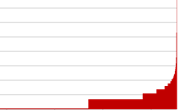
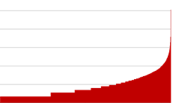
POS Tagging on Gigaword
How skewed is the distribution of the structures?
A small # of structures occur very frequently
Number of Tokens

Slide 45
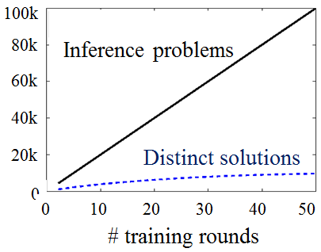
Redundancy in Inference and Learning
This redundancy is important since in all NLP tasks there is a need to solve many inferences, at least one per sentence.
However, it is as important in structured learning, where algorithms cycle between
performing inference, and
updating the model.

Slide 46
Amortized ILP Inference
These statistics show that many different instances are mapped into identical inference outcomes.
Pigeon Hole Principle
How can we exploit this fact to save inference cost over the life time of the learning & Inference program?
We give conditions on the objective functions
(for all objectives with the same # or variables and same feasible set),
under which the solution of a new problem Q is the same as the one of P (which we already cached)
If CONDITION (problem cache, new problem)
then (no need to call the solver)
SOLUTION(new problem) = old solution
Else
Call base solver and update cache
End
0.04 ms
2 ms

Slide 47
Theorem I
P
Q
max 2x₁+3x₂+2x₃+x₄
x₁ + x₂ ≤ 1
x₃ + x₄ ≤ 1
max 2x₁+4x₂+2x₃+0.5x₄
x₁ + x₂ ≤ 1
x₃ + x₄ ≤ 1
If
x*_{P}: <0, 1, 1, 0>
c_{P}: <2, 3, 2, 1>
c_{Q}: <2, 4, 2, 0.5>
The objective coefficients of active variables did not decrease from P to Q

Slide 48


Theorem I
Structured Learning: Dual coordinate descent for structured SVM still returns an exact model even if approximate amortized inference is used. [AAAI’15]
Then: The optimal solution of Q is the same as P’s
P
Q
x*_{P}=x*_{Q}
max 2x₁+3x₂+2x₃+x₄
x₁ + x₂ ≤ 1
x₃ + x₄ ≤ 1
max 2x₁+4x₂+2x₃+0.5x₄
x₁ + x₂ ≤ 1
x₃ + x₄ ≤ 1
If
And
x*_{P}: <0, 1, 1, 0>
c_{P}: <2, 3, 2, 1>
c_{Q}: <2, 4, 2, 0.5>
The objective coefficients of active variables did not decrease from P to Q
The objective coefficients of inactive variables did not increase from P to Q
$${∀i, \left(2y_{p,i}^{∗}−1\right)(c}_{Q,i}−c_{P,i})≥0$$
$${∀i, \left(2y_{p,i}^{∗}−1\right)(c}_{Q,i}−c_{P,i})≥−ε|c_{Q,i}|$$

Slide 49
Speedup & Accuracy
No training data is needed for this method. Once you have a model, you can generate a large cache that will be then used to save you time at evaluation time.
By decomposing the objective function, building on the fact that “smaller structures” are more redundant, it is possible to get even better results.
Solve only one in six problems!
Speedup
Results in [AAAI’15] show how to exploit amortized ILP in faster Structured Learning
1.0
Amortization schemes [EMNLP’12, ACL’13, AAAI’15]

Slide 50
%Solver Calls (Entity-Relation Extraction)
Recent results [AAAI’15] on how to exploit amortized ILP in faster Structured Learning
Exact
Exact
Better
Ent F1: 87.7
Rel F1: 47.6
% Solver Calls
Ent F1: 87.3
Rel F1: 47.8
Baseline
Amortized
Amortized+Appr.

