Slide 1
Part 2 Applications of ILP Formulations in Natural Language Processing
Roth & Srikumar: ILP formulations in Natural Language Processing

Slide 2
Outline
Example: Co-reference resolution
Example: Information Extraction
What do constraints give us?

Slide 3
Outline
Example: Co-reference resolution
Example: Information Extraction
What do constraints give us?

Slide 4
Co-reference Resolution
Clinton told National Public Radio that his answers to questions about Lewinsky were constrained by Starr’s investigation. NPR reporter Mara Liasson asked Clinton “whether you had any conversations with her about her testimony, had any conversations at all.”
[K-W Chang et al 2011, Denis & Baldridge, 2007]

Slide 5
Applying ILP inference for Coreference
Input: Mentions (i.e. spans of text)
Output: Clusters of mentions that refer to the same entity
Clinton told National Public Radio that his answers to questions about Lewinsky were constrained by Starr’s investigation. NPR reporter Mara Liasson asked Clinton “whether you had any conversations with her about her testimony, had any conversations at all.”

Slide 6
Best-Link Inference
For each mention, Best-Link considers the best mention on its left to connect to
Then, it creates a link between them if the score is above some threshold (typically 0)
Best-Link inference is simple and effective
[Bengtson and Roth, 2008]
1.5
3.1
m*
u
-1.5
1.2
0.2

Slide 7
All-Link Inference
It scores a clustering of mentions by including all possible pairwise links in the score:
[McCallum and Wellner, 2003; Finley and Joachims, 2005]
-0.5
1.5
3.1
1.5
Score: 1.5 + 3.1 - 0.5 + 1.5 = 5.6

Slide 8
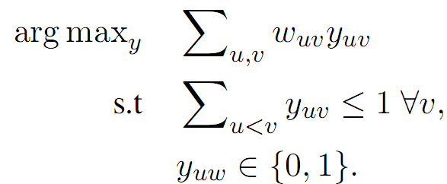
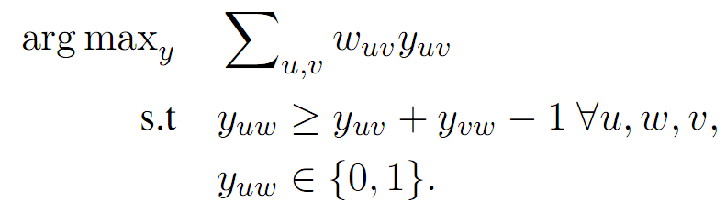
Integer Linear Programming (ILP) Formulation for Co-Reference
See Chang et. al, CoNLL’12 and EMNLP’13 for more a general formulation that incorporates background knowledge.
Best-Link
All-Link
Pairwise mention score
Binary variable:
(for every edge between u and v)
This is a totally uni-modular formulation
Enforce the transitive closure of the clustering
Transitivity constraints make the problem harder
Notes:
Say Bestlink is totally unimodular so the inference is easy but the all link has transitivity constraints, so it might be harder

Slide 9
Outline
Example: Co-reference resolution
Example: Information Extraction
What do constraints give us?

Slide 10
Reading comprehension is hard!
Water is split, providing a source of electrons and protons (hydrogen ions, H⁺) and giving off O₂ as a by-product. Light absorbed by chlorophyll drives a transfer of the electrons and hydrogen ions from water to an acceptor called NADP⁺.
What can the splitting of water lead to?
A: Light absorption
B: Transfer of ions
[Berant et al, 2014]

Slide 11
Reading comprehension is hard!
Water is split, providing a source of electrons and protons (hydrogen ions, H⁺) and giving off O₂ as a by-product. Light absorbed by chlorophyll drives a transfer of the electrons and hydrogen ions from water to an acceptor called NADP⁺.
What can the splitting of water lead to?
A: Light absorption
B: Transfer of ions

Slide 12
Reading comprehension is hard!
Enable
Water is split, providing a source of electrons and protons (hydrogen ions, H⁺) and giving off O₂ as a by-product. Light absorbed by chlorophyll drives a transfer of the electrons and hydrogen ions from water to an acceptor called NADP⁺.
What can the splitting of water lead to?
A: Light absorption
B: Transfer of ions

Slide 13
Reading comprehension is hard!
Enable
Water is split, providing a source of electrons and protons (hydrogen ions, H⁺) and giving off O₂ as a by-product. Light absorbed by chlorophyll drives a transfer of the electrons and hydrogen ions from water to an acceptor called NADP⁺.
Cause
What can the splitting of water lead to?
A: Light absorption
B: Transfer of ions

Slide 14
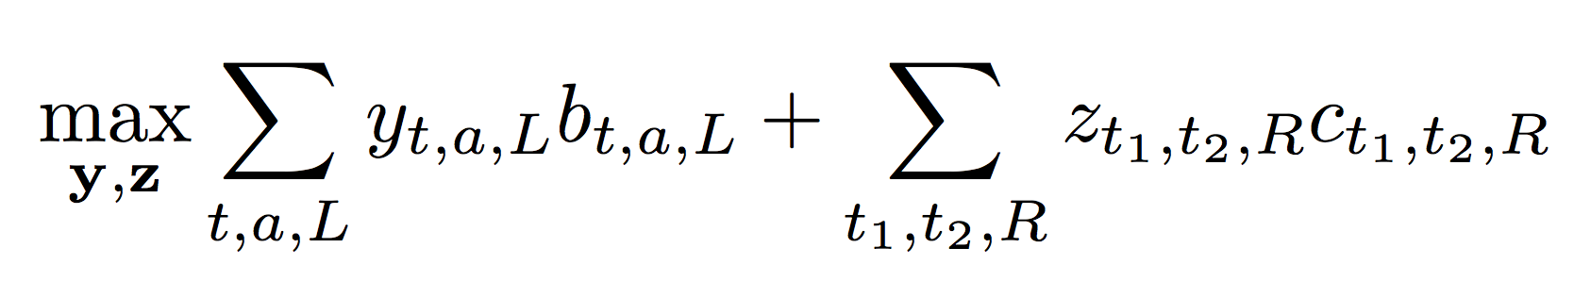
Event-arguments and event-event relations
Total event-argument score
Total event-event relation score
Theme
split
absorb
Theme
water
light
Enable
Cause
transfer
Theme
ions

Slide 15
Event-arguments and event-event relations
Total event-argument score
Score that arg-candidate has label L
Total event-event relation score
Trigger t
Argument candidate a
Argument label L
water
Agent
Theme
Source
…??
split
absorb
Agent
Theme
Source
…??
light
Agent
Theme
Source
…??
transfer
ions

Slide 16
Event-arguments and event-event relations
Total event-event relation score
Score that arg-candidate has label L
Score that trigger pair connected by relation R
Trigger t
Argument candidate a
Argument label L
Relation label R
Pair of events (t₁, t₂)
water
split
absorb
light
Enable, Prevent, Same…?
Enable, Prevent, Same…?
transfer
ions

Slide 17
Joint inference with constraints
No overlapping arguments
Maximum number of arguments per event
Maximum number of events per entity
Connectivity
Events that share arguments must be related
And a few other constraints

Slide 18
Joint inference with constraints
R
No overlapping arguments
Maximum number of arguments per trigger
Maximum number of triggers per entity
Connectivity
Events that share arguments must be related
Event 1
Not allowed!
Event 2
Result
Agent
Entity
And a few other constraints

Slide 19
Joint inference with constraints
R
No overlapping arguments
Maximum number of arguments per trigger
Maximum number of triggers per entity
Connectivity
Events that share arguments must be related
Event 1
Enable
Event 2
Result
Agent
Entity
And a few other constraints

Slide 20
Outline
Example: Co-reference resolution
Example: Information Extraction
What do constraints give us?

Slide 21
What do constraints give us?
Makes it easy to add additional knowledge
Specify them as Boolean formulas
Examples
“If y₁ is an A, then y₂ or y₃ should be a B or C”
“No more than two A’s allowed in the output”
Many inference problems have “standard” mappings to ILPs
Sequences, parsing, dependency parsing
At training time: Constraints act as surrogates for (many) training examples

Slide 22
ILP for inference: Remarks
Any combinatorial optimization problem can be written as an integer program
Even the “easy”/polynomial ones
Given an ILP, checking whether it admits a polynomial-time algorithm is intractable in general
ILPs are a general language for thinking about combinatorial optimization
The representation allows us to make general statements about inference
Important: Framing/writing down the inference problem is separate from solving it
Off-the-shelf solvers for ILPs are quite good
Gurobi, CPLEX
Use an off the shelf solver only if you can’t solve your inference problem otherwise

