Slide 1
Part 3 Modeling: Inference methods and Constraints
Roth & Srikumar: ILP formulations in Natural Language Processing

Slide 2
Outline
Modeling problems as structured prediction problems
Hard and soft constraints to represent prior knowledge
Augmenting Probabilistic Models with declarative constraints.
Inference Algorithms

Slide 3
Outline
Modeling problems as structured prediction problems
Hard and soft constraints to represent prior knowledge
Augmenting Probabilistic Models with declarative constraints
Inference Algorithms

Slide 4
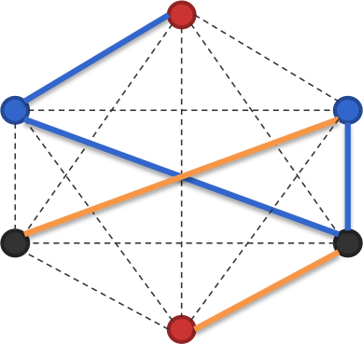
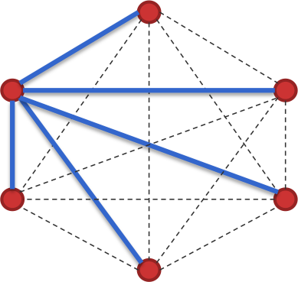
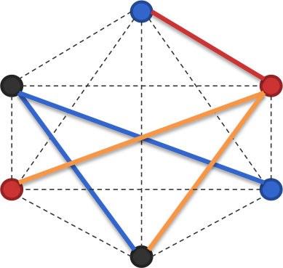
Modeling choices: Example
The scoring function (via the weight vector) scores outputs
For generalization and ease of inference, break the output into parts and score each part
The score for the structure is the sum of the part scores
What is the best way to do this decomposition? Depends….
Note: The output y is a labeled assignment of the nodes and edges
, , ,…
The input x not shown here
3 possible node labels
3 possible edge labels
Setting
Output: Nodes and edges are labeled and the blue and orange edges form a tree
Goal: Find the highest scoring labeling such that the edges that are colored form a tree

Slide 5
Modeling choices: Example
The output is a labeled assignment of nodes and edges
, , …
The input not shown here
3 possible node labels
3 possible edge labels
Setting
Output: Nodes and edges are labeled and the blue and orange edges form a tree
Goal: Find the highest scoring labeling such that the edges that are colored form a tree

Slide 6
Modeling choices: Example
The output is a labeled assignment of nodes and edges
, , …
The input not shown here
3 possible node labels
Modeling strategy
For generalization and ease of inference, break the output into parts and score each part
The score for the structure is the sum of the part scores
What is the best way to do this decomposition? Depends….
3 possible edge labels
Setting
Output: Nodes and edges are labeled and the blue and orange edges form a tree
Goal: Find the highest scoring labeling such that the edges that are colored form a tree

Slide 7
Modeling choices: Example
One option: Decompose fully. All nodes and edges are independently scored
3 possible node labels
3 possible edge labels
Setting
Output: Nodes and edges are labeled and the blue and orange edges form a tree
Goal: Find the highest scoring labeling such that the edges that are colored form a tree

Slide 8
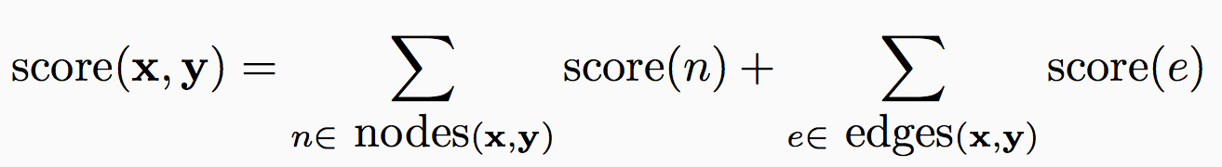
Modeling choices: Example
One option: Decompose fully. All nodes and edges are independently scored
3 possible node labels
3 possible edge labels
Setting
Output: Nodes and edges are labeled and the blue and orange edges form a tree
Goal: Find the highest scoring labeling such that the edges that are colored form a tree

Slide 9
Modeling choices: Example
One option: Decompose fully. All nodes and edges are independently scored
3 possible node labels
May be a linear functions
3 possible edge labels
Setting
Output: Nodes and edges are labeled and the blue and orange edges form a tree
Goal: Find the highest scoring labeling such that the edges that are colored form a tree

Slide 10
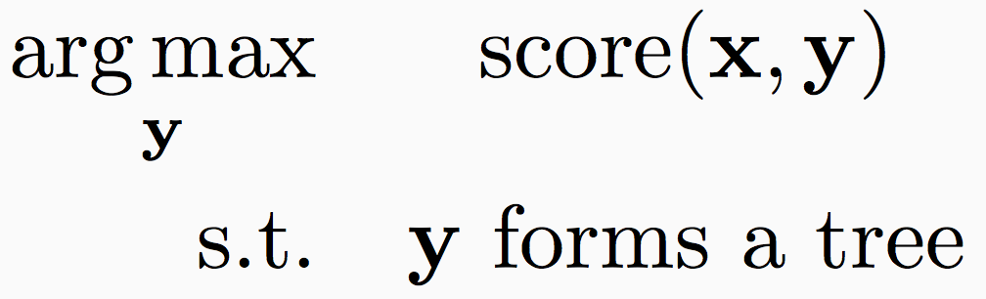
Modeling choices: Example
One option: Decompose fully. All nodes and edges are independently scored
Still need to ensure that the colored edges form a valid output (i.e. a tree)
3 possible node labels
May be a linear functions
3 possible edge labels
Setting
Output: Nodes and edges are labeled and the blue and orange edges form a tree
Goal: Find the highest scoring labeling such that the edges that are colored form a tree
Prediction:

Slide 11
Modeling choices: Example
One option: Decompose fully. All nodes and edges are independently scored
Still need to ensure that the colored edges form a valid output (i.e. a tree)
This is invalid output!
Even this simple decomposition requires inference to ensure validity
3 possible node labels
3 possible edge labels
Setting
Output: Nodes and edges are labeled and the blue and orange edges form a tree
Goal: Find the highest scoring labeling such that the edges that are colored form a tree
Prediction:

Slide 12
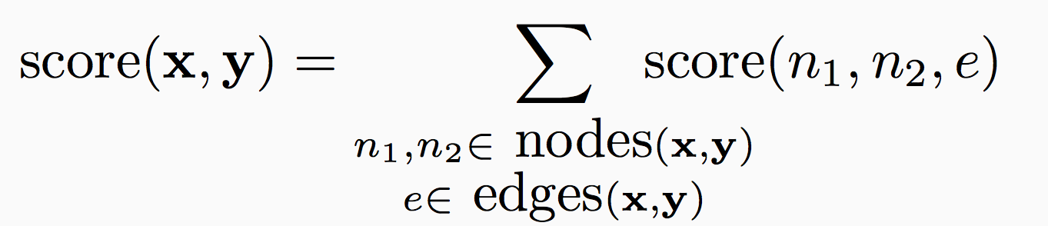
Modeling choices: Example
Another possibility: Score each edge and its nodes together
And many other edges…
Each patch represents piece that is scored independently
3 possible node labels
3 possible edge labels
Linear function
Setting
Output: Nodes and edges are labeled and the blue and orange edges form a tree
Goal: Find the highest scoring labeling such that the edges that are colored form a tree

Slide 13
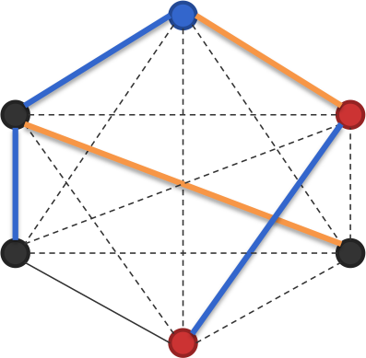
Modeling choices: Example
Another possibility: Score each edge and its nodes together
And many other edges…
Each patch represents piece that is scored independently
3 possible node labels
3 possible edge labels
Linear function
Setting
Output: Nodes and edges are labeled and the blue and orange edges form a tree
Goal: Find the highest scoring labeling such that the edges that are colored form a tree

Slide 14
Modeling choices: Example
Another possibility: Score each edge and its nodes together
And many other edges…
Each patch represents piece that is scored independently
3 possible node labels
3 possible edge labels
Setting
Output: Nodes and edges are labeled and the blue and orange edges form a tree
Goal: Find the highest scoring labeling such that the edges that are colored form a tree

Slide 15
Modeling choices: Example
Another possibility: Score each edge and its nodes together
And many other edges…
Each patch represents piece that is scored independently
3 possible node labels
3 possible edge labels
May be a linear function
Setting
Output: Nodes and edges are labeled and the blue and orange edges form a tree
Goal: Find the highest scoring labeling such that the edges that are colored form a tree

Slide 16
Modeling choices: Example
Another possibility: Score each edge and its nodes together
And many other edges…
Each patch represents piece that is scored independently
3 possible node labels
3 possible edge labels
Setting
Output: Nodes and edges are labeled and the blue and orange edges form a tree
Goal: Find the highest scoring labeling such that the edges that are colored form a tree
Inference should ensure that
The output is a tree, and
Shared nodes have the same label in all the parts

Slide 17
Modeling choices: Example
Another possibility: Score each edge and its nodes together
And many other edges…
Each patch represents piece that is scored independently
Invalid! Two parts disagree on the label for this node
3 possible node labels
3 possible edge labels
Setting
Output: Nodes and edges are labeled and the blue and orange edges form a tree
Goal: Find the highest scoring labeling such that the edges that are colored form a tree
Inference should ensure that
The output is a tree, and
Shared nodes have the same label in all the parts

Slide 18
Modeling choices: Example
We have seen two examples of decomposition
Many other decompositions possible…
3 possible node labels
3 possible edge labels
Setting
Output: Nodes and edges are labeled and the blue and orange edges form a tree
Goal: Find the highest scoring labeling such that the edges that are colored form a tree

Slide 19
Inference
Each part is scored independently
Key observation: Number of possible inference outcomes for each part may not be large
Even if the number of possible structures might be large
Inference: How to glue together the pieces to build a valid output?
Depends on the “shape” of the output
Computational complexity of inference is important
Worst case: intractable
With assumptions about the output, polynomial algorithms exist.
Predicting sequence chains: Viterbi algorithm
To parse a sentence into a tree: CKY algorithm
In general, might have to either live with intractability or approximate
Questions?

Slide 20
Stating inference problems vs solving them
Inference problems: Problem formulation is different from solving them
Important distinction!
Problem formulation: What combinatorial optimization problem are we solving?
Solution: How will we solve the problem? An algorithmic concern
Need a general language for for stating inference problems: Integer linear programming
Various algorithms exist. We will see some later

Slide 21
The big picture
MAP inference is combinatorial optimization
Combinatorial optimization problems can be written as integer linear programs (ILP)
The conversion is not always trivial
Allows injection of “knowledge” into the inference in the form of constraints
Different ways of solving ILPs
Commercial solvers: CPLEX, Gurobi, etc
Specialized solvers if you know something about your problem
Incremental ILP, Lagrangian relaxation, etc
Can approximate to linear programs and hope for the best
Integer linear programs are NP hard in general
No free lunch

Slide 22
What are linear programs?
[Skip this section]

Slide 23
Linear Programming
Detour
Minimizing a linear objective function subject to a finite number of linear constraints (equality or inequality)
A student wants to spend as little money on food while getting sufficient amount of vitamin Z and nutrient X. Her options are:
How should she spend her money to get at least 5 units of vitamin Z and 3 units of nutrient X?
Item | Cost/100g | Vitamin Z | Nutrient X
Carrots | 2 | 4 | 0.4
Sunflower seeds | 6 | 10 | 4
Double cheeseburger | 0.3 | 0.01 | 2

Slide 24
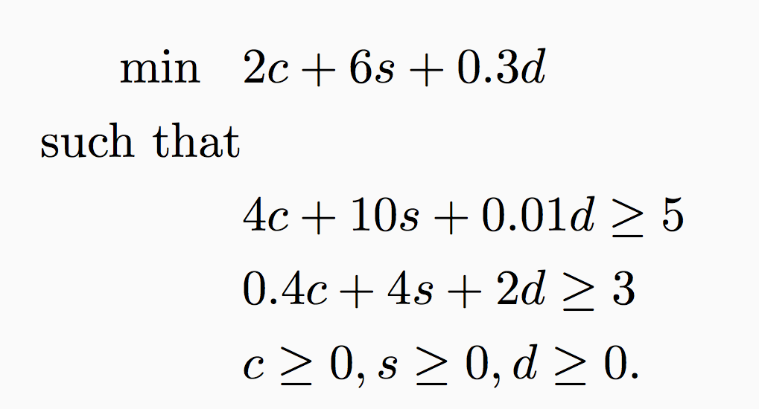
Example: The diet problem
A student wants to spend as little money on food while getting sufficient amount of vitamin Z and nutrient X. Her options are:
How should she spend her money to get at least 5 units of vitamin Z and 3 units of nutrient X?
Item | Cost/100g | Vitamin Z | Nutrient X
Carrots | 2 | 4 | 0.4
Sunflower seeds | 6 | 10 | 4
Double cheeseburger | 0.3 | 0.01 | 2
Let c, s and d denote how much of each item is purchased
Minimize total cost
At least 5 units of vitamin Z,
At least 3 units of nutrient X,
The number of units purchased is not negative

Slide 25
Example: The diet problem
A student wants to spend as little money on food while getting sufficient amount of vitamin Z and nutrient X. Her options are:
How should she spend her money to get at least 5 units of vitamin Z and 3 units of nutrient X?
Item | Cost/100g | Vitamin Z | Nutrient X
Carrots | 2 | 4 | 0.4
Sunflower seeds | 6 | 10 | 4
Double cheeseburger | 0.3 | 0.01 | 2
Let c, s and d denote how much of each item is purchased
Minimize total cost
At least 5 units of vitamin Z,
At least 3 units of nutrient X,
The number of units purchased is not negative

Slide 26
Example: The diet problem
A student wants to spend as little money on food while getting sufficient amount of vitamin Z and nutrient X. Her options are:
How should she spend her money to get at least 5 units of vitamin Z and 3 units of nutrient X?
Item | Cost/100g | Vitamin Z | Nutrient X
Carrots | 2 | 4 | 0.4
Sunflower seeds | 6 | 10 | 4
Double cheeseburger | 0.3 | 0.01 | 2
Let c, s and d denote how much of each item is purchased
Minimize total cost
At least 5 units of vitamin Z,
At least 3 units of nutrient X,
The number of units purchased is not negative

Slide 27
Example: The diet problem
A student wants to spend as little money on food while getting sufficient amount of vitamin Z and nutrient X. Her options are:
How should she spend her money to get at least 5 units of vitamin Z and 3 units of nutrient X?
Item | Cost/100g | Vitamin Z | Nutrient X
Carrots | 2 | 4 | 0.4
Sunflower seeds | 6 | 10 | 4
Double cheeseburger | 0.3 | 0.01 | 2
Let c, s and d denote how much of each item is purchased
Minimize total cost
At least 5 units of vitamin Z,
At least 3 units of nutrient X,
The number of units purchased is not negative

Slide 28
Example: The diet problem
A student wants to spend as little money on food while getting sufficient amount of vitamin Z and nutrient X. Her options are:
How should she spend her money to get at least 5 units of vitamin Z and 3 units of nutrient X?
Item | Cost/100g | Vitamin Z | Nutrient X
Carrots | 2 | 4 | 0.4
Sunflower seeds | 6 | 10 | 4
Double cheeseburger | 0.3 | 0.01 | 2
Let c, s and d denote how much of each item is purchased
Minimize total cost
At least 5 units of vitamin Z,
At least 3 units of nutrient X,
The number of units purchased is not negative

Slide 29
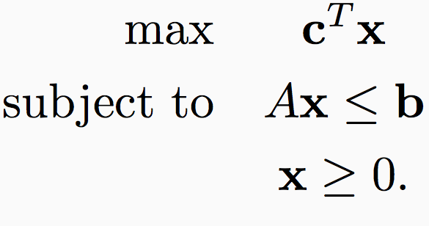
Linear programming
In general
This is a continuous optimization problem
And yet, there are only a finite set of possible solutions
The constraint matrix defines a convex polytope
Only the vertices or faces of the polytope can be solutions
linear
linear

Slide 30
Geometry of linear programming
The constraint matrix defines a polytope that contains allowed solutions (possibly not closed)

Slide 31

Geometry of linear programming
The constraint matrix defines a polytope that contains allowed solutions (possibly not closed)
One of the constraints: $A_{i}^{T}x≤b_{i}$
Points in the shaded region can are not allowed by this constraint

Slide 32
Geometry of linear programming
The constraint matrix defines a polytope that contains allowed solutions (possibly not closed)
Every constraint forbids a half-plane
The points that are allowed form the feasible region

Slide 33
Geometry of linear programming
The constraint matrix defines a polytope that contains allowed solutions (possibly not closed)

Slide 34
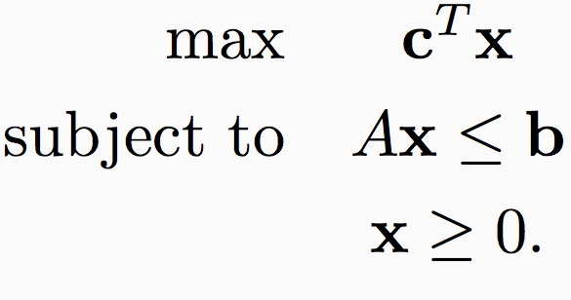
Geometry of linear programming
The constraint matrix defines a polytope that contains allowed solutions (possibly not closed)
The objective defines cost for every point in the space

Slide 35
Geometry of linear programming
The constraint matrix defines a polytope that contains allowed solutions (possibly not closed)
The objective defines cost for every point in the space

Slide 36
Geometry of linear programming
The constraint matrix defines a polytope that contains allowed solutions (possibly not closed)
The objective defines cost for every point in the space
Even though all points in the region are allowed, points on the faces maximize/minimize the cost

Slide 37
Linear programming
In general
This is a continuous optimization problem
And yet, there are only a finite set of possible solutions
The constraint matrix defines a polytope
Only the vertices or faces of the polytope can be solutions
Linear programs can be solved in polynomial time

Slide 38
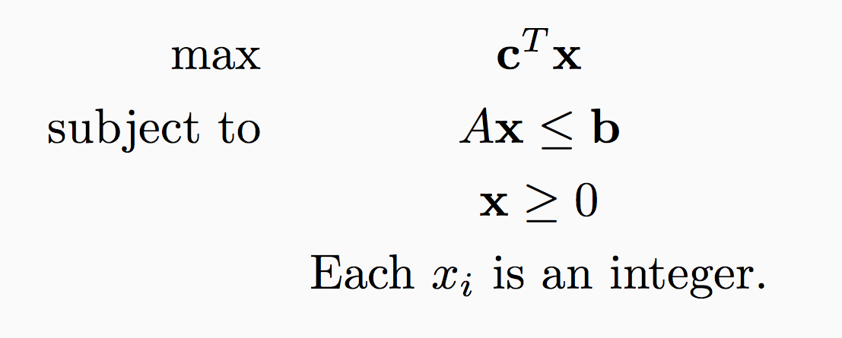
Integer linear programming
In general

Slide 39
Geometry of integer linear programming
The constraint matrix defines polytope that contains allowed solutions (possibly not closed)
The objective defines cost for every point in the space
Only integer points allowed

Slide 40
Geometry of integer linear programming
The constraint matrix defines polytope that contains allowed solutions (possibly not closed)
The objective defines cost for every point in the space
This vertex is not an integer solution.
Can not be the solution.
Only integer points allowed

Slide 41
Integer linear programming
In general
Solving integer linear programs in general can be NP-hard!
LP-relaxation: Drop the integer constraints and hope for the best

Slide 42
Thinking in ILPs for inference
Let’s start with multi-class classification
argmax_{y 2 {A, B, C}} w^{T}Á(x, y) = argmax_{y 2 {A, B, C}} score(y)
Introduce decision variables: Indicators for each label
z_{A} = 1 if output = A, 0 otherwise
z_{B} = 1 if output = B, 0 otherwise
z_{C} = 1 if output = C, 0 otherwise

Slide 43
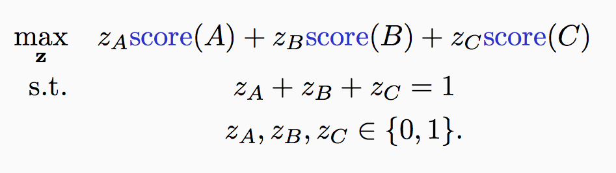
Thinking in ILPs
Let’s start with multi-class classification
argmax_{y 2 {A, B, C}} w^{T}Á(x, y) = argmax_{y 2 {A, B, C}} score(y)
Introduce decision variables: Indicators for each label
z_{A} = 1 if output = A, 0 otherwise
z_{B} = 1 if output = B, 0 otherwise
z_{C} = 1 if output = C, 0 otherwise
Maximize the score
Pick exactly one label

Slide 44
Thinking in ILPs
Let’s start with multi-class classification
argmax_{y 2 {A, B, C}} w^{T}Á(x, y) = argmax_{y 2 {A, B, C}} score(y)
Introduce decision variables: Indicators for each label
z_{A} = 1 if output = A, 0 otherwise
z_{B} = 1 if output = B, 0 otherwise
z_{C} = 1 if output = C, 0 otherwise
Maximize the score
Pick exactly one label
An assignment to the z vector gives us a y

Slide 45
Thinking in ILPs
Let’s start with multi-class classification
argmax_{y 2 {A, B, C}} w^{T}Á(x, y) = argmax_{y 2 {A, B, C}} score(y)
Introduce decision variables for each label
z_{A} = 1 if output = A, 0 otherwise
z_{B} = 1 if output = B, 0 otherwise
z_{C} = 1 if output = C, 0 otherwise
We have taken a trivial problem (finding a highest scoring element of a list) and converted it into a representation accommodates NP-hardness in the worst case!
Don’t solve multiclass classification with an ILP solver. This is a building block for a larger inference problem
Maximize the score
Pick exactly one label
An assignment to the z vector gives us a y

Slide 46
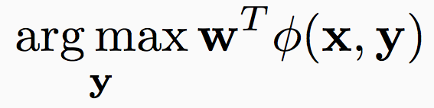
Example 2: Sequences
w^{T}Á_{T} (y₁, y₂)
w^{T}Á_{T} (y₂, y₃)
Suppose the outputs can be one of A or B
1
2
3
Typically, we want
w^{T}Á_{E} (x, y₁)
w^{T}Á_{E} (x, y₂)
w^{T}Á_{E} (x, y₃)
A first order sequence model, expressed as a factor graph

Slide 47
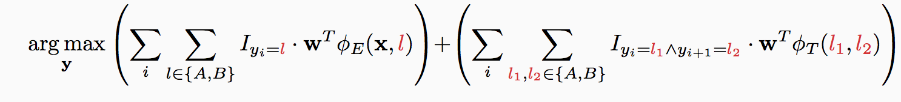
Example 2: Sequences
w^{T}Á_{T} (y₁, y₂)
w^{T}Á_{T} (y₂, y₃)
Suppose the outputs can be one of A or B
1
2
3
Typically, we want
w^{T}Á_{E} (x, y₁)
w^{T}Á_{E} (x, y₂)
w^{T}Á_{E} (x, y₃)
Or equivalently,
Emission score
Transition score

Slide 48
Example 2: Sequences
w^{T}Á_{T} (y₁, y₂)
w^{T}Á_{T} (y₂, y₃)
Suppose the outputs can be one of A or B
1
2
3
Typically, we want
w^{T}Á_{E} (x, y₁)
w^{T}Á_{E} (x, y₂)
w^{T}Á_{E} (x, y₃)
Or equivalently,
Emissions
Transitions

Slide 49
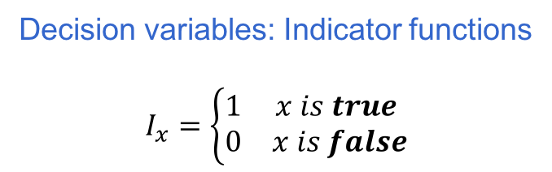
Example 2: Sequences
w^{T}Á_{T} (y₁, y₂)
w^{T}Á_{T} (y₂, y₃)
Suppose the outputs can be one of A or B
1
2
3
Typically, we want
w^{T}Á_{E} (x, y₁)
w^{T}Á_{E} (x, y₂)
w^{T}Á_{E} (x, y₃)
Or equivalently,
Emissions
Transitions
Decision variables: Indicator functions
$$I_{x}=\left\{\begin{matrix}1 & x is true \\ 0 & x is false\end{matrix}\right.$$

Slide 50
Example 2: Sequences
w^{T}Á_{T} (y₁, y₂)
w^{T}Á_{T} (y₂, y₃)
Suppose the outputs can be one of A or B
1
2
3
Typically, we want
w^{T}Á_{E} (x, y₁)
w^{T}Á_{E} (x, y₂)
w^{T}Á_{E} (x, y₃)
Or equivalently,
Score for decisions, from trained classifiers
Emissions
Transitions

Slide 51
Example 2: Sequences
w^{T}Á_{T} (y₁, y₂)
w^{T}Á_{T} (y₂, y₃)
Suppose the outputs can be one of A or B
1
2
3
Typically, we want
w^{T}Á_{E} (x, y₁)
w^{T}Á_{E} (x, y₂)
w^{T}Á_{E} (x, y₃)
Or equivalently,
Emissions
Transitions
One group of indicators per factor
One score per indicator

Slide 52
Example 2: Sequences
w^{T}Á_{T} (y₁, y₂)
w^{T}Á_{T} (y₂, y₃)
Suppose the outputs can be one of A or B
1
2
3
Typically, we want
w^{T}Á_{E} (x, y₁)
w^{T}Á_{E} (x, y₂)
w^{T}Á_{E} (x, y₃)
Or equivalently,
Emissions
Transitions
This expression explicitly enumerates every decision that we need to make to build the final output
One group of indicators per factor
One score per indicator

Slide 53
Example 2: Sequences
w^{T}Á_{T} (y₁, y₂)
w^{T}Á_{T} (y₂, y₃)
Suppose the outputs can be one of A or B
1
2
3
Typically, we want
w^{T}Á_{E} (x, y₁)
w^{T}Á_{E} (x, y₂)
w^{T}Á_{E} (x, y₃)
Or equivalently,
But we should only consider valid label sequences

Slide 54
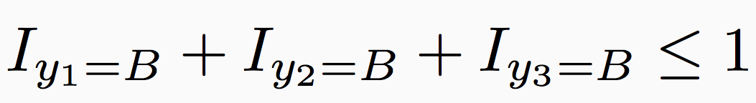
Example 2: Sequences
w^{T}Á_{T} (y₁, y₂)
w^{T}Á_{T} (y₂, y₃)
Suppose the outputs can be one of A or B
1
2
3
Typically, we want
w^{T}Á_{E} (x, y₁)
w^{T}Á_{E} (x, y₂)
w^{T}Á_{E} (x, y₃)
Or equivalently,
Predict with constraints
Each y_{i} can either be a A or a B
The emission decisions and the transition decisions should agree
There should be no more than one B in the output

Slide 55
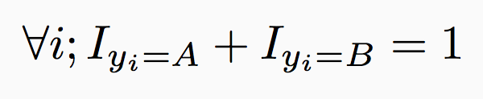
Example 2: Sequences
w^{T}Á_{T} (y₁, y₂)
w^{T}Á_{T} (y₂, y₃)
Suppose the outputs can be one of A or B
1
2
3
Typically, we want
w^{T}Á_{E} (x, y₁)
w^{T}Á_{E} (x, y₂)
w^{T}Á_{E} (x, y₃)
Or equivalently,
Predict with constraints
Each y_{i} can either be a A or a B
The emission decisions and the transition decisions should agree
There should be no more than one B in the output

Slide 56
Example 2: Sequences
w^{T}Á_{T} (y₁, y₂)
w^{T}Á_{T} (y₂, y₃)
Suppose the outputs can be one of A or B
1
2
3
Typically, we want
w^{T}Á_{E} (x, y₁)
w^{T}Á_{E} (x, y₂)
w^{T}Á_{E} (x, y₃)
Or equivalently,
Predict with constraints
Each y_{i} can either be a A or a B
The emission decisions and the transition decisions should agree
There should be no more than one B in the output
We can write this using linear constraints over the indicator variables

Slide 57
Example 2: Sequences
w^{T}Á_{T} (y₁, y₂)
w^{T}Á_{T} (y₂, y₃)
Suppose the outputs can be one of A or B
1
2
3
Typically, we want
w^{T}Á_{E} (x, y₁)
w^{T}Á_{E} (x, y₂)
w^{T}Á_{E} (x, y₃)
Or equivalently,
Predict with constraints
Each y_{i} can either be a A or a B
The emission decisions and the transition decisions should agree
There should be no more than one B in the output
We could add extra knowledge

Slide 58
Example 2: Sequences
w^{T}Á_{T} (y₁, y₂)
w^{T}Á_{T} (y₂, y₃)
Suppose the outputs can be one of A or B
1
2
3
Typically, we want
w^{T}Á_{E} (x, y₁)
w^{T}Á_{E} (x, y₂)
w^{T}Á_{E} (x, y₃)
Or equivalently,
Predict with constraints
Each y_{i} can either be a A or a B
The emission decisions and the transition decisions should agree
There should be no more than one B in the output
Questions?

Slide 59
Outline
Modeling problems as structured prediction problems
Hard and soft constraints to represent prior knowledge
Augmenting Probabilistic Models with declarative constraints
Inference Algorithms

Slide 60
Constraints at prediction time
Integer linear programming formulations allow us to naturally introduce constraints
Crucial part of the formalism
Introduce additional information
Might not have been available at training time
Add domain knowledge
Eg: All part-of-speech tag sequences should contain a verb
Enforce coherence into the set of local decisions
Eg: The collection of decisions should form a tree

Slide 61
Hard constraints
Hard constraints prohibit or enforce certain output relationships
Examples:
If an entity A is the RESULT of an event E1 occurring AND the same entity A is the AGENT of another event E2, then the event E1 must occur BEFORE the event E2
E1
HAPPENS-BEFORE
E2
RESULT
AGENT
A

Slide 62
Hard constraints
Hard constraints prohibit or enforce certain output relationships
Examples:
Transitivity of coreference: If mentions M1 and M2 are coreferent and mentions M2 and M3 are coreferent, then M1 and M3 should be coreferent
John said that he sold his car

Slide 63
When to use hard constraints?
When we want to impose structural restrictions on the output
Eg: The output should form a tree, or the output should form a connected component
When we want to introduce domain knowledge that is always true
This could come from the problem definition
Eg: For semantic role labeling, the predicate’s frame definition may prohibit certain argument labels for it

Slide 64
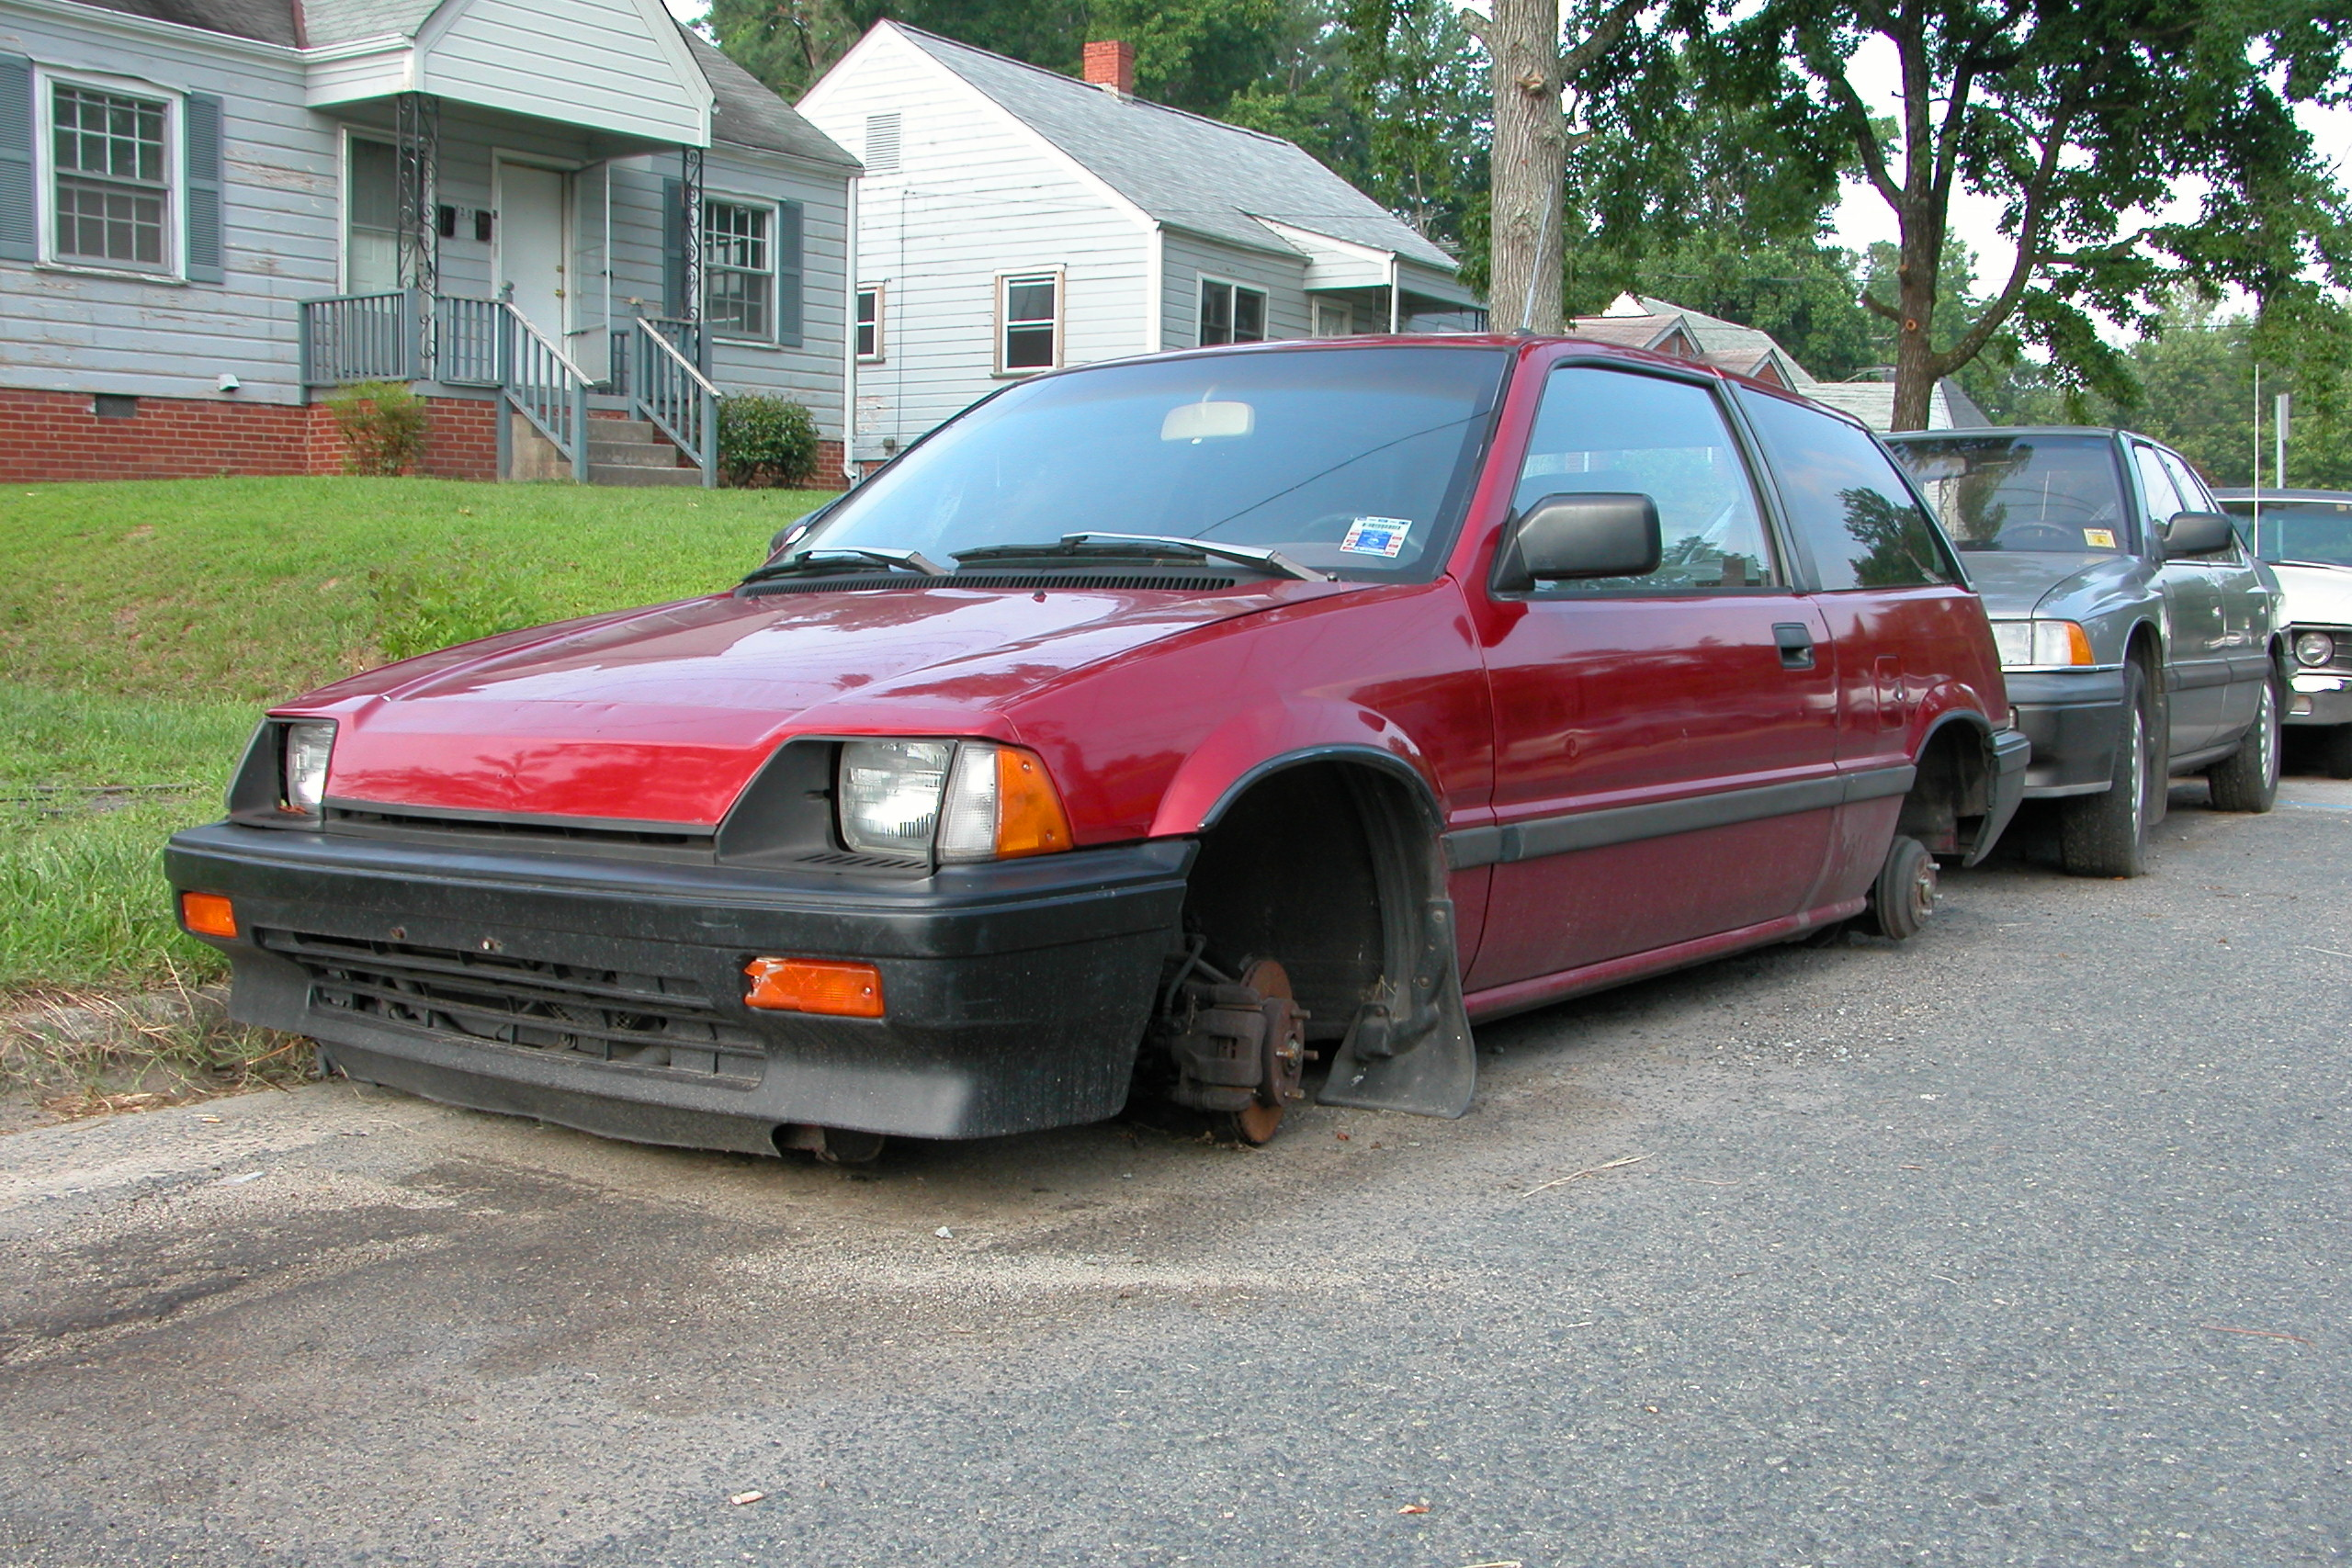
Constraints may not always hold
“Every car should have a wheel”
Yes
No
Sometimes constraints don’t always hold
Allow the model to consider structures that violate constraints

Slide 65
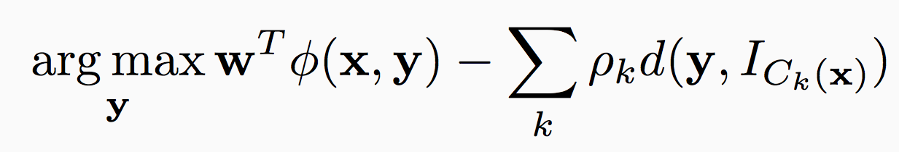
Constrained Conditional Model
General case: with soft constraints
The model score for the structure
Sometimes constraints don’t always hold
Allow the model to consider structures that violate constraints

Slide 66
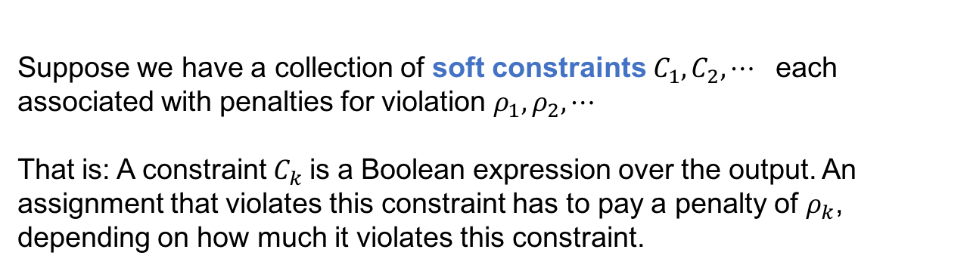
Constrained Conditional Model
General case: with soft constraints
The model score for the structure
Suppose we have a collection of soft constraints $C_{1}, C_{2}, ⋯$ each associated with penalties for violation $ρ_{1}, ρ_{2},⋯$
That is: A constraint $C_{k}$is a Boolean expression over the output. An assignment that violates this constraint has to pay a penalty of $ρ_{k}$, depending on how much it violates this constraint.
Sometimes constraints don’t always hold
Allow the model to consider structures that violate constraints

Slide 67
Constrained Conditional Model
General case: with soft constraints
The model score for the structure
Suppose we have a collection of soft constraints $C_{1}, C_{2}, ⋯$ each associated with penalties for violation $ρ_{1}, ρ_{2},⋯$
That is: A constraint $C_{k}$is a Boolean expression over the output. An assignment that violates this constraint has to pay a penalty of $ρ_{k}$, depending on how much it violates this constraint.
Sometimes constraints don’t always hold
Allow the model to consider structures that violate constraints

Slide 68
Constrained Conditional Model
General case: with soft constraints
The model score for the structure
Penalty for violating the constraint
If the constraint is hard, penalty = 1.
Sometimes constraints don’t always hold
Allow the model to consider structures that violate constraints

Slide 69
Constrained Conditional Model
General case: with soft constraints
The model score for the structure
How far is the structure y from satisfying the constraint C_{k}
The most simple case:
0: If satisfied
1: If not
Penalty for violating the constraint
If the constraint is hard, penalty = 1.
Sometimes constraints don’t always hold
Allow the model to consider structures that violate constraints

Slide 70
Constrained conditional models: review
Write down conditions that the output need to satisfy
Constraints are effectively factors in a factor graph whose potential functions are fixed
Different learning regimes
Train with the constraints or without
Remember: constraint penalties are fixed in either case
Prediction
Can write the inference formulation as an integer linear program
Can solve it with an off-the-shelf solver (or not!)
Extension
Soft constraints: Constraints that don’t always need to hold

Slide 71
Outline
Modeling problems as structured prediction problems
Hard and soft constraints to represent prior knowledge
Augmenting Probabilistic Models with declarative constraints.
Inference Algorithms

Slide 72
MAP inference is discrete optimization
A combinatorial problem
Computational complexity depends on
The size of the input
The factorization of the scores
More complex factors generally lead to expensive inference
A generally bad strategy in most but the simplest cases: “Enumerate all possible structures and pick the highest scoring one”
,….
-10
54.1

Slide 73
MAP inference is search
We want a collection of decisions that has highest score
argmax_{y} w^{T}Á(x,y)
No algorithm can find the max without considering every possible structure
Why?
How can we solve this computational problem?
Exploit the structure of the search space and the cost function
That is, exploit decomposition of the scoring function

Slide 74
Approaches for inference
Should the maximization be performed exactly?
Or is a close-to-highest-scoring structure good enough?
Exact: Search, dynamic programming, integer linear programming
Heuristic (called approximate inference): Gibbs sampling, belief propagation, beam search
Relaxations: linear programming relaxations, Lagrangian delaxation, dual decomposition, AD3

