Slide 1
Part 6: Developing ILP based applications
Roth & Srikumar: ILP formulations in Natural Language Processing

Slide 2
Outline
How to encode Boolean statements as linear inequalities
Illinois Structured Learning Library
A general purpose learning library in JAVA
Supports Structured Perceptron and Structured SVM

Slide 3
Outline
How to encode Boolean statements as linear inequalities
Illinois Structured Learning Library
A general purpose learning library in JAVA
Supports Structured Perceptron and Structured SVM

Slide 4
ILP constraints are Boolean expressions
One-to-one mapping between the two formalisms
Recipe for formulating ILP inference
Identify the decision variables
Write constraints in Boolean algebra
Convert Boolean algebra statements to linear inequalities
Allows constraints to be stated concisely as Boolean formulas

Slide 5
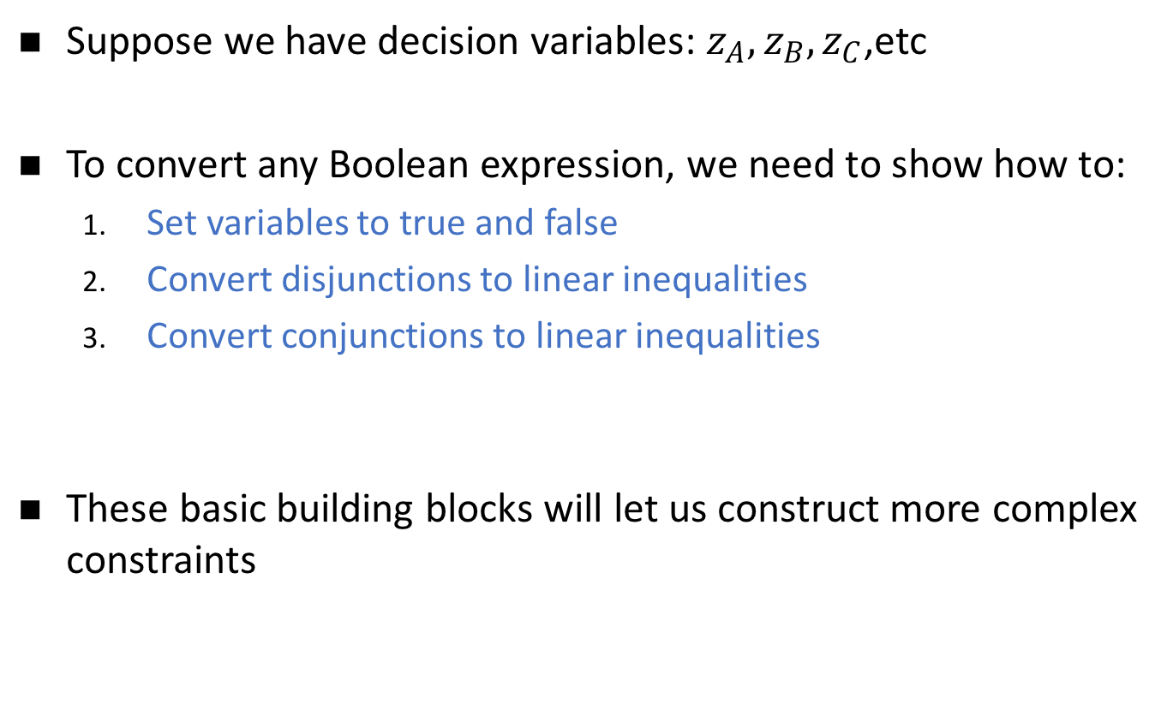
Writing constraints as linear inequalities: The setup
Suppose we have decision variables: $z_{A}, z_{B},z_{C}$,etc
To convert any Boolean expression, we need to show how to:
Set variables to true and false
Convert disjunctions to linear inequalities
Convert conjunctions to linear inequalities
These basic building blocks will let us construct more complex constraints

Slide 6
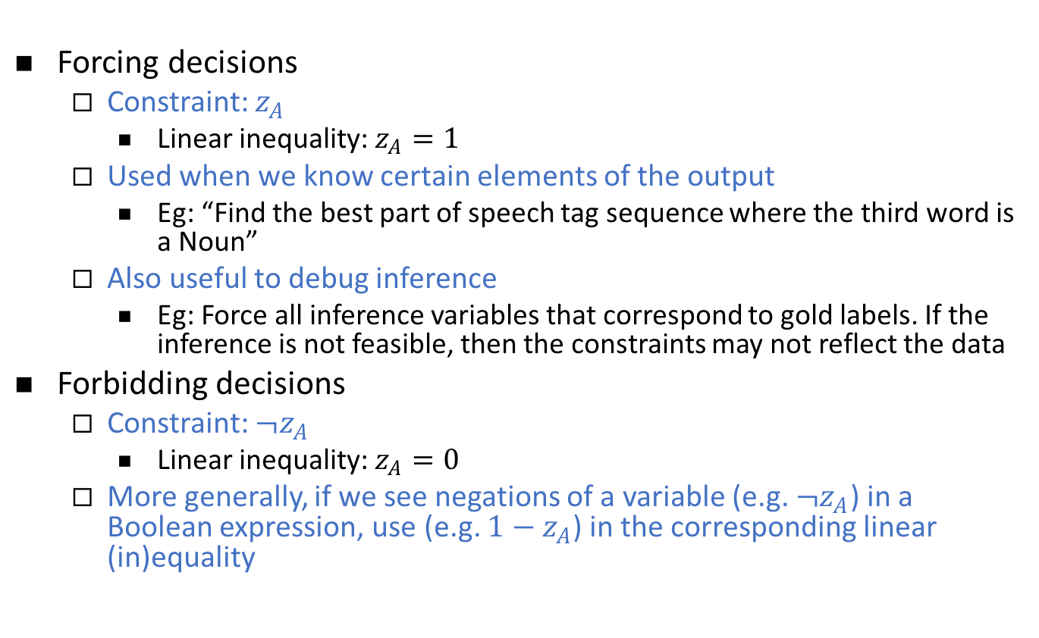
Basic building blocks 1: Variables & Negations
Forcing decisions
Constraint: $z_{A}$
Linear inequality: $z_{A}=1$
Used when we know certain elements of the output
Eg: “Find the best part of speech tag sequence where the third word is a Noun”
Also useful to debug inference
Eg: Force all inference variables that correspond to gold labels. If the inference is not feasible, then the constraints may not reflect the data
Forbidding decisions
Constraint: ${¬z}_{A}$
Linear inequality: $z_{A}=0$
More generally, if we see negations of a variable (e.g. ${¬z}_{A}$) in a Boolean expression, use (e.g. ${1−z}_{A}$) in the corresponding linear (in)equality

Slide 7
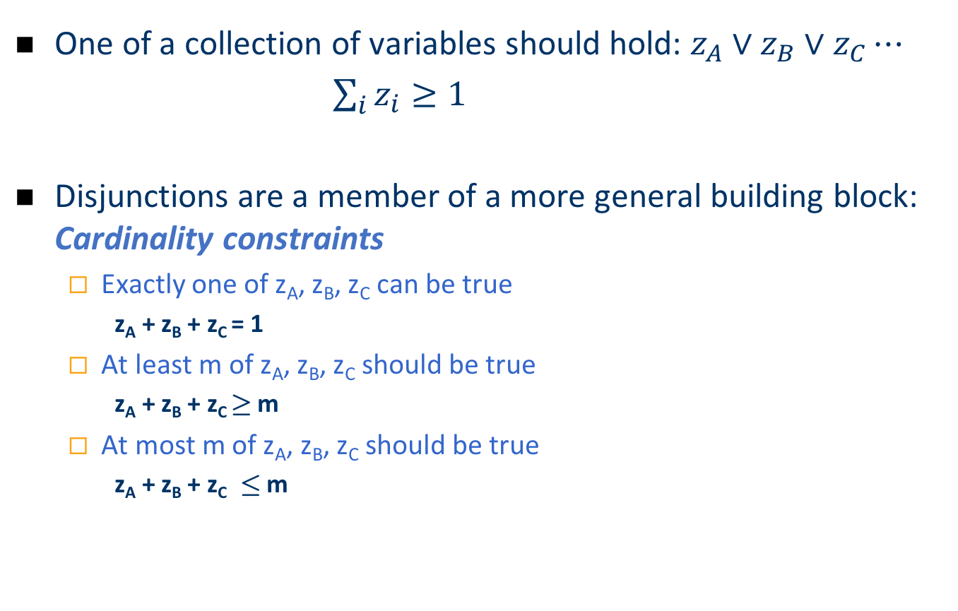
Basic Building Blocks 2: Disjunctions
One of a collection of variables should hold: $z_{A}∨z_{B}∨z_{C}⋯$
$\sum_{i}{z_{i}}≥1$
Disjunctions are a member of a more general building block: Cardinality constraints
Exactly one of z_{A}, z_{B}, z_{C} can be true
z_{A} + z_{B} + z_{C} = 1
At least m of z_{A}, z_{B}, z_{C} should be true
z_{A} + z_{B} + z_{C} ¸ m
At most m of z_{A}, z_{B}, z_{C} should be true
z_{A} + z_{B} + z_{C} · m

Slide 8
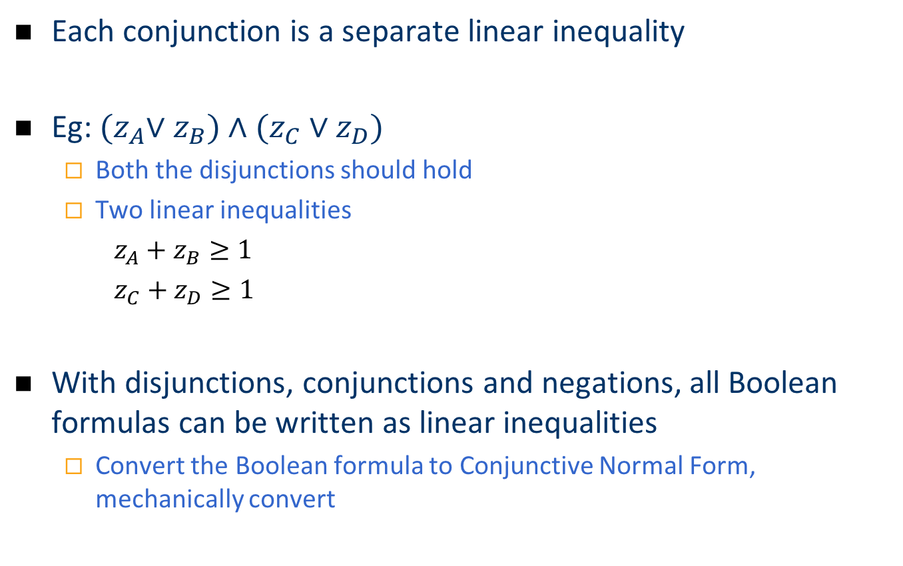
Basic Building Blocks 2: Conjunctions
Each conjunction is a separate linear inequality
Eg: ${(z}_{A}∨z_{B})∧(z_{C}∨z_{D})$
Both the disjunctions should hold
Two linear inequalities
$z_{A}+z_{B}≥1$
$z_{C}+z_{D}≥1$
With disjunctions, conjunctions and negations, all Boolean formulas can be written as linear inequalities
Convert the Boolean formula to Conjunctive Normal Form, mechanically convert

Slide 9
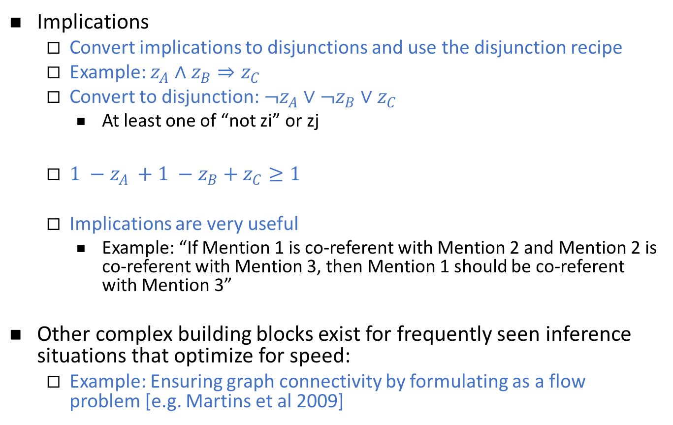
More complex building blocks
Implications
Convert implications to disjunctions and use the disjunction recipe
Example: $z_{A}∧z_{B}⇒z_{C}$
Convert to disjunction: $¬z_{A}∨¬z_{B}∨z_{C}$
At least one of “not zi” or zj
$1 −z_{A }+1 −z_{B}+z_{C}≥1$
Implications are very useful
Example: “If Mention 1 is co-referent with Mention 2 and Mention 2 is co-referent with Mention 3, then Mention 1 should be co-referent with Mention 3”
Other complex building blocks exist for frequently seen inference situations that optimize for speed:
Example: Ensuring graph connectivity by formulating as a flow problem [e.g. Martins et al 2009]

Slide 10
Outline
How to encode Boolean statements as linear inequalities
Illinois Structured Learning Library
A general purpose learning library in JAVA
Supports Structured Perceptron and Structured SVM

Slide 11
Illinois Structured Learning Library
[Chang et al 2015]
A general purpose learning library in JAVA
Learning Algorithms:
Structured Perceptron
Structured SVM
Support multi-core learning
Can be downloaded at
https://github.com/CogComp/illinois-sl
Other libraries to consider: PyStruct, Vowpal Wabbit, SVMStruct, StructEd, Factorie

Slide 12
Built-in applications
Task | Input | Structure | Inference | Features
POS Tagging | sentence | Tag sequence | Viterbi algorithm | Emission and transition features
Dependency Parsing | sentence | Dependency tree | Chu-Liu-Edmonds algorithm | Tree edge features
Cost-sensitive multiclass classification | document | Document category | Simple enumeration | Document features

Slide 13
Performance
On standard NLP tasks

Slide 14
LBJava
[Rizzolo 2012,…]
A compiler that converts constraints in first order logic to linear inequalities
Allows developers to think in first order logic instead of

Slide 15
Illinois SL details

Slide 16
For your own application
You need to implement the following classes/functions
Class/Functions | Explanation | Example
IInstance | Input | Sentence
Istructure | Output | POS tags
getFeatureVector | Feature generator | Emission/Transition Features
InferenceSolver | Inference | Viterbi
getLoss | Loss function | Hamming Loss

Slide 17
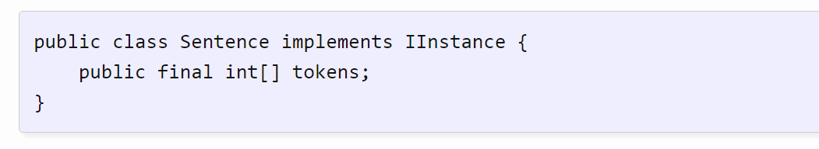
Example: IInstance for POS tagging

Slide 18
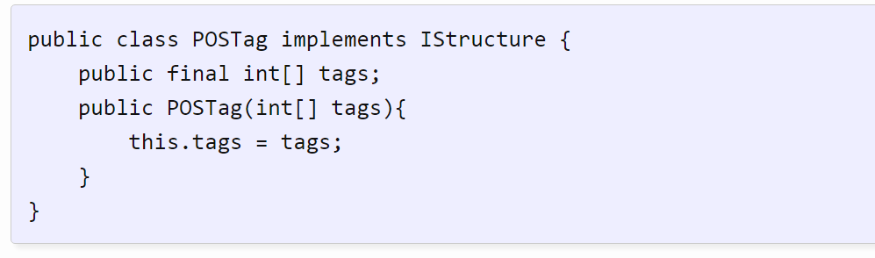
Example: IStructure for POS tagging

Slide 19
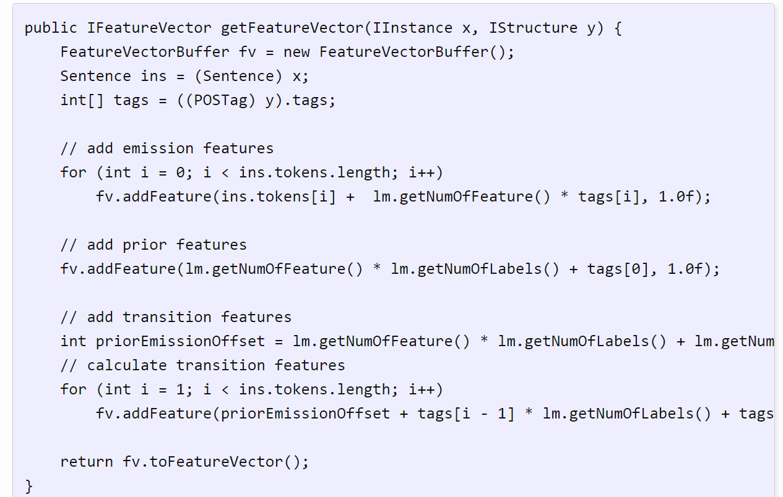
Example: Feature Generator
Add emission features to fv
Add transition features to fv

Slide 20
Example: Feature Generator

