Slide 1
Chapter 14
Exception Handling and Event Handling

Slide 2
Chapter 14 Topics
Introduction to Exception Handling
Exception Handling in C++
Exception Handling in Java
Exception Handling in Python and Ruby
Introduction to Event Handling
Event Handling with Java
Event Handling in C#
Copyright © 2017 Pearson Education, Ltd. All rights reserved.
1-<number>

Slide 3
Introduction to Exception Handling
In a language without exception handling
  When an exception occurs, control goes to the operating system, where a message is displayed and the program is terminated
In a language with exception handling
  Programs are allowed to trap some exceptions, thereby providing the possibility of fixing the problem and continuing
Copyright © 2017 Pearson Education, Ltd. All rights reserved.
1-<number>

Slide 4
Basic Concepts
Many languages allow programs to trap input/output errors (including EOF)
An exception is any unusual event, either erroneous or not, detectable by either hardware or software, that may require special processing
The special processing that may be required after detection of an exception is called exception handling
The exception handling code unit is called an exception handler
Copyright © 2017 Pearson Education, Ltd. All rights reserved.
1-<number>

Slide 5
Exception Handling Alternatives
An exception is raised when its associated event occurs
A language that does not have exception handling capabilities can still define, detect, raise, and handle exceptions (user defined, software detected)
Alternatives:
  Send an auxiliary parameter or use the return value to indicate the return status of a subprogram
  Pass a label parameter to all subprograms (error return is to the passed label)
  Pass an exception handling subprogram to all subprograms
Copyright © 2017 Pearson Education, Ltd. All rights reserved.
1-<number>

Slide 6
Advantages of Built-in Exception Handling
Error detection code is tedious to write and it clutters the program
Exception handling encourages programmers to consider many different possible errors
Exception propagation allows a high level of reuse of exception handling code
Copyright © 2017 Pearson Education, Ltd. All rights reserved.
1-<number>

Slide 7
Design Issues
How and where are exception handlers specified and what is their scope?
How is an exception occurrence bound to an exception handler?
Can information about the exception be passed to the handler?
Where does execution continue, if at all, after an exception handler completes its execution? (continuation vs. resumption)
Is some form of finalization provided?
Copyright © 2017 Pearson Education, Ltd. All rights reserved.
1-<number>

Slide 8
Design Issues (continued)
How are user-defined exceptions specified?
Should there be default exception handlers for programs that do not provide their own?
Can predefined exceptions be explicitly raised?
Are hardware-detectable errors treated as exceptions that can be handled?
Are there any predefined exceptions?
How can exceptions be disabled, if at all?
Copyright © 2017 Pearson Education, Ltd. All rights reserved.
1-<number>

Slide 9
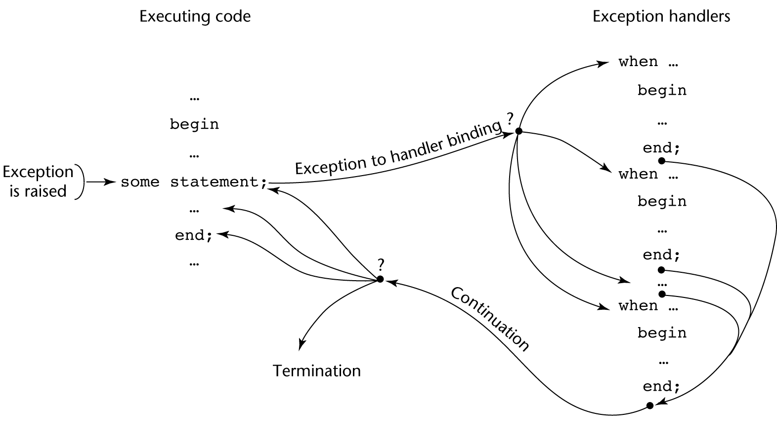
Exception Handling Control Flow
Copyright © 2017 Pearson Education, Ltd. All rights reserved.
1-<number>

Slide 10
Exception Handling in C++
Added to C++ in 1990
Design is based on that of CLU, Ada, and ML
Copyright © 2017 Pearson Education, Ltd. All rights reserved.
1-<number>

Slide 11
C++ Exception Handlers
Exception Handlers Form:
try {
-- code that is expected to raise an exception
}
catch (formal parameter) {
-- handler code
}
...
catch (formal parameter) {
-- handler code
}
Copyright © 2017 Pearson Education, Ltd. All rights reserved.
1-<number>

Slide 12
The catch Function
catch is the name of all handlers--it is an overloaded name, so the formal parameter of each must be unique
The formal parameter need not have a variable
  It can be simply a type name to distinguish the handler it is in from others
The formal parameter can be used to transfer information to the handler
The formal parameter can be an ellipsis, in which case it handles all exceptions not yet handled
Copyright © 2017 Pearson Education, Ltd. All rights reserved.
1-<number>

Slide 13
Throwing Exceptions
Exceptions are all raised explicitly by the statement:
throw [expression];
The brackets are metasymbols
A throw without an operand can only appear in a handler; when it appears, it simply re-raises the exception, which is then handled elsewhere
The type of the expression disambiguates the intended handler
Copyright © 2017 Pearson Education, Ltd. All rights reserved.
1-<number>

Slide 14
Unhandled Exceptions
An unhandled exception is propagated to the caller of the function in which it is raised
This propagation continues to the main function
If no handler is found, the default handler is called
Copyright © 2017 Pearson Education, Ltd. All rights reserved.
1-<number>

Slide 15
Continuation
After a handler completes its execution, control flows to the first statement after the last handler in the sequence of handlers of which it is an element
Other design choices
  All exceptions are user-defined
  Exceptions are neither specified nor declared
  The default handler, unexpected, simply terminates the program; unexpected can be redefined by the user
  Functions can list the exceptions they may raise
  Without a specification, a function can raise any exception (the throw clause)
Copyright © 2017 Pearson Education, Ltd. All rights reserved.
1-<number>

Slide 16
Evaluation
There are no predefined exceptions
It is odd that exceptions are not named and that hardware- and system software-detectable exceptions cannot be handled
Binding exceptions to handlers through the type of the parameter certainly does not promote readability
Copyright © 2017 Pearson Education, Ltd. All rights reserved.
1-<number>

Slide 17
Exception Handling in Java
Based on that of C++, but more in line with OOP philosophy
All exceptions are objects of classes that are descendants of the Throwable class
Copyright © 2017 Pearson Education, Ltd. All rights reserved.
1-<number>

Slide 18
Classes of Exceptions
The Java library includes two subclasses of Throwable :
  Error
    Thrown by the Java interpreter for events such as heap overflow
    Never handled by user programs
  Exception
    User-defined exceptions are usually subclasses of this
    Has two predefined subclasses, IOException and RuntimeException (e.g., ArrayIndexOutOfBoundsException and NullPointerException
Copyright © 2017 Pearson Education, Ltd. All rights reserved.
1-<number>

Slide 19
Java Exception Handlers
Like those of C++, except every catch requires a named parameter and all parameters must be descendants of Throwable
Syntax of try clause is exactly that of C++
Exceptions are thrown with throw, as in C++, but often the throw includes the new operator to create the object, as in: throw new MyException();
Copyright © 2017 Pearson Education, Ltd. All rights reserved.
1-<number>

Slide 20
Binding Exceptions to Handlers
Binding an exception to a handler is simpler in Java than it is in C++
  An exception is bound to the first handler with a parameter is the same class as the thrown object or an ancestor of it
An exception can be handled and rethrown by including a throw in the handler (a handler could also throw a different exception)
Copyright © 2017 Pearson Education, Ltd. All rights reserved.
1-<number>

Slide 21
Continuation
If no handler is found in the try construct, the search is continued in the nearest enclosing try construct, etc.
If no handler is found in the method, the exception is propagated to the method’s caller
If no handler is found (all the way to main), the program is terminated
To insure that all exceptions are caught, a handler can be included in any try construct that catches all exceptions
  Simply use an Exception class parameter
  Of course, it must be the last in the try construct
Copyright © 2017 Pearson Education, Ltd. All rights reserved.
1-<number>

Slide 22
Checked and Unchecked Exceptions
The Java throws clause is quite different from the throw clause of C++
Exceptions of class Error and RunTimeException and all of their descendants are called unchecked exceptions; all other exceptions are called checked exceptions
Checked exceptions that may be thrown by a method must be either:
  Listed in the throws clause, or
  Handled in the method
Copyright © 2017 Pearson Education, Ltd. All rights reserved.
1-<number>

Slide 23
Other Design Choices
A method cannot declare more exceptions in its throws clause than the method it overrides
A method that calls a method that lists a particular checked exception in its throws clause has three alternatives for dealing with that exception:
  Catch and handle the exception
  Catch the exception and throw an exception that is listed in its own throws clause
  Declare it in its throws clause and do not handle it
Copyright © 2017 Pearson Education, Ltd. All rights reserved.
1-<number>

Slide 24
The finally Clause
Can appear at the end of a try construct
Form:
  finally {
  ...
  }
Purpose: To specify code that is to be executed, regardless of what happens in the try construct
Copyright © 2017 Pearson Education, Ltd. All rights reserved.
1-<number>

Slide 25
Example
A try construct with a finally clause can be used outside exception handling
try {
for (index = 0; index < 100; index++) {
…
if (…) {
return;
} //** end of if
} //** end of try clause
finally {
…
} //** end of try construct
Copyright © 2017 Pearson Education, Ltd. All rights reserved.
1-<number>

Slide 26
Assertions
Statements in the program declaring a boolean expression regarding the current state of the computation
When evaluated to true nothing happens
When evaluated to false an AssertionError exception is thrown
Can be disabled during runtime without program modification or recompilation
Two forms
  assert condition;
  assert condition: expression;
Copyright © 2017 Pearson Education, Ltd. All rights reserved.
1-<number>

Slide 27
Evaluation
The types of exceptions makes more sense than in the case of C++
The throws clause is better than that of C++ (The throw clause in C++ says little to the programmer)
The finally clause is often useful
The Java interpreter throws a variety of exceptions that can be handled by user programs
Copyright © 2017 Pearson Education, Ltd. All rights reserved.
1-<number>

Slide 28
Exception Handling in Python
Exceptions are objects; the base class is BaseException
All predefined and user-defined exceptions are derived from Exception
Predefined subclasses of Exception are ArithmeticError (subclasses are OverflowError, ZeroDivisionError, and FloatingPointError) and LookupError (subclasses are IndexError and KeyError)
Copyright © 2017 Pearson Education, Ltd. All rights reserved.
1-<number>

Slide 29
Exception Handling in Python (continued)
try:
- The try block
except Exception1:
- Handler for Exception1
except Exception2:
- Handler for Exception2
...
else:
- The else block (no exception is raised)
finally:
- the finally block (do it no matter what)
Copyright © 2017 Pearson Education, Ltd. All rights reserved.
1-<number>

Slide 30
Exception Handling in Python (continued)
Handlers handle the named exception plus all subclasses of that exception, so if the named exception is Exception, it handlers all predefined and user-defined exceptions
Unhandled exceptions are propagated to the nearest enclosing try block; if no handler is found, the default handler is called
Raise IndexError creates an instance
The raised exception object can be gotten:
except Exception as ex_obj:
Copyright © 2017 Pearson Education, Ltd. All rights reserved.
1-<number>

Slide 31
Exception Handling in Python (continued)
The assert statement tests its Boolean expression (first parameter) and sends its second parameter to the constructor for the exception object to be raised
assert test, data
Copyright © 2017 Pearson Education, Ltd. All rights reserved.
1-<number>

Slide 32
Exception Handling in Ruby
Exceptions are objects
There are many predefined exceptions
All exceptions that are user handled are either StandardError class or a subclass of it
StandardError is derived from Exception, which has two methods, message and backtrace
Exceptions can be raised with raise, which often has the form:
raise ″bad parameter″ if count == 0
Copyright © 2017 Pearson Education, Ltd. All rights reserved.
1-<number>

Slide 33
Exception Handling in Ruby (continued)
Handlers are placed at the end of a begin-end block of code; introduced by rescue
begin
- Statements in the block
rescue
- Handler
end
The block could include else and/or ensure clauses, which are like else and finally in Java
Copyright © 2017 Pearson Education, Ltd. All rights reserved.
1-<number>

Slide 34
Exception Handling in Ruby (continued)
Unlike the other languages we have discussed, in Ruby the code that raised an exception can be rerun by placing a retry statement at the end of the handler
Copyright © 2017 Pearson Education, Ltd. All rights reserved.
1-<number>

Slide 35
Introduction to Event Handling
An event is a notification that something specific has occurred, such as a mouse click on a graphical button
The event handler is a segment of code that is executed in response to an event
Copyright © 2017 Pearson Education, Ltd. All rights reserved.
1-<number>

Slide 36
Java Swing GUI Components
Text box is an object of class JTextField
Radio button is an object of class JRadioButton
Applet’s display is a frame, a multilayered structure
Content pane is one layer, where applets put output
GUI components can be placed in a frame
Layout manager objects are used to control the placement of components
Copyright © 2017 Pearson Education, Ltd. All rights reserved.
1-<number>

Slide 37
The Java Event Model
User interactions with GUI components create events that can be caught by event handlers, called event listeners
An event generator tells a listener of an event by sending a message
An interface is used to make event-handling methods conform to a standard protocol
A class that implements a listener must implement an interface for the listener
Copyright © 2017 Pearson Education, Ltd. All rights reserved.
1-<number>

Slide 38
The Java Event Model (continued)
One class of events is ItemEvent, which is associated with the event of clicking a checkbox, a radio button, or a list item
The ItemListener interface prescribes a method, itemStateChanged, which is a handler for ItemEvent events
The listener is created with addItemListener
Copyright © 2017 Pearson Education, Ltd. All rights reserved.
1-<number>

Slide 39
Event Handling in C#
Event handling in C# (and the other .NET languages) is similar to that in Java
.NET has two approaches, Windows Forms and Windows Presentation Foundation—we cover only the former (which is the original approach)
An application subclasses the Form predefined class (defined in System.Windows.Forms)
There is no need to create a frame or panel in which to place the GUI components
Label objects are used to place text in the window
Radio buttons are objects of the RadioButton class
Copyright © 2017 Pearson Education, Ltd. All rights reserved.
1-<number>

Slide 40
Event Handling in C# (continued)
Components are positioned by assigning a new Point object to the Location property of the component
private RadioButton plain = new RadioButton();
plain.Location = new Point(100, 300);
plain.Text = ″Plain″;
controls.Add(plain);
All C# event handlers have the same protocol, the return type is void and the two parameters are of types object and EventArgs
Copyright © 2017 Pearson Education, Ltd. All rights reserved.
1-<number>

Slide 41
Event Handling in C# (continued)
An event handler can have any name
A radio button is tested with the Boolean Checked property of the button
private void rb_CheckedChanged (object o,
EventArgs e) {
if (plain.Checked) …
...
}
To register an event, a new EventHandler object must be created and added to the predefined delegate for the event
Copyright © 2017 Pearson Education, Ltd. All rights reserved.
1-<number>

Slide 42
Event Handling in C# (continued)
When a radio button changes from unchecked to checked, the CheckedChanged event is raised
The associated delegate is referenced by the name of the event
If the handler was named rb_CheckedChanged, we could register it on the radio button named plain with:
plain.CheckedChanged +=
new EventHandler (rb_CheckedChanged);
Copyright © 2017 Pearson Education, Ltd. All rights reserved.
1-<number>

Slide 43
Summary
Ada provides extensive exception-handling facilities with a comprehensive set of built-in exceptions.
C++ includes no predefined exceptions
Exceptions are bound to handlers by connecting the type of expression in the throw statement to that of the formal parameter of the catch function
Java exceptions are similar to C++ exceptions except that a Java exception must be a descendant of the Throwable class. Additionally Java includes a finally clause
An event is a notification that something has occurred that requires handling by an event handler
Java event handling is defined on the Swing components
C# event handling is the .NET model, which is similar to the Java model
Copyright © 2017 Pearson Education, Ltd. All rights reserved.
1-<number>

