Slide 1
Intimate Partner Violence
A pattern of coercive behavior intended to establish and maintain power and control
Abuser may be a current or former spouse, family member, intimate partner, or person with whom the perpetrator shares a child in common
Composed of many tactics of abuse
Not just physical or sexual violence:
  Emotional/psychological
  Threats to family/friends
  Threats to property
  Economic coercion

Slide 2
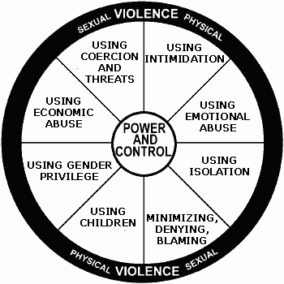
The Power & Control Wheel
Domestic Abuse Intervention Project - Duluth, Minnesota
2
Notes:
Refer to Ellen Pence,
Any of these tactics can have a workplace related outcome.
For example, economic abuse might be your member doesn’t have bus work to come to work because the abusive partner takes their paycheck
Using the children can mean the member fears leaving the children alone with the abusive partner so she misses work to stay home with them;
Physical violence, which is along the rim – which can be directed toward the partner, pets or values possessions, can result in injuries that requires missed days at work or use of vacations.

Slide 3
Workplace Impact
Happens at the workplace
  Appearance in the workplace/stalking
  Threat, harassing or violent incident
  Using work resources to perpetrate
Happens somewhere else but affects workplace
  Missing work
  Needing time off
  Performance issues – victim, perpetrator, co-workers
  Physical/mental health issues
  Trauma from previous incident

Slide 4
Workplace Impact/Costs: Survivors
Of 79% of stalking victims who had a job, one in eight lost time from work. More than half the victims surveyed lost five or more days from work.
(Baum, Bureau of Justice Statistics, 2009)
36% of rape/sexual assault victims lost more than 10 days of work after their victimization.
(Bureau of Justice Statistics, 2001)
Victims of intimate partner violence lose 8 million days of work each year.
  The equivalent of 32,000 full-time jobs
  Over 5.5 million days of household productivity
  (Centers for Disease Control and Prevention (2003).Costs of Intimate Partner Violence Against Women in the United States).

Slide 5
Workplace Impact/Costs: Perpetrators
Performance:
  80% of perpetrators said their own job performance was negatively affected by their perpetration of domestic violence.
  19% caused or almost caused an accident at work.
  In many cases supervisors were aware of the perpetrator’s behavior but failed to confront/admonish the employee about it.
  (Schmidt & Barnett, 2012)
  Missed Work:
    Between 42% and 51.8% of perpetrators of domestic violence were either late or missed work entirely because of their abusive behavior.
  Use of Company Resources:
  More than three-quarters of perpetrators used workplace resources at least once to express remorse or anger, check up on, pressure, or threaten the victim.
    (Lim, et al, 2004)

Slide 6
Workplace Impact/Costs: Employers
Lost Productivity: The annual cost of lost productivity due to domestic violence is $727.8 million (in 1995 dollars).
(CDC, 2003)
Medical costs: The costs of direct medical and mental health care services related to intimate partner violence total nearly $4.1 billion a year.
  (CDC, 2003)
Security Concerns: 94% of corporate security and safety directors at companies nationwide rank domestic violence as a high security concern.
(CAEPV, 2008)

Slide 7
Member-Survivor Concerns
Safety
Job retention
Employer assistance
Time off or other changes
Confidentiality
Reputation/appearance
Financial security

Slide 8
Union Concerns
The target may be a member
Perpetrator may be a member
Effect on co-workers
Safety of all
Job discipline
Job discharge
Workplace violence
Duty of Fair Representation (DFR) obligations

Slide 9
Co-Workers Concerns
Safety and trauma
Feeling obligated to assist target
Working effectively
Resentment
Might want to help but not meddle in someone else’s personal business

Slide 10
Comprehensive Workplace Response
Create a supportive workplace culture
Establish a multidisciplinary team
Raise awareness
Assess existing policies/guidelines and CBA agreements
Conduct training
Develop relationships with local service providers and law enforcement

