Slide 1
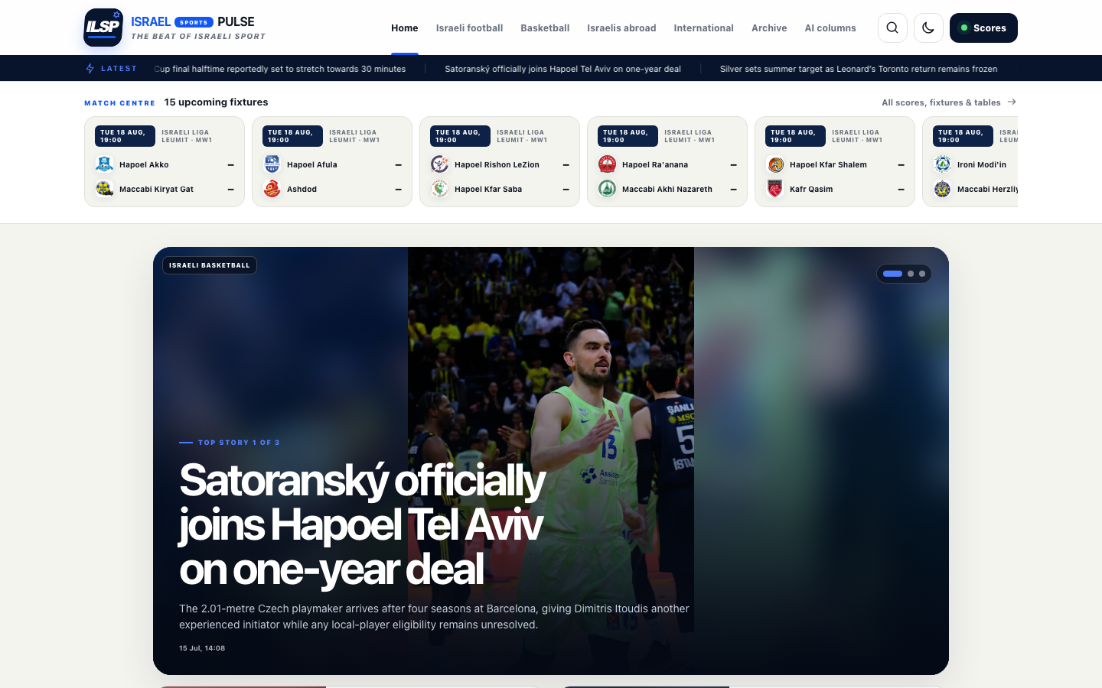
FOUNDING PARTNER BRIEF
THE DAILY HOME
FOR ISRAELI SPORT
English reporting. Scores. History. Community.
A professional English-language newsroom and daily sports habit—built in Israel for supporters everywhere.
12-MONTH LAUNCH · JULY 2026

Slide 2
THE OPPORTUNITY
Israeli sport is global. Its English daily layer is not.
The gap is not another translation feed. It is a trusted product that connects reporting, scores, history and community.
01
02
03
04
Daily relevance
Diaspora access
Utility + journalism
Partner-safe context
Football, basketball and Olympic sport move throughout the day—not once per news cycle.
Supporters outside Israel need accurate names, context and terminology in natural English.
Scores, tables and line-ups create habit; verified reporting creates trust.
A governed sports environment with measurable inventory and no editorial pay-to-play.
ILSP proposition
Fast enough for the match. Serious enough for the story.
ILSP partner brief · 17 July 2026
02

Slide 3
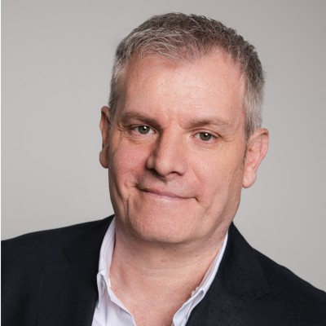
THE FOUNDER STORY
Distance from Israel turned a gap into a mission.
Patrick Vanden Broek is building the English sports home he searched for as an Israeli growing up in Belgium.
01
02
03
04
Tel Aviv, 1973
Belgium, 1982
The gap grew
Now: build it
Born to an Israeli mother and Belgian father, Patrick’s connection to Israel began as family, identity and home.
Moving countries changed the distance, not the bond. Culture, food, mentality and sport kept Israel close.
Barda, Itzhaki, Refaelov and other Israelis in Belgian football created interest without enough English context.
A decade-old idea becomes a daily newsroom and community for Israelis, Jews and every curious supporter.
Founder commitment
Passion starts it. Funding gives the newsroom people and time to last.
ILSP founder story · 17 July 2026
03

Slide 4
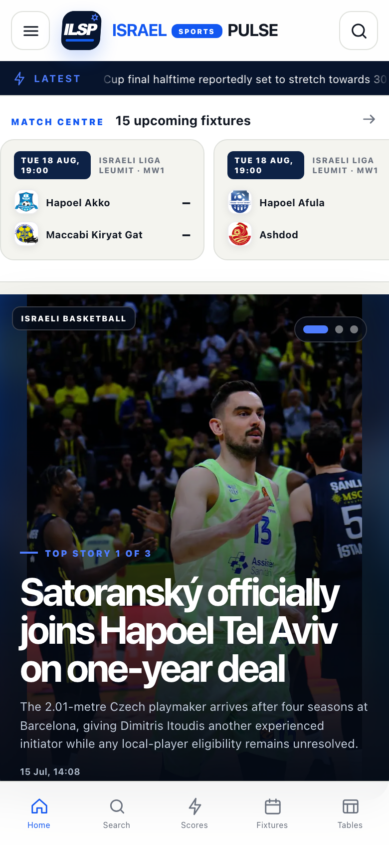
PRODUCT EVIDENCE
The product exists today—not as a pitch-deck promise.
A responsive local publication already combines dynamic headlines, fixtures, exact imagery and long-form reporting.
30
MIN
source cycle
8
candidates
last cycle
77 audit-clean published reports
Source: ILSP local ingestion and content audit, 17 July 2026
04

Slide 5
NEWSROOM ENGINE
Volume is discovered. Trust is earned at the gate.
ONE and Sport5 lead source discovery by configured volume; every report still needs independent, claim-specific verification.
01
02
03
04
05
06
Discover
Verify
Report
Unify
Publish
Audit
→
→
→
→
→
All enabled sources
every 30 minutes
Names, results, contracts
and material claims
Original idiomatic English
—not close translation
URL, event-key and
semantic deduplication
Professional word, fact
and paragraph gate
Homepage rank, image match,
freshness and corrections
3
3
Latest discovery mix
2
8 candidates discovered. Zero auto-published: the review gate held when final verification was unavailable.
0
0
ONE
Sport5
Walla
Ynet
Sport1
Source: ILSP local ingestion report, 17 July 2026
05

Slide 6
TRUST DESIGN
Four controls separate ILSP from a content farm.
The commercial model depends on a publication that supporters, rights holders and partners can safely share.
VERIFIED
Claim-specific research
ORIGINAL
Professional English reporting
Material identities, scores, contracts and competition facts are checked against current authoritative records.
Substantial stories use natural sports terminology and clearly distinguish confirmed fact from uncertainty.
EXACT
Rights-cleared action imagery
ACCOUNTABLE
Corrections and audit trail
No unrelated historical substitute; every public image must match the stated athlete, team, venue or event.
Homepage promotions, timestamps, duplicates and public-facing professionalism are reviewed every cycle.
Commercial support never buys coverage, rankings, facts or corrections.
ILSP partner brief · 17 July 2026
06

Slide 7
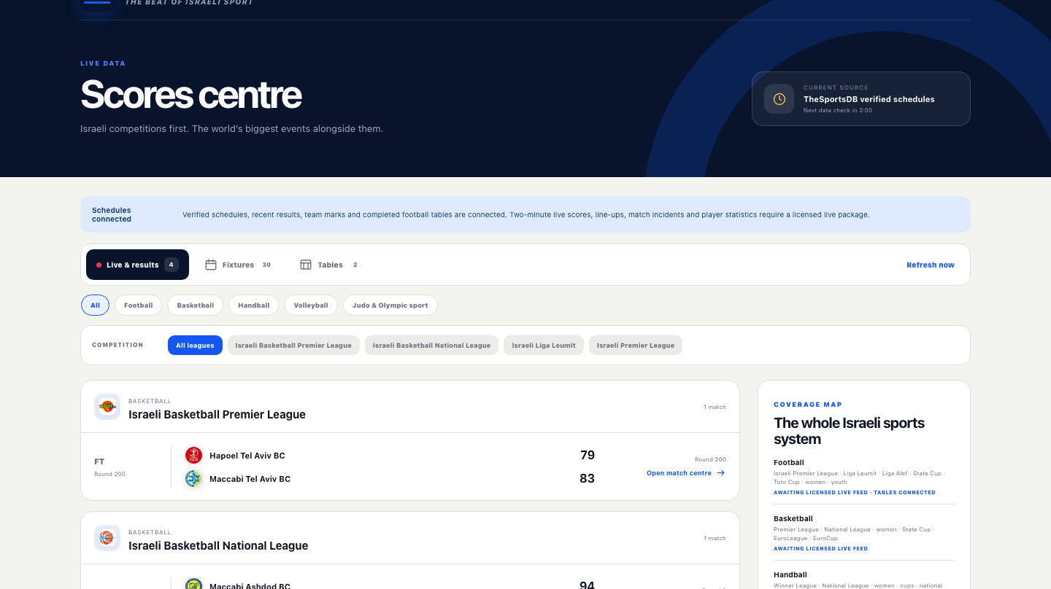
PRODUCT ROADMAP
Scores turn reporting into a daily habit.
Schedules, results, team marks and completed tables are connected. Licensed live events and deeper statistics are the funded next step—and the largest data dependency.
CONNECTED NOW
Fixtures · recent results · league tables · team marks · competition filters
FUNDED NEXT
Two-minute live scores
Starting line-ups
Goalscorers + incidents
Player and match statistics
Broad Israeli multi-sport depth
Current product: local preview · Live-feed coverage subject to provider validation and licence
07

Slide 8
AUDIENCE SYSTEM
One newsroom. Five reasons to return every day.
The website is the source of truth; each channel turns verified reporting into a repeatable supporter habit.
Website
Social
→
→
Breaking news + depth
Fast verified distribution
Newsletter
Alerts + apps
→
→
Morning and evening Pulse
Match and story return
DAILY ARCHIVE + QUIZ
ILSP partner brief · 17 July 2026
08

Slide 9
PARTNER VALUE
What does the partner actually gain?
A partner receives a defined audience product, measurable outcomes and category protection—not vague logo exposure.
01
Visible relevance
02
Audience access
Presence on the selected ILSP product, launch moments and approved campaign surfaces.
A credible route into English-speaking supporters of Israeli sport in Israel and worldwide.
03
Measured proof
04
Purpose + trust
Monthly delivery reporting and a quarterly impact review covering reach, usage and engagement.
Association with independent sport, diaspora connection and under-covered teams and athletes.
Founding advantage
Early category position, launch association and a first renewal conversation—without editorial influence.
Before audited traffic exists, ILSP sells a defined pilot and a baseline—not invented impressions or guaranteed reach.
ILSP partner value framework · 17 July 2026
09

Slide 10
PARTNER PORTFOLIO
Hundreds in the universe. Every approach remains personal.
The deck is a general foundation; each prospect receives a short, target-specific opening, relevant ask and approved attachment.
500
300
30–60
15–30
6–12
3–6
→
→
→
→
→
target universe
personalised approaches
replies or referrals
meetings / reviews
proposals or pilots
funded / in-kind
Operating cadence
Planning funnel—not a promise
25 personalised openings per month
Two useful follow-ups at most
CRM record, verified route and owner approval
Close the sequence when there is no fit
The ranges are workload and conversion assumptions. They become forecasts only after real reply, meeting and proposal data exists.
ILSP twelve-month outreach operating plan · No external messages sent
10

Slide 11
PARTNER INVENTORY
Five sponsor products—not five prospects.
Hundreds of organisations can receive a tailored proposal. Pricing remains illustrative until traffic, legal review and founder approval.
FOUNDING
MATCH CENTRE
DAILY PULSE
ARCHIVE
WOMEN + YOUTH
$30k
$20k
$12k
$10k
$12k
Launch association
+ quarterly impact
High-intent utility
+ usage reporting
Newsletter presence
+ campaign reporting
Heritage positioning
+ monthly reach
Under-covered sport
+ impact reporting
Every package includes
Clear deliverables · category protection · brand-safety controls · performance reporting · editorial firewall
No reader data sharing. No control over coverage. No unapproved discounts or promises.
ILSP partner brief · 17 July 2026
11

Slide 12
THE ASK
The professional 12-month launch target: $213,790.
A conservative founder-led model—not a fully staffed corporate newsroom. Public technology prices are verified; payroll, rights and data still require local quotes.
$213,790
12-month cash target
$14,465
$17,304
monthly operating run rate
one-time launch work
$22,906
$30,000
contingency reserve
indicative in-kind target
Recommended gate: one founding cash partner + one infrastructure/data partner before production purchases.
MODEL STATUS: math reconciles · public platform fees checked · employment, media and production-data costs remain estimates
Source: ILSP launch funding model · Public vendor prices rechecked 17 July 2026 · Quotes required before commitment
12

Slide 13
12-MONTH ROADMAP
Fund the proof. Validate the habit. Scale only on evidence.
Each phase has a release gate; apps and multilingual expansion follow a stable English newsroom and licensed data foundation.
Q1
Q2
Q3
Q4
FOUNDATION
HABIT
MOBILE
SCALE
Brand + legal baseline
Production website
Newsletter pilot
Score-feed coverage test
Social cadence
Daily archive + quiz
Scores expansion
First partner report
Android beta
iOS beta
Push architecture
Second-language prototype
Multi-sport depth
Partner renewals
Year-one impact
Runway decision
Cash + rights signed
Retention evidence
Privacy + QA complete
Audience + revenue proof
No app-store account, production deployment, data contract or external campaign is activated before the matching approval and funding gate.
ILSP partner brief · 17 July 2026
13

Slide 14
FOUNDING CONVERSATION
Help build the daily home of Israeli sport in English.
We are seeking:
01 A founding cash partner
02 A licensed data or infrastructure partner
03 Mission-aligned distribution and grant partners
NEXT: 30-minute partner-fit and launch-gate review
Israel Sports Pulse · ILSP · Planned primary domain: ilpulse.sport (registration pending)

