Slide 1

Building Java Programs
Chapter 1
Lecture 1-1: Introduction; Basic Java Programs
reading: 1.1 - 1.3
self-check: #1-14
exercises: #1-4
Notes:
hi
bye

Slide 2
What is CSE?
Computer Science
  Study of computation (information processing)
  Many subfields
    Graphics
    Computer Vision
    Artificial Intelligence
    ...
Computer Engineering
  Overlap with CS and electrical engineering
  Emphasis on hardware-software integration
Notes:
hi
bye

Slide 3
The CS job market
SOURCES: Tabulated by National Science Foundation/Division of Science Resources Statistics; data from Department of Education/National Center for Education Statistics: Integrated Postsecondary Education Data System Completions Survey; and NSF/SRS: Sur
Notes:
hi
bye

Slide 4
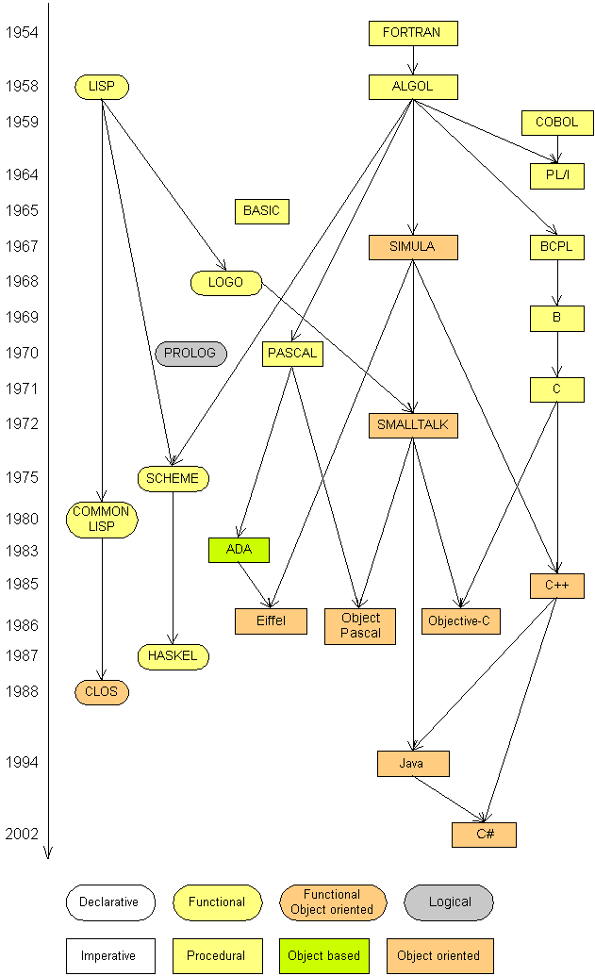
Programming languages
Some influential ones:
  FORTRAN
    science / engineering
  COBOL
    business data
  LISP
    logic and AI
  BASIC
    a simple language
Notes:
hi
bye

Slide 5
Java
A modern programming language
  Sun Microsystems in 1995
  Rich libraries
  Cross-platform
  Object-oriented
Taught in 150 and 160
  Shows basic concepts
  Good free, cross-platform tools
  Industry-grade language
Notes:
hi
bye

Slide 6
Basic Java programs with println statements
reading: 1.2 - 1.3
self-check: #5-14
exercises: #1-4
Notes:
hi
bye

Slide 7



Compiling/running a program
Write it.
  code or source code: The set of instructions in a program.
Compile it.
  compile: Translate a program from one language to another.
  byte code: The Java compiler converts your code into a format named byte code that runs on many computer types.
Run (execute) it.
  output: The messages printed to the user by a program.
source code
byte code
output
compile
run
Notes:
hi
bye

Slide 8
A Java program
public class Hello {
public static void main(String[] args) {
System.out.println("Hello, world!");
System.out.println();
System.out.println("This program produces");
System.out.println("four lines of output");
}
}
Its output:
Hello, world!
This program produces
four lines of output
Notes:
hi
bye

Slide 9
Structure of a Java program
class: a program
public class name {
public static void main(String[] args) {
statement;
statement;
...
statement;
}
}
Every executable Java program consists of a class,
  that contains a method named main,
    that contains the statements (commands) to be executed.
method: a named group
of statements
statement: a command to be executed
Notes:
hi
bye

Slide 10
System.out.println
A statement that prints a line of output on the console.
  pronounced "print-linn"
  sometimes called a "println statement" for short
Two ways to use System.out.println :
  System.out.println("text");
Prints the given message as output.
  System.out.println();
Prints a blank line of output.
Notes:
hi
bye

Slide 11
Names and identifiers
You must give your program a name.
public class GangstaRap {}
  Naming convention: capitalize each word (e.g. MyClassName)
  Your program's file must match exactly (GangstaRap.java)
    includes capitalization (Java is "case-sensitive")
identifier: A name given to an item in your program.
  must start with a letter or _ or $
  subsequent characters can be any of those or a number
    legal: _myName TheCure ANSWER_IS_42 $bling$
    illegal: me+u 49ers side-swipe Ph.D's
Notes:
hi
bye

Slide 12
Keywords
keyword: An identifier that you cannot use because it already has a reserved meaning in Java.
abstract default if private this
boolean do implements protected throw
break double import public throws
byte else instanceof return transient
case extends int short try
catch final interface static void
char finally long strictfp volatile
class float native super while
const for new switch
continue goto package synchronized
  i.e., You may not use char or while for the name of a class.
Notes:
hi
bye

Slide 13
Syntax
syntax: The set of legal structures and commands that can be used in a particular language.
  Every basic Java statement ends with a semicolon ;
  The contents of a class or method occur between { and }
syntax error (compiler error): A problem in the structure of a program that causes the compiler to fail.
Examples:
  Missing semicolon
  Too many or too few { } braces
  Illegal identifier for class name
  Class and file names do not match
  ...
Notes:
hi
bye

Slide 14
Syntax error example
1 public class Hello {
2 pooblic static void main(String[] args) {
3 System.owt.println("Hello, world!")_
4 }
5 }
Compiler output:
Hello.java:2: <identifier> expected
pooblic static void main(String[] args) {
^
Hello.java:3: ';' expected
}
^
2 errors
  The compiler shows the line number where it found the error.
  The error messages can be tough to understand!
Notes:
hi
bye

Slide 15
Strings
string: A sequence of characters to be printed.
  Starts and ends with a " quote " character.
    The quotes do not appear in the output.
  Examples:
  "hello"
  "This is a string. It's very long!"
Restrictions:
  May not span multiple lines.
  "This is not
  a legal String."
  May not contain a " character.
  "This is not a "legal" String either."
Notes:
hi
bye

Slide 16
Escape sequences
escape sequence: A special sequence of characters used to represent certain special characters in a string.
\t tab character
\n new line character
\" quotation mark character
\\ backslash character
  Example:
  System.out.println("\\hello\nhow\tare \"you\"?\\\\");
  Output:
  \hello
  how are "you"?\\
Notes:
hi
bye

Slide 17
Questions
What is the output of the following println statements?
System.out.println("\ta\tb\tc");
System.out.println("\\\\");
System.out.println("'");
System.out.println("\"\"\"");
System.out.println("C:\nin\the downward spiral");
Write a println statement to produce this output:
/ \ // \\ /// \\\
Notes:
hi
bye

Slide 18
Answers
Output of each println statement:
a b c
\\
'
"""
C:
in he downward spiral
println statement to produce the line of output:
System.out.println("/ \\ // \\\\ /// \\\\\\");
Notes:
hi
bye

Slide 19
Questions
What println statements will generate this output?
This program prints a
quote from the Gettysburg Address.
"Four score and seven years ago,
our 'fore fathers' brought forth on
this continent a new nation."
What println statements will generate this output?
A "quoted" String is
'much' better if you learn
the rules of "escape sequences."
Also, "" represents an empty String.
Don't forget: use \" instead of " !
'' is not the same as "
Notes:
hi
bye

Slide 20
Answers
println statements to generate the output:
System.out.println("This program prints a");
System.out.println("quote from the Gettysburg Address.");
System.out.println();
System.out.println("\"Four score and seven years ago,");
System.out.println("our 'fore fathers' brought forth on");
System.out.println("this continent a new nation.\"");
println statements to generate the output:
System.out.println("A \"quoted\" String is");
System.out.println("'much' better if you learn");
System.out.println("the rules of \"escape sequences.\"");
System.out.println();
System.out.println("Also, \"\" represents an empty String.");
System.out.println("Don't forget: use \\\" instead of \" !");
System.out.println("'' is not the same as \"");
Notes:
hi
bye

