Slide 1
Continuous integration
Git
Github
Travis-CI

Slide 2
Continuous integration
Merge all developer works several times a day
Prevent integration problems
Automated unit tests
Helps avoid one developer's work-in-progress breaking another developer's copy

Slide 3
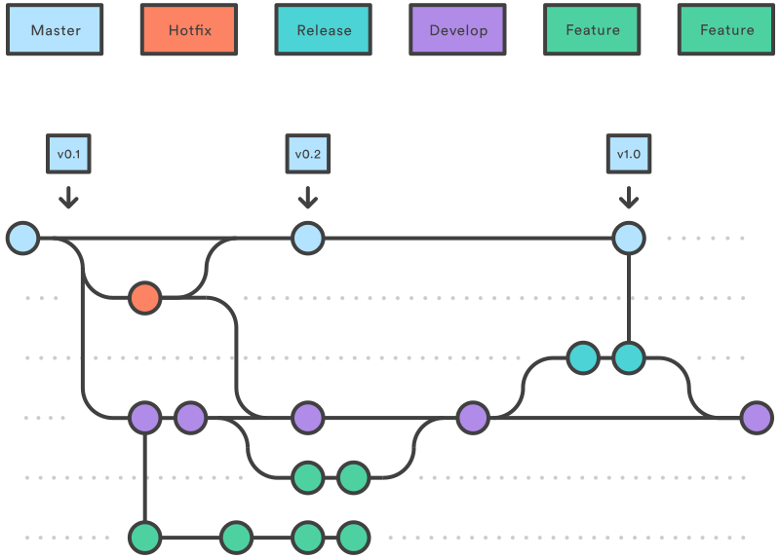
Workflow

Slide 4
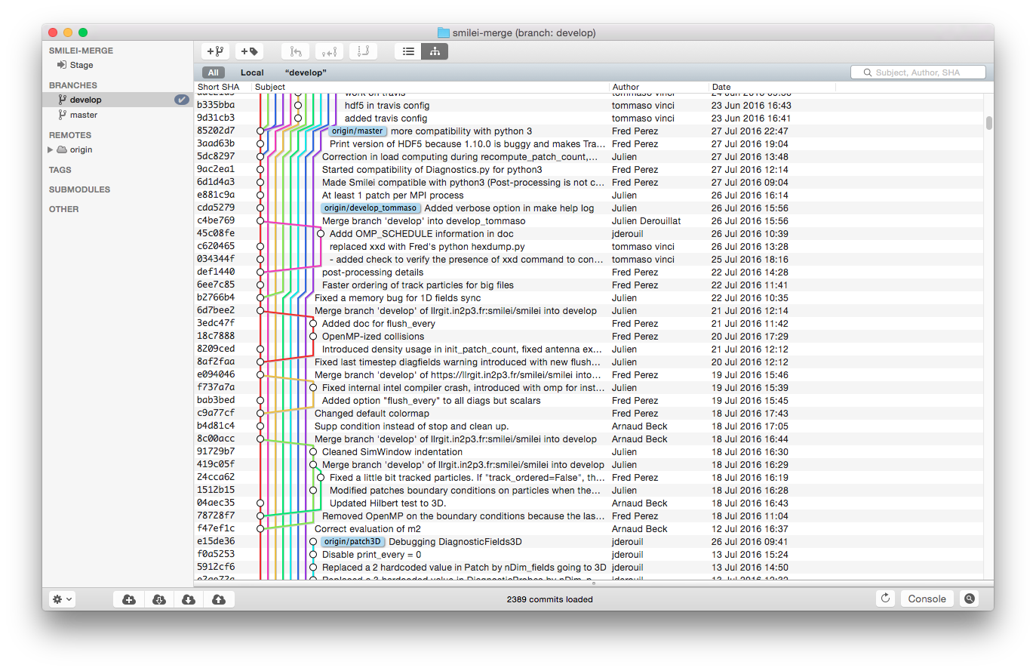
Smilei case: > 5 devs

Slide 5


What you need
Maintain code repository Git
Automate build Makefile
Make the build self testing Python
Every commit is built
Test in a clone Github
Show results Travis
Automate deployment

Slide 6
Integrate Github project with Travis
Neutrino
  Compile and build package
  Deploy DMG: https://github.com/iltommi/neutrino/releases
Smilei
  Build
  Create documentation
  Deploy doc: https://smileipic.github.io/Smilei/
TPUPMC
  Compile latex file
  Deploy PDF: https://github.com/iltommi/TPUPMC/releases

Slide 7
TP: co-written paper
Prerequisites:
  Github account integrated with travis
  Directory with paper draft
Working test:
https://github.com/iltommi/test

