Slide 1
noise_qec
How often should syndromes be measured?
From the paper's model to Selene's circuit (d = 3, 5, 7) and an estimate for H2
Starting point: Haug, Bharti & Aolita, arXiv:2608.06242, optimal syndrome-measurement timing
Stack: Selene (Guppy, native depolarizing noise) and Stim + PyMatching
Notes:
One question from the Haug–Bharti–Aolita paper: is there an optimal interval between syndrome rounds, and does it survive a real extraction circuit? Each slide is one step, from calibrating a Selene round to the Selene result and then to hardware-like idle noise.

Slide 2
Q
The question and the paper's model
arXiv:2608.06242 · Haug, Bharti & Aolita
THE TRADE-OFF
THE PAPER'S MODEL (BIT-FLIP, ONE SECTOR)
Measure too often: every extraction round puts its own faults on the data (p_stab) and adds noisy syndrome bits.
Measure too rarely: idle error accumulates past what the code can correct within one interval.
So the interval Δt between rounds should have an interior optimum.
channel | acts on | rate
extraction (p_stab) | each data qubit, once per round | p
idling | each data qubit, over wait Δt | p·λ·Δt
readout | each syndrome bit | b_read·p
Two free parameters: p (gate quality) and λ (idling relative to a round; ≈ 0.31 for Willow). No ancilla, no gates, no propagation.
Our job: find out whether an optimum survives when p_stab, λ and b_read come from a real extraction circuit instead of being declared.
THE SCORE
pL / T the paper's figure of merit, at fixed total time T = N·Δt
R = −ln(1 − 2pL) / 2T the same rate, still honest as pL → ½. Δt* minimises it.
Notes:
The paper's model has three channels and two free parameters. Everything that follows is about which of these we can reproduce, which we have to measure, and whether the optimum survives.

Slide 3
→
The route through the notebooks
D · Toward hardware
A · Make the noise model usable
B · Price one extraction round
C · Find the optimum
Idle noise as trapped ions have it: dephasing.
10 07 rate curves
11 07 Δt* scaling
12 07 Δt* map
13 07 §7b H2 check
1 noise_analysis
2 03 channel audit
3 04 surface extraction
4 04c adding p_2q
5 04d readout check
6 05 paper's model (Stim)
7 06a/b decoder
8 06c Selene, d = 3–7
9 06c distance law
Shape of the story: price one Selene round, feed it to the paper's model, test that against Selene's own circuit at d = 3, 5, 7, then move to physical idle noise and H2.
Notes:
Four phases; each step uses the one before it.

Slide 4
1
Selene charges operations, not time
notebooks/noise_analysis.ipynb
WHAT THE NOISE MODEL CAN EXPRESS
THE CATCH ON A LOGICAL QUBIT
Every error channel attaches to an operation: p_1q, p_2q, p_meas, p_init. Durations live only in the runtime, which schedules but charges no error.
An untouched qubit stays perfect (P(flip) = 0 with the gate channels at 0.3). There is no T1, T2 or dephasing model.
So Δt is an operation count. Idling has to be inserted as explicit ops, and its rate is declared, not measured.
CX-only circuit, 10 CX | P(any 1)
p_1q = 0.05 | 0.575
p_2q = 0.05 | 0.297
A CNOT compiles to native ops that include 1q rotations charged at p_1q, the same channel idling uses. Extraction and idling share one knob.
WHICH IDLE UNIT SURVIVES COMPILATION?
Δt | 0 | 2 | 5 | 10 | 20
idle only | 0.057 | 0.062 | 0.077 | 0.103 | 0.127
minus Δt=0 floor | 0 | 0.005 | 0.020 | 0.047 | 0.070
candidate | P(1), 20× at p_1q=0.05 | verdict
phased_x(0,0) | 0.355 | SURVIVES
x;x / z;z / h;h | 0.000 | cancelled
Encoded-block detection-event rate, p_1q = 0.001; p_meas stays flat in Δt
Decision: Δt = number of phased_x(q,0,0) per data qubit, one charged op each. On an encoded block the idle cost is read differentially. The shape is measured; the calibration is declared.
Notes:
Adjacent inverse gates are peepholed away, so identity pairs cost nothing; phased_x(0,0) and rz(0) survive. p_meas isolates cleanly and reads directly as the flip probability. The shared p_1q knob is what 04c later untangles.

Slide 5
2
Does Selene carry the paper's noise model?
notebooks/03_noise_channel_audit.ipynb
VERDICTS
paper | Selene | match
data fault p(1+λΔt) | p_1q, depolarizing | partial
syndrome flip p_read | p_meas | exact
propagating ancilla error | absent | excluded by both
Bit-flip is unreachable. The X-basis rate equals the Z-basis rate, so the channel is symmetric with no bias knob.
Substitution: for Z-checks only, depolarizing at p acts as bit-flip at 2p/3.
h costs 2 charged ops. Source gate counts are not charged-op counts.
Division of labour: Stim for anything that needs the paper's noise model. Selene for real extraction circuits, control flow and leakage heralds. Next: measure p_stab.
Notes:
p_1q tracks DEPOLARIZE1 and the 2p/3 curve, not X_ERROR. p_meas is an independent flip of the reported bit and matches Stim M(p). The mismatch is on the data side only.

Slide 6
3
What does one surface-code round cost the data?
notebooks/04_extraction_cost_surface.ipynb
3×
spread of p_stab across the block. It follows which end of each CNOT a qubit sits on, not its CX count.
λ = 1/n_data: 0.10–0.15 (paper: 0.31)
b_read floor: 1.15–1.31 (paper: 1)
No round-stacking: a first round and a marginal round agree within 8%.
Zero intercept in N: the round is the only contributor.
Proxy: |0⟩ⁿ through both sectors with the H removed from X-ancillas, so the round is logically inert but every CNOT is charged. X-ancilla faults still reach the data: X_c·CNOT = CNOT·X_c X_t.
CNOT end | charged ops per CX
control (data in a Z-check) | 1.44
target (data in an X-check) | 3.86
Consequence: λ and b_read are fixed by the circuit, not free. Both sit on the "measure less often" side of the paper's values.
Notes:
Six codes measured: rotated and unrotated, d = 3, 5, 7. The two-coefficient control/target model is stable across all six. Measured values are exported to surface_extraction_measured.yaml and read by 05 and 06.

Slide 7
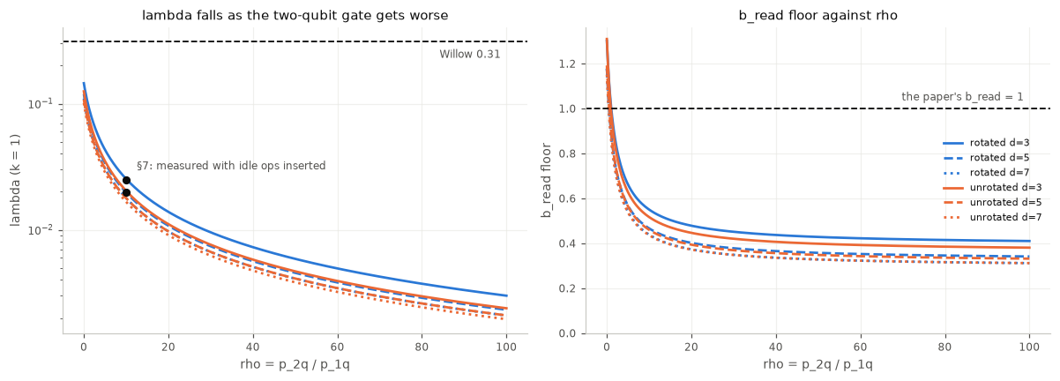
4
What does p_2q add, and what does it do to λ?
notebooks/04c_extraction_cost_p2q.ipynb
λ(ρ, k) = k / (n₁ + 0.8·ρ·n₂) ρ = p_2q/p_1q · k = idle ops per Δt unit · n₁, n₂ = 1q ops and Rzz events per round
1.5–1.7×
n₂ vs the qubit's own Rzz count. The excess is ancilla faults copied onto data (the hook mechanism).
λ is capped at ρ = 0 (0.10–0.15). p_2q only lowers it.
Paper's 0.31 needs k > 1: k ≈ 2–3 at ρ=0, 12–19 at ρ=10.
Validated: circuit with real idle ops matches λ to 3%.
Meaning: the gate ratio cannot supply the paper's λ. The idle unit must, which is physically right because λ is T1/T2 per cycle. b_read = 1 corresponds to ρ ≈ 1.
Notes:
p_1q and p_2q stay additive on surface codes within 0.4 sigma, so lambda can be built from two separately measured counts. One Rzz per CNOT, on both qubits.

Slide 8
5
Is the readout bookkeeping right?
notebooks/04d_readout_composition.ipynb · 04 calibrated with p_meas = 0; 05–06c add it afterwards
check | result
p_meas changes the data cost? | No. n_data 6.86 vs 6.89 (d=3), 8.34 vs 8.40 (d=5)
p_meas + ancilla faults combine as | independent flips, a ⊕ b. The 1−(1−a)(1−b) rule fails at p_meas = 0.3 (χ²/dof 53 vs 1.0)
final data readout in the theory | carries p_meas only (0.002, not 0.005): theory p_L about 4% lower
that readout's share of p_L | 0.7% at Δt = 1 up to 5.8% at Δt = 32; Δt* moves < 0.5σ
What changes
p_read = p_anc ⊕ p_meas.
The final data readout carries p_meas alone.
At the operating point the ⊕ correction is 6×10⁻⁶.
Why the ancilla counts as readout.
An X fault on a Z-ancilla stays on the ancilla (it is the CNOT target), so it only flips that round's syndrome bit: to the decoder, the same as a misread bit. So p_read = p_anc ⊕ p_meas.
Verdict: λ and p from 04 hold with p_meas on. The readout corrections move the theory curve by about 4%, inside its errors.

Slide 9
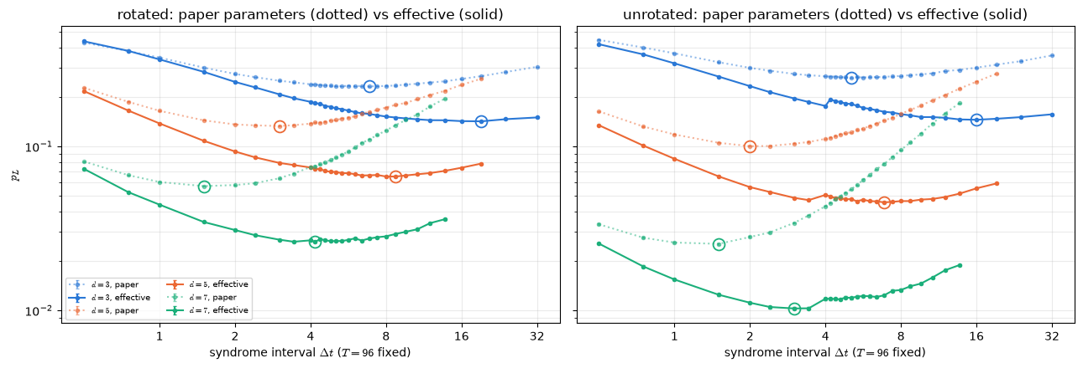
6
Is there an optimum in the paper's own model? (Stim)
notebooks/05_surface_code_interval.ipynb
The paper's model in Stim, twice: with the paper's λ = 0.31 and b_read = 1, and with λ and b_read calibrated from one Selene round (04).
Δt* | d3 | d5 | d7
rot, paper | 6.4 | 2.7 | 1.6
rot, calibrated | 16.6 | 8.0 | 4.4†
unrot, paper | 5.5 | 2.2 | 1.2
unrot, calibrated | 16.0 | 6.8† | 2.8†
λ does it: λ alone moves Δt* 2.2–3.2×, within 5% of Eq. 6's 0.31/λ.
Control: with p_stab off there is no interior optimum.
† decoder weight tie; decoder-sensitive.
Fixed T = 96, N = T/Δt ≥ d, p = 0.01, 3 × 100k shots per point. Dotted: paper parameters. Solid: calibrated.
Result: calibrated idling is 2–3× cheaper than the paper assumes, so the optimum is 2.6–3× longer. Still phenomenological: no faults inside the round.
Notes:
Calibrated constants lengthen the optimum 2.6–3x; lambda alone accounts for almost all of it (05 section 7).

Slide 10
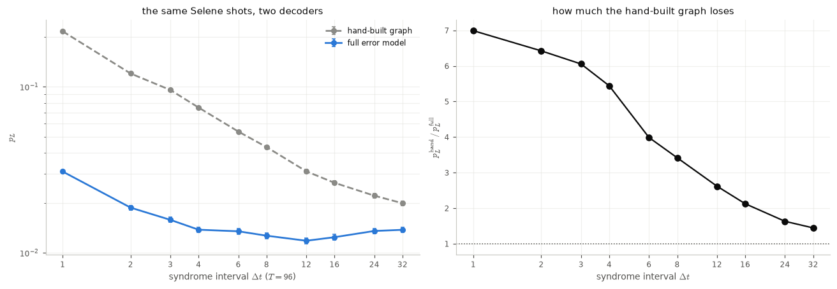
7
The decoder must see the whole circuit
notebooks/06a_stim_mirror.ipynb · 06b_decoder_comparison.ipynb
Δt | p_L: hand-built / full model
1 | 0.216 / 0.031 (7.0×)
4 | 0.075 / 0.014 (5.4×)
8 | 0.043 / 0.013 (3.4×)
12 | 0.031 / 0.012 (2.6×)
32 | 0.020 / 0.014 (1.4×)
The same Selene shots (rotated d = 3, p_1q = 0.0005, p_meas = 0.002, T = 96), decoded two ways.
06a: a gate-for-gate Stim copy of Selene's compiled circuit is statistically indistinguishable from Selene (d = 3, 5, 7), so Stim supplies the full detector error model.
06b: the full model wins all 50 blocks (d = 3) and all 368 (d = 5). The hand-built graph has no edges for faults inside the round (3–14% of fault probability).
Why it matters: a decoder built from the paper's simple picture misses faults inside the round and hides the optimum entirely. The full error model is required.

Slide 11
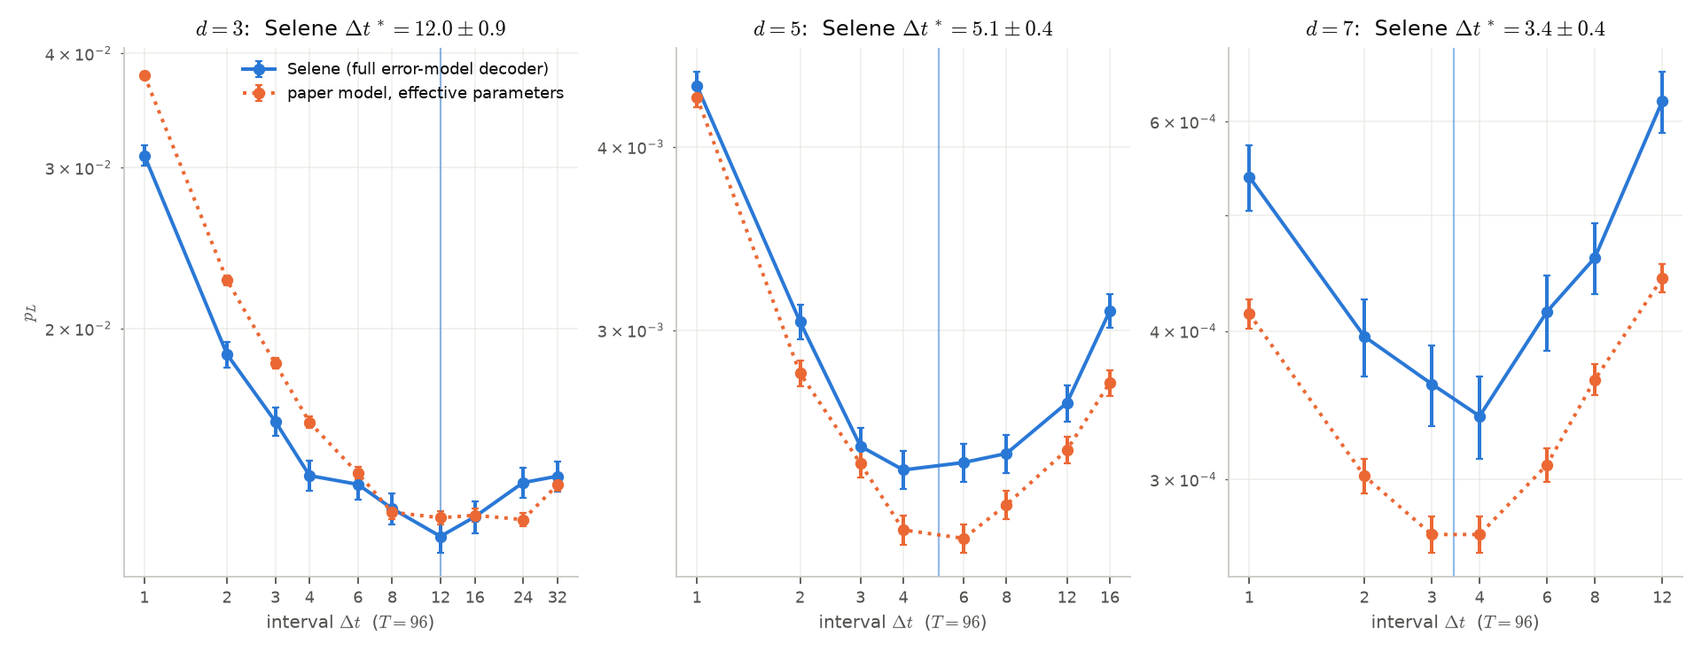
8
Selene shows the optimum at d = 3, 5, 7
notebooks/06c_selene_interval.ipynb · rotated, p_1q = 0.0005, p_meas = 0.002, T = 96
Δt*: Selene vs paper's model
d=3 12.0±0.9 vs 16.6±2.6
d=5 5.1±0.4 vs 5.7±0.2
d=7 3.4±0.4 vs 3.4±0.2
No fitting: the model's parameters come from 04's calibration.
12 → 5 → 3.4
Selene: 50k (d=3) and 460k (d=5, 7) shots per point, full error-model decoder. Line: fitted Δt*.
Δt* at d = 3, 5, 7: it shortens with distance, as the paper predicts.
Interval, not round count: doubling T keeps Δt* at 12 (d = 3) while N doubles.
p_L gap grows with d: Selene/model 0.82–1.10, 1.02–1.13, 1.26–1.41; a near-constant factor at d = 7.
Main result: an interior optimum under Selene's own noise at every distance, located by the paper's model with no fitted parameter.

Slide 12
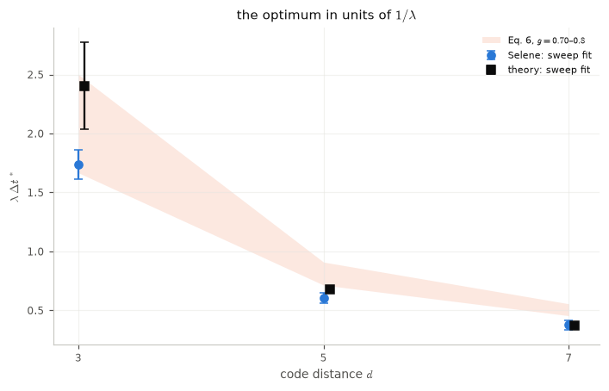
9
How the optimum scales with distance
06c §4 · Eq. 6: λ·Δt* = 1/(α − 1), α = g(d + 1)/2
What Eq. 6 gets right
1/(λΔt*) is a straight line in d (χ² = 0.03, 1 dof).
Δt*(5)/Δt*(7) = 1.48 ± 0.19; Eq. 6 says 1.45–1.51.
g implied: 0.79, 0.88, 0.92
g = 1.06 ± 0.10
Band: Eq. 6 with g = 0.70–0.8. Points: sweep fits, Selene (blue) and the paper's model (black).
from the slope of 1/(λΔt*) against d; the paper's 0.8 (fitted at d = 11–27) is 2.7σ away.
Form holds: Δt* shortens with d along Eq. 6's straight line.
Constant doesn't: slope and intercept need different g, and the implied g rises with d.
Reading: Eq. 6's shape survives at d ≤ 7; its single constant g does not. d = 9 would show whether g keeps rising.

Slide 13
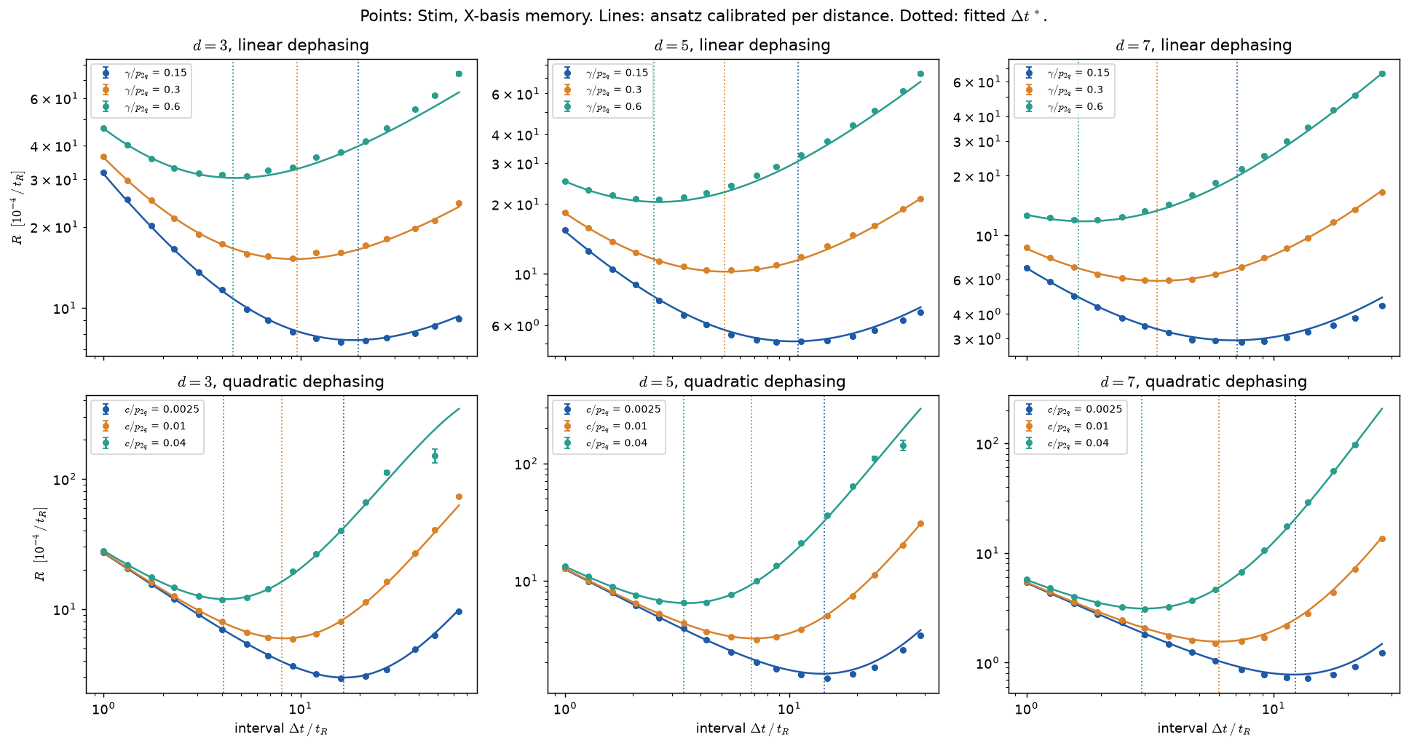
10
Every dephasing curve has an interior optimum
notebooks/07_dephasing_interval.ipynb · rate R against the interval, 6 idle settings × d = 3, 5, 7
What the curves show
Left of the minimum: each round's extraction cost dominates, R falls as 1/Δt.
Right: idle error per interval dominates and R rises.
Lines: R(Δt) = (A/Δt)(1 + q/p_e)^α, three constants per d.
21 / 21
curves with an interior optimum (18 shown, plus the mixed setting at each d).
Points: Stim, X-basis memory, 2 × 100k shots. Dotted: fitted Δt*. Top: linear, bottom: quadratic dephasing.
Reading: stronger idle noise moves the optimum to shorter Δt. Quadratic curves only separate at long Δt, where cΔt² takes over.

Slide 14
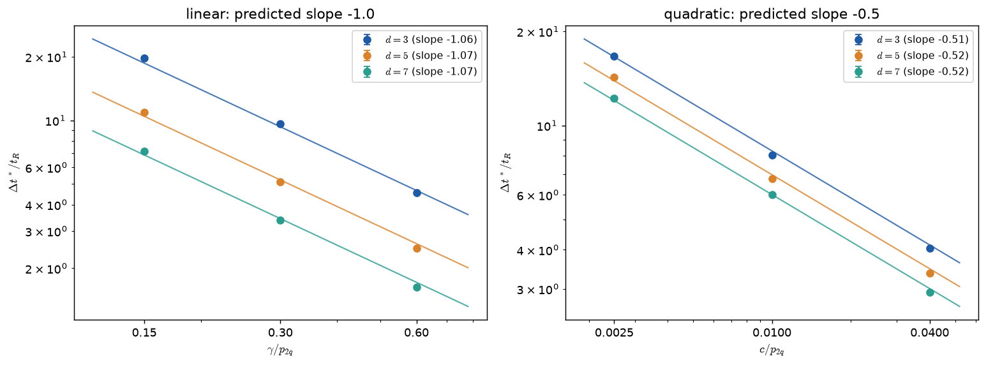
11
Physical idle noise: dephasing (Stim)
notebooks/07_dephasing_interval.ipynb · idle error per interval q(Δt) = γΔt + sin²(√c·Δt)
idle noise | Δt* scales as
linear, γΔt | γ⁻¹ (slope −1.06)
quadratic, cΔt² | c^(−1/2) (slope −0.51)
d = 3 → 7, linear | shortens 2.85×
d = 3 → 7, quadratic | shortens 1.34×
mixed (not fitted) | formula within 5%
X-basis memory, H2-1E noise ratios ×4.76, T = 192 t_R, d = 3, 5, 7. Points: simulated Δt*.
Why X basis: trapped-ion idling is Z-only (Quantinuum emulator model); a Z-basis memory cannot see it.
Formula: R(Δt) = (A/Δt)(1 + q(Δt)/p_e)^α predicts Δt* to about 5%, including a held-out mixed case.
Reading: the form of the idle noise sets how Δt* scales. Under quadratic dephasing, distance barely moves it.

Slide 15
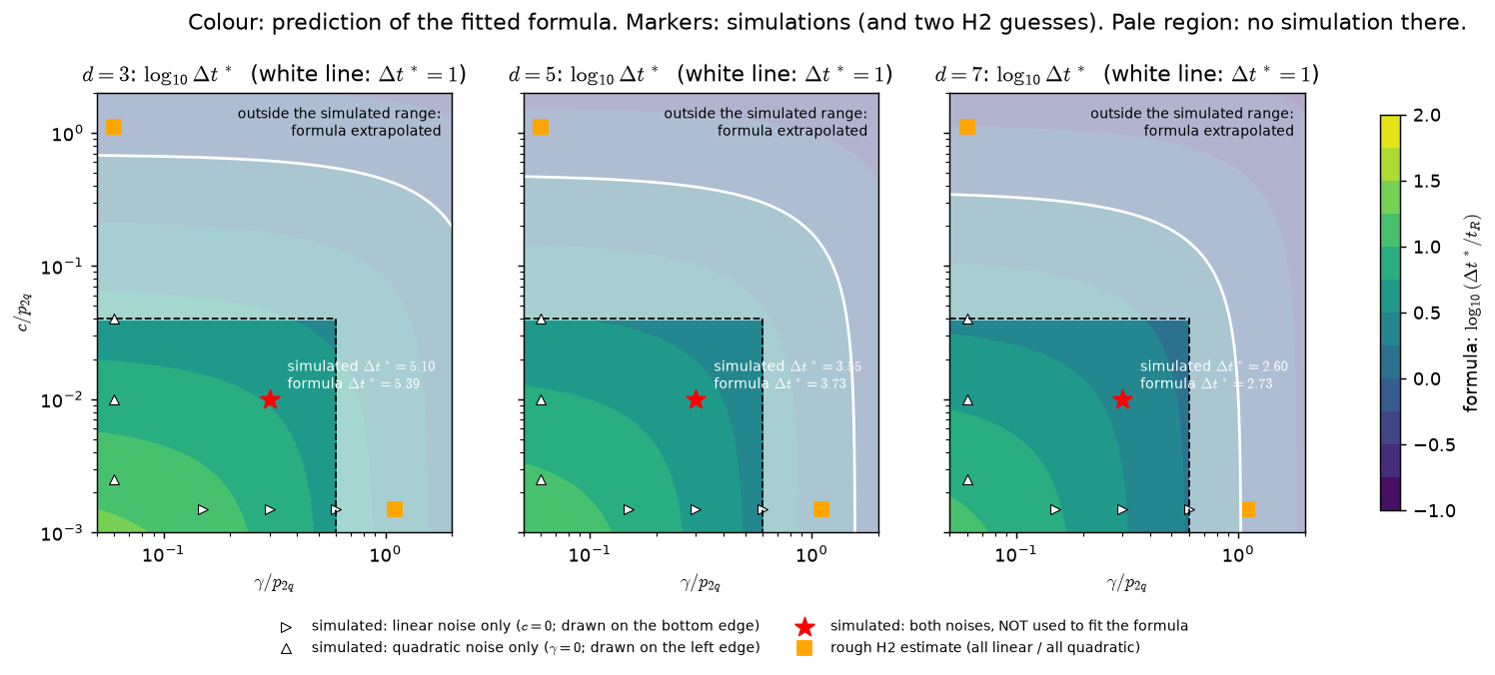
12
Where waiting pays: the Δt* map
07 §8 · Δt* from the calibrated formula for every mix of linear (γ) and quadratic (c) dephasing
How to read it
Colour: Δt* predicted by the formula. White line: Δt* = 1.
Inside the line, waiting between rounds pays; outside, run back to back.
Pale region: no simulation there, formula extrapolated.
≈ 5%
formula vs simulation at the held-out mixed point (star): 5.39 vs 5.10 at d = 3.
Markers: simulations (triangles, star) and two rough H2 estimates (squares). Panels: d = 3, 5, 7.
Reading: the H2 squares sit near the Δt* = 1 line but outside the simulated range. The next slide simulates them directly.

Slide 16
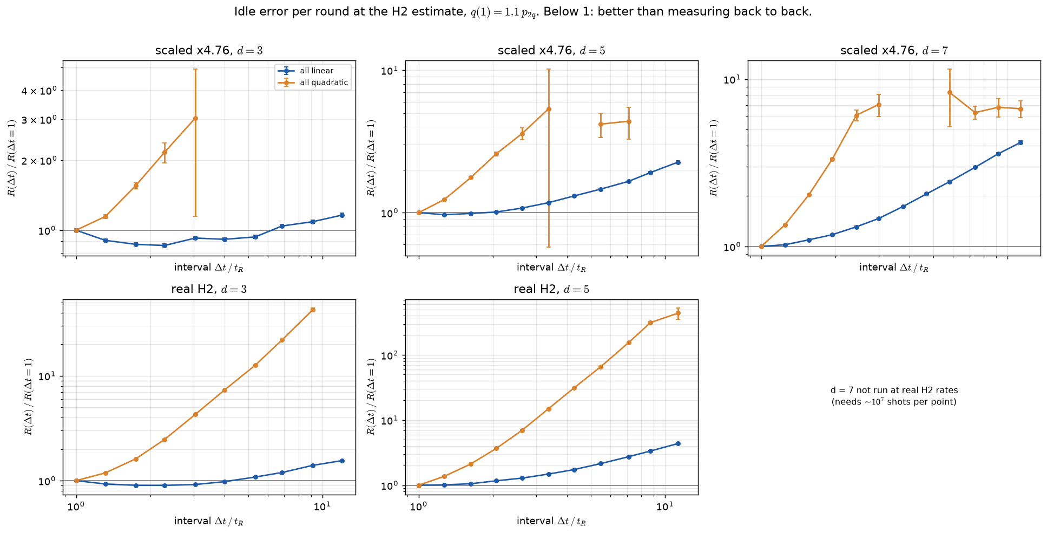
13
On H2: measure back to back
07 §7b · simulated directly at H2's estimated idle ratio, q(1) ≈ 1.1·p_2q
Best Δt at H2's ratio
linear, d=3 2.3 (−11%)
linear, d=5 1
quadratic, all 1
Real H2-1E gate rates, d = 3 and 5, 1M shots per point.
Δt* ≈ 1
R(Δt)/R(1): below 1 means waiting helps. Top: noise ×4.76 (d = 3, 5, 7). Bottom: real H2 rates (d = 3, 5).
Rounds back to back are best, or within 3%, at every d ≥ 5.
Quadratic: waiting only hurts; R is 2–5× worse already at Δt = 3.
Linear: a short wait helps only at d = 3, by 11–16%.
Caveat: H2's idle-to-gate ratio (1.1·p_2q) is assumed from 6 layers per round, not measured.

Slide 17
Σ
Where the arc stands
Established
Still open
Measured vs declared
Interior Δt* under Selene's native noise at d = 3, 5, 7 (fixed T, full error-model decoder).
The paper's model, calibrated from the circuit, predicts Δt* within 1.7σ at every d.
Δt* follows Eq. 6's straight line in d; its single g does not fit (implied 0.79–0.92).
Dephasing: Δt* ∝ γ⁻¹ or c^(−1/2). At H2's ratio, back to back is best.
H2's idle-to-gate ratio is assumed (6 layers per round), not measured.
Selene's p_L sits 30–40% above the model at d = 7.
Readout noise does not move Selene's Δt* the way the model predicts.
Only d ≤ 7; the paper fits g at d = 11–27.
Measured: p_stab per qubit, n_data, n_anc, Δt* at d = 3–7, the H2-ratio curves.
Declared: Selene's idle rate (an op count); H2's idle ratio (6 layers per round).
Absent: T1, leakage, crosstalk, asymmetric readout, d ≥ 9 in Selene.
Notes:
What is established, what is still open, and what was measured versus assumed.

Slide 18
Next
1
Measure H2's idle ratio
2
d = 9 in Selene
Round duration and the linear/quadratic split from the hardware specs.
Does the implied g keep rising, towards or past the paper's 0.8?
3
Re-run 06c's p_meas sweep
4
Per-qubit p_stab in the model
With disjoint seeds: the model predicts Δt* moving; Selene shows none.
Does it close the 30–40% p_L gap at d = 7?
5
Carry 04d's fixes into 05 and 06c
6
A gain map for 07
⊕ readout, and p_meas alone on the final data readout.
Colour by R(1)/R(Δt*): where waiting pays, not only where Δt* > 1.
Notes:
Items 1 and 2 are the direct continuations of 07. Items 3 to 5 extend the noise model. Item 6 is a guard against silent breakage.

