Slide 1
Thinking as a
"Data Scientist"
Saghir Bashir
www.ilustat.com

Slide 2
Outline
Questions to Decisions
Data Processing
Analysis
Communication
Summary
Thinking as a “Data Scientist”

Slide 3
Objectives
My objectives are to encourage you to:
> Adapt good working practices.
> Challenge your thinking.
> Build trust in your work.
> Enjoy your work.
Thinking as a “Data Scientist”

Slide 4
What about R?
This presentation applies to data science independent of the software you use.
> I will give examples and references from R.
Thinking as a “Data Scientist”

Slide 5
Questions to Decisions
Thinking as a “Data Scientist”

Slide 6
Weather Example
Questions
  Will it rain today?
Decisions
  Take an umbrella.
  Don’t take an umbrella.
  Don’t go out.
Thinking as a “Data Scientist”
Thinking as a “Data Scientist”
Questions to Decisions → Data Processing → Analysis → Communication → Summary

Slide 7










Weather Example
Yesterday
08:00
Forecast
Decision
Thinking as a “Data Scientist”
Questions to Decisions → Data Processing → Analysis → Communication → Summary

Slide 8
“Data Science” Thinking
Questions
Data
Simplify
Analysis
Accessible
Communicate
Usable
Decisions
Thinking as a “Data Scientist”
Questions to Decisions → Data Processing → Analysis → Communication → Summary

Slide 9
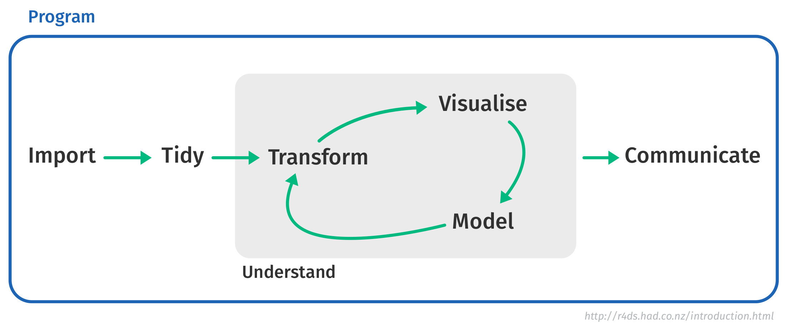
“Data Science” Doing
Questions
Decisions
Thinking as a “Data Scientist”
Questions to Decisions → Data Processing → Analysis → Communication → Summary

Slide 10
Definition: “Data Science”
Generally accepted definition
  Does not exist.
  This is a discussion for another day.
Presentation definition
  “Using data, statistics and programming, in a given context, to support decision making.”
Thinking as a “Data Scientist”
Thinking as a “Data Scientist”
Questions to Decisions → Data Processing → Analysis → Communication → Summary

Slide 11
Questions to Decisions
Define unbiased and clear questions
  Will it rain today? / What is the weather forecast today?
  Do free gifts increase sales? / What factors impact sales?
Decisions
  Understand the decisions that could be taken.
  Very useful for data science thinking and planning.
Thinking as a “Data Scientist”
Thinking as a “Data Scientist”
Questions to Decisions → Data Processing → Analysis → Communication → Summary

Slide 12
Weather Example
Questions
  What is the weather forecast for today?
  Key interest is in going to work and returning.
Decisions
  Take an umbrella.
  Don’t take an umbrella.
  Work from home.
Thinking as a “Data Scientist”
Thinking as a “Data Scientist”
Questions to Decisions → Data Processing → Analysis → Communication → Summary

Slide 13
Weather Example – Original
Yesterday
08:00
Forecast
Decision
Thinking as a “Data Scientist”
Questions to Decisions → Data Processing → Analysis → Communication → Summary

Slide 14
Weather Example – Updated
Yesterday
08:00
12:00
18:00
Decision
?

Thinking as a “Data Scientist”
Questions to Decisions → Data Processing → Analysis → Communication → Summary

Slide 15
Making Decisions
Data Science supports decision making, which involves:
> Balancing information
→ Data science is often one part of a bigger picture.
> Personal experience
→ Different decisions can be taken using the same information.
> Risk taking
→ Varies by person and situation.
Thinking as a “Data Scientist”
Thinking as a “Data Scientist”
Questions to Decisions → Data Processing → Analysis → Communication → Summary

Slide 16

Valid Decisions – Skin Sensitivity
Yesterday
08:00
12:00
18:00
Decision




Thinking as a “Data Scientist”
Questions to Decisions → Data Processing → Analysis → Communication → Summary

Slide 17
Valid Decisions – British
Yesterday
08:00
12:00
18:00
Decision
Thinking as a “Data Scientist”
Questions to Decisions → Data Processing → Analysis → Communication → Summary

Slide 18
Data Processing
Thinking as a “Data Scientist”

Slide 19
The Data
Key Points
> Accessibility – Format & legal restrictions
> Appropriateness & Validity – Generalisability
> Quality – Garbage in, garbage out (GIGO)
Thinking as a “Data Scientist”
Questions to Decisions → Data Processing → Analysis → Communication → Summary

Slide 20
Understand The Data
Before doing analysis or programming, ask:
> How and when was the data collected?
> Who collected it? Who owns it?
> Was it quality controlled? How?
> Are there confidentiality or privacy issues?
> What information (e.g. variables) do you have?
> Can the data answer the questions of interest?
Thinking as a “Data Scientist”
Questions to Decisions → Data Processing → Analysis → Communication → Summary

Slide 21
Tidy Data
> Wrangle your data into tidy data* where:
→ Each variable is in a column.
→ Each observation is a row.
→ Each value is a cell.
> Will most likely take a majority of the time.
> R makes this easier with tidyverse packages.
→ *See www.tidyverse.org
Var 1 | Var 2 | Var 3
# | # | #
# | # | #
# | # | #
Thinking as a “Data Scientist”
Questions to Decisions → Data Processing → Analysis → Communication → Summary

Slide 22
Data Processing in R
> Importing Data
→ From Files – readr & readxl
→ SAS, Stata & SPSS – haven
→ Web – rvest, xml2, httr & jsonlite
> Tidy and Transform
→ Tidy – tibble & tidyr
→ Transform – dplyr, stringr, lubridate, hms & forcats
→ Pipes – Use %>% (magrittr)
Thinking as a “Data Scientist”
Questions to Decisions → Data Processing → Analysis → Communication → Summary

Slide 23
Analysis
Thinking as a “Data Scientist”

Slide 24
Analysis Objectives
Your answers should be:
> Unbiased
> Robust
> Generalisable
Thinking as a “Data Scientist”
Questions to Decisions → Data Processing → Analysis → Communication → Summary

Slide 25
Analysis
Key Point – Simplify The Data
> Data Summaries
> Visualisation
> Modelling
Thinking as a “Data Scientist”
Questions to Decisions → Data Processing → Analysis → Communication → Summary

Slide 26
Basic Statistics and Plots
Start simple
> Understand the raw data.
> Summary statistics are your friends.
> Data visualisations can teach you a lot.
> These might be enough to answer the questions.
> Very useful to understand further analysis.
Thinking as a “Data Scientist”
Questions to Decisions → Data Processing → Analysis → Communication → Summary

Slide 27
Modelling
Specify and justify all models fully:
> Data used
> Model variables
> Model equations, formulas and/or algorithms
> Model ASSUMPTIONS
This applies to machine learning too!
Thinking as a “Data Scientist”
Questions to Decisions → Data Processing → Analysis → Communication → Summary

Slide 28
Health Warning
Modelling (analysis) is STATISTICS!
> The laws of gravity apply to Data Scientists too!
> You must understand the models you use.
> All models have strengths and weaknesses.
→ Understand them.
→ Be open and transparent about them.
Thinking as a “Data Scientist”
Questions to Decisions → Data Processing → Analysis → Communication → Summary

Slide 29
Useful Quotes
"Essentially, all models are wrong, but some are useful"
George E.P. Box (1987)
"Remember that all models are wrong; the practical question is how wrong do they have to be to not be useful."
George E.P. Box (1987)
"Far better an approximate answer to the right question, which is often vague, than an exact answer to the wrong question, which can always be made precise."
John W. Tukey (1962)
Thinking as a “Data Scientist”
Questions to Decisions → Data Processing → Analysis → Communication → Summary

Slide 30
Analysis in R
> Basic Statistics and Visualisation
→ Summary Statistics – dplyr (summarise)
→ Visualisation – ggplot2 & plotly
> Modelling
→ Tidy modelling – broom & modelr
→ Statistical models – lm, glm, anova, nlm, ...
→ Machine learning – caret, rpart, randomForest, ...
> Reproducibility
→ Code, results & commentary – Rmarkdown
Thinking as a “Data Scientist”
Questions to Decisions → Data Processing → Analysis → Communication → Summary

Slide 31
Communication
Thinking as a “Data Scientist”

Slide 32
Communication – Key Points
> Objectives
→ Questions
> Data
→ Source, collection methodology (e.g. survey), representativeness,
quality and validity
> Analysis
→ Summary statistics/graphs
→ Analysis – assumptions, methods?
→ Results – graphical / quantitative
> Conclusions
> Subject matter expert input needed throughout
Thinking as a “Data Scientist”
Questions to Decisions → Data Processing → Analysis → Communication → Summary

Slide 33
Communication
> Understand Your Audience
→ Need full details – full report or publication.
→ Summary details – article or blog.
→ Executive summary – presentation.
> Openess and Transparency
→ Share and link programs, data and full report.
→ Make sure your work is reproducible.
> Communication Style
→ Understandable, relevant and interesting.
→ Keep it simple, clear and concise.
Thinking as a “Data Scientist”
Questions to Decisions → Data Processing → Analysis → Communication → Summary

Slide 34
Communication Via R
> Outputs & Presentations
→ PDF, HTML & DOCX – Rmarkdown
> Sharing data and results
→ Web applications – shiny, opencpu & htmlwidgets
→ Interactive maps – leaflet & rmaps
Thinking as a “Data Scientist”
Questions to Decisions → Data Processing → Analysis → Communication → Summary

Slide 35
Summary
Thinking as a “Data Scientist”

Slide 36
“Data Science” Thinking
Questions
Data
Simplify
Analysis
Accessible
Communicate
Usable
Decisions
Thinking as a “Data Scientist”
Questions to Decisions → Data Processing → Analysis → Communication → Summary

Slide 37
Summary
> Focus on answering the questions with data
→ Understand the decisions that could be taken.
→ Don’t answer the wrong question.
> Try to keep everything simple
→ Easier for you to understand and explain.
→ Communicate clearly and concisely.
→ Make your work reproducible.
> Work closely with your collaborators
→ Subject area experts, programmers, statisticians, ...
→ Data Science & R user communities.
Thinking as a “Data Scientist”
Questions to Decisions → Data Processing → Analysis → Communication → Summary

Slide 38
References
R Project – www.r-project.org
Tidyverse packages – www.tidyverse.org
Box, George E. P. & Norman R. Draper (1987). “Empirical Model-Building and Response Surfaces”, Wiley.
John W. Tukey (1962). “The future of data analysis”, Annals of Mathematical Statistics 33: 1-67
Images: https://commons.wikimedia.org/wiki/Main_Page
Thinking as a “Data Scientist”
References

Slide 39

This work is licensed under the
Creative Commons Attribution-NonCommercial 4.0
International License.
To view a copy of this license, visit http://creativecommons.org/licenses/by-nc/4.0/

