Slide 1
family assistant
Buyevich Ilya

Slide 2
Tech Stack
Java
Spring Boot
Spring Data JPA
PostgreSQL
REST API
Swagger
Flyway
Docker
Docker compose

Slide 3
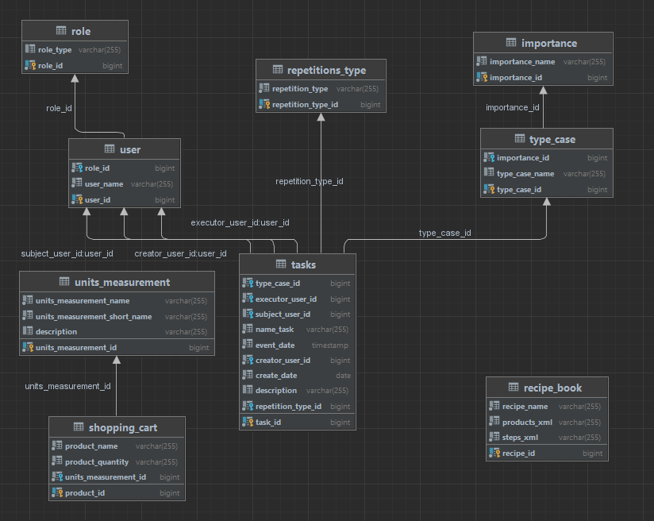
database schema

Slide 4
main controllers
RecipeBookController
getAll
getById
create
delete
addProductsToCart

Slide 5
main controllers
ShoppingCartController
getAll
getById
create
delete

Slide 6
main controllers
ShoppingCartController
getAll​
getById​
create​
delete
getByExecutorUserId
getBySubjectUserId
getByCreatorUserId
getByTypeRole

Slide 7
Secondary Controllers
ImportanceController
RepetitionTypeController
RoleController
TypeCaseController
UnitsMeasurementController
UserController

Slide 8
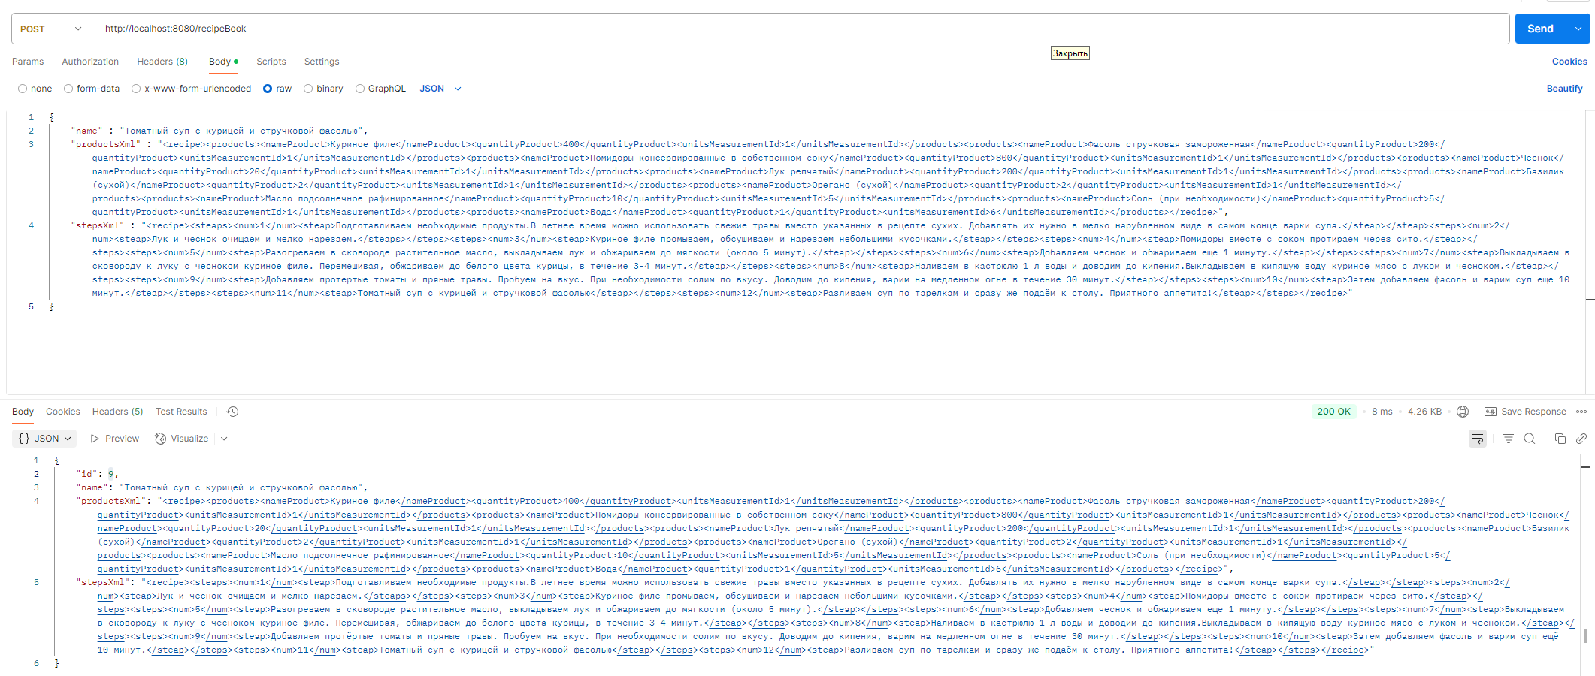
Show of the work "Recipe Book"

Slide 9
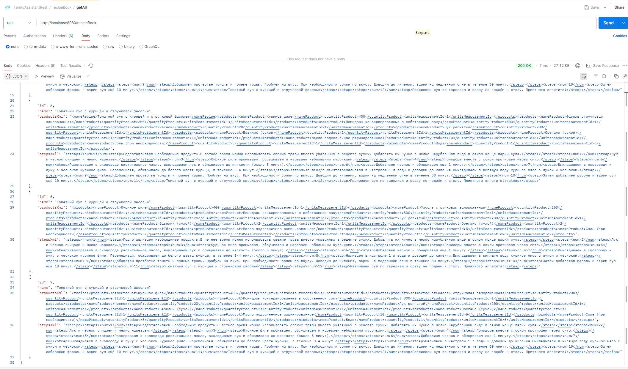
Show of the work "Recipe Book"

Slide 10
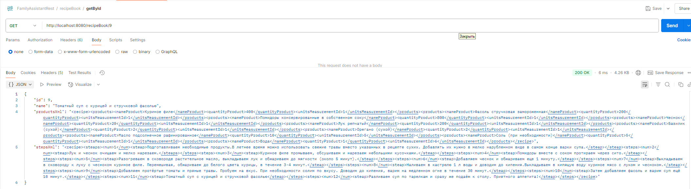
Show of the work "Recipe Book"

Slide 11
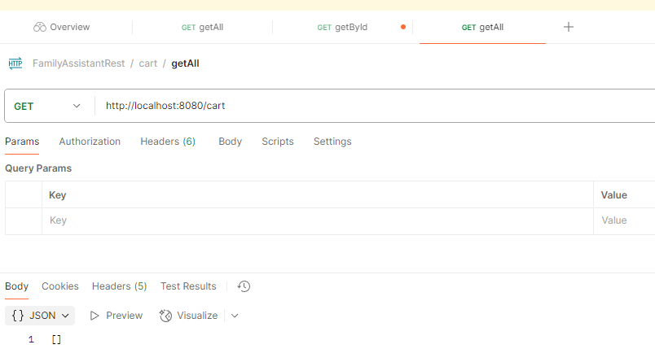
Show of the work "Recipe Book"

Slide 12
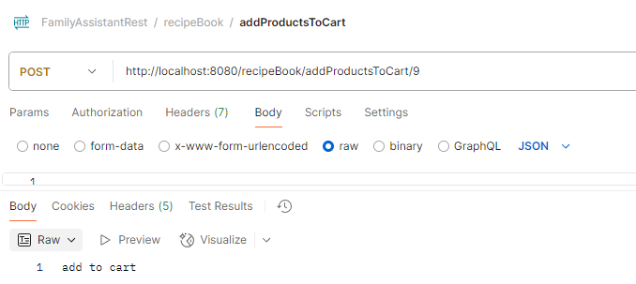
Show of the work "Recipe Book"

Slide 13
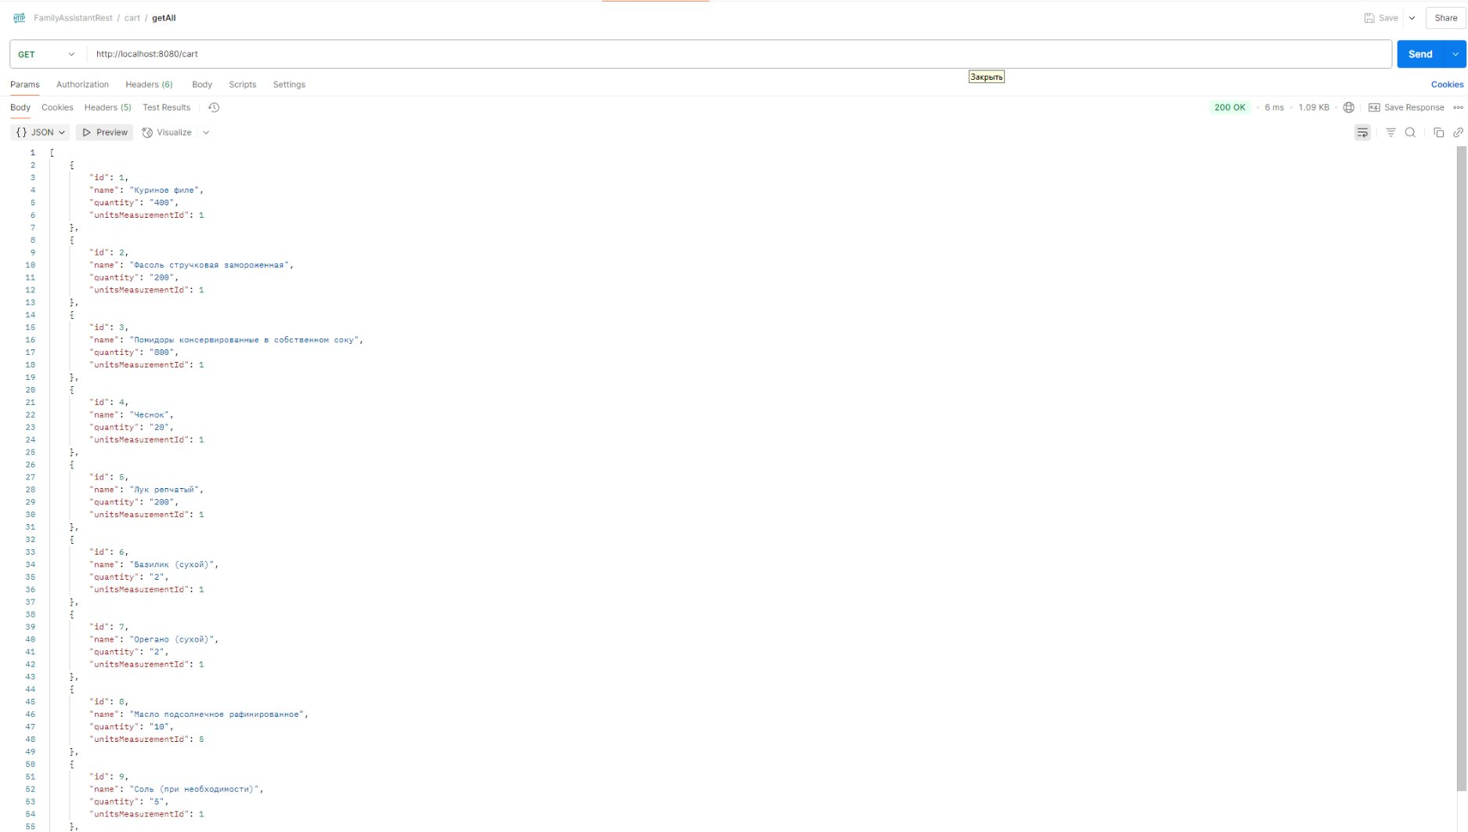
Show of the work "Recipe Book"

Slide 14
FINISH

