Slide 1
Android Application for Collaborative Trip Planning
Faculty of Computer Science
Department of Software Engineering
Moscow
2025
Ilya Novik
Software Engineering Student, BSE-223
Supervisor:
Alexander Breiman
Department of Software Engineering
Notes:
Good afternoon. My name is Ilya Novik. I am presenting my project "Android Application for Collaborative Trip Planning." The goal of the project is to create one mobile product that helps travel groups plan together with fewer mistakes and lower coordination effort.

Slide 2

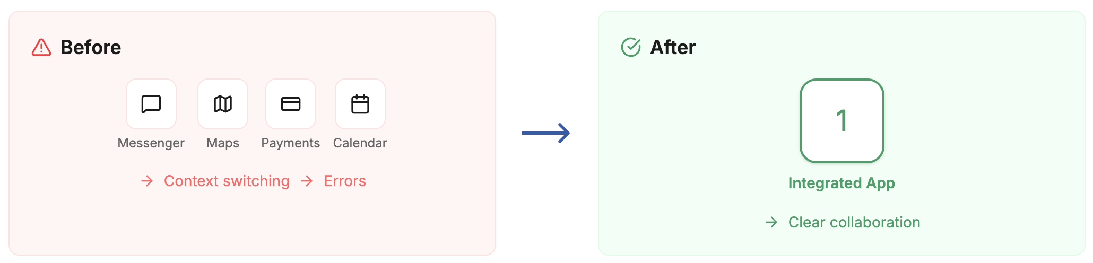
The problem
Faculty of Computer Science
Department of Software Engineering
Ilya Novik
iinovik@edu.hse.ru
Android Application for Collaborative Trip Planning
Group travel planning is fragmented across many apps
Chat, maps, bookings, and budgets are separated
Results: duplicated work, unclear decisions, budget mistakes
Organizer becomes a manual integrator
Notes:
At present, one group trip is usually planned in many separate apps. Communication, places, bookings, and costs are stored in different systems. As a result, data is scattered, work is repeated, and final decisions are less clear. Budget mistakes also become more likely.

Slide 3
Stakeholders and User Needs
Faculty of Computer Science
Department of Software Engineering
Ilya Novik
iinovik@edu.hse.ru
Android Application for Collaborative Trip Planning
Main users: friends, families, and colleagues planning trips
Key needs: single source of truth, transparent decisions, itinerary clarity, clear balances, AI recommendations, and stable work with weak internet
Stakeholder segment | Pain Point | Needed Capability
Trip members | Context loss across tools | Shared planning space
Trip owner | Coordination overload | Roles / invites / moderation
Planning group | Budget confusion | Transparent balancing
Planning group | Too many options | AI recommendations
Users with unstable internet | Lost updates | Offline queue + sync
Notes:
The main users are small travel groups: friends, families, and colleagues. A second important segment is the trip owner, who coordinates group decisions. As shown in the table, users face five key problems: context loss, coordination overload, budget confusion, too many activity options, and unstable internet conditions. To address these problems, the product must provide a shared planning space, role-based collaboration controls, transparent expense balancing, AI recommendations for places and activities, and offline synchronization.

Slide 4
Existing Solutions and Gap
Faculty of Computer Science
Department of Software Engineering
Ilya Novik
iinovik@edu.hse.ru
Android Application for Collaborative Trip Planning
Each product covers only part of the workflow. Gap: integrated collaborative planning workspace.
Product | Collaboration | Itinerary | Expense balancing | Weather | AI
Splitwise | ✅ | ❌ | ✅ | ❌ | ❌
Wanderlog | ✅ | ✅ | ✅ | ❌ | ❌
TravelSpend | ✅ | ❌ | ✅ | ❌ | ❌
TripIt | ✅ | ✅ | ❌ | ✅ | ✅
Yandex Travel | ✅ | ✅ | ❌ | ❌ | ❌
RUSSPASS | ❌ | ✅ | ❌ | ❌ | ✅
Proposed app | ✅ | ✅ | ✅ | ✅ | ✅
Notes:
A review of popular products shows that each tool is strong only in part of the process. Some focus on expenses, some on itinerary, and some on booking workflows. However, a full collaborative workflow in one place is still missing. This is the main gap addressed by the project.

Slide 5
Proposed Solution
Faculty of Computer Science
Department of Software Engineering
Ilya Novik
iinovik@edu.hse.ru
Android Application for Collaborative Trip Planning
Android App + Kotlin Backend. End-to-end trip lifecycle
Sign in
Create trip
Invite members
Collect ideas + comments
Build itinerary by days
Track shared expenses
Weather
AI suggestions
Offline sync
Notes:
The proposed solution includes an Android app and a backend server. It covers the full planning flow from start to finish. Users can sign in, create trips, invite members, discuss ideas, build itinerary plans, and track shared expenses. The system also provides weather context and AI suggestions.

Slide 6
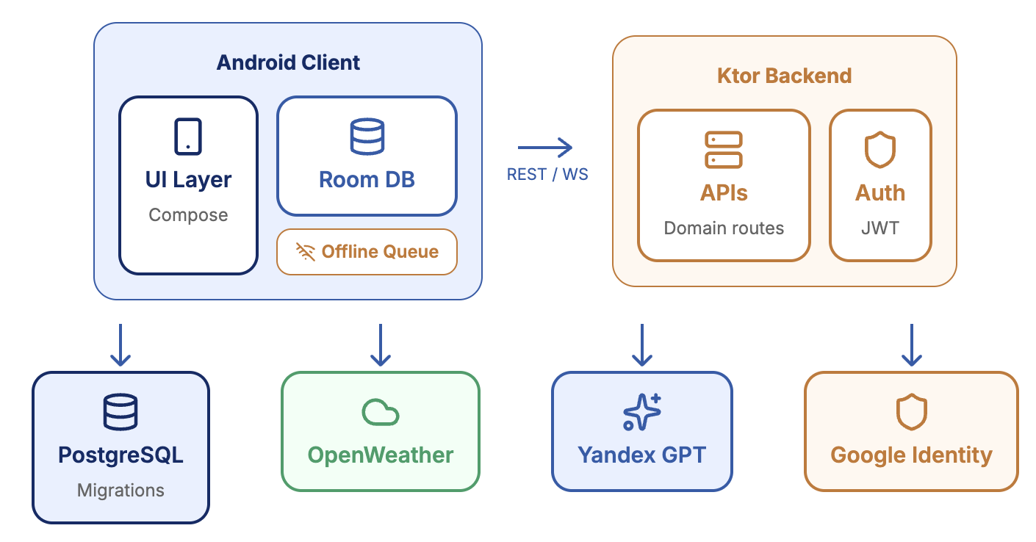
System Architecture
Faculty of Computer Science
Department of Software Engineering
Ilya Novik
iinovik@edu.hse.ru
Android Application for Collaborative Trip Planning
Notes:
The architecture follows a client-server model. The Android app is the client, and the backend is built with Ktor. Domain data is stored in PostgreSQL. External integrations include OpenWeather, Yandex GPT, and Google sign-in. Real-time updates are delivered through WebSocket, and offline changes are synchronized after reconnect.

Slide 7
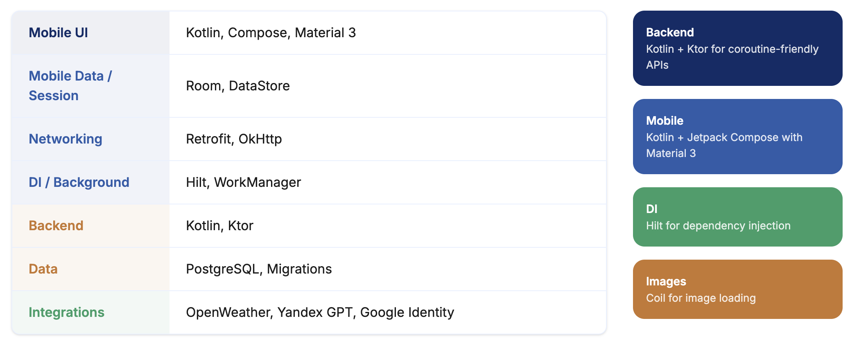
Technology Stack
Faculty of Computer Science
Department of Software Engineering
Ilya Novik
iinovik@edu.hse.ru
Android Application for Collaborative Trip Planning
Notes:
The technology stack is practical and consistent. The mobile side uses Kotlin and Jetpack Compose. Dependency injection is handled by Hilt. Network communication uses Retrofit and OkHttp. Local persistence uses Room and DataStore, and background synchronization uses WorkManager. The backend uses Kotlin, Ktor, and PostgreSQL.

Slide 8
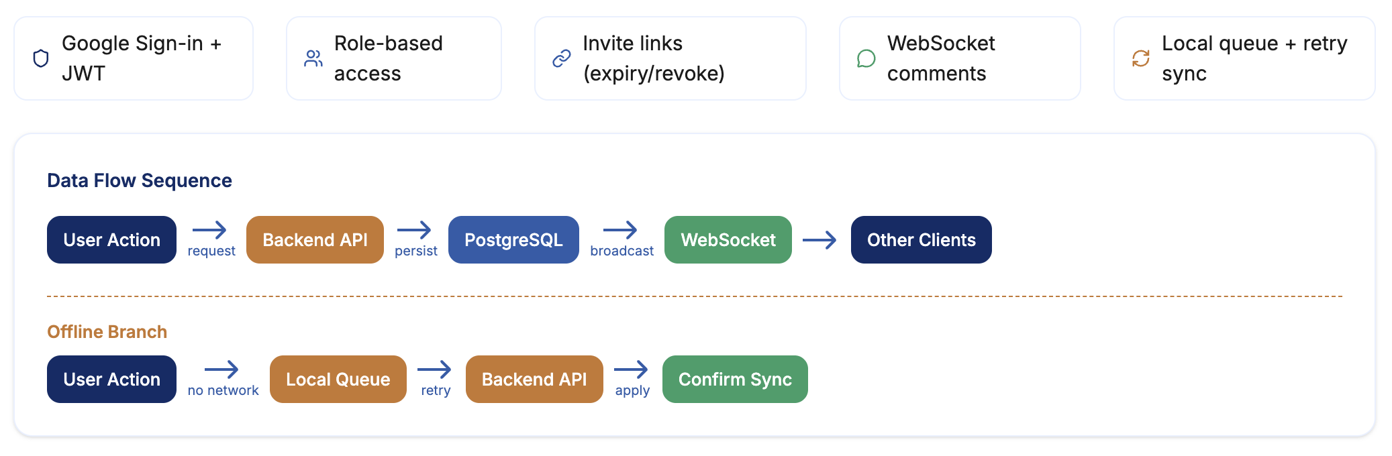
Collaboration, Security, and Sync
Faculty of Computer Science
Department of Software Engineering
Ilya Novik
iinovik@edu.hse.ru
Android Application for Collaborative Trip Planning
Notes:
Security and collaboration are core requirements. Users sign in with Google, and the system uses JWT tokens for protected access. Role-based rules control allowed actions. Invite links include expiration logic. Comments are updated in near real time through WebSocket. If internet is unavailable, changes are stored locally and sent later.

Slide 9
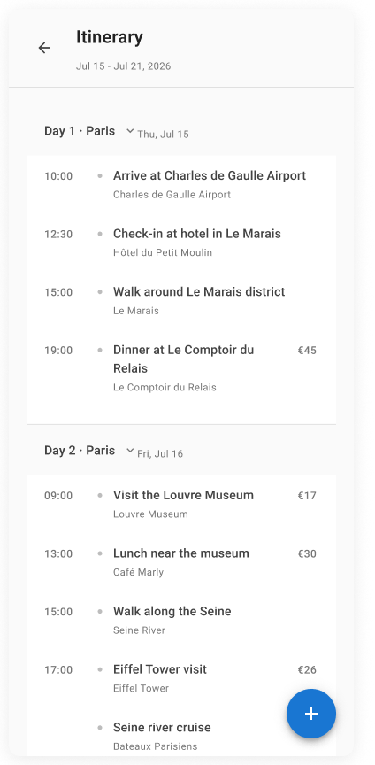
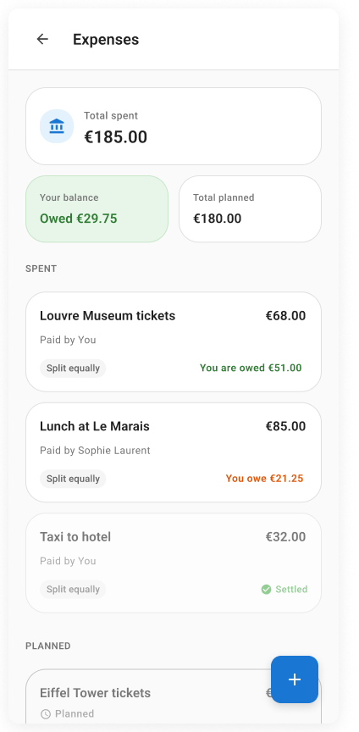
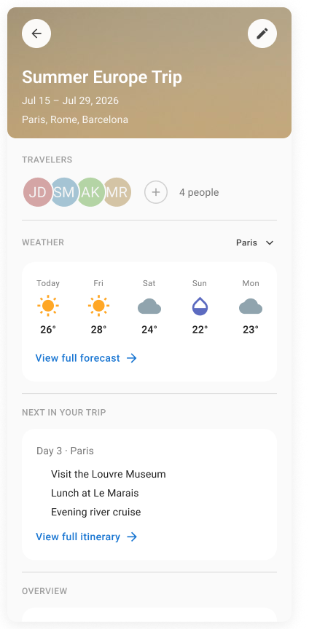
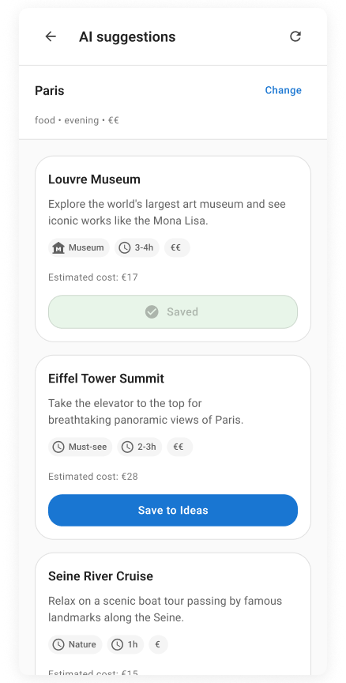
Functional Modules, Weather, and AI
Faculty of Computer Science
Department of Software Engineering
Ilya Novik
iinovik@edu.hse.ru
Android Application for Collaborative Trip Planning
Notes:
The core user value comes from integrated modules. The itinerary subsystem stores trip days and ordered activities. The expense subsystem records shared costs, split logic, and participant balances. Weather context is provided through OpenWeather with cache-aware updates. AI suggestions are generated through provider abstraction, with Yandex GPT as the production provider. Importantly, AI output is advisory and always validated by users before being saved.

Slide 10
Deployment and Publication
Faculty of Computer Science
Department of Software Engineering
Ilya Novik
iinovik@edu.hse.ru
Android Application for Collaborative Trip Planning
Backend deployment on Yandex.Cloud
Environment-based configuration
Logging and health monitoring
Android release configuration and signing
Planned publication in Google Play
Notes:
The system is designed as a production-ready solution. The backend is deployed on Yandex.Cloud and uses environment-based configuration. It also includes logging and health monitoring for stable operation. On the Android side, the project includes release configuration and signing for production builds. The final publication target is Google Play.

Slide 11
Current Progress and Next Work
Faculty of Computer Science
Department of Software Engineering
Ilya Novik
iinovik@edu.hse.ru
Android Application for Collaborative Trip Planning
Implemented: Android modules, backend routes, schema, WebSocket comments, sync worker
Remaining: broader automated tests, sync edge-case hardening, release polishing
Notes:
Most core components are already implemented. Android feature modules are available, backend routes are in place, and database schema with migrations is ready. WebSocket comments and sync worker are also implemented. The next stage includes broader tests, sync edge-case checks, and final release polishing.

Slide 12
Expected Results
Faculty of Computer Science
Department of Software Engineering
Ilya Novik
iinovik@edu.hse.ru
Android Application for Collaborative Trip Planning
A working Android application for collaborative trip planning
Shared trip management for several users
Ideas, comments, and itinerary planning in one workflow
Shared expenses with automatic balance calculation
Weather support and AI recommendations
Backend deployment and Google Play publication readiness
Notes:
The expected result of the project is a working Android application for collaborative trip planning. The application should support several users in one shared trip space. It should combine ideas, comments, itinerary planning, and shared expenses in one workflow. It should also provide weather support and AI recommendations. From the technical side, the expected result includes a deployed backend and an Android build prepared for publication in Google Play.

Slide 13
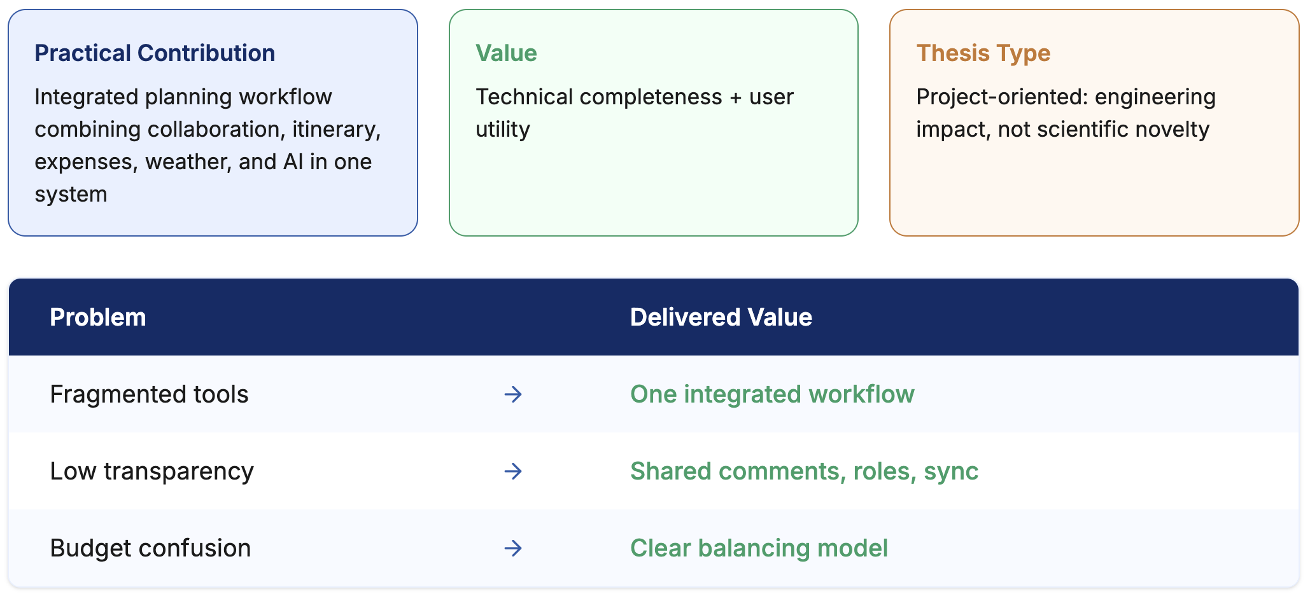
Conclusion
Faculty of Computer Science
Department of Software Engineering
Ilya Novik
iinovik@edu.hse.ru
Android Application for Collaborative Trip Planning
Notes:
In conclusion, the project addresses a common practical problem in group travel planning. It combines planning, discussion, expenses, weather, and AI support in one product. The main contribution is practical engineering value and clear user benefit.

Slide 14
References
Faculty of Computer Science
Department of Software Engineering
Ilya Novik
iinovik@edu.hse.ru
Android Application for Collaborative Trip Planning
[1] Splitwise. https://www.splitwise.com/
[2] Wanderlog. https://wanderlog.com/
[3] TravelSpend. https://travel-spend.com/
[4] TripIt. https://www.tripit.com/
[5] Yandex, "Yandex Travel Simplifies Joint Trips," 2025. https://yandex.ru/company/news/01-03-04-2025
[6] Google Play, "RUSSPASS." https://play.google.com/store/apps/ details?id=ru.russpass.tourist
[7] Ktor Docs. https://ktor.io/docs/
[8] Kotlin Docs. https://kotlinlang.org/docs/
[9] Jetpack Compose Docs. https://developer.android.com/compose
[10] Hilt Docs. https://developer.android.com/training/dependency-injection/hilt-android
[11] Retrofit Docs. https://square.github.io/retrofit/
[12] OpenWeather API. https://openweathermap.org/api
[13] YandexGPT Docs. https://yandex.cloud/en/docs/ai-studio/concepts/generation/models
[14] Google Play Distribution Docs. https://developer.android.com/distribute/google-play
Notes:
This slide shows the references used for analysis, architecture choices, and technology decisions.

Slide 15
Thank you for your attention!
Ilya Novik
iinovik@edu.hse.ru
Notes:
I appreciate your time and attention. Please feel free to ask any questions. I’ll be happy to answer.

