Slide 1
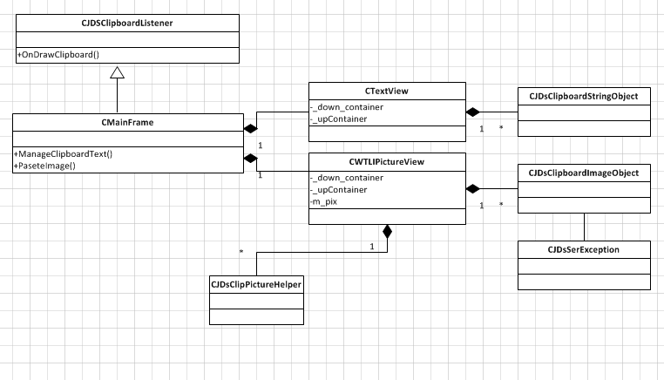
Classes

Slide 2
Classes

