Slide 1


Dot-Run Aesthetics

Slide 2
Colors
Approach from: https://refactoringui.com/previews/building-your-color-palette/

Slide 3
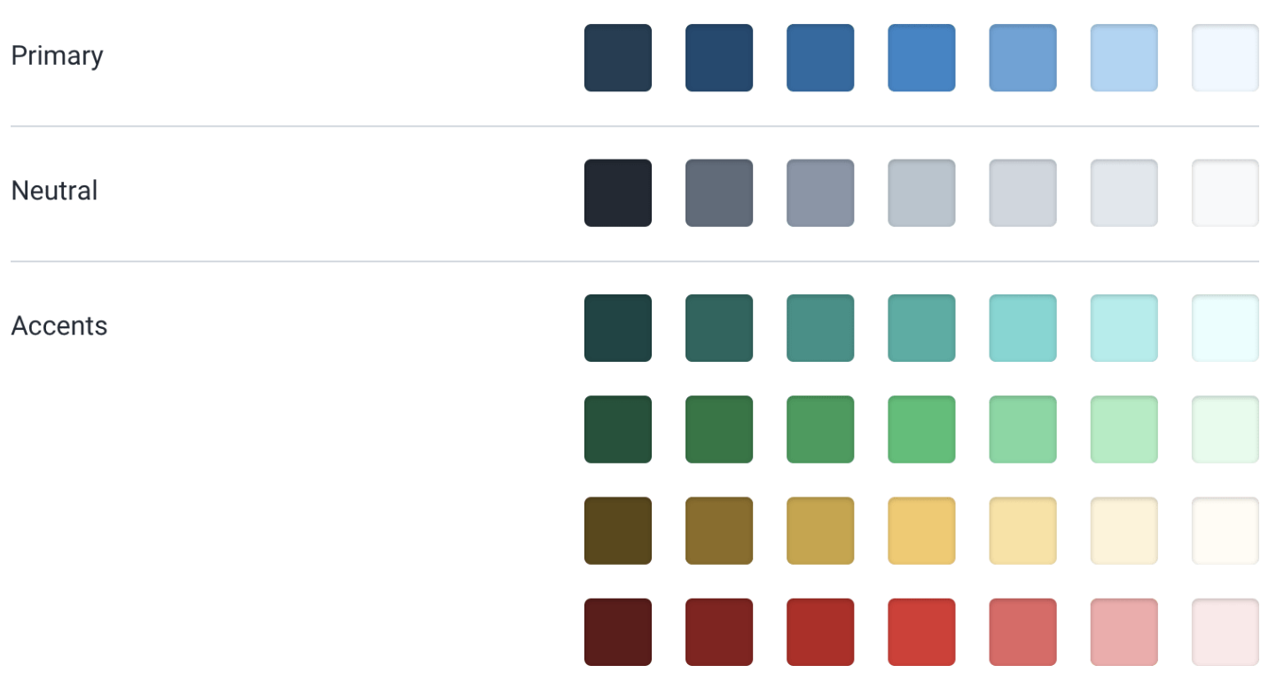
Outline

Slide 4
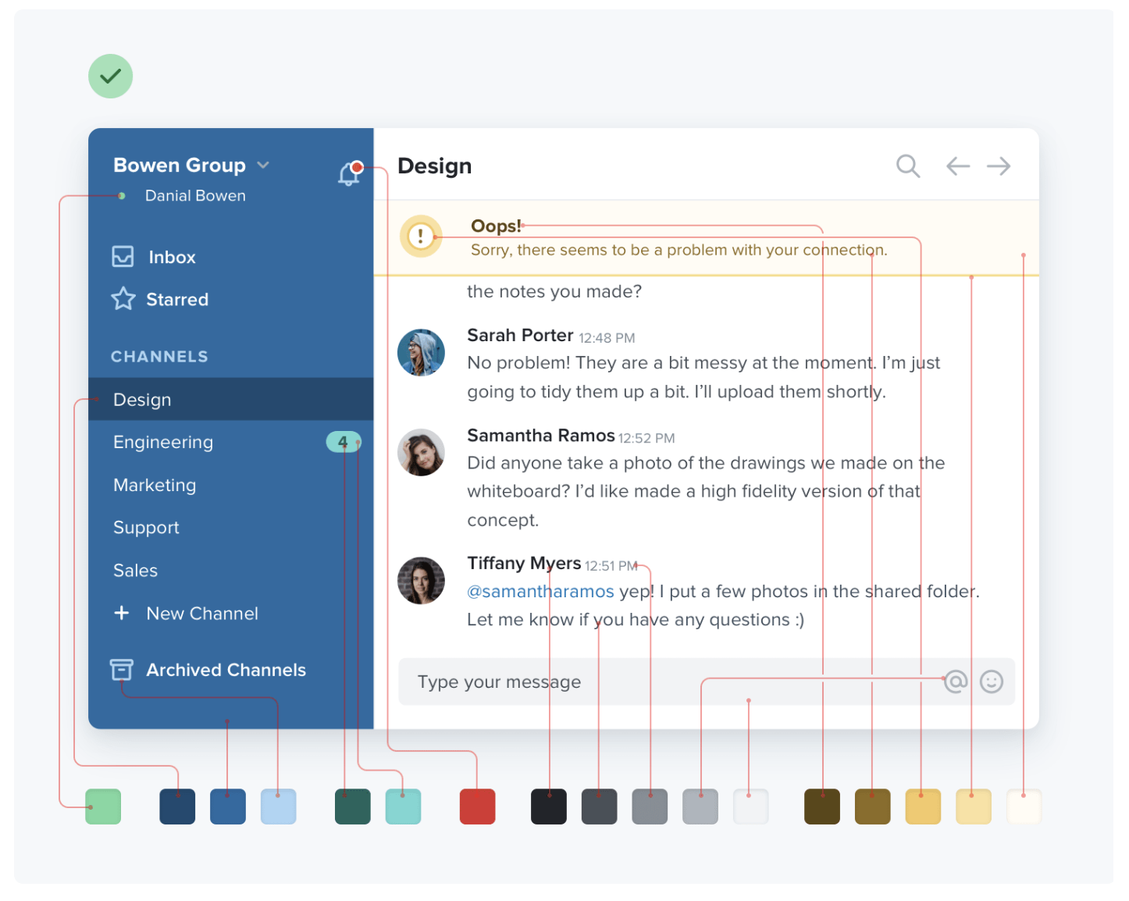
Example

Slide 5
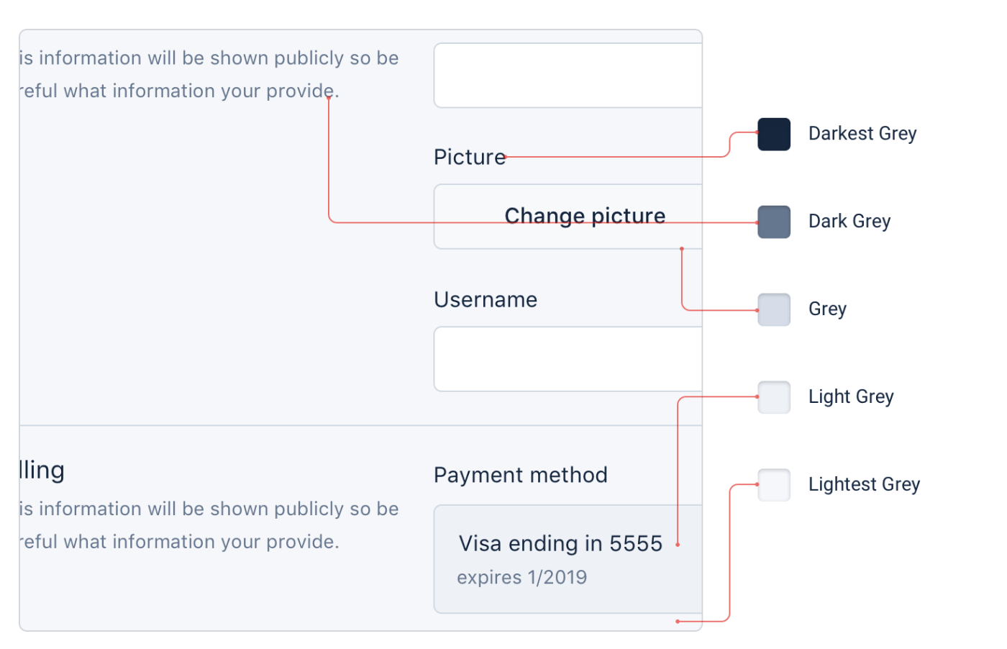
Greys

Slide 6
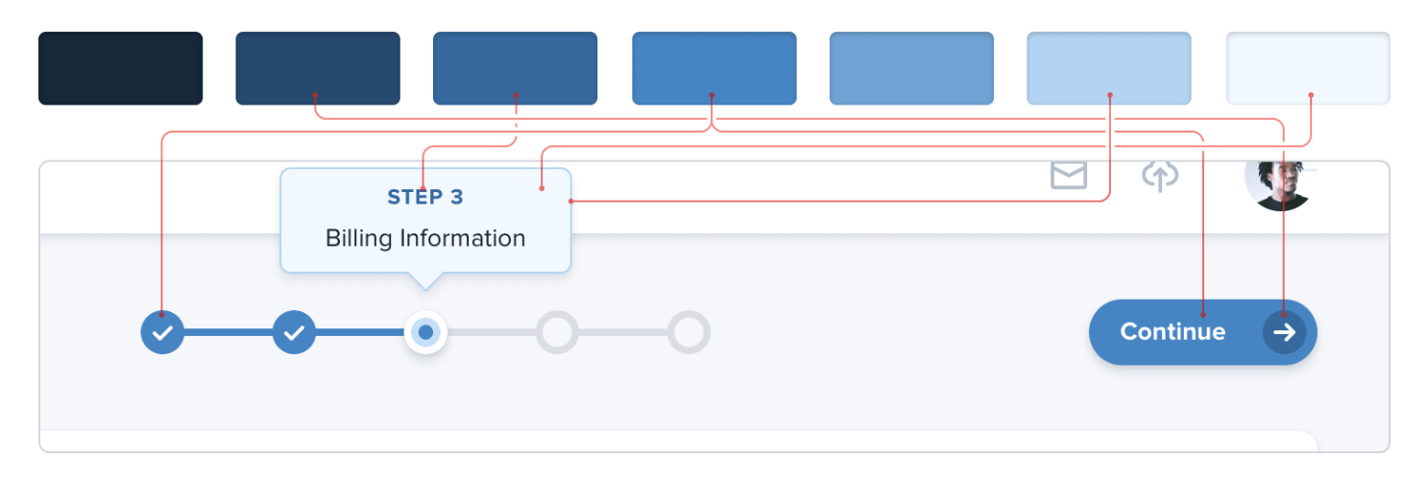
Primary Color

Slide 7
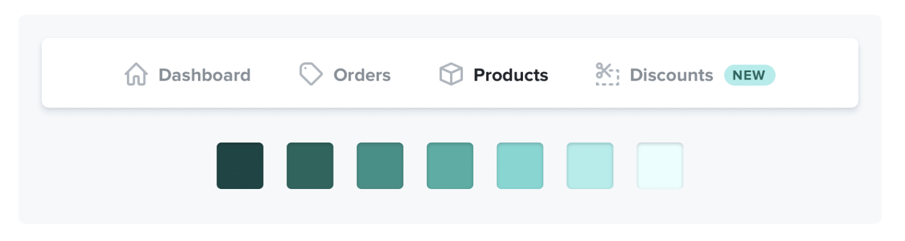
Accent Colors 1 - Neutral

Slide 8
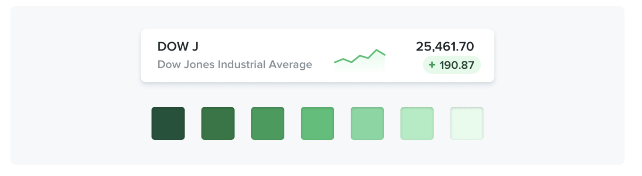
Accent Colors 2 – Things are Good

Slide 9
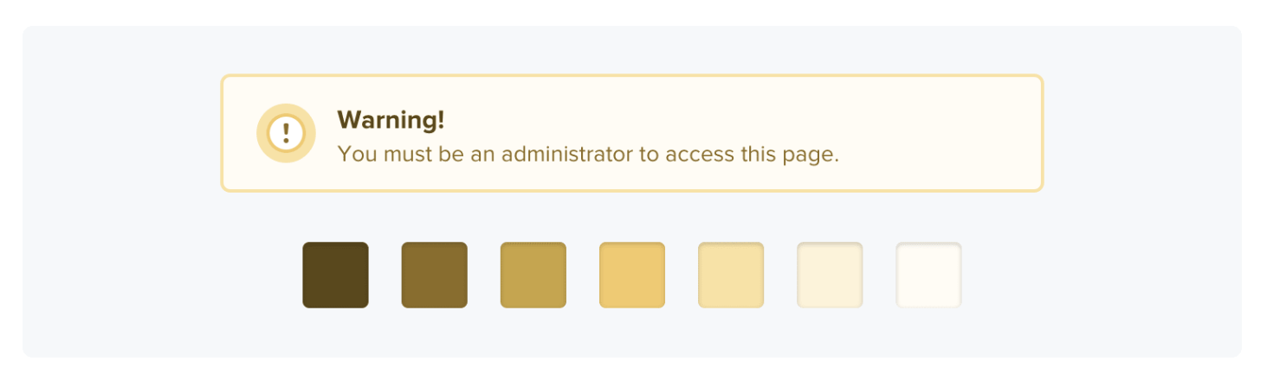
Accent Colors 3 - Attention

Slide 10
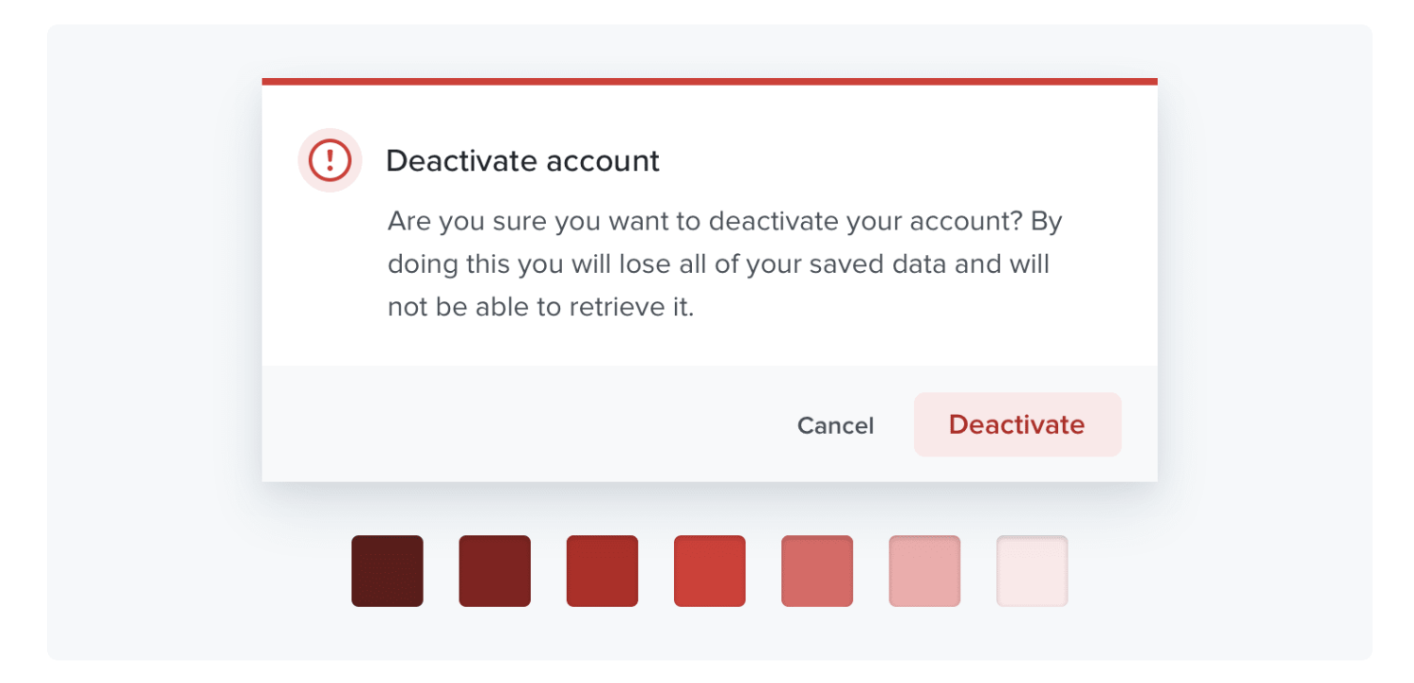
Accent Colors 2 – Things are Bad

