Slide 1
Statistical Query Transformations for Question Answering in the Web
Ilya Boyandin
St. Petersburg State University, 2003
Notes:
In my master thesis I investigated learning query transformation algorithms in the context of question answering.

Slide 2
Question Answering
Goal:
Find a short text fragment which answers the question.
Example:
Q: Who invented the light bulb?
A: Thomas Edison
Notes:
Goal: Given a factual question in a natural laguage…
QA is a more general concept, but this kind of QA is discussed most often currently.

Slide 3
Question Answering
Retrieve answers rather than documents.
Precision is important, recall isn’t.
The “correct” answer is one that can be found in the collection.
No new knowledge is produced.
Notes:
Unlike traditional Search Engines:
Retrieve answers rather than documents in response to a question.
Precision is important, recall isn’t.
Unlike Expert Systems: No new knowledge is produced.
logical deduction

Slide 4
TREC: Text REtrieval Conference
TREC QA Track
  Collection of documents (newspaper)
  Test set of questions
TREC-9 (2002)
  979,000 documents (3Gb of text)
  682 questions (Encarta log, Excite log)
  Best resut: 65% of questions answered (Falcon)

Slide 5
Using Web for QA
Benefits
Vast number of answers
Constant updates
Challenges
Wrong and contradictory answers
Undated information
Heterogeneous, irregular structure
Redundancy
Notes:
Wrong answers: No centralized control over publication.
Irregular: No fixed vocabulary, no strictly defined structure.
Undated information: There can be many different answers to “Who is the President of the USA?” because there are undated and outdated documents.
How does redundancy help? Different phrasings of answers to the same questions: those that are similar to the phrasing used in the given question are easier to find.
Многие системы на TREC2002 использовали Web как data source, но по-разному:
Одни использовали Веб как основной источник ответов, и затем «отображали» документ в документ коллекции, чтобы вернуть его в качестве ответа (ответ – пара: [ответ, документ]).
Другие наоборот: искали ответ в коллекции, а затем проверяли кандидаты в Веб.
А некоторые комбинировали результаты поиска в веб и в коллекции.
Многие системы из TREC2002 после классификации обращались к online справочникам и энциклопедиям, доступным в Веб (federated approach to QA)

Slide 6




Components of a QA System
?
Question
Answers
Notes:
Question is transformed into one or several queries for the IR engine so that most of the retrieved documents contain answers to the given question.
IR engine retrieves documents by the given queries.
Short text fragments containing potential answers are extracted from the documents. Those of them the systems are more confident about are finally returned as answers to the original question.
In my master thesis I was investigating the problem of formulating such queries by a given question that produce the best results for the subsequent steps of QA.
// Question Type is identified. This information is then used in the next steps in some way.

Slide 7
Query Formulation
Goals:
  “Translate” the question into the form the IR engine understands
  Narrow the set of documents to consider
Example:
Question: When was Nabokov born?
Query: Nabokov /4 !born
Notes:
Example: [Question: 1 of first 5 Query: 5 of first 5]
Why Yandex?
Richer query language.
Allowed to make automated requests for my experiments.

Slide 8
Question Transformation
Types of Transformations:
  Remove question words/other words
  Add words/phrases likely to be in the answer
  Add synonyms
  Morphological changes
  Add query language operators
  …
Why Learning?
  Hard to predict what transformations will be better
  Far from all patterns are obvious
Notes:
The problem of query formulation is essentially the problem of transforming the original question into one or more IR engine queries.
Why Learning transformation patterns, why not using Hard-Coded patterns?

Slide 9


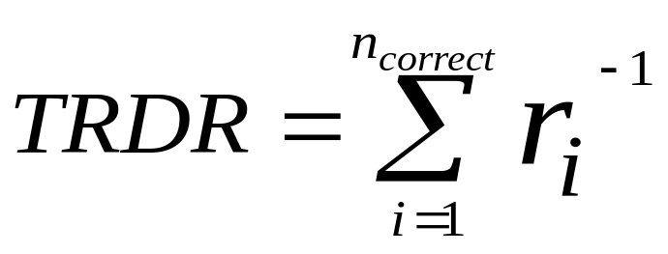
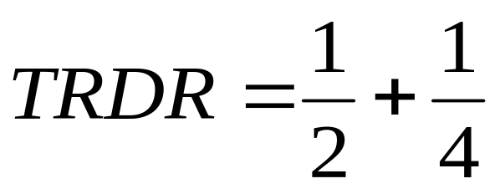
Evaluating Transformations
TRDR Metric:
  Query is sent to the IR engine
  Positions of the documents containing the right answers: (of the first returned documents)
Example:
Radev et al 2001
Notes:
Total reciprocal [ris'iprekel] (обратный) document rank

Slide 10
QASM Algorithm
Atomic Operators
  E.g. add/remove/substitute words
  Transformation is a composition of atomic operators
Query Features
  E.g. type, number of words, number of nouns
  Context of a query: values of all features
  Questions/queries with the same context are treated in the same way
Radev et al 2002
Notes:
For a practical implementation of this algorithm we need to choose a set of atomic operators and query features
A particular implementation can use these or any other Operators and Features: they are not specified in the model.

Slide 11
QASM: Learning
Training Set
  Questions with answers
Iterative Learning
  Applies every atomic operator to the query
  Submits to the IR engine
  Evaluates results, updates the model
  Applies the best operator to the query
  Next iteration
Resulting Model
  Allows to find the best (statistically) operators for any
  context
Radev et al 2002
Notes:
Based on EM algorithm: Proven to constantly give better results converge to a local maximum.
Tries to find the best sequence of atomic operators for each question. Iteratively applies operators, evaluates results, updates the model.
До локального максимума: до тех пор пока наилучшее преобразование не идентичное
Почему локальный максимум существует? Потому что атомарные операции такие
В процессе обучения пытается найти наилучшую последовательность элементарных операций преобразования для каждого из вопросов тренировочного набора и выявить общие зависимости между значениями свойств вопросов и наилучшими операциями для них.
Как обучается?
Основан на алгоритме максимизации ожидания
Пытается применить каждую атомарные операции к вопросу тестового набора, оценивает качество получаемых запросов, модифицирует модель на основании результатов, затем преобразует запрос в соответствии с моделью
После обучения: генерирует преобразование наилучшего предсказанного качества

Slide 12
QASM: Question Transformation
Input:
  Question
Iterative Transformation
  Calculates the context of the query
  Finds the best operator for the context
  If it’s IDENTITY then stops
  Applies the best operator to the query
  Next iteration
Output:
  IR engine query

Slide 13
Experimental Environment
Test set
  100 questions from the Yandex log
Atomic Operators
  Remove words (based on frequency)
  Add query language operators: distance; restrict morphological changes
Query Features
  Question type; Number of words; Number of nouns
Notes:
I build a meta-search engine using Yandex as the underlying system.

Slide 14
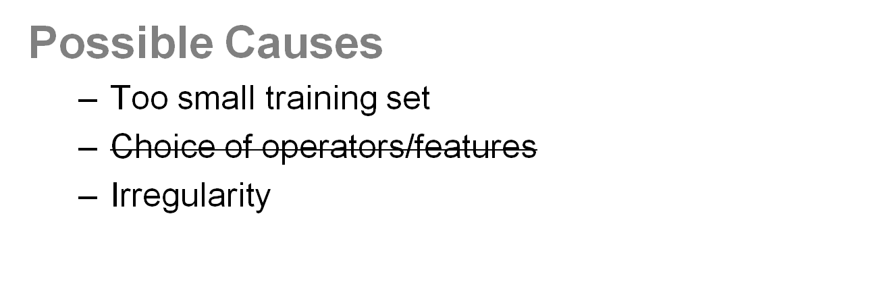
QASM Analysis
Results
  No quality improvement in most cases
Problem
  The selectivity of the generated transformations was
  often too low or too high
Who won the Nobel peace prize in 1975?
Who won the Nobel peace prize in 1979?

Slide 15
“Optimal” QASM
Same atomic operators and query features
Use only the best transformation for each question
Improvement ~50%

Slide 16
mQASM
Changes to QASM
  Generates a set of best queries ordered by selectivity
  Submits queries until there is enough results
  Weights results and builds one ordered list

Slide 17
Evaluation Results
Stability of the Comparisons
  40 random combinations
    60 questions for training, 40 for testing
  Significance level: 5%
  Wins/Losses/Draws
 | Yandex |  |  | QASM
QASM | 2 | 29 | 9 | -
mQASM | 37 | 0 | 3 | 40 | 0 | 0

Slide 18
Evaluation Results
Same Experiment with Google
Environment is the same as with Yandex, except using less atomic operators
 | Google |  |  | QASM
Max | 15 | 0 | 25
QASM | 12 | 4 | 24 | -
mQASM | 15 | 3 | 22 | 8 | 4 | 28

