Slide 1
Smart Energy Arbitrage 2026
Architecture review: Dagster, Docker, data, ML evidence, and DFL roadmap
2026-05-11
Documentation-only review; production code unchanged

Slide 2
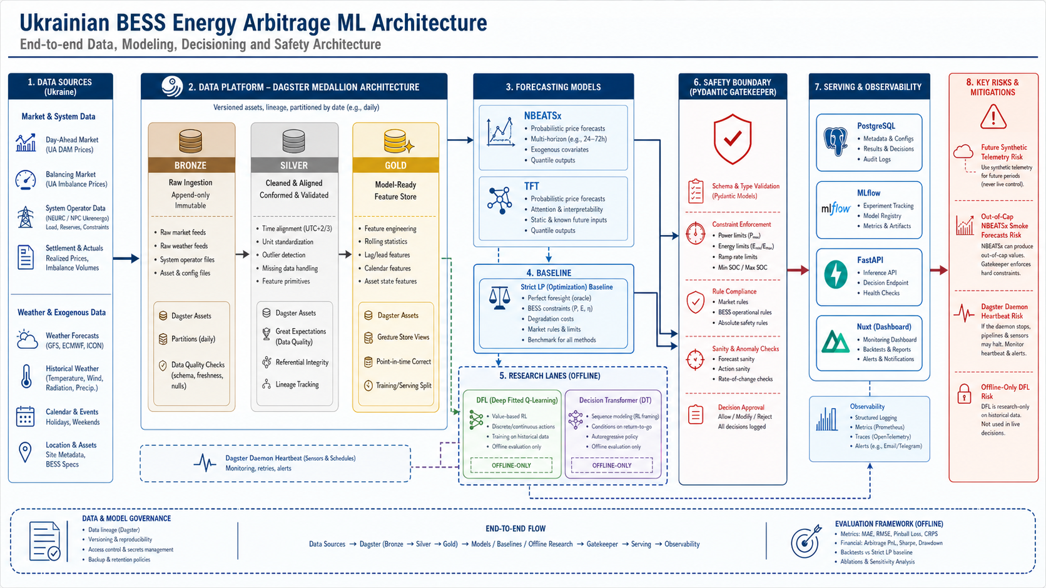
Architecture map

Slide 3
Executive verdict
Direction is coherent and thesis-defensible
Current system is a reproducible evidence platform, not a trading bot
Preserve offline/read-model claim boundaries for DFL and DT

Slide 4
Dagster evidence
109 assets, 25 checks, 2 jobs, 2 schedules, 0 sensors
Medallion tags and evidence-scope tags are useful
Daemon heartbeat warnings need runtime hardening

Slide 5
Docker runtime
API, Dagster webserver, MLflow, and Postgres were running
docker compose config passed
MQTT and telemetry services are defined but were not in current compose ps snapshot

Slide 6
Data audit
OREE observed DAM rows are cap-clean
Open-Meteo tenant coverage is uneven
Synthetic telemetry has future timestamps and must be fixed before live SOC claims

Slide 7
Forecast and strategy audit
strict_similar_day plus LP remains the strongest fallback
Official NBEATSx smoke rows are out of DAM cap and should be quarantined
TFT rows are cleaner but still need value promotion

Slide 8
DFL and Decision Transformer
Schedule/Value Learner V2 has offline read-model promotion only
Decision Transformer is preview-only
Full differentiable DFL and market execution remain blocked

Slide 9
Regulatory fit
NEURC caps require venue-specific forecast sanity gates
EU electricity reform supports flexibility and market coupling
AI Act framing supports logging, human oversight, and deterministic safety boundaries

Slide 10
Immediate roadmap
Fix future synthetic telemetry handling with tests
Add forecast sanity gate/quarantine with tests
Investigate Dagster daemon heartbeat warnings
Add latest-common-panel gate

Slide 11
Defense language
Use: strict LP baseline, forecast evidence surface, offline DFL research lane
Avoid: live trading bot, deployed Decision Transformer, full DFL, production BESS controller
Keep market_execution_enabled=false visible until evidence changes

