Slide 1
SMART ENERGY ARBITRAGE | DIPLOMA DEFENSE
Credentialless Academic MVP with HF Decision Transformer shadow evidence
Fixed boundary
market_execution_enabled=false
no ProposedBid
no market order payload
DT not promoted
V2+ remains fallback
The product boundary is DAM delivery-day operator preview. DT/LAVA is a research-shadow sequence-policy lane, not a promoted controller.
97,431
6940
0
research rows
train sequences
promotable rows
chronological DT shadow train rows
HF DecisionTransformerModel smoke
V13 receipts remain blocked
Defense deck generated from local evidence packets | 2026-05-25
01

Slide 2
BOUNDARY
The diploma MVP passes as operator preview, not as market submission.
PASS
FALSE
FALSE
BLOCKED
Academic MVP
Market execution
DT promotion
Receipt readiness
credentialless thesis demo
read model only
research-shadow evidence
market-submission claim gate
What is valid now
What stays blocked
DAM delivery-day recommendation preview for an operator, backed by source-governance and offline regret/value evidence.
Live DAM/IDM bidding, SCMO/OREE receipt proof, ProposedBid emission, market order payloads, and deployed DT/LAVA control.
Academic MVP + DT Shadow evidence | preview only | market_execution_enabled=false
02

Slide 3
ARCHITECTURE
V2+ stays the teacher/fallback while DT is evaluated as an offline challenger.
Forecast context
Candidate schedules
V2+ comparator
DT shadow lane
Strict gate
calibrated NBEATSx/TFT coverage and DAM features
feasible LP schedule families with SOC/value context
teacher, default strategy, and fallback
candidate-index sequence policy, not raw market actions
LP/oracle regret, value, safety, rolling robustness
Policy target
DT predicts candidate id / schedule family. The selected candidate is expanded into the same hourly charge/discharge/hold table used by the operator preview.
Academic MVP + DT Shadow evidence | preview only | market_execution_enabled=false
03

Slide 4
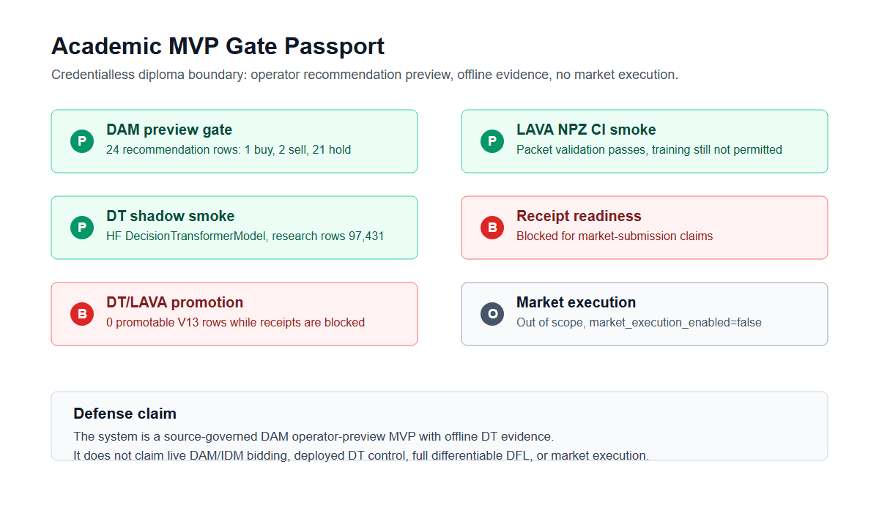
GATE PASSPORT
Credentialless gates pass for preview and smoke evidence; source-readiness gates stay blocked.
Source: docs/thesis/demo-day-2/assets/academic-mvp-gate-passport.png
04

Slide 5
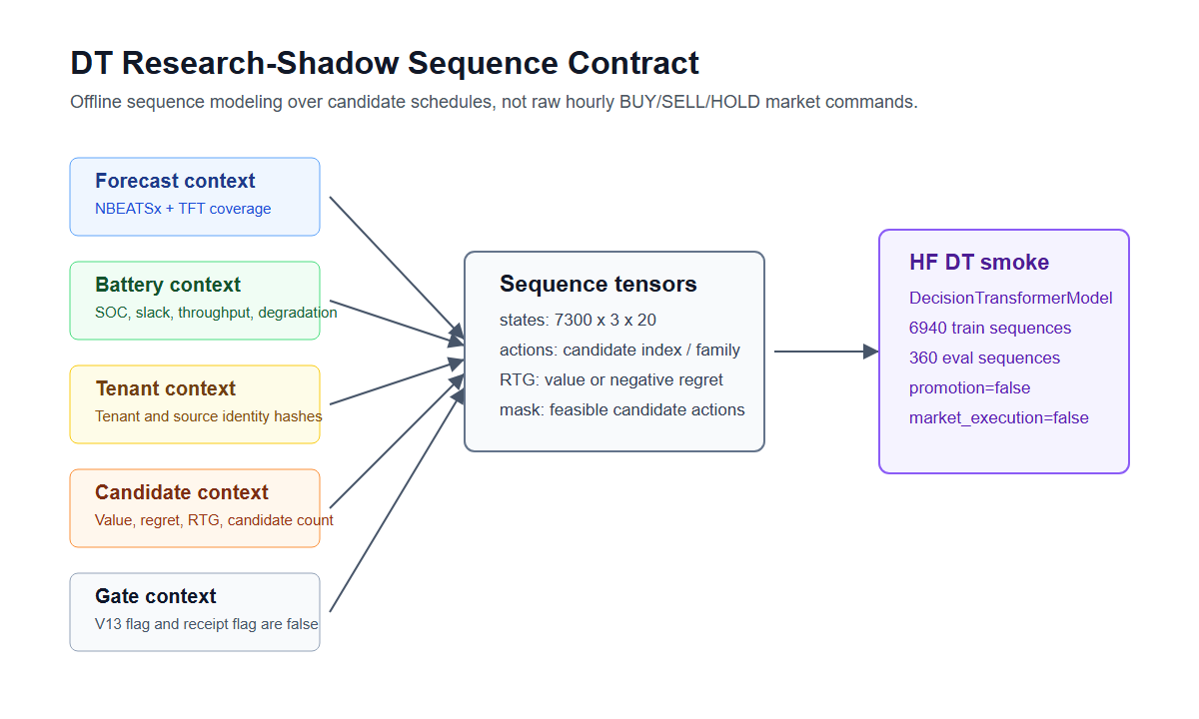
DT DATASET CONTRACT
The transformer is trained on chronological candidate-policy sequences, not market commands.
20
state dimension
forecast + SOC + tenant + gates
7300
sequences
chronological delivery-time split
360
eval sequences
research-shadow holdout
Action target: candidate_index_or_schedule_family; raw hourly BUY/SELL/HOLD is not the model output
05

Slide 6
HF TRANSFORMER SMOKE
The HF-backed DecisionTransformerModel path runs, evaluates, and remains non-promoted.
HF
TRUE
1.026
0
backbone
HF available
train loss
infeasible actions
huggingface_decision_transformer_model
hf_decision_transformer_importable
single smoke epoch
deterministic safety projection
Gate
Evidence
Decision
Chronological split
delivery-time split passes
use for research shadow
Promotion rows
0 V13-permitted rows
block promotion
Market execution
market_execution_enabled=false
block execution
V2+ role
teacher/comparator/fallback
keep default
Academic MVP + DT Shadow evidence | preview only | market_execution_enabled=false
06

Slide 7
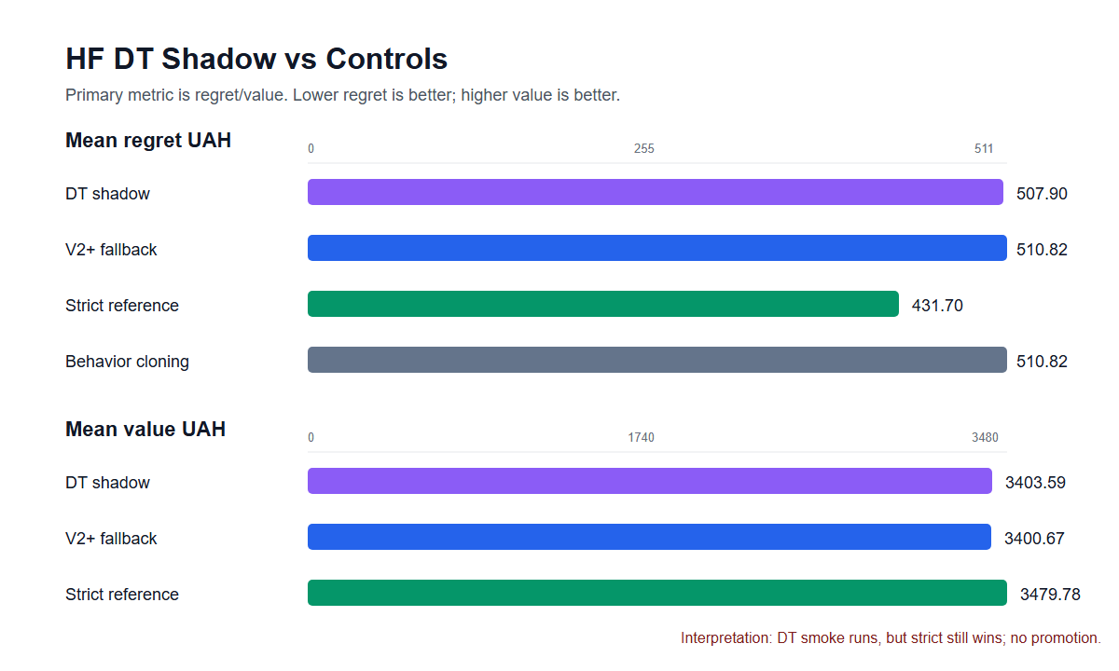
REGRET/VALUE EVIDENCE
DT is useful diagnostic evidence because it is scored against V2+, strict reference, and behavior cloning.
Current result
DT vs V2+ regret: -2.92 UAH
DT vs strict regret: +76.20 UAH
Interpretation: HF DT smoke slightly beats V2+/BC on this eval slice, but strict reference still wins. That means prototype works; promotion does not pass.
Primary metric is regret/value; accuracy remains secondary
07

Slide 8
OPERATOR SWITCH
The dashboard now separates default recommendation from manual DT/shadow inspection.
Best valid recommendation
DT Shadow
Poland/TFT Shadow
DFL diagnostics
V13/DT/LAVA blocked
Default view
DT Shadow preview table
schedule_value_learner_v2_plus
Hour
Action
MW
Status
Best honest/gate-passed strategy. V2+ remains teacher, comparator, and fallback.
00:00
hold
0.000
accepted
01:00
discharge
0.080
accepted
04:00
charge
0.250
accepted
No DT default switch.
06:00
discharge
0.182
accepted
Selected family: frozen_v2_plus_fallback. This is still DT's selected candidate for this tenant snapshot.
Manual shadow preview endpoint: /dashboard/shadow-recommendation-preview
08

Slide 9
NEXT PROMOTION PATH
Move quickly toward real DFL/DT by promoting only through strict offline evidence.
1
2
3
4
5
Freeze V2+
Train challenger
Score through strict gate
Require robustness
Keep no-execution
Keep V2+ as default teacher/comparator/fallback.
Candidate id or schedule-family DT on chronological splits.
LP/oracle regret and value vs V2+, strict, and BC.
Lower mean regret, no median degradation, 4/4 rolling windows.
Zero safety violations and market_execution_enabled=false.
SCMO credentials are not required for this academic promotion experiment.
They only block market-submission-grade publication receipt readiness.
Next step: strict LP/oracle DT challenger benchmark, not market execution
09

