Slide 1
SMART ENERGY ARBITRAGE | UKRAINE 2026
Після Demo 1: від MVP-прев’ю до Offline Strategy Promotion
Claim boundary
Offline/read-model strategy evidence only. No live market execution, no deployed DT, no dashboard/API default switch.
Архітектура, дані, експерименти, результат проти strict_similar_day і межі академічних тверджень.
365
5
33.55%
rolling anchors
canonical tenants
best latest improvement
Ukrainian backfill panel
source-backed evidence
schedule/value learner vs strict
Supervisor progress meeting | 2026-05-13
01

Slide 2
WEEK 2 BASELINE
Demo 1 вже мав end-to-end operator preview, але ще не доказ DFL.
Data
Dagster
Baseline
Read model
Dashboard
OREE / Open-Meteo / tenant YAML
Bronze / Silver / Gold assets
strict_similar_day forecast + LP dispatch
FastAPI evidence and projected SOC
operator preview, not execution
Що було сильним
Що ще не було доведено
Відтворюваний operator-facing контур: tenant -> weather -> baseline recommendation -> SOC/value preview.
Neural / DFL / DT шар був roadmap, не promotion-grade evidence. Потрібні rolling-origin, oracle regret і no-leakage gates.
Source: Week 2 report and demo package
02

Slide 3
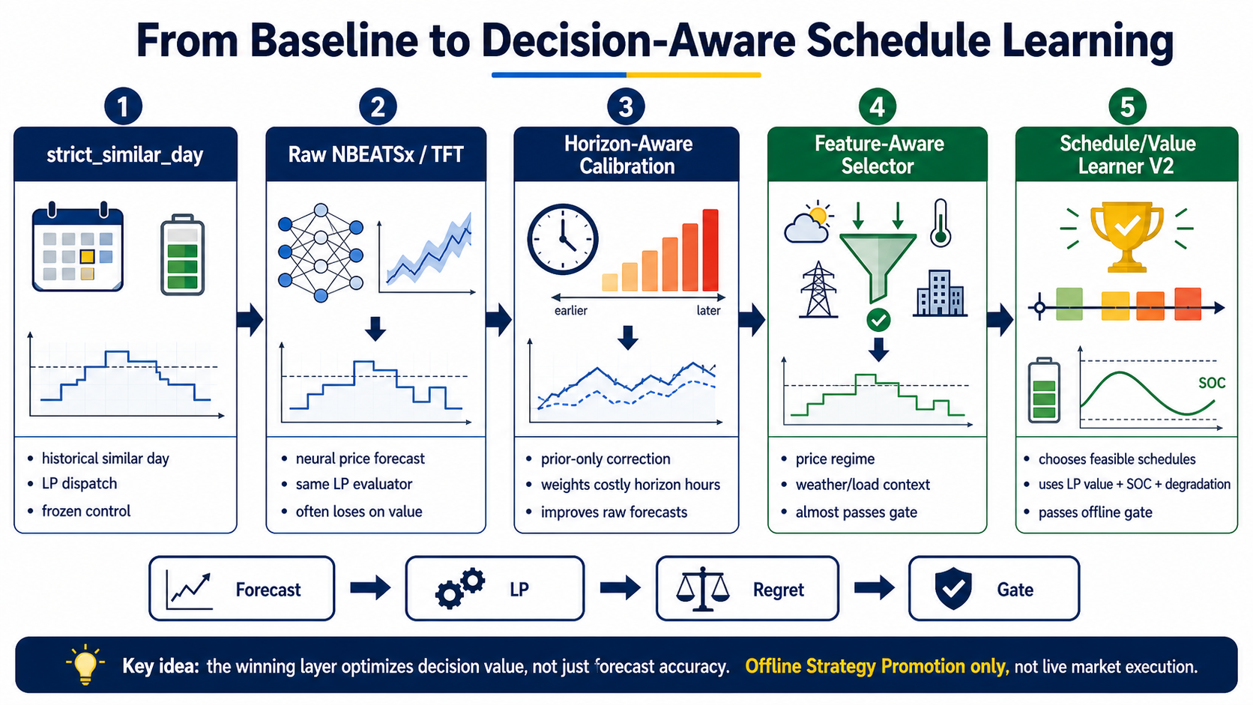

Slide 4
NEW EVIDENCE PIPELINE
Ми перестали питати 'який forecast має менший MAE?' і почали питати 'який schedule має менший regret?'
Observed panel
Official global panel
Candidate library
Schedule/value learner
Promotion gate
OREE DAM + Open-Meteo + tenant/load context
strict/raw/calibrated/perturbed feasible schedules
prior-only selection over feasible LP schedules
strict LP/oracle regret, rolling robustness, fallback
Nixtla-style NBEATSx/TFT training frame
Academic point
Це predict-then-optimize з DFL-style selection: neural forecast є джерелом кандидатів, але фінальна оцінка йде через UAH net value, SOC feasibility та oracle regret.
Every selected challenger remains behind strict_similar_day fallback
04

Slide 5
DATA SHAPE
Поточний headline-result вже не demo/synthetic-only: це source-backed Ukrainian panel.
58,190 x 60
365
1,825
90
0
official panel frame
anchors per tenant
strict rows
latest holdout rows/source
EU rows in training
Nixtla-style training rows/features
largest current UA backfill evidence
5 tenants x 365 anchors
18 anchors x 5 tenants
external features blocked
Layer
What enters evidence
Status
Prices
Observed Ukrainian OREE DAM
used
Weather
Open-Meteo historical context
used
Tenant/load
YAML config + load proxy context
used
Market coupling
ENTSO-E/OPSD/Ember/Nord Pool/PriceFM/THieF
blocked
Source-backed Ukrainian evidence; external feature route prepared but closed
05

Slide 6
RAW OFFICIAL FORECASTS DID NOT WIN
Official global-panel NBEATSx was useful, but not as a direct replacement for strict_similar_day.
strict_similar_day
431.52 mean regret
Interpretation
NBEATSx global-panel raw
708.14
Raw/corrected forecasts still lose over the full 365-anchor panel. The result is not 'NBEATSx forecast superiority'. The breakthrough came from decision selection over feasible schedules.
NBEATSx horizon-calibrated
602.51
Metric: UAH oracle regret; lower is better
06

Slide 7
EXOGENOUS/CONTEXT FEATURES HELPED POLICY SELECTION
Weather/load context fixed the blind spot; feature-aware selectors nearly cleared strict control before official schedule/value learning.
1,560
80.23%
64.83%
55.19%
AFL rows
LP-value failure
rank/extrema failure
spread-shape failure
5 tenants x 2 compact models
main remaining failure mode
price order still hard
forecast shape issue
raw NBEATSx
raw ref
What this proved
feature-aware NBEATSx
299.73
Prior-only Ukrainian weather/load/context features improved selector behavior by 63.15% vs raw NBEATSx and 70.19% vs raw TFT. But they missed the 5% strict-control gate by a small margin: 4.79% and 4.96%.
raw TFT
raw ref
feature-aware TFT
299.19
strict_similar_day
314.81
Do not claim EU market-coupling helped: those features are still blocked
07

Slide 8
SCHEDULE/VALUE LEARNER IS THE FIRST PROMOTION-GRADE RESULT
The learner chooses among feasible schedules; strict LP/oracle still scores the final decision.
Source
Strict mean/median
Raw source mean/median
Learner mean/median
Latest gain
NBEATSx global-panel
310.58 / 198.39
771.26 / 393.49
225.44 / 109.69
27.41%
NBEATSx calibrated
310.58 / 198.39
622.25 / 290.22
206.37 / 96.02
33.55%
4/4
production_promote=true
market_execution=false
rolling strict-control passes
internal field; thesis language = Offline Strategy Promotion
not live bidding; no dashboard default switch
365-anchor result generalizes the earlier 104-anchor signal
08

Slide 9
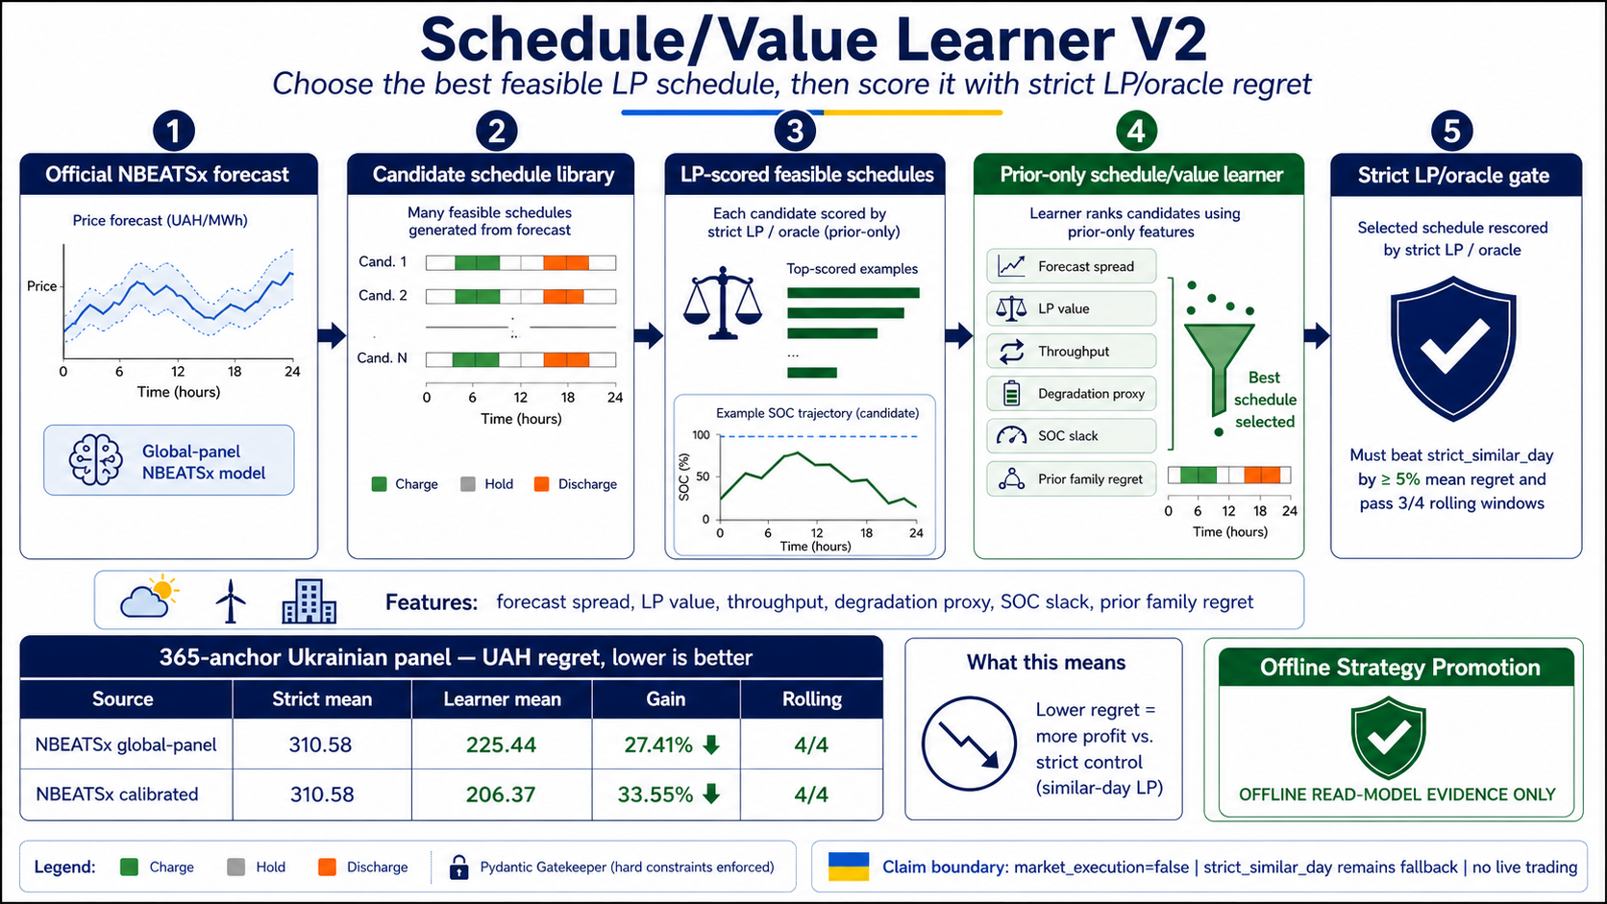

Slide 10
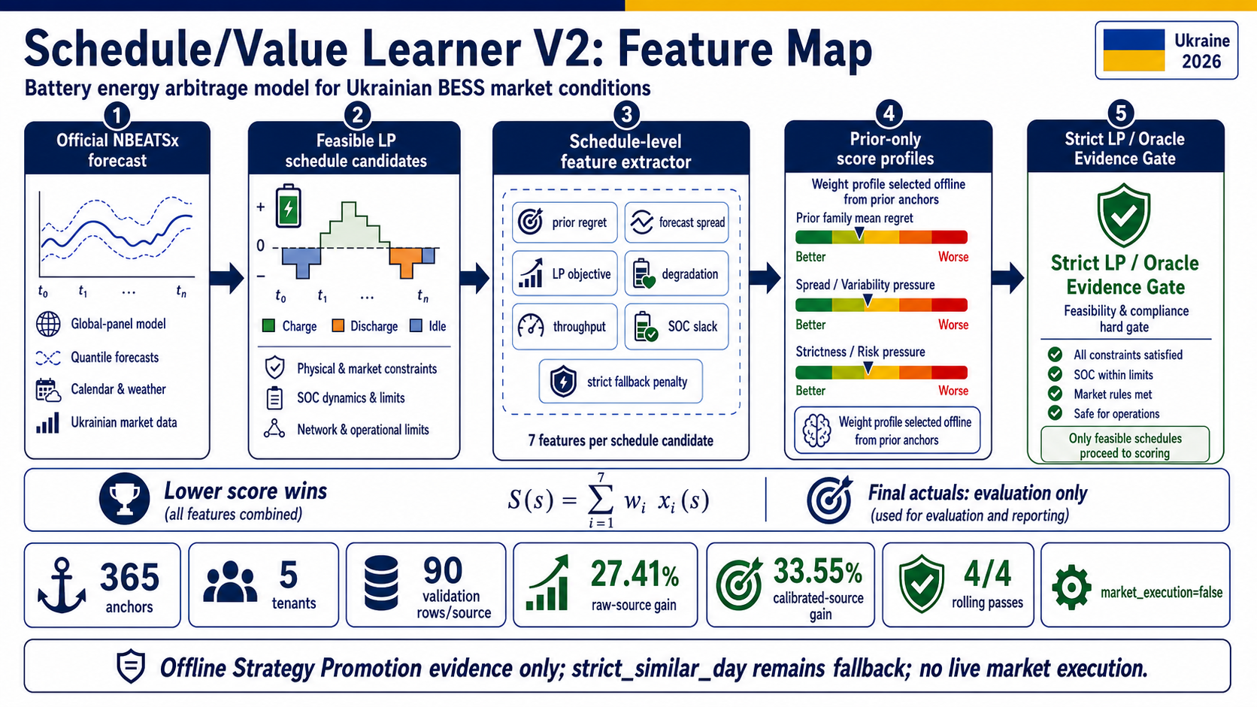

Slide 11
MARKET-COUPLING ROUTE EXISTS, BUT REMAINS CLOSED
European/neighbor signals are prepared as governed feature candidates, not training data.
Source-backed sample
Temporal availability
Normalization
Domain validation
Training route
ENTSO-E / OPSD / Ember / Nord Pool / PriceFM / THieF
published before Ukrainian DAM anchor
timezone/DST + prior EUR/UAH FX + market-rule mapping
licensing + Ukrainian holdout evidence
approved_for_training only after all gates
Current status: 6 external feature candidates, 0 approved external columns. official_global_panel_training_frame records external_feature_training_status=blocked_by_governance.
Boundary: market-coupling features may help later, but did not produce the current promotion result
11

Slide 12
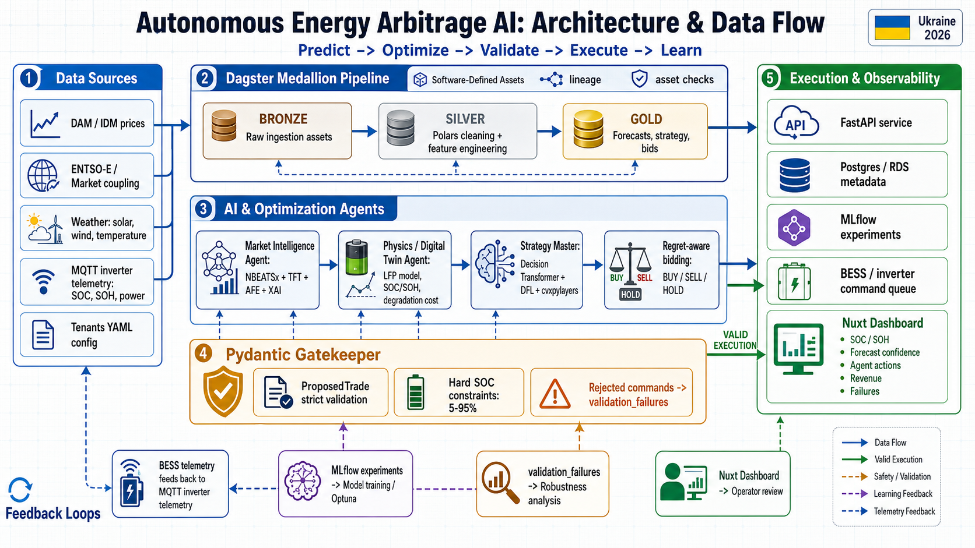
WHAT THIS MEANS FOR THE DIPLOMA
The architecture now has a defensible path from MVP to DFL-style offline evidence.
Thesis claim strengthened
Robust offline schedule/value challenger passed on 365 Ukrainian anchors.
Still scientifically honest
Raw forecasts lose; schedule/value selection creates the decision-value gain.
Next work
GPU/host-CUDA + HF Jobs, UA backfill, governed market-coupling, then later DT.
Bottom line: strict_similar_day remains fallback; DFL-style schedule/value layer is now credible offline strategy evidence.
No live execution claim; Pydantic Gatekeeper remains mandatory
12

Slide 13

EXTERNAL FEATURE BOUNDARY
ENTSO-E, OPSD, Ember, Nord Pool, PriceFM and THieF are represented in governance, not in training results.
Evidence item
Current state
External feature route
6 x 23 rows; all blocked
Approved external columns
0
Training panel status
blocked_by_governance
Allowed columns CSV
empty string
365-anchor result
Ukrainian OREE + Open-Meteo/load only
Simple answer: ні, ці джерела ще не потрапили в training або в promoted result. Вони є у source map і governance route, щоб майбутнє підключення не створило leakage.
Source: MARKET_COUPLING_EXOGENOUS_FEATURE_INTERFACE.md
13

Slide 14
HORIZON-AWARE REGRET-WEIGHTED CALIBRATION
Це prior-only correction: модель вчиться, на яких годинах горизонту її помилки дорожчі для LP schedule.
Prior anchors
Regret weights
Horizon correction
Strict LP score
only already-known forecast/actual/evaluation rows
hours that cause high lost UAH get more influence
per-hour bias/spread adjustment, no final-holdout actuals
same oracle regret gate after calibration
raw TFT
2361.96
Plain explanation
calibrated TFT
1727.29
If a forecast is wrong at a boring hour, it matters less. If it is wrong at a charge/sell peak, it can break the LP value. Calibration learns this horizon pattern from prior anchors only.
raw NBEATSx
2070.28
calibrated NBEATSx
1804.38
strict_similar_day
1384.70
Dnipro 90-anchor calibration preview: improved neural candidates, not a baseline replacement
14

Slide 15
REMAINING FAILURES ARE DECISION/RANKING FAILURES
Простими словами: модель часто помиляється не просто в ціні, а в тому, які години треба заряджати або продавати.
80.23%
64.83%
55.19%
LP-value failure
rank/extrema failure
spread-shape failure
schedule loses UAH value vs strict
wrong high/low price hours
wrong daily arbitrage spread
LP-value
Rank/extrema
Spread-shape
Forecast may look close, but the resulting charge/discharge schedule earns less money.
Battery arbitrage depends on catching the cheapest and most expensive hours, not average error.
If the model flattens or exaggerates the spread, LP chooses the wrong energy cycle.
AFL audit: context missing rate fixed; dominant blocker is value/ranking quality
15

Slide 16
WHY SELECTORS ALMOST PASSED, AND SCHEDULE/VALUE CLEARED THE GATE
Feature-aware rules improved raw neural schedules; schedule/value learner used richer feasible-schedule features and passed robustness.
Stage
NBEATSx
TFT / calibrated
Decision
Feature-aware selector
299.73 mean; +4.79% vs strict
299.19 mean; +4.96% vs strict
useful, just below 5% gate
Schedule/value learner V2
225.44 mean; +27.41% vs strict
206.37 mean; +33.55% vs strict
passes latest + 4/4 rolling
Selector inputs
Schedule/value inputs
Gate
Outcome
price regime, spread volatility, rank stability, weather/load context
forecast spread, LP objective, throughput, degradation, SOC slack, prior family regret
>=5% mean improvement, median not worse, 90 holdout rows, 4 rolling windows
Offline Strategy Promotion; strict remains fallback; no market execution
Architecture detail: final-holdout actuals score decisions only; they do not choose selector rules or learner weights
16

