Slide 1
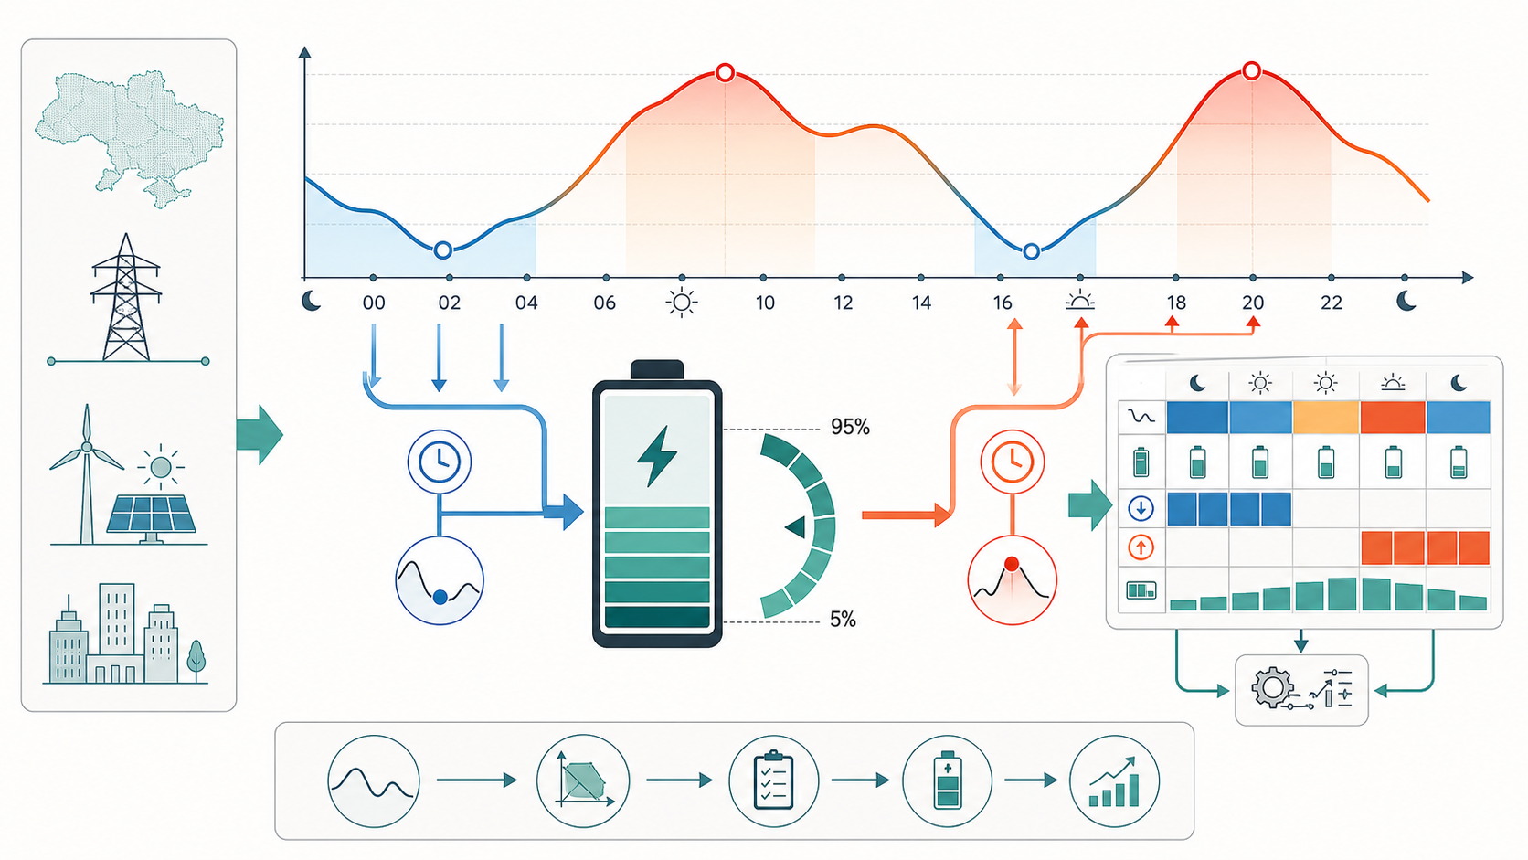
01
LP смотрит на 24 часа цен. Если цена низкая - выгодно зарядить батарею. Если цена высокая - выгодно разрядить и продать энергию. Он выбирает не одно действие, а весь безопасный профиль charge/discharge/SOC.
Как работает LP
Механизм покупки, продажи и физических ограничений
max sum_t [ price_t * (discharge_t - charge_t) * dt - k_deg * (charge_t + discharge_t) * dt ]
- SOC: 5-95% емкости
- charge/discharge <= max power
- SOC_t+1 = SOC_t + charge*sqrt(RTE)*dt - discharge/sqrt(RTE)*dt
- Коммитится только первый час rolling horizon
Результат: BUY если net_power < 0, SELL если > 0, HOLD если около 0.
DAM recommendation preview / offline evidence / no market execution
market_execution_enabled=false

Slide 2
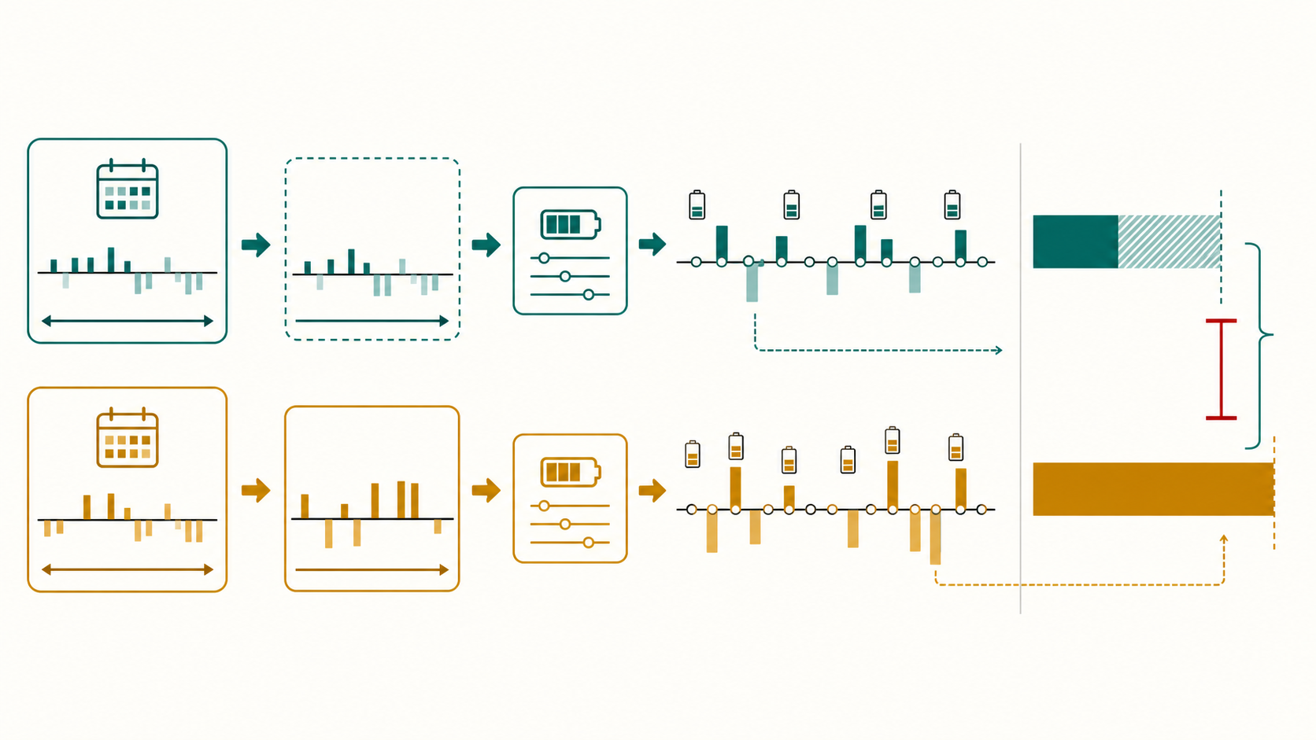
02
Strict benchmark не обучается. Он берет похожий прошлый день как прогноз: для Tue-Fri чаще yesterday, иначе same weekday last week. Потом LP строит schedule по этому прогнозу.
Strict Similar Benchmark
Как считается regret и связь с oracle
regret = oracle_value - achieved_value
- achieved_value: schedule из strict forecast, оцененный на actual prices
- oracle_value: тот же LP, но с actual future prices
- oracle - это верхняя планка, не реальный доступный режим
- Меньше regret = лучше decision quality
Benchmark нужен как честный frozen comparator для V2+, DT и forecast models.
DAM recommendation preview / offline evidence / no market execution
market_execution_enabled=false

Slide 3
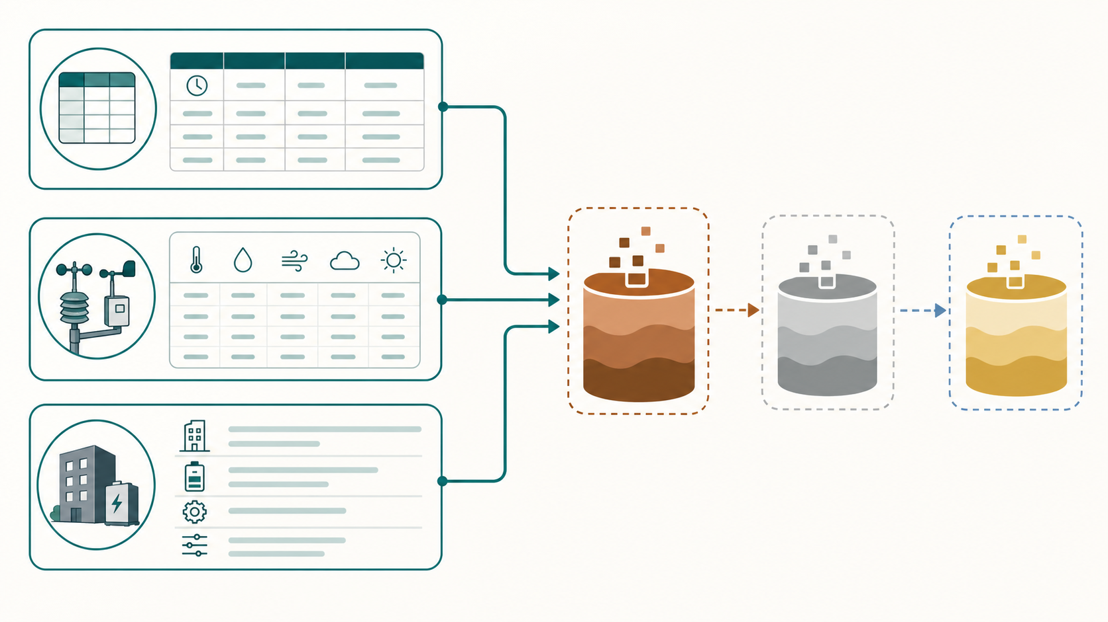
03
Основной raw input - hourly rows: timestamp + price/weather/source metadata. Украинская цена DAM одна для market zone IPS; tenants отличаются погодой, координатами, BESS параметрами, SOC и economics.
Raw Data
Какие данные входят сырыми и какой формы
hourly row = timestamp + tenant_id/source + value columns + provenance
- OREE DAM: hourly price, UAH/MWh, market zone IPS
- Open-Meteo: hourly weather by tenant coordinates/timezone
- Tenant config: capacity, power, SOC limits, degradation cost
- Synthetic fallback rows are demo stability only, not measured-performance claims
Pipeline shape: Bronze observed rows -> Silver features -> Gold schedule/evidence rows.
DAM recommendation preview / offline evidence / no market execution
market_execution_enabled=false

Slide 4
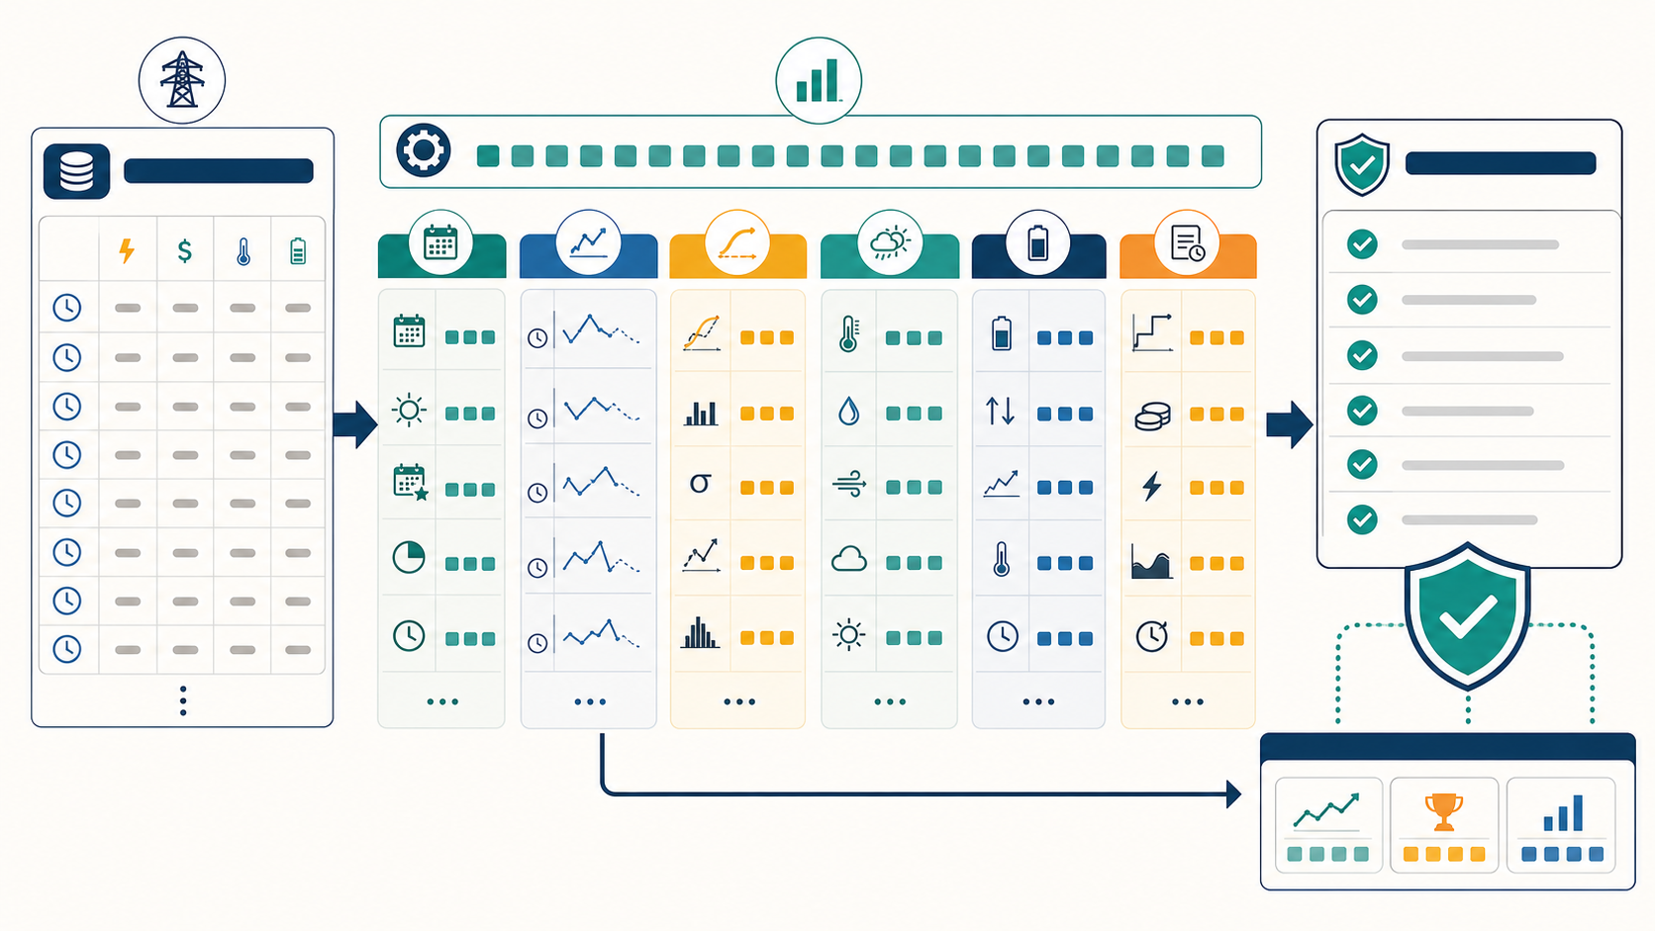
04
Features создаются после source/governance checks. Они описывают время, историю цен, погоду, батарею и candidate schedule. Важное правило: нельзя использовать future actual/oracle/regret как input.
Features
Что создается, как выбирается и где используется
features_t = calendar + lags + rolling stats + weather + BESS + candidate context
- Forecast stage: calendar, lags, rolling price stats, forecast-available weather
- LP stage: forecast vector + BESS limits + degradation cost
- V2+/DT stage: prior context, candidate family, dispatch/SOC/throughput summaries
- Leakage guard blocks actual/oracle/regret/labels from selector inputs
Features are chosen by availability at decision time, not by after-the-fact usefulness.
DAM recommendation preview / offline evidence / no market execution
market_execution_enabled=false

Slide 5
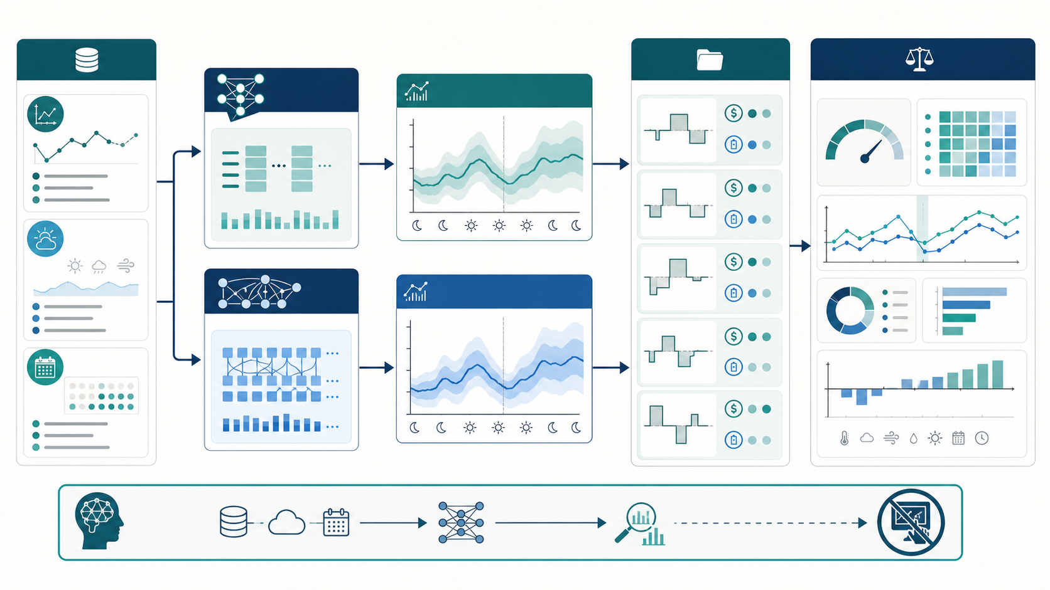
05
TFT/NBEATSx - это forecast adapters. Они дают hourly price forecast and explanatory signals. Дальше LP/candidate scorer превращает прогноз в feasible schedules; V2+/DT выбирают между candidate schedules.
TFT и NBEATSx
Их роль в V2+ и DT strategy
history + exogenous features -> forecast vector -> LP/candidates -> evidence
- Они не являются controller и не отправляют market bids
- TFT полезен еще и VSN/explainability evidence
- NBEATSx/TFT сравниваются через same frozen LP/oracle scorer
- Текущие claims: adapter readiness/research evidence, not SOTA execution
Short version: forecast layer, not execution layer.
DAM recommendation preview / offline evidence / no market execution
market_execution_enabled=false

Slide 6
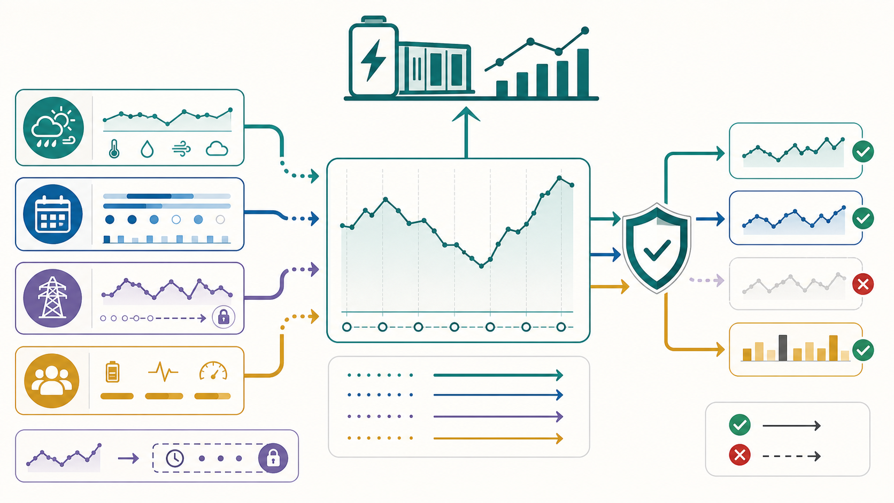
06
Exogenous features - внешние сигналы, которые известны до решения и помогают объяснить price regime: weather, calendar, neighboring-market context, tenant context.
Exogenous Features
Что это, какие используются, что с Poland
target = UA DAM; exogenous = context, not replacement target
- Used/available: weather, calendar, tenant/BESS context, lagged market features
- Poland lane: ENTSO-E PL day-ahead price aligned as lag-24 context
- Poland features: lag-24 level, deltas, daily spread/rank, peak/trough hour
- Governance blocks EU/PL rows from becoming Ukrainian training targets
Current Poland result is not promoted: mechanically usable, but weaker than frozen V2+.
DAM recommendation preview / offline evidence / no market execution
market_execution_enabled=false

Slide 7
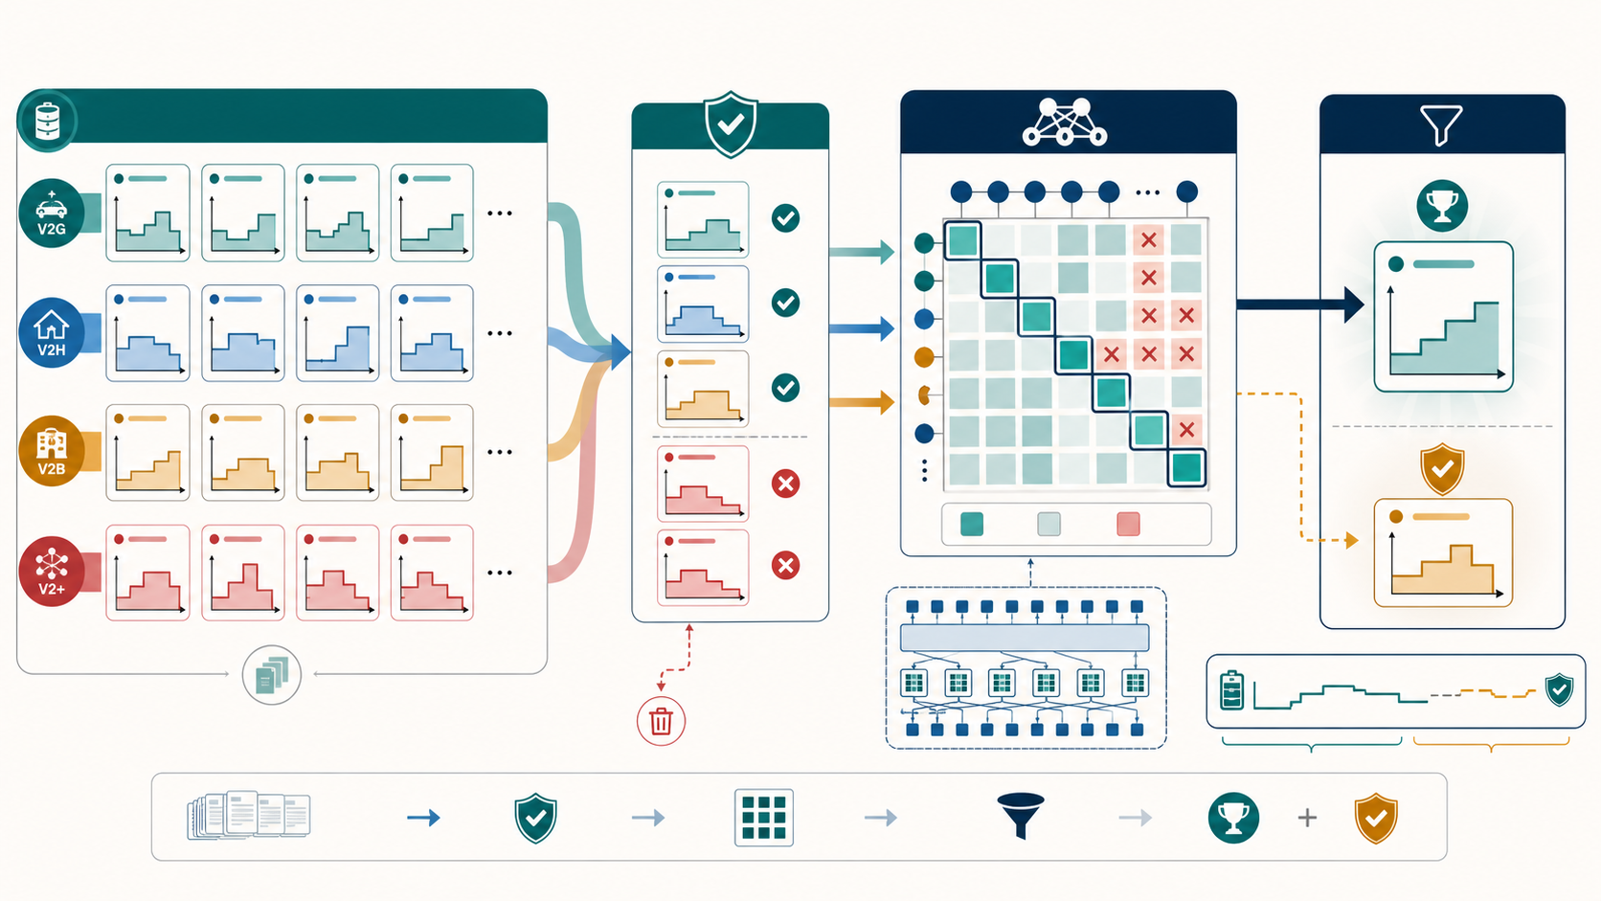
07
V2+ builds a candidate library: several schedule families perturb or guard the baseline schedules, then each candidate is LP/oracle-scored offline. The selector chooses the lowest prior-regret/value candidate, with fallback to frozen V2.
Schedule Selection
Как V2+ создает много schedules и как DT выбирает safe schedules
candidate library -> safety/feasibility -> prior-only selector -> selected family
- V2+ families include extrema perturbation, spread penalty, neighborhood shift, block reconciliation, terminal SOC target
- DT-shadow does not output raw hourly actions; it predicts when switching away from V2+ is safe
- It switches only if predicted improvement clears threshold and tail-risk guard passes
- Otherwise it abstains and keeps V2+
All of this is offline recommendation evidence, not market execution.
DAM recommendation preview / offline evidence / no market execution
market_execution_enabled=false

Slide 8
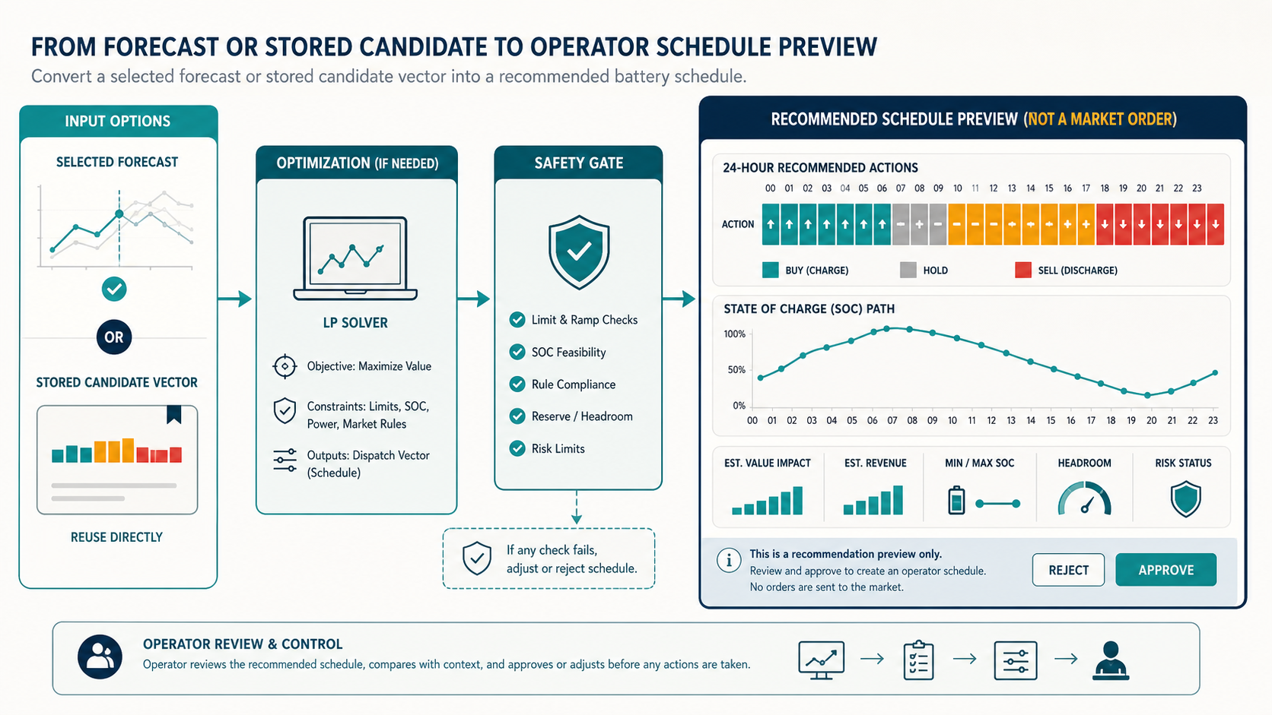
08
If the selected input is a forecast, LP solves charge/discharge/SOC under battery limits and creates a feasible 24h schedule. If the selected input is an existing candidate, the system reuses its stored dispatch vector.
From Prediction to Recommendation
How forecast/candidate becomes feasible LP schedule
stored dispatch vector = [dispatch_mw at hour 1...24] plus SOC/action metadata
- forecast vector -> LP -> dispatch_mw_vector + soc_fraction_vector
- candidate row already stores dispatch_mw_vector from earlier LP/candidate scoring
- operator preview reads committed_action and committed_power_mw
- Gatekeeper blocks candidates outside physical/market envelope
The output is BUY/SELL/HOLD recommendation schedule, not ProposedBid.
DAM recommendation preview / offline evidence / no market execution
market_execution_enabled=false

Slide 9
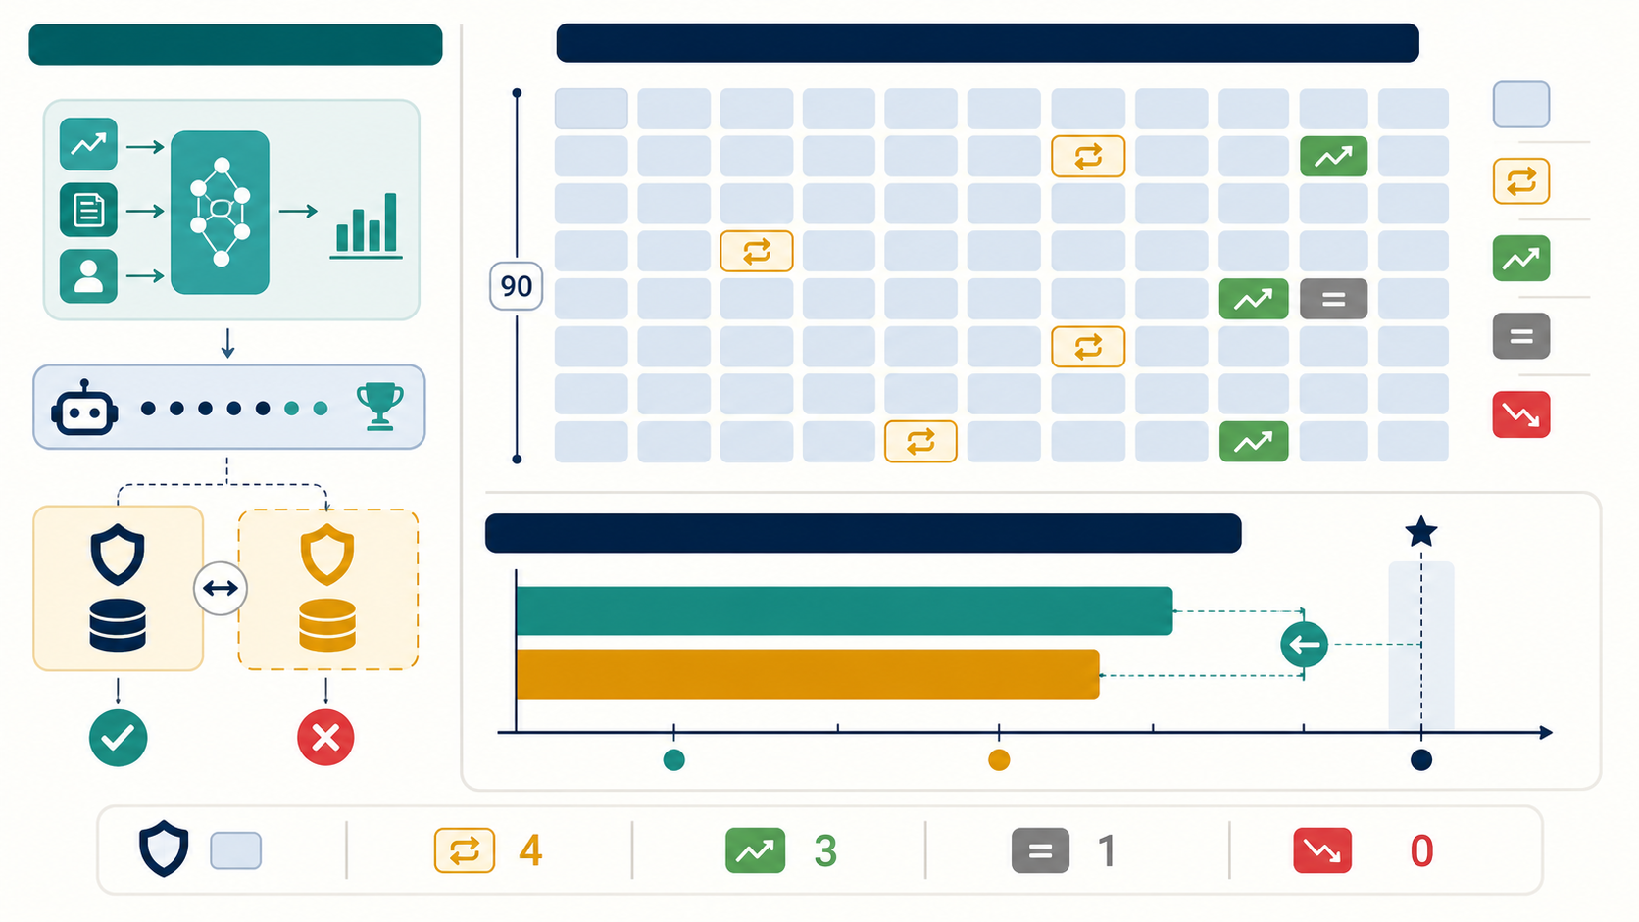
09
The selector was conservative. Out of 90 final anchors, it kept V2+ for 86 and switched only 4 times to strict_reference. Those 4 switches produced 3 lower-regret wins and 1 equal-regret tie, with 0 losses.
Current DT Shadow Candidate
Why 3 wins and 1 tie; how it got about 3.8% better than V2+
mean regret: V2+ 174.77 UAH -> selected 168.16 UAH = 3.78% lower
- Wins: Kyiv mall, Lviv office, Odesa hotel at 2026-04-15T23:00
- Tie: Kharkiv hospital at the same anchor
- It noticed a prior-context/candidate-family pattern where strict_reference looked safer than V2+
- It did not see future oracle; oracle/regret scored the choice afterward
Boundary: V2+ remains default; DT/LAVA not promoted; market_execution_enabled=false.
DAM recommendation preview / offline evidence / no market execution
market_execution_enabled=false

