Slide 1
Nature of cooperation
RDGCTF 2024

Slide 2
Problem
You have to connect via TCP to the server to send and receive messages.
Use one of the tools to connect manually: ncat (netcat), telnet, putty.
When connected the rules are described and one of the plots is chosen.

Slide 3
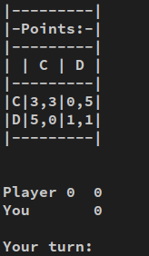
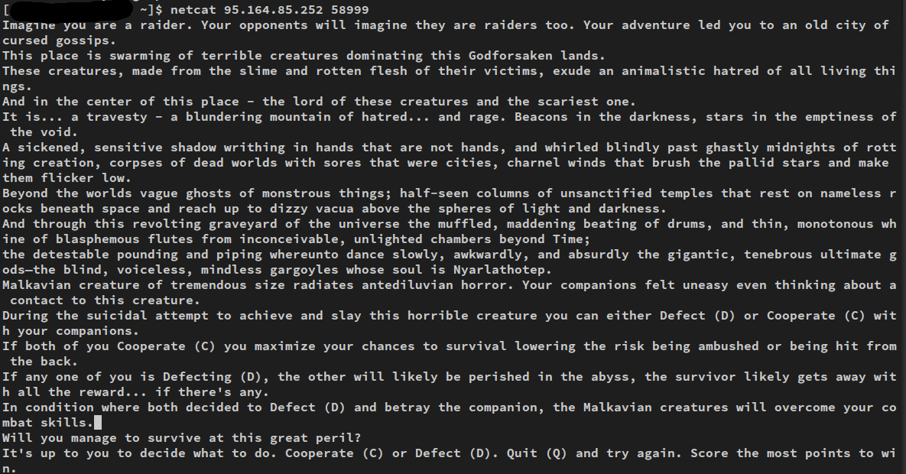
Problem

Slide 4
Problem
Every turn you have to make a decision: continue cooperating (C) or defect (D).
It depends on the decision what score each player gets.

Slide 5

Problem
The most profitable decision is to defect (D) on the current turn against the cooperation (C) of the opponent. However, the opponent might do it first and mutual defect would lead to a non-profitable result for both sides.
Moreover, the opponent would lose trust, that can affect his decisions in the future.

Slide 6
Problem
There’re 12 players (bots) in this version of the game and each one implements a unique strategy to achive the result.
1 round with each other player.
Everyone plays with everyone.
There’re 100 +/- 10 turns in a single round.
Every player to do 1200 turns and there are 78 rounds overall.

Slide 7
Solution
Let’s write a simple Python program to communicate with the server:
from socket import *
# create a TCP socket and connect the dedicated IP, port
s = socket(AF_INET, SOCK_STREAM)
s.connect((HOST, PORT))
text = s.recv(20_000) # receiving the server’s message
while True:
text = s.recv(20_000)
print(text.decode())
if text == b"":
break
elif text.endswith(b"Your turn: "):
s.send(b"C\n") # sending the decision
s.close()

Slide 8
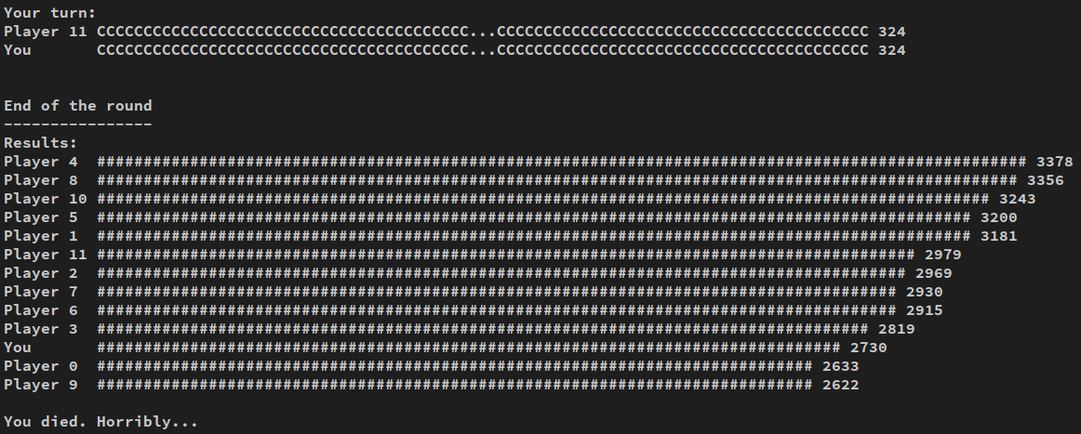
Solution
Now we have learned to send the same answer. Such an approach will not lead us to a good result.

Slide 9
Solution
Let’s try sending different decisions depending on the opponent’s one:
iteration = 0
def make_decision(msg: bytes) -> bytes:
if iteration == 0:
return b"C"
# parsing the last opponent’s decision
match = re.search(br"Player \d+\s+(C|D|\.)*?(?P<decision>C|D) \d+", msg)
if not match:
raise ValueError("Can't find last decision")
match match.group("decision"):
# answer in a mirror way
case b"C":
return b"C"
case b"D":
return b"D"
case _:
raise ValueError

Slide 10
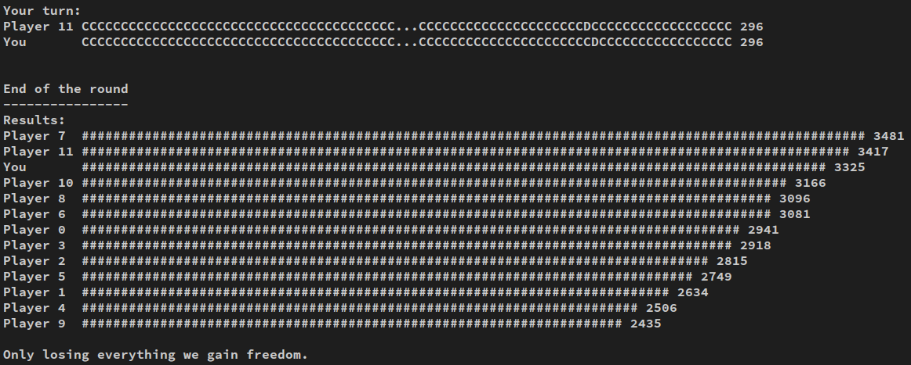
Solution
Seems better. You can even occasionally win with this strategy if the other players will get a result worse than usual.

Slide 11
Solution
That's all! By improving your strategy you can achieve a stable victory in the game.
There is no single correct strategy.
For a complex strategy, you may need to consider your opponent's last few moves.
To properly parse responses, it makes sense to pay close attention to the data returned from recv. Some lines may be fragmented or, conversely, merged into one message.

Slide 12

History
In the last century, American political scientist Robert Axelrod conducted such an experiment between programs from different people.
More than 60 people sent Robert their programs.

Slide 13
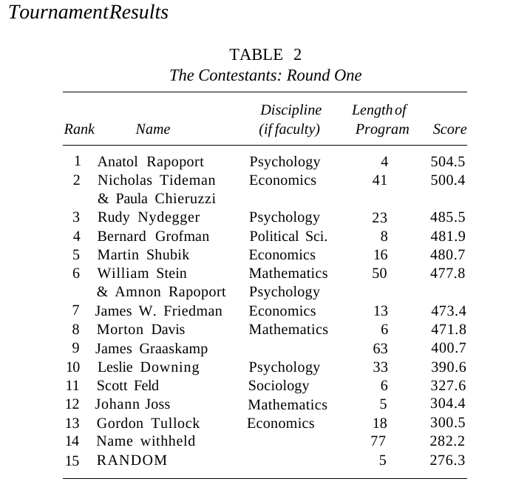
History
He noticed that the most consistently high results were shown by the TitForTat or “Eye for an Eye” program sent by American philosopher Anatoly Rapoport.
In 1984, Robert wrote the book “The Evolution of Cooperation.”

Slide 14
History
After analyzing the top-scoring strategies, Axelrod stated several conditions necessary for a strategy to succeed:
  Nice: The strategy will not defect before its opponent does (this is sometimes referred to as an "optimistic" algorithm). Almost all the top-scoring strategies were nice. A purely selfish strategy will not "cheat" on its opponent for purely self-interested reasons first.
  Retaliating: The strategy must sometimes retaliate. An example of a non-retaliating strategy is Always Cooperate, a very bad choice that will frequently be exploited by "nasty" strategies.
  Forgiving: Successful strategies must be forgiving. Though players will retaliate, they will cooperate again if the opponent does not continue to defect. This can stop long runs of revenge and counter-revenge, maximizing points.
  Non-envious: The strategy must not strive to score more than the opponent.
Conclusion: be nice, retaliating, forgiving and non-envious and you will score the best in this our game so called «life».

