Slide 1
Permissions Management
What is the best way to do it in corporate?
Ilya Rokhkin | Cloud Operations DevOps

Slide 2
How many tickets a new employee needs to open to get all access required?
Challenge

Slide 3
--- name: Ilya last_name: Rokhkin married: true kids: 3 title: DevOps Engineer experience: 20 years --- team: Cloud Operations DevOps responsibility: - Production, SRE, monitoring - DevEnv, CI/CD, cost, and much more … - Help to other DevOps teams
Who Am I?

Slide 4
The story
Up to 20 tickets to get access to AWS only
Org AD groups were broken after reorgs and access was lost.
People who moved to other groups still had access to production
Access to production was given immediately
Org AD groups are often nested and can’t give access

Slide 5
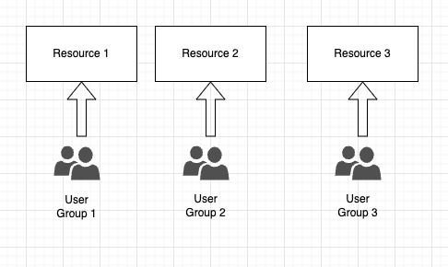
How it works – the group is giving access to the resource Current situation

Slide 6
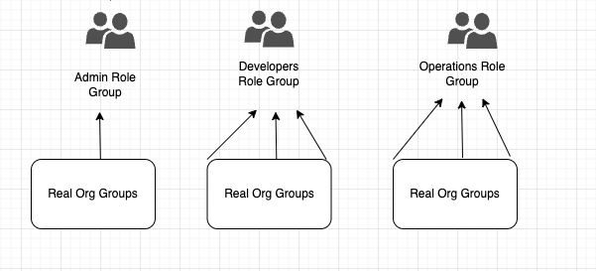
Solution
Role Based groups templates

Slide 7
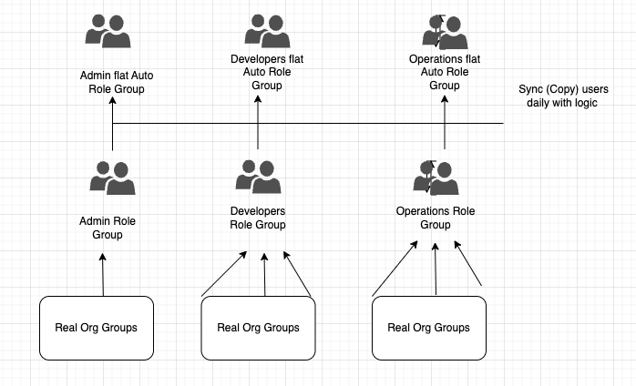
Solution
Role flat groups automatically synced - Smart Sync groups logic
The sync adds new users and removes left users, (including internal moves )
If more than 3 users intended to be removed, Smart Sync stops and notifies possible reorg
Delay of addition to Admin and Operations group only after 10 days

Slide 8
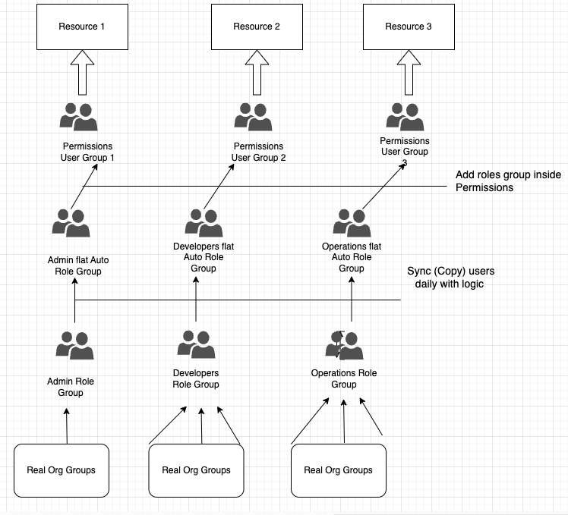
The complete Solution

Slide 9
Summary
New user gets all-needed access automatically to all resources without opening a single ticket to HD
Access is stable and not influenced by reorgs
Once we added our smart groups to resource groups, we do not depend on other groups MIS, HD, CloudInfra, etc. anymore
PRD is safer as new users get access after some time automatically
User that moves to another BU, her/his access is removed automatically

Slide 10
More Info
For more info, please contact me: astra07_2010 at yahoo.com

Slide 11
Q & A

Slide 12
Thank You

