Slide 1
Git Best Practices
Do you really use Git efficiently?
Ilya Rokhkin
2020

Slide 2
Git – meaning?
What does the word Git means?

Slide 3
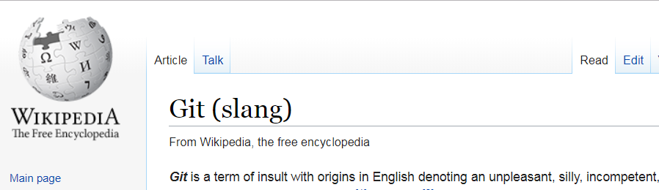
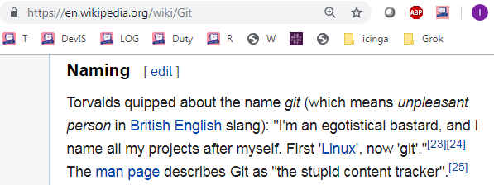
GIT Overview

Slide 4
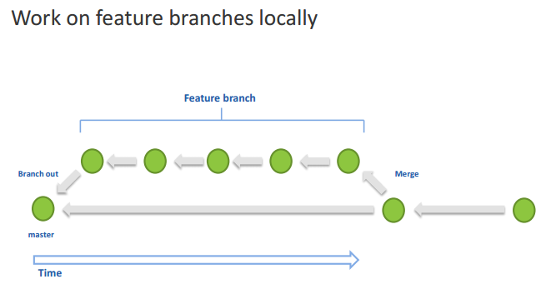
Best practices – local feature branches (topics)
Demo: create feature branch, checkout
*
4

Slide 5
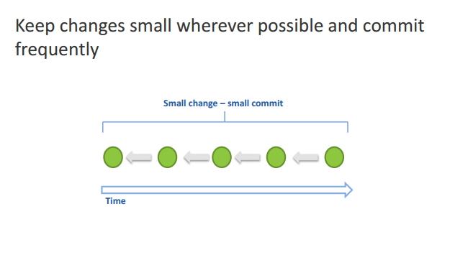
Best practices – commit
Demo: vim, change, save -> auto-commit, git log –c, git reset
*
5

Slide 6
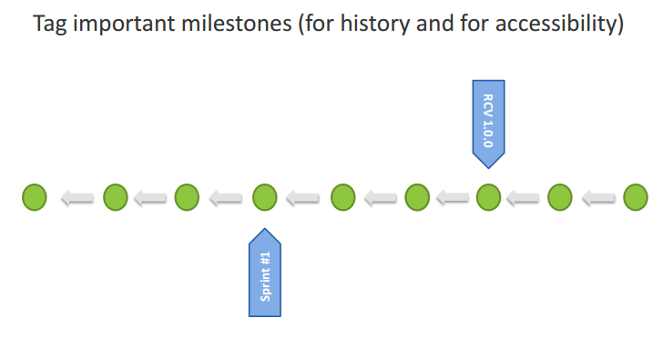
Best practices – tag milestones (even local)
*
6

Slide 7
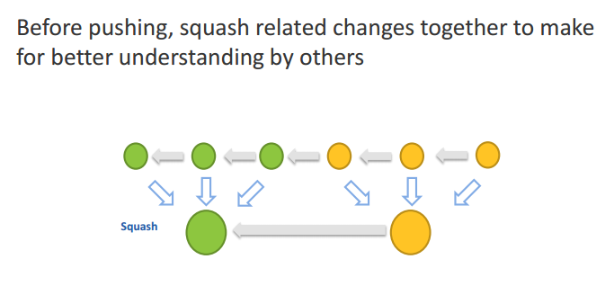
Best practices – squashing before push
Demo: git merge --squash, git commit, git log --oneline --graph --all, git push
*
7

Slide 8
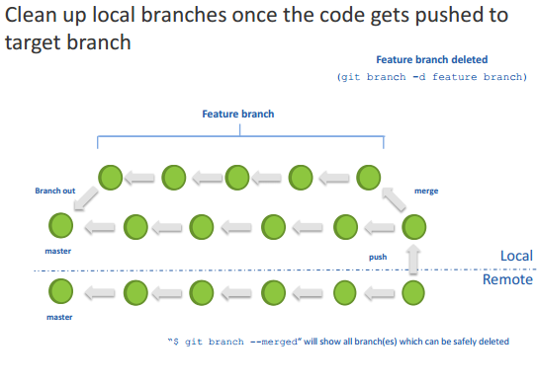
Best practices – clean up local branches
*
8

Slide 9
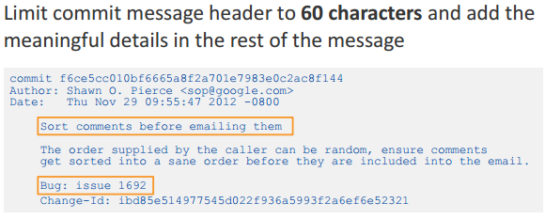
Best practices - concise commit messages
Limit commit message Subject to 70 chars and it must be simple, clear, self explained – this is the line all will see!
Meaningful details put in the body of the commit message
Demo: Example:
https://github.com/datreeio/node-datreeio/commits/master

Slide 10
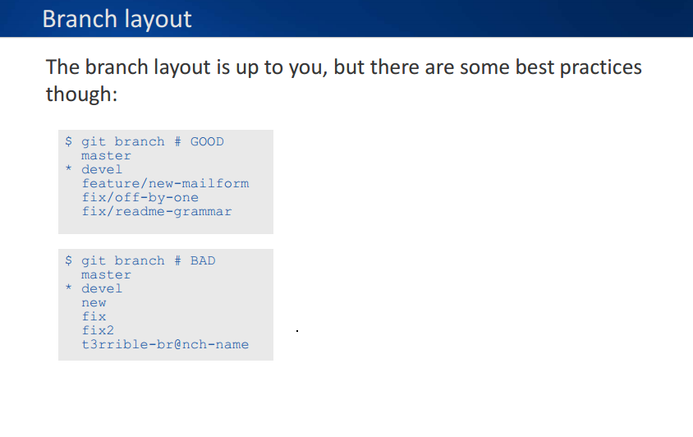
Best practices – Branch Layout

Slide 11
Questions? Summary Ilya Rokhkin (Git Trainings) https://github.com/ilyaro/git_best_practices_ppt rokhkin_ilya@yahoo.com 054-5224805
*
11

Slide 12
Git Best Practices
Thank You!

