Slide 1
Git General Training
Deep inspection of basic commands
Ilya Rokhkin
2015

Slide 2
Agenda:
1. Basic concepts and commands – 2h
  DVCS, Repository, Commit, Parent Commit, Tree, Blob, Index.
  Staged, Modified, Committed files.
  Basic commands to work in Repository and outside.
  Sharing work with peers.
2. Practical part, lab work – 1 hour
  with 1 hour optional for who want to practice more

Slide 3
GIT Overview
Quick and efficient
Expedite distributed development
Complete repositories
Atomic transactions
A clean internal design
Suited to handle thousands of developers
Support and encourage branched development

Slide 4
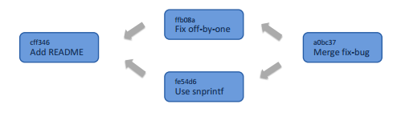
What is a commit and repository?
Commit is atomic change, that specifies code baseline, that can’t be removed
Repository is a collection of commits & DB
A commit includes
• The hash of the root tree
• The hash of the parent commit(s)
• Commit message
• Author
• Committer
• Date/time of the commit

Slide 5
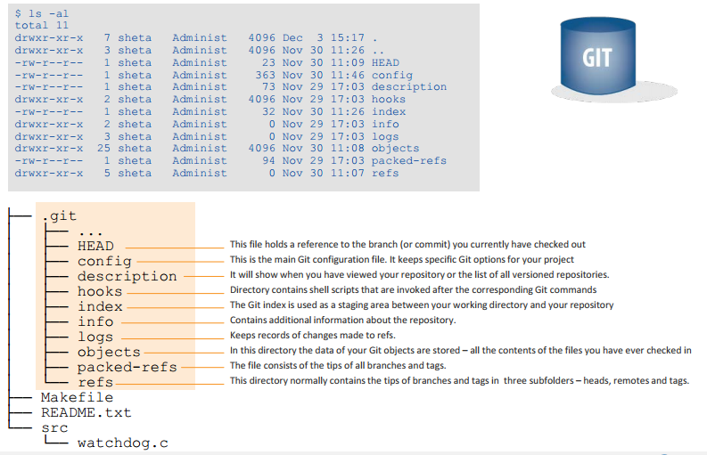
Git repository structure (.git)
© 2010 Marvell Confidential. All rights reserved.

Slide 6
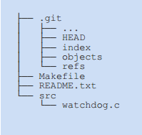
The working directory
Working tree has all files and folders as found in your HEAD,
plus the changes you made since your last commit
• There is only ONE working tree per repository (and only 1 .git
folder as well)
The working tree
© 2010 Marvell Confidential. All rights reserved.

Slide 7
Objects
Every object in GIT composed of three elements –
  Type – “blob”, “tree”, “commit” or “tag”.
  Size – the size of the content.
  Content
  A "blob" is basically like a file – it is used to store the content of a source file.
  A "tree" is basically like a directory - it references a group of other
  trees (subdirectories) and/or blobs (files).
A "commit" points to a single tree, marking it as what the project
looked like at a certain point in time. Keeps changed files since the last commit, author of the changes, a reference to the parent commit(s), etc.
A "tag/branch" is a way to mark a specific commit as special in some way.
It is usually used to tag certain commits as specific releases or
something along those lines.

Slide 8
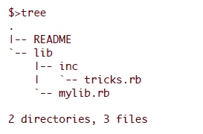
Objects cont.
Almost all of GIT is built around manipulating this simple structure of four different object types. It is sort of its own little file system that sits on top of your machine's file system.
Lets say we have a small project that looks like this:
If we will commit this project to a GIT repository, it will be represented in GIT like this:

Slide 9
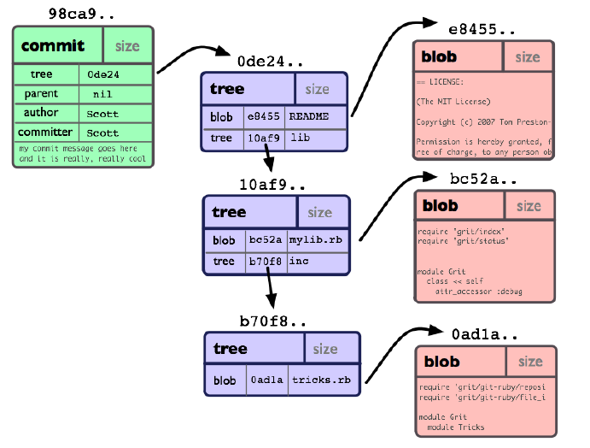
Commit Object
© 2010 Marvell Confidential. All rights reserved.

Slide 10
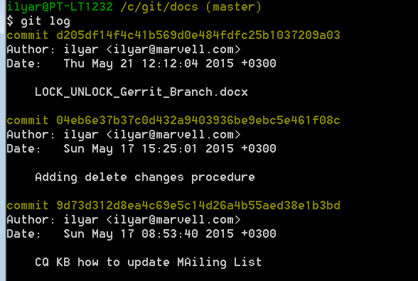
Secure Hash Algorithm – SHA1
Each object in GIT is represented by a 40-digit string, that looks something like that: 7bf68ebf3d8cff042bd3cb87e7592ddda9caa665.
This string is being calculated by taking the SHA1 hash of the
contents of the object.
Unlike most SCM systems, GIT stores a snapshot of what all the files
in the project look like in this tree structure, each time a commit is made.
© 2010 Marvell Confidential. All rights reserved.

Slide 11
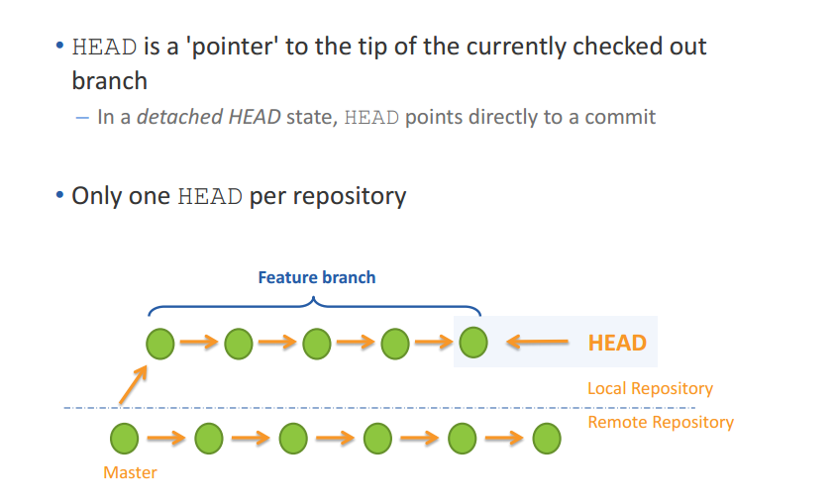
The HEAD
© 2010 Marvell Confidential. All rights reserved.

Slide 12
States of files
Untracked – in the repository folder, git does not keep a version of it.
Modified – tracked, modified since last stage or commit.
Staged – a snapshot of the file, ready to be committed. Even if modified, git will still keep the snapshot.
Committed – version of file saved in repository DB

Slide 13
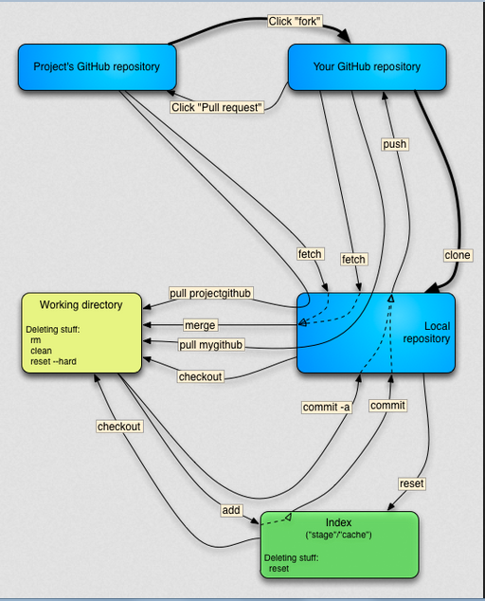
GIT
Architecture
ISEC
Nov 20,2011

Slide 14
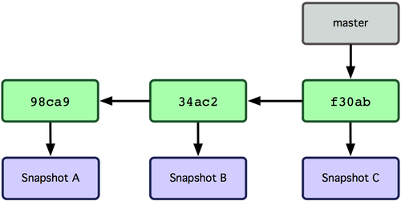
Git branches
Git branch is simply a movable pointer to a commit
Pointer moves forward automatically with each commit on a branch
© 2010 Marvell Confidential. All rights reserved.

Slide 15
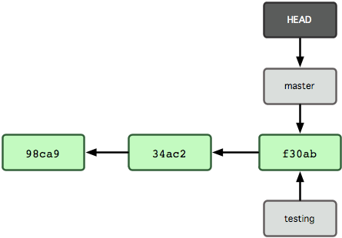
Creating new branch
New branch creates a new reference
      > git branch testing
To know "current" Git has a special pointer called HEAD
© 2010 Marvell Confidential. All rights reserved.

Slide 16
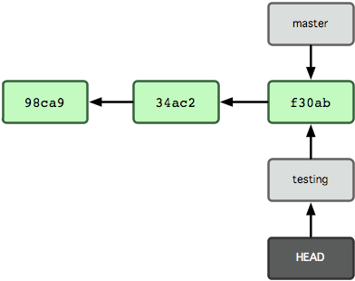
Switching to a branch
Git checkout branch-name switches to an existing branch
      > git checkout testing
© 2010 Marvell Confidential. All rights reserved.

Slide 17
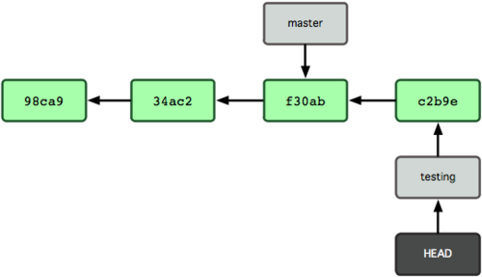
New commit moves current branch
      > vi file04.txt
      > git commit -a -m 'Commit message'
© 2010 Marvell Confidential. All rights reserved.

Slide 18
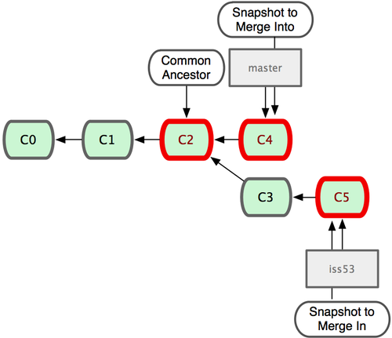
Merging branches
© 2010 Marvell Confidential. All rights reserved.

Slide 19
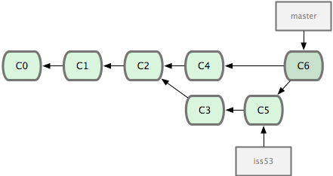
Merging branches (continued)
As a result of merge Git creates a new commit, which has two parents:
© 2010 Marvell Confidential. All rights reserved.

Slide 20
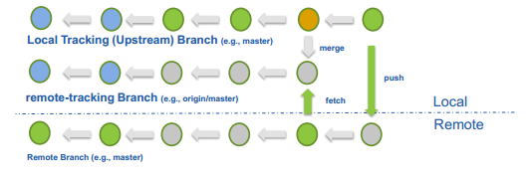
What are tracking and remote-tracking branches?
The combination of these branches defines a relationship
between a local branch and one in the remote repository.
• When a repository is cloned, Git automatically creates remote-tracking branches (e.g., origin/master) for the remote branches and a tracking branch (e.g., master) to allow for local changes in relationship to the remote branch
© 2010 Marvell Confidential. All rights reserved.

Slide 21
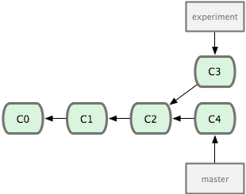
Rebasing branches
Rebase takes all the changes committed on one branch and replays them on another one:
      > git checkout experiment
      > git rebase master
      First, rewinding head to replay your work on top of it...
      Applying: added staged command
© 2010 Marvell Confidential. All rights reserved.

Slide 22
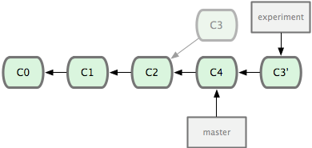
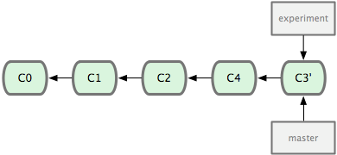
Rebasing branches
Result of rebase:
After rebase master branch can do a fast-forward merge:
© 2010 Marvell Confidential. All rights reserved.

Slide 23
Perils of rebase
Do not rebase commits that you have pushed to a public repository.
If you follow that guideline, you’ll be fine. If you don’t, people will hate you, and you’ll be scorned by friends and family.
© 2010 Marvell Confidential. All rights reserved.

Slide 24
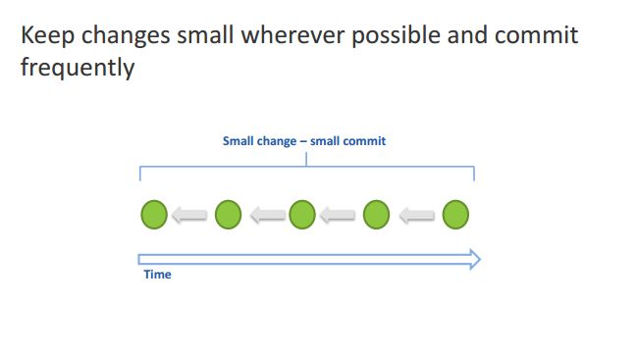
Best practices – commit
© 2010 Marvell Confidential. All rights reserved.

Slide 25
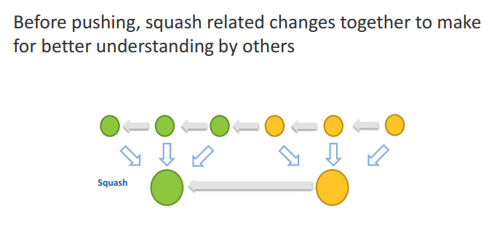
Best practices – squashing
© 2010 Marvell Confidential. All rights reserved.

Slide 26
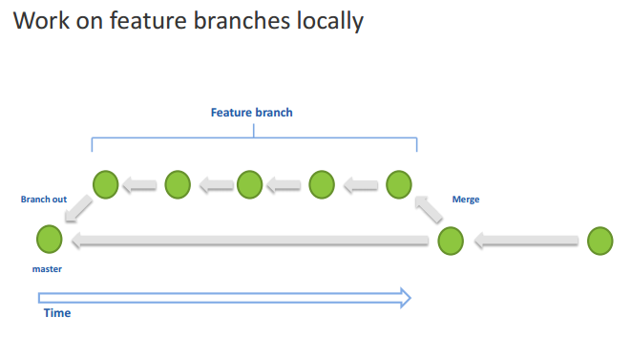
Best practices – local feature branches
© 2010 Marvell Confidential. All rights reserved.

Slide 27
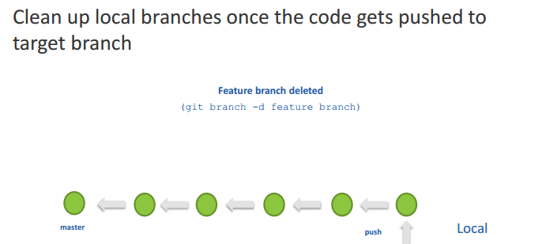

Best practices – clean up local branches
© 2010 Marvell Confidential. All rights reserved.

Slide 28
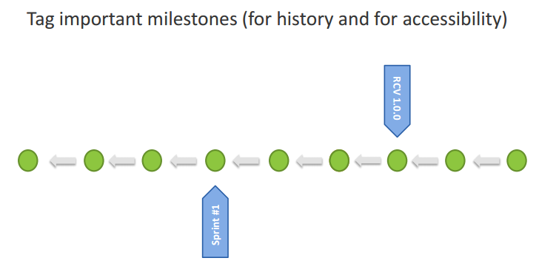

Best practices – tag milestones
© 2010 Marvell Confidential. All rights reserved.

Slide 29
Question?
© 2010 Marvell Confidential. All rights reserved.

