Slide 1
Git General Training
Deep inspection of basic commands
Ilya Rokhkin
2017

Slide 2
Agenda:
1. Basic concepts and commands
Git Architecture, data model
DVCS, Repository, Commit, Parent Commit, Tree, Blob, Index.
Staged, Modified, Committed files.
Basic commands to work in Repository and outside.
Sharing work with peers.
Best practices
2. Practical part, lab work

Slide 3
GIT Overview
Quick and efficient
Expedite distributed development
Atomic transactions, commit, cross repository
Commits (Change) management
A clear internal design
Suited to handle everything from small to very large projects with speed and efficiency
Support and encourage branched development

Slide 4
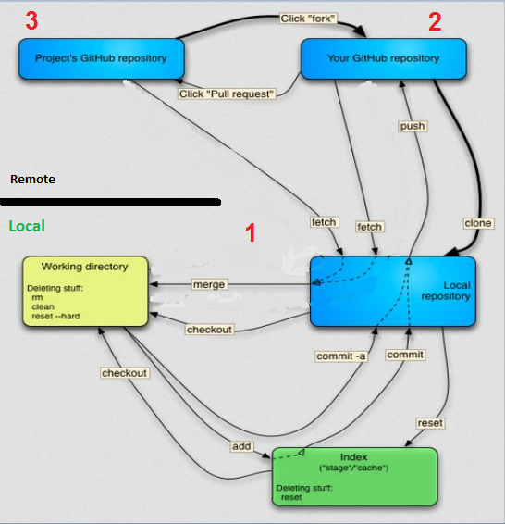
GIT Architecture
1 Local repo
2 Remote (Origin)
3 Common (Community) Remote Origin
Nov 20,2011
‹#›

Slide 5
Demo
Lab 1 - 2
We will configure your git user and e-mail
Will create remote, bare repository in home dir
Clone it to work repo1 in home dir also, add,commit and push
Restructure files, add, commit and push

Slide 6
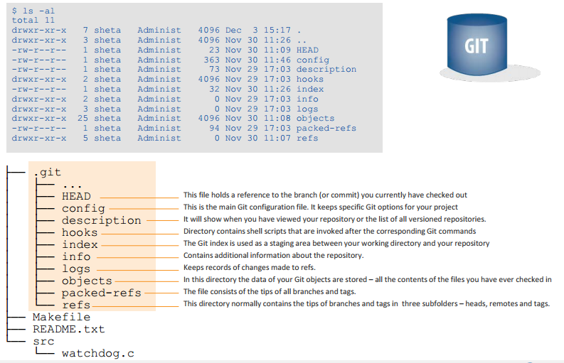
Git repository structure (.git)
*
‹#›

Slide 7
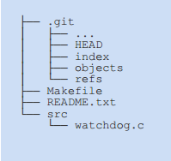
The Working Tree
Working tree has all files and folders as found in your HEAD, plus the changes you made since your last commit
There is only ONE main working tree per repository (and only 1 .git folder as well)
The Working Tree
*
‹#›

Slide 8
States of files in Working Tree
Untracked – in the repository folder, git does not keep a version of it.
Modified – tracked, modified since last stage or commit.
Staged – a snapshot of the file, ready to be committed. Even if modified, git will still keep the snapshot.
Committed – version of file saved in repository DB

Slide 9
Objects
Every object in GIT composed of those elements –
Type – “blob”, “tree”, “commit”, “tag/branch”.
A "blob" is basically like a file – it is used to store the content of a source file.
A "tree" is basically like a directory - it references a group of other
trees (subdirectories) and/or blobs (files).
A "commit" points to a single tree, marking it as what the project
looked like at a certain point in time. Keeps changed files since the last commit, author of the changes, a reference to the parent commit(s), etc.
A "tag/branch" is a way to mark a specific commit as special in some way. It is usually used to tag certain commits as specific releases or
something along those lines.

Slide 10
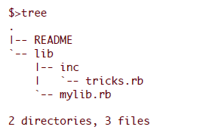
Objects cont.
Almost all of GIT is built around manipulating this simple structure of four different object types. It is sort of it's own little file system that sits on top of your machine's file system.
Let's say we have a small project that looks like this:
If we will commit this project to a GIT repository, it will be represented in GIT like this:

Slide 11
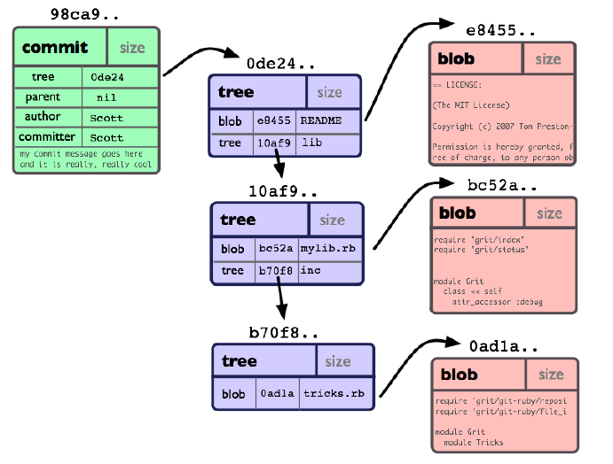
Commit Object
*
‹#›

Slide 12
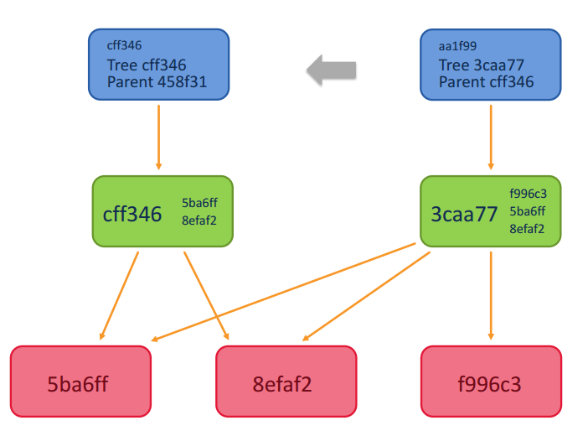
Commit object with its parent
Links from tree object to common blobs
Commit Obj
Tree Obj
Blob obj.

Slide 13
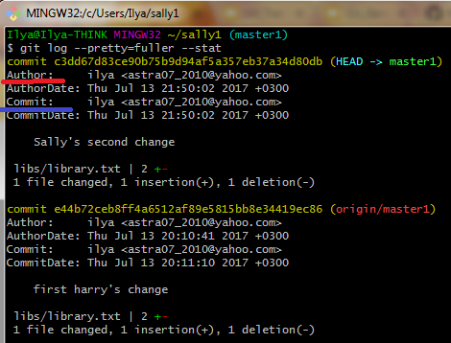
Secure Hash Algorithm – SHA1
Each object in GIT is represented by a 40-digit string, that looks something like that: 7bf68ebf3d8cff042bd3cb87e7592ddda9caa665.
This string is being calculated by taking the SHA1 hash of the
contents of the object.
Each commit has Author and Committer
Author is who really wrote the code and committed
Committer, if not the same as Author, took Original commit and reused it in his branch
*
‹#›

Slide 14
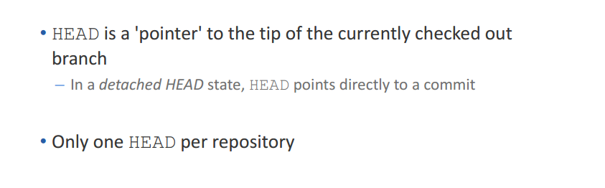
The HEAD
HEAD
Local Repository
master
98ca9
34ac2
f30ab
*
‹#›

Slide 15
Demo
Lab 3
Teamwork, parallel work:
We will clone second work repo2
Will commit changes in both repositories
Push and pull with silent rebase to apply the commit of one repo into another
Overview results

Slide 16
Rebasing Remote Tracking Branch
HEAD
Local Repository
master
Tracking Branch (Local)
98ca9
34ac2
f30ab
origin/master
Remote Tracking Branch
Remote Repository
After clone/pull Remote Tracking Branch and Tracking (Local) branch pointing to the same commit
98ca9
34ac2
f30ab
master

Slide 17
Rebasing Remote Tracking Branch
HEAD
Local Repository
Tracking Branch (Local)
master
98ca9
34ac2
f30ab
6df01
Remote Tracking Branch
origin/master
Commit on local repository
$ git commit
Remote Repository
98ca9
34ac2
f30ab
master

Slide 18
Rebasing Remote Tracking Branch
HEAD
Local Repository
Tracking Branch (Local)
master
98ca9
34ac2
f30ab
6df01
Remote Tracking Branch
origin/master
Push another Commit to remote repository from another repository/user
Remote Repository
98ca9
34ac2
f30ab
0bddb
master

Slide 19
Rebasing Remote Tracking Branch
HEAD
Local Repository
Tracking Branch (Local)
master
98ca9
34ac2
f30ab
6df01
Fetch/Pull the Commit from remote repository to Remote Tracking Branch
0bddb
Remote Tracking Branch
origin/master
Remote Repository
98ca9
34ac2
f30ab
0bddb
master

Slide 20
Rebasing Remote Tracking Branch
HEAD
Local Repository
master
Tracking Branch (Local)
$ git rebase First, rewinding head to replay your work on top of it...
98ca9
34ac2
f30ab
6df01
0bddb
Remote Tracking Branch
origin/master
Remote Repository
98ca9
34ac2
f30ab
0bddb
master

Slide 21
Rebasing Remote Tracking Branch
HEAD
Local Repository
master
Tracking Branch (Local)
6df01
98ca9
34ac2
f30ab
0bddb
3f9f9
$ git rebase ...to replay your work on top of it…
Applying: diff/patch of commit 6dfo into commit 3f9f9
Remote Tracking Branch
origin/master
Remote Repository
98ca9
34ac2
f30ab
0bddb
master

Slide 22
Rebasing Remote Tracking Branch
HEAD
Local Repository
master
Tracking Branch (Local)
98ca9
34ac2
f30ab
0bddb
3f9f9
$ git push of commit 3f9f9
Remote Tracking Branch
origin/master
Remote Repository
98ca9
34ac2
f30ab
0bddb
3f9f9
master

Slide 23
Rebasing Remote Tracking Branch
HEAD
Local Repository
Tracking Branch (Local)
master
98ca9
34ac2
f30ab
0bddb
3f9f9
After push Remote Tracking Branch and Tracking (Local) branch points to the same commit
Remote Tracking Branch
origin/master
Remote Repository
98ca9
34ac2
f30ab
0bddb
3f9f9
master

Slide 24
Perils of rebase
Do not rebase commits that you have pushed to a public repository.
If you follow that guideline, you’ll be fine. If you don’t, people will hate you, and you’ll be scorned by friends and family.
*
‹#›

Slide 25
Demo
Lab 4
Teamwork, parallel work with rebase and conflicts resolution:
We will do commits in both repos, with change in the same line of the same file
Pull with rebase, resolve conflicts, save the resolution file
Add the file to the staging area - means resolve.
Commit and push

Slide 26
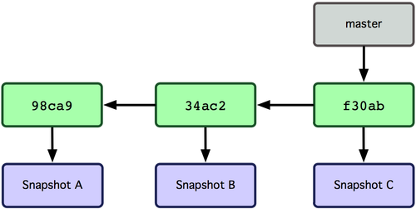
Git branches
Git branch is simply a movable pointer to a commit
Pointer moves forward automatically with each commit on a branch
*
‹#›

Slide 27
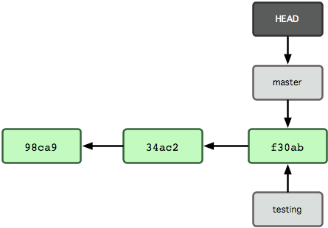
Creating new branch
New branch creates a new reference
> git branch testing
*
‹#›

Slide 28
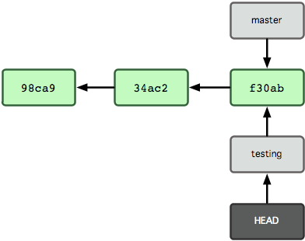
Switching to a branch
Git checkout branch-name switches to an existing branch
> git checkout testing
*
‹#›

Slide 29
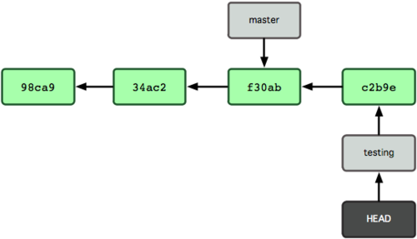
New commit moves current branch
> vi file04.txt
> git commit -a -m 'Commit message'
*
‹#›

Slide 30
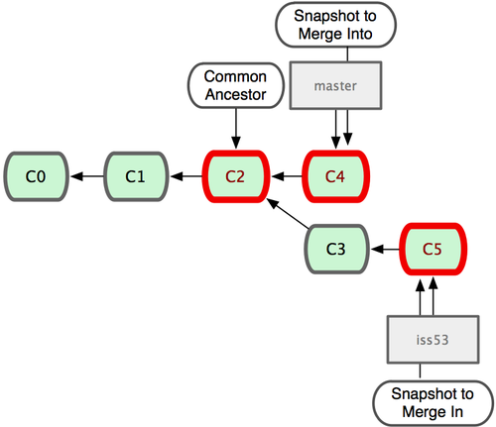
Merging branches
*
‹#›

Slide 31
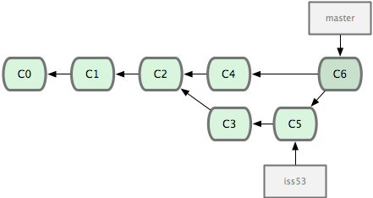
Merging branches (continued)
As a result of merge Git creates a new commit, which has two parents:
*
‹#›

Slide 32
Demo
Lab 5 - 7
We will create tag
Create branch bugfix from the tag
Will do bugfix commit in bugfix branch
Check out master branch and commit new change
Merge bugfix branch
Overview results

Slide 33
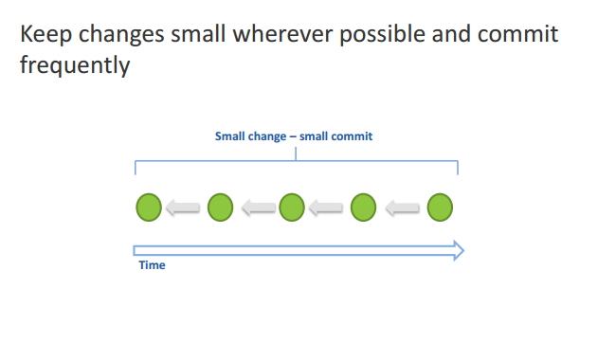
Best practices – commit
*
‹#›

Slide 34
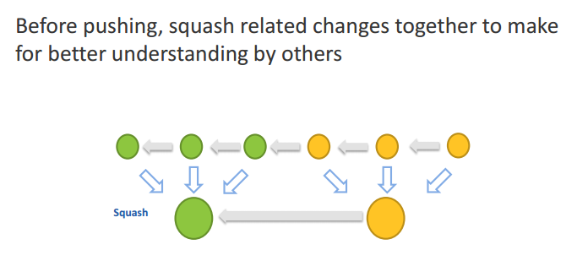
Best practices – squashing
*
‹#›

Slide 35
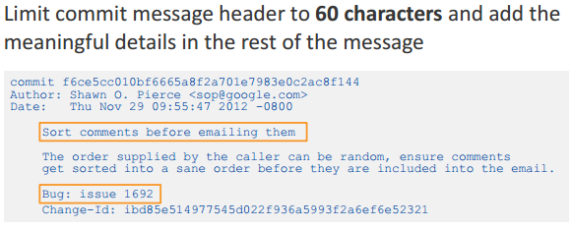
Best practices - concise commit messages

Slide 36
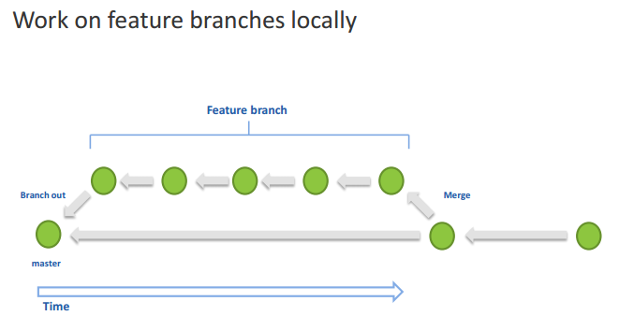
Best practices – local feature branches
*
‹#›

Slide 37
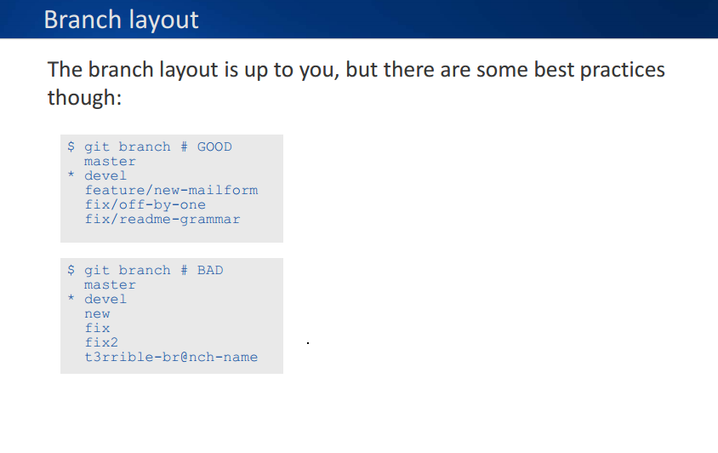
Best practices – Branch Layout

Slide 38
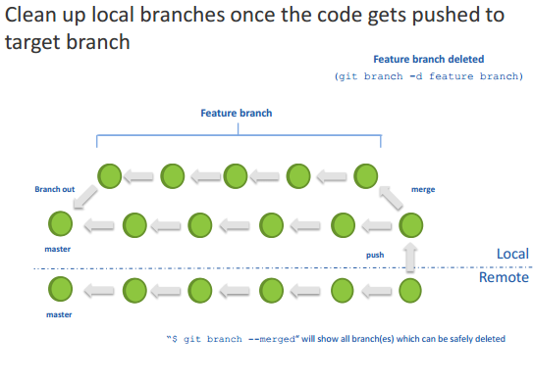
Best practices – clean up local branches
*
‹#›

Slide 39
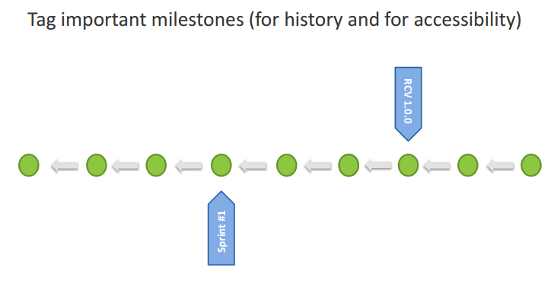
Best practices – tag milestones
*
‹#›

Slide 40
Lab 8 - 10
We will create branch bugfix2, from Release_01
Cherry-pick 1 commit from master branch
Undo modified file, undo staged file
Undo latest local commit, revert pushed commit
Stash meanwhile work aside, make commit, return work from stash

Slide 41
Lab 11 - 13
Format patch in 1 repository, and apply it in another repository
We will create 2 local commits and squash them to 1 commit by interactive rebase, and push only 1 commit to remote repository
Create commit in 1 repository and pull it from another repository, without pushing to origin repository

Slide 42
Question?
Thanks!
*
‹#›

Slide 43
Backup slides

Slide 44
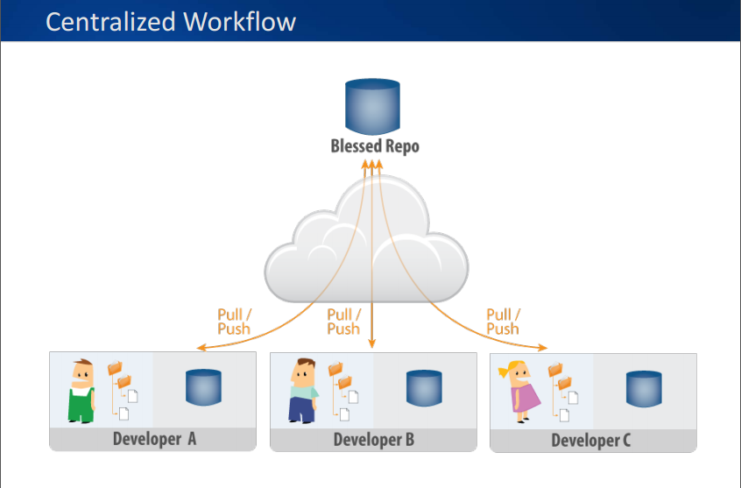

Slide 45
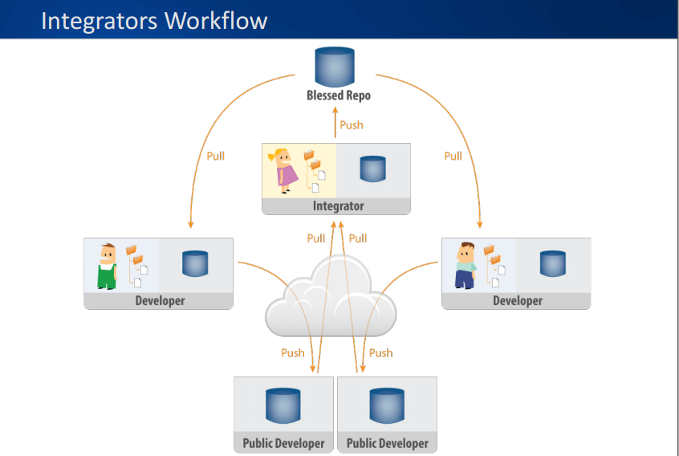

Slide 46
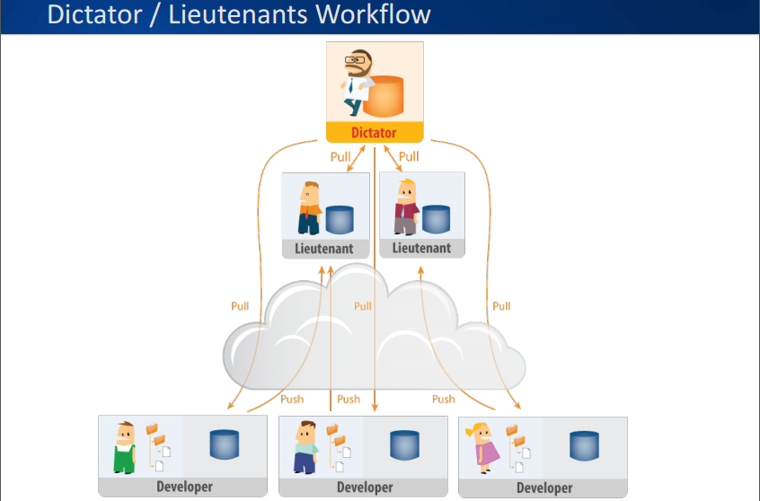

Slide 47
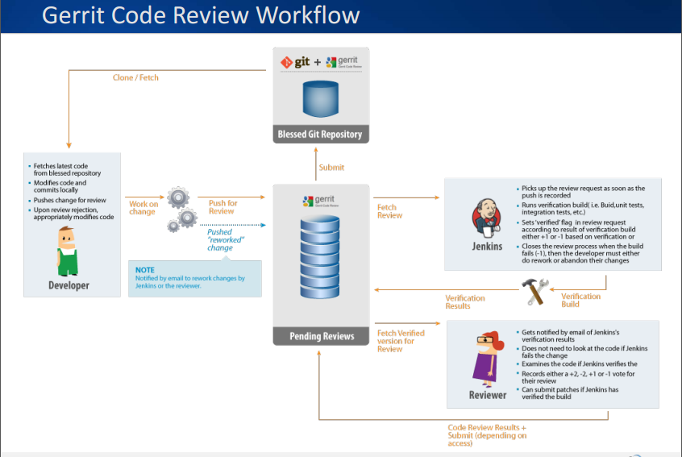

Slide 48
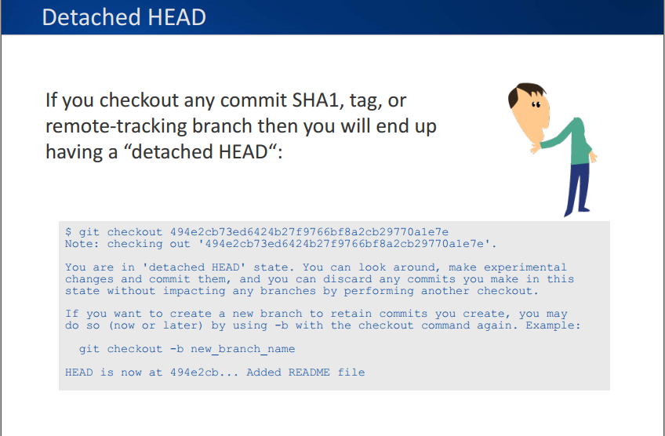

Slide 49
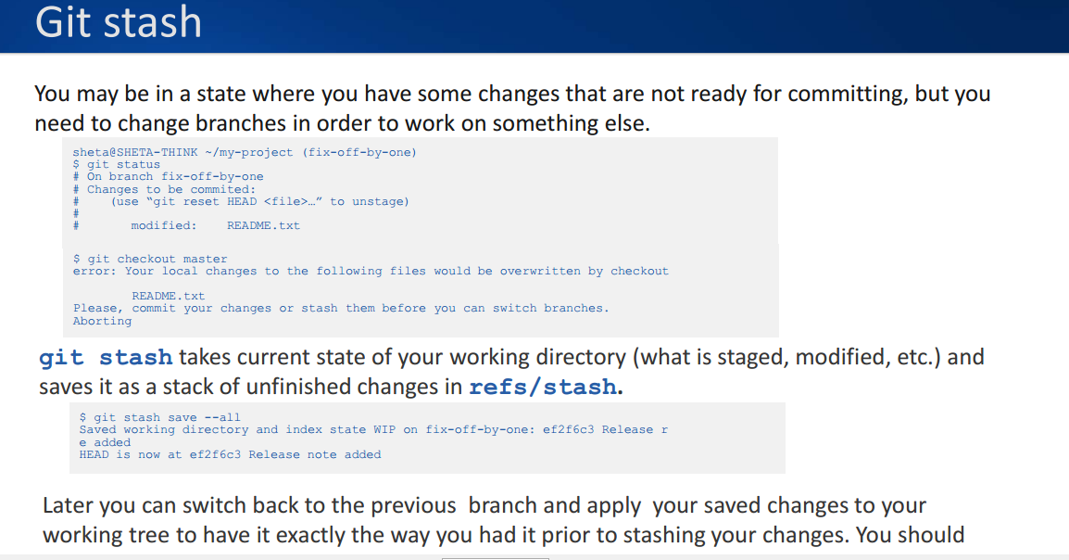

Slide 50
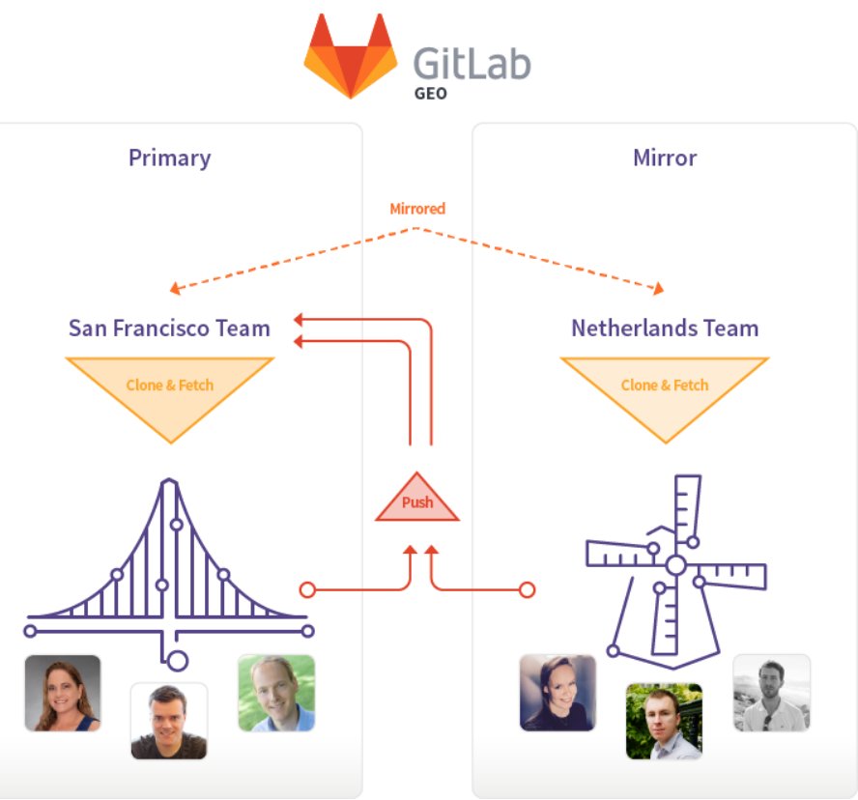
Git Master->Slave
Mirroring

Slide 51
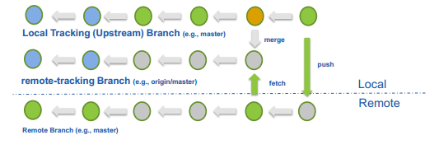
What are tracking and remote-tracking branches?
The combination of these branches defines a relationship between a local branch and one in the remote repository.
When a repository is cloned, Git automatically creates remote-tracking branches (e.g., origin/master) for the remote branches and a tracking branch (e.g., master) to allow for local changes in relationship to the remote branch
*
‹#›

