Slide 1
Git General Training
Deep inspection of basic commands
Ilya Rokhkin
2020

Slide 2
Agenda:
1. Basic concepts and commands
Git Architecture, data model
DVCS, Repository, Commit, Parent Commit, Tree, Blob, Index.
Staged, Modified, Committed files.
Basic commands to work in Repository and outside.
Sharing work with peers.
Best practices
2. Practical part, lab work

Slide 3
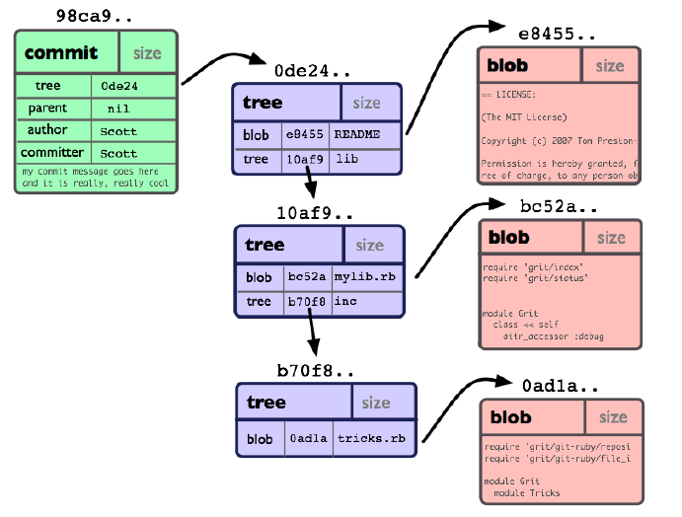
Commit Object
*
3

Slide 4
Rebasing Remote Tracking Branch
Remote Repository
Tracking Branch (Local)
master
98ca9
34ac2
FTR-10
Remote Tracking Branch
Local Repository
origin/FTR-10
origin/master
98ca9
34ac2
FTR-10
HEAD

Slide 5
Rebasing Remote Tracking Branch
Remote Repository
Tracking Branch (Local)
master
98ca9
34ac2
FTR-10
Remote Tracking Branch
Local Repository
origin/FTR-10
origin/master
98ca9
34ac2
67def
FTR-10
LCL-10_1
HEAD

Slide 6
Rebasing Remote Tracking Branch
Remote Repository
Tracking Branch (Local)
master
98ca9
34ac2
FTR-10
Remote Tracking Branch
Local Repository
origin/FTR-10
origin/master
98ca9
34ac2
67def
67def
FTR-10
LCL-10_1
HEAD

