Slide 1
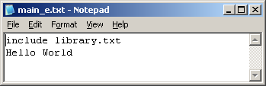
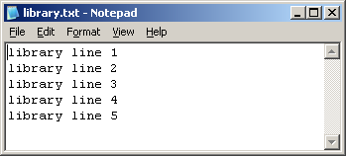
The Working Cycle Exercise I: adding files
First say to Git who are you, this info will appear on each commit you do. Example:
$ git config --global user.name <YourUSERNAME> $ git config --global user.email <YourEMAIL>
Please Create new (git init) „bare“ repository to be your origin(remote) repository
$ git init --bare --shared ~/gitlab
Then clone it to harry repo: cd .git and overview repository objects
$ git clone ~/gitlab ~/harry
Go to harry folder and create two files in your working directory (fill them with these text lines):
$ cd ~/harry main_e.txt
library.txt
Add your changes to the index $ git add *
Check your status before commit
$ git status
Commit your changes as “Initial project”
$ git commit -m "Initial project"

Slide 2
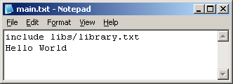
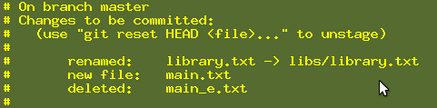
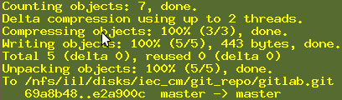
The Working Cycle Exercise II: restructuring files
Rename main_e.txt into main.txt $ git mv main_e.txt main.txt Create a folder named libs $ mkdir libs
Move library.txt into libs (modify main.txt accordingly!) ‏And add modified main.txt to Index
$ git mv library.txt libs
$ vi main.txt $ git add *
Check your status and diff before commit
$ git status $ git diff --staged main.txt
Commit your changes as “Restructuring project” $ git commit -m "Restructuring project“
Push all your work to origin (remote) repository $ git push

Slide 3
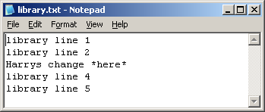
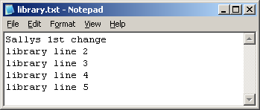
The Working Cycle Exercise III: teamwork
Change the third line in Harry‘s repo and check the status $ git status $ git diff HEAD
Commit Harry's changes as “Harry’s 1st changes in our library” $ git commit -a -m "Harry’s 1st changes in our library“
Clone the gitlab repo again (cd .. and into a folder named „sally“) $ git clone ~/gitlab ~/sally
Push all your work in Harry‘s repo to origin (central) repo $ git push
Change the first line in Sally's repo commit it and try to push $ git diff $ git commit -a -m “Sally’s 1st changes in our library“ $ git push
Pull updates to Sally's repo: $ git pull --rebase Overview what you got: $ gitk Compare what changes you got in „Commit Viewer“:
$ git diff HEAD^ HEAD – compare HEAD commit with previous commit, do you see both Sally and Harry hange?
Push Sally's changes: $ git push

Slide 4
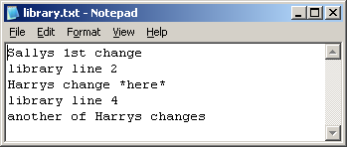
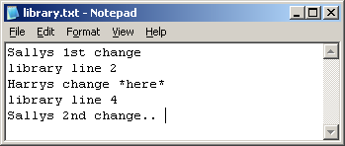
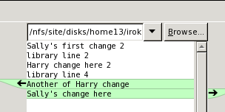
The Working Cycle Exercise IV: conflicts (with rebase)
Pull Harry's repo to get Sally's last changes: ~/harry] $ git pull
Change the fifth (last) line in Harry's repo, see your change: $git diff HEAD
Commit Harry's changes as „Harry's 2nd changes in our library“ ~/harry]$ git commit -a -m "Harry's 2nd changes in our library“
Push Harry’s changes:~/harry]$ git status ~/harry]$ git push
Change the fifth (last) in Sally's repo commit and try to push ~/sally]$ git commit -a -m "Sally 2nd change in library“ ~/sally]$ git push Why do you think it failed?
Pull Sally's repo: ~/sally]$ git pull --rebase
Edit and resolve the conflict: ~/sally]$ git gui -> Right Click library.txt
-> Run Merge Tool
Save the file library.txt after the merge conflicts were solved

Slide 5
The Working Cycle Exercise IV: conflicts (with rebase) (Continue)
Run "git add library.txt" to mark resolution and add the file to staging area
~/sally]$ git add library.txt
Run git status to see what is next?
~/sally]$ git status
rebase in progress; onto fe343dc. You are currently rebasing branch 'master' on 'fe343dc'.
(all conflicts fixed: run "git rebase --continue")
Run git rebase --continue to continue and finish the rebase
~/sally]$ git rebase --continue
Applying: Sally 2nd change in library
Recorded resolution for 'library.txt’
Run git status to see what is next?
~/sally]$ git status
Your branch is ahead of 'origin/master' by 1 commit.
(use "git push" to publish your local commits)
Run git log with diff to see results of rebase and conflict resolution
~/sally]$ git log -c -2 Now we can push Sally’s changes after rebase ~/sally]$ git push

Slide 6
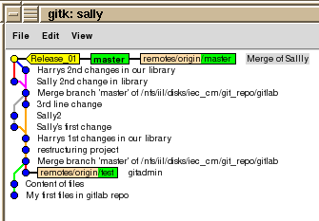
Exercise V Tagging
Create a tag named „Release_01“ with commit message "tag Release_01" ~/sally]$ git tag Release_01 -m "Official Release_01 GA“
Run git log to see the Tag in yellow color ~/sally]$ git log --graph --oneline --all
Push the tag to origin
~/sally]$ git push --tags
Go to Harry repo, run „Commit Viewer“ gitk to see, that you still do not see the tag in Harry repo ~/harry]$ gitk
Fetch with the tag from the harry repository
~/harry]$ git fetch --tags
Run git log to see the tag in yellow color ~/harry]$ git log --graph --oneline --all
Rebase to align local master branch with origin/master ~/harry]$ git rebase First, rewinding head to replay your work on top of it...
Fast-forwarded master to refs/remotes/origin/master.

Slide 7

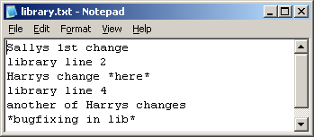
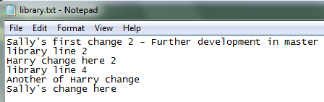
Exercise VI: Branching
Create a branch named „bugfix/release_01_fix1“ ~/harry]$ git branch `All in Harry repo only!
Check out this new branch:
~/harry]$ git checkout bugfix/release_01_fix1
Change Harry’s repo main.txt and libs/library.txt:
Then commit with message „bugfixing“ and push
~/harry]$ git commit -a -m "bugfixing“
~/harry]$ git push --set-upstream origin bugfix/release_01_fix1 Check if remote tracking branch was set, for bugfix/release_01_fix1
~/harry]$ git branch -vv
* bugfix/release_01_fix1 afae908 [origin/bugfix/release_01_fix1]
Check out master branch: ~/harry]$ git checkout master
Add a line in Harry’s repo library.txt master branch, diff and commit it as „making progress in master“, then check status and push the change
~/harry]$ git diff HEAD or ~/harry]$ git gui
~/harry]$ git commit -a -m "making progress in master”
See new branch in log graph
~/harry]$ git log --graph --oneline --branches
~/harry]$ git status and ~/harry]$ git push

Slide 8
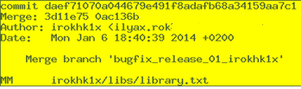
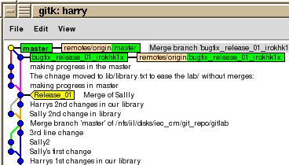
Exercise VII: Merging
Check if you are on master branch in Harry repo
~/harry]$ git status
# On branch master
nothing to commit (working directory clean)
Merge bugfix/release_01_fix1 into master branch
~/harry]$ git merge bugfix/release_01_fix1
Check if the merge add the bugfix into the master branch
~/harry]$ git log -c
~/harry]$ git diff HEAD^ HEAD
~/harry]$ gitk
Push the merge changes to original repo, see file annotation
~/harry]$ git push ~/harry]$ git blame ./libs/library.txt

Slide 9

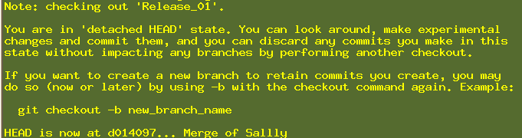
Check Out, Branch and Cherry Pick old commit
Exercise VIII
Check if you are on master branch in Harry‘s repo
~/harry]$ git status
# On branch master
nothing to commit (working directory clean)
Run log to find commit we want to check out (with tags)
~/harry]$ git log --decorate
Check out specific revision, Tag Release_01 points to
~/harry]$ git checkout Release_01 Or ~/harry]$ git checkout d01409754a6d77cdb1e7f2c3a72394fee7ddeb0d
Check out the merge add the bugfix into the master branch
~/harry]$ git checkout -b bugfix/release_01_fix2 Or ~/harry]$ git branch bugfix/release_01_fix2 Release_01
Cherry Pick commit („making progress in the master”) into current branch bugfix/release_01_fix2 ~/harry]$ git log master --decorate --name-only and copy appropriate commit string
~/harry]$ git cherry-pick 3d11e757f7e6d6843a2f7965c2e901874d13c48f
~/harry]$ git diff HEAD^ HEAD – review check-pick merge results
~/harry]$ gitk --all
Push the cherry-pick changes to the original repo
~/harry]$ git push --set-upstream origin

Slide 10

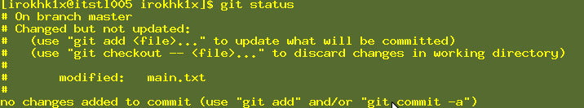

Git Reverts of all kinds
Exercise IX
Check if you are on master branch in Harry‘s repo
~/harry]$ git status
# On branch master
nothing to commit (working directory clean)
How to undo modify Edit the file main.txt add a line „# Add temp line“ save the file ~/harry]$ vi main.txt
Run git status and see how to discard last file changes
~/harry]$ git status
Discard the change in the Working Copy in the file main.txt, remember the discard is irreversible
~/harry]$ git diff HEAD main.txt – Always see what you are going to discard first!!!
~/harry]$ git checkout -- main.txt (discard the change)
Run git status and see status of the file now
~/harry]$ git status
How to undo staged changes
Do the below steps again (vi main.txt, git status, git diff HEAD main.txt) ~/harry]$ git add main.txt (To add main.txt to the Index)
~/harry]$ git diff --staged (Compare HEAD and staged, see what you are going to discard first!!!)
~/harry]$ git reset HEAD main.txt (Unstage the file)
~/harry]$ git diff
~/harry]$ git checkout -- main.txt (discard the change)

Slide 11

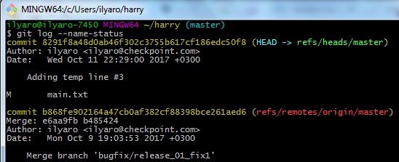
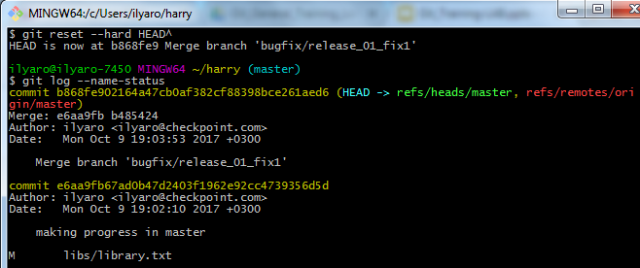
Git Reverts of all kinds
Exercise IX Continue
How to revert latest local commit Do the upper steps again (vi main.txt, git status, git diff main.txt, git add main.txt) ~/harry]$ git commit -a -m "Adding temp line number 3 commit“
Run log to see the two latest commits ~/harry]$ git log --name-status
Run git reset to reset current branch to previous commit
~/harry]$ git reset --hard HEAD^ (Be carefull --hard resets Index, Working Tree also)
Run log now to see the previous good commit back to be first ~/harry]$ git log --name-status
Where is the temp commit? It exists, just not
Referenced, run reflog to see it:
~/harry]$ git reflog $ git reflog
8291f8a HEAD@{1}: commit: Adding temp line #3

Slide 12
Git Reverts of all kinds
Exercise IX Continue
How to Revert Remote Commit
Let us reset master branch back to "Adding temp line number 3 commit“
~/harry]$ git reset --hard 8291f8a
Push the commit to the original repo
~/harry]$ git push
See the log and copy commit sha1
~/harry]$ git log -2
Now let us revert already pushed to origin commit, never mind who did it. Let us revert commit "Adding temp line number 3 commit”
~/harry]$ git revert 8291f8a48d0ab46f302c3755b617cf186edc50f8
Run diff of the file main.txt to see what we get after revert
~/harry]$ git diff HEAD^ HEAD – you should see 1 line less
~/harry]$ git log -2
Run git status and see revert commit
~/harry]$ git status
Push the origin commit revert to the original repo
~/harry]$ git push

Slide 13


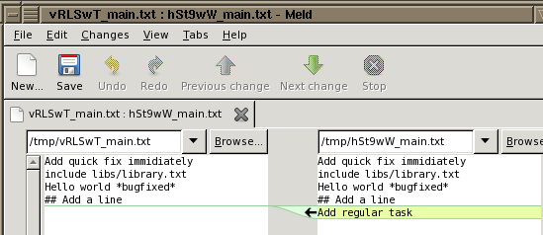
Git Stash usage
Exercise X
When you are in the middle of something, your boss comes in and demands that you fix something immediately. Stash you work, do emergency fix, commit it and pop you stash back
Do regular task in master branch, change file main.txt add line „Add regular Task“
~/harry]$ vi main.txt
~/harry]$ git stash Saved working directory and index state WIP on master: 581fe85 Revert "Adding temp line #3"
HEAD is now at 581fe85 Revert "Adding temp line #3"
Do emergency fix in master branch, change file main.txt add first line „Add quick fix immediately “
~/harry]$ vi main.txt
~/harry]$ git commit -a -m "Fix a bug in a quick"
~/harry]$ git stash pop
Auto-merging ilyar/main.txt
# On branch master
Dropped refs/stash@{0} (bd59435b9a1e08a702f8416f642c4d207d72e020)
Now continue you work, diff changes, commit and push
~/harry]$ git diff
~/harry]$ git commit -a -m "Regular task"
~/harry]$ git push

Slide 14
Format/Apply Patch
Exercise XI
Go to Harry’s repository and add line to the END of file library.txt
~/harry/libs (master)
$ vi library.txt
Commit the change in Harry’s repository
~/harry/libs (master)
$ git commit -am “harry’s commit for patch“
Format patch of the last commit
~/harry/libs (master)
$ git format-patch -1 7b82010d86bcc9f020c413e216a1caf3d0651147
0001-harry-s-patch-change.patch
See the patch file on file system
~/harry/libs (master)
$ ls
0001-harry-s-patch-change.patch library.txt
Go to Sally’s repository and pull latest commits
~/harry/libs (master)
$ cd ~/sally/libs
~/sally/libs (master)
$ git pull

Slide 15
Format/Apply Patch
Exercise XI Continue
See what you got in the patch $ ~/sally/libs (master)
$ git apply --stat ~/harry/libs/0001-harry-s-patch-change.patch
library.txt | 2 ++
1 file changed, 2 insertions(+)
Check if the patch is applicable, “no output no errors”
$ ~/sally/libs (master)
$ git apply --check ~/harry/libs/0001-harry-s-patch-change.patch
See content of the patch file, looks familiar?
$ ~/sally/libs (master)
$ cat ~/harry/libs/0001-harry-s-patch-change.patch
Apply the patch with signature of the patch
$ ~/sally/libs (master)
$ git am --signoff < ~/harry/libs/0001-harry-s-patch-change.patch
Applying: harry's patch change
$ ~/sally/libs (master)
$ git log -1 -c
commit 38a8ce3ce4cd260303ba930ab1a3c2b49e3dd217
harry's patch change Signed-off-by: Ilya <astra07_2010@yahoo.com

Slide 16
Squash several commits to 1 commit
Exercise XII
In Sally’s repository do 2 changes and 2 commits
We want to squash 2 commits 9fb9d06 and 5822495
$ ~/sally/libs (master)
$ git log --pretty=oneline -3
9fb9d060ab4ffe34f033d7b61163ce6697894a7b Add 2nd commit for squash
5822495ba795f4b0a18e89d52e77473dcd700c65 Add alt commit line
38a8ce3ce4cd260303ba930ab1a3c2b49e3dd217 harry’s commit for patch
Run git rebase interactively on commit before 2 commits you want to squash
$ ~/sally (master)
$ git rebase -i HEAD^^ OR $ git rebase -i 38a8ce3ce4cd260303ba930ab1a3c2b49e3dd217
The first commit pick (leave it)
The second squash into first commit
[detached HEAD e33ede3] Add alt commit line
2 files changed, 3 insertions(+)
Successfully rebased and updated refs/heads/master.
Run now $git log -c -2 You should see only 1 commit instead of 2 that was before
What happened with the 2 commits being squashed? Disappeared? Let us find them
$ git reflog
pick 5822495 This is parent commit
s 9fb9d06 This is child commit
# Rebase 38a8ce3..9fb9d06 onto 38a8ce3

Slide 17
Pull directly from another repository not origin.
Exercise XIII
Pull then push in Sally’s repository and pull again to be fully synced with Harry
~/sally/libs (master)
$ git log --pretty=oneline -1
fde4fd370a20dd1491e5f5edd8498f1cc833912d Push for harry
Pull then push in Harry’s repository and Pull again to be fully synced with Sally
Let’s see harry’s log from within sally’s repository
~/sally/libs (master)
$ git -C ~/harry log master --pretty=oneline -1
fde4fd370a20dd1491e5f5edd8498f1cc833912d Add alt commit line
Change sally's file and commit it
~/sally/libs (master)
$ vi library.txt $ git diff $ git commit -am "Commit to pull for harry"
Go to harry’s repository: $ cd ~/harry and pull the commit
~/harry (master)
$ git pull ~/sally master:master
Let us see the logs of the 2 repositories again
~/harry (master)
$ git log master --pretty=oneline -1
c98ab2d24894ee330a5c75f1c7fc77d83a7061db (HEAD -> master) Commit to pull for harry
$ git -C ~/sally log master --pretty=oneline -1
c98ab2d24894ee330a5c75f1c7fc77d83a7061db (HEAD -> master) Commit to pull for harry

Slide 18
Backup slides

Slide 19
Rebase (Already present in TeamWork)
Exercise VIII
Go to Sally’s repository and add line to the END of file library.txt
$ ~/sally/libs (master)
$ vi library.txt
Commit the change in Sally’s repository
$ ~/sally/libs (master)
$ git commit -a -m "sally’s commit"
[master 4a14da9] sally commit
1 file changed, 2 insertions(+)
Push the change to origin
$ ~/sally/libs (master)
$ git push origin
Go to Harry’s repository
$ ~/sally/libs (master)
$ cd ~/harry/libs
Add first line to the beginning of the file library.txt
$ ~/harry/libs (master)
$ vi library.txt

Slide 20
Rebase (Already present in TeamWork)
Exercise VIII Continue
Commit the change in Harry’s repository
$ ~/harry/libs (master)
$ git commit -a -m "harry's change"
[master 70ed6d3] harry's change
1 file changed, 2 insertions(+)
Fetch the Sally’s commit
$ ~/harry/libs (master)
$ git fetch
From c:/Users/Ilya/gitlab
06cfb7a..4a14da9 master -> origin/master
See the log, where is the Sally’s commit and where is Harry’s commit, are they on the same line?
$ ~/harry/libs (master)
$ git log --graph --oneline --branches
Now run rebase
$ ~/harry/libs (master)
$ git rebase
First, rewinding head to replay your work on top of it... Applying: harry's change
Now see the log, where is the Sally’s commit and where is Harry’s commit now? Why?
$ ~/harry/libs (master)
$ gitk

Slide 21
Push directly to another repo not origin, From sally to harry directly. Exercise XVI
Pull then push in Sally’s repository and pull again to be fully synced with Harry
$ ~/sally/libs (master)
$ git log --pretty=oneline -3
93dffff1a6160c747d18c5fd36d0cf82062042a2 harry's change
e33ede3a4a6428f523d8bec1041098464cad58b7 Add alt commit line
930ab1a3c2b49e3dd217 harry's patch change
Pull then push in Harry’s repository and Pull again to be fully synced with Sally
Let’s see harry’s log from within sally’s repository
$ ~/sally/libs (master)
$ git -C ~/harry log master --pretty=oneline -3
93dffff1a6160c747d18c5fd36d0cf82062042a2 harry's change
e33ede3a4a6428f523d8bec1041098464cad58b7 Add alt commit line
930ab1a3c2b49e3dd217 harry's patch change
Change sally's file
$ ~/sally/libs (master)
$ vi library.txt
$ git diff HEAD
$ ~/sally (master)
$ git commit -a -m "Push for harry"

Slide 22
Push directly to another repo not origin, From sally to harry directly. Exercise XVI continue
$ ~/sally/libs (master)
$ git push ~/harry master:master
Worked? Why not? Go to Harry’s repository
$ ~/sally/libs (master)
$ cd ~/harry/libs
Check another branch:
~/harry]$ git checkout bugfix/release_01_fix1
Back to Sally’s repository $ cd ~/sally
$ ~/sally (master)
$ git push ~/harry master:master
To c:/Users/Ilya/harry 93dffff..fde4fd3 master -> master
$ ~/harry (master)
$ git -C ~/harry log master --pretty=oneline -1
fde4fd370a20dd1491e5f5edd8498f1cc833912d Push for harry

Slide 23
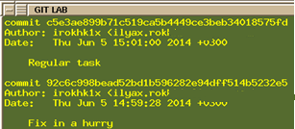
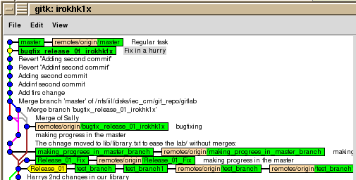
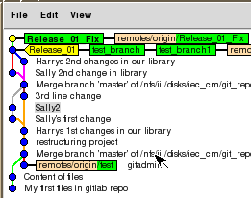
Advanced working with branches
Exercise XI
How to take changes that happened on the master in the meanwhile
Let us check out bugfix/release_01_fix1 branch
~/harry]$ git checkout bugfix/release_01_fix1
Run git log --all (refs) and copy „Fix in a hurry“ commit sha1
~/harry]$ git log –all
Now let us merge our branch bugfix/release_01_fix1 with commit HEAD^ on master branch 92c6c998bead52bd1b596282e94dff514b5232e5
~/harry]$git merge 92c6c998bead52bd1b596282e94dff514b5232e5
Updating 0ac136b..92c6c99
Fast-forward
ilyar/libs/library.txt | 2 +-
ilyar/main.txt | 3 ++-
2 files changed, 3 insertions(+), 2 deletions(-)
Compare my branch to the master (as it was when I last updated from master)
~/harry]$ git checkout bugfix/release_01_fix1 Run Git log to see when last time was merged from master?
~/harry]$ gitk &

Slide 24
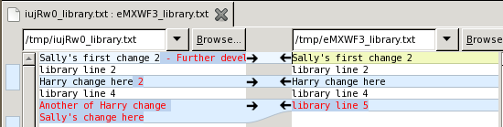
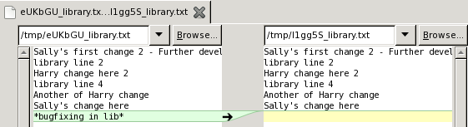
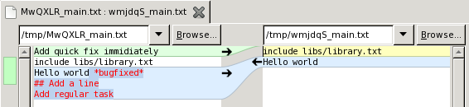
Advanced working with branches
Exercise XI Continue
~/harry]$ git diff HEAD bccdb778dc129c990a0c09147c914a34eff12dda
How to Compare two branches
Let us diff master and bugfix_release_01_fix1 branches
~/harry]$ git difftool master bugfix/release_01_fix1
~/harry]$ git diff master bugfix/release_01_fix1 – without external tool
diff --git a/ilyar/libs/library.txt b/ilyar/libs/library.txt
index 59a920d..0ebca13 100644
--- a/ilyar/libs/library.txt
+++ b/ilyar/libs/library.txt
@@ -4,4 +4,3 @@ Harry change here 2
library line 4
Another of Harry change
Sally's change here
-*bugfixing in lib*
diff --git a/ilyar/main.txt b/ilyar/main.txt
index 75bb070..1e22422 100644
--- a/ilyar/main.txt
+++ b/ilyar/main.txt
@@ -1,5 +1,2 @@
-Add quick fix immidiately
include libs/library.txt
-Hello world *bugfixed*
-## Add a line
-Add regular task
+Hello world

Slide 25
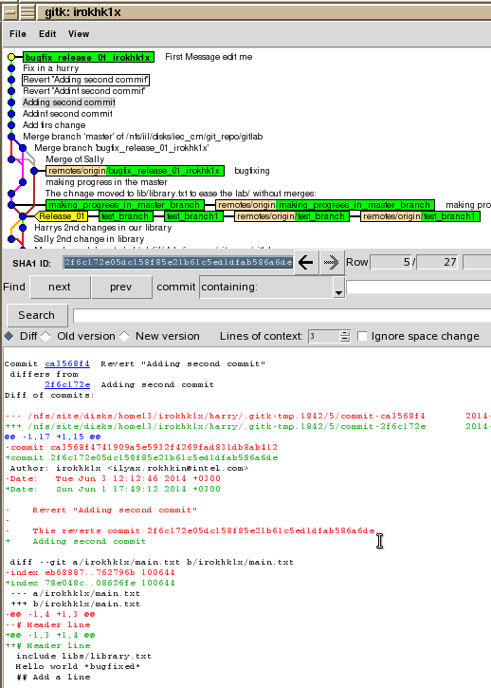
Using the git log
Exercise XII
Git log in cmd and GUI
This is the log command in cmd to see merge info + files,
that were changed + all branches
~/harry]$ git log -c --branches
~/harry]$ gitk --all & to see gui log of all branches and
~/harry]$ gitk & to see log of only current branch
Write click on commit and select “Mark this commit”
Now go to another commit, write click on it and
select “Compare with marked commit”
Check out bugfix/release_01_fix1 branch
~/harry]$ git checkout bugfix/release_01_fix1
Check that you have commits not yet pushed,
only such commits Can be changed!!!

Slide 26
Using the git log
Exercise XII Continue
~/harry]$ git push origin --dry-run
0ac136b..b597fd2 bugfix/release_01_fix1 -> bugfix/release_01_fix1
Change commit message to “We can edit unpushed messages only”
~/harry]$ git commit --amend -m "We can edit unpushed messages only“
[bugfix/release_01_fix1 d4e3205] We can edit unpushed messages only
1 files changed, 1 insertions(+), 0 deletions(-)
~/harry]$ git log
commit d4e3205f7c80db7d4bda4ac588b5fcfd73f9ee31
Author: ilyar <astra07_2010@yahoo.com>
Date: Sun Jun 8 15:30:33 2014 +0300
We can edit unpushed messages only
Now push latest changes to the origin repo
~/harry]$ git push

