Slide 1
Git and GitLab Best Practices
Do you really use Git and Gitlab efficiently?
Ilya Rokhkin
2020

Slide 2
Git – meaning?
What does the word Git means?

Slide 3
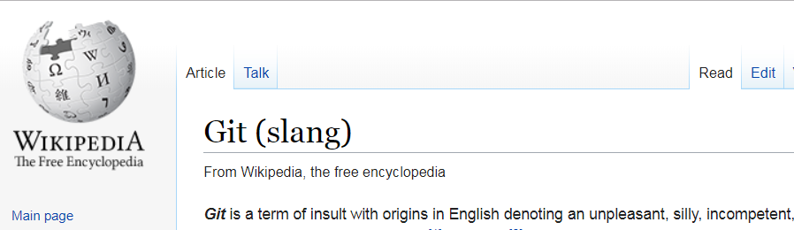
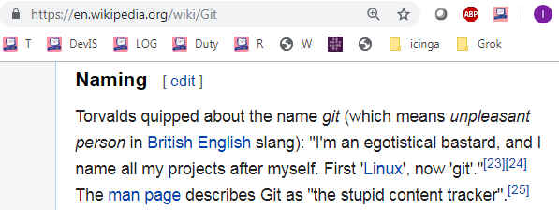
GIT Overview

Slide 4
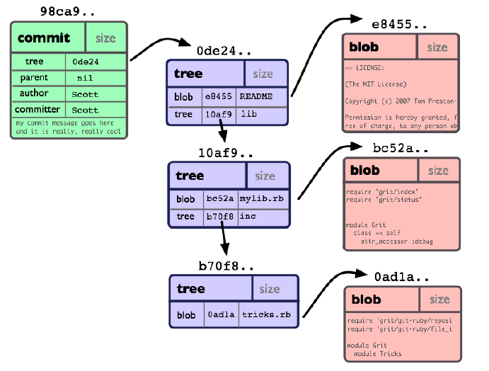
Commit Object
*
4

Slide 5
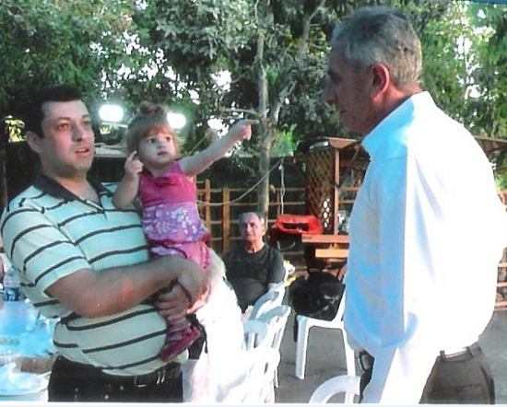
About myself: Ilya Rokhkin - 20+ years experience in Version Control Systems - Official Git trainer in CKP, Intel, Marvell. - Freelance Git trainer. - Volunteer as Hebrew teacher in “Ulpan” 10+ years

Slide 6
Agenda:
Git + GitLab best practices in a workflow
Git + GitLab best practices hands on
GitLab Best practices
GitLab CI overview

Slide 7
1. Git + GitLab best practices in work flow. Best practice: 1 Commit per Jira issue in main branches
Remote Repository
FTR-7
FTR-8
FTR-9
FTR-10
master
98ca9
34ac2
45v34
3ed90

Slide 8
Create new feature branch FTR-10 (Jira)
Remote Repository
Tracking Branch (Local)
FTR-7
master
FTR-8
98ca9
34ac2
fix/FTR-10
Remote Tracking Branch
Local Repository
Clone + checkout feature branch FTR-10
origin/fix/FTR-10
origin/master
98ca9
34ac2
fix/FTR-10
HEAD

Slide 9
Checkout local branch lcl-10, save->auto commit
Remote Repository
FTR-7
master
FTR-8
98ca9
34ac2
fix/FTR-10
Local Repository
Checkout local branch LCL-10 Changing files + auto commit
origin/fix/FTR-10
origin/master
98ca9
34ac2
67def
fix/FTR-10
lcl-10
HEAD

Slide 10
Save -> auto commit, tag important changes: working1
Remote Repository
FTR-7
master
FTR-8
98ca9
34ac2
fix/FTR-10
Local Repository
Each save -> auto commit
Tag working commits: workingN
origin/fix/FTR-10
origin/FTR-10
98ca9
34ac2
working1
67def
347e4
fix/FTR-10
lcl-10
HEAD

Slide 11
Making how many auto commits as needed, tagging as needed working2
Remote Repository
FTR-7
master
FTR-8
98ca9
34ac2
fix/FTR-10
Local Repository
Changing files + auto commit Each save -> auto commit
origin/fix/FTR-10
origin/master
98ca9
34ac2
working2
67def
347e4
24t56
fix/FTR-10
working1
lcl-10
HEAD

Slide 12
Merge --squash lcl-10 to fix/FTR-10
git checkout fix/FTR-10 git merge –squash lcl-10
git commit Squash merge to 1 commit in FTR-10 branch
(Possibly Rebase master)
Remote Repository
FTR-7
master
FTR-8
98ca9
34ac2
fix/FTR-10
HEAD
Local Repository
origin/fix/FTR-10
origin/master
fix/FTR-10
98ca9
34ac2
345r3
67def
347e4
24t56
working1
lcl-10
working2

Slide 13
Push -> trigger CI, remove branch lcl-10
Push triggers CI pipeline:
Build
Unit test
Static Code Analysis
Code coverage test
Snippet, Security code analysis
…
Deploy
Functional Test
Remote Repository
FTR-7
master
FTR-8
fix/FTR-10
98ca9
34ac2
345r3
Push
HEAD
Local Repository
origin/fix/FTR-10
origin/master
fix/FTR-10
98ca9
34ac2
345r3
67def
347e4
24t56
working1
lcl-10
Delete local branch
working2

Slide 14
Open Gitlab MR
Open Merge Request
If CI succeeded only
Remote Repository
FTR-7
master
FTR-8
fix/FTR-10
98ca9
34ac2
345r3
HEAD
Local Repository
origin/fix/FTR-10
origin/master
fix/FTR-10
98ca9
34ac2
345r3
67def
347e4
24t56
working1
working2

Slide 15
Change not approved, need to fix comments
Code review not approved
No go, need to fix
Remote Repository
FTR-7
master
FTR-8
fix/FTR-10
98ca9
34ac2
345r3
HEAD
Local Repository
origin/fix/FTR-10
origin/master
fix/FTR-10
98ca9
34ac2
345r3
67def
347e4
24t56
working1
working2

Slide 16
Again checkout lcl-10,save->autocommit
Code review -2
No go, need to fix
Remote Repository
FTR-7
master
FTR-8
fix/FTR-10
98ca9
34ac2
345r3
git checkout -b lcl-10 Each save->auto commit in local branch lcl-10
Local Repository
origin/fix/FTR-10
origin/master
fix/FTR-10
HEAD
98ca9
34ac2
345r3
67def
347e4
24t56
lcl-10
567r4
e3rf5
45t19
working1
working2
working3
working4

Slide 17
Squash merge to FTR-10
Squash merge to 1 commit in FTR-10 branch
Tag commit
(Possibly Rebase master)
Remote Repository
FTR-7
master
FTR-8
fix/FTR-10
98ca9
34ac2
345r3
HEAD
Local Repository
origin/fix/FTR-10
origin/master
fix/FTR-10
98ca9
34ac2
345r3
57y23
67def
347e4
24t56
lcl-10
567r4
e3rf5
45t19
working1
working2
working3
working4

Slide 18
Push fix of review, CI, delete local branch lcl-10
Push triggers CI pipeline:
Build
Unit test
Static Code Analysis
Code coverage test
Snippet, Security code analysis
- …
Deploy
Functional Test
Remote Repository
FTR-7
master
FTR-8
98ca9
34ac2
fix/FTR-10
345r3
57y23
HEAD
Local Repository
push
origin/fix/FTR-10
origin/master
fix/FTR-10
98ca9
34ac2
345r3
57y23
67def
347e4
24t56
Delete branch
lcl-10
567r4
e3rf5
45t19
working1
working2
working3
working4

Slide 19
Open Merge Request, Approve MR
Open Merge Request
If CI succeeded only
Approve MR
Remote Repository
FTR-8
FTR-7
master
98ca9
34ac2
fix/FTR-10
345r3
57y23
HEAD
Local Repository
origin/fix/FTR-10
origin/master
fix/FTR-10
98ca9
34ac2
345r3
57y23
67def
347e4
24t56
567r4
e3rf5
45t19
working1
working2
working3
working4

Slide 20
Other commit was merged, FF merge no possible now
Need to rebase feature branch on master branch, in remote repository or if conflicts in local repository
Remote Repository
FTR-7
FTR-8
FTR-9
master
98ca9
34ac2
45v34
345r3
57y23
fix/FTR-10
HEAD
Local Repository
origin/fix/FTR-10
origin/master
fix/FTR-10
98ca9
34ac2
345r3
57y23
67def
347e4
24t56
567r4
e3rf5
45t19
working1
working2
working3
working4

Slide 21
Rebase with squash only
Commits 345r3 and 57y23 squashed and applied upon commit 45v34 (Rebase)
Remote Repository
FTR-7
FTR-8
FTR-9
master
fix/FTR-10
98ca9
34ac2
45v34
345r3
57y23
3ed90
HEAD
Local Repository
origin/fix/FTR-10
origin/master
fix/FTR-10
98ca9
34ac2
345r3
57y23
67def
347e4
24t56
567r4
e3rf5
45t19
working1
working2
working3
working4

Slide 22
Trigger CI on new commit
New commit triggers CI
Build
Unit test
Static Code Analysis
Code Coverage Test
Snippet, Security code analysis
- …
Deploy
Functional Test
Remote Repository
FTR-7
FTR-8
FTR-9
master
fix/FTR-10
98ca9
34ac2
45v34
345r3
57y23
3ed90
HEAD
Local Repository
origin/fix/FTR-10
origin/master
fix/FTR-10
98ca9
34ac2
345r3
57y23
67def
347e4
24t56
567r4
e3rf5
45t19
working1
working2
working3
working4

Slide 23
FF Merge, Tag and Remove Source Branch, Fast Forward Merge must
Remote Repository
master
FTR-7
FTR-8
FTR-9
FTR-10
98ca9
34ac2
45v34
3ed90
345r3
57y23
fix/FTR-10
Tag source branch
Working_FTR-10
Remove source branch
HEAD
Local Repository
origin/fix/FTR-10
origin/master
fix/FTR-10
98ca9
34ac2
345r3
57y23
67def
347e4
24t56
567r4
e3rf5
45t19
working1
working2
working3
working4

Slide 24
We got desired result: 1 Commit per Jira issue in main branch. Start new Feature FTR-11
FTR-7
FTR-8
FTR-9
FTR-10
master
Remote Repository
98ca9
34ac2
45v34
3ed90
fix/FTR-11
Local Repository
HEAD
FTR-7
FTR-8
FTR-9
FTR-10
origin/master
Fix/FTR-11
origin/fix/FTR-11
98ca9
34ac2
45v34
3ed90
67def
347e4
24t56
345r3
working1
45t19
working2
567r4
e3rf5
working3
working4

Slide 25
2. Git + GitLab best practices hands on https://gitlab.com/ilyaro/git_gitlab_best_practices https://gitlab.com/ilyaro/git_gitlab_best_practices/-/blob/master/Commands.md
1.Work with local feature branches (topics)
Create your own feature branch from master: fix/<Jira-task> here: https://gitlab.com/ilyaro/demo-be
git clone -b fix/<Jira-task> https://gitlab.com/ilyaro/demo-be
git checkout lcl-<task>
Configure IDE/Editor to auto commit: https://gitlab.com/ilyaro/git_best_practices_ppt/README.md
git log - to show initial status
2. Edit .\demo-be\src\main\java\com\example\dep\Dep.java (Use IntelliJ, VS Code, vim or any other IDE,

Slide 26
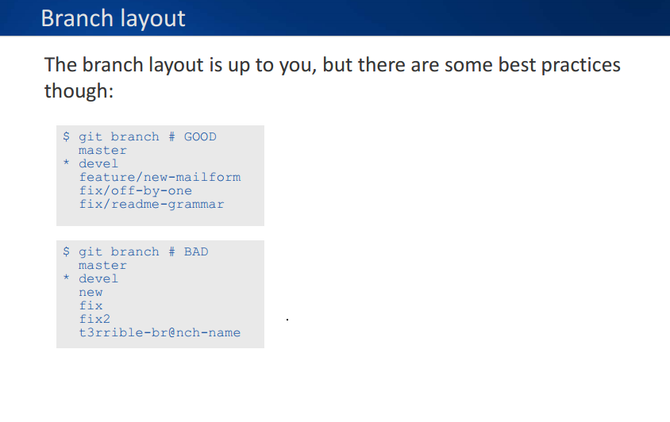
Best practices – Branch Layout

Slide 27
Git + GitLab best practices hands on cont.
after configure on save trigger) Change 1 line – save Add 1 line – save Delete 1 line – save It will create 3 commits
3 Tag important commit (working commits) git tag working1
4 Log with diff with only change, hash and refs git log -c -U0 --pretty="format:%H%d“ Or in GUI

Slide 28
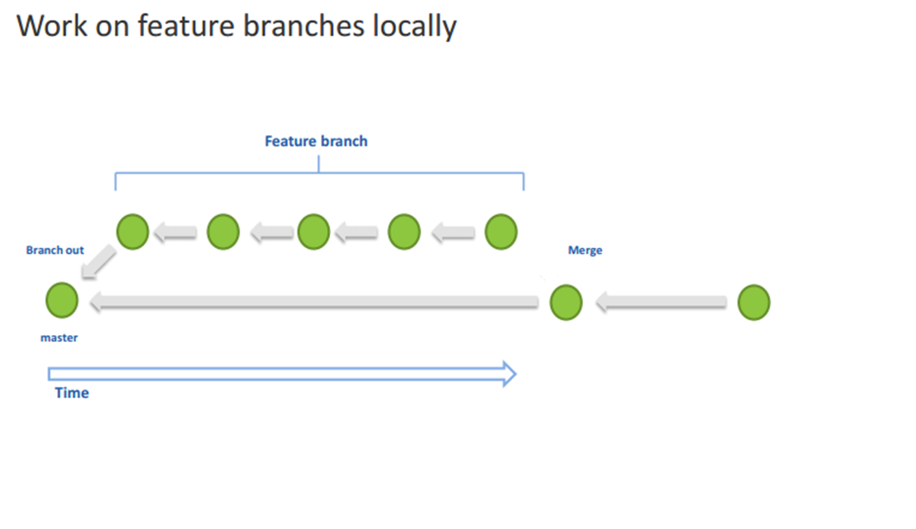
Best practices – local feature branches (topics)
Demo: create feature branch, checkout
*
28

Slide 29
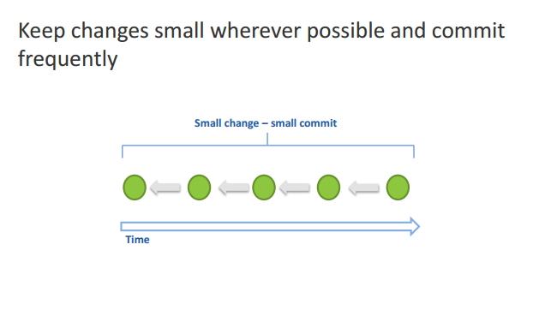
Best practices – commit
Demo: vim, change, save -> auto-commit, git log –c, git reset
*
29

Slide 30
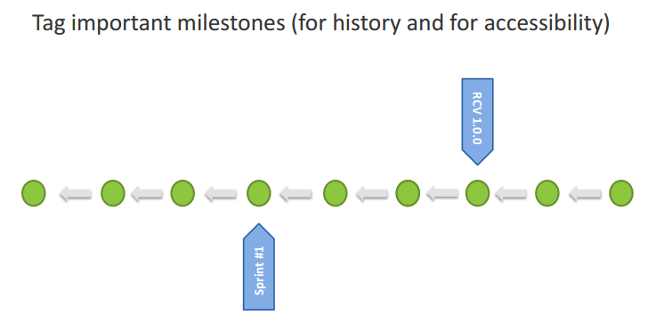
Best practices – tag milestones (even local)
*
30

Slide 31
Git + GitLab best practices hands on cont.
5. Squash in merge from feature branch to master See what to merge with git log --graph or IDE GUI git log --oneline --graph –all checkout feature branch git checkout fix/<Jira-task> merge --squash from topic/demo_gh git merge --squash lcl-<task> now commit 1 squashed commit to the feature branch: Give meaningfull and concise commit message: Example: "Testing auto commit on save and squash merge "Specify Jira-task in commit message body
git commit

Slide 32
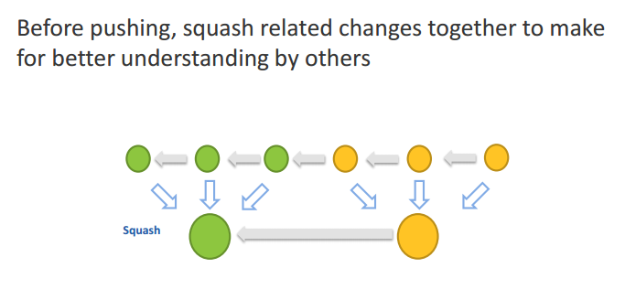
Best practices – squashing before push
Demo: git merge --squash, git commit, git log --oneline --graph --all, git push
*
32

Slide 33
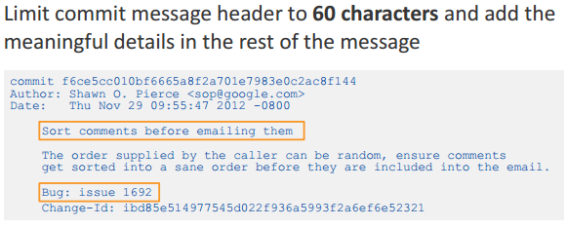
Best practices - concise commit messages
Limit commit message Subject to 70 chars and it must be simple, clear, self explained – this is the line all will see!
Meaningful details put in the body of the commit message
Demo: Example:
https://github.com/datreeio/node-datreeio/commits/master

Slide 34
Git + GitLab best practices hands on cont.
6. Delete local branch
git branch -D lcl-<Jira-task> See log again git log --oneline --graph --all
7. Push to Gitlab Feature branch git push
See Gitlab CI piopeline running: https://gitlab.com/ilyaro/demo-be/pipelines

Slide 35
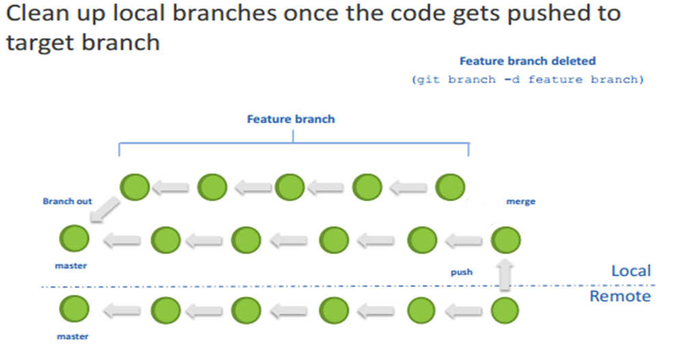
Best practices – clean up local branches
*
35

Slide 36
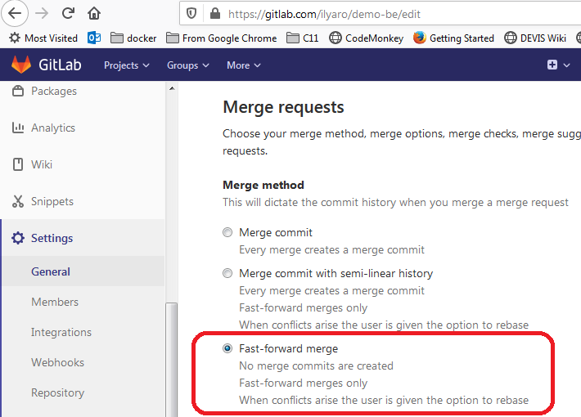
3. GitLab Best practices Fast-forward Merge in Gitlab

Slide 37
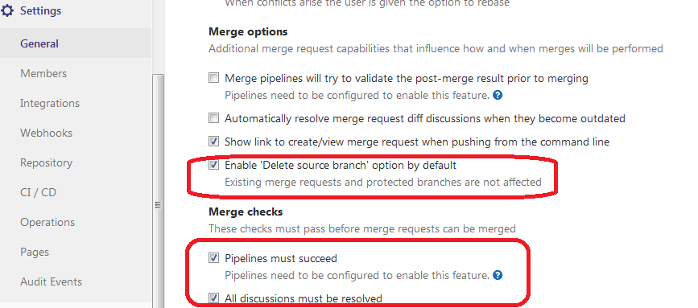
3. GitLab Best practices cont. Delete source branch, pipeline, discussions

Slide 38
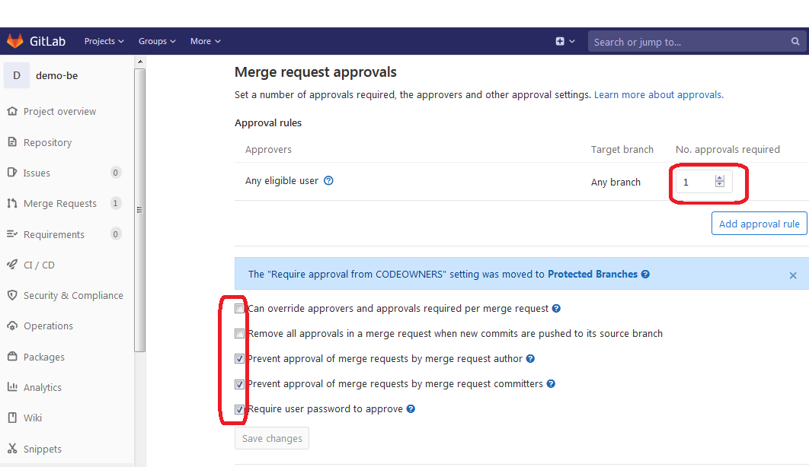
3. GitLab Best practices Must at least 1 approver, not author and not committer.

Slide 39
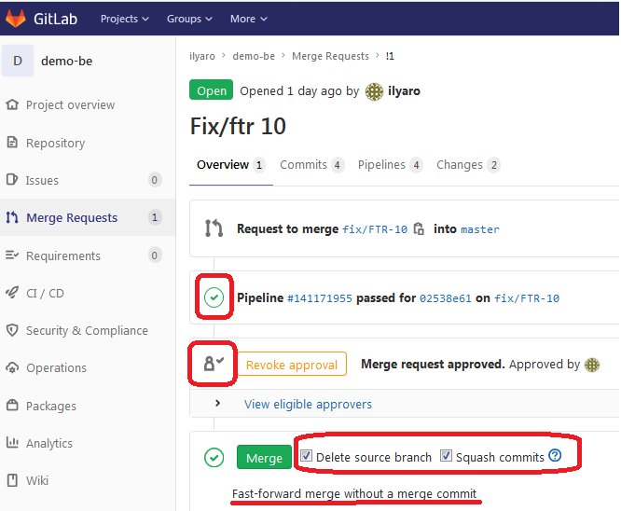
FF Merge only after: CI Pipeline succeed and Code Review + Approval. Squash + Delete Source Branch

Slide 40
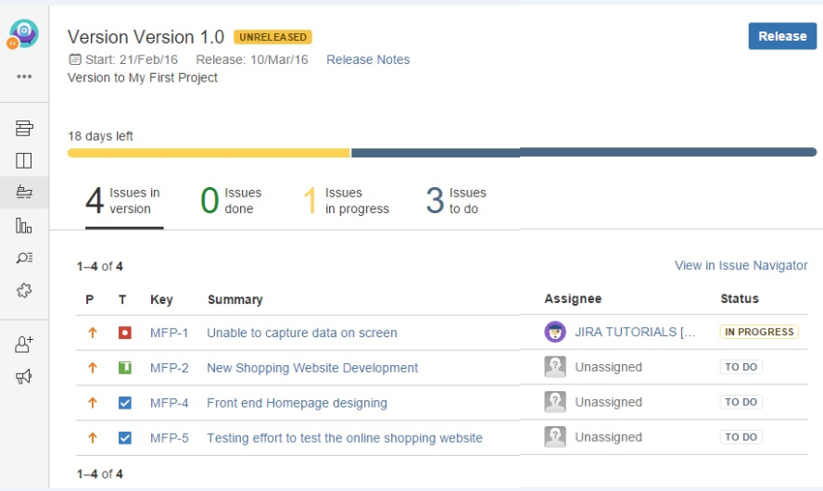
Gitlab FF Merge must be related to Jira Version Release. Only tasks in Version must be merged.

Slide 41
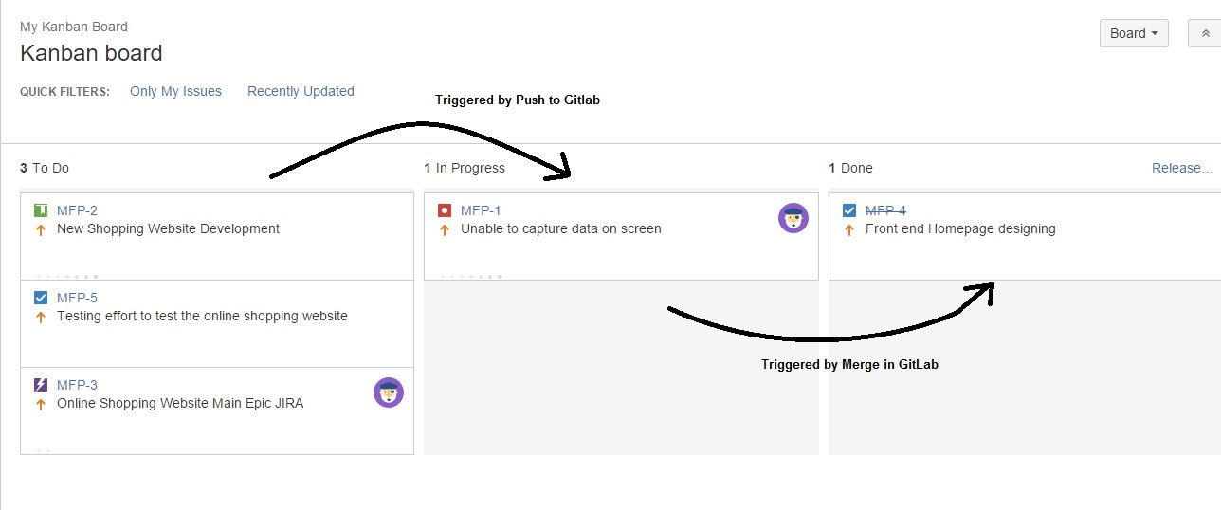
Merge need to change status to “Done”, Approve to status “Code Review”, Push – to status “In Progress”

Slide 42
3. GitLab Best practices cont. GitLab CI best practices. DevOps templates
Push triggers CI/CD pipeline (topic/feature branch):
Build
Unit test
Static Code Analysis
Code coverage test
Snippet, Security code analysis
…
STG Deploy
Functional Tests
Regression Tests
Fast Forward Merge to master branch, triggers CI pipeline:
PRD Deploy (Automatic/Manual)
Functional Test
Regression Tests

Slide 43
4. Git Lab CI overview
CI reference Guide https://docs.gitlab.com/ee/ci/yaml/
CI definition file https://gitlab.com/ilyaro/demo-be/-/blob/master/.gitlab-ci.yml
Pipelines https://gitlab.com/ilyaro/demo-be/pipelines

Slide 44
Questions? Summary Ilya Rokhkin (Git Trainings) https://github.com/ilyaro/git_best_practices_ppt rokhkin_ilya@yahoo.com 054-5224805
*
44

Slide 45
Git GitLab Best Practices
Thank You!

