Slide 1
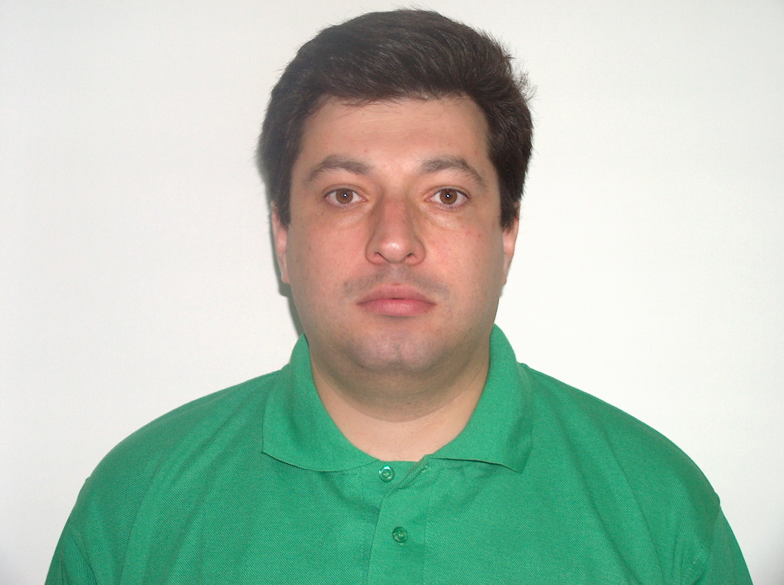
Ilya Rokhkin, M.Sc. Computers, Systems and Networks
Configuration Manager, Integrator, Build Manager, Installation Master
Mobile: +972-(0)-545224805
Tel:+972-(0)-97659225
E-mail: rokhkin_ilya@yahoo.com
Fax in USA: +1(270)964-7571
Web Site: http://www.freewebtown.com/rokhkin
Address: Rokhkin Ilya.
Tchernihovsky 13/2
Kfar Saba 44281
Israel

