Slide 1
My open source Git Training with hands-on for GitHub User Group
Deep inspection of basic commands
Ilya Rokhkin

Slide 2
Git – meaning?
What does the word git mean?

Slide 3

About myself: Ilya Rokhkin – DevOps engineer - 20+ years experience in Version Control Systems - Git trainer in Checkpoint, Intel, Marvell, and Freelancer. - Volunteer as a Hebrew teacher in “Ulpan” for 10+ years

Slide 4
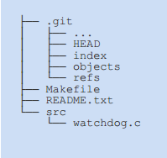
The Working Tree
The working tree has all files and folders as found in your HEAD, plus the changes you made since your last commit
There is only ONE main working tree per repository (and only 1 .git folder as well)
The Working Tree
*
4

Slide 5
Objects
Every object in GIT composed of those elements –
Type – “blob”, “tree”, “commit”, “refs” (branch/tag).
A "blob" is basically like a file – it is used to store the content of a source file.
A "tree" is basically like a directory - it references a group of other
trees (subdirectories) and/or blobs (files).
A "commit" points to a single tree, marking it as what the project
looked like at a certain point in time. Keeps changed files since the last commit, author of the changes, a reference to the parent commit(s), etc.
A “refs" is a way to mark a specific commit as special in some way. It is usually used to tag certain commits as specific releases or something along those lines.

Slide 6
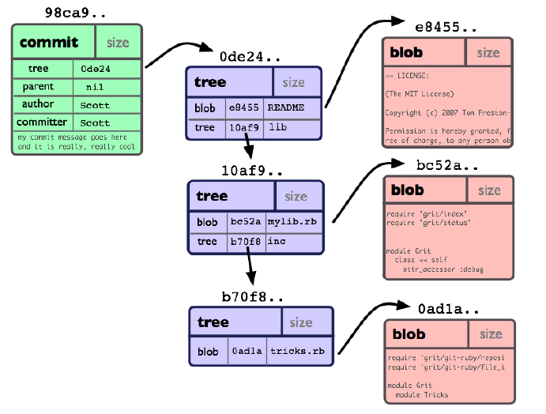
Commit Object
*
6

Slide 7
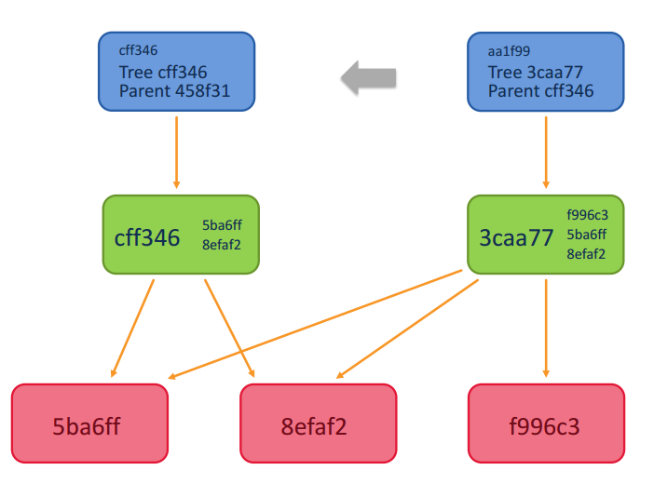
Commit object with its parent
Links from tree object to common blobs
Commit Obj
Tree Obj
Blob obj.

Slide 8
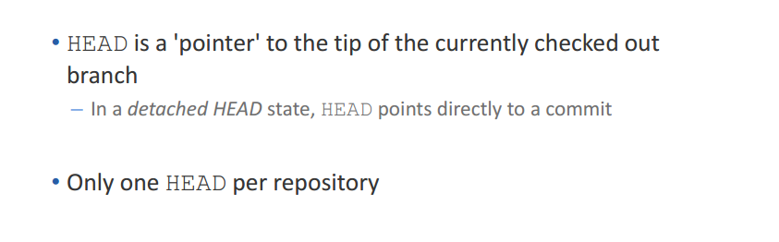
The HEAD
HEAD
Local Repository
master
98ca9
34ac2
f30ab
*
8

Slide 9
Rebasing Remote Tracking Branch
HEAD
Local Repository
feat/PRJ-777
Tracking Branch (Local)
98ca9
34ac2
f30ab
origin/master
origin/feat/PRJ-777
Remote Tracking Branch
Remote Repository
master
After clone/pull Remote Tracking Branch and Tracking (Local) branch pointing to the same commit
98ca9
34ac2
f30ab
feat/PRJ-777

Slide 10
Rebasing Remote Tracking Branch
HEAD
Local Repository
Tracking Branch (Local)
origin/master
feat/PRJ-777
98ca9
34ac2
f30ab
6df01
Remote Tracking Branch
origin/feat/PRJ-777
Commit on local repository
$ git commit
Remote Repository
master
98ca9
34ac2
f30ab
feat/PRJ-777

Slide 11
Rebasing Remote Tracking Branch
HEAD
Local Repository
Tracking Branch (Local)
orig/master
feat/PRJ-777
98ca9
34ac2
f30ab
6df01
Remote Tracking Branch
origin/feat/PRJ-777
Merge another Commit to remote repository from another feature branch
Remote Repository
98ca9
34ac2
f30ab
0bddb
feat/PRJ-777
master

Slide 12
Rebasing Remote Tracking Branch
HEAD
Local Repository
Tracking Branch (Local)
feat/PRJ-777
98ca9
34ac2
f30ab
6df01
Fetch/Pull the Commit from remote repository to Remote Tracking Branch
feat/PRJ-777
0bddb
Remote Tracking Branch
origin/master
Remote Repository
98ca9
34ac2
f30ab
0bddb
feat/PRJ-777
master

Slide 13
Rebasing origin/master
HEAD
Local Repository
Tracking Branch (Local)
feat/PRJ-777
$ git rebase origin/master First, rewinding head to replay your work on top of it...
98ca9
34ac2
f30ab
6df01
origin/feat/PRJ-777
0bddb
origin/master
Remote Tracking Branch
Remote Repository
98ca9
34ac2
f30ab
0bddb
feat/PRJ-777
master

Slide 14
Rebasing Remote Tracking Branch
HEAD
Local Repository
feat/PRJ-777
Tracking Branch (Local)
6df01
98ca9
34ac2
f30ab
0bddb
3f9f9
$ git rebase origin/master ...to replay your work on top of it…
Applying: diff/patch of commit 6dfo on top of origin/master to create commit 3f9f9
Remote Tracking Branch
origin/feat/PRJ-777
origin/master
Remote Repository
98ca9
34ac2
f30ab
0bddb
feat/PRJ-777
master

Slide 15
Rebasing Remote Tracking Branch
HEAD
Local Repository
Tracking Branch (Local)
feat/PRJ-777
98ca9
34ac2
f30ab
0bddb
3f9f9
$ git push of commit 3f9f9
Remote Tracking Branch
origin/feat/PRJ-777
origin/master
Remote Repository
98ca9
34ac2
f30ab
0bddb
3f9f9
master
feat/PRJ-777

Slide 16
Rebasing Remote Tracking Branch
Tracking Branch (Local)
HEAD
Local Repository
feat/PRJ-777
98ca9
34ac2
f30ab
0bddb
3f9f9
After push Remote Tracking Branch and Tracking (Local) branch points to the same commit
Remote Tracking Branch
origin/master
origin/feat/PRJ-777
Remote Repository
98ca9
34ac2
f30ab
0bddb
3f9f9
master
feat/PRJ-777

Slide 17
Perils of rebase
Do not rebase commits that you have pushed to a public repository.
If you follow that guideline, you’ll be fine. If you don’t, people will hate you, and you’ll be scorned by friends and family.
*
17

Slide 18
Question?
Thanks!
*
18

Slide 19
Backup Slides
*
19

Slide 20
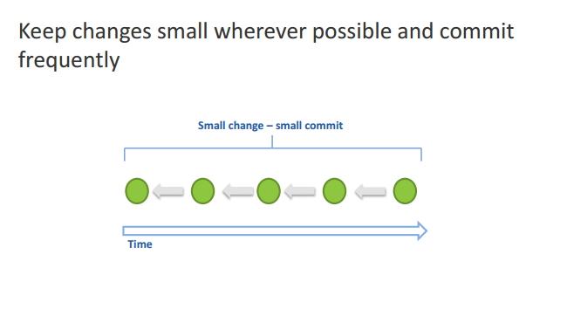
Best practices – commit
*
20

Slide 21
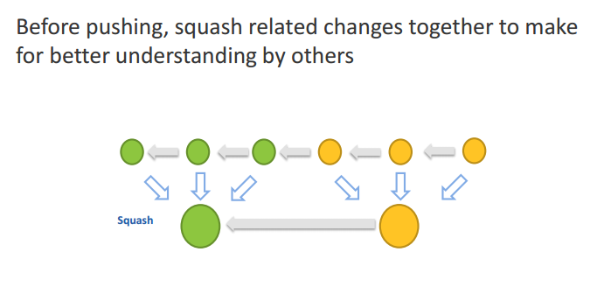
Best practices – squashing
*
21

Slide 22
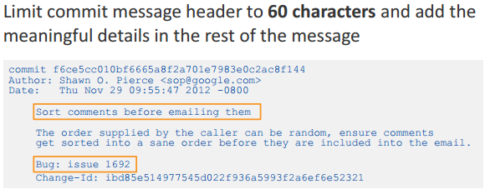
Best practices - concise commit messages

Slide 23
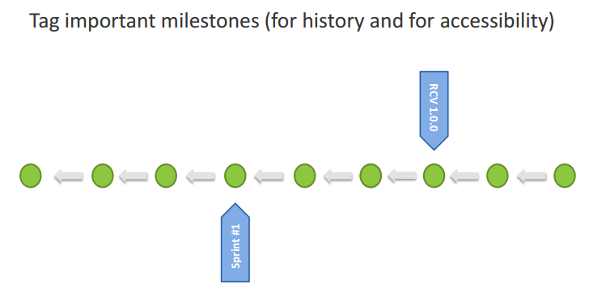
Best practices – tag milestones
*
23

