Slide 1
Git General Training
Deep inspection of basic commands
Ilya Rokhkin

Slide 2
Git – meaning?
What does the word Git mean?

Slide 3
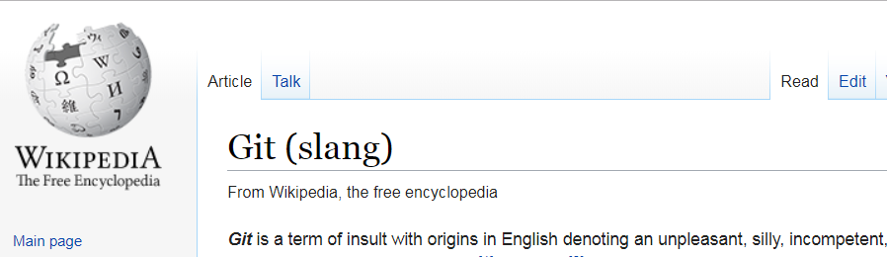
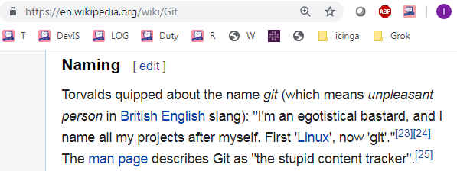
GIT Overview

Slide 4
Agenda:
1. Basic concepts and commands
Git Architecture, data model
DVCS, Repository, Commit, Parent Commit, Tree, Blob, Index.
Staged, Modified, and Committed files.
Basic commands to work in the Repository and outside.
Sharing work with peers.
Best practices
2. Practical part, lab work

Slide 5
GIT Overview
Quick and efficient
Expedite distributed development
Atomic transactions, commit, cross repository
Commits (Change) management
A clear internal design
Suited to handle everything from small to very large projects with speed and efficiency
Support and encourage branched development

Slide 6

About myself: Ilya Rokhkin - 20+ years experience in Version Control Systems - Official Git trainer in Checkpoint, Intel, Marvell. - Freelance Git trainer. - Volunteer as Hebrew teacher in “Ulpan” 10+ years

Slide 7
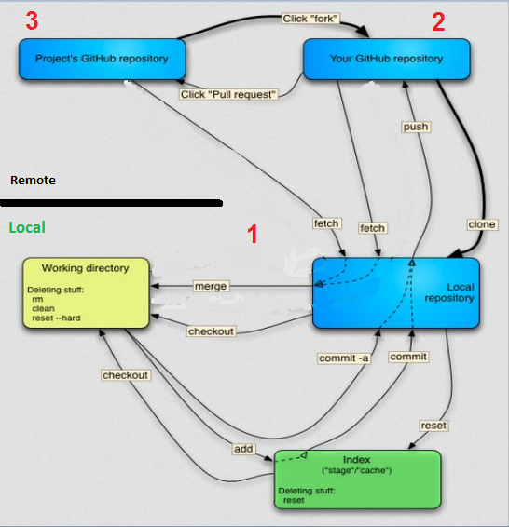
GIT Architecture
1 Local repo
2 Remote (Origin)
3 Common (Community) Remote Origin
Nov 20,2011
7

Slide 8
Demo
Lab 1 - 2
We will configure your git user and e-mail
Will create a remote, bare repository in the home directory
Clone it to work repository1 in the home directory also, add, commit, and push
Restructure files, add, commit, and push

Slide 9
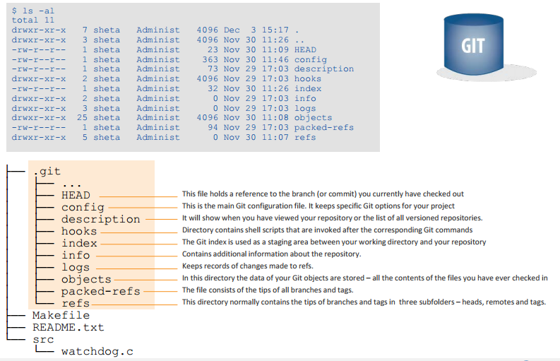
Git repository structure (.git)
*
9

Slide 10
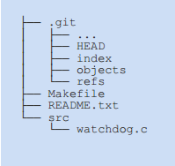
The Working Tree
The working tree has all files and folders as found in your HEAD, plus the changes you made since your last commit
There is only ONE main working tree per repository (and only 1 .git folder as well)
The Working Tree
*
10

Slide 11
States of files in Working Tree
Untracked – in the repository folder, git does not keep a version of it.
Modified – tracked, modified since last stage or commit.
Staged – a snapshot of the file, ready to be committed. Even if modified, git will still keep the snapshot.
Committed – version of file saved in repository DB

Slide 12
Objects
Every object in GIT composed of those elements –
Type – “blob”, “tree”, “commit”, “refs” (branch/tag).
A "blob" is basically like a file – it is used to store the content of a source file.
A "tree" is basically like a directory - it references a group of other
trees (subdirectories) and/or blobs (files).
A "commit" points to a single tree, marking it as what the project
looked like at a certain point in time. Keeps changed files since the last commit, author of the changes, a reference to the parent commit(s), etc.
A “refs" is a way to mark a specific commit as special in some way. It is usually used to tag certain commits as specific releases or something along those lines.

Slide 13
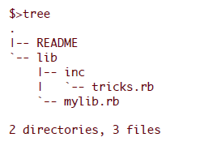
Objects cont.
Almost all the GIT is built around manipulating this simple structure of four different object types. It is sort of it's own little file system that sits on top of your machine's file system.
Let's say we have a small project that looks like this:
If we will commit this project to a GIT repository, it will be represented in GIT like this:

Slide 14
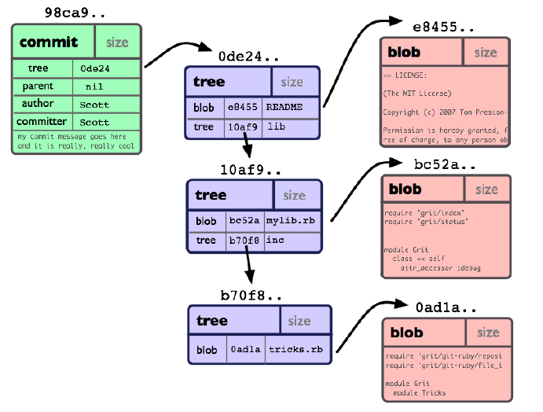
Commit Object
*
14

Slide 15
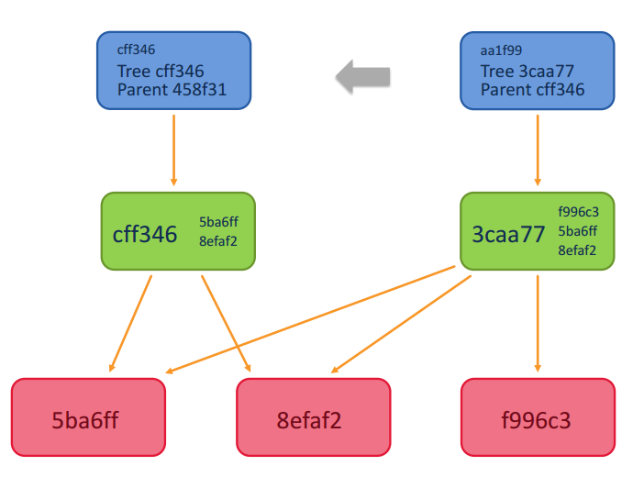
Commit object with its parent
Links from tree object to common blobs
Commit Obj
Tree Obj
Blob obj.

Slide 16
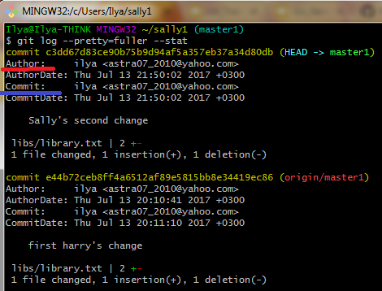
Secure Hash Algorithm – SHA1
Each object in GIT is represented by a 40-digit string, that looks something like that: 7bf68ebf3d8cff042bd3cb87e7592ddda9caa665.
This string is being calculated by taking the SHA1 hash of the
contents of the object.
Each commit has Author and Committer
The Author is who really wrote the code, and committed
Committer, if not the same as the Author, took Original commit and reused it in his branch
*
16

Slide 17
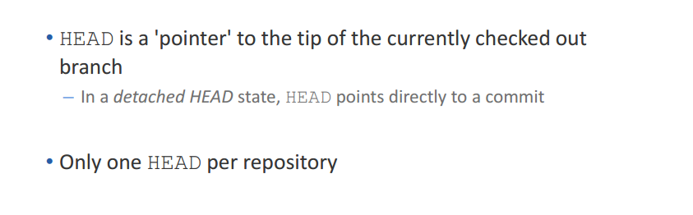
The HEAD
HEAD
Local Repository
master
98ca9
34ac2
f30ab
*
17

Slide 18
Demo
Lab 3
Teamwork, parallel work:
We will clone the second work repository2
We will commit changes in both repositories
Push and pull with silent rebase to apply the commit of one repo into another
Overview results

Slide 19
Rebasing Remote Tracking Branch
HEAD
Local Repository
feat/PRJ-777
Tracking Branch (Local)
98ca9
34ac2
f30ab
origin/master
origin/feat/PRJ-777
Remote Tracking Branch
Remote Repository
master
After clone/pull Remote Tracking Branch and Tracking (Local) branch pointing to the same commit
98ca9
34ac2
f30ab
feat/PRJ-777

Slide 20
Rebasing Remote Tracking Branch
HEAD
Local Repository
Tracking Branch (Local)
origin/master
feat/PRJ-777
98ca9
34ac2
f30ab
6df01
Remote Tracking Branch
origin/feat/PRJ-777
Commit on local repository
$ git commit
Remote Repository
master
98ca9
34ac2
f30ab
feat/PRJ-777

Slide 21
Rebasing Remote Tracking Branch
HEAD
Local Repository
Tracking Branch (Local)
orig/master
feat/PRJ-777
98ca9
34ac2
f30ab
6df01
Remote Tracking Branch
origin/feat/PRJ-777
Merge another Commit to remote repository from another feature branch
Remote Repository
98ca9
34ac2
f30ab
0bddb
feat/PRJ-777
master

Slide 22
Rebasing Remote Tracking Branch
HEAD
Local Repository
Tracking Branch (Local)
feat/PRJ-777
98ca9
34ac2
f30ab
6df01
Fetch/Pull the Commit from remote repository to Remote Tracking Branch
feat/PRJ-777
0bddb
Remote Tracking Branch
origin/master
Remote Repository
98ca9
34ac2
f30ab
0bddb
feat/PRJ-777
master

Slide 23
Rebasing origin/master
HEAD
Local Repository
Tracking Branch (Local)
feat/PRJ-777
$ git rebase origin/master First, rewinding head to replay your work on top of it...
98ca9
34ac2
f30ab
6df01
origin/feat/PRJ-777
0bddb
origin/master
Remote Tracking Branch
Remote Repository
98ca9
34ac2
f30ab
0bddb
feat/PRJ-777
master

Slide 24
Rebasing Remote Tracking Branch
HEAD
Local Repository
feat/PRJ-777
Tracking Branch (Local)
6df01
98ca9
34ac2
f30ab
0bddb
3f9f9
$ git rebase origin/master ...to replay your work on top of it…
Applying: diff/patch of commit 6dfo on top of origin/master to create commit 3f9f9
Remote Tracking Branch
origin/feat/PRJ-777
origin/master
Remote Repository
98ca9
34ac2
f30ab
0bddb
feat/PRJ-777
master

Slide 25
Rebasing Remote Tracking Branch
HEAD
Local Repository
Tracking Branch (Local)
feat/PRJ-777
98ca9
34ac2
f30ab
0bddb
3f9f9
$ git push of commit 3f9f9
Remote Tracking Branch
origin/feat/PRJ-777
origin/master
Remote Repository
98ca9
34ac2
f30ab
0bddb
3f9f9
master
feat/PRJ-777

Slide 26
Rebasing Remote Tracking Branch
Tracking Branch (Local)
HEAD
Local Repository
feat/PRJ-777
98ca9
34ac2
f30ab
0bddb
3f9f9
After push Remote Tracking Branch and Tracking (Local) branch points to the same commit
Remote Tracking Branch
origin/master
origin/feat/PRJ-777
Remote Repository
98ca9
34ac2
f30ab
0bddb
3f9f9
master
feat/PRJ-777

Slide 27
Perils of rebase
Do not rebase commits that you have pushed to a public repository.
If you follow that guideline, you’ll be fine. If you don’t, people will hate you, and you’ll be scorned by friends and family.
*
27

Slide 28
Demo
Lab 4
Teamwork, parallel work with rebase, and conflict resolution:
We will do commits in both repositories, with changes in the same line of the same file
Pull with rebase, resolve conflicts, and save the resolution file
Adding the file to the staging area means resolving the issue.
Commit and push

Slide 29
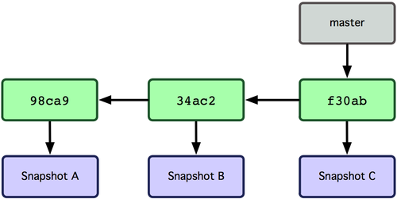
Git branches
Git branch is simply a movable pointer to a commit
Pointer moves forward automatically with each commit on a branch
*
29

Slide 30
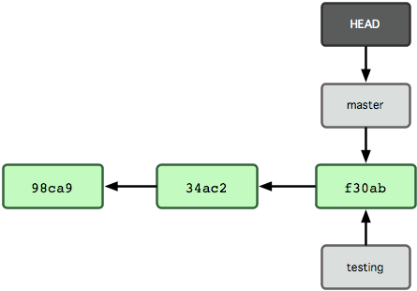
Creating new branch
New branch creates a new reference
> git branch testing
*
30

Slide 31
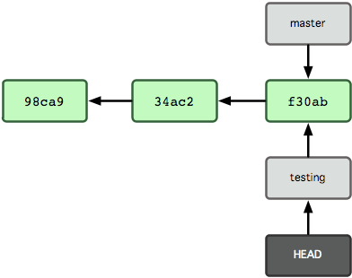
Switching to a branch
Git checkout branch-name switches to an existing branch
> git checkout testing
*
31

Slide 32
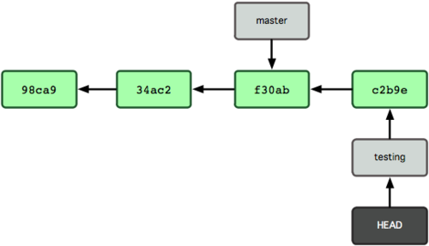
New commit moves current branch
> vi file04.txt
> git commit -a -m 'Commit message'
*
32

Slide 33
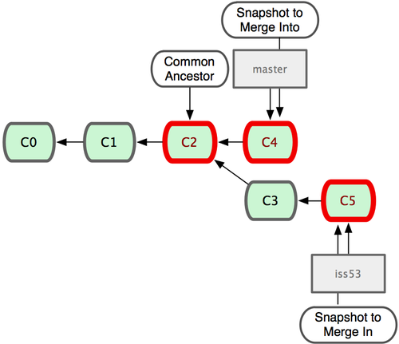
Merging branches
*
33

Slide 34
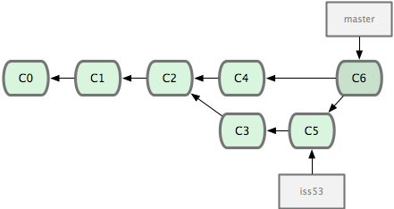
Merging branches (continued)
As a result of merge Git creates a new commit, which has two parents:
*
34

Slide 35
Demo
Lab 5 - 7
We will create a tag
Create branch bugfix from the tag
I will do a bugfix commit in the bugfix branch
Check out the master branch and commit a new change
Merge bugfix branch
Overview results

Slide 36
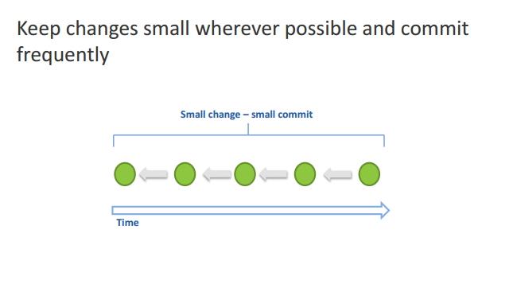
Best practices – commit
*
36

Slide 37
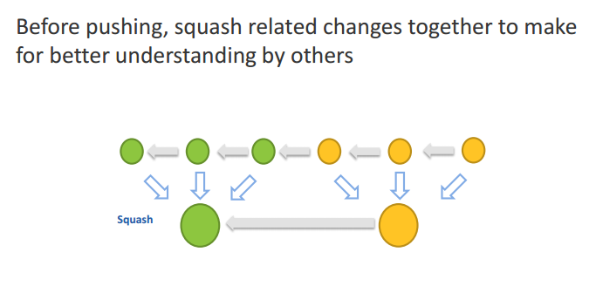
Best practices – squashing
*
37

Slide 38
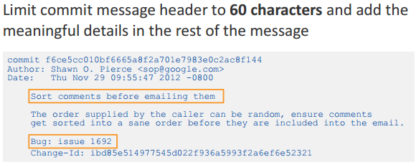
Best practices - concise commit messages

Slide 39
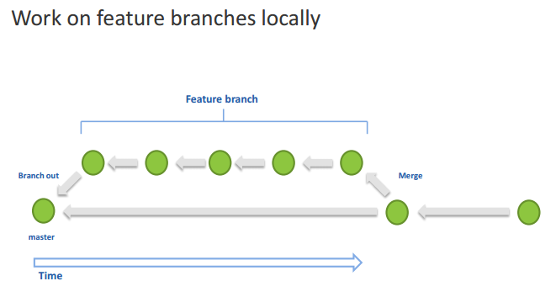
Best practices – local feature branches
*
39

Slide 40
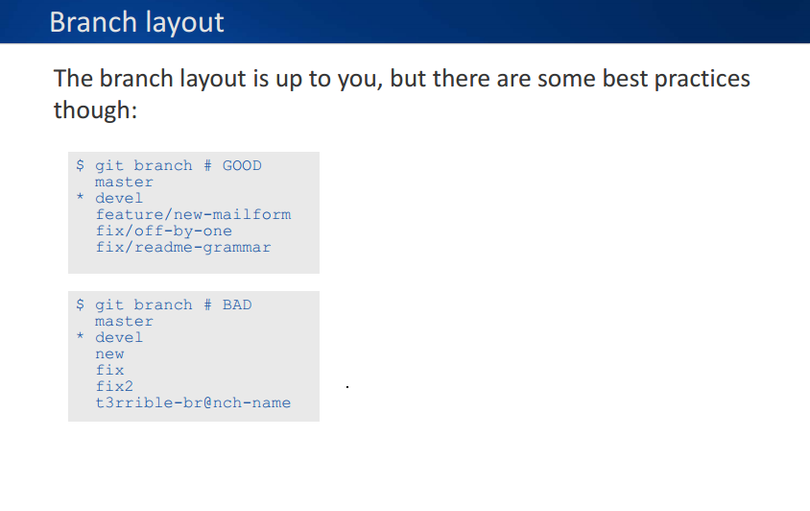
Best practices – Branch Layout

Slide 41
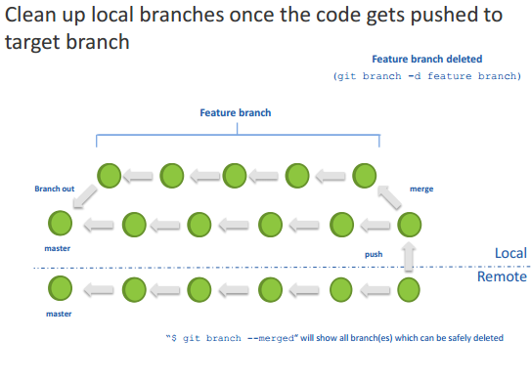
Best practices – clean up local branches
*
41

Slide 42
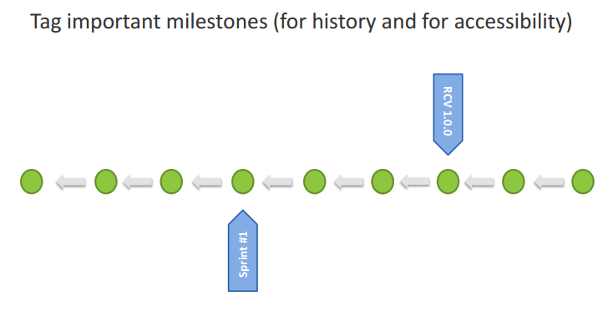
Best practices – tag milestones
*
42

Slide 43
Lab 8 - 10
We will create branch bugfix2, from Release_01
Cherry-pick 1 commit from the master branch
Undo modified file, undo staged file
Undo the latest local commit, revert the pushed commit
Stash meanwhile work aside, make a commit, return work from stash

Slide 44
Lab 11 - 13
Format patch in 1 repository, and apply it in another repository
We will create 2 local commits squash them to 1 commit by interactive rebase, and push only 1 commit to the remote repository
Create a commit in 1 repository and pull it from another repository, without pushing it to the origin repository

Slide 45
Question?
Thanks!
*
45

Slide 46
Backup slides

Slide 47
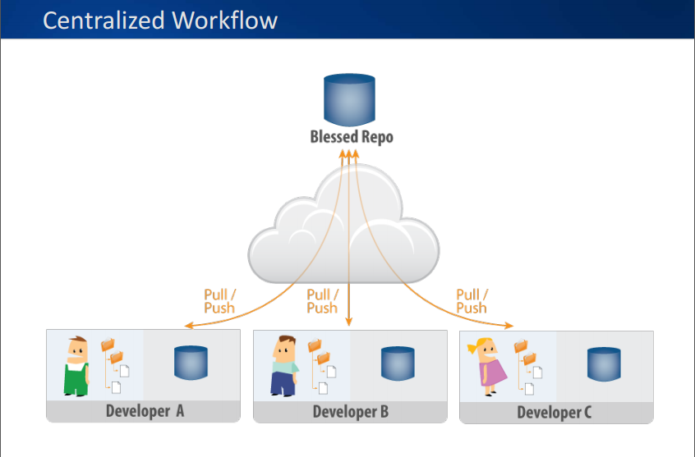

Slide 48
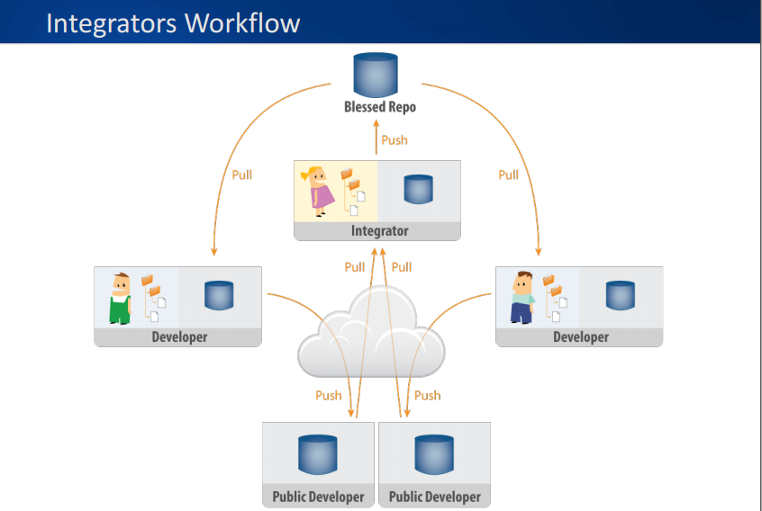

Slide 49
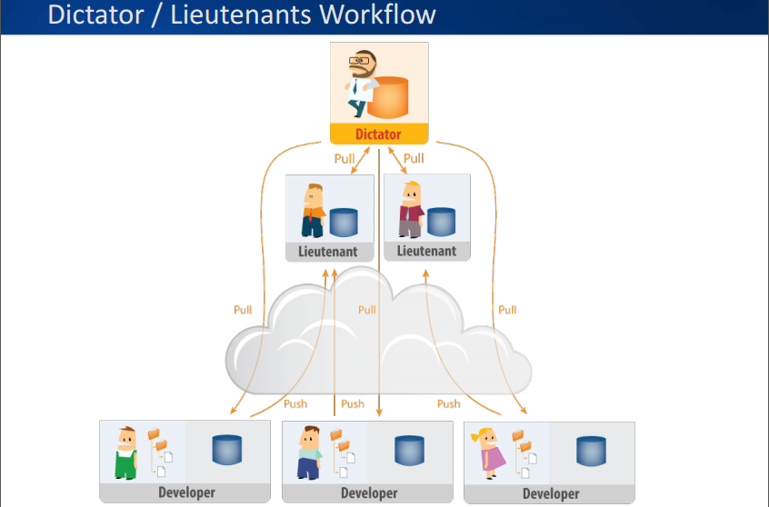

Slide 50
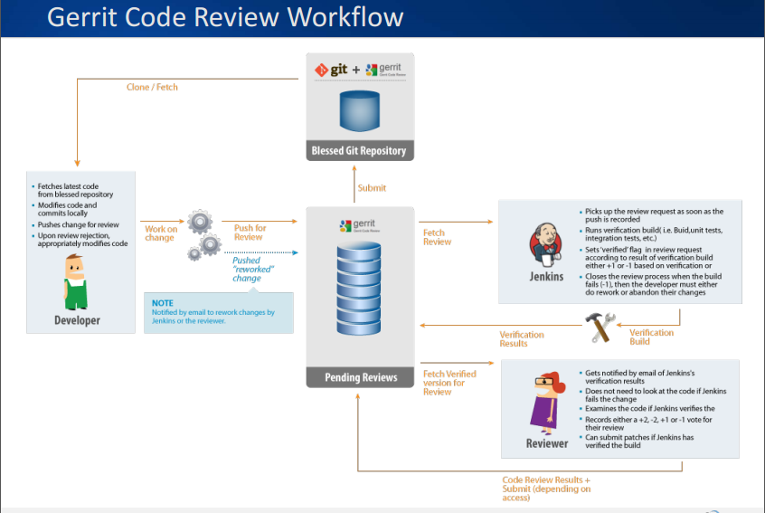

Slide 51
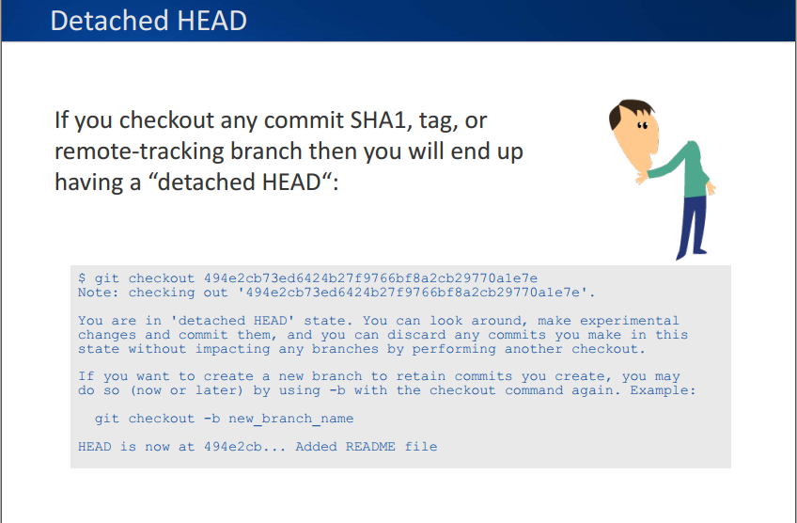

Slide 52
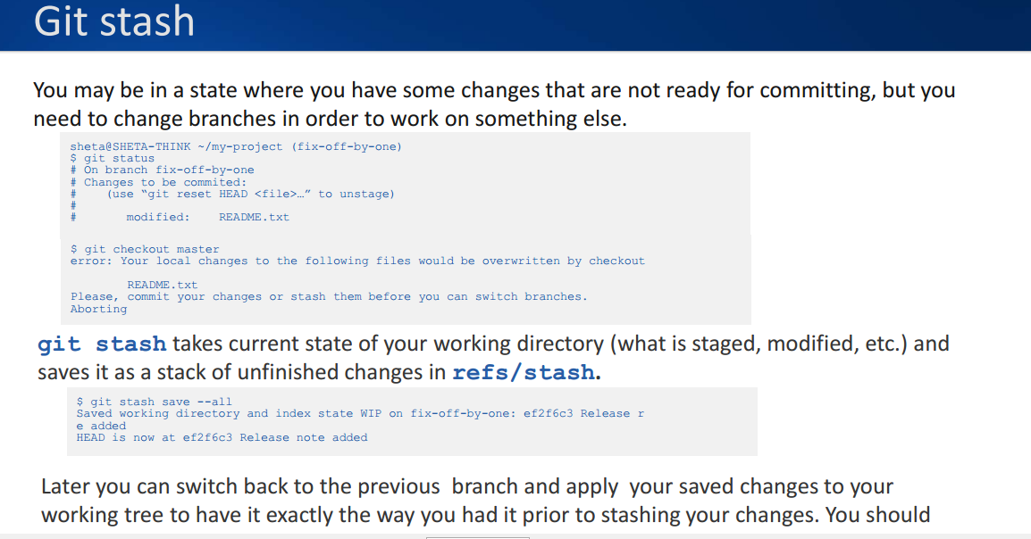

Slide 53
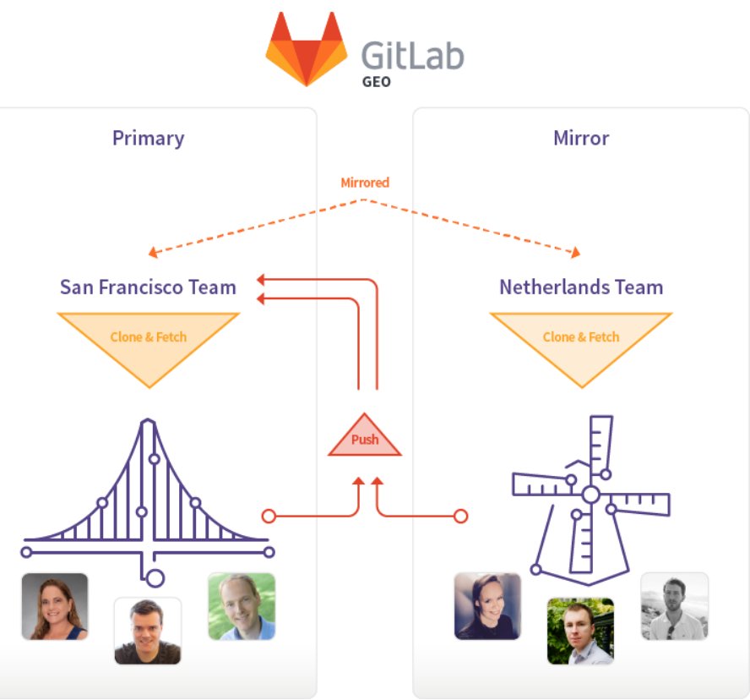
Git Master->Slave
Mirroring

Slide 54
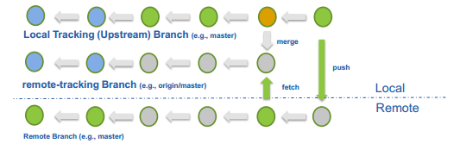
What are tracking and remote-tracking branches?
The combination of these branches defines a relationship between a local branch and one in the remote repository.
When a repository is cloned, Git automatically creates remote-tracking branches (e.g., origin/master) for the remote branches and a tracking branch (e.g., master) to allow for local changes in relationship to the remote branch
*
54

