Slide 1
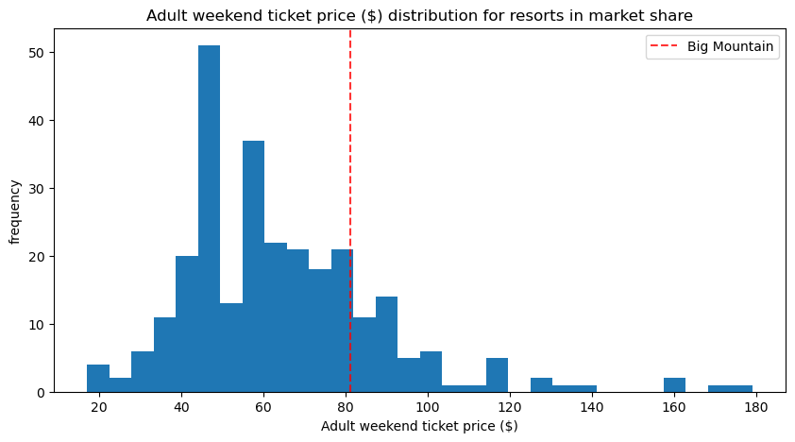
Big Mountain wants to know what price it should charge to maximize its profit. It feels it could be making more than it is right now so it wants to perform an analysis to see how the current price should be changed.
Above we see a distribution of prices for all of the resorts in the dataset with the redline displaying the price for Big Mountain. We can see that the current price charged is already bigger that what the majority of resorts charge.

Slide 2
From what was modeled using the best model out of the few that were tried it would seem more likely than not that the resort can increase its revenue if it were to increase its price. After modeling the relationship between feature values and ticket prices for hundreds of other resorts in the country it was found that the ticket price for Big Mountain would have been $100.24 if it were to follow the model. This is almost $20 more that what the resort is currently charging. The mean absolute error was found to be $10.05. The model that gave $100.24 as the modeled price was random forest with median as the imputation strategy and 33 predictors. Seeing a modeled price that is higher than the current price suggests that more likely than not the highest profit can be achieved through raising the price, not reducing it. This aligns well with the finding that after comparing many attributes that correlate positively with price the values for those attributes for Big Mountain were usually significantly higher than the mean of those attributes for all the resorts in the dataset.

Slide 3
The random forest model was found to give the most accurate predictions out of all the models employed. The metrics used to determine how well the model fit were R-squared, mean absolute error and mean squared error. The model also underwent tuning to find the best number of estimators and to determine whether median or mean was best to fill in missing values. It was found that using the median to fill in missing values with 33 estimators gave the best model for random forest. This was found using grid search.

Slide 4
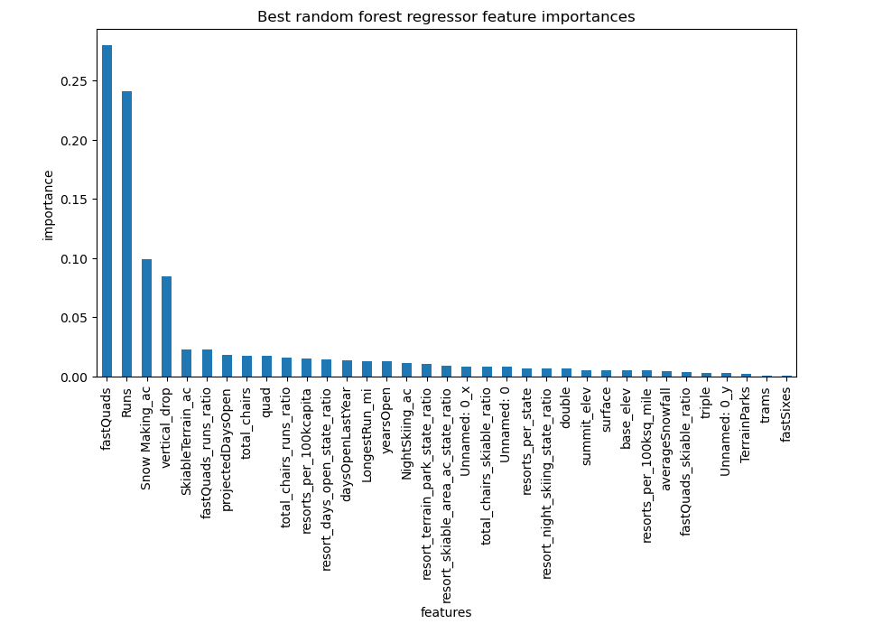
Some features play a much bigger role in affecting the modeled price than others. The output below gives an idea of which how important each feature is for generating profit:

Slide 5
When using cross-validation the dataset was split into 5 folds and the mean absolute error was about $10. This tells us that the current ticket price is almost 2 mean absolute errors away from the price we would have expected from the feature values of the resort based on the data modeling for the other resorts. Mean absolute error is similar to a standard deviation so it would also be correct to say that the current price is about 2 standard deviations below the modeled price.

Slide 6
Looking at just one model does not tell the whole story. We might be interested in how a certain subset of variables is expected to affect the modeled price, while holding the rest constant. This should give an idea of which attributes the resort should consider increasing and which ones it should consider decreasing. For that purpose we created a function whose inputs are the subset of variables for which we want to examine changes in value and the corresponding changes for each of the variables. The output is the expected increase in the predicted price. For example it was found the removing two of the least used runs would slightly increase the predicted price.

Slide 7
After applying three methodologies of modeling the most accurate model suggests that the resort prices its tickets by significantly less than what we would expect based on its other attribute values. Out of the three prediction algorithms we used random forest beat out the training mean method and linear regression. There are a lot more prediction algorithms to try out so very likely there is something that would give more accurate predictions. With this being said the random forest model is a very common and reliable algorithm, and based on its results it would be expected that profit can be increased by increasing the ticket price.

