Slide 1
Secure DevOps Practices with Azure & VSTS
@Gurucharan94
July 2018

Slide 2




About Me
Gurucharan Subramani (www.gurucharan.in)
/gurucharan94
ABB Digital – R&D. 3+ years of Software Engineering
Full Stack .NET Developer
Azure and VSTS
DevOps Principles and Practices
First Tech Talk
Notes:
Find me online here https://www.one-tab.com/page/zYErqWDPQp2gNfTXuVic-g

Slide 3
Agenda
The Current Security Landscape
The Vulnerability Supply Chain
The Answer to 95% of Security Problems in Code
The Burden of our Secrets
Protecting Azure Infra with Secure DevOps Kit for Azure
Building a Security First Mindset

Slide 4
Audience Survey
How many have a full DevOps pipeline ?
How many are InfoSec people?
How many are from Engineering ?
How many have strong / transparent security policies?

Slide 5
The Current Security Landscape
Is the threat real ? Endless debate on value
Our team is good?
We have never been breached.
Understand the concerns but do nothing about it
Notes:
Endless debate about the value of hardening security
Security Features are not given the same importance as Functional Features.
The Fancy Progress bar always takes precedence over prevention of SQL Injection.
We don’t have a security first mindset.

Slide 6
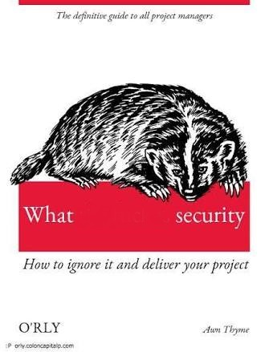
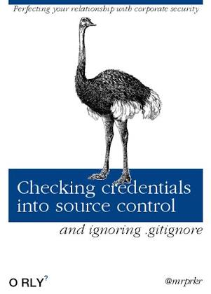
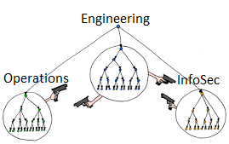
The Current Security Landscape
Notes:
DevRant Stuff

Slide 7
The Vulnerability Supply Chain
OWASP top 10 account for 97% of security breaches.
FOSS Components
Code that we write.
Credentials in Code
Insecure Communication Mechanisms.
Poorly Configured Infrastructure
Notes:
The Open Web Application Security Project (OWASP) is a worldwide not-for-profit charitable organization focused on improving the security of software.
We will look at some of the OWASP Top 10 issues that we can tackle immediately.
Having http and https both enabled. Long living SAS token for Storage Account.
Principle of least priviledge.

Slide 8
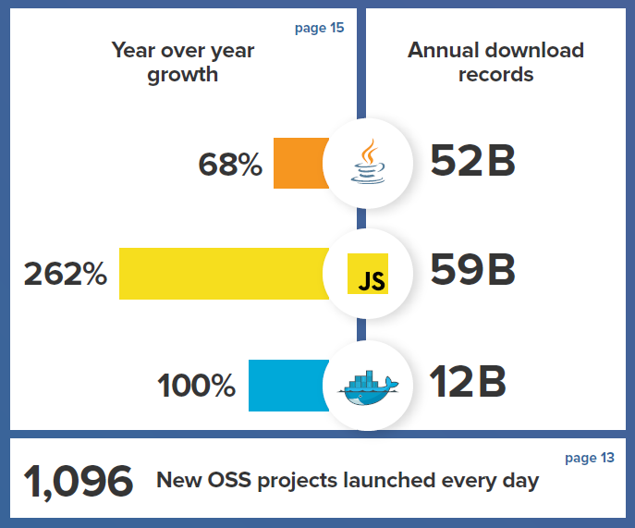
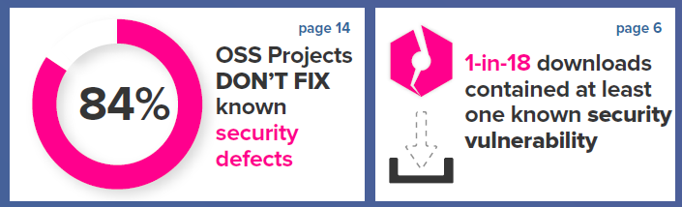
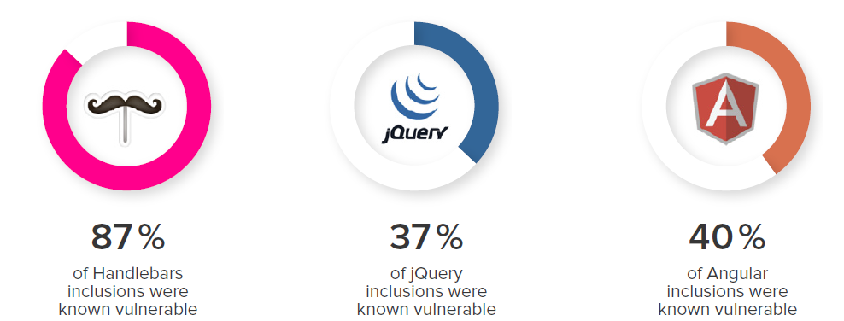
The Cost of Free & Open Source Software
2017 State of the Software Supply Chain (https://www.sonatype.com/learn-white-papers)
Notes:
Quickest Exploit 3 days
Mean Time to Exploit 25 days
Mean Time to Fix 233 days
https://www.sonatype.com/learn-white-papers

Slide 9
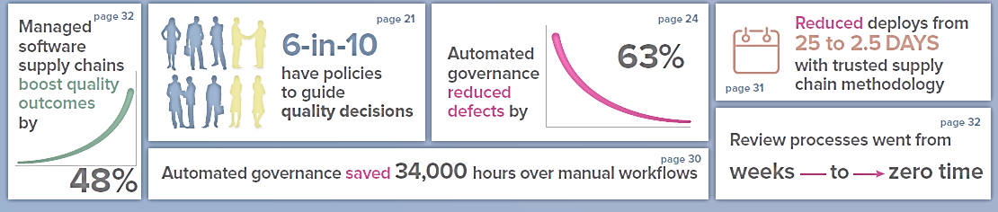
Open Source Governance
Tools
Dependency Check
Nessus
WhiteSource
BlackDuck
Notes:
Demo of WhiteSource
How many people here work in organizations that have an OSS Governance and Compliance Policy?
What are the tools that you use?
How often do you scan? Is It part of Your Pipeline

Slide 10
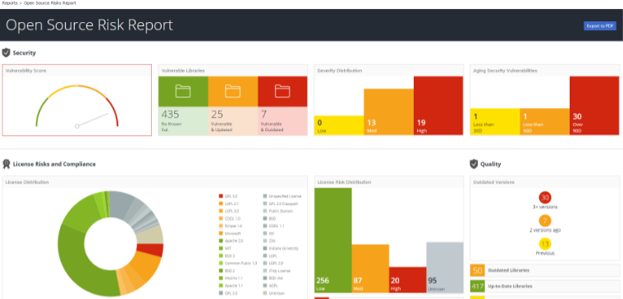
Open Source Vulnerability Scan
Demo 01 - WhiteSource (Bolt)
Notes:
Go to VSTS Demo Generator ( https://vstsdemogenerator.azurewebsites.net/ ) and try the whitesource Demo
https://blogs.msdn.microsoft.com/devops/2016/10/11/team-services-october-extensions-roundup-rugged-devops/

Slide 11
Fixing OWASP Security Issues
Demo 02 - Visual Studio Extensions (Free)
Security Code Scan
Cred Scan
SonarLint
Microsoft Fx Cop Rules
Notes:
https://www.one-tab.com/page/qZ-5LPYsQK-z9YRbtGIe4g

Slide 12
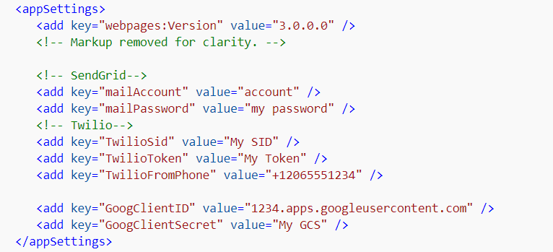

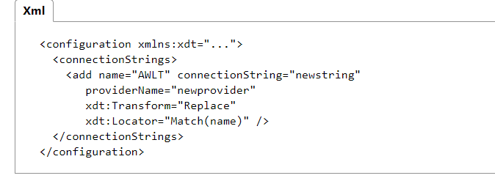
The Burden of Your Secrets

Slide 13
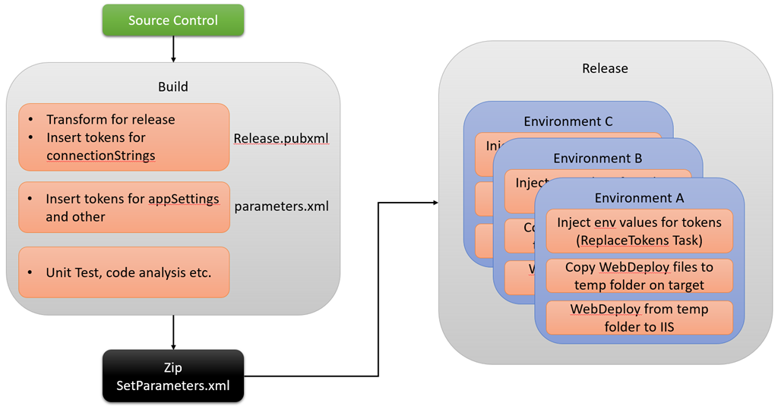
The Burden of Your Secrets
Demo 03 - Deploying On-Premises or Lift-Shift Scenarios
https://colinsalmcorner.com/post/end-to-end-walkthrough-deploying-web-applications-using-team-build-and-release-management
Notes:
https://www.one-tab.com/page/Fe8nPzE3SfOxn8e9jGrdrQ
https://docs.microsoft.com/en-us/aspnet/identity/overview/features-api/best-practices-for-deploying-passwords-and-other-sensitive-data-to-aspnet-and-azure

Slide 14
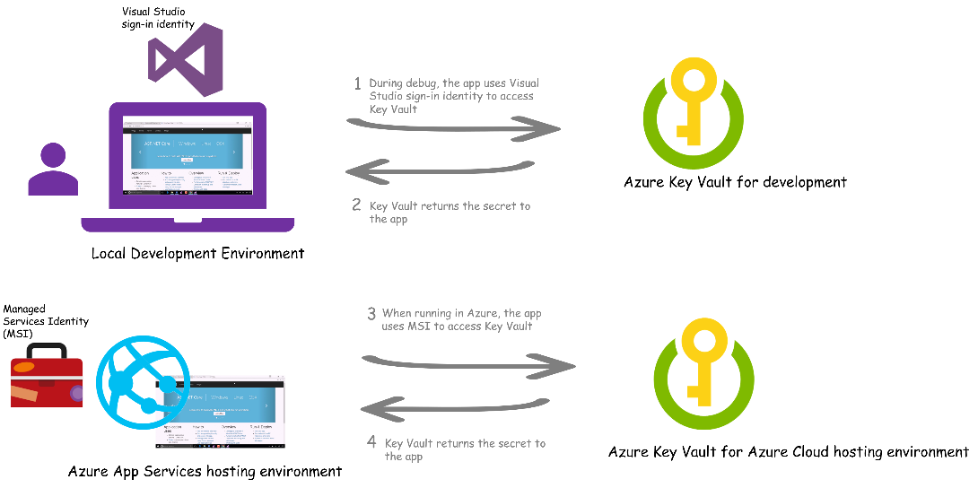
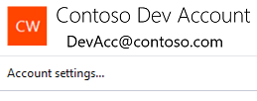
The Burden of Your Secrets
Key Vault, MSI and App Service Authentication
Notes:
https://www.one-tab.com/page/AzX-3-OUTRudceHeLPD_wA

Slide 15
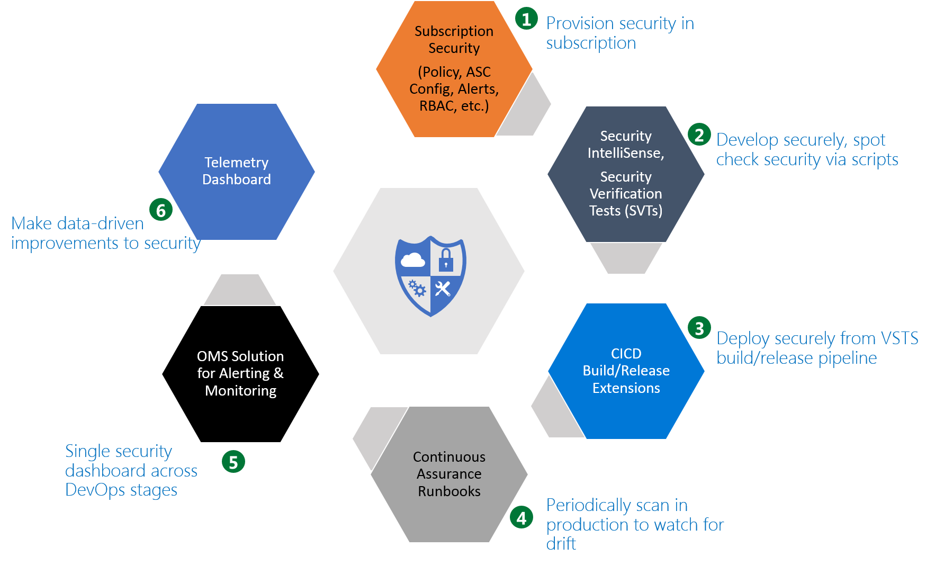
Secure Devops Kit for Azure
https://github.com/azsk/DevOpsKit-docs
Notes:
What is this ?
The "Secure DevOps Kit for Azure" (will be referred to as 'AzSK' henceforth) is a collection of scripts, tools, extensions, automations, etc. that caters to the end to end Azure subscription and resource security needs for dev ops teams using extensive automation and smoothly integrating security into native dev ops workflows helping accomplish secure DevOps.
Installation and Setup
Three modes of scanning
SDL – Developer WorkStation (Ad-hoc)
CI / CD – VSTS
Continuous Assurance Mode – Azure Automation

Slide 16
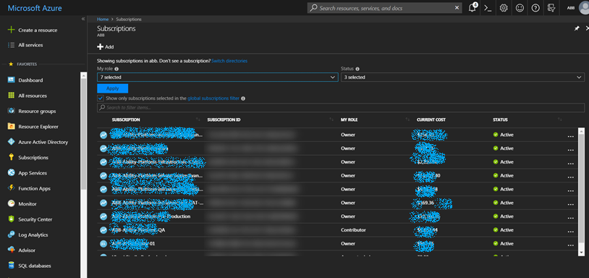
Secure Devops Kit for Azure
Security Verification Test
RBAC Policies
ARM Policies
Resource Locks
Contact Info
Alerts
Notes:
**Access control configuration** - Identity and Access Management issues. Count of Owners, Central Accounts, Stale / External acocunts
- **Alert configuration** - Activity alerts for sensitive actions in the subscription.
- **Azure Security Center configuration** - Configuration of ASC (security point of contact, various ASC policy settings, etc.)
- **ARM Policy and Resource Locks configuration** - Presence of desired set of ARM policy rules to prevent certain activities and resource locks.

Slide 17
Secure Devops Kit for Azure
Security Verification Test – Supported Resources
AppService
Automation
Batch
BotService
CDN
ContainerInstances
CosmosDB
VirtualNetwork
EventHub
KeyVault
LoadBalancer
LogicApps
Redis Cache
ServiceBus
ServiceFabric
SQLDatabase
Storage
TrafficManager
VirtualMachine
VirtualNetwork
Notes:
Get-AzSKSupportedResourceTypes

Slide 18
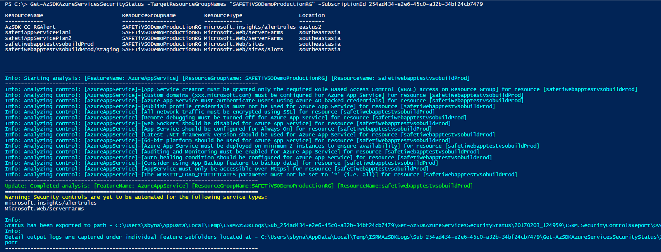

Secure DevOps Kit for Azure
Demo 05 – Install AzSK and run your first security scan
Subscription Security
Security Verification Test for Resources
SVTs
Notes:
The scan was all great for a deployment that is already done. How does AZSK help in my development process?

Slide 19
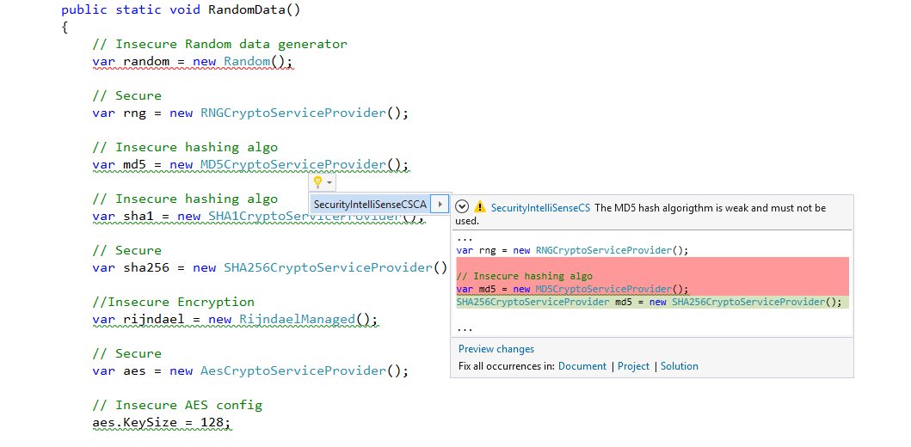
Secure DevOps Kit for Azure
Demo 06 – Security during Development
Security Intellisense

Slide 20
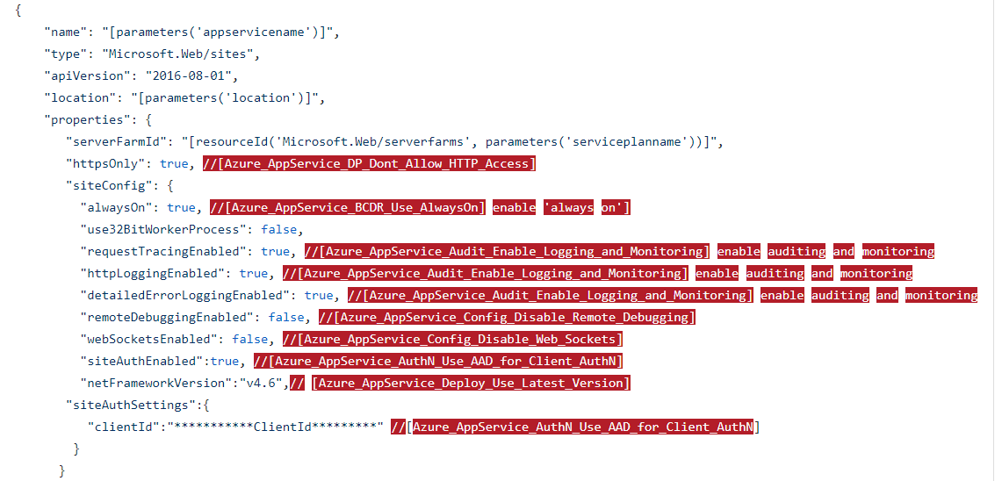
Secure DevOps Kit for Azure
Demo 06 – Security during Development
ARM Template Checker
Notes:
All the infrastructure configurations checks are made in the ARM Template.

Slide 21
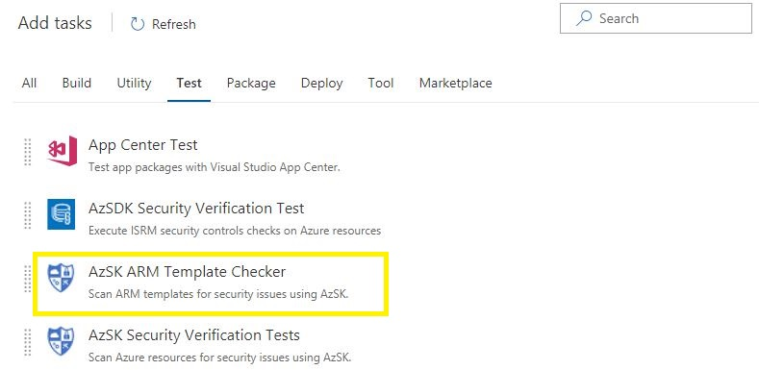
Secure DevOps Kit for Azure
Demo 07 – Security in your DevOps Pipeline
ARM Template Checker
SVT
Notes:
https://marketplace.visualstudio.com/items?itemName=azsdktm.AzSDK-task

Slide 22
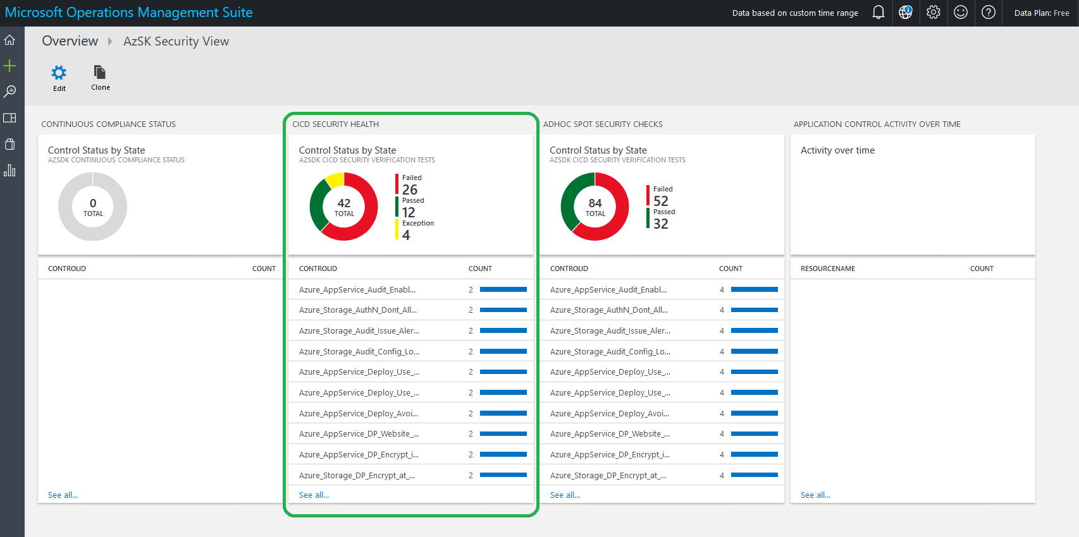
Secure DevOps Kit for Azure
Continuous Assurance Mode

Slide 23
Secure DevOps Kit for Azure
Advanced Features
Auto Generating Fixes
Customizing the Policies for Your Organization
Attestation Controls
Notes:
Generates Fix Scripts for a good number of issues. Does not run the fixes. It is upto us to verify whether the scripts make sense and will not break our applications.
Customizing the Security Policies for your organization helps you to enforce a standard across the organization. You can check for organizational level compliance in a single view dashaboard (OMS or otherwise).
Attesting Controls is a feature where we tell the kit that we are willing to override certain policies.

Slide 24
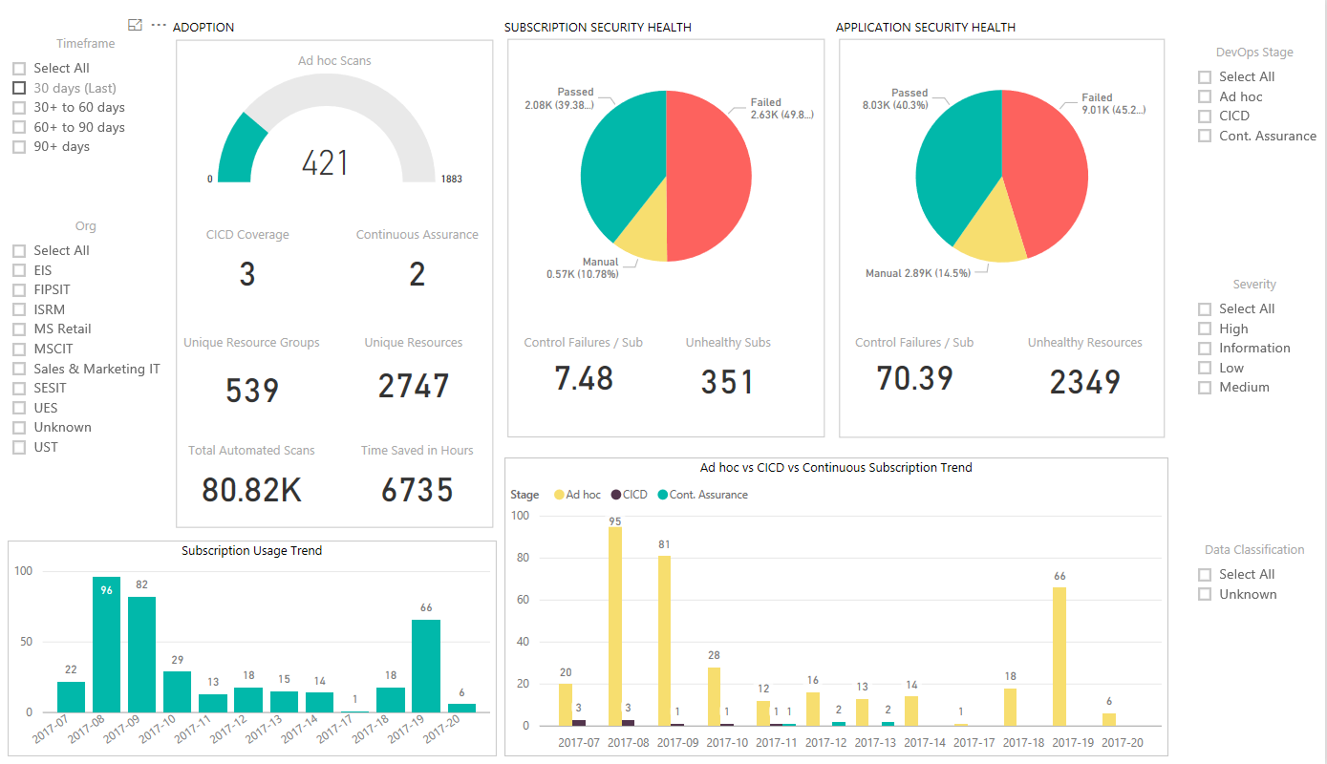
Secure DevOps Kit for Azure
Make Data Driven Decisions
Courtesy : Seth Malcom, MS Ignite 2017

Slide 25
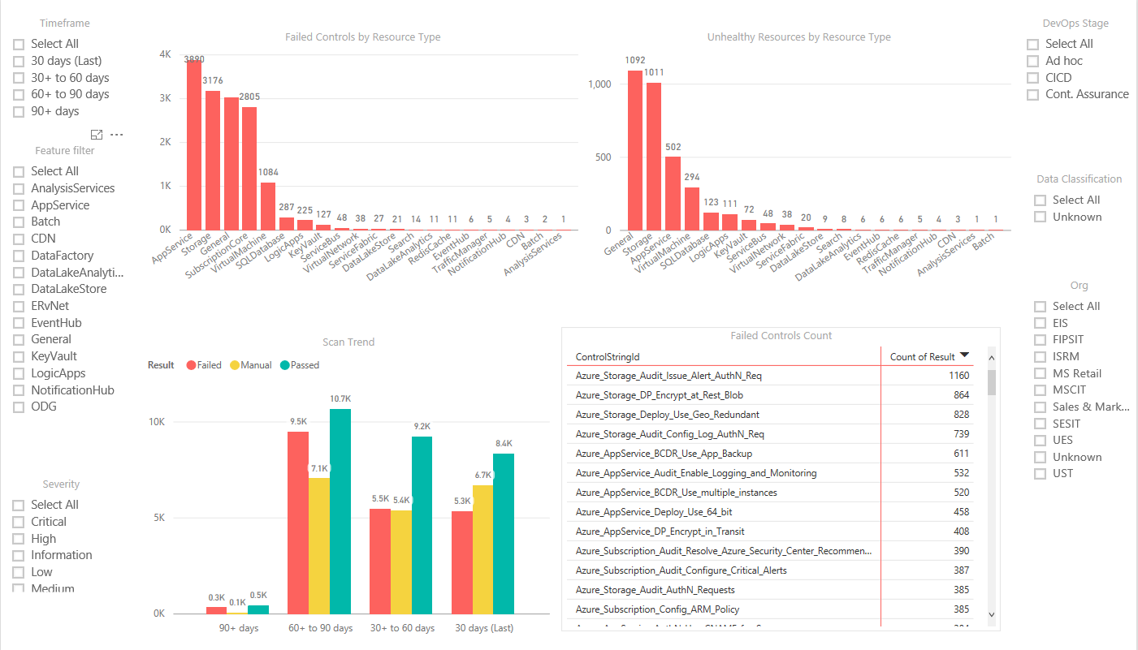
Secure DevOps Kit for Azure
Make Data Driven Decisions
Courtesy : Seth Malcom, MS Ignite 2017

Slide 26
Secure DevOps Kit – Impact at Microsoft
462 subscriptions scanned
4245 Azure resources secured
40+ enterprise LOB apps across IT
95000 controls scanned till date
8000+ hours of manual effort saved
250+ security controls across 25 Azure services
Stats Courtesy : Seth Malcom, MS Ignite 2017

Slide 27
Security First Mindset
If somebody wants to get in, they get in. – Michael Hayden, Former NSA / CIA
Security is a highly asymmetric game.
Do you run security war games ?
Do you have telemetry to identify breaches and unusual activity ?
Do you have a security breach response and recovery plan?
The modern regulations around cybersecurity require you to do so.
Notes:
Unfair Game. Assymetric Game.
If Security Features are not given importance, how to advance to a security first mindset? Run War Games. Do PEN Testing. Have Ground Rules.
67 % Breaches were notified by external entity.
GDPR
Data breach is “a breach of security leading to the accidental or unlawful destruction, loss, alteration, unauthorized disclosure of, or access to, personal data transmitted, stored, or otherwise processed.”
Organizations have 72 hours to report becoming aware of a data breach.
The extent of risk will significantly impact fines and corrective measures a supervising authority may consider imposing.
Organizations need to have appropriate “organizational measures” to deal with breaches.

Slide 28
Key Takeaways
Fixing your OWASP Top 10 Vulnerabilites
Having an OSS Governance Policy.
Manage your Secrets better.
Think Continuous Security / Compliance / Monitoring.
Build a Security First Mindset.

Slide 29
Thank You

