Slide 1
Operators Expressions and Statements
İşleçler
İfadeler
Bildirimler

Slide 2

You will learn about the following in this chapter:
Keyword:
While, typedef
Operators:
=
- +
* /
%
++ --
(type)
C’s multitudinous operators, including those
used for common arithmetic operations.
Operator precedence and the meanings of the terms statement and expression.
The handy while loop
Compound statements, automatic type conversions, and type casts
How to write functions that use arguments

Slide 3
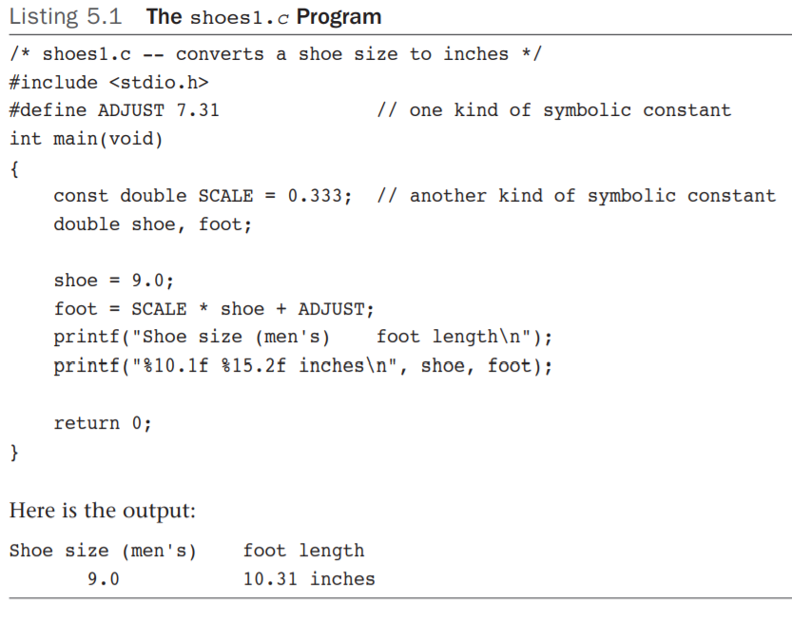
Introducing Loops
A one-shot program that does just one shoe size is a waste of time and effort.
You could make the program more useful by writing it as an interactive program, but that still barely taps the potential of a computer.
What’s needed is some way to have a computer do repetitive calculations for a succession of shoe sizes.

Slide 4
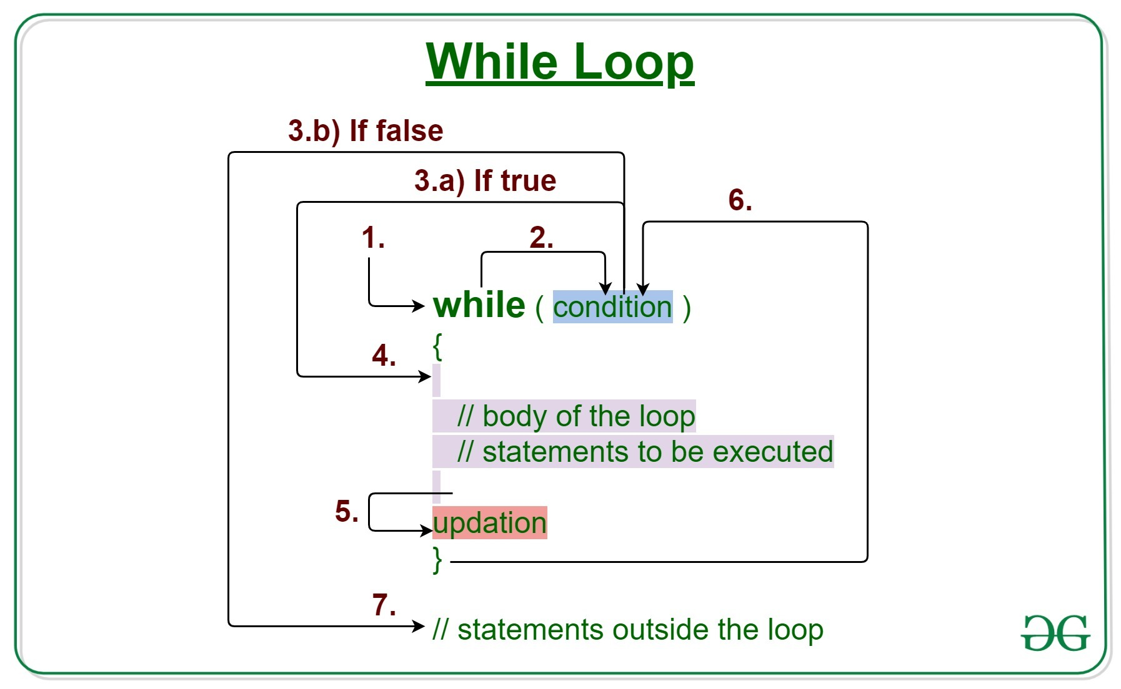
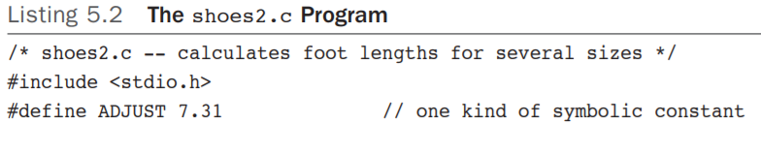
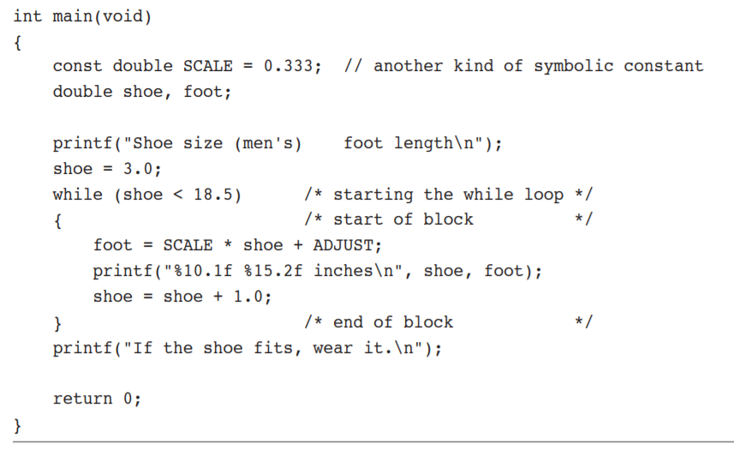
While Loops

Slide 5
Now take a look at the operators used for basic arithmetic: =, +, -, *, and /.
(C does not have an exponentiating operator. The standard C math library, however, provides the pow() function for that purpose. For example, pow(3.5, 2.2) returns 3.5 raised to the power of 2.2.)
Fundamental
Operators

Slide 6
In C, the equal sign does not mean “equals.” Rather, it is a value-assigning operator. The statement;
// left side = right side
bmw = 2002; //assigns the value 2002 to the //variable named bmw.
That is, the item to the left of the = sign is the name of a variable, and the item on the right is the value assigned to the variable. The = symbol is called the assignment operator.
The action goes from right to left for this operator.
Assignment
Operator:
=

Slide 7
A statement such as
2002 = bmw;
makes no sense in C (and, indeed, is invalid) because 2002 is what C calls an rvalue, in this case, just a literal constant.
Actually, the left side must refer to a storage location.
The simplest way is to use the name of a variable, but, as you will see later, a “pointer(*)” can be used to point to a location.
More generally, C uses the term modifiable lvalue to label those entities to which you can assign values.
Assignment
Operator:
=

Slide 8
Some Terminology : Data Objects, Lvalues, Rvalues, and Operands

Slide 9

Data object is a general term for a region of data storage that can be used to hold values.
The C standard uses just the term object for this concept. One way to identify an object is by using the name of a variable.
For example, you could specify an element of an array, a member of a structure, or use a pointer expression that involves the address of the object.

Slide 10
C uses the term lvalue to mean any such name or expression that identifies a particular data object.
Object refers to the actual data storage, but an lvalue is a label used to identify, or locate, that storage.
In the early days of C, saying something was an lvalue meant two things:
1. It specified an object, hence referred to an address in memory.
2. It could be used on the left side of an assignment operator, hence the “l” in lvalue.

Slide 11
The term rvalue refers to quantities that can be assigned to modifiable lvalues but which are not themselves lvalues For instance, consider the following statement:
bmw = 2002;
Here, bmw is a modifiable lvalue, and 2002 is an rvalue.

Slide 12
Let’s look at a short example:
int ex;
int why;
int zee;
const int TWO = 2;
why = 42;
zee = why;
ex = TWO * (why + zee);
TWO is a non-modifiable lvalue; it can only be used on the right side.
As long as you are learning the names of things, the proper term for what we have called an “item” (as in “the item to the left of the =") is operand. Operands are what operators operate on.

Slide 13
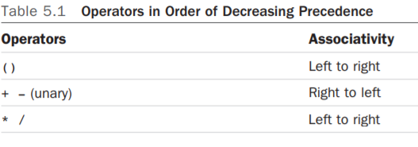

Operator Precedence
Consider the following line of code:
butter = 25.0 + 60.0 * n / SCALE;

Slide 14
The sizeof Operator and the size_t Type (page 187)
int n = 0;
size_t intsize;
intsize = sizeof (int);
printf("n = %d, n has %zd bytes;
all ints have %zd bytes.\n",
n, sizeof n, intsize );
To review, the sizeof operator returns the size, in bytes, of its operand.
The operand can be a specific data object, such as the name of a variable, or it can be a type. If it is a type, such as float, the operand must be enclosed in parentheses.
C says that sizeof returns a value of type size_t
Array and sizeof() ?...

Slide 15
Modulus Operator: %
The modulus operator is used in integer arithmetic. It gives the remainder that results when the integer to its left is divided by the integer to its right.
For example, 13 % 5 (read as “13 modulo 5”) has the value 3, because 5 goes into 13 twice, with a remainder of 3.
Don’t bother trying to use this operator with floating-point numbers. It just won’t work.
min = sec / SEC_PER_MIN;
left = sec % SEC_PER_MIN;

Slide 16

Increment and Decrement Operators: ++ and --

Slide 17
Increment and Decrement Operators:
++ and --
The increment operator performs a simple task; it increments (increases) the value of its operand by 1.
This operator comes in two varieties.
The first variety has the ++ come before the affected variable; this is the prefix mode.
++ultra;
The second variety has the ++ after the affected variable; this is the postfix mode.
super++;

Slide 18
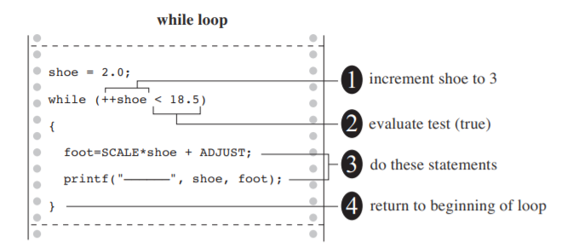

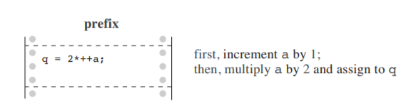
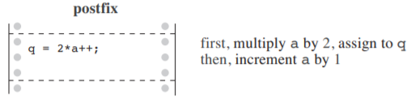
Decrementing: --
For each form of increment operator, there is a corresponding form of decrement operator .
Instead of ++, use -- .

Slide 19

Precedence
nextnum = (2 + 3)*6
= 5*6
= 30
The increment and decrement operators have a very high precedence of association; only
parentheses are higher.
Therefore, x*y++ means (x)*(y++),
not (x*y)++, which is fortunate because the latter is invalid.
The increment and decrement operators affect a variable (or, more generally, a modifiable lvalue), and the combination x*y is not itself a modifiable lvalue, although its parts are.
What value does nextnum get?

Slide 20

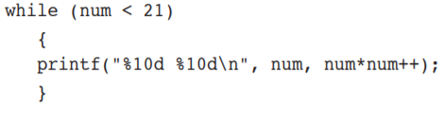

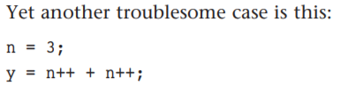
Don’t Be Too Clever (page 195)
You can easily avoid these problems:
■ Don’t use increment or decrement operators on a variable that is part of more than one argument of a function.
■ Don’t use increment or decrement operators on a variable that appears more than once in an expression.

Slide 21
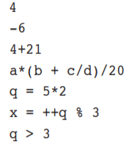
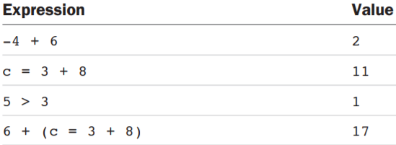
Expressions (ifadeler)
An expression consists of a combination of operators and operands. (An operand, recall, is what an operator operates on.)
As you can see, the operands can be constants, variables, or combinations of the two. Some expressions are combinations of smaller expressions, called subexpressions. For example, c/d is a subexpression of the fourth example.
Every Expression Has a Value :
An important property of C is that every C expression has a value.

Slide 22
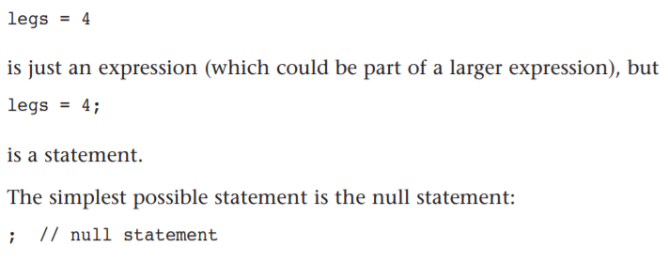
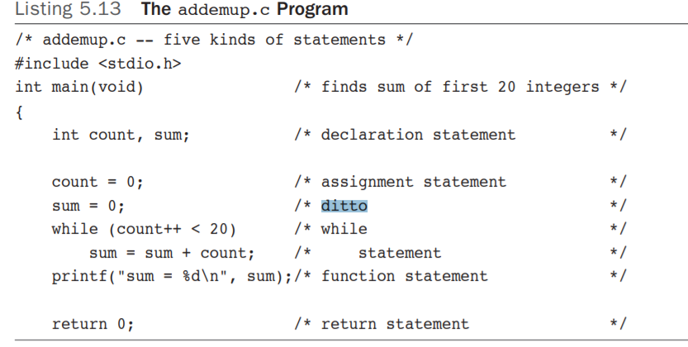
Statements (Bildirimler)
Statements are the primary building blocks of a program.
A program is a series of statements with some necessary punctuation. A statement is a complete instruction to the computer.
In C, statements are indicated by a semicolon(;) at the end.

Slide 23
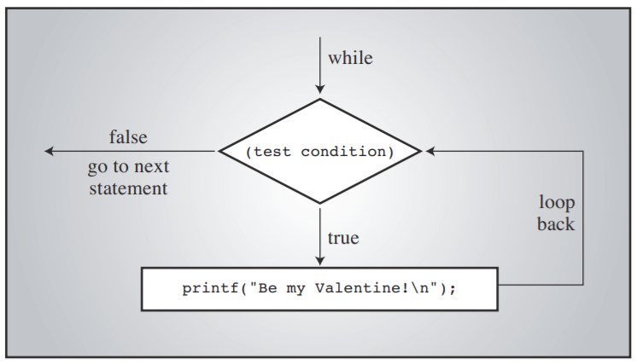
The while statement belongs to a class of statements sometimes called structured statements because they possess a structure more complex than that of a simple assignment statement.

Slide 24

Side Effects and Sequence Points
A side effect is the modification of a data object or file.
states = 50;
A sequence point is a point in program execution at which all side effects are evaluated before going on to the next step.
In C, the semicolon in a statement marks a sequence point

Slide 25
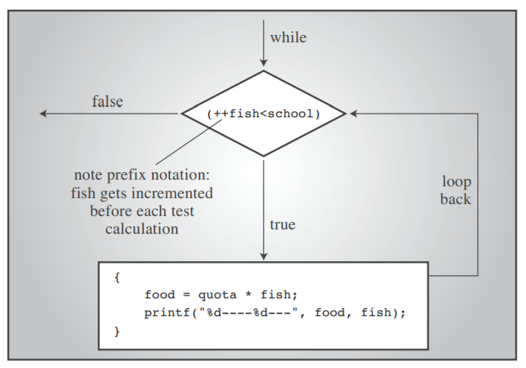
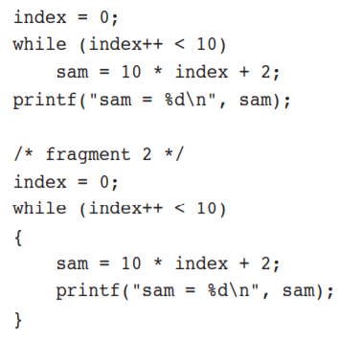
Compound Statements (Blocks :Birleştirilmiş Bildirimler)
A compound statement is two or more statements grouped together by enclosing
them in braces; it is also called a block.

Slide 26
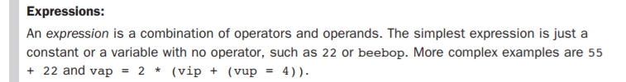
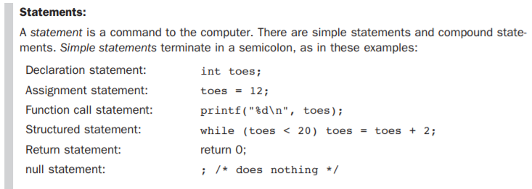
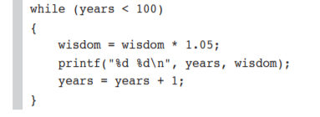

Summary: Expressions and Statements

Slide 27
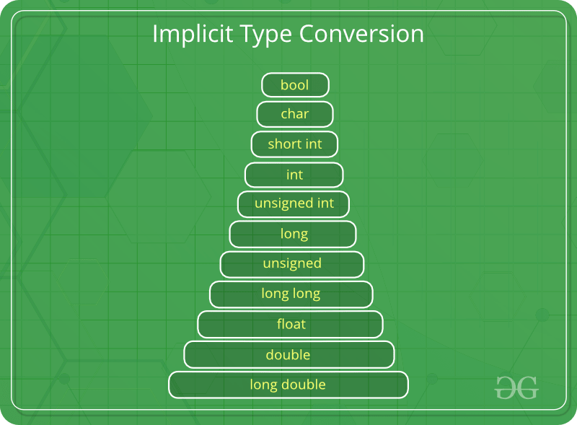
Type Conversions
1- Implicit Type Conversion
Also known as ‘automatic type conversion’.
Done by the compiler on its own, without any external trigger from the user.
Generally takes place when in an expression more than one data type is present. In such condition type conversion (type promotion) takes place to avoid lose of data.
All the data types of the variables are upgraded to the data type of the variable with largest data type.
It is possible for implicit conversions to lose information, signs can be lost (when signed is implicitly converted to unsigned), and overflow can occur (when long long is implicitly converted to float).

Slide 28
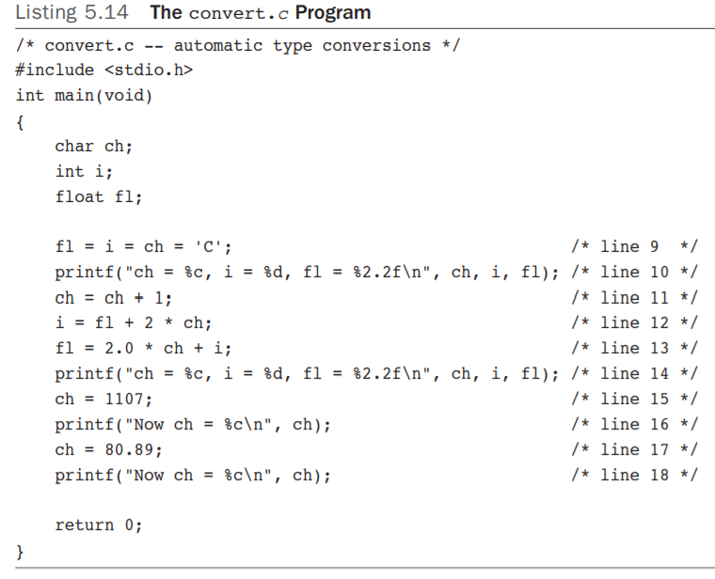
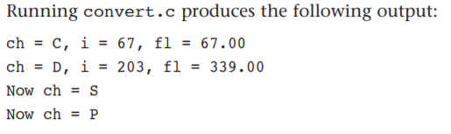
Page 204

Slide 29
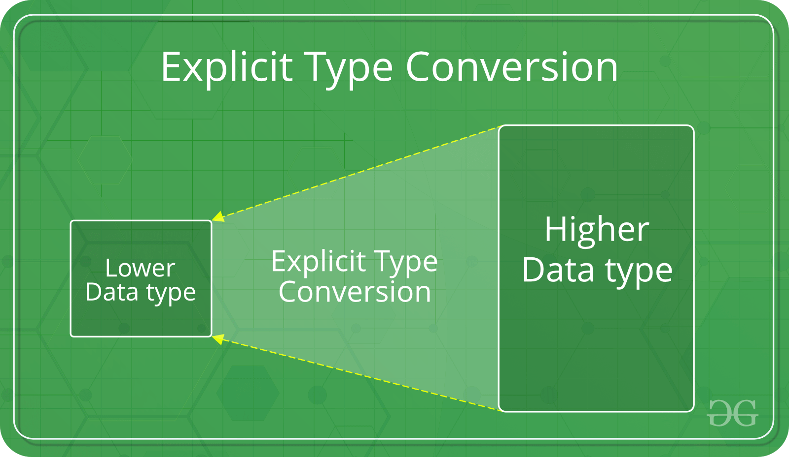
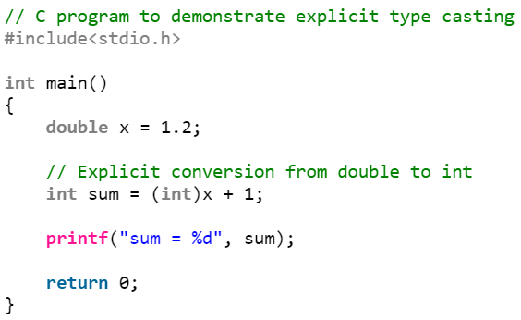
2. Explicit Type Conversion
The syntax in C:
(type) expression
This process is also called type casting and it is user defined.
Here the user can type cast the result to make it of a particular data type.
What if a floating-point value will fit into an integer type?
When floating types are demoted to integer types, they are truncated, or rounded toward zero.
That means 23.12 and 23.99 both are truncated to 23 and that -23.5 is truncated to -23 .

Slide 30
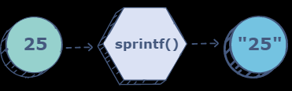
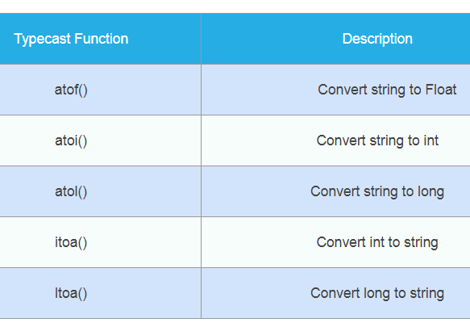
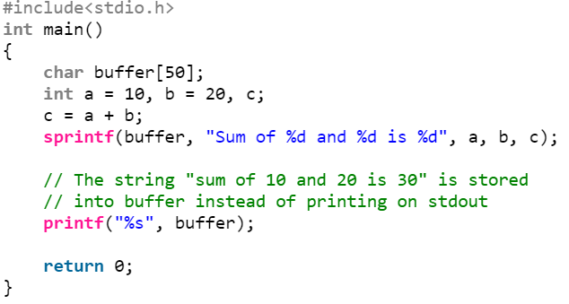
Inbuilt Typecast Functions In C:
Syntax:
int sprintf(char *str, const char *string,...);
sprintf stands for “String print”. Instead of printing on console, it store output on char buffer which are specified in sprintf
Sum of 10 and 20 is 30

Slide 31
Thanks!
Any questions?
You can find me at:
@username
user@mail.me

