Slide 1
GOMYCODE · COME BUILD WITH AI · MOROCCO · 27.09.2026
Real or Clone?
حقيقي أم مستنسخ؟ — detecting AI voice-clone scams in voice notes
Ilyas Daoud · Oualid Karmoun · Ayoub El Mouhib
Live: real-or-clone-9m7lxdq0i.gobrev.dev
Code: github.com/ilyasdaoudrma/real-or-clone
Real or Clone?

Slide 2
THE PROBLEM
Voice cloning made phone scams cheap
3 s
1 in 4
70%
of audio are enough to clone a voice
adults faced an AI voice scam or know a victim
can't tell a clone from a real voice (77% of victims lost money)
“Mom, I had an accident. Send money now.” — a fake voice note, sent on WhatsApp.
Users: families & older parents, mobile-money agents, bank / fintech call centres, fact-checkers.
Source: McAfee survey, 7,054 adults, 7 countries.
Real or Clone?

Slide 3
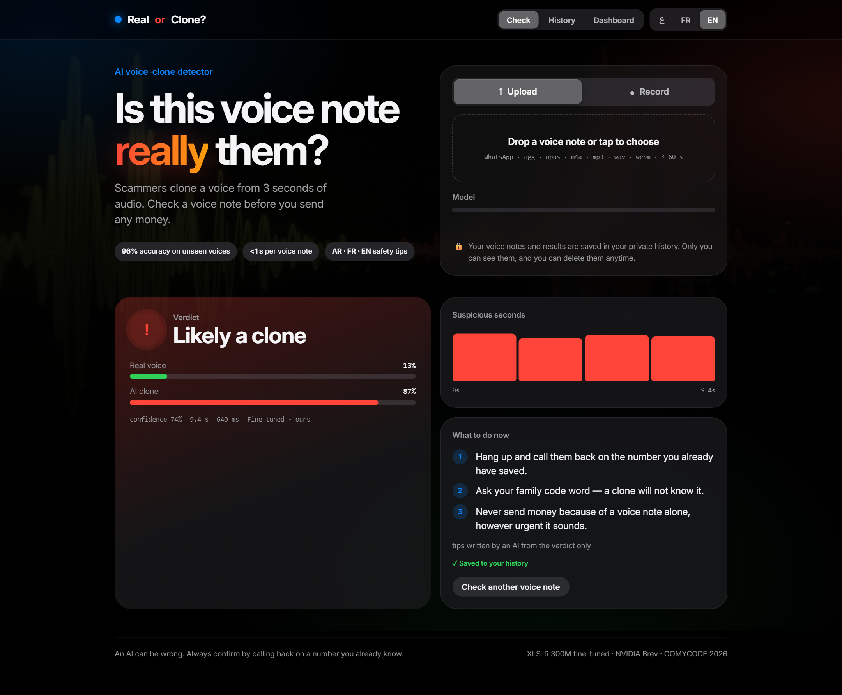
OUR SOLUTION
Upload or record a voice note. Get the truth in < 1 s.
✓ Verdict: likely real / likely clone / uncertain
✓ Confidence + real-vs-clone probability bars
✓ Timeline of the suspicious seconds (4 s windows)
✓ 3 safety tips in Arabic, French or English, written by an LLM from the verdict only — it can never change it
✓ Before/after switch: XLS-R before fine-tuning vs ours
✓ Clerk login, private history (audio + result, deletable) and dashboard
Real or Clone?

Slide 4
PIPELINE
How we built the detector (all on one NVIDIA L40S, Brev)
Data
Fresh clones
Voice-note sim
Fine-tune
Serve
FLEURS + VoxPopuli (real)
MLAAD + In-the-Wild (fake)
EN / FR, ~50k clips
1,619 Chatterbox clones
of real speakers
(scam-style texts)
Opus 16 kbps · 8 kHz
noise · reverb
same for real AND fake
XLS-R 300M (Meta)
real/fake head · bf16
balanced 50/50
FastAPI + web app
Groq LLM tips
Clerk + SQLite
Split by speaker and by generator — no voice or TTS engine in the test set was seen in training.
Real or Clone?

Slide 5
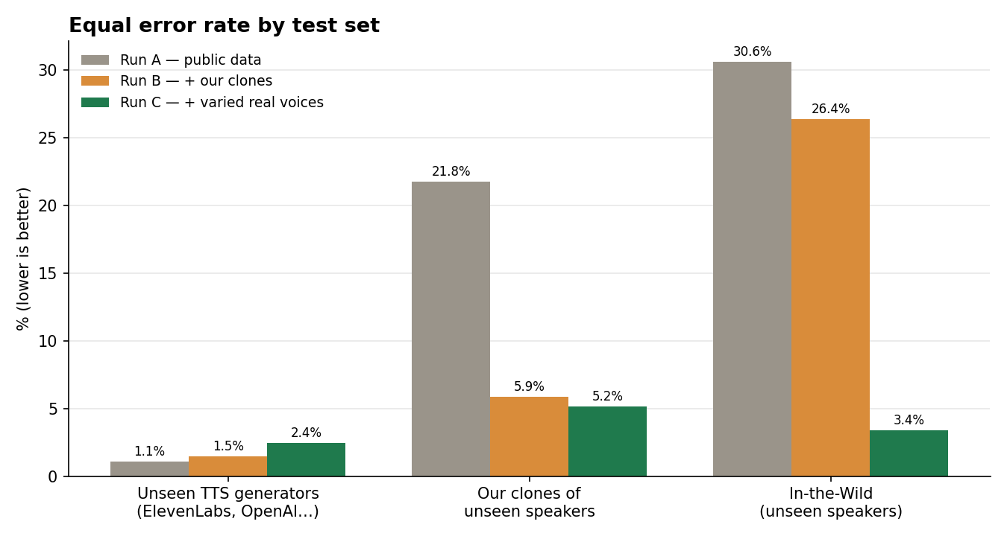
RESULTS · HELD-OUT TEST (10,122 CLIPS)
Fresh clones cut the error on cloned voices 4×
96.1%
accuracy (run C) on voices it never heard
2.4% EER
on ElevenLabs, OpenAI, Gemini… never seen in training
Real or Clone?

Slide 6
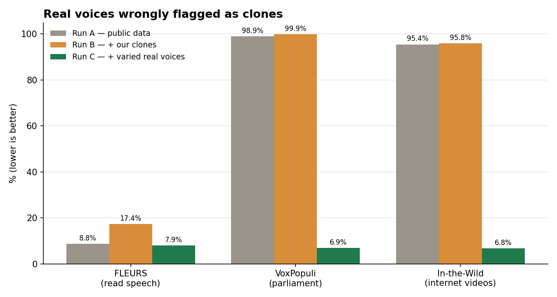
TESTING & RELIABILITY
Our own test caught a shortcut — and we fixed it
Run A/B: learned “sounds like FLEURS = real”. 96–99% of real voices from other sources were flagged; the team lead's own phone note scored 1.00 fake.
Run C: + varied real voices (VoxPopuli, In-the-Wild speakers) → false alarms ~7%, In-the-Wild EER 30.6% → 3.4%.
Caveat: In-the-Wild test is speaker-disjoint but no longer a new domain for run C.
Real or Clone?

Slide 7
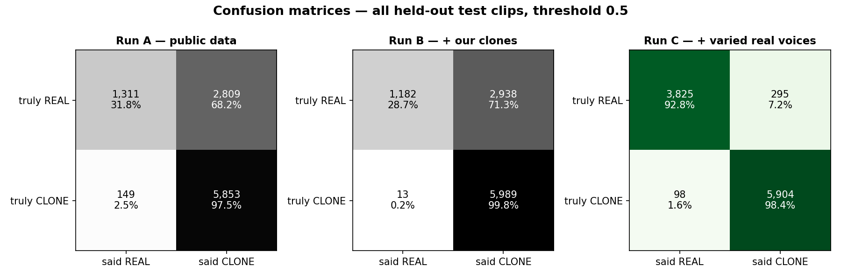
RUNS A → B → C
Before vs after: confusion matrices
Accuracy 70.8% → 70.8% → 96.1% · F1 0.798 → 0.802 → 0.968 · 30 ms per 10 s of audio on the L40S
Real or Clone?

Slide 8
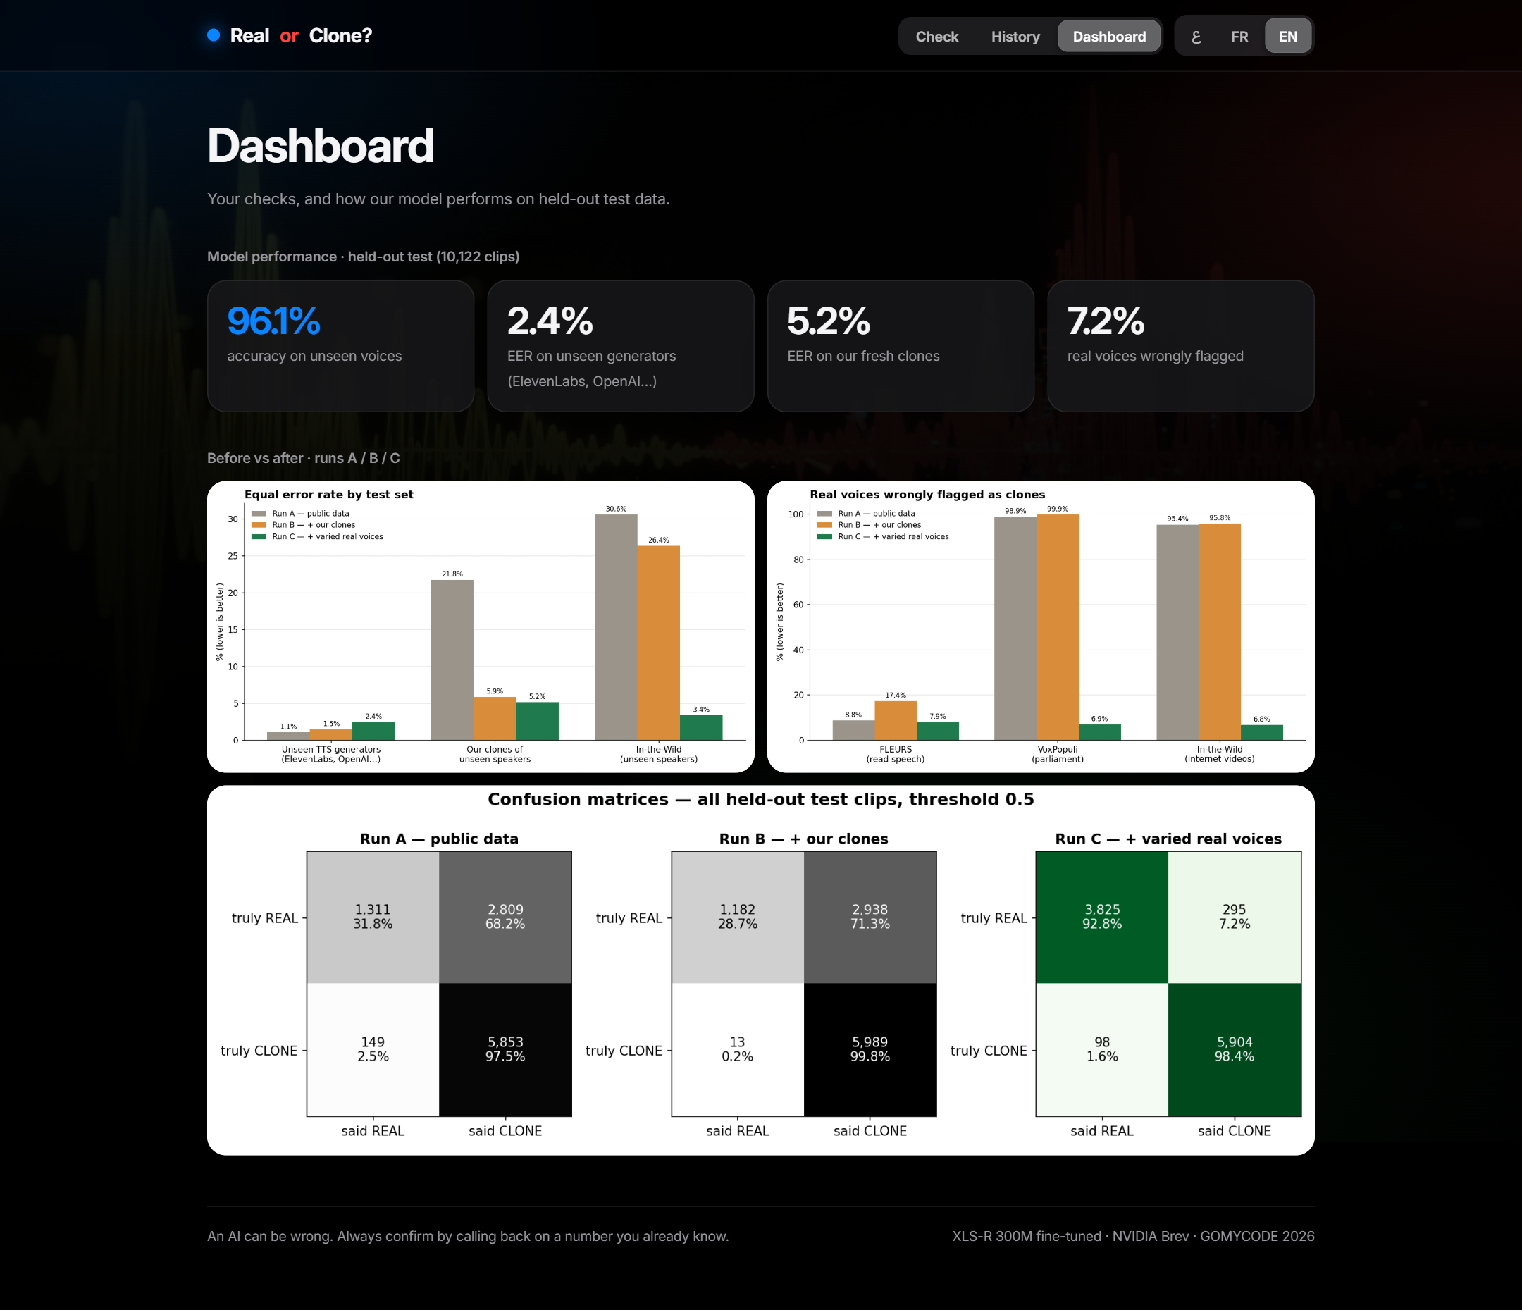
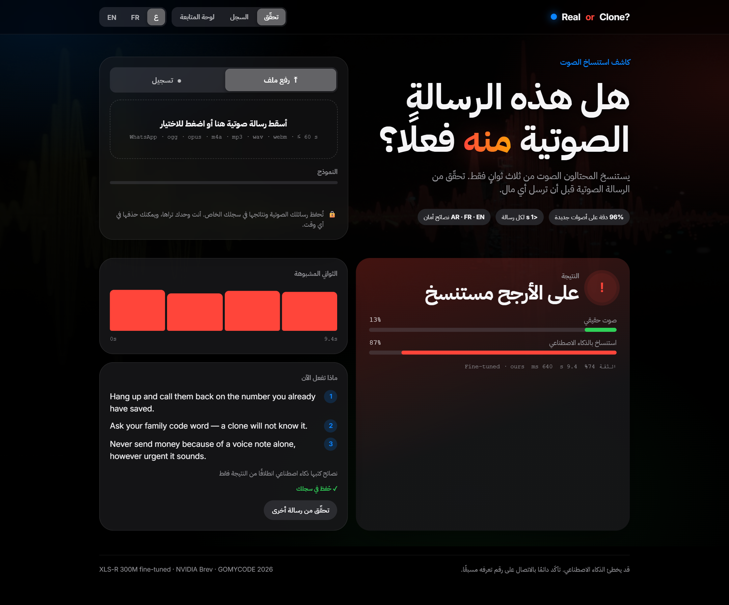
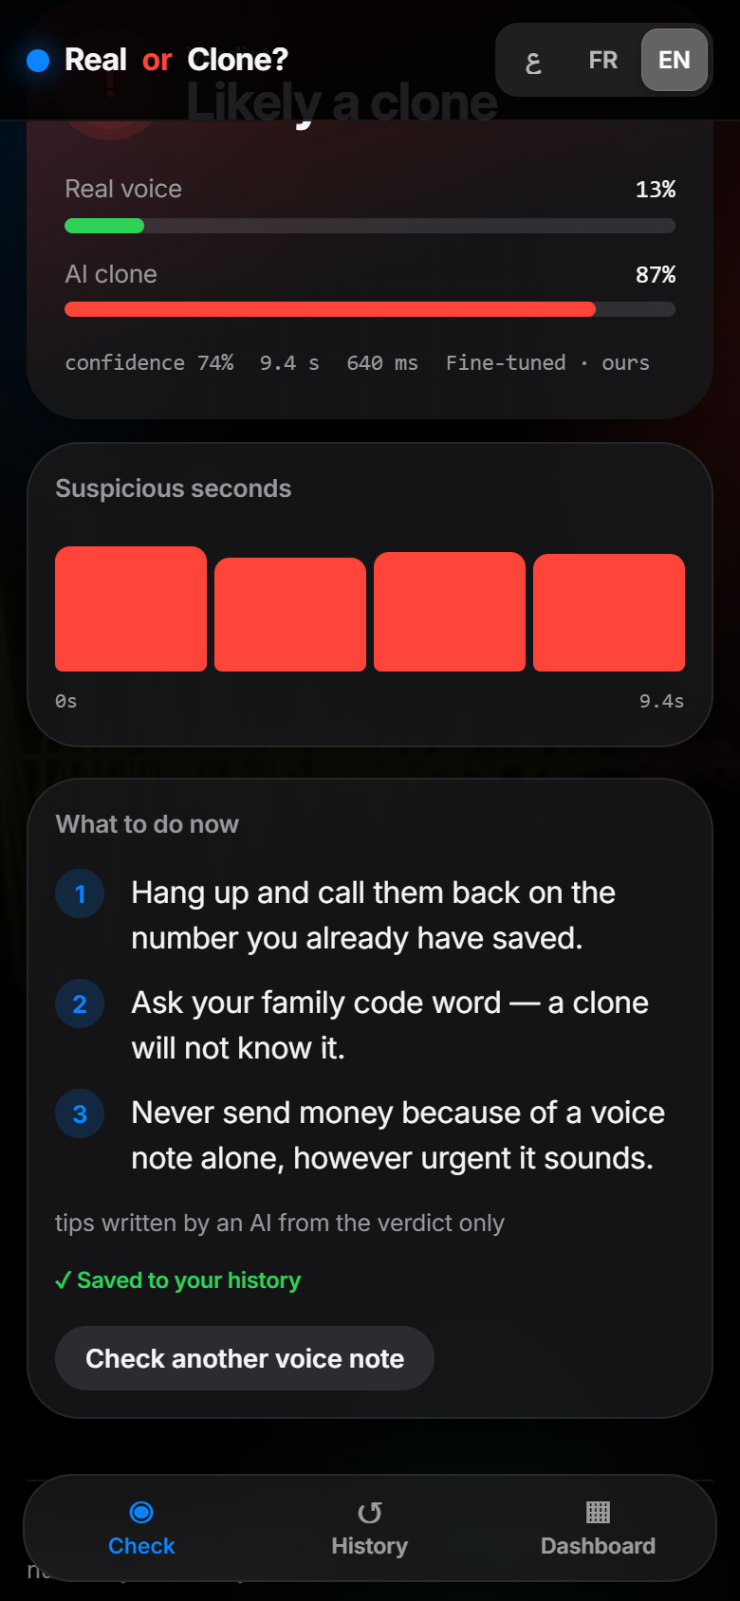
PRODUCT
The app: EN / FR / AR, mobile-first, private history
Real or Clone?

Slide 9
HONEST BY DESIGN
Responsible AI, cost and limits
Privacy Login required; each user's audio + results are private and deletable item by item.
LLM scope the LLM never hears the audio and cannot change the verdict; fixed tips if it fails.
Consent demo voice = team lead, written consent.
Humility “An AI can be wrong — always call back on a number you know.”
Cost 1× L40S on Brev at $2.14/h — whole project ≈ $10 of the $100 credit.
Limits English + French only — not validated on Arabic or Darija voices yet.
Licences MLAAD is CC-BY-NC → non-commercial prototype.
Next Darija data, real phone calls, more generators, on-device model.
Real or Clone?

Slide 10
WHAT WE USED
Stack & AI disclosure
Models XLS-R 300M (Meta, Apache-2.0, fine-tuned by us) · Chatterbox Multilingual (MIT) · gpt-oss-120b on Groq (tips only)
Data FLEURS (CC-BY) · VoxPopuli (CC0) · MLAAD (CC-BY-NC) · In-the-Wild (CC-BY-SA)
Infra NVIDIA Brev L40S · PyTorch · Transformers · FastAPI · Clerk · SQLite · Motion
AI help Claude Code wrote most of the code; the team chose the approach, ran every GPU step, listened to the clones, checked the numbers and caught the shortcut.
Try it real-or-clone-9m7lxdq0i.gobrev.dev — sign in with Google or email
Real or Clone?

Slide 11
Thank you
Real or Clone? · شكرًا · Merci
real-or-clone-9m7lxdq0i.gobrev.dev
Real or Clone?

