Slide 1

MedAxis-Africa
Africa Digital ID Hackathon use case

Slide 2

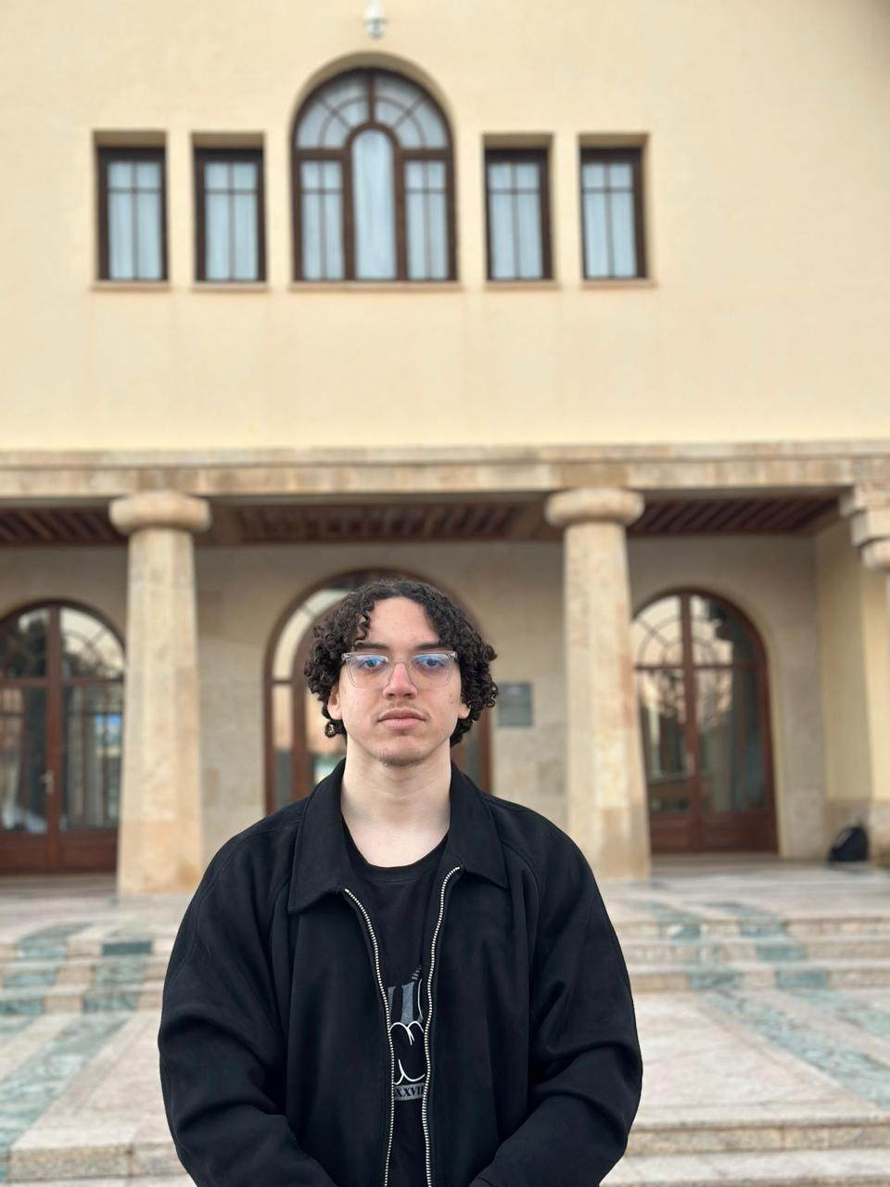


North Africa
Team introduction
Morocco | MedAxis-Africa
Al Akhawayn University in Ifrane
Ilyass Lhafi
Lina Lassri
Youssef Assemlali
Salma Essagar

Slide 3
Time: 1 min
Use case introduction:
MedAxis is a Digital Public Infrastructure (DPI) layer that anchors pharmaceutical dispensing to verified national identities using the live MOSIP/Inji stack. We transform high-risk paper prescriptions into cryptographically signed, single-use digital Verifiable Credentials.
01
Morocco's paper-based prescription system enables forgery, duplicate dispensing across pharmacies, and unverified doctor licenses — fueling drug abuse and insurance fraud.
02
Every prescription is issued digitally by a verified doctor, cryptographically signed, and permanently locked on a national ledger once dispensed. No reuse. No forgery.
03
Doctors, pharmacists, and patients authenticate via MOSIP eSignet using their digital ID. Prescriptions are issued as W3C Verifiable Credentials — downloadable via Inji Wallet and verifiable via Inji Verify at the pharmacy counter.

Slide 4
Time: 1 min
Problem statement: The Failure of Paper-Based Governance
The pharmaceutical sector in Morocco and across Africa operates on a zero-visibility paper trail. This isn't just an administrative delay; it is a structural security gap in national healthcare.
Current process: Doctors write paper prescriptions. Patients take them to any pharmacy. No verification of the doctor's license, no check on whether the prescription was already used elsewhere, no central record.
Barriers: Patients can visit multiple pharmacies with the same prescription. Counterfeit prescriptions are easy to produce. Pharmacists have no way to verify doctor licenses in real time. Rural patients are excluded from any digital health record.
How absence of Digital ID worsens it: Without a national Digital ID link, there is no way to tie a prescription to a specific verified doctor or patient. Duplicate identities, forged credentials, and anonymous dispensing are all possible.
Scale and urgency: Morocco spends over $2.5B annually on healthcare — an estimated 15-20% lost to fraud and duplicate dispensing. Controlled substance abuse rates are rising 12% year-on-year. 6.5 million patients have no formal health record linkage.

Slide 5
Time: 1 min 30 sec
Proposed solution overview
MedAxis eliminates paper-based fraud through an Offline-First protocol, ensuring that from the remote clinic to the urban pharmacy, every citizen has sovereign, secure, and paperless access to life-saving care across the continent
01
MedAxis is a tamper-proof national prescription ledger where every prescription is cryptographically signed and permanently locked once dispensed — making fraud structurally impossible, not just policy-restricted
02
Digital ID at the core — all actors authenticate via MOSIP eSignet using their national CNIE. Prescriptions become W3C Verifiable Credentials downloaded via Inji Wallet and verified at the pharmacy counter via Inji Verify. Zero passwords. Zero paper.
03
USP — the only prescription system where reuse is mathematically impossible. Built entirely on open-source MOSIP infrastructure, deployable across all 54 African nations with no new infrastructure needed.
04
Feasibility — requires an operational national Digital ID program, basic pharmacy internet connectivity, and a Ministry of Health mandate. All technical components are already production-ready.

Slide 6
Time: 1 min
Information flow (Technical)
System components:
Data flow:
MedAxis Portal — React 19 + Node.js + SQLite national prescription ledger
MOSIP eSignet — OpenID Connect authentication for all 4 actors
Inji Certify — Issues W3C Verifiable Credentials (Ed25519 signed)
Inji Wallet — Patient downloads signed prescription PDF with QR code
Inji Verify — Pharmacist scans and verifies credential authenticity
Doctor (eSignet auth) -> Issues prescription -> National Ledger
Patient (eSignet auth) -> Inji Certify -> Downloads VC PDF
Pharmacist (eSignet auth) -> Inji Verify -> Verifies VC -> Confirms dispense -> Ledger locked
Regulator -> Real-time audit dashboard + disputes review
Key tools: MOSIP eSignet, Inji Certify, Inji Verify, Inji Web, W3C VC standard, DID:web

Slide 7
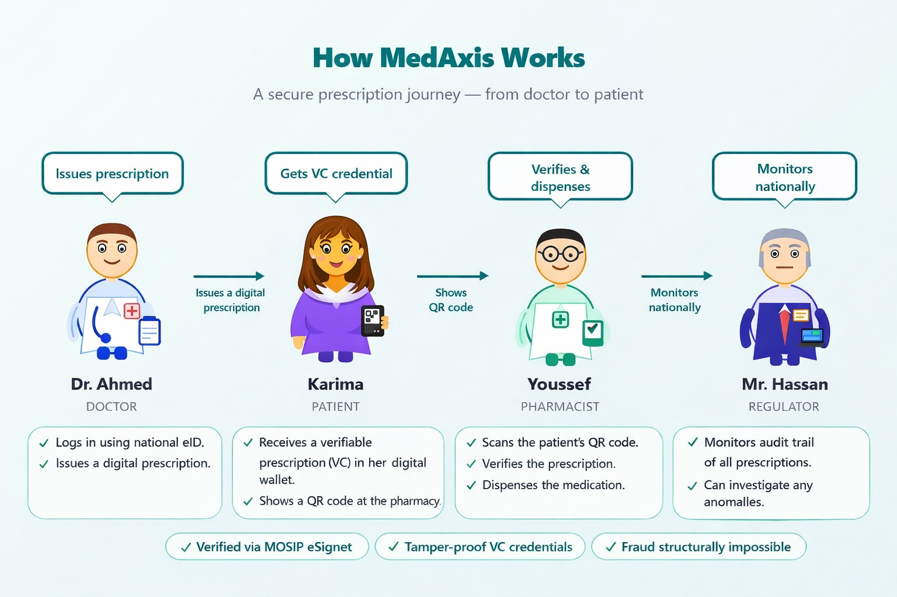
Time: 1 min 30 sec
User journey flow
Real-world demo using the live MOSIP stack: Dr. Ahmed authenticates via eSignet, prescription issued as a signed Verifiable Credential, Karima downloads the VC as a PDF, pharmacist verifies signature via Inji Verify.

Slide 8
Time: 1 min 30 sec
Potential Impact
37M+
MedAxis will protect over 37 million Moroccan citizens by providing a fraud-proof health infrastructure that guarantees secure, equitable access to medicine for everyone, especially the most vulnerable.
$4B
Annual loss to falsified medicines across Africa — MedAxis atomic guardrails eliminate pharmacy-hopping and multi-dispensing fraud
54
African nations where MedAxis deploys via any MOSIP-compatible national ID system — same stack, same protocol, different country registry

Slide 9
Time: 1 min 30 sec
Challenges and stakeholder mapping
Anticipated barriers and how MedAxis addresses each
Challenges | Solution | Stakeholder
Low Smartphone Penetration: Rural patients cannot run Inji Web to download their VC PDF, creating an Inclusion Gap in digital prescription access. | Multi-Modal Trust: Pharmacist-assisted flow using printed QR codes (PDF downloaded on any shared device). The cryptographic integrity of the Ed25519 signature is maintained regardless of how the PDF was obtained. | Ministry of Digital Transition; Telcos (Maroc Telecom, Inwi, Orange)
DID Key Management: Every Docker restart regenerates the Ed25519 key pair. The DID document on GitHub Pages must be manually updated each time, or Inji Verify will reject all signatures. | Solution: Automate DID key synchronization via a CI/CD pipeline (GitHub Actions) that fetches the new public key from Certify’s well-known endpoint and pushes it to GitHub Pages on every restart — eliminating manual steps in production. | MOSIP Technical Team; Ministry of Health IT (to host DID document on official .gov.ma domain)

Slide 10
Annex
Not to be Presented
Supporting slides and ideas.

Slide 11
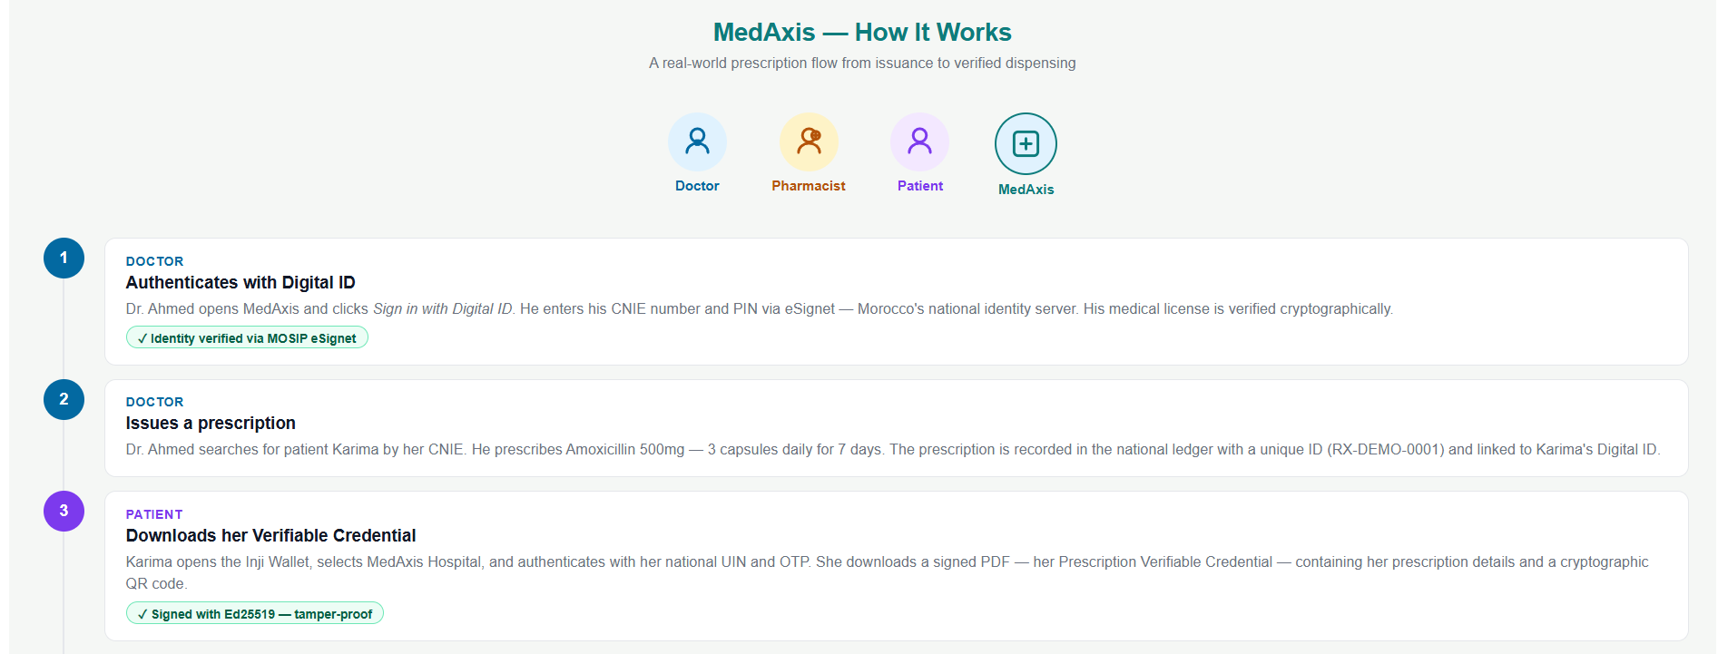
Annex
Not to be Presented

Slide 12
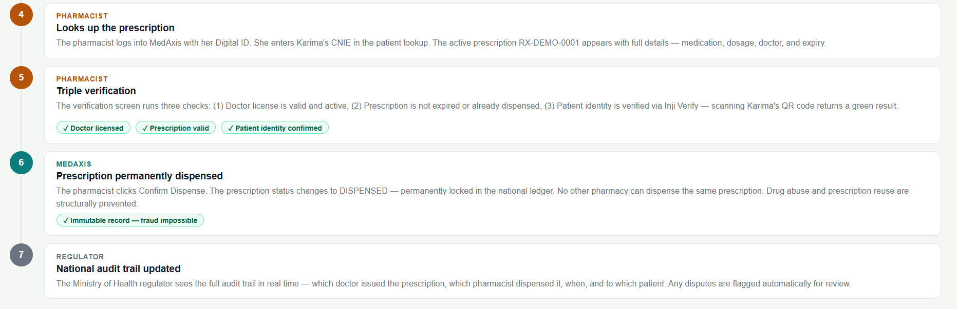
Not to be Presented

