Slide 1
End of studies internship
Credit price optimization using a historical method and pricing package implementation
End of studies internship
Presented by:
Ilyass Seddoug
Internship tutor :
Yohann Feneche
Academic tutor :
Antoine Henrot

Slide 2
Table of contents
Introduction
Pricing Methodologies
01
02
Pricing projects
Conclusions
03
04
End of studies internship
Introduce the environment and problematics
Present the different pricing methododlogies
Present the projects we worked on
Prensent the results

Slide 3

Introduction
01
Introduction
Introcude the internship environement and the problematic

Slide 4



BNP Paribas Personal Finance
Introduction
French company
Specialized in credit
Subsidiary of BNP Paribas
Present in 33
countries with almost 20.000 co-workers
Notes:
BNP Paribas Personal Finance is a French company specialized in credit. It’s a fully owned subsidiary of BNP Paribas. It is present in 33 countries and counts almost 20.000 co-workers. It offers a wide variety of products (loans, insurance, credit cards ) in order to accompany its customers in their different projects . All these solutions are available online, as Personal Finance is the European Leader of Internet credit, mobile, and in several point of sales (stores, car dealerships). It has its central office based in Paris.

Slide 5

BNP Paribas Personal Finance
Introduction
Loans
Credit cards
Insurance
Notes:
BNP Paribas Personal Finance is a French company specialized in credit. It’s a fully owned subsidiary of BNP Paribas. It is present in 33 countries and counts almost 20.000 co-workers. It offers a wide variety of products (loans, insurance, credit cards ) in order to accompany its customers in their different projects . All these solutions are available online, as Personal Finance is the European Leader of Internet credit, mobile, and in several point of sales (stores, car dealerships). It has its central office based in Paris.

Slide 6

BNP Paribas Personal Finance
Introduction
Leader in internet credit
Central office in Paris
Notes:
BNP Paribas Personal Finance is a French company specialized in credit. It’s a fully owned subsidiary of BNP Paribas. It is present in 33 countries and counts almost 20.000 co-workers. It offers a wide variety of products (loans, insurance, credit cards ) in order to accompany its customers in their different projects . All these solutions are available online, as Personal Finance is the European Leader of Internet credit, mobile, and in several point of sales (stores, car dealerships). It has its central office based in Paris.

Slide 7
BNP Paribas Personal Finance
Introduction
Finance
Commercial and marketing
(DCM)
Risk
Notes:
Personal Finance is divided into those different departments. It is organized as follows:
• Finance department: report the budget forecasts and financial results, ensuring the refinancing of PF activities.
• Commercial and Marketing department (DCM): focus on the development of PF, design the global sales and marketing strategies and monitor their implementation in a country.
• Risk department: manage the risk linked to PF’s activities, such as Credit and Counterparty risk, market risk, funding and liquidity risk and insurance risk.
The internship took place in DCM, and precisely, in the MAP (Marketing Analytics and Performance) team.

Slide 8
Marketing Analytics And Performance
Introduction
Design marketing campaigns and study effect on customers behavior
Marketing action
Customer reaction
Notes:
The main activity of MAP is to design marketing campaigns, and study their effect on customers behavior. The goal is to study the effect of an action on the customer. The actions in here are marketing actions (send an email, lower the price, ...). The results are then analyzed in order to adapt the decisions taken to the customers. This is called test and learn. For example, if the action taken is to lower the price, we observe the reaction of the customers to this price decrease, and adapt the future prices to meet the customer behavior.

Slide 9
Marketing Analytics And Performance
Introduction
Step 1 - Test
Target group
Reaction to targeting
Control group
Normal behavior
Notes:
This is the first step. During this step, a marketing action is performed on a subgroup of customers called the treatment or target group. Another group of customers called the control group, doesn’t receive any marketing action. The goal is to observe the difference between the target and the control groups, in order to measure the effect of the marketing campaign. The control group reflects the normal behavior of customers without any taken action, and the target group reveals the reaction of customers to the marketing action. However, there are some conditions the control and the target groups should respect in order to be able to analyze the results:

Slide 10
Marketing Analytics And Performance
Introduction
Step 1 - Test
Example:
Random distribution of target and control
02
01
Even days are
Control group
Odd days are
Target group
Notes:
This is the first step. During this step, a marketing action is performed on a subgroup of customers called the treatment or target group. Another group of customers called the control group, doesn’t receive any marketing action. The goal is to observe the difference between the target and the control groups, in order to measure the effect of the marketing campaign. The control group reflects the normal behavior of customers without any taken action, and the target group reveals the reaction of customers to the marketing action. However, there are some conditions the control and the target groups should respect in order to be able to analyze the results:

Slide 11
Marketing Analytics And Performance
Introduction
Step 2 - Learn
Response if treated | N | Do not disturb | Lost Cause
 | Y | Sure thing | Persuadable
 |  | Y | N
 |  | Response if not treated
Notes:
At the end of the test, an analysis of the result takes place. There are four types of customers represented in here:
• The sure thing: customers who will always purchase, whether they are targeted by the marketing action or not.
• The persuadable: customers who do not purchase, unless they are targeted by the marketing action.
• The lost causes: contrary to the sure thing, they will never purchase.
• The do-not-disturb: customers who will purchase unless they are targeted by the campaign.
The project that will be developed concerns the pricing of credits. The goal is to attribute to customers the best price for a specific credit application, in order to get the maximum conversion rate (conversion of an application to an accepted application) and maximum profit.

Slide 12
02
Pricing methodologies
Pricing methodologies
Present the different methods

Slide 13
Pricing
Pricing methodologies
Profit
Credit pricing
A/B testing
Historical pricing
Best price
Price
Notes:
The pricing consists of determining the best price for a product for a specific customer. In our case, the product is credit we will go through the different pricing methodologies used by PF:
Micro margin analysis
A/B tests
Historical pricing

Slide 14
A/B testing
Pricing methodologies
Action A
The more effective action for customers satisfaction
Action B
Notes:
The A/B testing methodology is a customer experience research methodology. A/B tests consist of a randomized experiment with two actions, A and B. A/B testing is a way to compare two versions of a single variable, by testing a subject’s response to action A vs action B, and determining which of the two actions is more effective. A/B tests are useful for understanding the customer satisfaction regarding a marketing action. In the case of selling credit, the A/B tests consist of testing two different price grids. One with a high price and another one with a low price (Examples in tables 2.1 and 2.2 ). The prices are attributed randomly. For example, if the customer submits his application during an odd day of the month, then we attribute to his application a price from the low price grid. If he submits his application during an even day of the month, we attribute a high price. The tests are conducted during several months until getting a specific number of financed customers (2000 for PF). The test allows a measure of the effect of a lower price on the conversion and then on the total benefit.

Slide 15
A/B testing
Pricing methodologies
01
02
Odd days
Even days
Low price grid
High price grid
Duration / Amount | >100k€ | [10k€ - 100k€] | <10K€
> 60 Months | 7,5% | 8,5% | 9,5%
30 Months - 60 Months | 8,5% | 9,5% | 10,5%
< 30 Months | 9,5% | 10,5% | 11,5%
Duration / Amount | >100k€ | [10k€ - 100k€] | <10K€
> 60 Months | 9,5% | 10,5% | 11,5%
30 Months - 60 Months | 10,5% | 11,5% | 12,5%
< 30 Months | 11,5% | 12,5% | 13,5%
Notes:
In the case of selling credit, the A/B tests consist of testing two different price grids. One with a high price and another one with a low price. The prices are attributed randomly. For example, if the customer submits his application during an odd day of the month, then we attribute to his application a price from the low price grid. If he submits his application during an even day of the month, we attribute a high price. The tests are conducted during several months until getting a specific number of financed customers (2000 for PF). The test allows a measure of the effect of a lower price on the conversion and then on the total benefit.

Slide 16

Historical pricing
Pricing methodologies
$Elasticity=\frac{\% change in quantity}{\% change in price}$​
Elasticity to price change in marketing
1% change in the price
How much change in conversion?
Notes:
D’abord on va définir l’élasticité.
Price elasticity is a measure used to show the responsiveness, or elasticity, of the quantity demanded of a good or service to a change in its price when nothing but the price changes. More precisely, it gives the percentage change in quantity demanded in response to a one percent change in price. In marketing, it is how sensitive customers are to a change in the price.

Slide 17

Historical pricing
Pricing methodologies
Elasticity model
Use available historical loan client and market data
Individual
elasticity
Elasticity
model
Subscription probability
Subscription probability
Proposed rate
Proposed rate
Customer A
Customer B
Notes:
The core idea of the elasticity model is to use the available data (client and loan characteristics, market benchmarks, . . . ) to predict the subscription probability of the client as a function of the proposed rate. The subscription probability should be a smooth and decreasing function of the proposed rate. The price sensitivity – the dependency of the subscription probability on the proposed rate – should vary from client to client.

Slide 18
Historical pricing
Pricing methodologies
Elasticity model
2 tree based models to predict a smooth interpretable and individualized conversion
$$ℙ(conversion)=φ(\hat{β_{0}}\left(x_{1},…,x_{k}\right)+\hat{β_{1}}\left(x_{1},…,x_{k}\right)×rate)$$
Natural propensity to convert regardless of the price
Slope of the conversion when
proposed interest rate changes
Notes:
D’abord on va définir l’élasticité.
Price elasticity is a measure used to show the responsiveness, or elasticity, of the quantity demanded of a good or service to a change in its price when nothing but the price changes. More precisely, it gives the percentage change in quantity demanded in response to a one percent change in price. In marketing, it is how sensitive customers are to a change in the price.

Slide 19
Historical pricing
Pricing methodologies
Step 1 - Gather financial assumptions to project the expected NIBT for
each loan request and each possible proposed rate
NIBT* for each proposed rate
For each historical loan request
Conversion for each proposed rate
Probability of conversion
$$𝔼(NIBT)$$
Proposed rate
Proposed rate
Optimal price maximizing NIBT for this request
Step 2 - Comply with business constraints and select the right target for
the volume of production
Current price
O
C
I
Best iso-volume price
I
$$𝔼(NIBT)$$
Best price
C
O
* NIBT: Net Income Before Tax
$$𝔼(Volume)$$
Notes:
D’abord on va définir l’élasticité.
Price elasticity is a measure used to show the responsiveness, or elasticity, of the quantity demanded of a good or service to a change in its price when nothing but the price changes. More precisely, it gives the percentage change in quantity demanded in response to a one percent change in price. In marketing, it is how sensitive customers are to a change in the price.

Slide 20
Historical pricing
Pricing methodologies
Step 3 - Find a closed-form pricing formula easy to implement
The final price formula is simple to read and implement
Coût du risque (CdR) déclaratif
CdR ≤ 0.5% | +0,0%
CdR ∈ ]0,5% ; 1%] | +0,9%
CdR ∈ ]1% ; 1,5%] | +1,9%
CdR ∈ ]1,5% ; 2,5%] | +2,5%
CdR > 2.5% | +3,1%
Durée (mois)
< 28 | -0,0%
28 < n < 40 | -1,3%
40 < n < 54 | -1,8%
54 < n < 66 | -2,5%
66 < n < 80 | -3,2%
80 < n < 90 | -3,6%
90 < n < 102 | -5,0%
> 102 | -4,0%
Montant demandé
< 3495 | +9,6%
3495 < n < 3713 | +2,5%
3713 < n < 5895 | -1,2%
5895 < n < 9880 | -2,0%
9880 < n < 14979 | -2,2%
14979 < n < 19971 | -2,4%
19971 < n < 24996 | -2,5%
24996 < n < 29484 | -2,7%
29484 < n < 39814 | -3,1%
39814 < n < 51031 | -3,4%
51031 < n < 77455 | -3,7%
77455 < n < 97250 | -5,7%
> 97250 | -7,1%
Revenus (mensuels foyer)
< 2000 | +0,0%
2000 < n < 2488 | -0,3%
2488 < n < 3000 | -0,5%
3000 < n < 3500 | -0,8%
3500 < n < 5480 | -1,1%
5480 < n < 56732 | -0,8%
> 56732 | -1,7%
Prix de base : 4,64%
Type de projet
VN | -0,7%
VO ; Autre | +0,0%
DIVERS ; TRAVAUX | +0,3%
Ancienneté dans l'emploi
0 | +0,0%
2 < n < 9 | +0,2%
9 < n < 31 | +0,4%
> 31 | +0,8%
Charges mensuelles
< 4 | +0,0%
4 < n < 18618 | +0,5%
> 18618 | +1,1%
Situation à l’habitat
DIVERS, LOG. FAM., NR, PROPRIETAIRE | -0,8%
LOCATAIRE, LOG. EMPLOYER, Autre | +0,0%
ACCESSION PROPRIETE | +0,2%
Client connu
Non | -1,3%
Oui ; Autre | +0,0%
Notes:
D’abord on va définir l’élasticité.
Price elasticity is a measure used to show the responsiveness, or elasticity, of the quantity demanded of a good or service to a change in its price when nothing but the price changes. More precisely, it gives the percentage change in quantity demanded in response to a one percent change in price. In marketing, it is how sensitive customers are to a change in the price.

Slide 21
Pricing projects
03
Pricing projects
Present the different methods

Slide 22

Poland
Historical pricing projects
Introduction to the data
Applications data: ID Dossier, Amount, Duration, Application date, Interest rate, …
January 2019 to July 2021
Applicants' data: Date of Birth, Income, Years in job, Marital status, …
Financial equation: Financial KPIs
Notes:
The core idea of the elasticity model is to use the available data (client and loan characteristics, market benchmarks, . . . ) to predict the subscription probability of the client as a function of the proposed rate. The subscription probability should be a smooth and decreasing function of the proposed rate. The price sensitivity – the dependency of the subscription probability on the proposed rate – should vary from client to client.

Slide 23
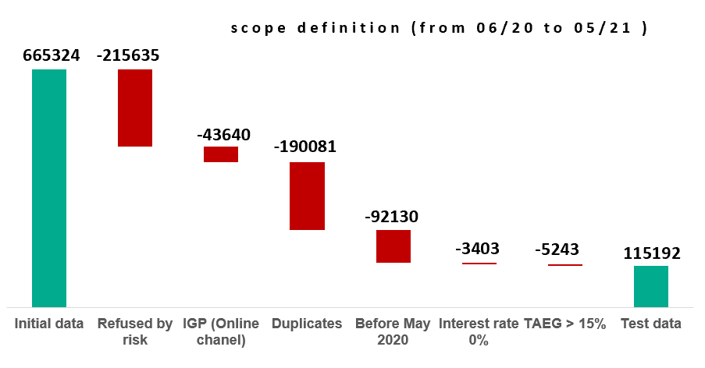
Poland
Historical pricing projects
Pre-Analysis and randomness check
We delete:
Refused by risk
Online channel
Duplicates
Applications before May 2020
Interest rate = 0%
TAEG > 15%
Notes:
In this step, we do some primary analysis of the data to define the scope of data we can use for our historical modeling and to check the possibility of building this model. An essential condition to try to build the model is variability in the historical price data. The Cetelem Poland gave us the information that the pricing strategy have changed starting from May 2020. So, to build a pricing strategy based on the historical data, it would not be possible to train our model on data before May 2020. • The applications that were refused by the risk department can’t be included in the data scope, because they don’t give us any information about the customer. We don’t know if the customer would have accepted the proposed interest rate because he didn’t have the opportunity to see it. The refused by risk (Evt_name equals to ’REF’) are then deleted from the data scope used. • The applications coming from the online channel won’t be included in the used data scope because they have received special opening fees during the last months. This will introduce a bias to our data. • We call duplicates applications that have the same ID_Person. The method of treatment of the duplicates is still in discussion. However, we have treated them as follows: We group applications by periods of 3 months. If for a 3-months period there are financed applications, we keep only those financed ones. If there are no financed applications, we keep the last application in time. This rule was applied because we suppose that the last application is the one that reflects the better what the customer wants. • Some interest rates are equal to 0%, we delete them because those might be missing interest rates or special interest rates. • We calculate the TAEG (global rate) which is the total interest paid by the client. It corresponds to the interest rate plus the opening fees and insurance. We delete the TAEGs that are higher than 15% because we assume they are very high.

Slide 24
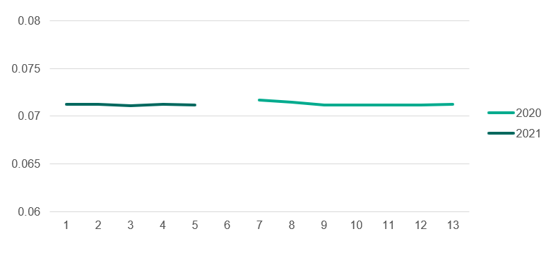
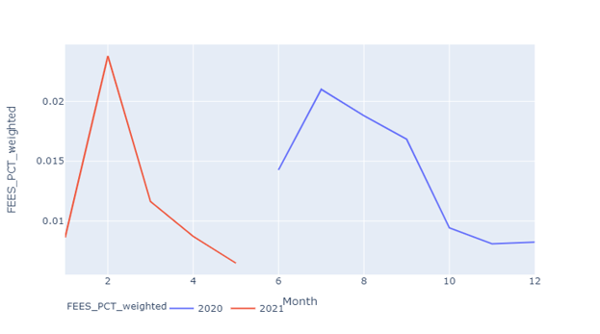
Poland
Historical pricing projects
Pre-Analysis and randomness check
Price evolution in time for the data scope
Opening fees evolution in time
Notes:
In this subsection, we will try to check the price randomness. To do this, we first check the graphs of the evolution of the price in time. Since the pricing strategy have changed in Poland, and for the remaining data, we have only one rate with no derogation, the tested price don’t vary a lot in time. We find that 80% of the prices assigned to customers are equal to 7.2%. This price is the same since June 2020. The evolution of the interest rate average by months is represented in Figure 3.2. Since the interest rate didn’t change in time, we decided to do our analysis on the entry fees. The opening fees in our data have moved a lot between 0% and 8%. We can see in Figure 3.3 that the entry fees have changed in time. To see if those changes don’t depend on other features, meaning that the variance is a real one and not one that can be explained by he variation in some other customer information, we train an xgboost model using our features to predict opening fees. We use a temporal validation in order to test our trained model.

Slide 25
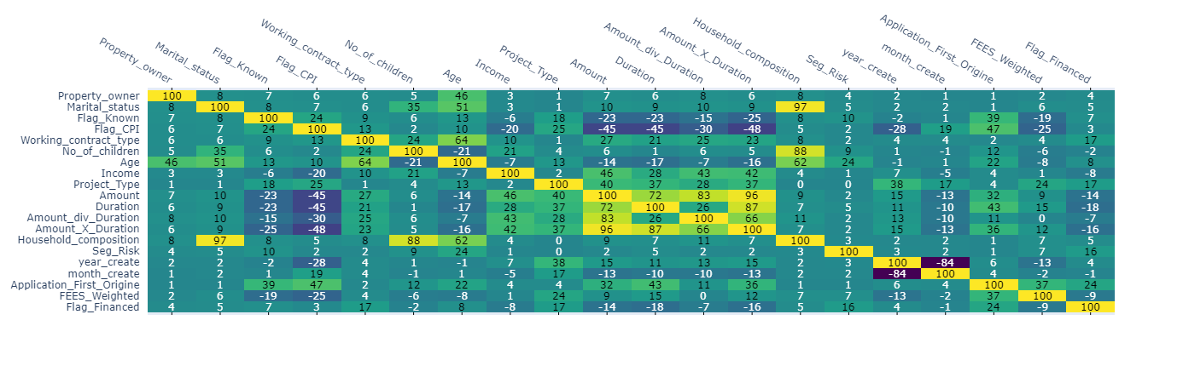
Poland
Historical pricing projects
Pre-Analysis and randomness check
Correlation matrix
XGBoost
 | Scope | R²
Train | 06/20 to 03/21 | 76%
Test | After 03/21 | 28%
Notes:
To see if those changes don’t depend on other features, meaning that the variance is a real one and not one that can be explained by he variation in some other customer information, we train an xgboost model using our features to predict opening fees. We use a temporal validation in order to test our trained model. First we compute the correlation matrix of opening fees with other features in Figure 3.4. We can see that there is no high correlation of the opening fees with some other features. On our training set, Which is from June 2020 to March 2021, we get an R2 of 76% and on our test set, which is May and June 2021 we get an R2 of 28%. Our model can’t then predict the opening fees with a good precision. Which means that the opening fees variation can not be explained by other features, we can then say that it is a real variation. Now that we found variation in the fees, and before training the elasticity model, we try to predict the conversion with an xgboost. If we get a good performance using this model, we can go to the next step and train the elasticity model.

Slide 26
Poland
Historical pricing projects
XGBoost to predict conversion
 | Scope | AUC
Train | 06/20 to 03/21 | 77%
Test | After 03/21 | 72%
Overfitting due to a difference between the data in train and in test:
Opening fees increased in February 2021
The competitors fees dropped to 0%
The data before February and after it are different

Slide 27
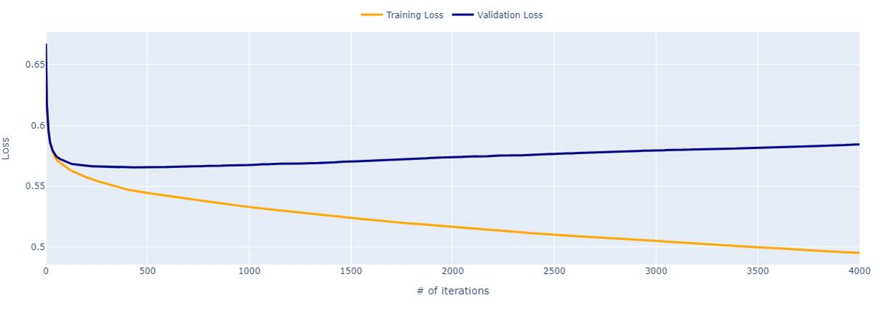
Poland
Historical pricing projects
Elasticity model
Train and validation loss
 | Train | Test
AUC | 77% | 72%
Overfitting on the train set

Slide 28
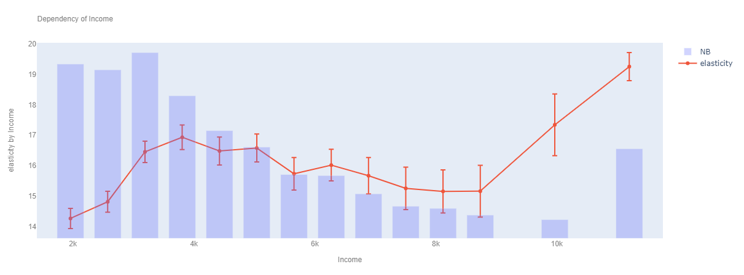
Poland
Historical pricing projects
Elasticity model
Notes:
On our training set, Which is from June 2020 to March 2021, we get an R2 of 76% and on our test set, which is May and June 2021 we get an R2 of 28%. Our model can’t then predict the opening fees with a good precision. Which means that the opening fees variation can not be explained by other features, we can then say that it is a real variation.

Slide 29
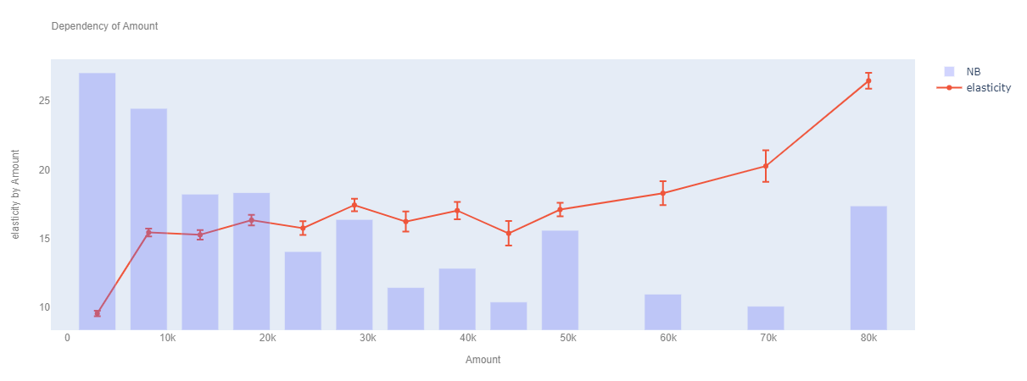
Poland
Historical pricing projects
Elasticity model
Notes:
On our training set, Which is from June 2020 to March 2021, we get an R2 of 76% and on our test set, which is May and June 2021 we get an R2 of 28%. Our model can’t then predict the opening fees with a good precision. Which means that the opening fees variation can not be explained by other features, we can then say that it is a real variation.

Slide 30
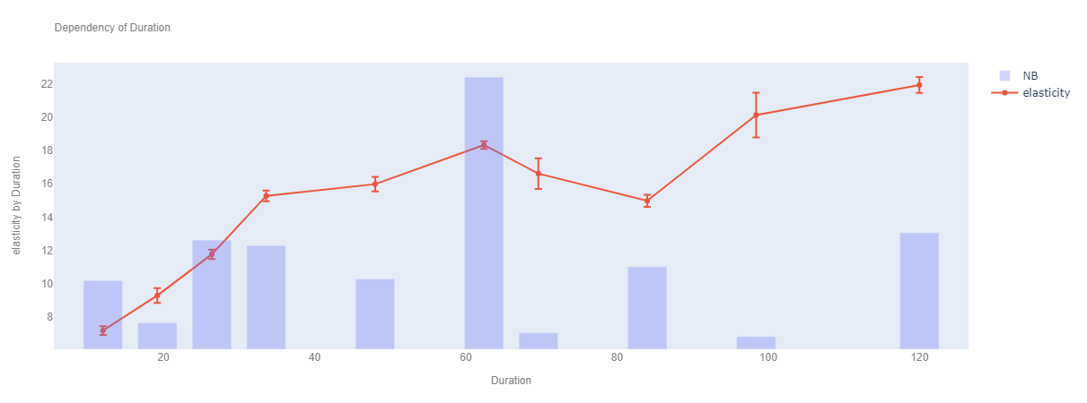
Poland
Historical pricing projects
Elasticity model
Notes:
On our training set, Which is from June 2020 to March 2021, we get an R2 of 76% and on our test set, which is May and June 2021 we get an R2 of 28%. Our model can’t then predict the opening fees with a good precision. Which means that the opening fees variation can not be explained by other features, we can then say that it is a real variation.

Slide 31
Poland
Historical pricing projects
Results
Data from 2020 can’t be used to train the model because there was a change in the strategy between 2020 and 2021
The elasticity model found some good elasticity insights that were validated by the country
We suggested to launch an A/B test on interest rate and opening fees and insurance to increase the conversion
Notes:
As we have seen, the model over-fits on the training set. This can be explained by the change in the environment between 2020 and 2021. The interest rate have been fixed from June 2020 to 7.2%, and The opening fees attribution strategy have changed too. So, the data from 2020 can’t be used to build an elasticity model to use for 2021. The evolution of the opening fees brings a lot of noise and bias to our model, and if we decide to build a model using only 2021 data, we will have a low volume of data to use for training. However, the findings concerning the elasticity were validated by the Cetelem Poland. We can then find elasticity for the changes of the opening fees and the insurance fees. And since the interest rate is fixed at 7.2% for all the competitors, it may be interesting to check lower prices to look for elasticity. We can also see that the opening fees increase in February 2021 has caused the conversion rate to drop. We can then say that the opening fees variation has an important impact on the conversion rate. Since the Cetelem Poland have already run an A/B price test during 2018, our recommendation is to run a new A/B test for the interest rate (try lower levels than 7.2%) and the opening fees (try high and low opening fees grids). Those recommendations are to be discussed with the country and check the feasibility with them in the next weeks of the internship.

Slide 32

Romania
Historical pricing projects
Data
Applications data: ID Dossier, Amount, Duration, Application date, Interest rate, …
January 2018 to June 2021
Applicants' data: Date of Birth, Income, Years in job, Marital status, …
Financial equation: Financial KPIs
Notes:
In this section, we will present the historical pricing project for Cetelem Romania. In this project, the Pace team, which is a team that have conducted several other historical pricing projects (France and Sweden), will take the lead and we will work as support to complete the findings. The Romanian pricing strategy have changed during the last three years several times (two changes each year), so we believe that the first condition could be verified before starting the analysis. However, the price still depends on a pricing grid that is defined by product types and pricing barems. So we can define the price for each client using the price grid. The data sent by the Cetelem Romania contains applications data from January 2018 to June 2021. This gives us a good amount of data but we can’t use all the data because some of it is defined as out of the analysis scope by the country. The data contains the same essential columns as the Poland data, so we are not going to go into a detailed description of the data columns. However, we have a Pricing_Barem column that defines the customer category and that plays a role in the price attribution. The financial KPIs couldn’t be calculated yet because we didn’t receive the financial equation from the country, we are then going to do the first checks on the data to verify if we can build a historical model using the data we have. We will first define the scope of data to use for the analysis

Slide 33
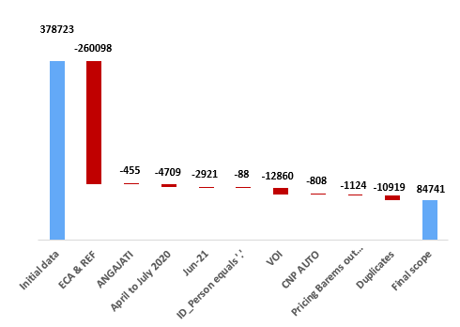
Romania
Historical pricing projects
Scope
We delete:
Automatically discarded and Refused
ANGAJATI: employees
April to July 20
June 21
ID Person = ‘.’
Product type VOITURE
Application first origin CNP AUTO
Pricing Barems out of scope
Duplicates
Notes:
In this section, we will present the historical pricing project for Cetelem Romania. In this project, the Pace team, which is a team that have conducted several other historical pricing projects (France and Sweden), will take the lead and we will work as support to complete the findings. The Romanian pricing strategy have changed during the last three years several times (two changes each year), so we believe that the first condition could be verified before starting the analysis. However, the price still depends on a pricing grid that is defined by product types and pricing barems. So we can define the price for each client using the price grid. The data sent by the Cetelem Romania contains applications data from January 2018 to June 2021. This gives us a good amount of data but we can’t use all the data because some of it is defined as out of the analysis scope by the country. The data contains the same essential columns as the Poland data, so we are not going to go into a detailed description of the data columns. However, we have a Pricing_Barem column that defines the customer category and that plays a role in the price attribution. The financial KPIs couldn’t be calculated yet because we didn’t receive the financial equation from the country, we are then going to do the first checks on the data to verify if we can build a historical model using the data we have. We will first define the scope of data to use for the analysis

Slide 34
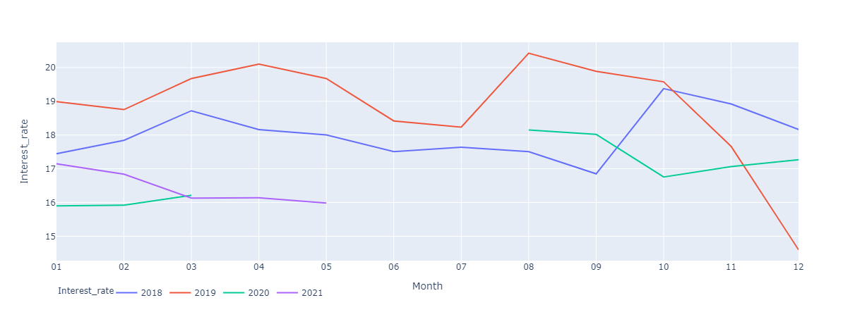
Romania
Historical pricing projects
Pre-Analysis and randomness check
Price evolution in time
Notes:
We can see that the interest rate moves between 15% and 21%. We can then try to predict the conversion using an XGBoost, and see if we can get a good performance so we can get to the elasticity modeling.

Slide 35
Romania
Historical pricing projects
XGBoost to predict conversion
Good AUC on train and test set compared to France
Overfitting on the train set, can be explained by the changes in the market or changes in the risk rules
 | Train | Test
AUC | 89% | 81%
We can still train the model on this data, but we need the financial equation for the optimization step

Slide 36
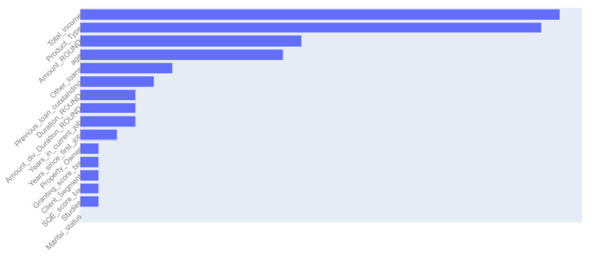
Romania
Historical pricing projects
Elasticity model
 | Train | Test
AUC | 84% | 79%
We train the model with the most important features found in the XGBoost
The model has good AUCs but overfits on the train set
The risk score doesn’t appear in the most important features for the elasticity model which is not normal

Slide 37
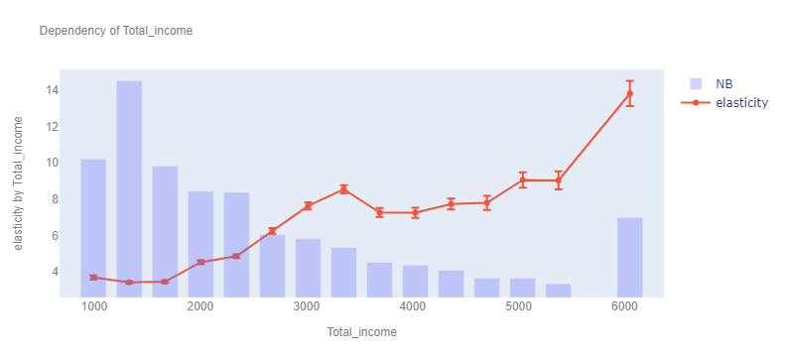
Romania
Historical pricing projects
Elasticity model

Slide 38
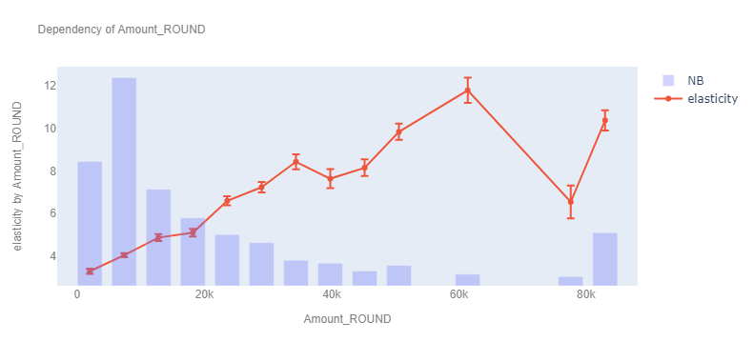
Romania
Historical pricing projects
Elasticity model

Slide 39
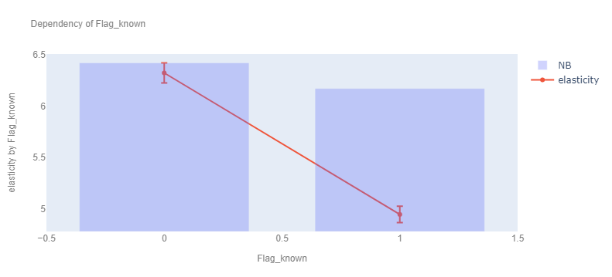
Romania
Historical pricing projects
Elasticity model

Slide 40
Romania
Historical pricing projects
Results and ongoing steps
The elasticity model shows insights that can be explored. The AUCs are at a good level.
We don’t have the complete financial equation to compute the price optimization, the country is going to deliver the information at the end of the month
The absence of the cost of risk can mislead the model, and we can get lower prices for risky clients

Slide 41
Denmark
Historical pricing projects
The final scope of data has a very low volume (50000)
The conversion rate is at 15%
Some prices do not correspond to the price grid while there is no derogation
The price is deterministic and doesn’t vary in time

Slide 42
Germany
Historical pricing projects
Low volumes (28k applications) After the elimination of duplicates, technical applications with interest rates equal to 5,79% and the rejected applications
Not enough noise observed in past data Only two values of the interest rate are used in past data and overriding the model.
Deterministic model built on past data When we try to build a model using the final scope of data, we find that the model is very deterministic, and can predict the interest rates.
176608
-58899
-89089
-453
28167
It is not possible to conclude on this scope with the historical approach.

Slide 43
Advanced Pricing Analytics package
Advanced Pricing Analytics package
Objective:
Automate the pricing methodologies
Eval
3 Different sessions
Modeling
Grid search

Slide 44
Advanced Pricing Analytics package
Advanced Pricing Analytics package
Eval Session
Prepare the data for pricing methodologies
Clean the data
Calculate the financial KPIs using the financial equation
Return an html report that summaries the A/B test results

Slide 45
Advanced Pricing Analytics package
Advanced Pricing Analytics package
Eval Session
The eval session can be launched from the terminal with a
Python run command
For less technical users, we created a Jupyter Notebook that launches the session and returns processed data

Slide 46


Advanced Pricing Analytics package
Advanced Pricing Analytics package
Eval Session
An upload button to upload the needed files:
Once uploaded we can see the number of uploaded files:

Slide 47
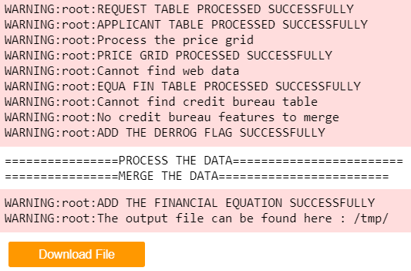
Advanced Pricing Analytics package
Advanced Pricing Analytics package
Eval Session
Once finished, we can launch the next cell that returns a download button to download the processed file and all the logs

Slide 48
Advanced Pricing Analytics package
Advanced Pricing Analytics package
Modeling session
Like the eval session, the modeling can be run in the terminal
The inputs are the data output of the eval session and the modeling parameters

Slide 49
Advanced Pricing Analytics package
Advanced Pricing Analytics package
Modeling session
The output is the tree model in pdf and a summary of the performance of the model
We sort leaves of the tree by uplift, and we set as S+ customers of the best leaves
The best model is:
The one with the best NIBT on the test set and where the genos and conversion uplifts of the S+ are higher than the S-
The optimal price of the S+ is lower than the S-

Slide 50
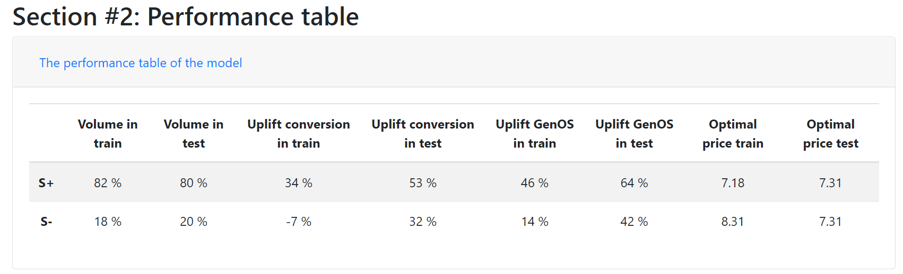
Advanced Pricing Analytics package
Advanced Pricing Analytics package
Modeling session
The final part is a HTML report of the performance of the model and a comparison with the risk-based model and the undifferentiated model

Slide 51
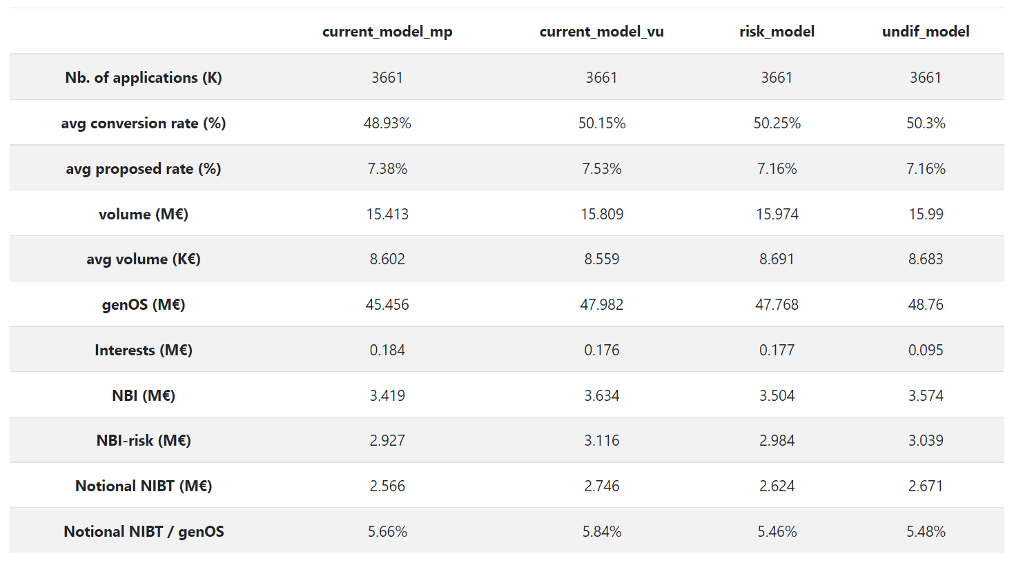
Advanced Pricing Analytics package
Advanced Pricing Analytics package
Modeling session
The final part is a HTML report of the performance of the model and a comparison with the risk-based model and the undifferentiated model

Slide 52
Advanced Pricing Analytics package
Advanced Pricing Analytics package
Grid search session
This session is to fine tune the parameters of the tree model to find the best parameters. The best model is chosen the same way we have chosen it in the modeling session

Slide 53
Advanced Pricing Analytics package
Advanced Pricing Analytics package
Grid search session
We train different models using different parameters
Model params A
Model params B
Model params C

Slide 54
Advanced Pricing Analytics package
Advanced Pricing Analytics package
Grid search session
We train different models using different parameters
We try different:
Depth of the tree
Variables used for the model
Other hyperparameters
We return a table of all tested parameters and the performance of each model in terms of amount and conversion uplift and the nibt and optimal prices for S+ and S- segments

Slide 55
Conclusion
04
Conclusion
Present the different methods

Slide 56
Conclusion
Conclusion
We directed a historical pricing methodology and concluded to start an A/B test that is going to test two levels of interest rate and opening fees
The historical approach is promising, we conducted the first analysis, and we are waiting for the completion of the data from the country to deliver a new price grid
The part of the advanced pricing analytics package that can automate the A/B test is already finalized. It is ready for the next price test and support teams are being formed to use the package and upgrade it continually

Slide 57
Thanks

