Slide 1

Le : 17/06/2021
HISTORICAL Pricing APPROACH

Slide 2
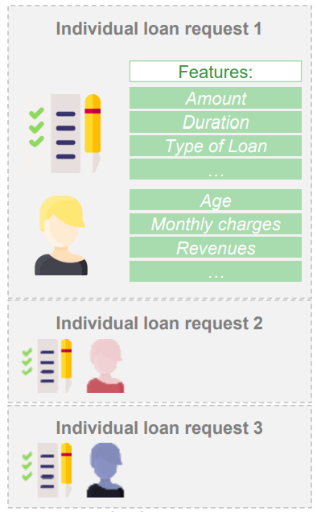
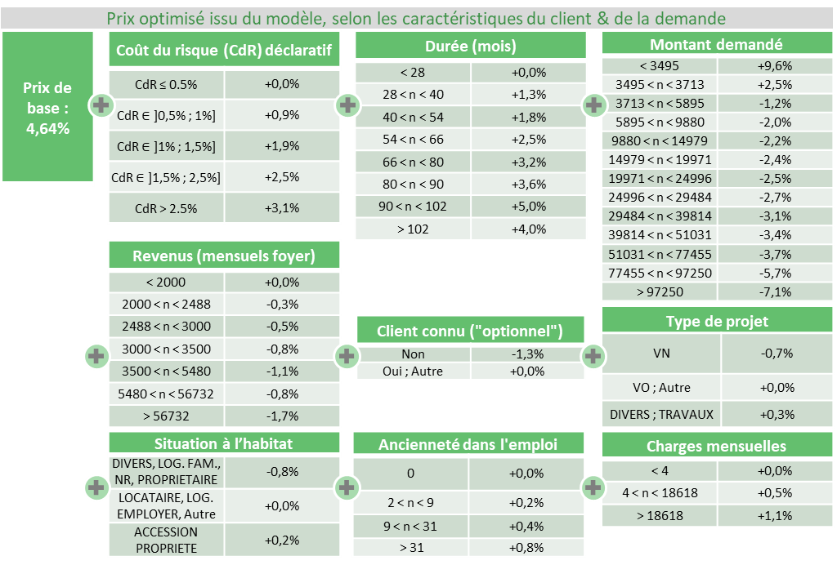
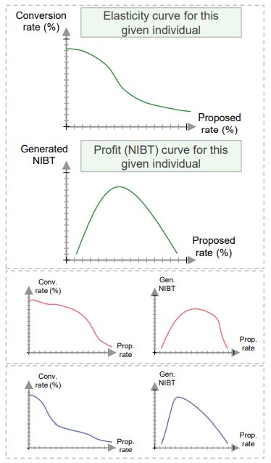
Historical method : creates ready to implement price grid Score from historical loan requests
Input
AI Engine
Output
Determine price sensitivity through the analysis of historical loan requests containing “enough noise”
Profitability calculated at application level
Determine price elasticity at customer level through a machine learning algorithm
Define the optimal price to maximize profits / production
Creates ready to implement price grid Score from historical loan requests
2

Slide 3



Process for a pricing strategy based on a Historical Method
1
2
3
4
ELASTICITY MODEL
MONITOR & UPDATE
A dedicated homemade ML algorithm, ElasticBoost, is able to predict subscription probability of a client when the proposed interest rate changes.
The model leverages either historical loan data or high-low price data gathered explicitly for this purpose.
Some indicators must be checked periodically to determine if a model update is suitable to adapt to market and data evolutions.
Random test on price can be implemented to progressively improve the elasticity model.
PRICING FORMULA
A/B VALIDATION
A second homemade ML algorithm finds the optimal pricing formula maximizing profit under business and financial constraints.
Readily interpretable and easily implementable pricing formula.
A champion/challenger test is conducted in production on a small but representative sample to check the validity of the new pricing formula against the current strategy.
If the new pricing formula outperforms the current strategy, it is rolled-out on all the production.

Slide 4

HISTORICAL PRICING : Process to get a price GRID
Pre analysis : price variation analysis (pre requisite to historical modelling)
Check price variation through time. For each price grid cell, check standard deviation (derogations)
Try to predict price with available client features
Conversion sensitivity : predict an individualized conversion based on client profile and proposed rate
Individualized Conversion = [Conversion propensity on client profile] + rate x [price elasticity]
From Conversion to profitability :
Get financial Margins (include to proposed rate Insurance, fees, Opex, CoR)
Prospect expected profit = Margin x GenOS x Conversion probability
Simulations : Include Business strategy to adjust price
Create different scenarios (Same production as BAU, +/- 5% production)
Global NIBT optimization with business constraints and get coherent price grid
Performance Analyzis :
Create a comparison basis (for example performance of a fixed price strategy)
Compare this basis to selected Scenarios
Conversion rate (%)
Elasticity curve
Proposed rate (%)

Slide 5
Historical pricing ROADMAP
Jun. 21
Aug. 21
Oct. 21
Roadmap to historical pricing implementation in package
Pre-analysis Data exploration :
price correlation
variation of the conversion rate with other variables
pre-analysis : Check randomness of price (pre-requisite to historical modelling)
test on Poland / Romania
Conversion sensitivity
Conversion propensity on client profile
price elasticity modelling
Poland : entry fees optimization
(pre-sale for a complete price test) (MA + AI)
Historical pricing projects
Germany : price grid based on historical modelling (Start July, MA + PACE + AI)
CZ : planned sept => Dec.
Romania : planned in Q3 (MA + AI)

Slide 6
APPENDIX

Slide 7
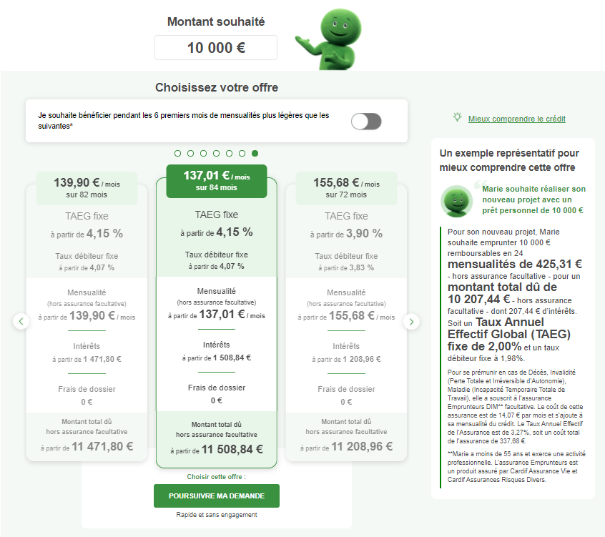

2
France – www.cetelem.fr
1st step of the subscription journey
1
Loan Simulator
4 Inputs: Project Type, Amount, Monthly installment and duration
7

Slide 8



Advanced Pricing analytics : 3 approaches to pricing optimizations
Micro Margin Analysis
Random test
Historical Method
Approaches
Assess loan profitability at a granular level to spot areas of profitability
(Data Preparation + Exploration only)
Determine price sensitivity through a A/B test
From data prep to modelling
Determine price sensitivity through the analysis of a large historical data set containing “enough noise”
From data prep to modelling
 | Data preparation | Data exploration | Modeling | Model performance monitoring
Advanced Pricing Analytics Process | ready to analysis data for MA including duplicates handling following Boost approach (in appendix) Complete data ready for financial modelling | HTML report (randomness check, financial simulation, feature importance) | Model + HTML report of its performance (AB Test + histo) Model Comparison | HTML report of the global model performance
8

Slide 9
Expected outcome and methodology
Expected outcome
Methodology
Fine tune pricing grid (slope, hook rate, etc.)
Improve derogations monitoring
Profitability calculated at application level
Identify areas of the grid / segments or sub segments with higher or lower profitability than expected and adjust price grid accordingly
Micro Margin Analysis
Define the optimal price to maximize profits / production
Greater pricing individualization capacity based on client sensitivity
Profitability calculated at application level
Determine price elasticity at customer level through a machine learning algorithm
Once first outputs are evaluated, take the decision to implement the approach
Historical Method
Define the optimal price to maximize profits / production
Differentiate pricing based on sensitivity
Develop capabilities to run a random test with a standard and promo price
Analyze the test results to identify sensitive and non sensitive segments
Roll out the sensitivity model
Random test
9

Slide 10

How to choose the most relevant one ?
Potential
gain
Analytics
robustness
Pre
requisite
Monthly
Volumes
required
Country
Project
efforts
Impl.
efforts
Price
individ.
potential
Monitoring
& Evolution
Micro Margin Analysis
Low to Medium
Access to granular data
Low to Medium
Low, focused on
data and business
Low, focused on the price grid
Low
Low
Historical Method
Medium to High,
Performance depends on what has been done in the past
Different price strategies in the past that contains “enough noise”
Low to Medium (# months of historical data to be assessed)
Low, focused on
data and business
High, IT front + ES to be adapted. Agents to be trained
High
Control group desired
Data science experts to review models. Central support req.
Low to Medium, as leveraging project dev.
Random test
Medium
to High,
More robust and based on recent observations
Capacity to implement the test correctly with sufficient spreads
High
High, IT front + ES to be adapted. Call center to be trained
Medium,
2 to 3 differentiated price grids
Control group desired
Data science experts to review models. Central support req.
10

Slide 11
Historical Method
Approach
Expected outcome
Methodology
Determine price sensitivity through the analysis of a large historical data set containing “enough noise”
Define the optimal price to maximize profits / production
Greater pricing individualization capacity based on client sensitivity
Profitability calculated at application level
Determine price elasticity at customer level through a machine learning algorithm
Once first outputs are evaluated, take the decision to implement the approach
Historical Method
Potential
gain
Pre
requisite
Monthly
Volumes
required
Country
Project
efforts
Impl.
efforts
Price
individ.
potential
Monitoring
& Evolution
Characteristics
Medium to High,
Performance depends on what has been done in the past (expected +10% NIBT)
Different price strategies in the past that contains “enough noise”
Low to Medium (# months of historical data to be assessed)
Low, focused on
data and business
High, IT front + ES to be adapted. Agents to be trained
High
Control group desired
Data science experts to review models. Central support req.

Slide 12
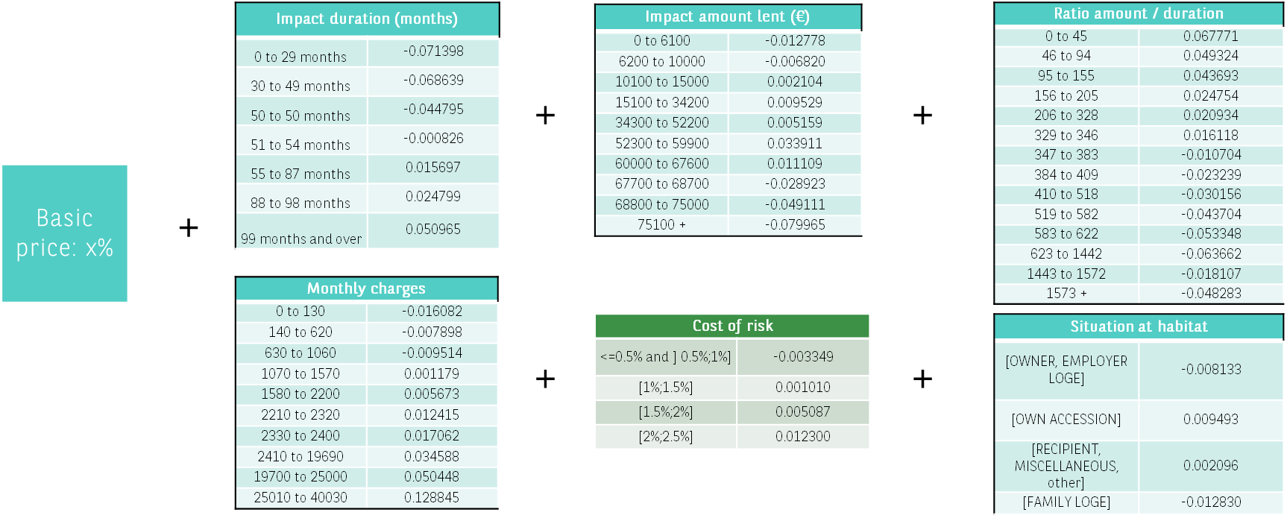
Historical pricing core concept and output
Elasticity model :
Predict the subscription probability of the client as a function of the proposed rate. Depending on the client and the loan characteristics and market benchmarks.
Profit optimization strategy :
Margin-based profit increase for low-sensitivity clients.
Volume-based profit increase for high-sensitivity clients.
The historical pricing is based on an internally developed method
AGBoost, a predictive modeling pipeline designed to benefit from machine learning accuracy while displaying the results in a fully interpretable model.
Example output

Slide 13




Historical data approach has been tested since 2018
and leverages already several successful implementations across BNPP entities & products
 | Entity |  | Details
 | Personal Loan | Implemented | +10% NBI observed since implementation in Nov 18 (champion challenger test) Model updated in Oct 19 and July 20
 | SME | Validation test ongoing | Modelisation OK, test ongoing S1 2021
 | Real estate | Validation test in discussion | POC done Champion challenge test under discussion
 | SME | Validation test planned | test ongoing S1 2021
 | SME | Validation test planned | +10% NIBT observed on live model (10% and then 20% of prod) Test on hold in 2020 due to covid – Test relaunched Q1 2021
 | Personal Loan | Preliminary random test | Model to be elaborated following random test to create « noise »
 | Personal Loan | Validation test planned | Model done end of 20 to be live tested in 21
 | Personal Loan | Implemented | Model elaborated in Q2-Q3 20 and live in prod in Jan 21 – first results analysed
Retail
Banking
Personal
Finance

Slide 14
The model built using the historical data in France
Mesure of performance (AUC¹) of the model, for periods between july and december 2019
Prix optimisé issu du modèle, selon les caractéristiques du client & de la demande
Prix de base : 4,64%
Coût du risque (CdR) déclaratif
CdR ≤ 0.5% | +0,0%
CdR ∈ ]0,5% ; 1%] | +0,9%
CdR ∈ ]1% ; 1,5%] | +1,9%
CdR ∈ ]1,5% ; 2,5%] | +2,5%
CdR > 2.5% | +3,1%
Durée (mois)
< 28 | +0,0%
28 < n < 40 | +1,3%
40 < n < 54 | +1,8%
54 < n < 66 | +2,5%
66 < n < 80 | +3,2%
80 < n < 90 | +3,6%
90 < n < 102 | +5,0%
> 102 | +4,0%
Montant demandé
< 3495 | +9,6%
3495 < n < 3713 | +2,5%
3713 < n < 5895 | -1,2%
5895 < n < 9880 | -2,0%
9880 < n < 14979 | -2,2%
14979 < n < 19971 | -2,4%
19971 < n < 24996 | -2,5%
24996 < n < 29484 | -2,7%
29484 < n < 39814 | -3,1%
39814 < n < 51031 | -3,4%
51031 < n < 77455 | -3,7%
77455 < n < 97250 | -5,7%
> 97250 | -7,1%
0,78
0,82
VO
VN
Revenus (mensuels foyer)
< 2000 | +0,0%
2000 < n < 2488 | -0,3%
2488 < n < 3000 | -0,5%
3000 < n < 3500 | -0,8%
3500 < n < 5480 | -1,1%
5480 < n < 56732 | -0,8%
> 56732 | -1,7%
0,80
0,75
Client connu ("optionnel")
Non | -1,3%
Oui ; Autre | +0,0%
Type de projet
VN | -0,7%
VO ; Autre | +0,0%
DIVERS ; TRAVAUX | +0,3%
TVX
DV
Situation à l’habitat
DIVERS, LOG. FAM., NR, PROPRIETAIRE | -0,8%
LOCATAIRE, LOG. EMPLOYER, Autre | +0,0%
ACCESSION PROPRIETE | +0,2%
Ancienneté dans l'emploi
0 | +0,0%
2 < n < 9 | +0,2%
9 < n < 31 | +0,4%
> 31 | +0,8%
Charges mensuelles
< 4 | +0,0%
4 < n < 18618 | +0,5%
> 18618 | +1,1%
1: Aire sous la courbe ROC (receiver operating characteristic), valant entre 0,5 (modèle aléatoire) et 1 (modèle prédictif parfait)

Slide 15


Sweden has switched in 2021 to a pricing strategy based on historical data
Context
Pricing on Sweden Brokerage was risk based using SW PF score
Local Business observed pricing positioning issues on lower risk profiles
No AB Testing possible ➔ Decision to apply new historical approach: Measurement of elasticity observed through variation of price level over 21 months: August 2018 to April 2020.
Yearly Production forecast (M€)
Yearly Generated NIBT (M€)
1,84%
1,56%
Individualized pricing formula (Fake example)
Implementation steps
Implementation on the 5th of Jan 2021
First implementation in PF of a pricing formula that provides a strong level of price individualization
First weeks following implementation showing potential need to adapt slightly model : elasticity observed is higher than modelized ➔ deeper review planned in April
Good and close cooperation between local and central team
Pricing elements | Interest | Individualised
Base price | 1,20% | No
Margin | +1,70% | No
Tenor | +0,50% | Yes (3 levels)
Volume | +0,50% | Yes (4 levels)
No Co-applicant | +0,20% | Yes (2 levels)
Sevenday score | +3,00% | Yes (10 levels)
PD adjustment | +0,20% | Yes (10 levels)
Rounding | +0,15% | Yes
Approved interest | 7,25% | Yes
Example
Tenor
24 | 0%
72 | 0,25%
144 | 0,50%
Volume
50.000 | 0,50%
150.000 | 0,25%
350.000 | -0,15%
500.000 | 0,30%

Slide 16

POLAND Price test first conclusion (2018) Interest rate and fees positioning are not interrelated
A price test in 2018 in Poland led to the conclusion that the interest rate and the fees are independent.
A price test is going to take place for the interest rate and it would be accompanied by a historical approach on the fees
Generated OS / application – based on IR and fees (2018 Results)
There is no dependency between interest rate and fees positioning. The optimization will be thus realized in two separate steps:
a first optimization of Interest rate and then an optimization of the fees

Slide 17
Historical Pricing POLAND : Scope and target definition
scope definition (from 06/20 to 05/21 )
665324
-215635
Two principal components of the price are the interest rate and the entry fees.
The interest rate is stable at the usury rate, at a level of 7.2% for the cash loans and 6.9% for the consolidation loans.
The entry fees have a higher variance than the interest rate
Test the randomness of the entry fees
-43640
-190081
-92130
-3403
-5243
115192
Product Type | Number of requests | Financed rate | Financed Amount (in billion of zł) | Financed Genos (in billion of zł)
Cash Loan | 91 591 | 69 % | 1,67 | 4,18
Consolidation Loan | 23 601 | 65 % | 0,86 | 2,74

Slide 18
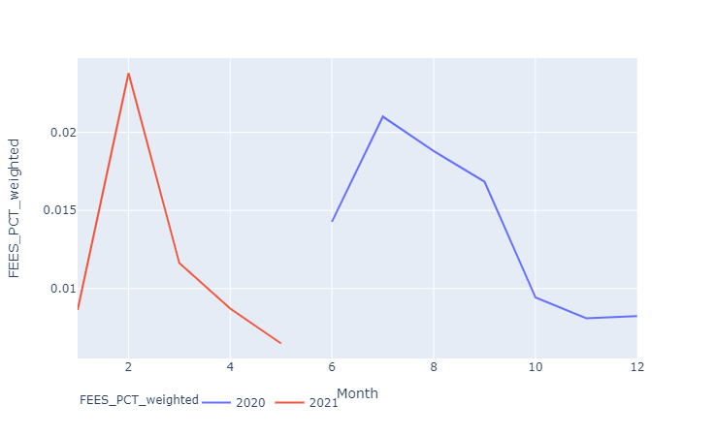
Historical Pricing POLAND : ENTRY FEES : target to test an historical pricing
More than 80% of the interest rates are equal to the usury rate (7.2%), and this price hasn’t move since June 2020.
Therefore, it will be impossible to build an elasticity model on the nominal price
However, the entry fees have changed a lot in one year, between 0% and 8% of the GenOS.
We have enough noise to test an historical model with the entry fees as a target.
Evolution of the entry fees between June 2020 and May 2021

Slide 19


1. Core concepts of the elasticity model
The core idea of the elasticity model is to use the available data (client and loan characteristics, market benchmarks, …) to predict the subscription probability of the client as a function of the proposed rate.
Deep historical data set
Elasticity modelling
Individual elasticity curves
The subscription probability should be a smooth and decreasing function of the proposed rate.
The price sensitivity – dependency of the subscription probability on the proposed rate – should vary from client to client.
Loans & financial data
Clients
Subscription probability
Customer A
Subscription probability
Customer C
Proposed rate
Competition
Applications
Application Data has to include “noise” (change in price positioning, derogations, etc.) to avoid creating a deterministic model
Customer B
Proposed rate
Subscription probability
Proposed rate

Slide 20
Elasticity modelling to predict aN individualized conversion
CONVERSION PROBABILITY
different conversion and price sensitivity for each client and loan simulation
Input :
ElasticBoost to predict a smooth, interpretable and individualized conversion
LOANS
2 TREE-BASED MODELS
CLEINTS
MODEL 1 : Conversion tendency regardless of the price
+
MODEL 2 : Conversion sensitivity to price
Subscription probability
Customer A
Subscription probability
MARKET
Proposed rate
Proposed rate
Model 1 and Model 2 are two tree-based models jointly trained in order to predict a different conversion and price sensitivity for each client and loan simulation.
Rate, margin on top of break-even price or even price gap with competitors can be simultaneously tested and then selected.
Subscription probability
Customer B
Subscription probability
Proposed rate
Proposed rate

Slide 21
2. The price elasticity measure enables to optimize profits with more volumes or higher margins
MARGIN-BASED
PROFIT INCREASE FOR
LOW-SENSITIVITY CLIENTS
VOLUME-BASED
PROFIT INCREASE FOR
HIGH-SENSITIVITY CLIENTS
Increasing the client’s rate of low-sensitivity clients leads to a small volume loss and to a bigger increase of margins per granted loan.
This increase leads to an increase of the overall profit.
Decreasing the client’s rate of high-sensitivity clients entails high volume gain and a smaller decrease of the margins per granted loan.
This decrease leads to an increase of the overall profit.
Business decision to set the constraints to the model considering trade-offs between different scenarios:
Keep the same average proposed rate whilst boosting significantly the accepted rate
Maintain the same volume of production while increasing the profitability

Slide 22

2. The 2nd optimization engine computes the individual elasticity to create a global and
optimized function, taking into account the given constraints
NIBT curve calculation at granular level
Output
Individual loan request 1
Optimization of 1 KPI (eg Profit, displayed as an efficiency curve)
under various degrees of freedom (volume, RONE…)
For each scenario, an explicit and easy to read price formula is computed (cf. details next slide)
NB: the model can take into account several contraints (gap with old strategy, min/max price …)
Individual loan request 1
Individual loan request 1
Conversion rate (%)
Elasticity curve
OPTIMIZATION ENGINE
Reco.
Scenario A
Profit M€
Profit (NIBT) curve
Reco.
Scenario B
Generated NIBT
Curve of projected scenarios of optimization depending on volume constraint
Proposed rate (%)
Current situation
Proposed rate (%)
Prod. (M€)
Financials

Slide 23
2. Historical data pricing formula is based on internally developed method AGBoost*
AGBoost is a complete predictive modeling pipeline designed to benefit from machine learning accuracy while displaying the results in the form of a classical linear model, fully interpretable and sometimes easier to implement
Impact duration (months)
0 to 29 months | -0.071398
30 to 49 months | -0.068639
50 to 50 months | -0.044795
51 to 54 months | -0.000826
55 to 87 months | 0.015697
88 to 98 months | 0.024799
99 months and over | 0.050965
Impact amount lent (€)
0 to 6100 | -0.012778
6200 to 10000 | -0.006820
10100 to 15000 | 0.002104
15100 to 34200 | 0.009529
34300 to 52200 | 0.005159
52300 to 59900 | 0.033911
60000 to 67600 | 0.011109
67700 to 68700 | -0.028923
68800 to 75000 | -0.049111
75100 + | -0.079965
Ratio amount / duration
0 to 45 | 0.067771
46 to 94 | 0.049324
95 to 155 | 0.043693
156 to 205 | 0.024754
206 to 328 | 0.020934
329 to 346 | 0.016118
347 to 383 | -0.010704
384 to 409 | -0.023239
410 to 518 | -0.030156
519 to 582 | -0.043704
583 to 622 | -0.053348
623 to 1442 | -0.063662
1443 to 1572 | -0.018107
1573 + | -0.048283
+
+
Basic price: x%
+
Monthly charges
0 to 130 | -0.016082
140 to 620 | -0.007898
630 to 1060 | -0.009514
1070 to 1570 | 0.001179
1580 to 2200 | 0.005673
2210 to 2320 | 0.012415
2330 to 2400 | 0.017062
2410 to 19690 | 0.034588
19700 to 25000 | 0.050448
25010 to 40030 | 0.128845
Cost of risk
<=0.5% and ] 0.5%;1%] | -0.003349
[1%;1.5%] | 0.001010
[1.5%;2%] | 0.005087
[2%;2.5%] | 0.012300
Situation at habitat
[OWNER, EMPLOYER LOGE] | -0.008133
[OWN ACCESSION] | 0.009493
[RECIPIENT, MISCELLANEOUS, other] | 0.002096
[FAMILY LOGE] | -0.012830
+
+
(*): Automatic Generalized Additive Model Boosted Trees

Slide 24


3. Validation and monitoring through empirical testing
A true data-driven approach relies on empirical testing.
For validation
For Monitoring
The performance of the model is validated empirically with a Champion/Challenger test.
The test is performed in production on a statistically significant sample size.
This aims not only to determine if the proposed strategy outperforms the current one but also to confirm the foreseen financial impact.
The test allows to identify potential difficulties in implementing the strategy and address them before moving to a full deployment in production.
Strategical decisions regarding the opportunity for model evolutions must also be data-driven.
During the Run, KPIs such as volume of requests, rate of subscription, revenues and margin must be monitored and compared to theoretical predictions to spot eventual drifts.
We suggest to monitor periodically the match between the training dataset and the treated requests (in term of clients’ profiles).
Updates may be needed if the model’s constraints need to evolve or if the addressed population (or market) changes significantly (ex.: Covid-19).

Slide 25
4. Once the pricing strategy is in place, what specific efforts are required to manage it ?
Type of update
Accounting
Required Effort & Time Local / Central
Competition/ Financial information data update
The price grid can take into account financial information as risk/segment or funding/duration or competition data
No update of the elasticity prediction
Pricing formula to be updated if not already included
~1 week + IT implementation
Update of constraints used within optimization engine
Model parameterization, constraints in volume, gap with previous strategy, …
No update of the elasticity prediction
~2 weeks (Data sharing and analysis)
+ IT implementation
Elasticity Model Review
Review of the core concept of the method (elasticity prediction) to update global pricing strategy to adapt to market and data evolutions
~1,5 month (incl. Business review) + IT implementation
Share of work between Local and Central is to be discuss and will depend on the capacity of the local team to handle the ML models (Python)

Slide 26

Optimizing the price means balancing Financial margins vs. Volume (demand elasticity) and Risk (self-selection)
Demand elasticity and self-selection: Impact of price variation on volume and risk
Demand elasticity (1)
Lower prices drive higher volumes, and vice versa.
At acquisition stage, the lower the price, the higher the generated outstanding thanks to higher response, financing rates, loan amounts and, to some extent, duration.
During the life cycle, the lower the price the lower the early repayments.
Population size
The lower the price, the higher the volume (1) and the lower the average risk level (2)
Potential customers
Customer demand at:
(1)
high price
medium price
Self selection (2)
The lower the price, the lower the risk, and vice versa.
The additional customers acquired by a lower price have a lower risk profile – it is a positive self-selection.
This increase in low risk customers lowers the average risk.
Note: an adverse selection is a negative self-selection.
(1)
low price
Demand thresholds
Risk level
Note: This schematic evolution not only depends on the real price, but on its perception by customers.
high risk
low risk
(2)

Slide 27
The key to optimize is the magnitude of demand elasticity and self-selection
Illustration: Materializing demand elasticity and self-selection with test results
Profit margin
Generated outstanding
Profit
(
NBI / outstanding*
-
Cost of Risk
)
x
Financing rate**
x
Production per Financed
x
Financial Duration
=
(NBI – Risk) per lead
Standard price
(Champion)
(
5%
-
2%
)
x
1%
x
5 000 €
x
4 yrs
=
6,00 €
Test outcome:
100-bp price raise (Challenger)
favorable
(
6% 
-
2,25% 
)
x
0,95% 
x
4 750 € 
x
3,75 yrs 
=
6,35 €
A
unfavorable
(
6% 
-
2,5% 
)
x
0,90% 
x
4 500 € 
x
3,5 yrs 
=
4,96 €
B
Price change
self-selection
demand elasticity
Two possible outcomes:
Favorable case: a 100-bp price increase is more profitable by 0,35€ per lead
Unfavorable case: a 100-bp price increase is less profitable by 1,04€ per lead
A
* cost of capital/equity deducted
** measures the loss between an initial lead and a financed customer
B
Note: with a decrease in price, the trends (symbolized by arrows) would be reversed.

Slide 28










The success will rely on the collaboration of a cross functional / local and central team
Project plan
0. SET SCOPE & TEAM
1. DATA COLLECTION*
& FIRST EXPLORATION
2. ELASTICITY MODEL BUILDING
3. PROFITABILITY ASSESSMENT
4. PRICING FORMULA OPTIMIZATION
5. DESIGN & LAUNCH OF A/B VALIDATION
6. INDUSTRIALIZATION, MONITORING & UPDATES
Kick-off meeting
10 March 2021
Business Validation
xxx
Test launch decision
xxx
~3 months
Project team to be staffed
Project Sponsors
Dirk Smeesters
Business Owners / Marketing offer
xx
Pricing experts/ Business analysts
Dirk Smeesters
Romain Giry
Data & Analytics
Matthieu Cutivet
Zhen Li
Yohann Feneche Yacine Zounani
Yelle Kleykens
Finance and Risk
xx
IT
xx
*: including legal aspects (Privacy by Design, DPA…)

