Slide 1
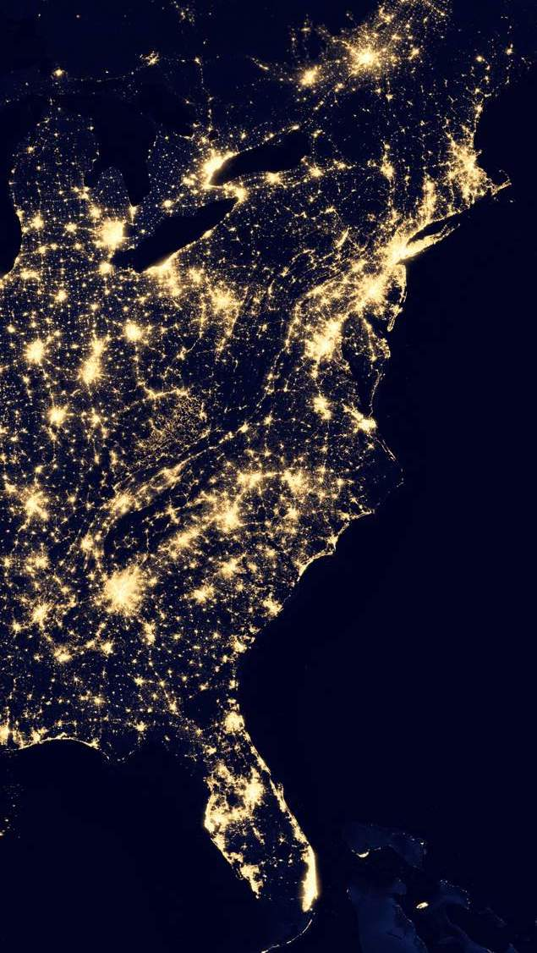
Wrangling Geospatial Data with Python, R and qgis
Grace Kim and Amreen Gillani
August 2020

Slide 2
agenda
Intro of geospatial analysis
Data sources
tips
Package recommendations
Demo with grace: jupyter notebook
Demo with Amreen: r markdown + qgis
Q&a

Slide 3
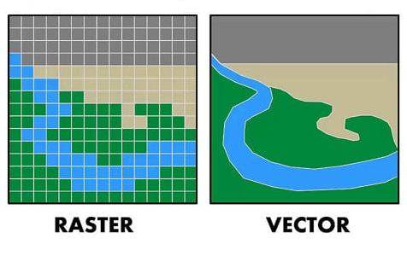
Intro of geospatial analysis
What is gis?
GIS stands for “Geographic Information System” and provides the ability to capture and analyze spatial and geographic data.
What’s the difference between raster and vector data?
Raster data is a grid of pixels organized in rows and columns. Rasters are digital aerial photographs, imagery from satellites, digital pictures, or even scanned maps.
Vector data is made up of points, lines and polygons.
Notes:
It’s primarily working with data that has location attributed to the data. An example would be having a dataset that has latitude and longitude coordinates..
The most prevalent example that you’re all familiar with is GPS navigation. Another example would be let’s say you’re an owner of a Foot Locker, you’ll want to look at demographic data, city zoning data, road layers, and you can use that data to understand that you’re opening the location in the right demographics. Close to highways, in a commercial zone, and conduct a suitability analysis.
You want to use vector data when possible because it’s going to be more accurate. For example, if you zoom into the vector image in QGIS, you’ll get more accuracy. If you zoom into the raster image, it will become more pixelated.
Most of the time you want to use vector data, but there are times where you’ll want to use raster data. For example, if you want to detect change in an environment, such as a refugee camp or destruction after an earthquake, then you’ll want to use raster data because you’re looking at before and after pictures. So you’re conducting change detection to see which pixels have changed. Where it did and where did it shrink?

Slide 4
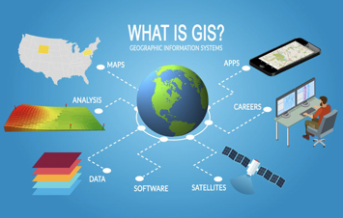
Data sources
Open Street Map (vector)
Google imagery (vector and raster)
Government and county websites (vector)
Landsat & more from NASA (raster)
With a dataset of latitude and longitude, you can make your own vector point data in Python, R or Excel.
This data can be read into a GIS software like QGIS, or analyzed in your preferred programming language with the help of geospatial packages.
Notes:
Here are some data sources with geolocated data.
OSM and google imagery can be used as a basemap to overlay your vector and raster data. For Amreen’s analysis, we’ll look at Chesapeake data that we pulled from their county website. Landsat data can be used to monitor water quality, glacier recession, sea ice movement, invasive species encroachment, coral reef health, land use change, deforestation rates and population growth.

Slide 5
tips
QGIS is a great tool for geospatial analysis because it’s open source, easy-to-use and all the documentation is available online.
Know the difference in file formats.
While a .png or .jpg may look like raster data, if there is no geographic metadata associated with the image, it is not raster. A .tif image has location in the metadata and can be used as raster data.
For shapefile data, you will need at least 3 files in the folder for QGIS to read the data. They are .shp, which is the main file that stores the feature geometry, .shx, the index file that stores the index of the feature geometry, and the .dbf, which is the dBASE table that stores the attribute information of features.
Many scientific raster datasets are delivered in a .nc file, which denotes a netCDF file. Although it is an uncommon format, you can access the metadata and arrays with just a few commands with the help of open source packages
Notes:
QGIS will be able to read file formats without geographic metadata but will not be able to locate it.

Slide 6
Package recommendations
Python
geopandas
netCDF4
scipy.spatial
DS packages: numpy, pandas, matplotlib
R
ggplot
readr
shiny
leaflet

Slide 7
Demo with grace

Slide 8



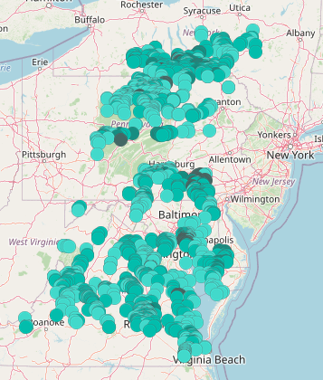
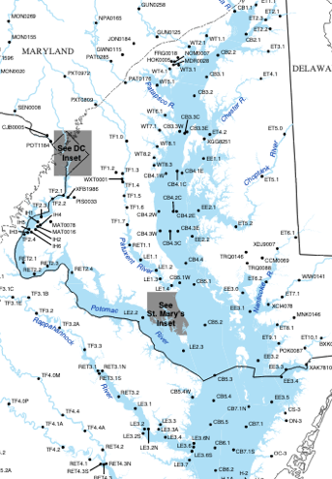
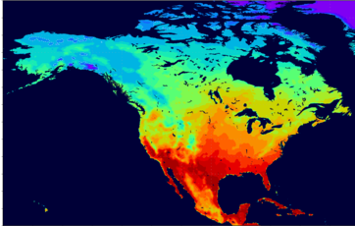
harnessing Citizen science to tackle climate change impacts on water quality
Citizen Science
Water Quality
Local Gov’t Agencies
Water Quality
North American Regional Reanalysis
Climate
Notes:
Grace
The North American Regional Reanalysis (NARR) is a regional reanalysis of North America containing temperatures, winds, moisture, soil data, and dozens of other parameters. Produced by the National Centers for Environmental Prediction (NCEP), the NARR model takes in, or assimilates, a great amount of observational data to produce a long-term picture of weather over North America. The data that are assimilated in order to initialize the model to real-world conditions are temperatures, winds, and moisture from radiosondes as well as pressure data from surface observations. Also included in this dataset are dropsondes, pibals, aircraft temperatures and winds, satellite radiance (a measure of heat) from polar (orbiting Earth) satellites, and cloud drift winds from geostationary (fixed at one location viewing Earth) satellites.

Slide 9
Maximize cmc data for modeling nutrient pollution with augmented datasets
Notes:
Grace
~2337 data points from CMC; 30,000+ total

Slide 10
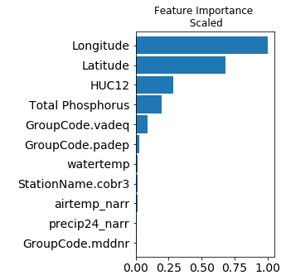
Model Explainability: Nitrogen concentrations depend on location
Features:
Latitude
Longitude
Group
HUC12
Time
Month
Year
Dissolved Oxygen
Total Phosphorus
Water Temperature
Air Temperature
Precipitation
Wind Speed
Target:
Total Nitrogen
Notes:
Lucy

Slide 11
Demo with amreen

Slide 12
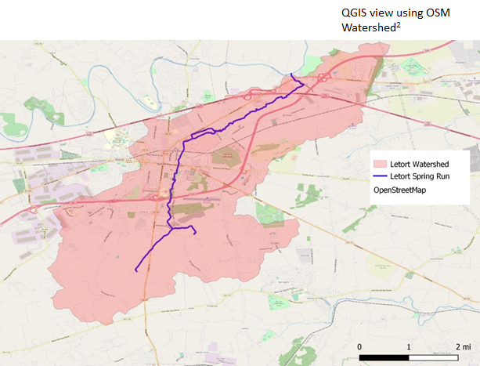
LETORT SPRING RUN
The LeTort Spring Run is a 9.4-mile-long tributary of Conodoguinet Creek in Cumberland County, Pennsylvania. The LeTort Spring Run is a warm water stream.
•According to the Water Research Watershed Center, warm water streams should not exceed 31.667° Celsius¹
•pH should be between 6.5 and 8.5 (provided by CMC)
The spring faces problems with pollution and alteration of important wildlife habitats, specifically for about one mile as it flows through Carlisle and part of North Middlesex Township near the heavily-traveled State Route 11, there is urban stormwater pollution and habitat alteration.³
Notes:
In my analysis, I studied water temperature and pH levels specifically in Letort spring run. I used QGIS and R for my geospatial analysis. In the light red, I’ve highlighted the Letort Watershed, and in blue is the Letort Spring Run. I used Open Street Map as my basemap.
Demo in QGIS: what’s so important about QGIS is that it’s open source and it’s free. There are many geospatial software, such as ArcGIS and ArcMap but they cost thousands of dollars a year for a license. So QGIS really changed the game because now it’s accessible to anyone with zero cost.

Slide 13
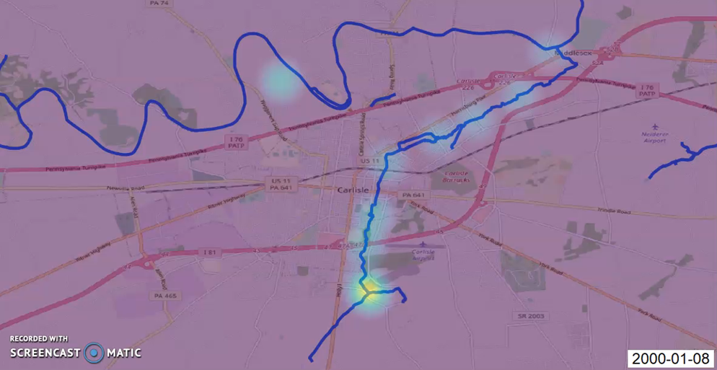
Heat map of water temperature using qgis

Slide 14
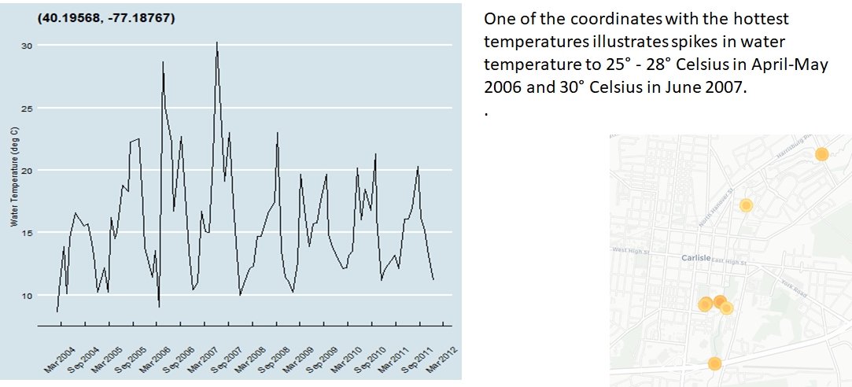
Trending of the hot spots: (40.19568, -77.18767)

Slide 15
Q&A

Slide 16

Want to practice your geospatial coding skills on water quality data in the Chesapeake Bay? Sign up for Hack the Bay: hack-the-bay.devpost.com
Hack the Bay: Chesapeake Bay Water Quality Hackathon
Running from Aug. 3- Sep. 14
All virtual (coding tutorials, environmental justice panels, "office hours“)
Open to Booz Allen and external audiences (18+)
Four Challenge Tracks:
Teams with the most compelling entries in each track will be invited to virtually present their findings to a distinguished panel from the Chesapeake Monitoring Cooperative, Booz Allen Hamilton, and other experts in the field. Help address real challenges faced by the leading scientists in watershed conservation!
Develop a Restoration Case Study
Identify Data Gaps
Model Water Pollution
Design a Water Quality Scorecard
Notes:
Kate

