Slide 1


Microsoft Cloud for financial services
customer insights data pipeline FOR FSI (AZURE DATA FACTORY)
Doc v1.0 – 10/30/2021

Slide 2
OVERVIEW
ARCHITECTURE
PREREQUISITES
SOURCE
TARGET
PIPELINE
AZURE DATA FACTORY
DEPLOYMENT
DATAFLOWS
PIPELINE
TROUBLESHOOTING

Slide 3
ARCHITECTURE

Slide 4




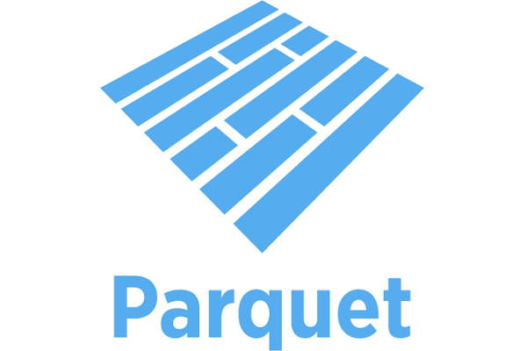
architecture
CSV
CDM Folder (Source)
CI FSI template (vnext)
Dataverse
Data Source (Connect to CDM folder’, credentials)
Dataverse
Export to Data Lake
Attach
CDM Folder
Measures
FSI solution (card)
Customer Insights
Segments
FSI Churn
CDM Folder (Target)
Customer’s
Azure Data Lake
(BYODL)
Customer Insights
Data Pipeline
For FSI
(ADF)

Slide 5
PREREQUISITES

Slide 6
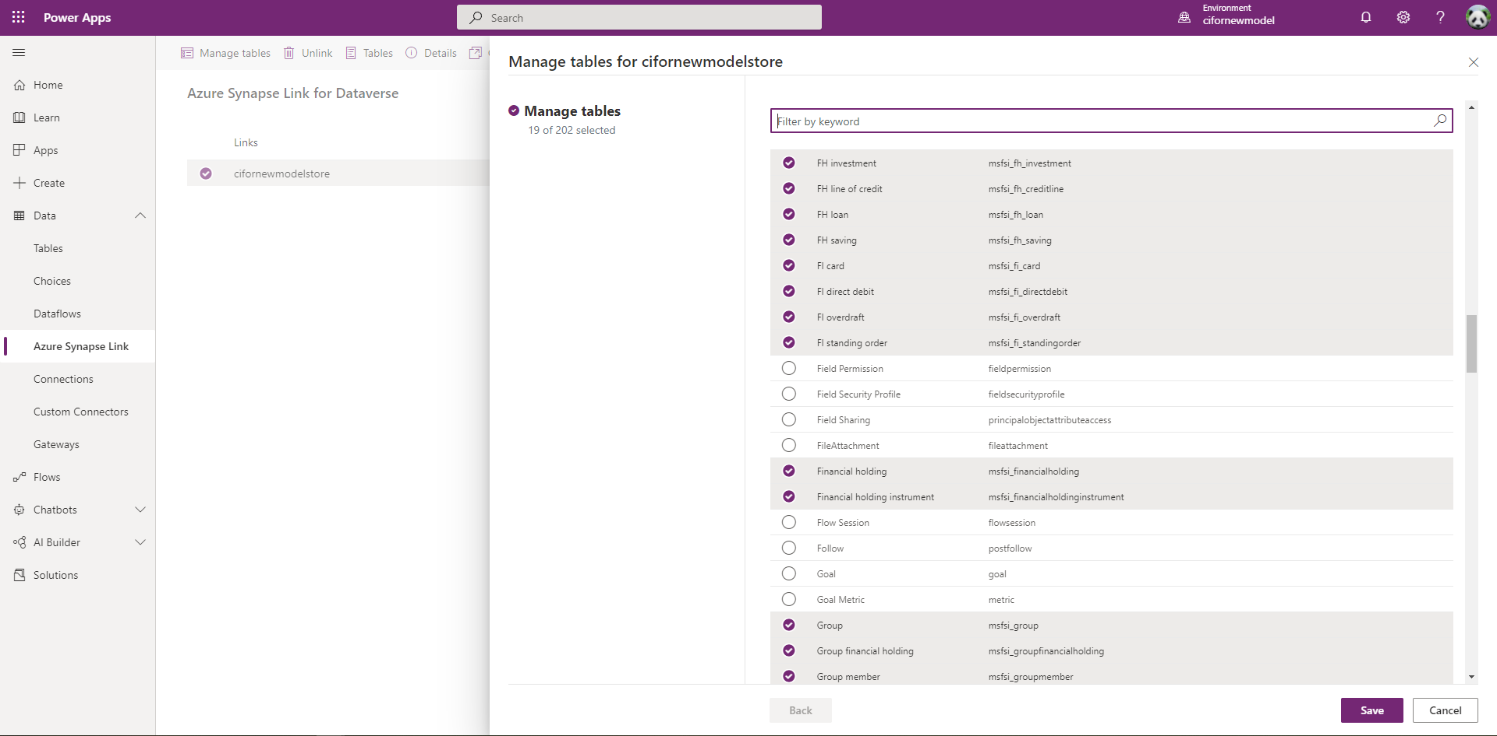
Prerequisites | SOURCE
Dynamics 365 w/FSI
Azure Data Lake Storage Gen2
“Source” for ADF Pipeline
w/Hierarchical namespace
See doc
Azure Synapse Link for Dataverse
Include all FSI entities (19)
See doc
Access & Permissions
Dynamics 365 Admin
ADLS Container Owner

Slide 7
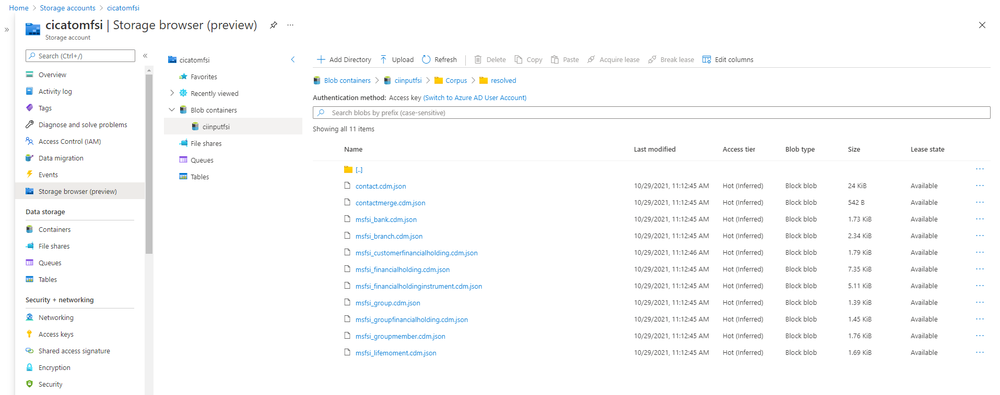
Prerequisites | TARGET
Customer Insights Instance (B2C)
Azure Data Lake Storage Gen2
“Target” for ADF Pipeline
w/Hierarchical namespace
Same Azure Region as CI Instance
See doc
Common Data Model Corpus
In Corpus/resolved/ Folder
Include all FSI entities for CI (11)
Access & Permissions
ADLS Container BLOB Data Contributor
See doc

Slide 8
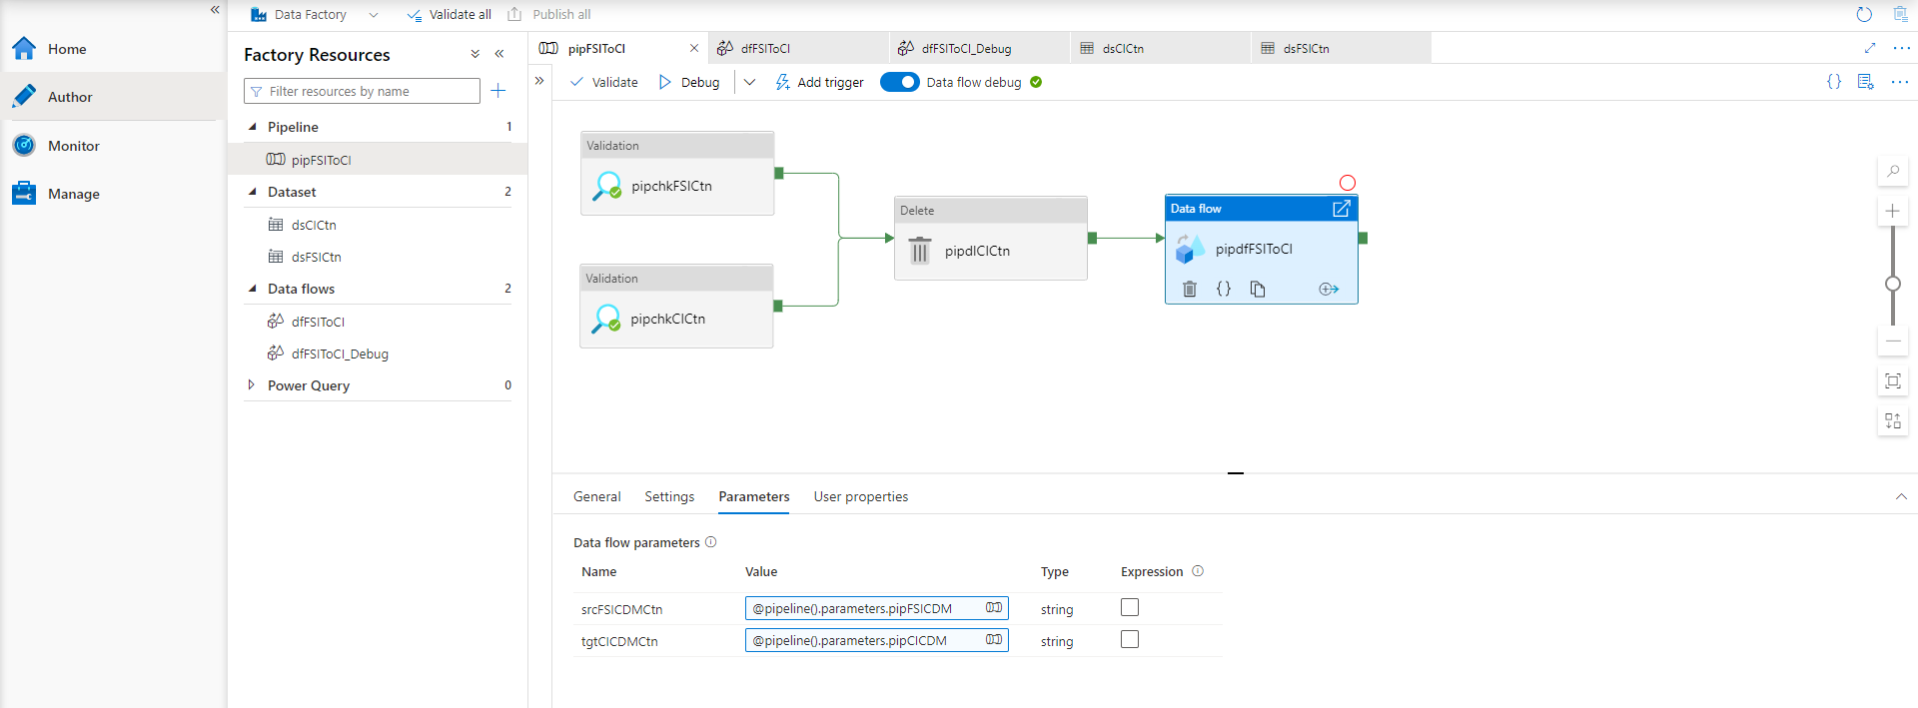
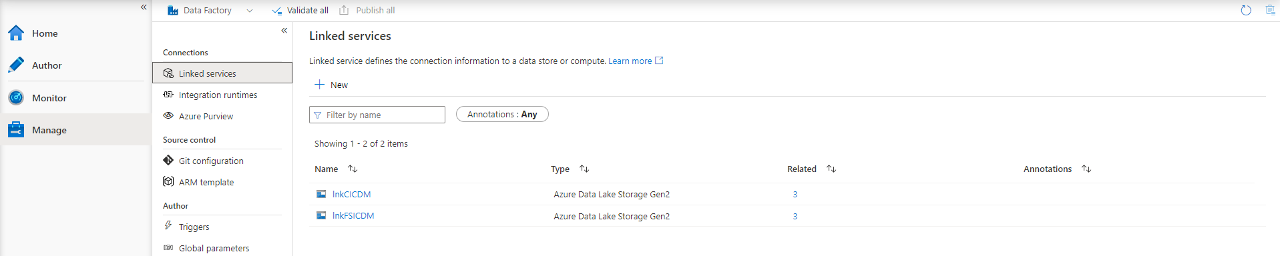
Prerequisites | PIPELINE
Azure Data Factory v2 Instance
Create if/as Needed
Any Supported Region
Same Azure Subscription as Target ADLS
See doc
CI Data Pipeline for FSI (ADF)
1 x Pipeline (pipFSIToCI)
2 x Dataflows (dfFSIToCI, dfFSIToCI_Debug)
2 x Datasets (dsFSICtn, dsCICtn)
2 x Linked Services (lnkFSICDM, lnkCICDM)
Access & Permissions
Access to Source/Target ADLS Containers

Slide 9
AZURE DATA FACTORY

Slide 10
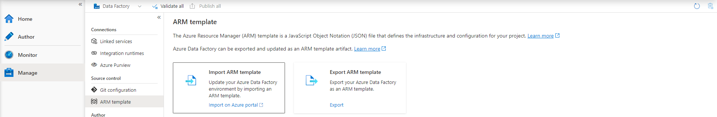
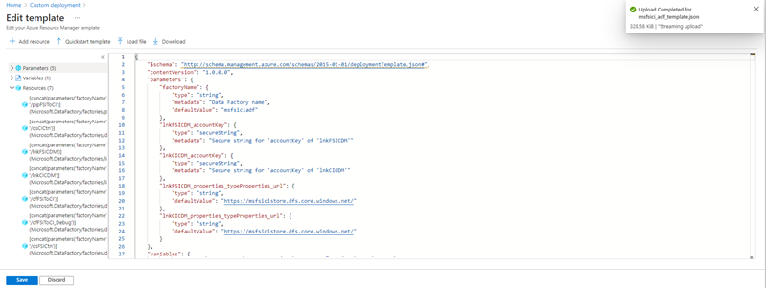
AZURE DATA FACTORY | DEPLOYMENT
Prerequisites
Synapse Link for Dataverse(“Source”)
ADLS Container Gen2 for CI (“Target”)
Existing Azure Data Factory v2 Instance
ARM Template for ADF Pipeline
Template file (msfsici_adf_template.json)
Import from Within ADF Instance
Set Parameter Values:
LnkFSICDM_properties_type Properties_url
LnkCICDM_properties_type Properties_url
LnkFSICDM_account Key
LnkCICDM_account Key
See doc

Slide 11
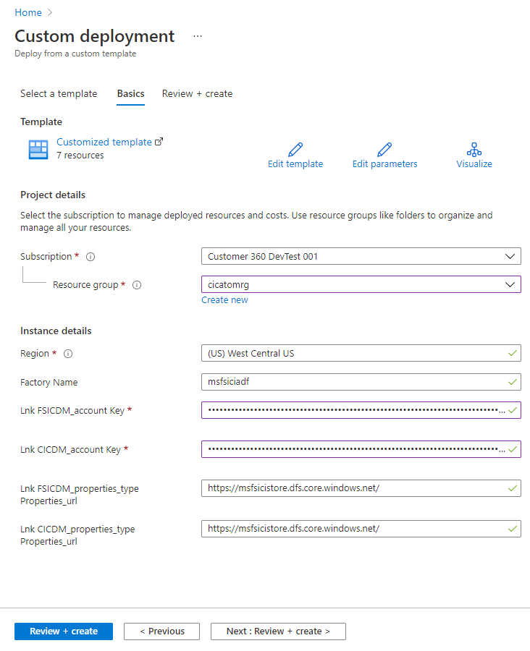
AZURE DATA FACTORY | DEPLOYMENT | EXAMPLE
Subscription ➔ Azure Subscription of the ADF v2 Instance
Resource Group ➔ Resource Group of the ADF v2 Instance
Region ➔ Azure Region of the ADF v2 Instance
Factory Name ➔ Name of the ADF v2 Instance to Deploy Template To
LnkFSICDM_account Key ➔ Dataverse Linked Container Account Key
LnkCICDM_account Key ➔ Target ADLS Container Account Key
LnkFSICDM_properties_type Properties_url ➔ Dataverse Linked Container URL
LnkCICDM_properties_type Properties_url ➔ Target ADLS Container URL

Slide 12
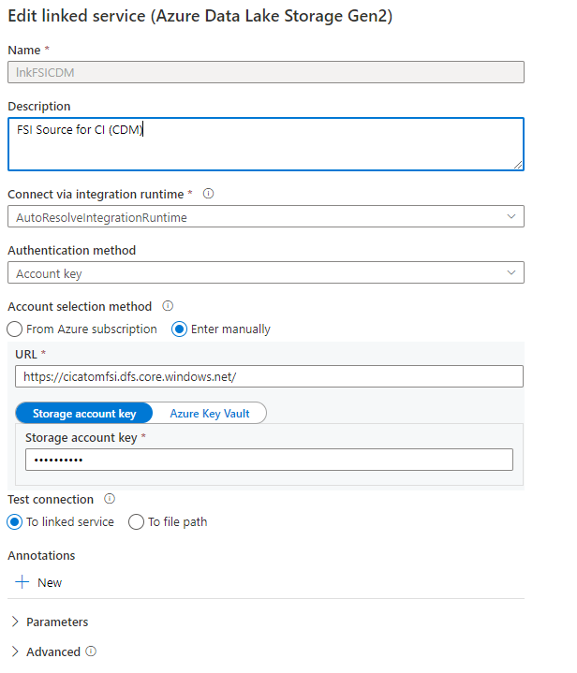
AZURE DATA FACTORY | DEPLOYMENT | EXAMPLE | POST DEPLOY
LnkFSICDM_properties_type Properties_url ➔ Dataverse Linked Container URL
LnkFSICDM_account Key ➔ Dataverse Linked Container Account Key

Slide 13
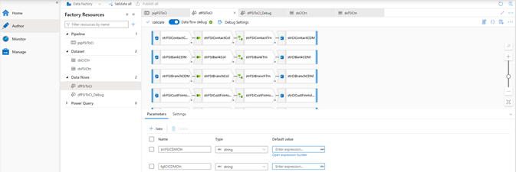
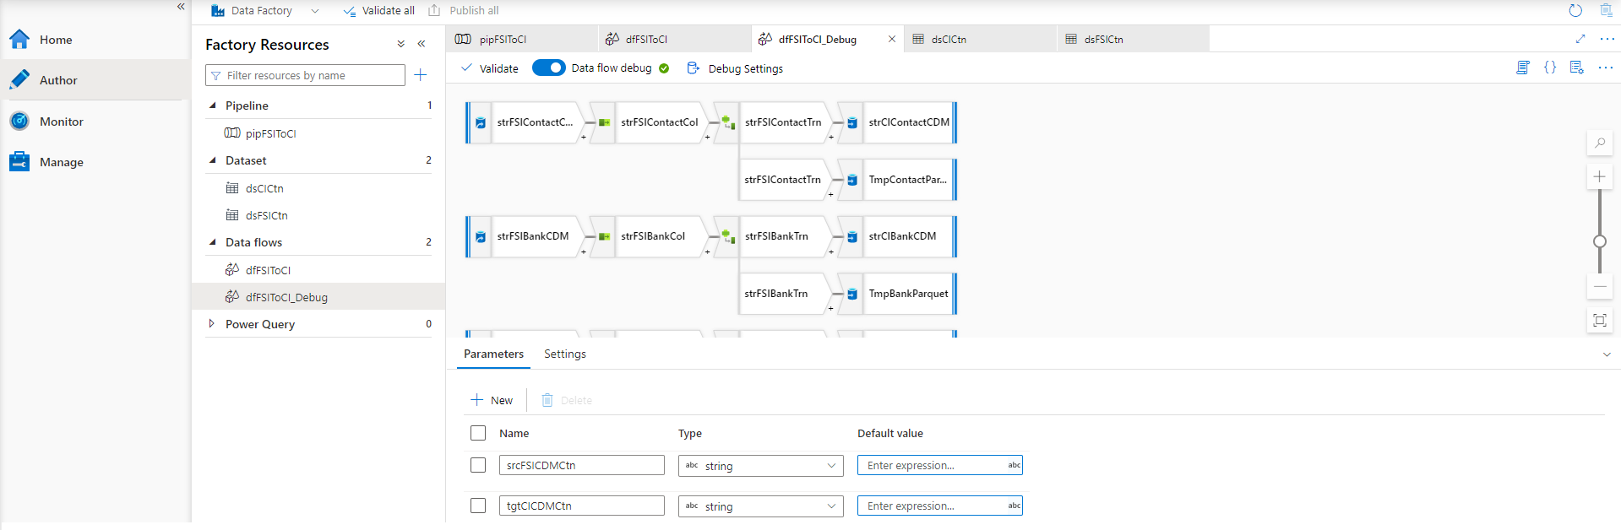
Azure data factory | DATAFLOWS
MAIN
CI Data Pipeline for FSI (ADF)
2 x Dataflows (dfFSIToCI, dfFSIToCI_Debug)
Share the Same:
Parameters
Source/Sink Pairs (11)
Transformations
dfFSIToCI Dataflow
All Transformations:
Read from same Dataverse Linked Container CDM Folder (Source)
Write to Same ADLS Gen2 Container CDM /Data Folder (Target)
dfFSIToCI_Debug Dataflow
All Transformations:
Read from same Dataverse Linked Container CDM Folder (Source)
Write to same ADLS Gen2 Container CDM /Data Folder (Target)
Also write entity data files (Parquet) to /Debug Folder (Target)
DEBUG

Slide 14
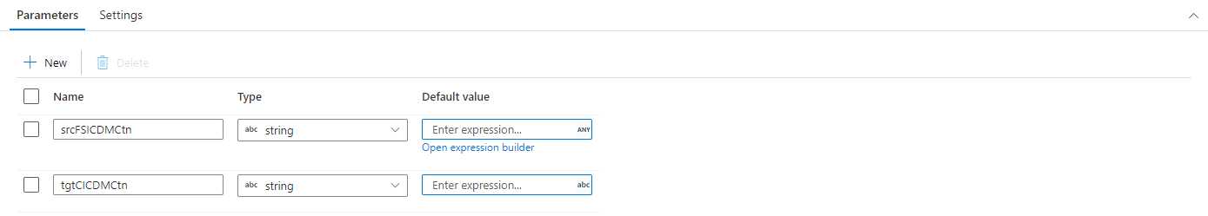
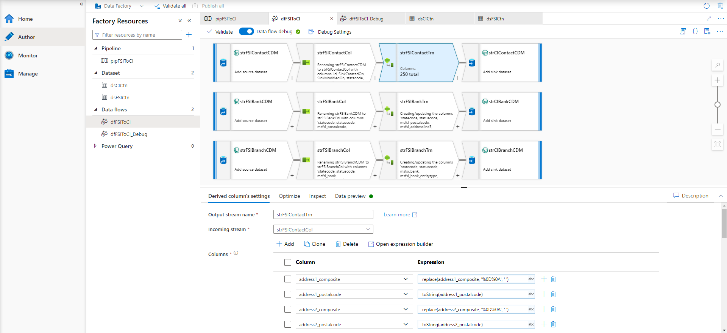
Azure data factory | DATAFLOWS | main
dfFSIToCI Dataflow
Parameters
srcFSICDMCtn
Path to Source Dataverse Linked CDM folder
Must contain complete model.json
tgtCICDMCtn
Path to Target ADLS CDM folder
Must contain /Corpus/Resolved folder
Sources
Root of srcFSICDMCtn
CDM entities pointed to by model.json (20)
Sinks
/Data folder at root of tgtCICDMCtn
Folder gets created at runtime if/as needed
CDM entities as defined in /Corpus/resolved folder (11)

Slide 15
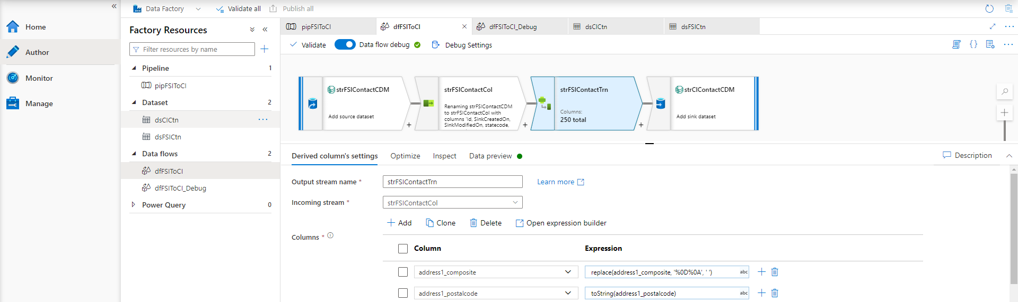
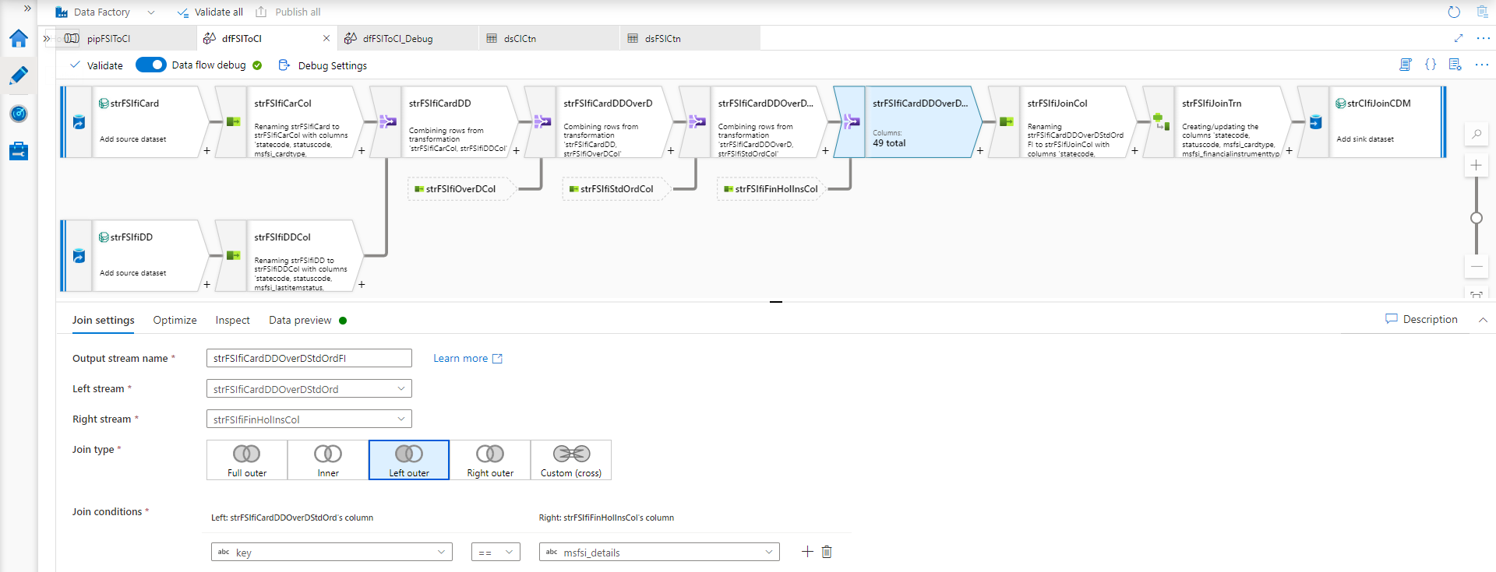
Azure data factory | DATAFLOWS | main | TRANSFORMATIONS
dfFSIToCI Transformations
For most target “simple” entities (9):
Select Activity
Project subset of columns from source
Typically, only a handful of columns/entity
Preserve source column names, datatypes
Derived Columns Activity
Apply transformations at column level
Typically, only a handful columns/entity
E.g., remove CRLF (contact), convert to String
Rename <table>Id field -> “Key” everywhere
Additionally, For few “composite” entities (2):
Union Activity
Union entities (by column names)
Join Activity
Join entities (left outer join)

Slide 16
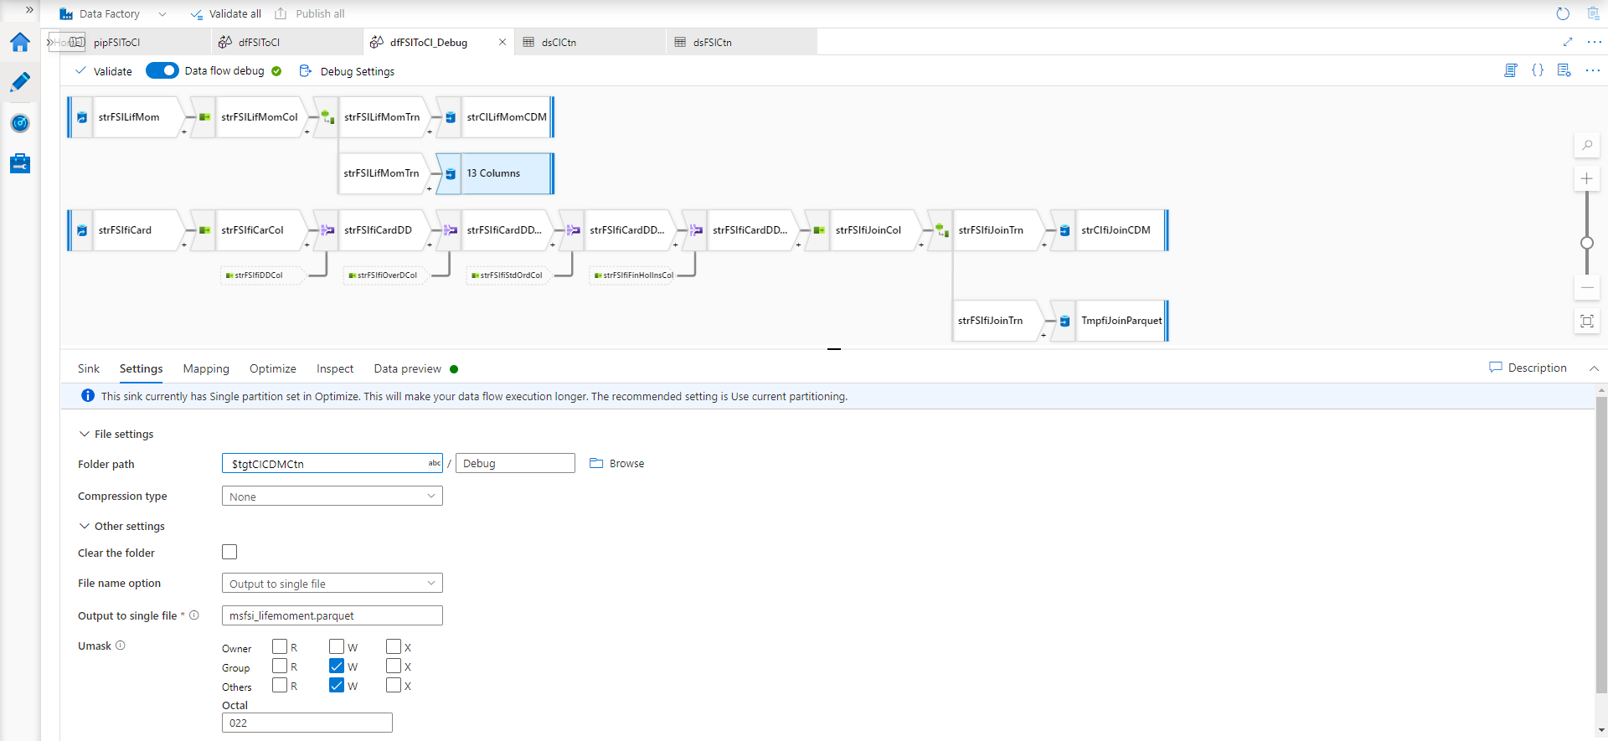
Azure data factory | DATAFLOWS | DEBUG
dfFSIToCI_Debug Dataflow
Parameters
srcFSICDMCtn
Path to Source Dataverse Linked CDM folder
Must contain complete model.json
tgtCICDMCtn
Path to Target ADLS CDM folder
Must contain /Corpus/Resolved folder
Sources
Root of srcFSICDMCtn
CDM entities pointed to by model.json (20)
Sinks
/Data folder at root of tgtCICDMCtn
Folder gets created at runtime if/as needed
CDM entities as defined in /Corpus/resolved folder (11)
/Debug folder at root of tgtCICDMCtn
Folder gets created at runtime if/as needed
Parquet files (one per entity, non-compressed)
Existing files in this folder are automatically written over

Slide 17
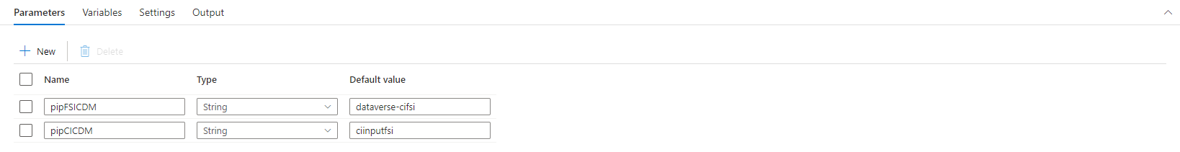
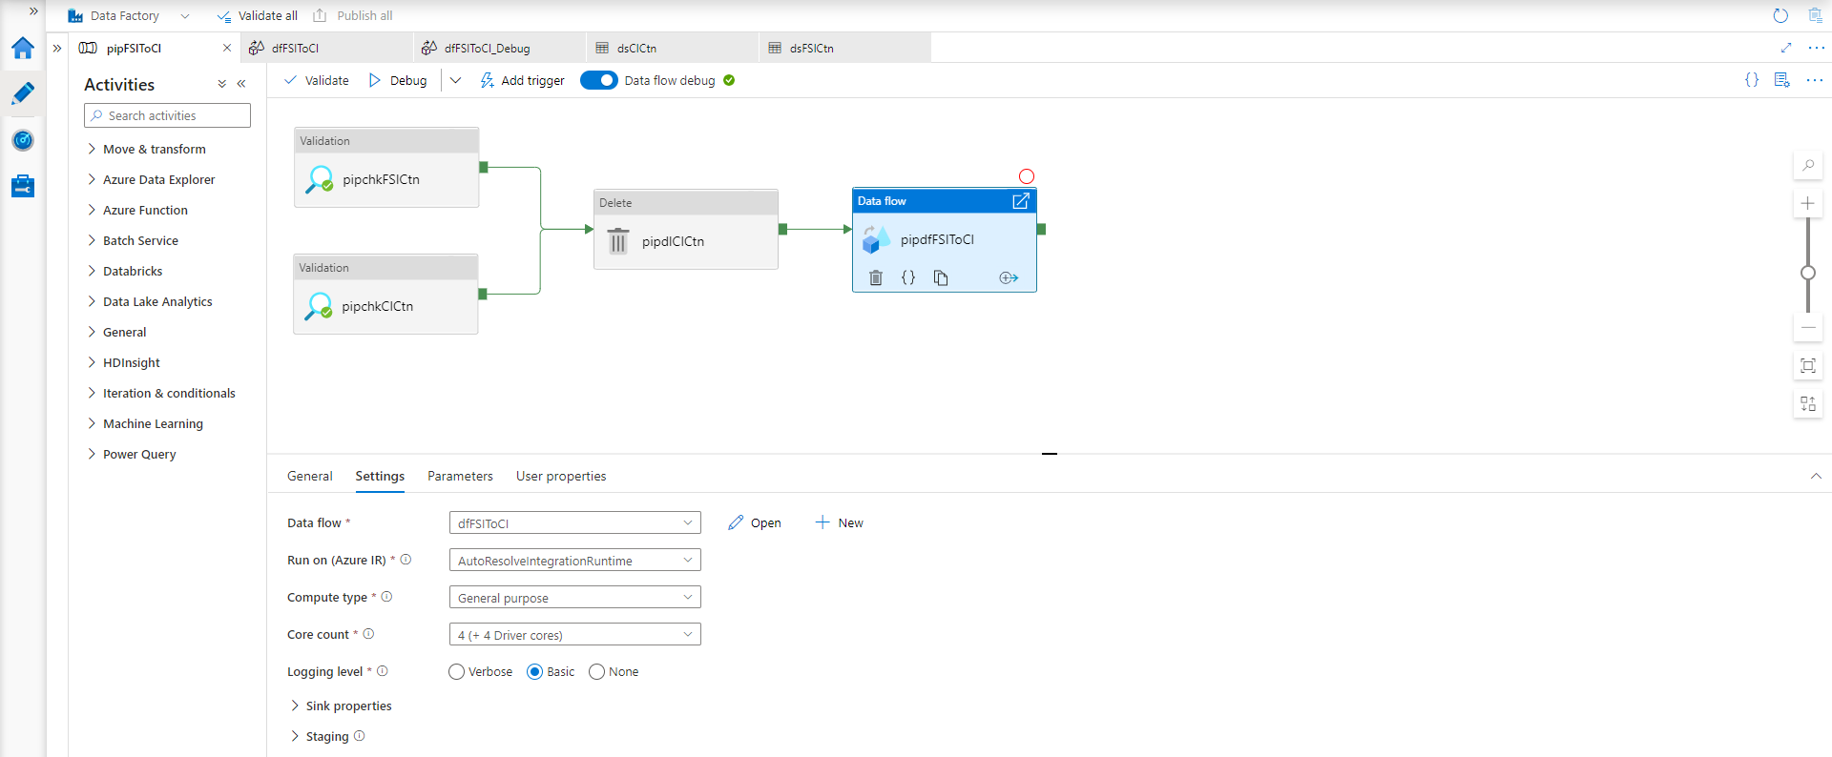
Azure data factory | PIPELINE
pipFSIToCI Pipeline
Parameters
pipFSICDM
Path to Source Dataverse Linked CDM folder
Must contain complete model.json
Passed into Dataflow parameter ➔ srcFSICDMCtn
Default value: “dataverse-cifsi”
pipCICDM
Path to Target ADLS CDM folder
Must contain /Corpus/Resolved folder
Passed into Dataflow parameter ➔ tgtCICDMCtn
Default value: “ciinputfsi”
Activities
Validations (2)
Delete (1)
Run Dataflow (1)

Slide 18
Azure data factory | PIPELINE | ACTIVITIES
Validation
pipchkFSICtn
Looks for model.json in Source CDM Folder
Fails Pipeline if:
Cannot access
Or timeout (1min)
pipchkCICtn
Looks for /Corpus/resolved/ in Target CDM Folder
Fails Pipeline if:
Cannot access
Or timeout (1min)
Delete
pipdlCICtn
Deletes entire /Data Subfolder in Target CDM Folder
Includes: Manifest file, all entities and their partitions
Does not Include: /Debug folder (if running _Debug Dataflow)
Run Dataflow
pipdfFSIToCI
Can be set to run either dfFSIToCI or dfFSIToCI_Debug Dataflows

Slide 19
TROUBLESHOOTING

Slide 20
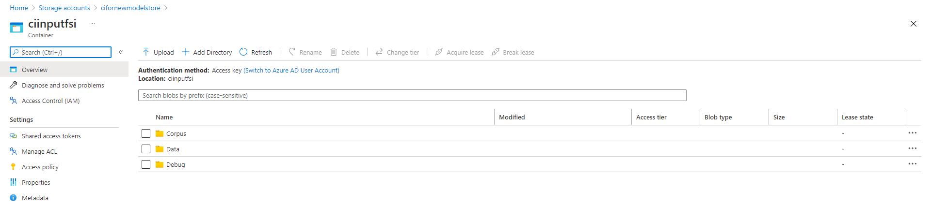
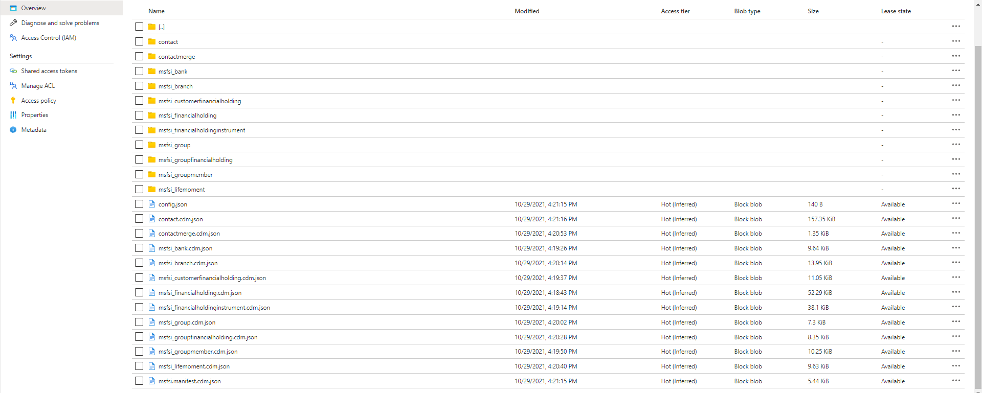
TROUBLESHOOTING | EXPECTED OUTPUT
Output Folders
Corpus
Unchanged Corpus/resolved/ folder contents
Debug
Only after running dfFSIToCI_Debug dataflow
1 <entity>.parquet data file per target entity (11)
Data
Updated msfsi.manifest.cdm.json file + config.json
1 <entity>.cdm.json metadata file per target entity (11)
1 <entity> folder with 1 subfolder for each entity (11)
1 <lastrundate> folder with 1 or more <entity*>.parquet files
The # of data files can be adjusted (Optimize tab of Sink) per entity

Slide 21
TROUBLESHOOTING | Q&A
Synapse Link: Hangs indefinitely after selecting entities
Check settings & permissions (Owner) on linked ADLS Gen2 Container
ADF Template: Import fails with “resource not found” error
Check that the Azure subscription, resource group and ADF instance (must exist before deployment) are correct
ADF Pipeline: Run fails with “Job failed due to reason: at Source ‘<source>': null, Details:” error
This can happen if the pipeline cannot access the source data partitions; check that the model.json file points to the correct ADLS (hard-coded, absolute) folders
As a result of this error, the /Data/ folder in the target ADLS container may get deleted before the pipeline fails, if it had passed the validations (those do not check the contents of model.json)
ADF Pipeline: Run fails with “Column operands are not allowed in literal expressions”
Check that the Pipeline parameter “Expression” boxes are unchecked, and that their values are correctly set
ADF Pipeline: Run fails with “filesystem does not match expected pattern” error or after short (1min) timeout
Check that the Pipeline parameter values for source/target ADLS containers as well as access permissions are correct
Also check that the source CDM folder contains a model.json file at the root, and that the Corpus/resolved folder has been uploaded to the root of the target folder
If all the above is correct and network access to the ADLS folder is slow, timeout values can be adjusted in both Validation activities of the ADF pipeline
ADF Pipeline: Run fails with “Could not read ‘<entity>.json' from the 'dataflow' namespace”
This indicates an issue reading the entity definition file from the target ADLS container’s /Corpus/resolved folder; check that the folder exists at the root of the container and contains .cdm.json files for all entities
ADF Pipeline: Run succeed but all fields in target CDM entities are of type String
This points to ADF having issues resolving the CDM types at design or run time; one possible reason may be that the CDM Corpus foundations cannot be accessed – check that <entity>.cdm.json> files import "corpusPath": "cdm:/foundations.cdm.json"
ADF Pipeline: Debug folder with parquet files is left behind after successful run of dfFSIToCI dataflow
This is by design: the /Debug/ folder and its contents are created for validation purposes when the dfFSIToCI_Debug dataflow runs successfully, it can safely be deleted by hand if needed

